Slide 1
Ocean Tidal Magnetic Modeling using CHAMP and Swarm data using the Comprehensive Inversion (CI)
Terence J Sabaka, Nils Olsen, Lars Tøffner-Clausen

Slide 2
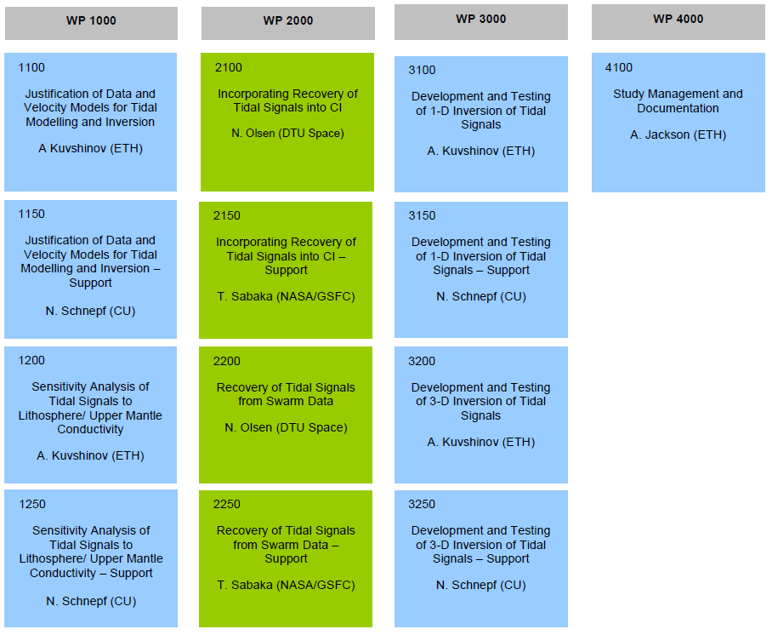
Study Work Breakdown Structure

Slide 3
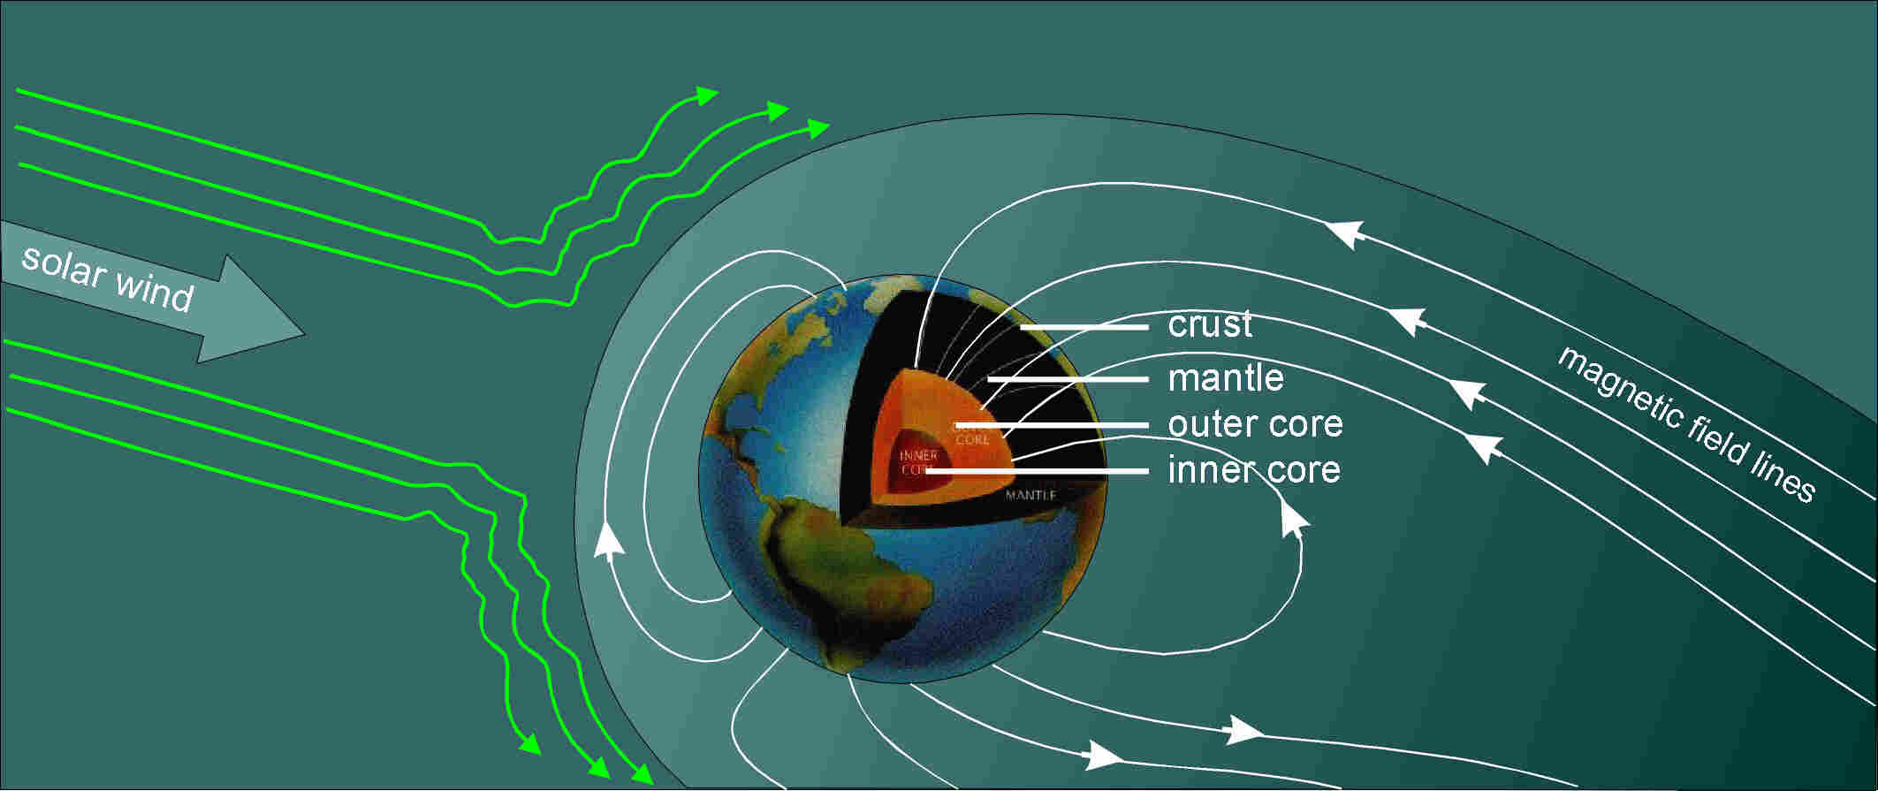
Sources of the Earth’s Magnetic Field
Internal sources
  94% fluid outer core flow of molten iron
  3% crust magnetization of rocks
    mantle (non-magnetic)
External sources
  3% ionosphere and magnetosphere
  caused by solar particles and radiation
  highly time-variable
Separation of internal and external sources by means of geomagnetic field modeling:
B = - ∇V
Global expansion of potential V using Spherical Harmonics

Slide 4
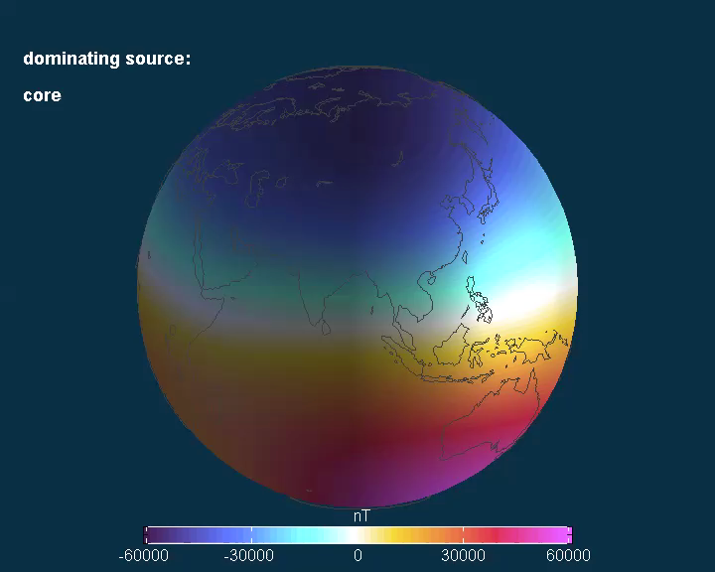
Radial magnetic component at satellite altitude

Slide 5
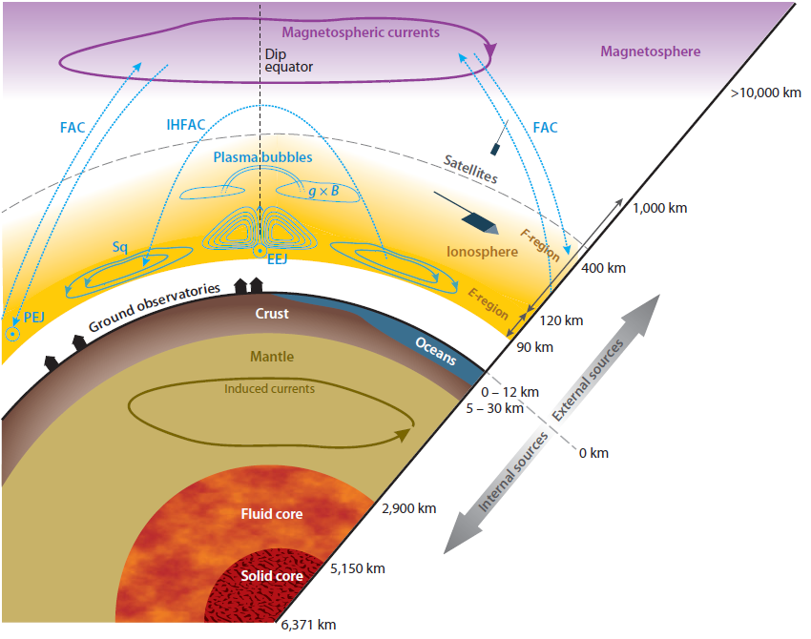
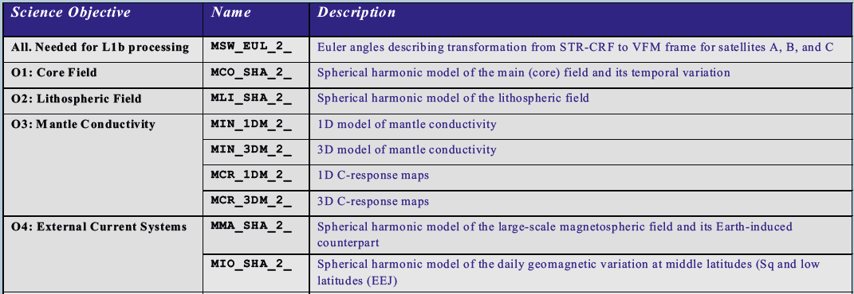
Comprehensive Inversion (CI)
an approach to derive consistent models of the core, lithospheric, ionospheric Sq and magnetospheric field
by co-estimation of all relevant sources
New: magnetic field due to oceanic tidal motion
(not yet Level-2 product)

Slide 6
2nd Release of Swarm CI Level 2 Products
Input Data
  Swarm Mag L1b 1 Hz data, decimated to 15 sec, Nov 2013 to Dec 2015,
  Hourly mean values from 121 ground observatories, Nov 2013 to July 2015
  Kp, Dst geomagnetic indices (for data selection)
  and solar flux F_{10.7} (for scaling the strength of ionospheric Sq field)
Output Level-2 Products
  Core field: SW_OPER_MCO_SHAi2C_20131126T000000_20160101T000000_0202
  Lithospheric field SW_OPER_MLI_SHAi2C_00000000T000000_99999999T999999_0202
  Ionospheric Field (Sq): SW_OPER_MIO_SHAi2C_20131126T000000_20160101T000000_0202
  Magnetospheric field: SW_OPER_MMA_SHAi2C_20131126T000000_20151231T235959_0202
Spherical Harmonic Model CI model validity period 2nd release

Slide 7
Why is Co-Estimation so Important?
D
B
D is a “data” space and A and B represent the spans of two different collections of basis functions comprising a model.
A
“disputed territory”
In “co-estimation” the model parameters of A and B are estimated from A\B and B\A, respectively, for optimal separation with no “disputed territory”.

Slide 8
Treating Field Modeling Errors
Ensemble members
The “Mean-Squared Error” (MSE) of an ensemble of estimates of X consists of a variance term and a squared-bias term.
Variance may be accounted for using covariance functions, but biases must be co-estimated via nuisance parameters.
Ensemble mean
True state
Often dominant!
Solid Blue
Dashed Red
Solid Red

Slide 9
The CI1 Model
Algorithm: CI from the Level-2 Swarm data processing
Data: Selection essentially follows that of SIFM (Olsen et al., 2015)
  Swarm satellites:
    Span is 28 November 2013 to 15 August 2015 (20.5 months of data)
    Vector/scalar field data only in night sector
      |dRC/dt| < 2 nT/h
      |QD lat| <= 55º, then |dRC/dt| < 3 nT/h
      |QD lat| > 55º, then MEF < 0.8 mV/m
    Vector/scalar sums/differences data at all local times
      Kp <= 3⁰ and |dRC/dt| < 3 nT/h
      |QD lat| > 10º only
  Observatories:
    Span is 1 January 2013 to 16 June 2015
    Hourly-means at all local times
      Kp <= 2⁰ and |dDst/dt| < 2 nT/h
      119 stations used

Slide 10
The CI1 Model
Parameterization: Procedure basically follows that of Sabaka et al. (2013)
  Core/lithosphere:
    Degree/order (D/O) 90 internal spherical harmonic expansion (SHE)
    Linear time dependence up to D/O 13
  Magnetospheric/induced:
    D/O 1 internal/external SHEs, both in 1 hr bins
  Ionospheric/induced:
    Similar to CM5
  M2 and N2 tides:
    D/O 36 internal SHE for both with appropriate sinusoidal temporal frequency
  Vector magnetometer alignment:
    3 Euler angles in 10 day bins for each satellite
  OHM vector biases for each station
Application of SIVW:
  Nominal Core: All nightside data
  Nominal lithosphere: All field and difference data, except low-latitude dayside
  Ionosphere: All except difference data
  Magnetosphere/induced: All data
  Nominal tidal: All field and difference data, except low-latitude dayside

Slide 11
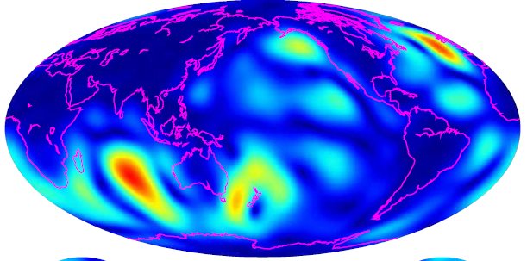
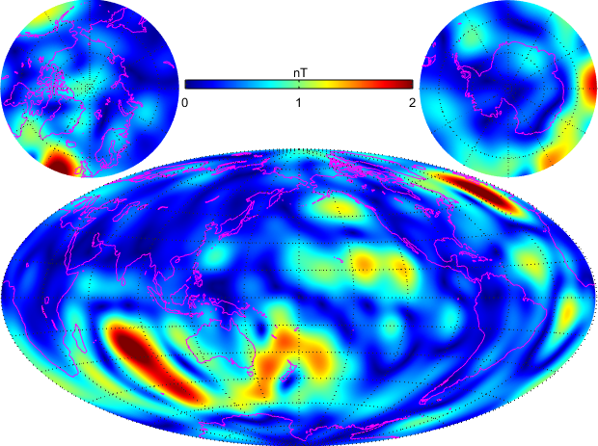
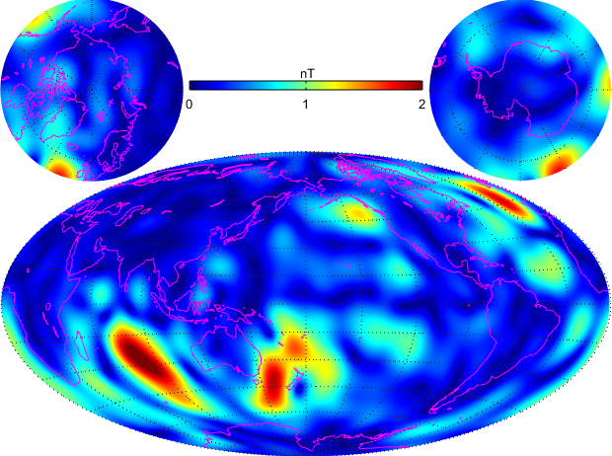
M₂ Tidal Field
|B_{r}| of M₂ tide
18 months of Swarm data allows for an astonishing determination of the M₂ tidal signal, comparable to what has been obtained using
10 years of CHAMP data (at lower altitude)
Model prediction
CI (Swarm)
CM5 (CHAMP)
Sabaka et al., GRL (2016)
Sabaka et al., GJI (2015)

Slide 12
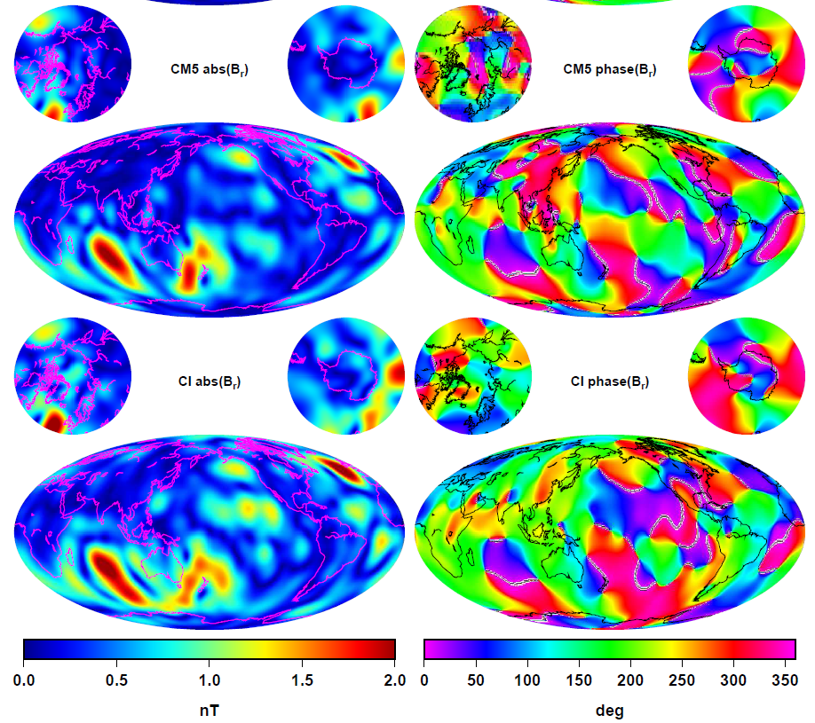
Comparison of M₂ Amplitudes and Phases
B_{r} at ground, from CHAMP (CM5, top) and Swarm (CI, bottom)

Slide 13

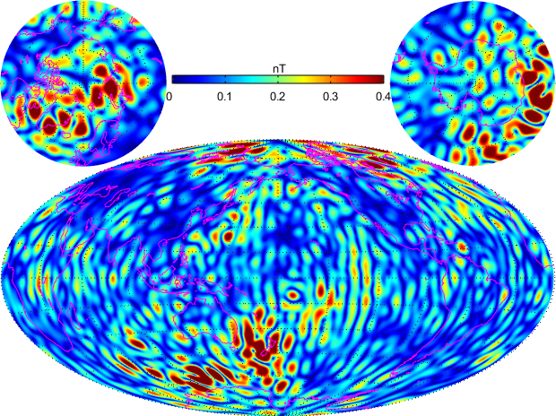
Experiments with Different SH Truncation Levels
n = 1 - 18
n = 1 - 36
n = 19 - 36

Slide 14
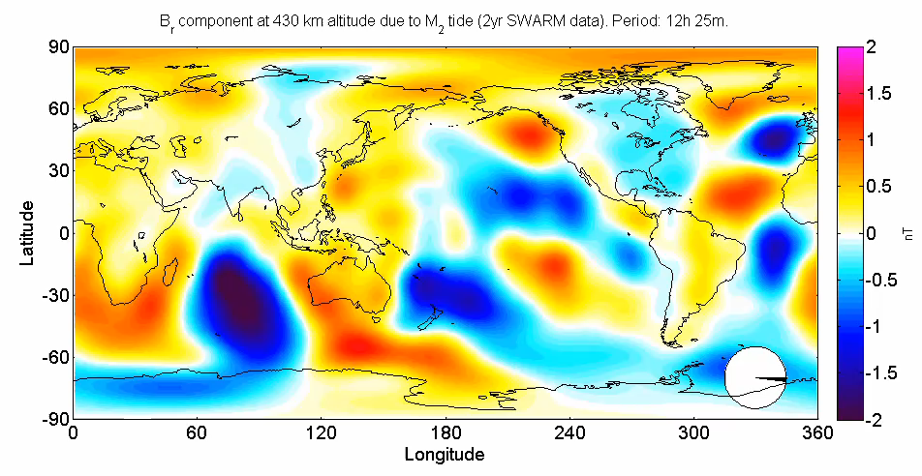
Determination of Oceanic Magnetic
Tidal Signal in Swarm data
B_{r} at 430 km altitude due to oceanic M₂ tide,
determined from 2 years of Swarm magnetic data
After T. J. Sabaka, R.H. Tyler, and N. Olsen, Extracting ocean-generated tidal magnetic signals from Swarm data through satellite gradiometry, Geophys. Res. Lett., 2016

Slide 15
Swarm M₂ Power Spectrum at Earth’s Surface
After T. J. Sabaka, R.H. Tyler, and N. Olsen, Extracting ocean-generated tidal magnetic signals from Swarm data through satellite gradiometry, Geophys. Res. Lett., 2016

Slide 16
Swarm M₂ Radial Field Amplitude at 430 km
After T. J. Sabaka, R.H. Tyler, and N. Olsen, Extracting ocean-generated tidal magnetic signals from Swarm data through satellite gradiometry, Geophys. Res. Lett., 2016

Slide 17
Swarm M₂ Radial Field Phase at 430 km
After T. J. Sabaka, R.H. Tyler, and N. Olsen, Extracting ocean-generated tidal magnetic signals from Swarm data through satellite gradiometry, Geophys. Res. Lett., 2016

Slide 18
Conclusions
Both CHAMP and Swarm M2 Rn spectra show peaks around degree 5, with the latter showing generally more power for n < 26. This probably means less noise in the Swarm solution.
Swarm M2 Rn with no EW gradients shows generally more power than with no NS gradients for n > 9. This is a strong indication that the unique EW gradients from the Swarm low-pair are critical in resolving a clean M2 field.
The M2 radial field amplitude and phase maps at satellite altitude for n = 1-36 indicate that the Swarm NS gradients remove much of the spurious polar signals while the EW gradients remove much of the along-track banding in the signal.
They also confirm that while both NS and EW gradients allow for better tidal recovery, it is the unique Swarm EW gradients that are even more critical.
M2 from 20.5 months of Swarm has the same quality as 10 years of CHAMP data even though Swarm was at a higher altitude and was operating at higher magnetic disturbance levels.
Recovery of N2 from Swarm shows some promise in that better resolution was seen in areas of larger expected signal.

Slide 19
Recommendations for Future Work
Include the latest Swarm data in the analysis.
Combine Swarm and CHAMP data sets and see if annual variability can be detected in M2.
Use knowledge of M2 to extract N2 and other semi-diurnal tidal constituents.
Use tidal forward codes in a “data-assimilation” approach to estimating more tidal constituents.
Further refining of selection procedure/application of SIVW to do a better job of extraction.

