Slide 1
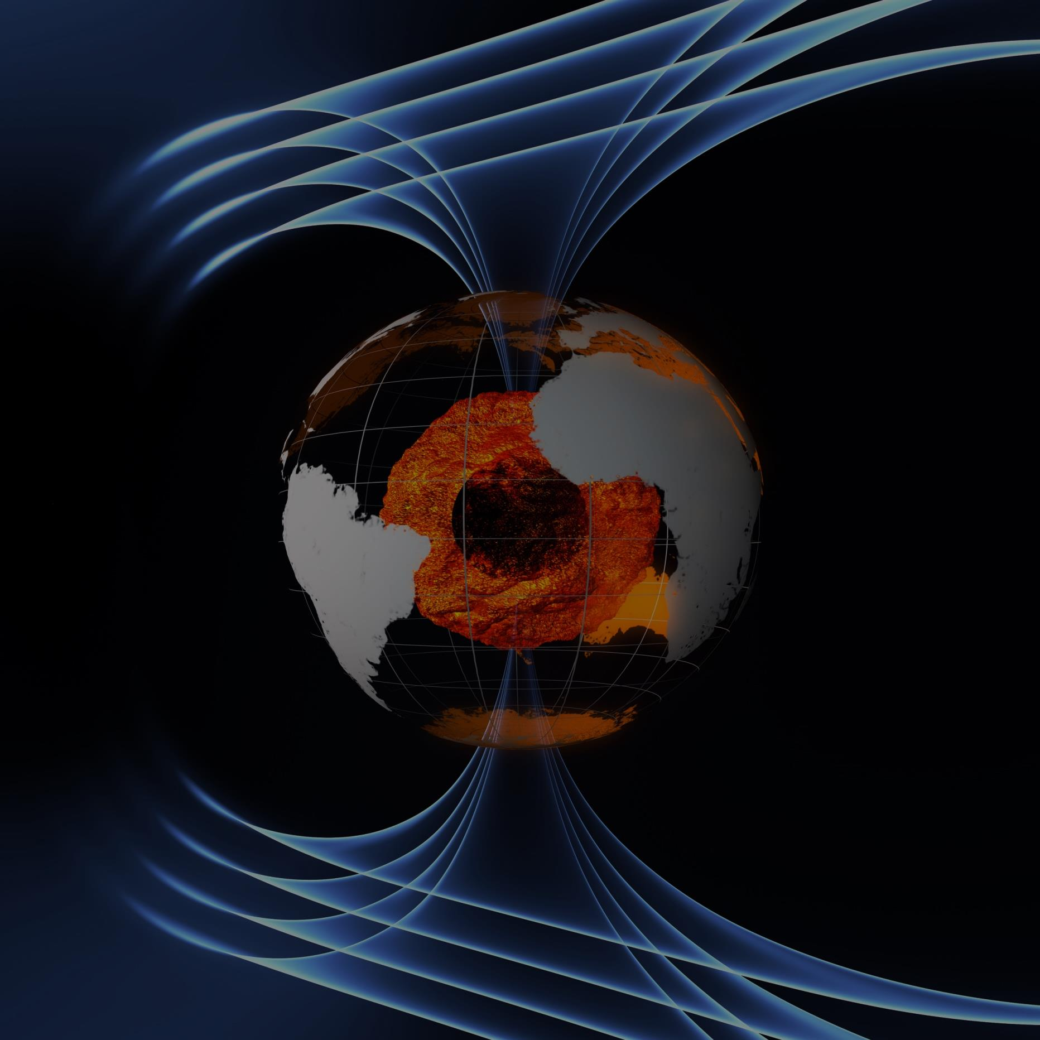
From Core to Space First Swarm Scientific Results
Nils Olsen, Claudia Stolle and the Swarm ESL Science Team
Patrick Alken, Ciaran D Beggan, Peter Brauer, Stephan C. Buchert, Johnathan Burchill, Arnaud Chulliat, Eelco Doornbos, Joao Teixeira da Encarnacao, Ludwig Grunwaldt, Brian Hamilton, Rune Floberghagen, Eigil Friis-Christensen, Giuseppe Ottavianelli, Gauthier Hulot, Jose van den IJssel, John L. Jørgensen, David J. Knudsen, Alexey Kuvshinov, Jean-Michel Leger, Vincent Lesur, Hermann Luehr, Susan Macmillan, Stefan Maus, Jose Merayo, Ingo Michaelis, Max Noja, Nils Olsen, Poul Erik H Olsen, Jaeheung Park, Radek Peresty, Gernot Plank, Christoph Puethe, Jan Rauberg, Patricia Ritter, Martin Rother, Terence J Sabaka, Reyko Schachtschneider, Olivier Sirol, Claudia Stolle, Erwan Thebault, Alan W P Thomson, Lars Tøffner-Clausen, Jakub Velımsky, Pierre Vigneron, Pieter N Visser

Slide 2
From Core to Space First Swarm Scientific Results
Nils Olsen, Claudia Stolle and the Swarm ESL Science Team
Swarm magnetic observations and the various source of Earth’s magnetic field
Earth’s main field: How has it changed within the last 6 months?
Earth’s environment

Slide 3
Sources of the Earth’s Magnetic Field

Slide 4
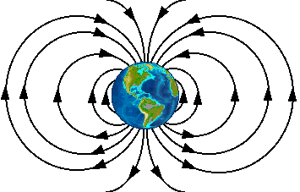
Radial magnetic component at satellite altitude

Slide 6
Geomagnetic Field Model
Mathematical Expansion to Describe the Field in Space and Time
What is the magnetic field B at a given location and time?
$$B=−∇V$$
$$V=a\sum_{n,m}{\left(g_{n}^{m}\cos{mφ}+h_{n}^{m}\sin{mφ}\right)}{\left(\frac{a}{r}\right)}^{n+1}P_{n}^{m}\left(θ\right)$$
Gauss coefficients $g_{n }^{m}$ and $h_{n }^{m}$ are time dependent
The more coefficients, the better the magnetic field description

Slide 7
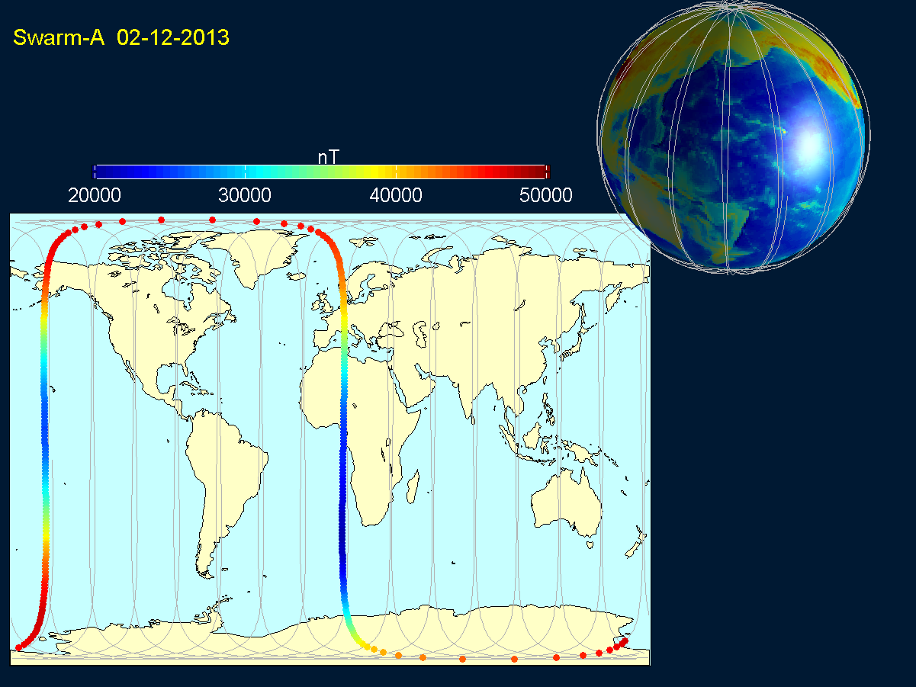

Slide 8
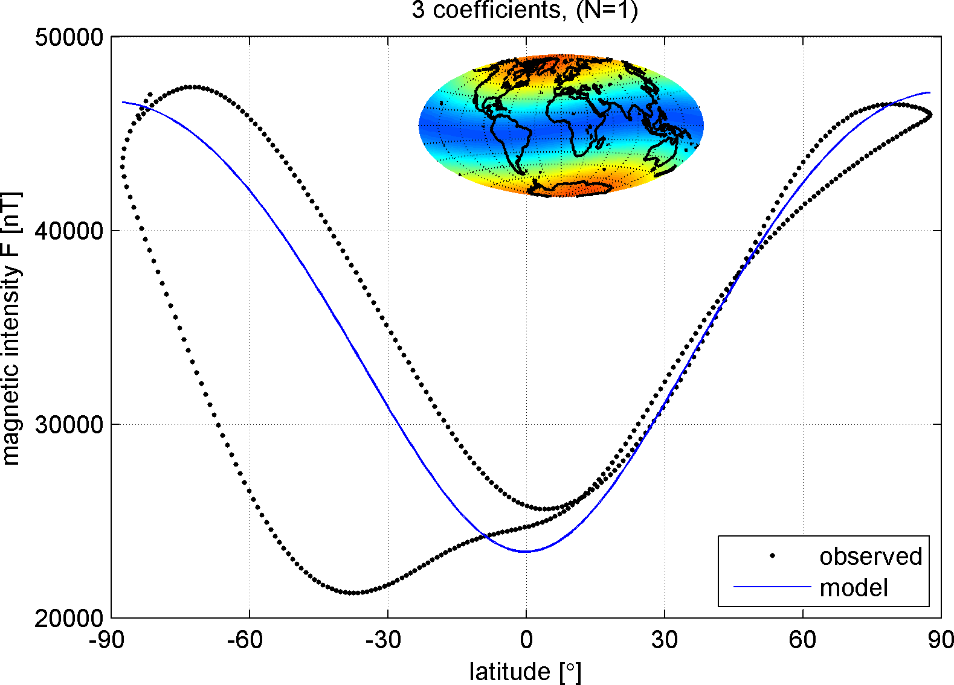
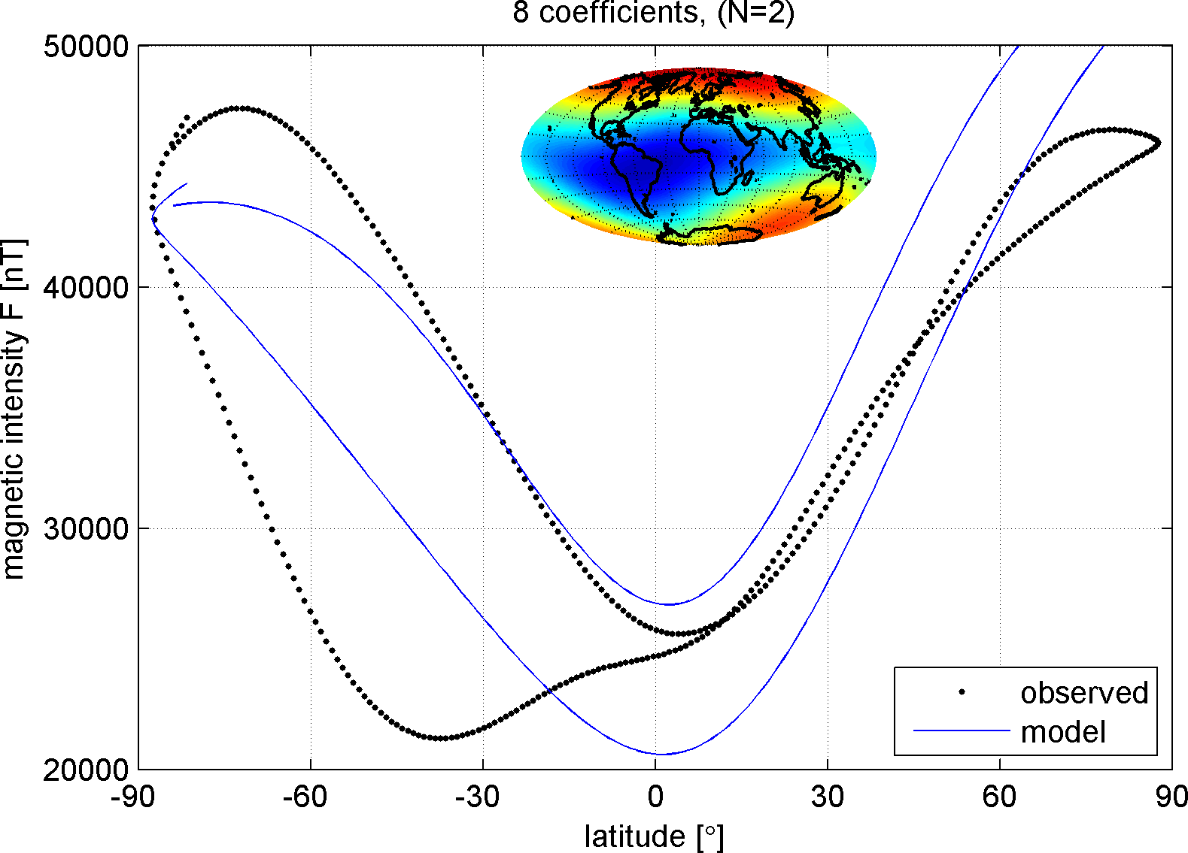
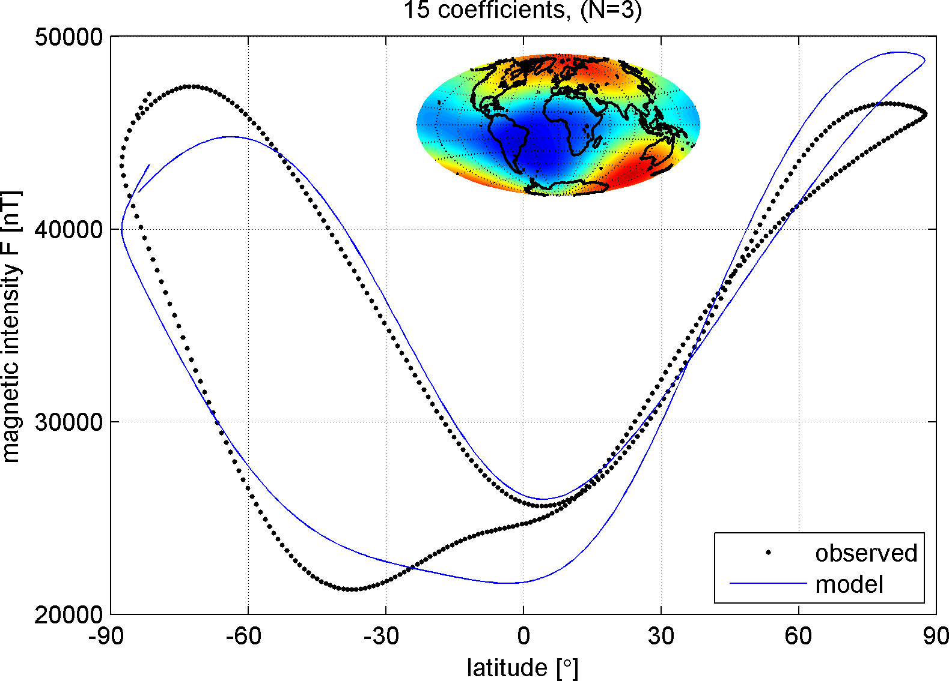
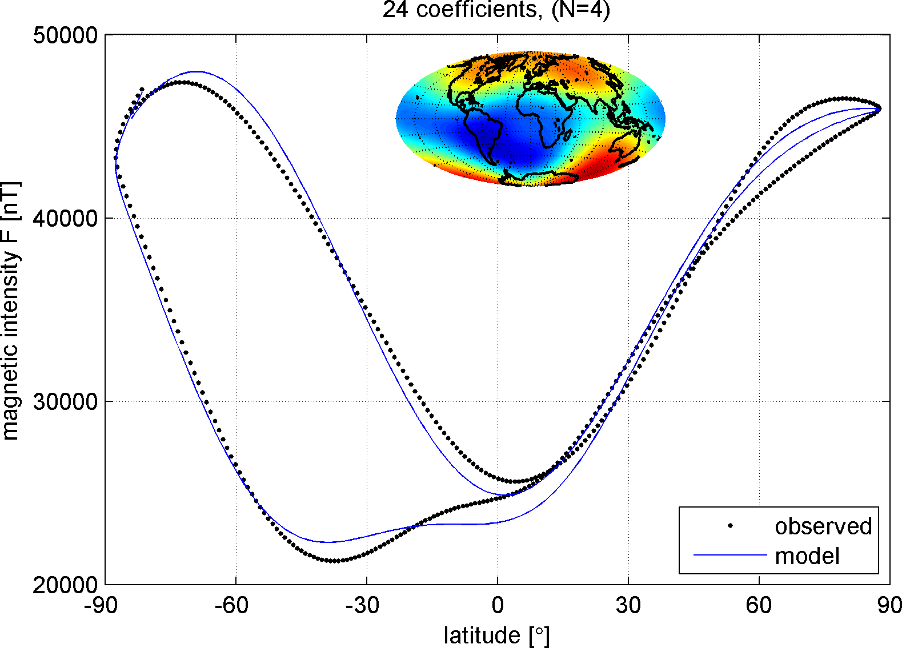
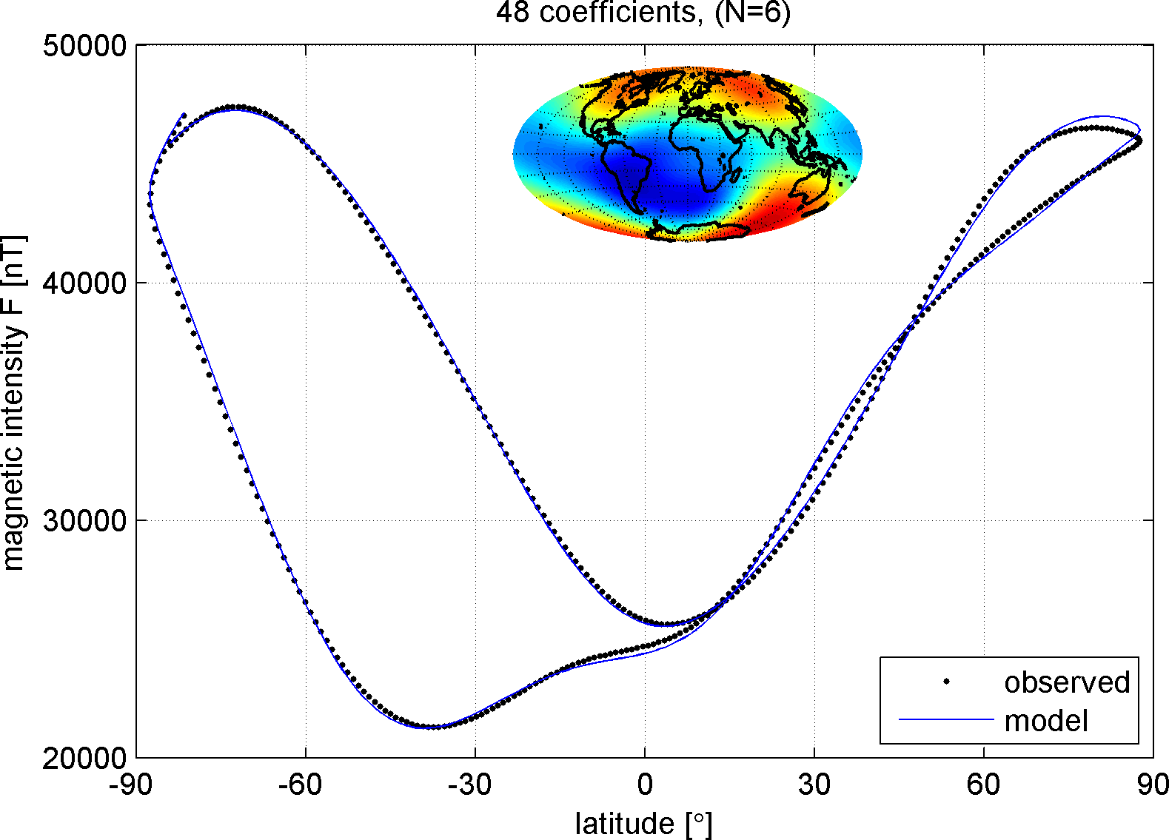
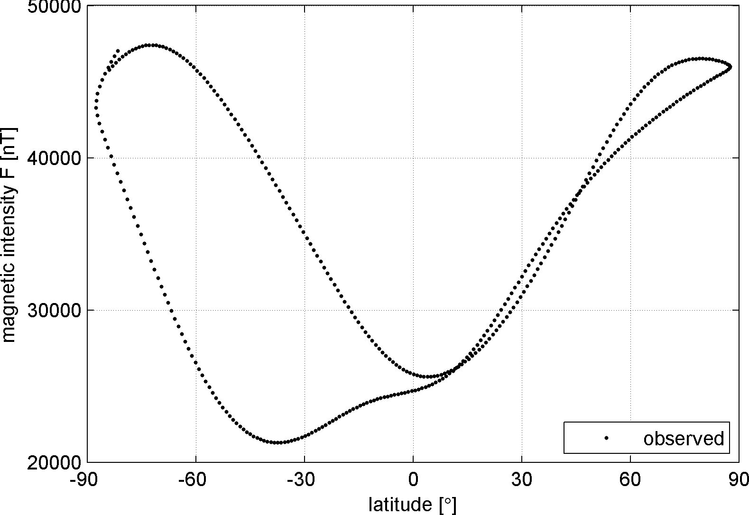
Swarm-A 2 December 2013, Quiet day (Kp ≤ 0⁺)

Slide 9
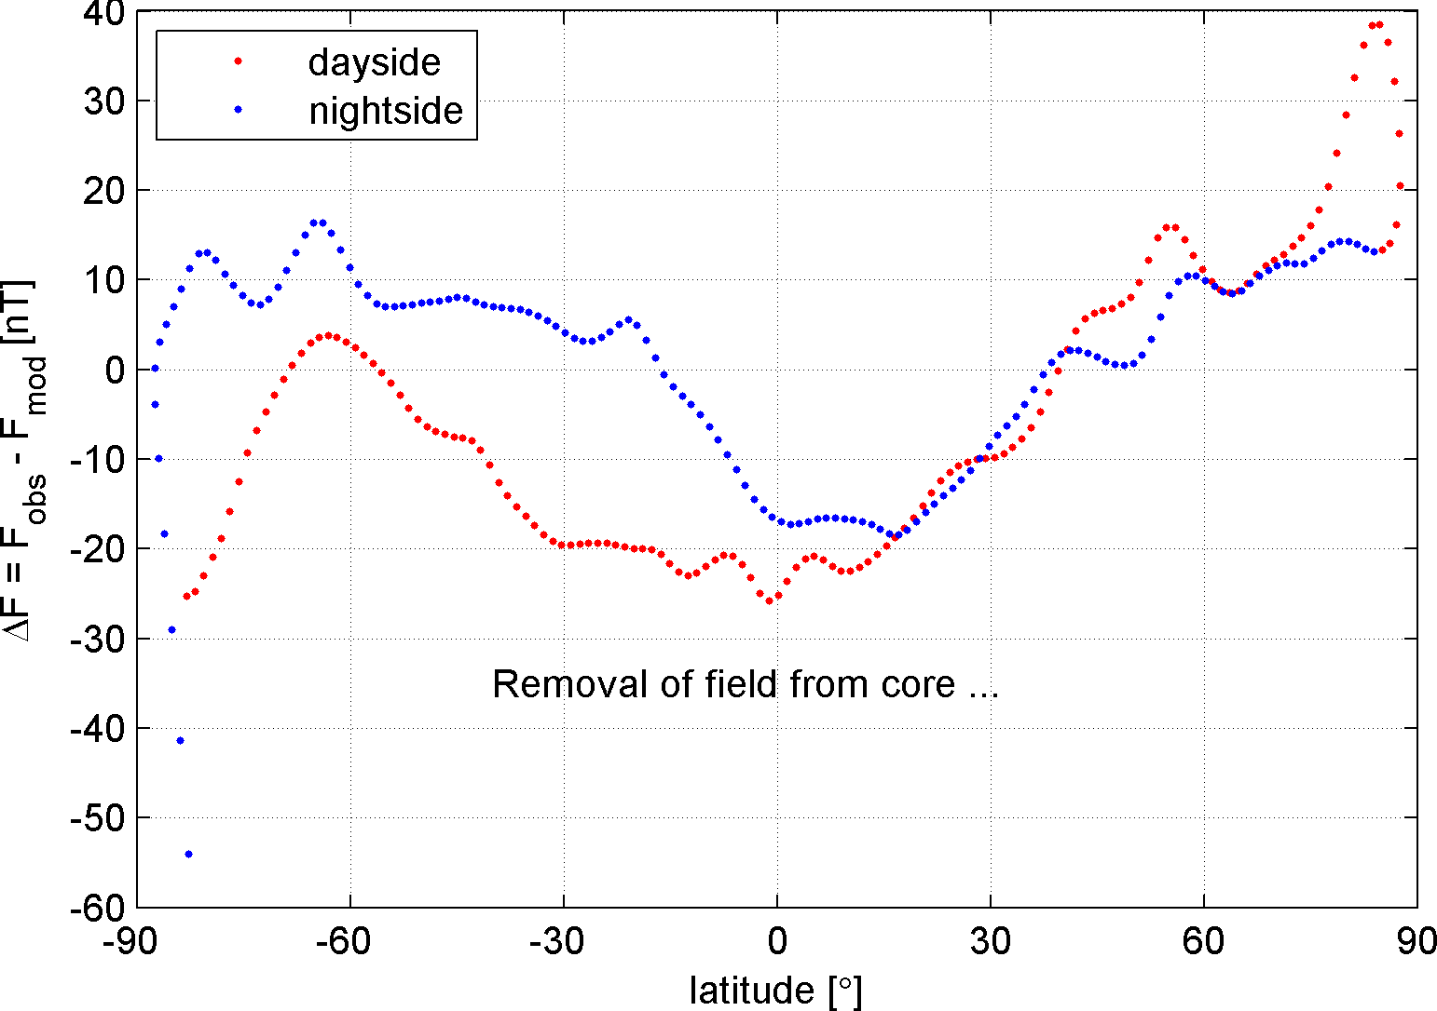
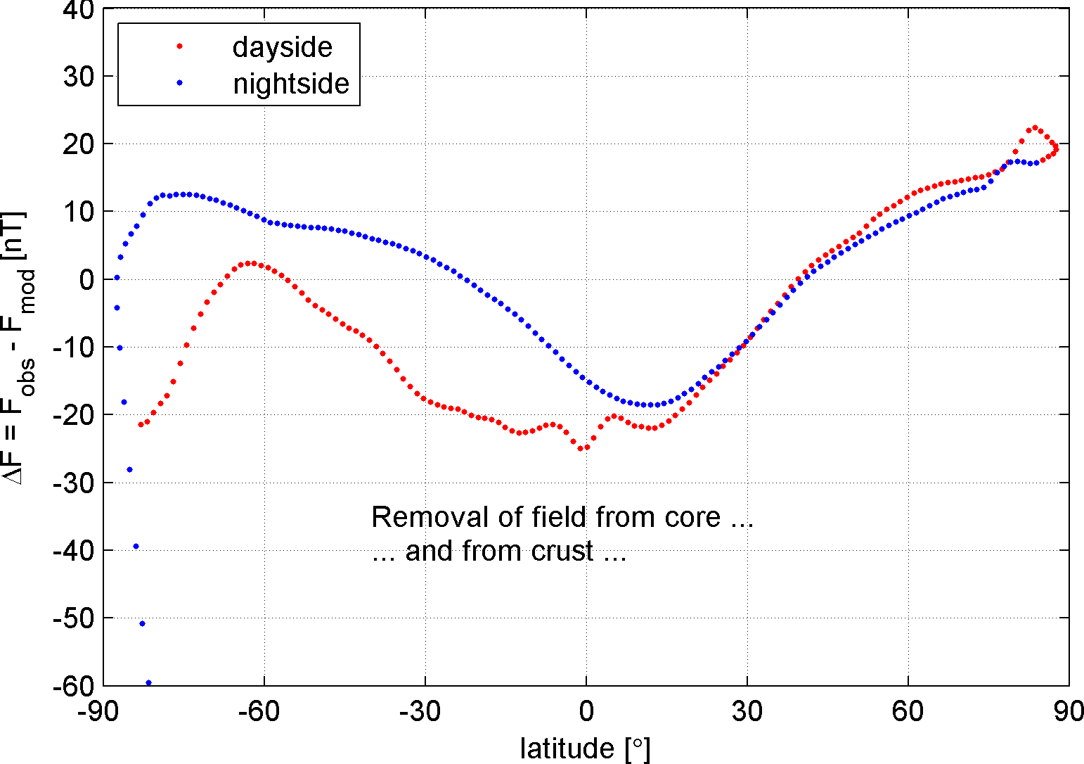
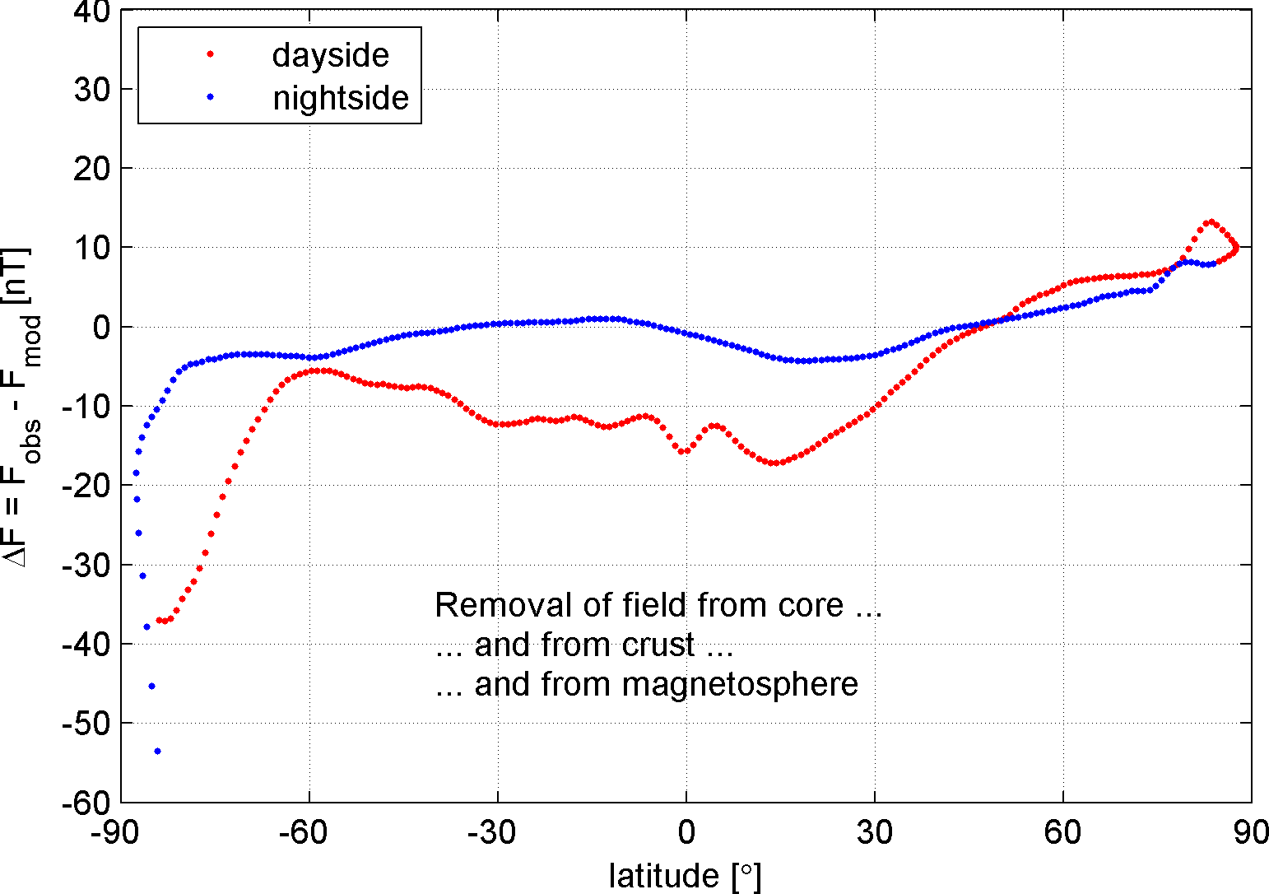
Swarm-A 2 December 2013, Quiet day (Kp ≤ 0⁺)
CHAOS-4 model subtracted

Slide 10
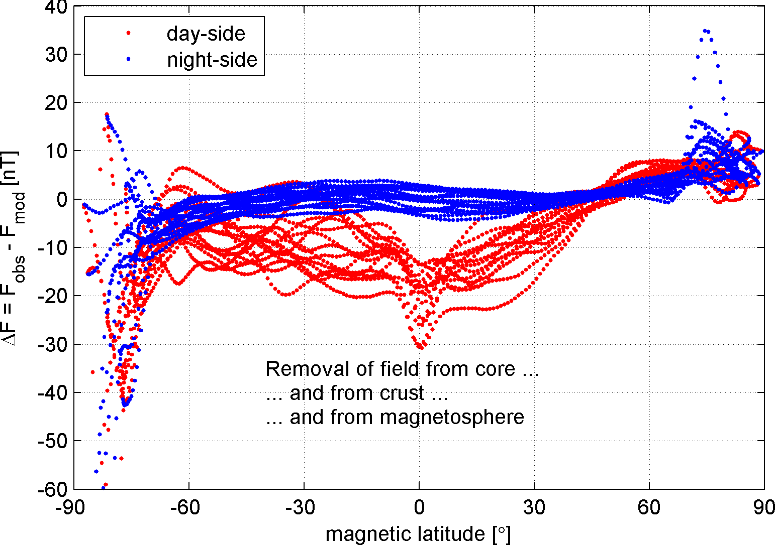
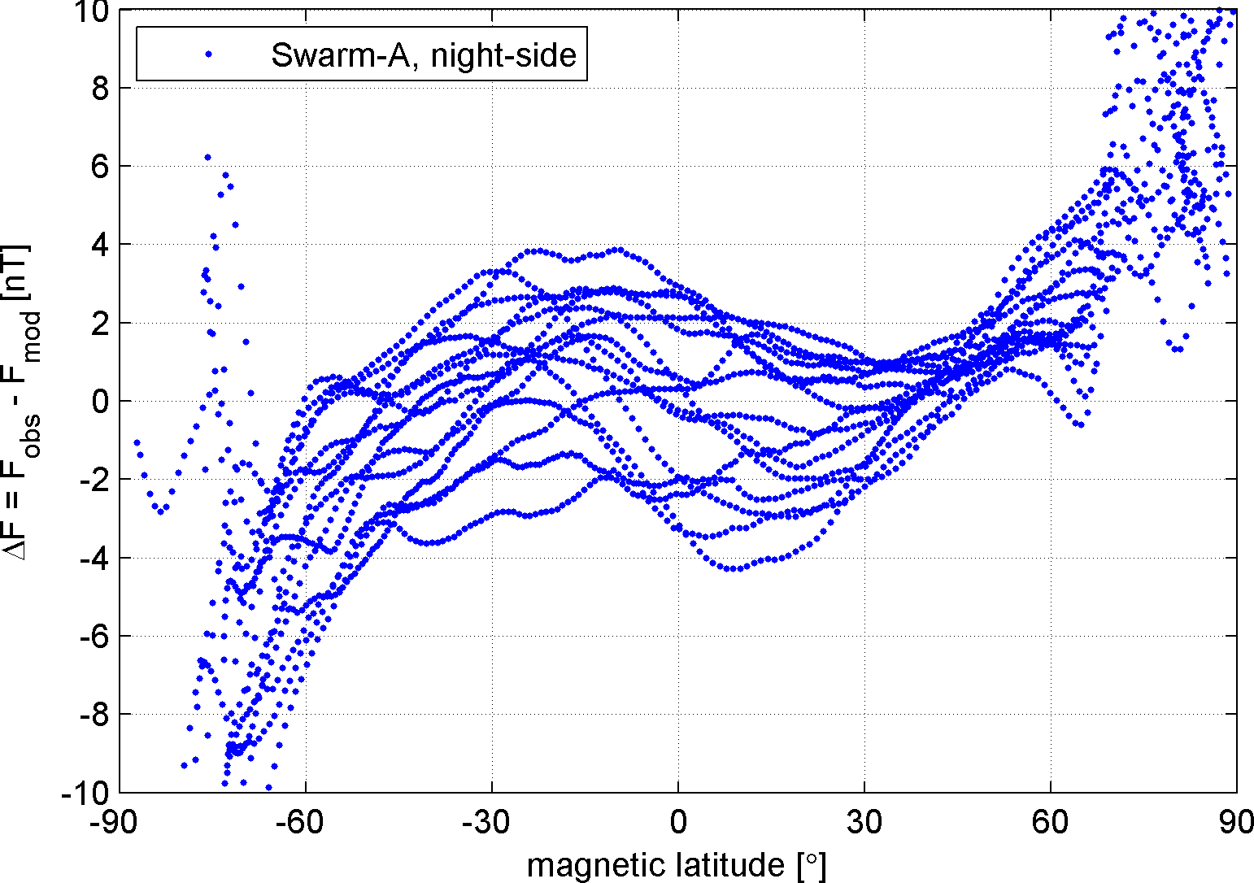
Swarm-A 2 December 2013, Quiet day (Kp ≤ 0⁺)
CHAOS-4 model subtracted

Slide 11
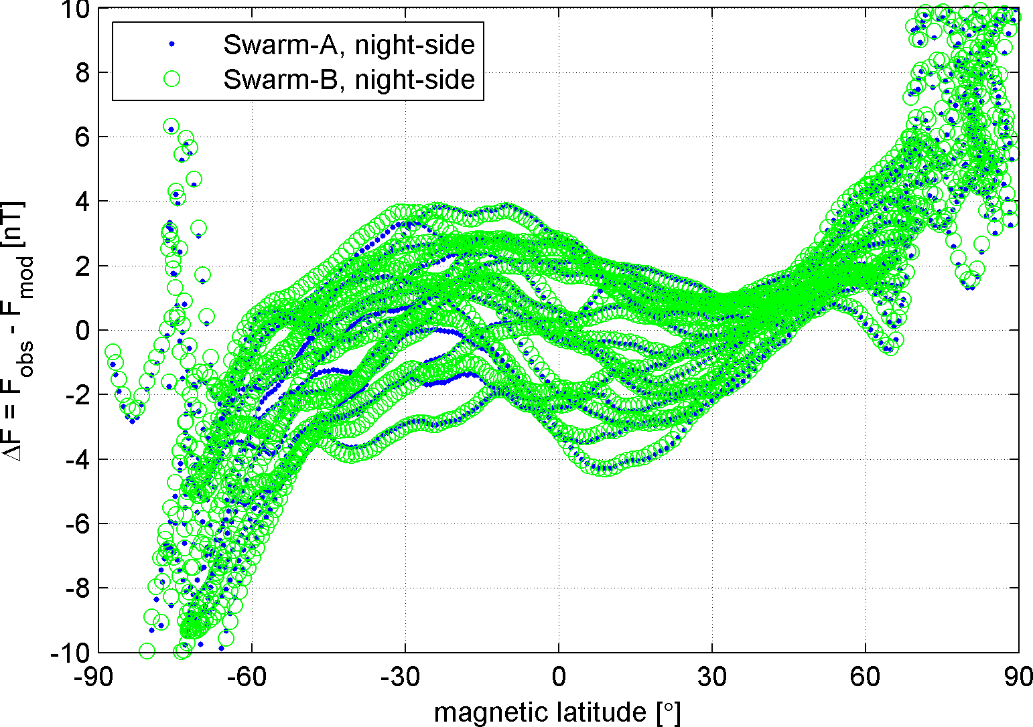
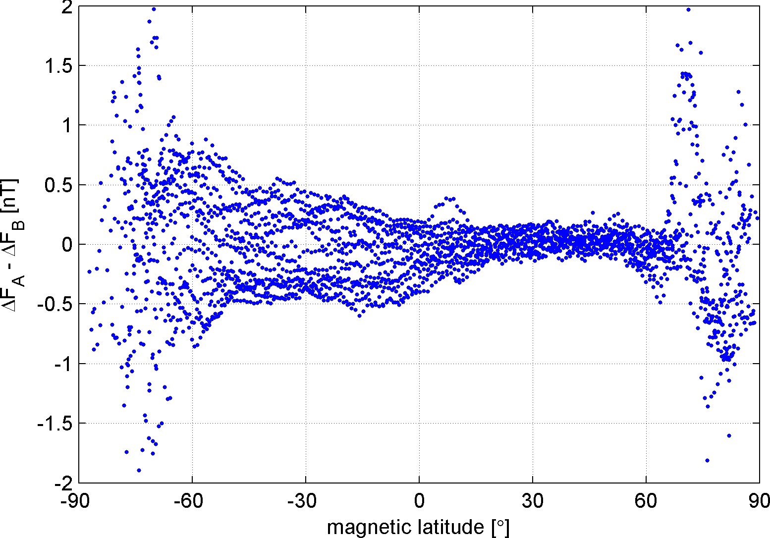
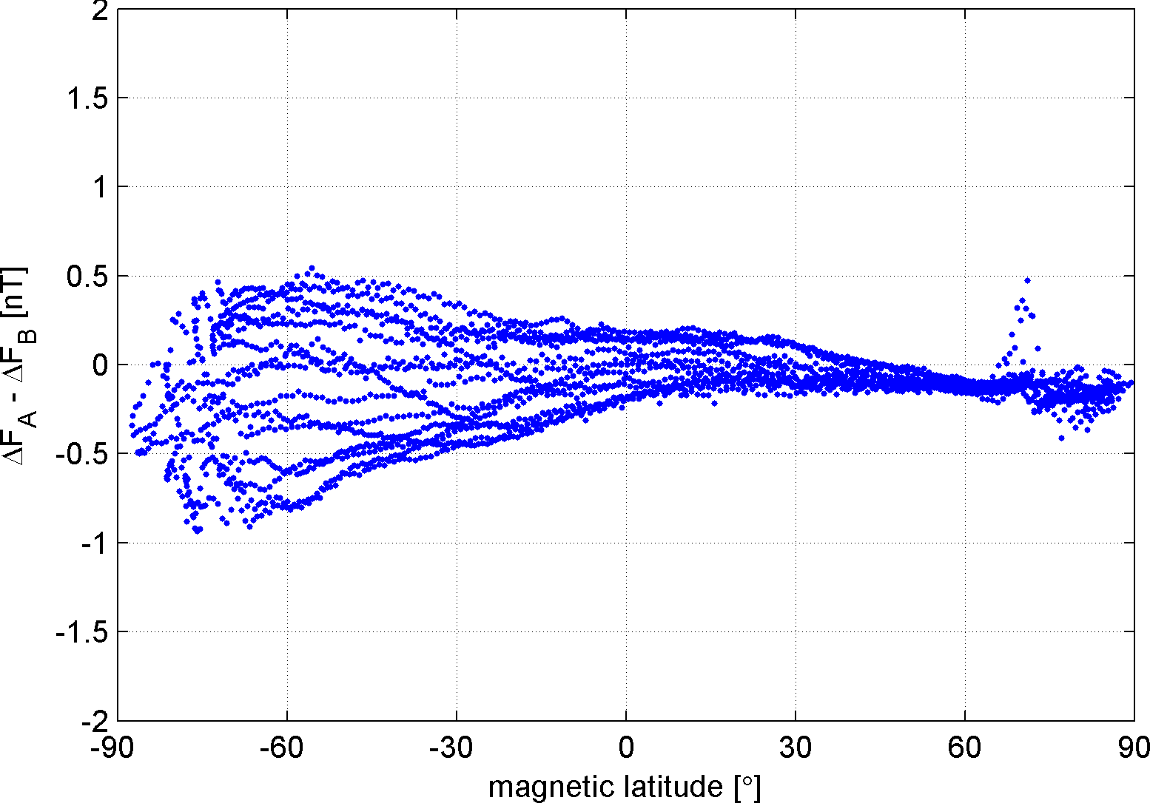
Swarm-A and Swarm-B 2 December 2013, Quiet day (Kp ≤ 0⁺)
CHAOS-4 model subtracted
Difference Swarm A -Swarm B
Swarm-B data shifted by 15s since satellite flies 120 km behind Swarm-A (on that day)

Slide 12
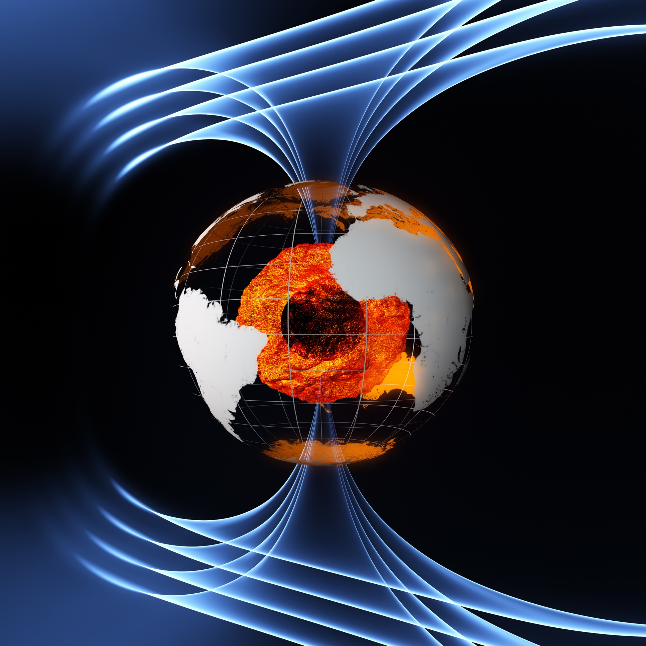
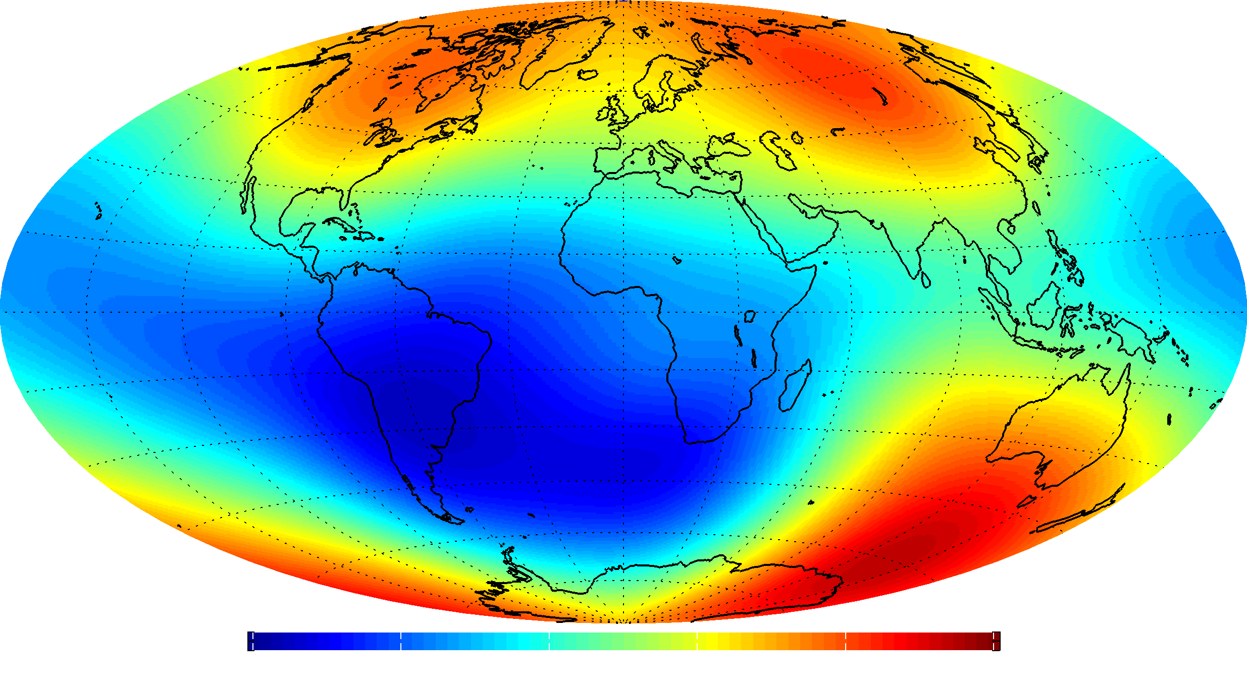
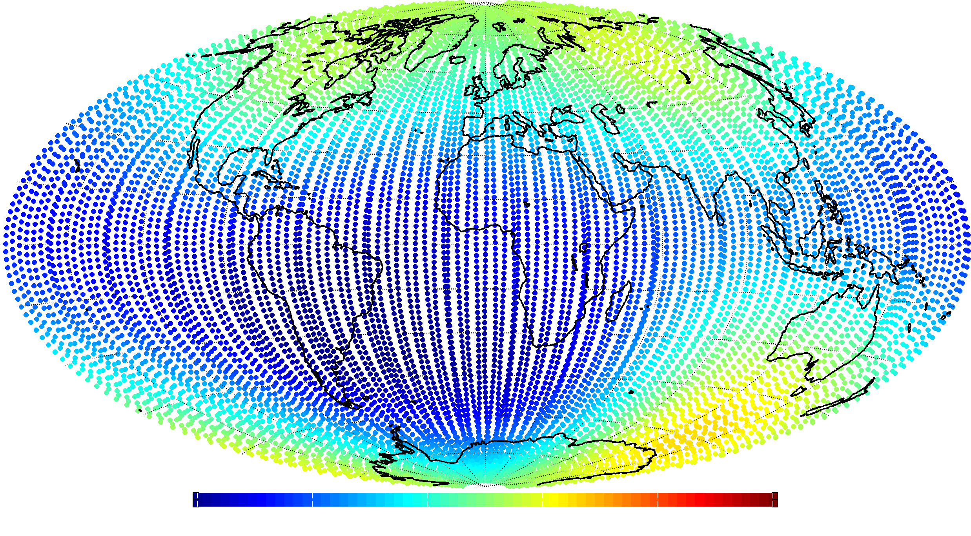
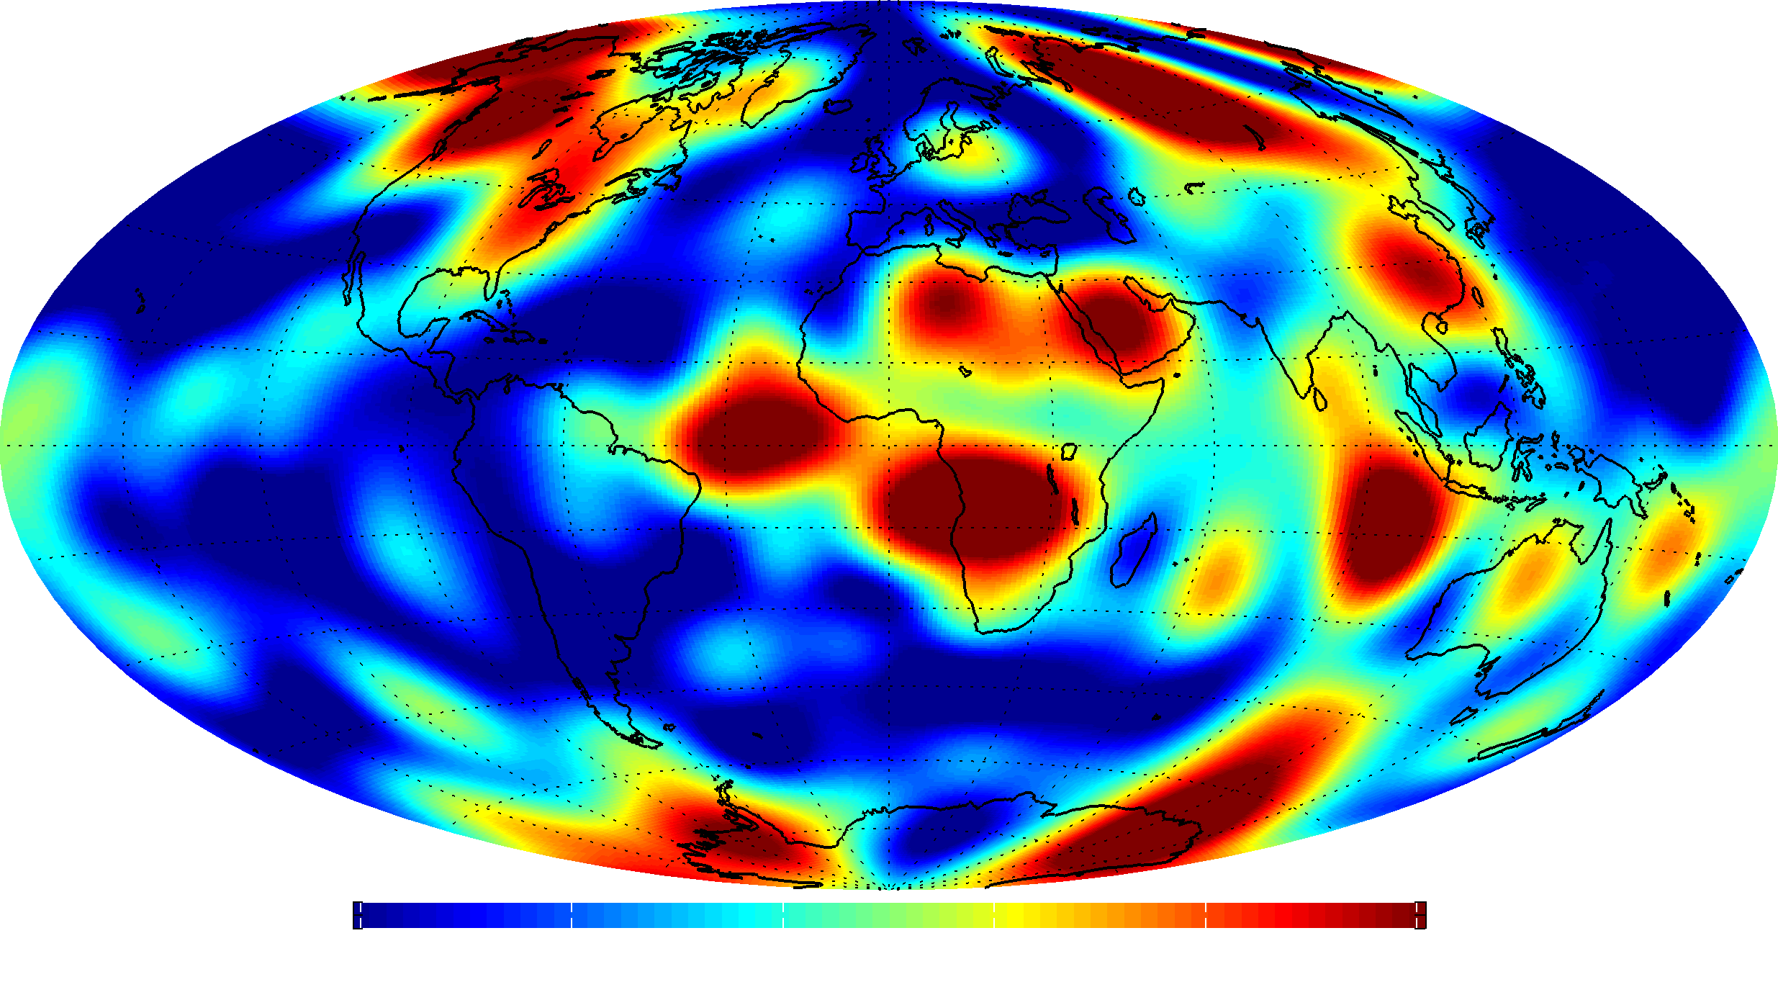
Magnetic Field Strength
at satellite altitude
at ground
at core surface (3000 km depth)

Slide 13
Magnetic Field Intensity in May 2014 Swarm-A, 4 days of May 2014
at satellite altitude of 470 km

Slide 14
Magnetic Field Intensity in May 2014 based on Swarm data spanning 6 months
at Earth’s surface

Slide 15
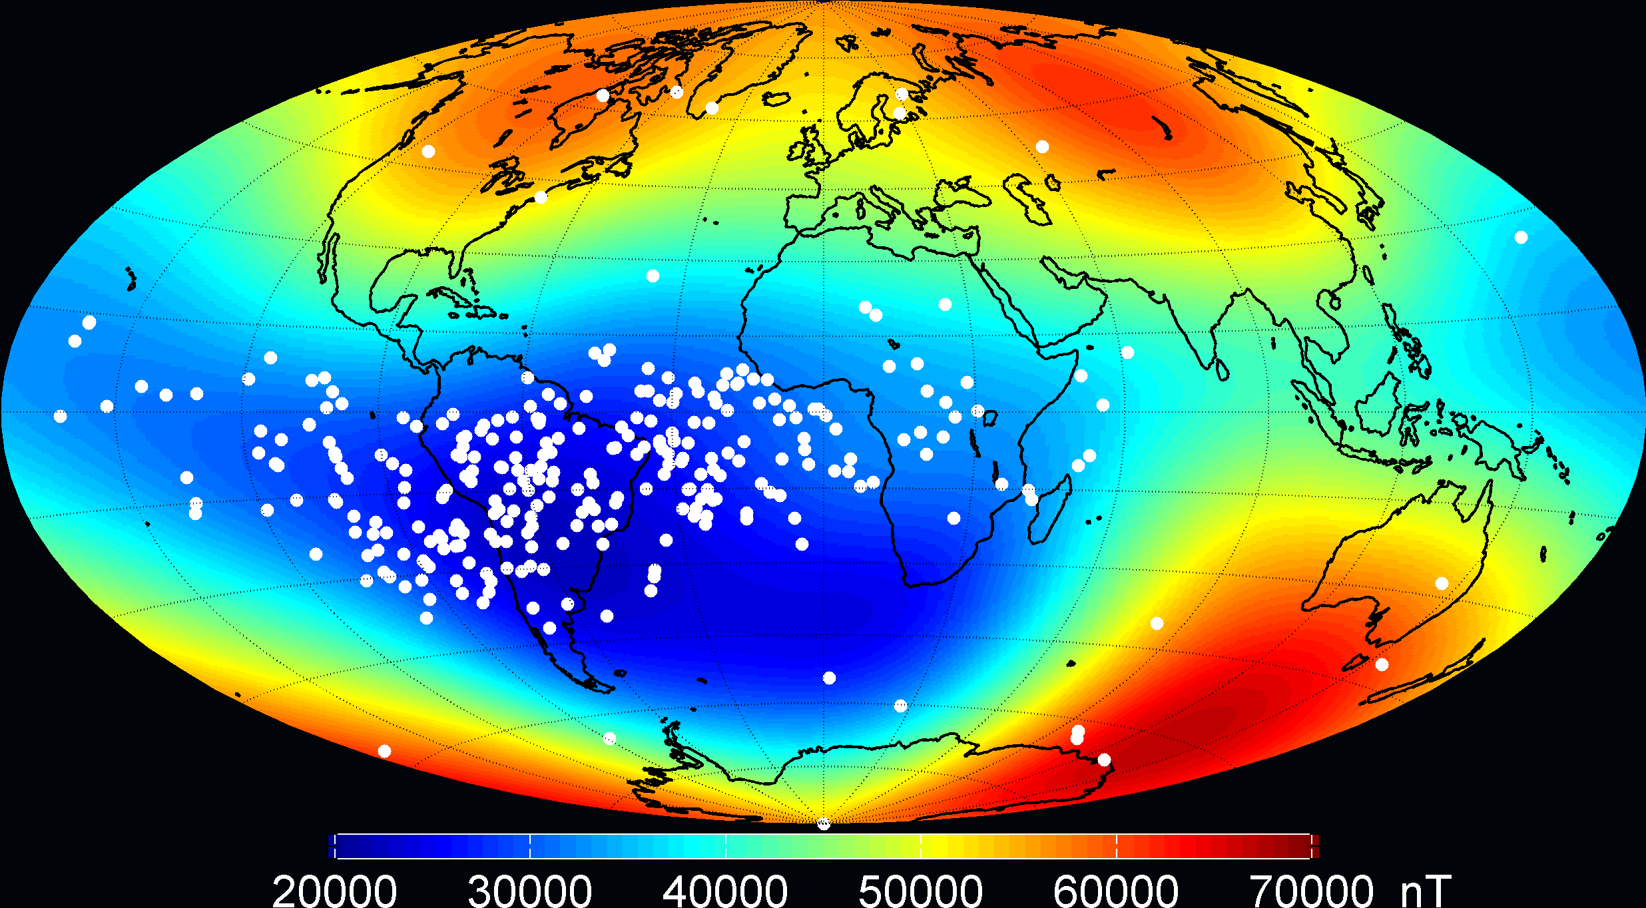
Magnetic Field Intensity Single Event Upset of TOPEX Poseidon Satellite
at Earth’s surface

Slide 16
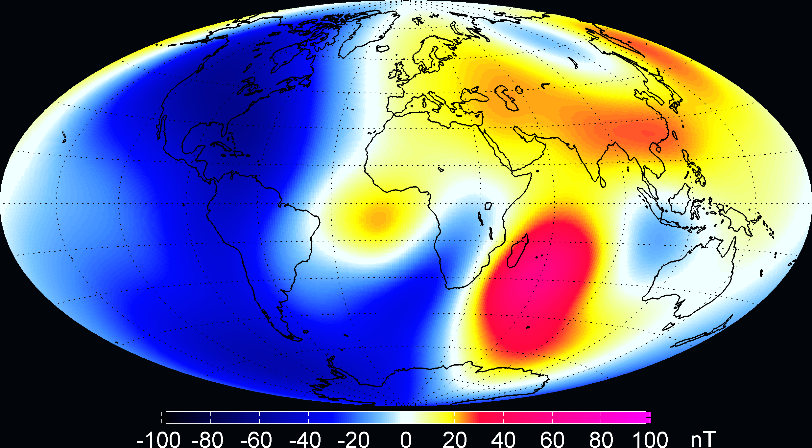
Magnetic Field Intensity change in 6 months (December 2013 to June 2014)
at Earth’s surface

Slide 17
Dynamics of the Core: Magnetic Field Acceleration
Vertical component d²Z/dt² at Earth’s surface

Slide 18
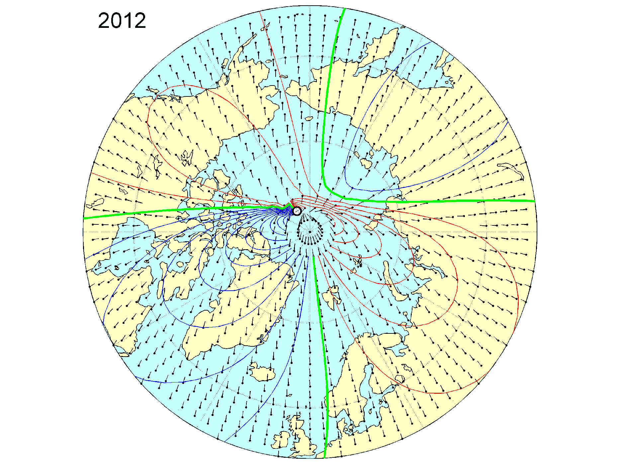
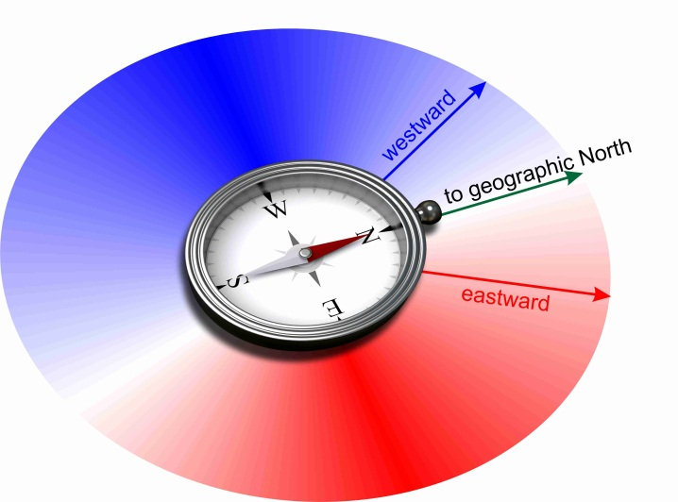
Declination in 2014
Compass points in direction eastward / westward of geographic pole
Compass points towards geographic pole
IGRF: International Geomagnetic Reference Field 2015-2020
The model for application (navigation, …)
Will be derived in autumn based on Swarm data

Slide 19
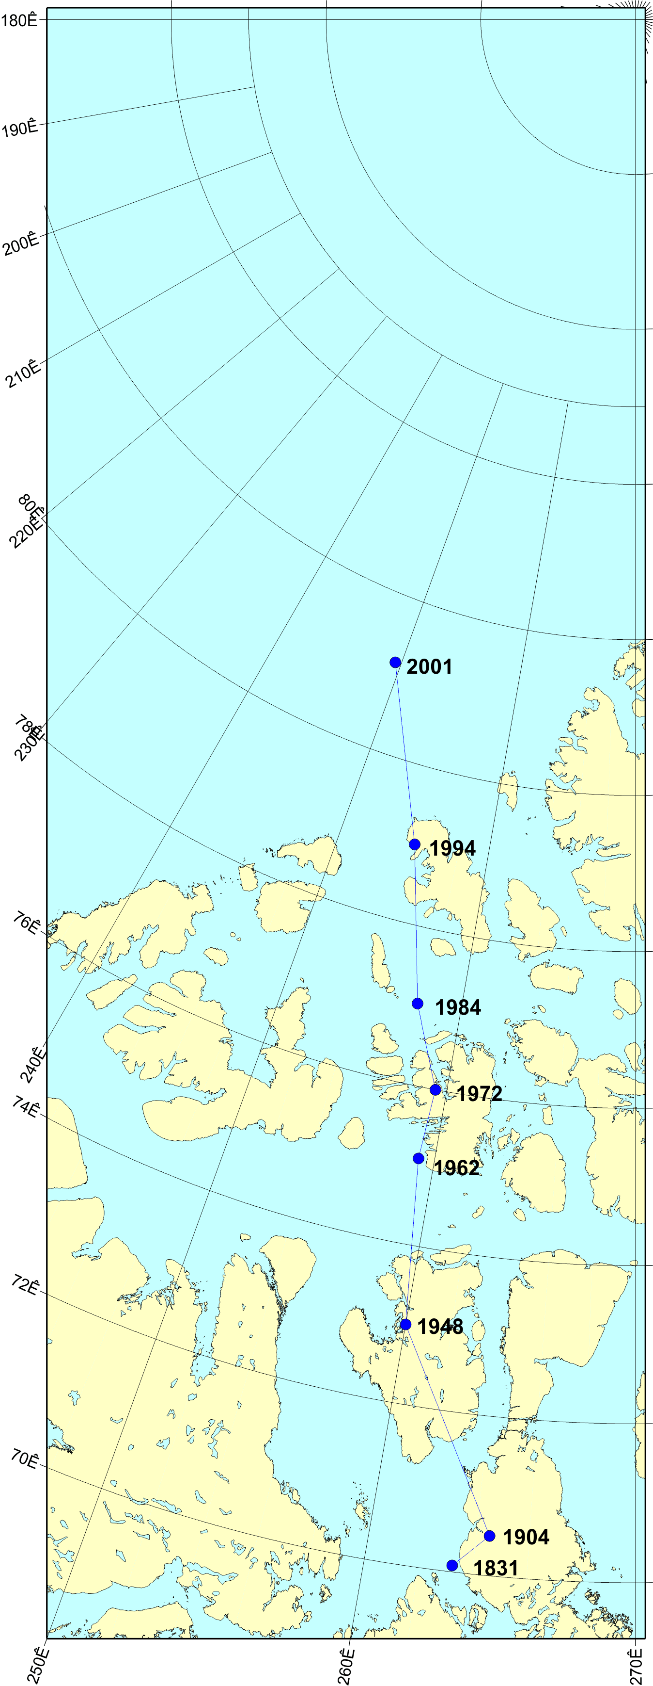
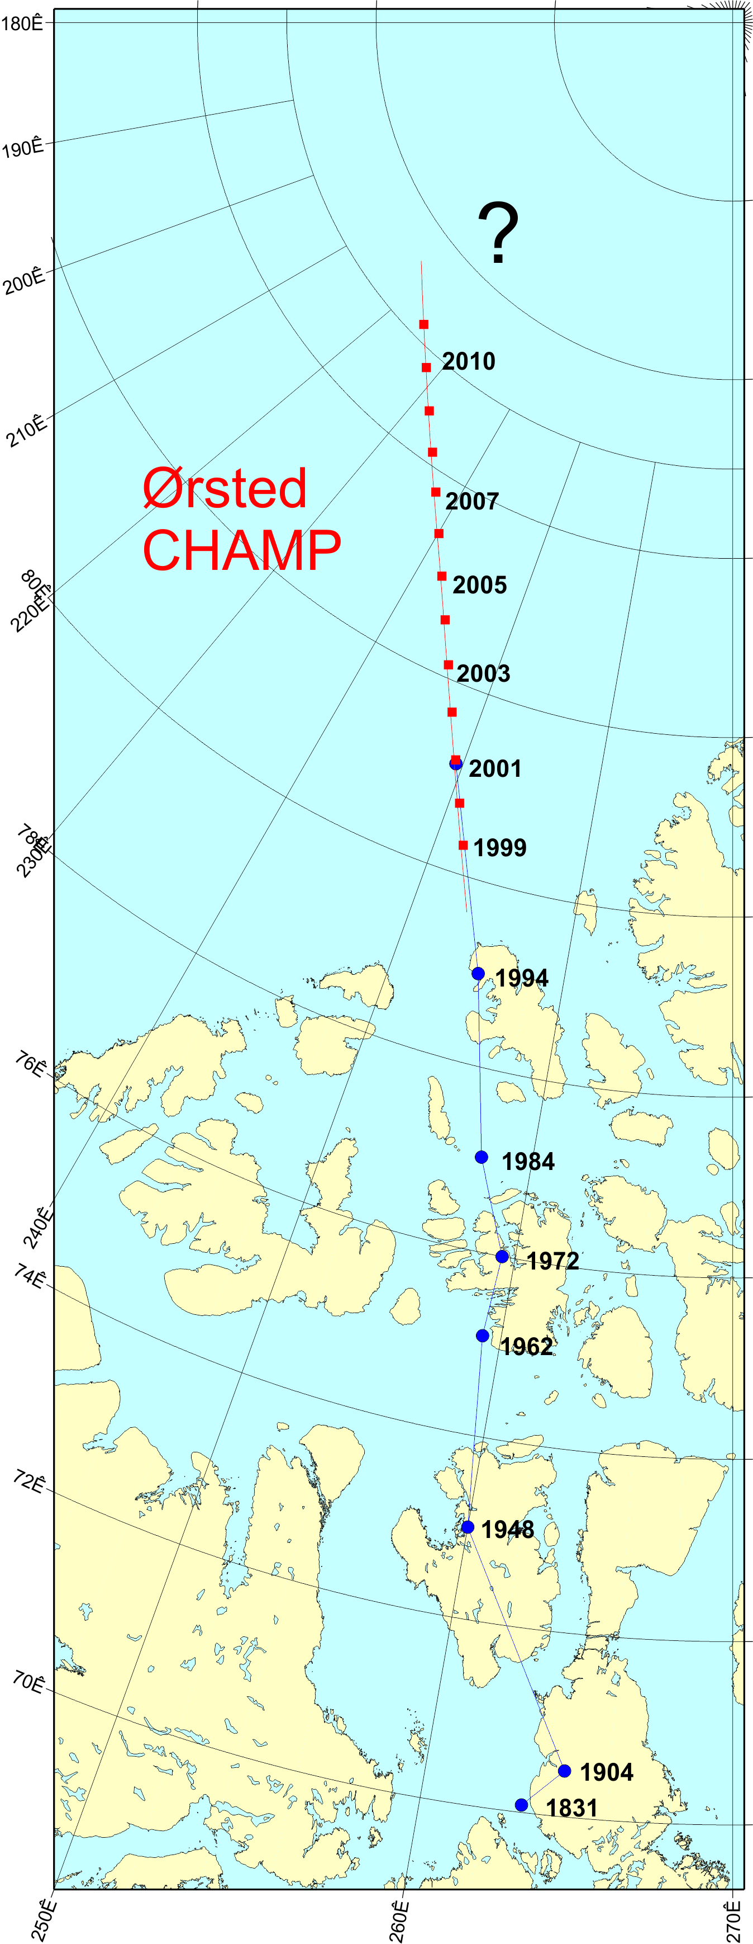
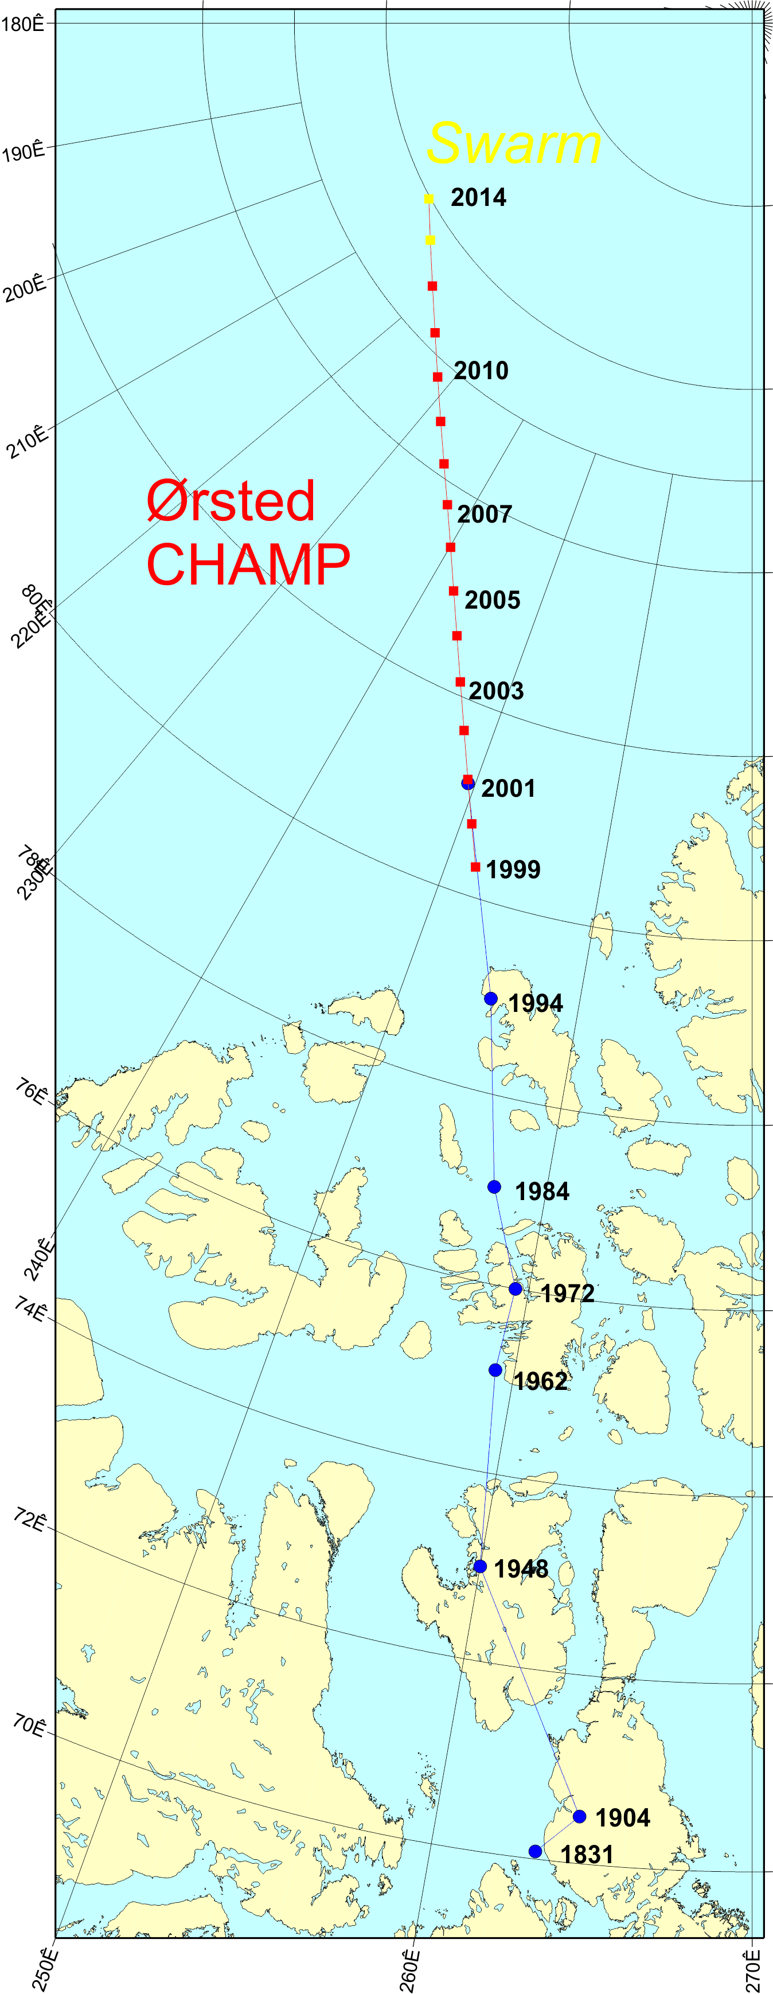
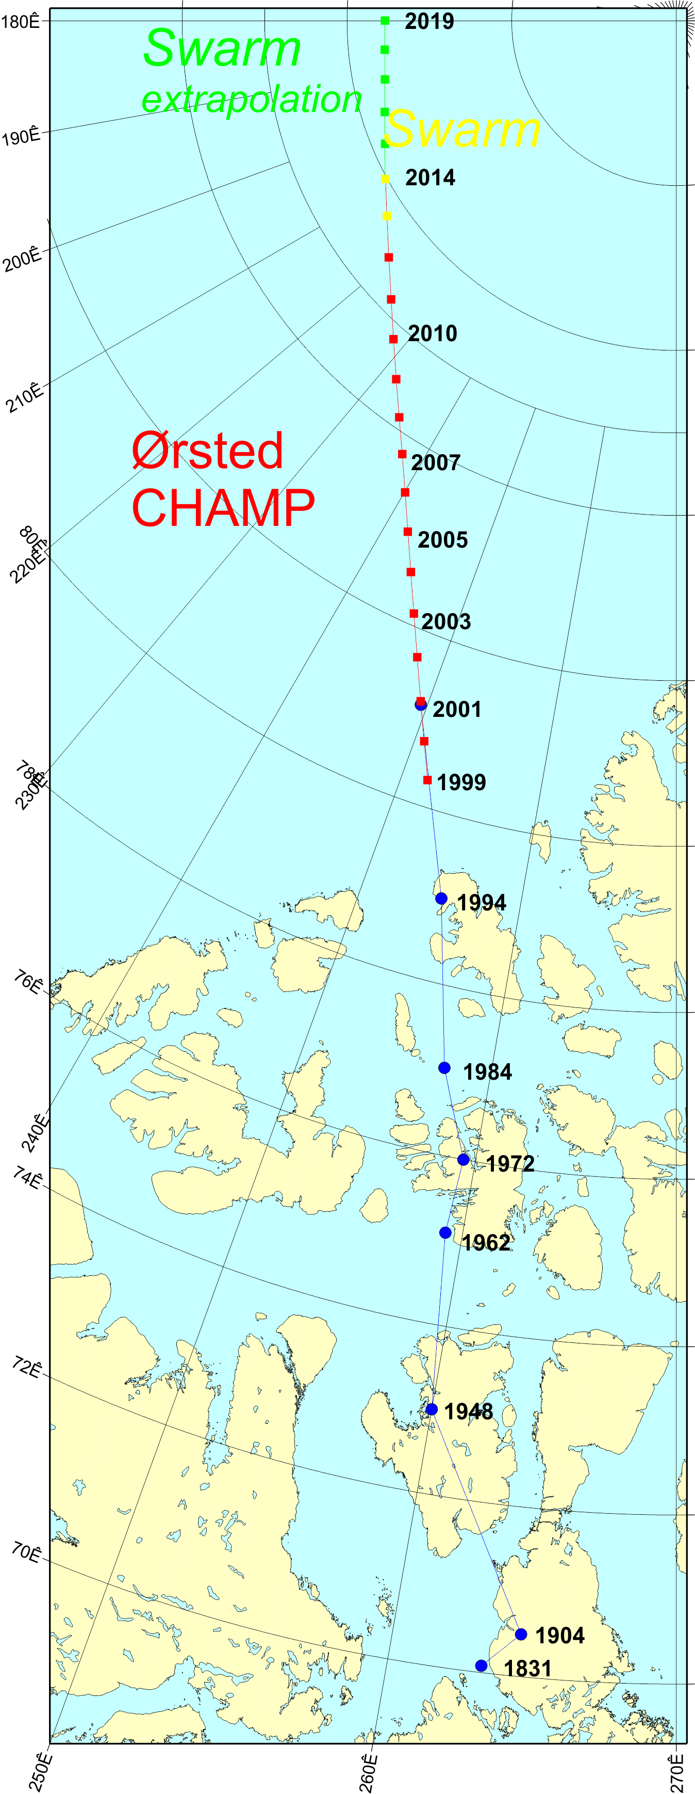
Movement of the magnetic North Pole
Ground expeditions
1831 James Clark Ross
1904 Roald Amundsen
Previous satellites
Ørsted
CHAMP
Swarm

Slide 20
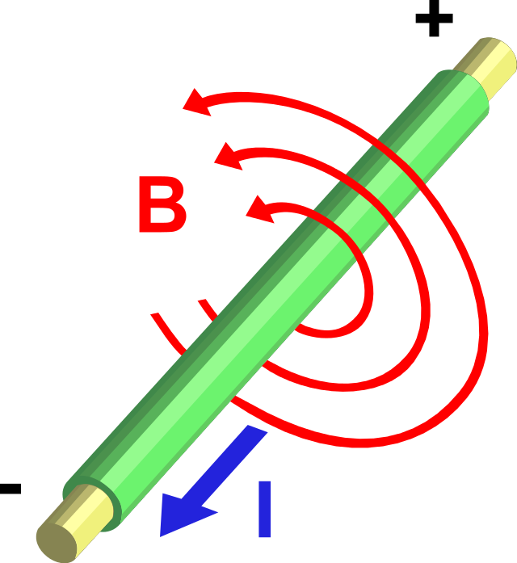
The Kursk Magnetic Anomaly as seen by Swarm A
observed
crustal field model prediction
vertical magnetic field
?
Electron density
Electrons
Electric current
Magnetic field

Slide 21
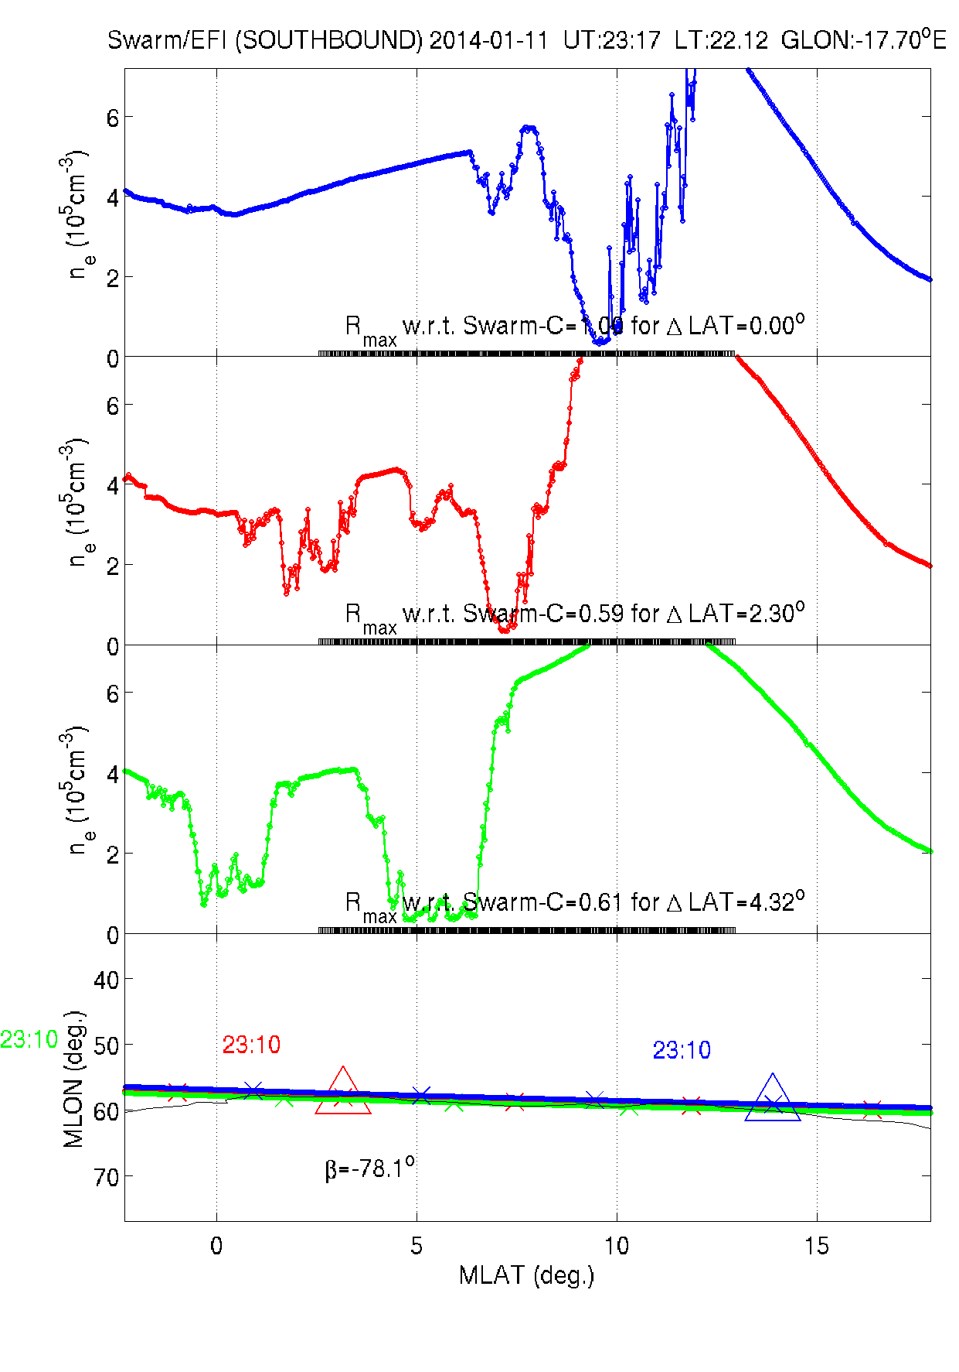
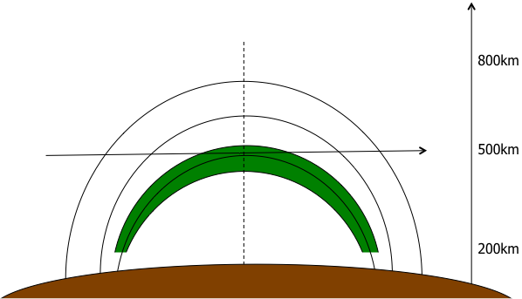
Equatorial plasma irregularities

Slide 22
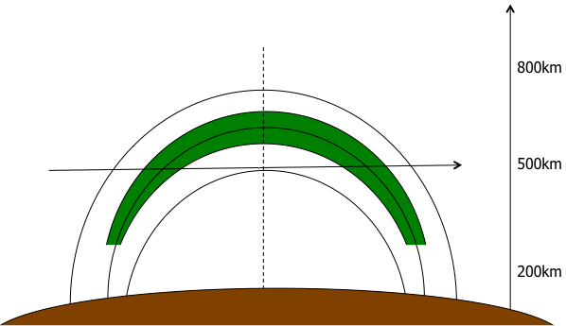
Equatorial plasma irregularities

Slide 23
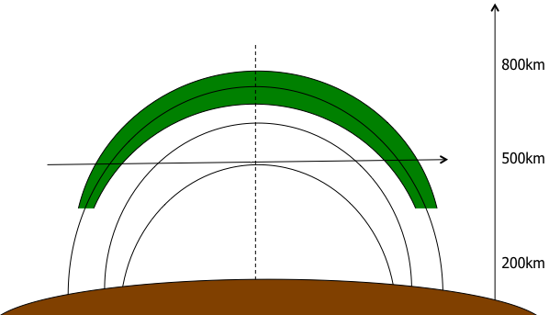
Equatorial plasma irregularities

Slide 24
Conclusions
Very exciting first data!
Magnetic Field change since launch: up to 100 nT
Community driven activity in next months: determination of the IGRF 2015

