Slide 1
Magnetic Navigation
Nils Olsen
DTU Space – Technical University of Denmark

Slide 2
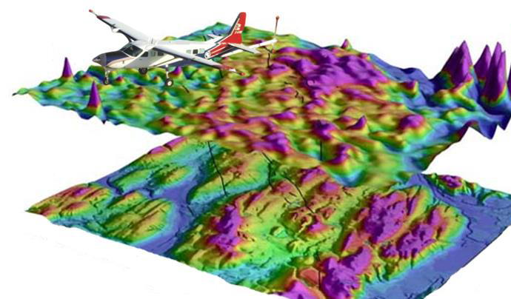
Magnetic Navigation – an Alternative to Position Determination with GNSS
Earth’s magnetic field is traditionally used to determine orientation (=direction)
Huge potential to use magnetic field (also) to determine position
Applicable globally, including over water, does not depend on time of day or weather
Passive navigation system, emitting no signal unlike similar fielded terrain-following systems
No attackable infrastructure - Magnetic field cannot be jammed!
(since it decays 1/d³ with distance d, as opposed to 1/d² for radio signals including GNSS)
Position error under optimal conditions
(low altitude, high-fidelity magnetic map, clean platform): 13 m rms
Internationally leading role of Denmark
in global geomagnetic field modelling (Ørsted and Swarm satellites)…
… and unique magnetic ground infrastructure in Greenland
(needed as reference stations for magnetic surveying
for obtaining high-fidelity magnetic maps)

Slide 3
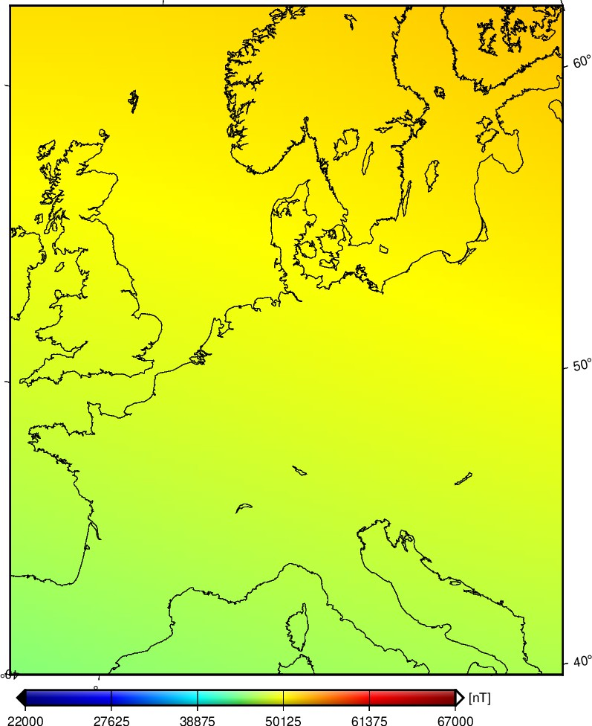
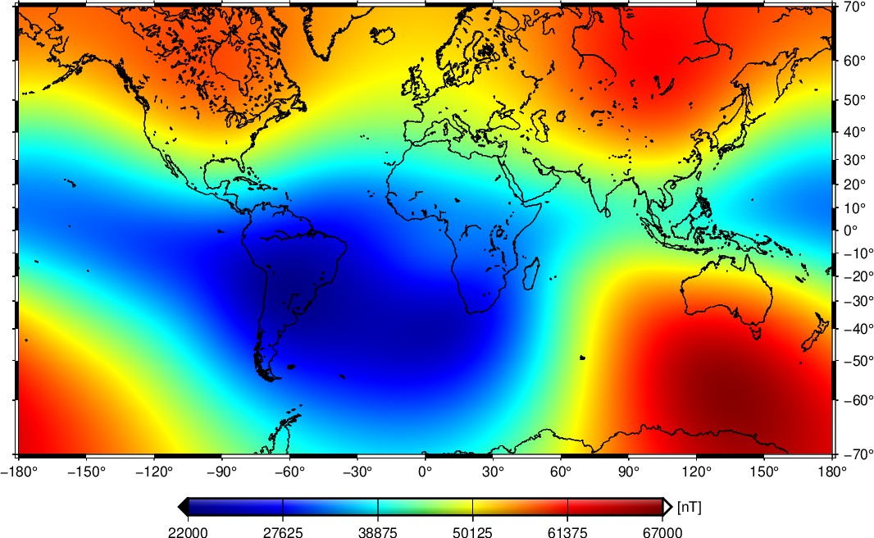
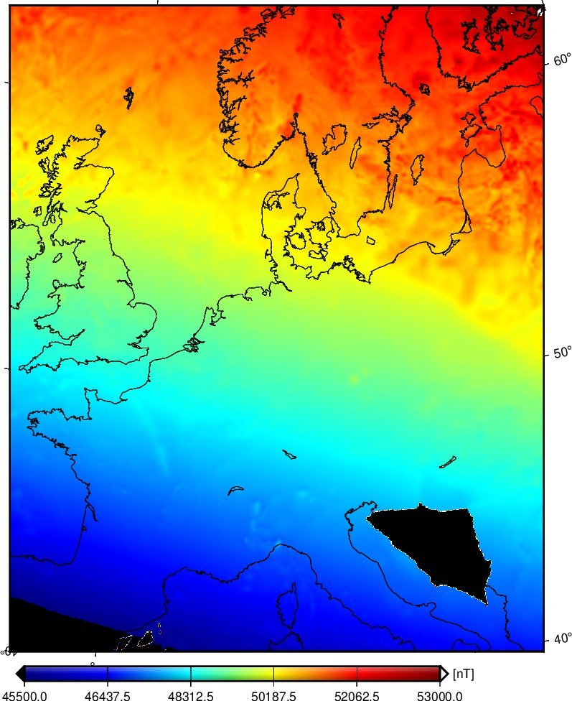
Magnetic Field Strength – dominated by Earth’s core field
95% of Earth’s magnetic field is due to Earth’s core
(dominated by a dipole field)
Crustal field is much weaker and masked by core field

Slide 4
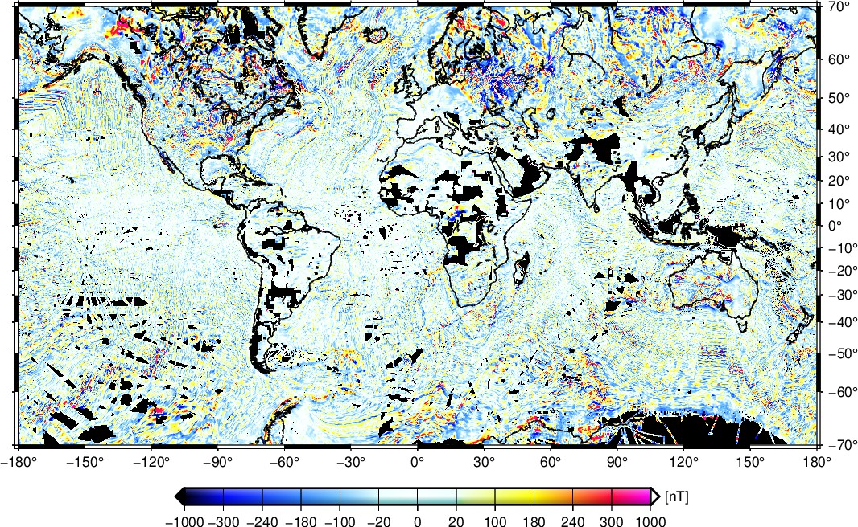
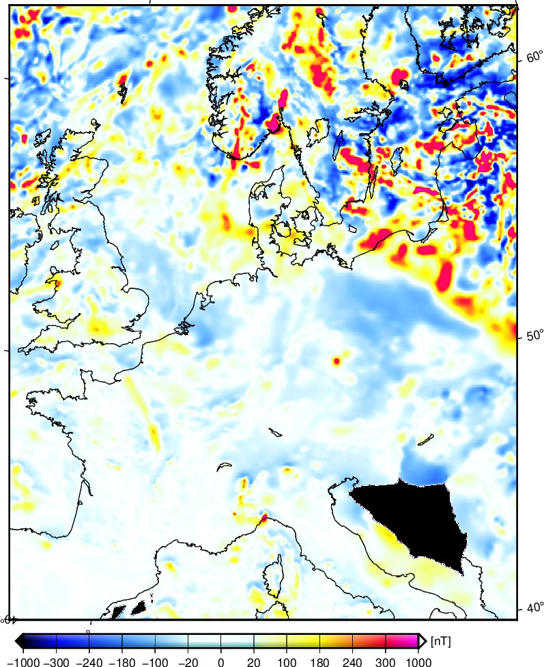
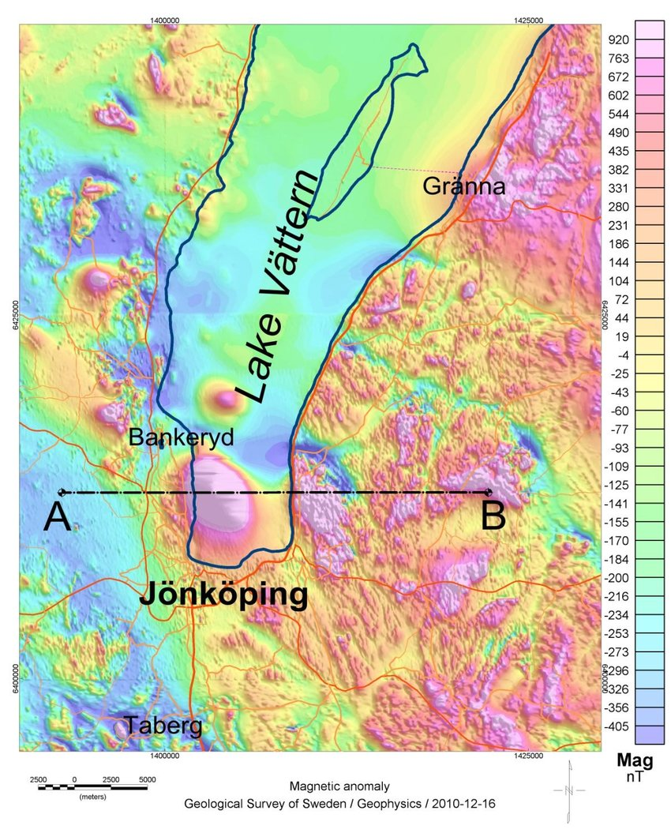
Magnetic Field Strength – after removal of Earth’s core field
“Highs and lows” of crustal field (due to magnetized rocks in upper 10 – 30 km)
(“magnetic topography”) allows for use of magnetic field to navigate
Crustal field is much weaker and masked by core field

Slide 5
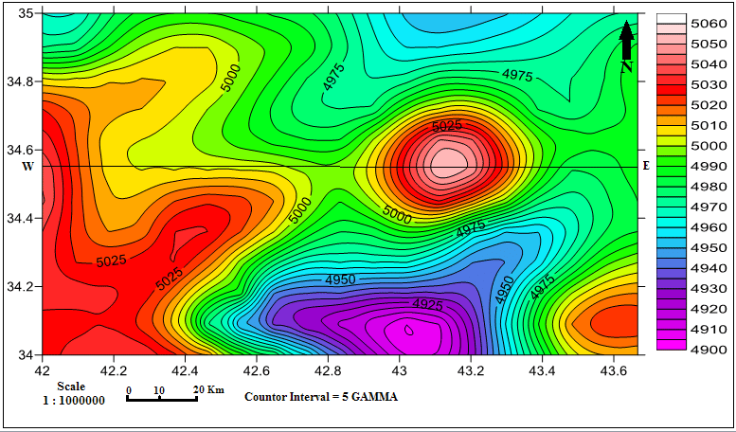
How Magnetic Navigation works:
Observed magnetic field strength ΔF at one measurement point
yields “position candidates” along isolines of ΔF
No single unique position
Observed magnetic field strength ΔF variations along flight path of moving platform
allows for a unique estimate of position (with some uncertainty Δx)
Flight path

Slide 6
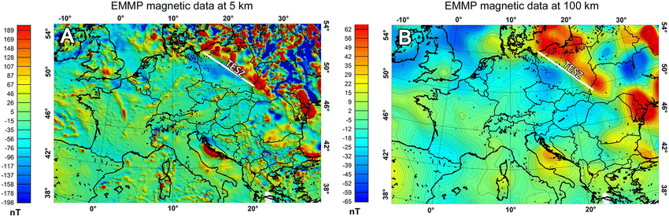
Pre-Requisite for Magnetic Navigation:
A Good Map of the Crustal Magnetic Field
Horizontal spatial resolution (wavelength of smallest feature) of the magnetic map
determines the quality of the position determination (higher resolution gives higher quality)
Rule-of-thumb for determining magnetic map:
horizontal spatial resolution is equal to the height of the observation

Slide 7
Pre-Requisite for Magnetic Navigation:
A Good Map of the Crustal Magnetic Field
Horizontal spatial resolution (wavelength of smallest feature) of the magnetic map
determines the quality of the position determination (higher resolution gives higher quality)
Rule-of-thumb for determining magnetic map:
horizontal spatial resolution is equal to the altitude h_{s} of the survey
  Aeromagnetic survey at h_{s} = 500 m altitude yields map of 500 m spatial resolution;
  this requires flight line spacing smaller than 500 m
  High altitude drone survey (e.g. h_{s} = 15 km altitude)
  Low flying satellites: presently down to h_{s} = 300 km, in future perhaps h_{s} = 200 km and lower
Global coverage is only possible with satellites, but map resolution is limited by survey altitude:
map resolution of 100 km at most seems to be possible
Continental-scale maps can be obtained with high-altitude drones:
map resolution of 10 km
Regional maps from low-altitude aeromagnetic survey:
map resolution 100 – 1000 m

Slide 8
Test case: what position can be obtained at 500 m altitude?
Canciani (2017)

Slide 9
Test Results: Optimal vs present-state situations
Position error: MagNav position vs GPS position
Estimated position uncertainty (± 1σ)
Optimal situation:
flying in a signal-rich area at very low altitude of 500 m
magnetically clean geo-survey aircraft
Obtained position error (rms): 13 m
Canciani (2017)

Slide 10
Test Results: Optimal vs present-state situations
Optimal situation:
flying in a signal-rich area at very low altitude of 500 m
magnetically clean geo-survey aircraft
Obtained position error (rms): 13 m
Present-state realistic situation:
flying at 1.500 m altitude
magnetically disturbed F-16 aircraft
Obtained position error (rms): 100 m
Canciani (2017)
Canciani (2021)

Slide 11
From map resolution to position error
Position error Δx is determined by flight altitude h,
which has to be ≥ altitude of magnetic map h_{s} (= survey altitude)
Flight altitude of h = 500 m leads to position error Δx = 10 – 20 m
Δx ≈ h / 25, thus position error is 25 times better than flight altitude (map resolution)
Scaling to other altitudes
  Magnetic map surveyed with high-altitude drones:
  h_{s} = 15 – 30 km leads to Δx = 600 – 1.200 m
  Magnetic map surveyed with satellites: h_{s} = 100 – 200 km leads to Δx = 4 – 8 km
What are the position requirements for a given application?

Slide 12
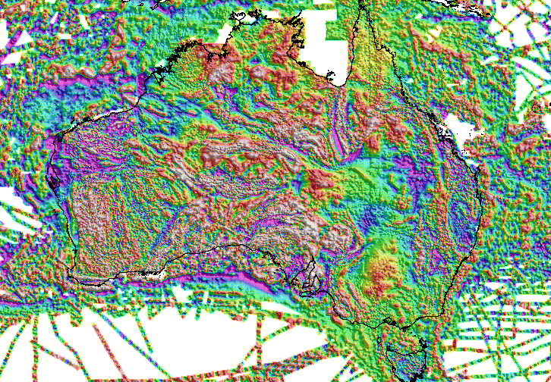
Testbed for Magnetic Navigation :
Continental-scale Magnetic Surveys
Only existing continental-scale magnetic map: Australia
Testbed for Magnetic Navigation:
Greenland (polar regions) in addition to Australia (non polar)

Slide 13
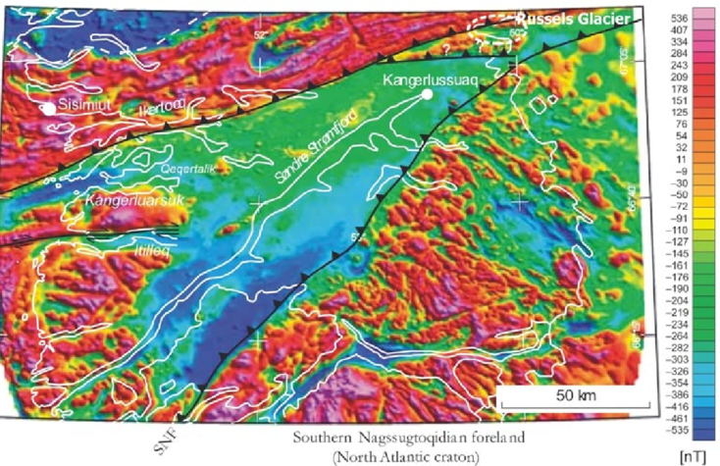
Magnetic Map of Greenland

Slide 14
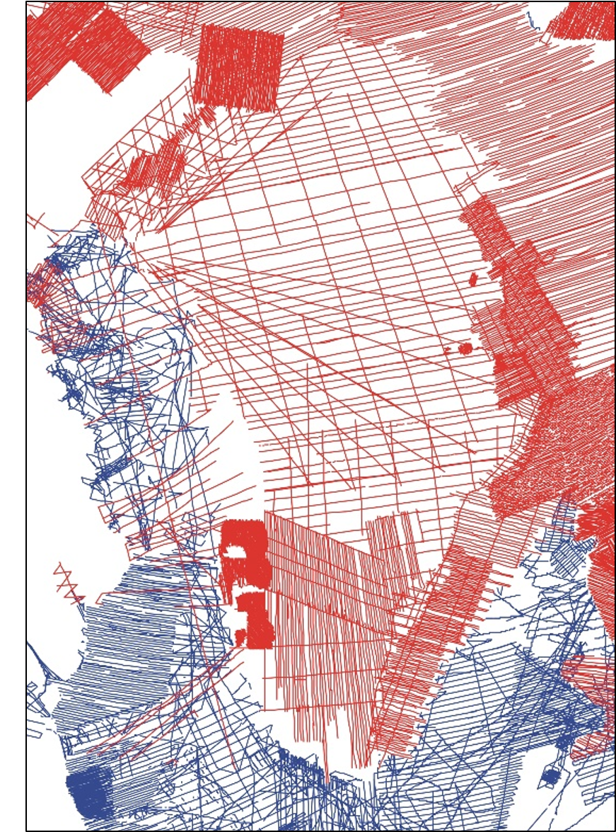
Only old Data “covering” central Greenland
Only survey of central Greenland in 1970s and 80s
Poor positioning (no GPS), 100 – 150 km line-spacing (aliasing!)

Slide 15
Magnetic Navigation – an Alternative to Position Determination with GNSS
Earth’s magnetic field is traditionally used to determine orientation (=direction)
Huge potential to use magnetic field (also) to determine position
Applicable globally, including over water, does not depend on time of day or weather
Passive navigation system, emitting no signal unlike similar fielded terrain-following systems
No attackable infrastructure - Magnetic field cannot be jammed!
(since it decays 1/d³ with distance d, as opposed to 1/d² for radio signals including GNSS)
Position error under optimal conditions
(low altitude, high-fidelity magnetic map, clean platform): 13 m rms
Internationally leading role of Denmark
in global geomagnetic field modelling (Ørsted and Swarm satellites)…
… and unique magnetic ground infrastructure in Greenland
(needed as reference stations for magnetic surveying
for obtaining high-fidelity magnetic maps)

