Slide 1
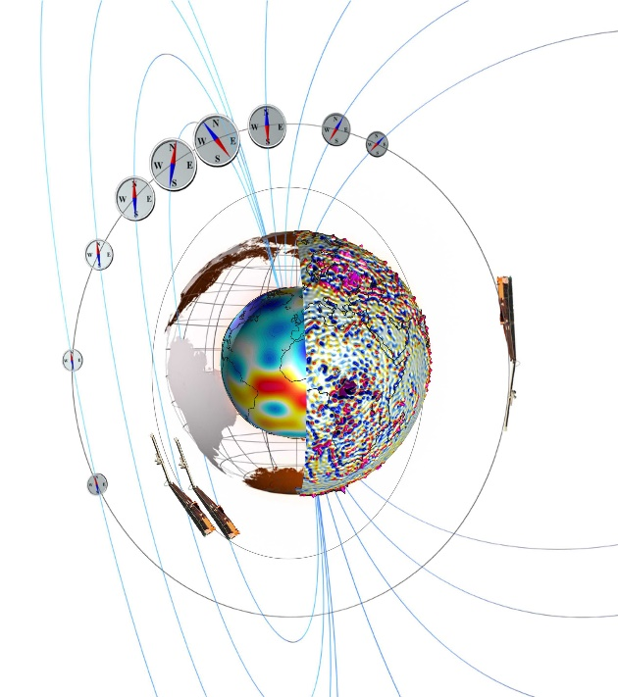
Exploring Earth from Space –
Towards a true Swarm of Magnetic Satellites
Nils Olsen, Lars Tøffner-Clausen, Clemens Kloss, Chris Finlay
DTU Space – Technical University of Denmark / DK
Satellites for measuring Earth’s magnetic field
On magnetometer data calibration
Cryosat-2 magnetometer data
Some scientific applications
Fully calibrated Cryosat-2 magnetic data (Aug 2010 – Dec 2018)
are freely available as daily files in CDF (similar to Swarm L1b data) at
ftp://swarm-diss.eo.esa.int/%23CryoSat-2

Slide 2
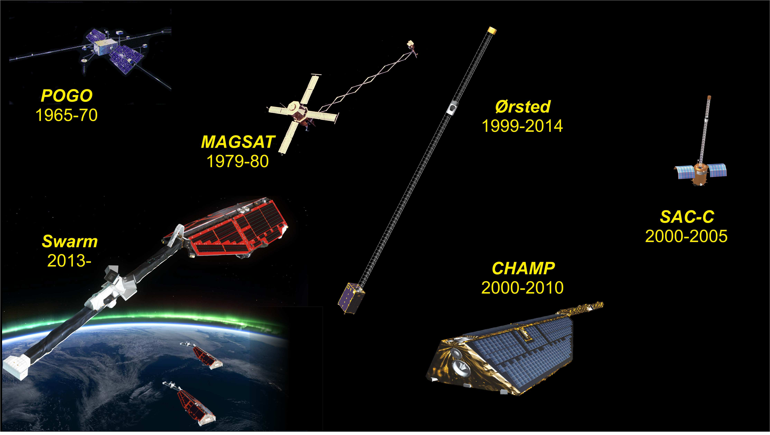
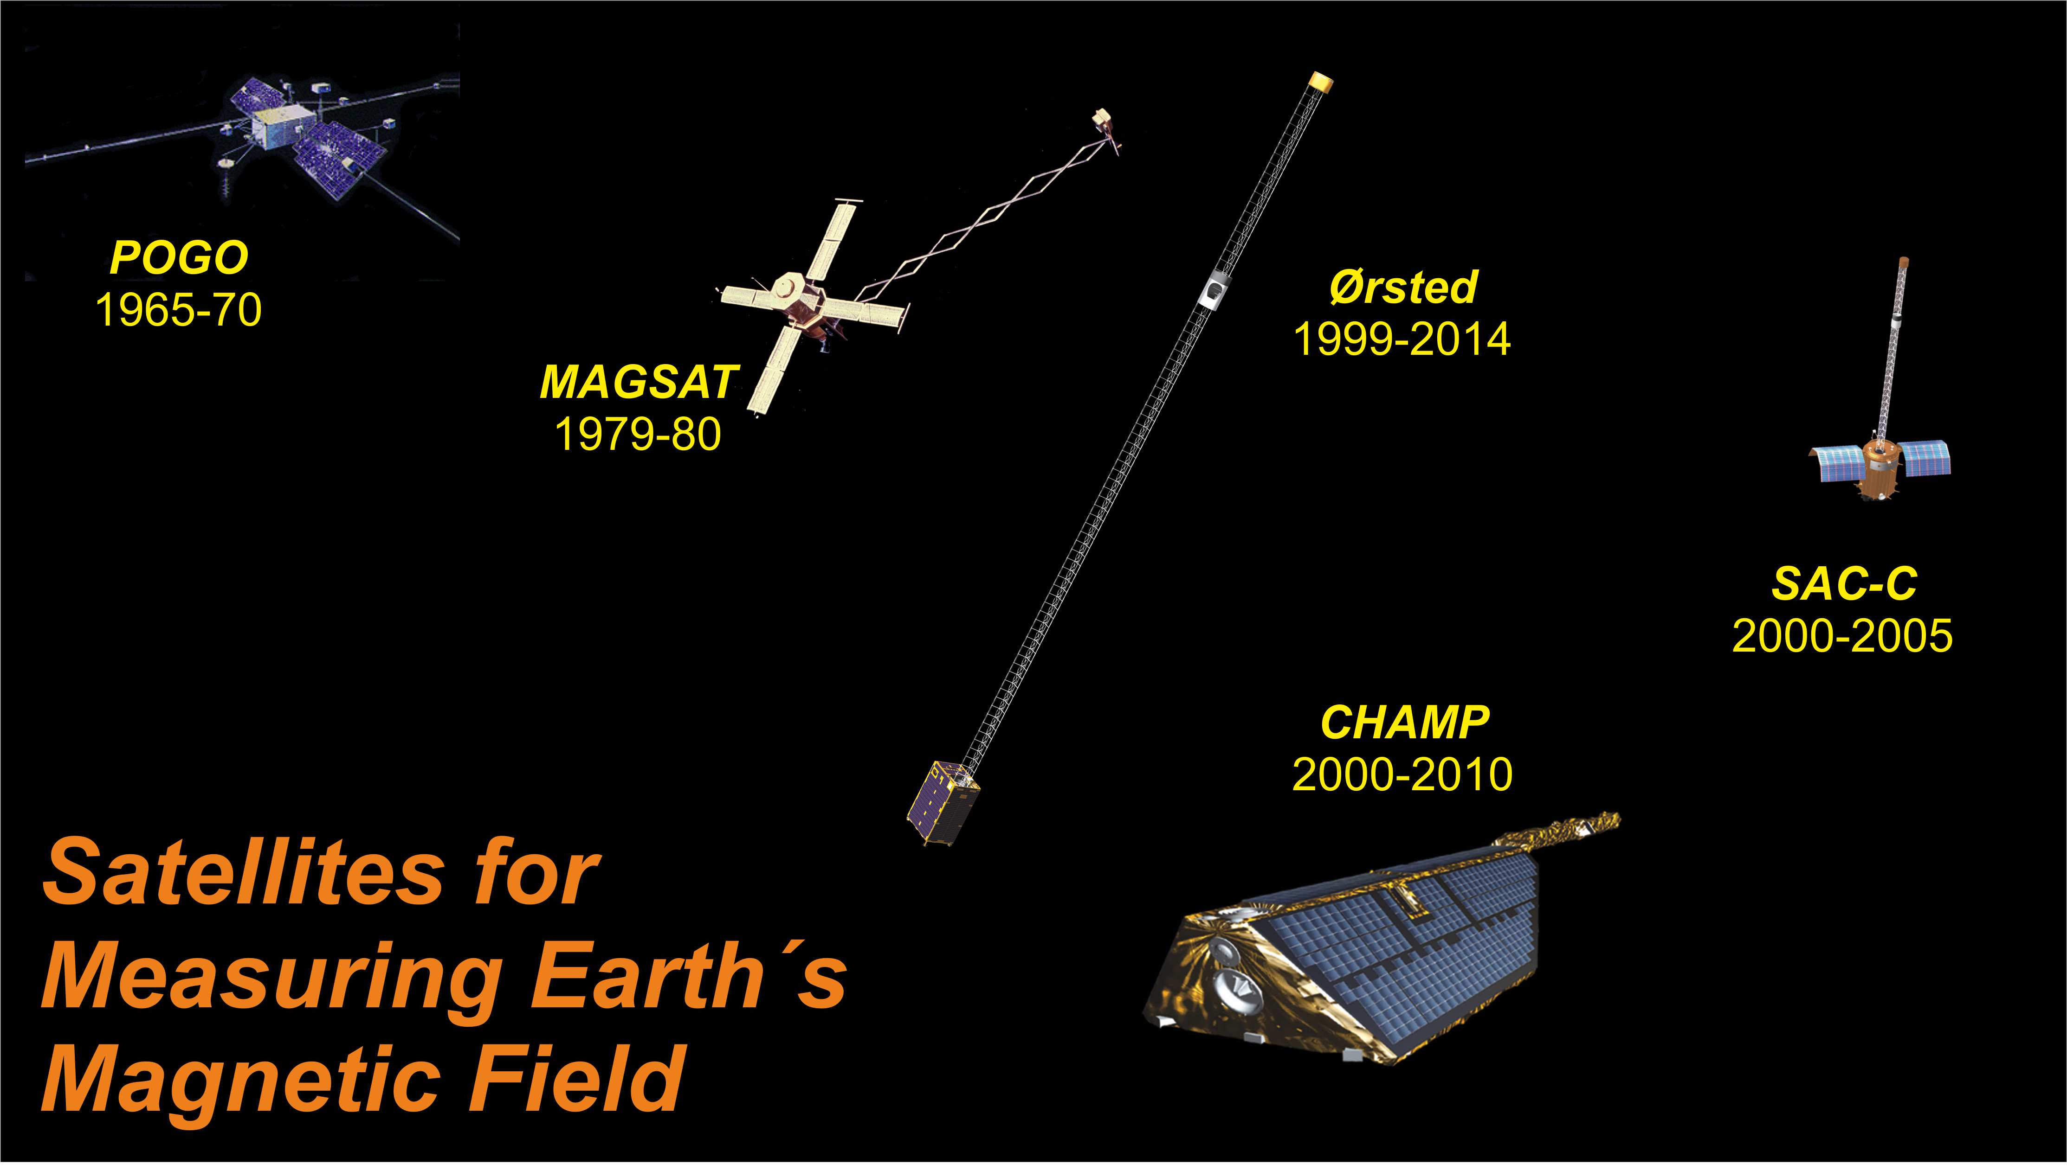
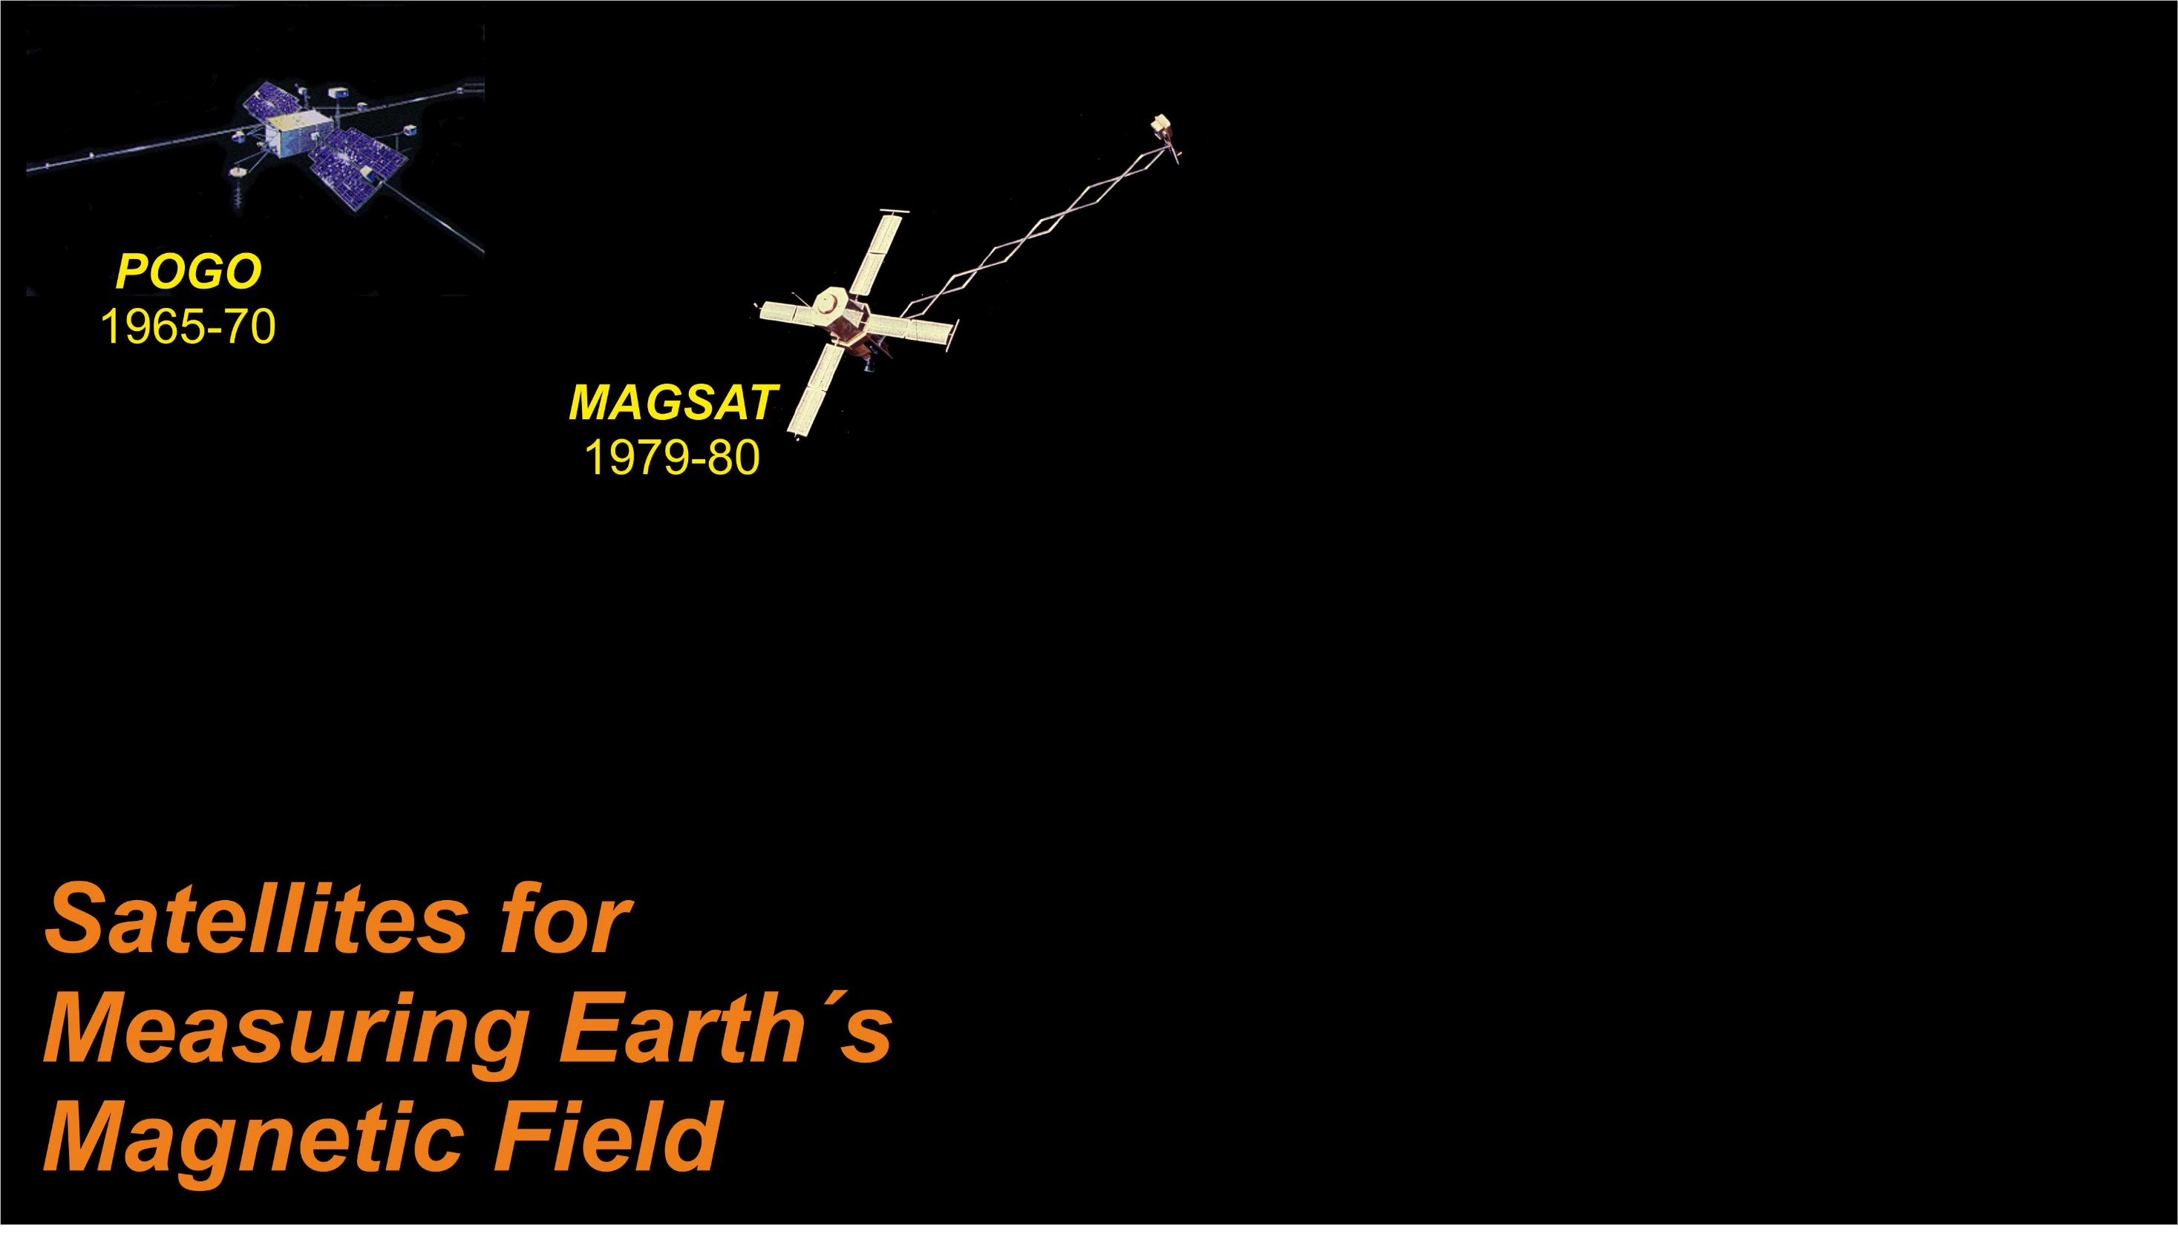

Slide 3
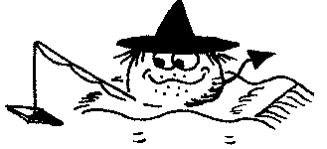
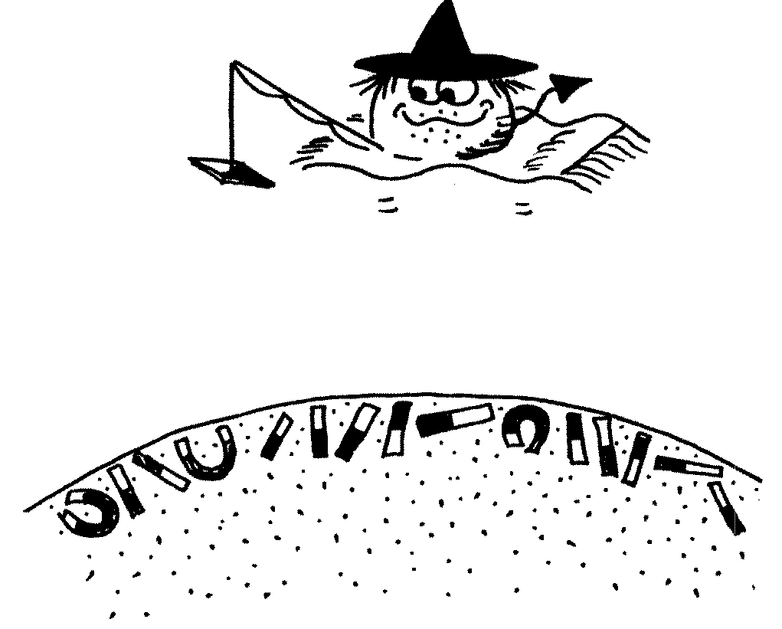
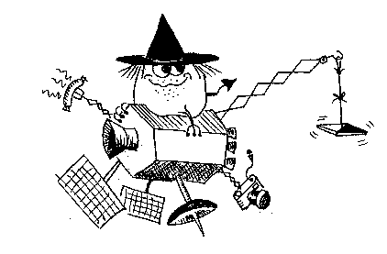



Most satellites carry magnetometer for navigational purposes
The data of these platform magnetometers have scientific value but data calibration is essential
Towards a true swarm of satellites …

Slide 4
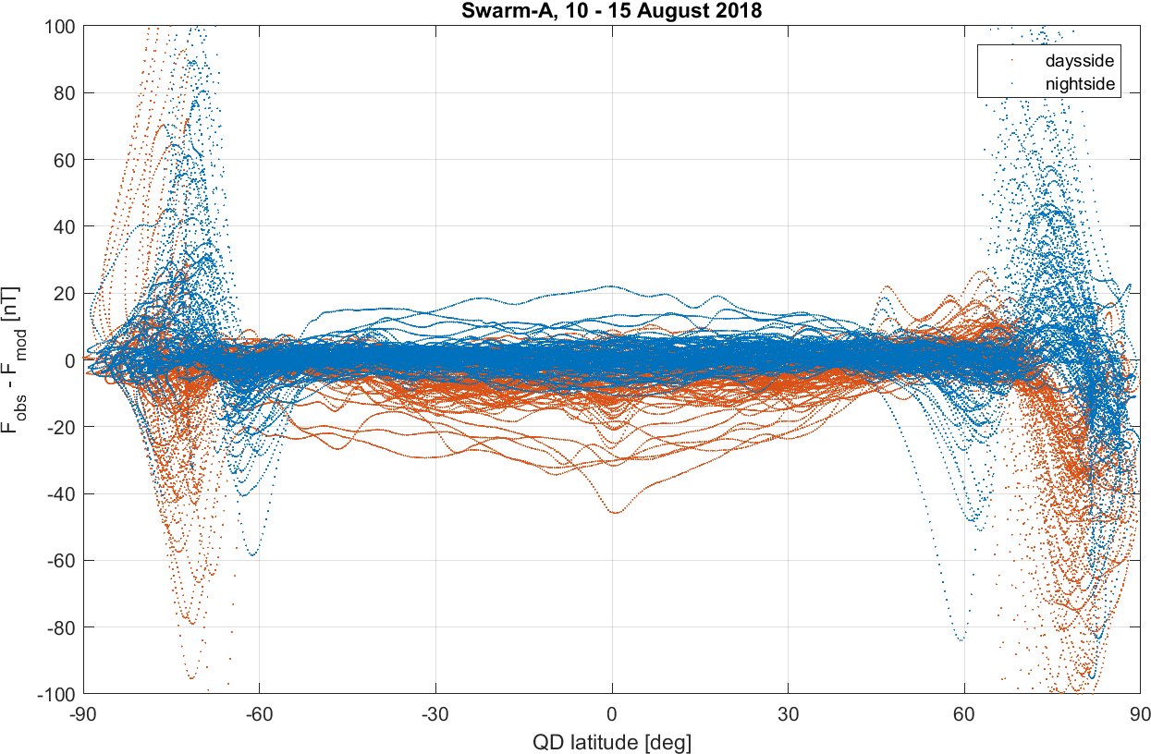
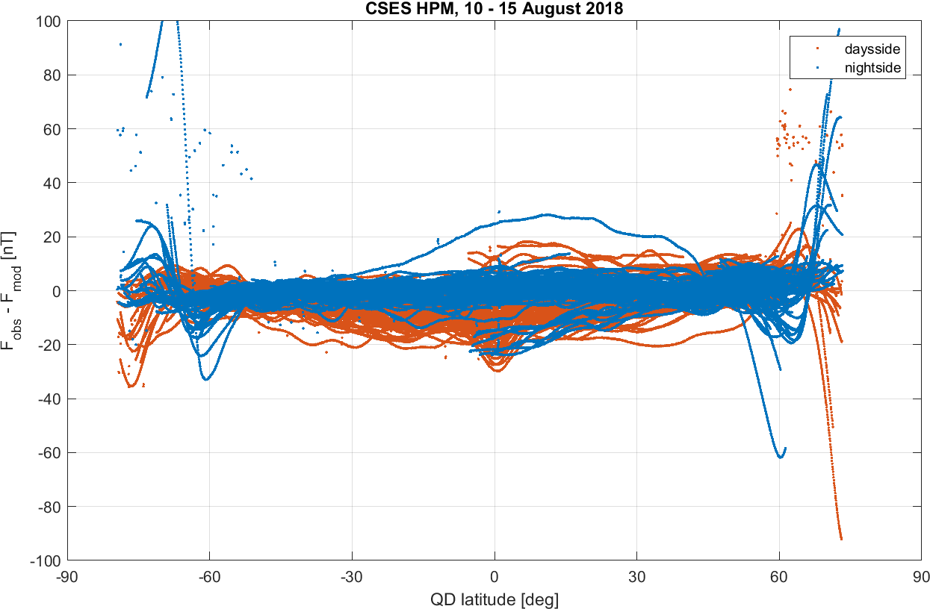
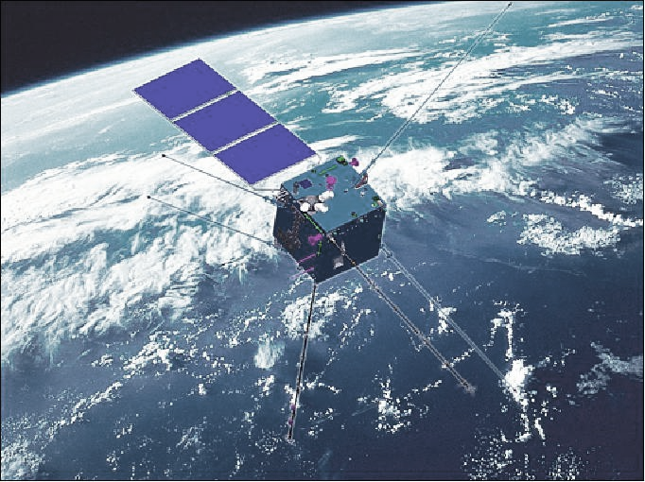
Swarm
CSES
China Seismo-Electromagnetic Satellite / Zhangheng 1

Slide 5
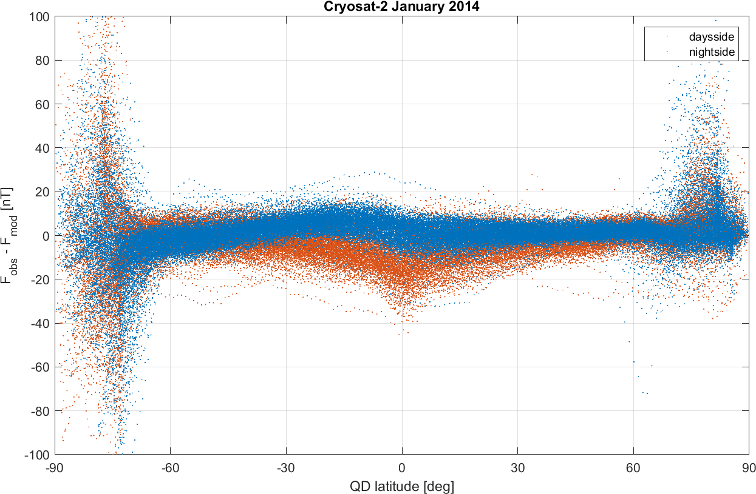
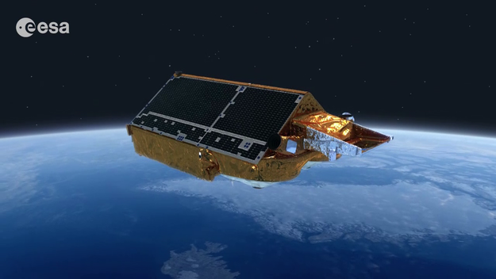
Swarm
CSES
China Seismo-Electromagnetic Satellite / Zhangheng 1
Cryosat

Slide 6
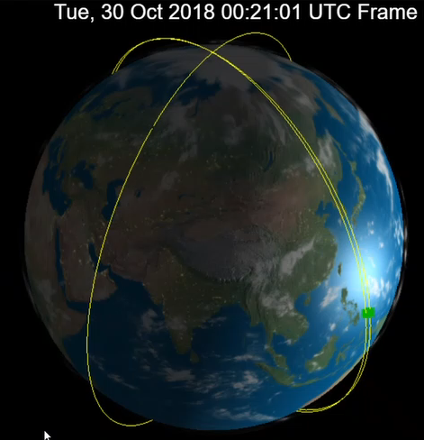
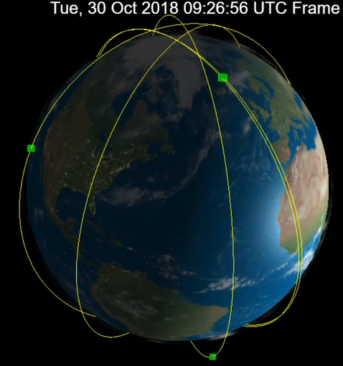
Swarm only …
Swarm + Cryosat + CSES
Sven Kardol, http://orbits.tudelft.nl/

Slide 7
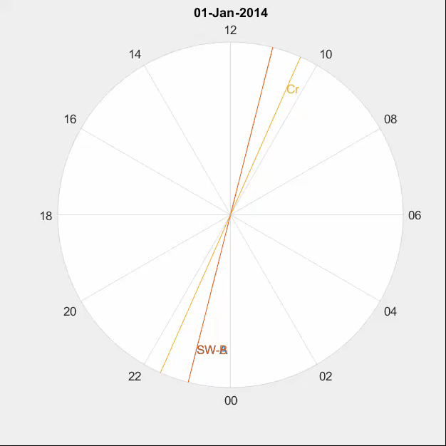
Local Time evolution
Swarm A/C + B and Cryosat

Slide 8
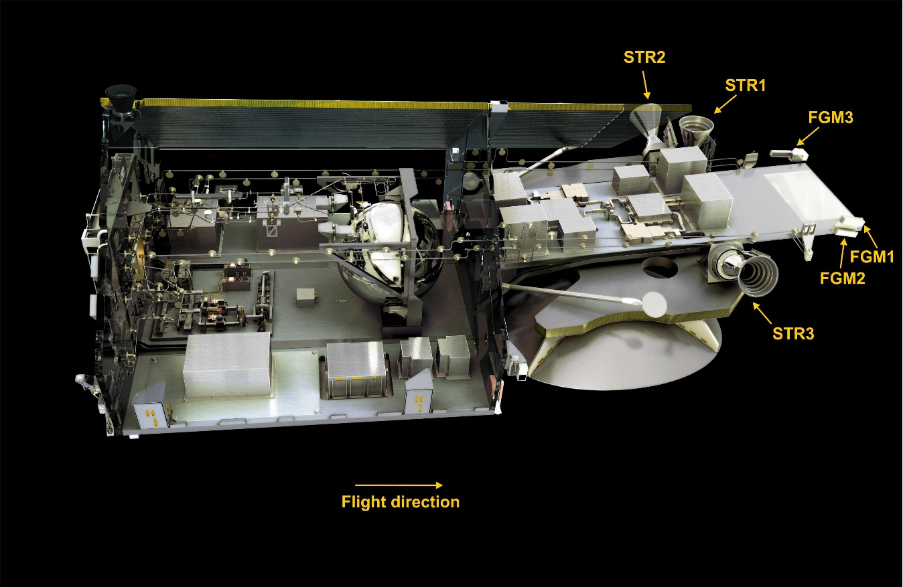
Cryosat-2
Launched in April 2010 – and still in operation
720 – 730 km altitude, 92 degree orbital inclination
3 platform vector Fluxgate magnetometers (FGMs)
3 Star imagers (STRs)

Slide 9
Terminology …
Calibration: From Vector Fluxgate Magnetometer (FGM) 3-sensor output E
to magnetic field B_{FGM} vector in FGM frame
Alignment: Rotation of B_{FGM} from FGM frame to Star Imager frame (CRF)
and further to B_{NEC} in NEC (North-East-Center) frame
Estimation of calibration and alignment parameters
requires FGM sensor output E and STR quaternions q
and model values B_{mod} of the magnetic field vector at satellite position and time
Available: 4-sec sampled Cryosat data spanning 9.5 years (Aug 2010 – Dec 2018)
Alternative to this sequential approach: Co-estimation of calibration + alignment parameters together with geomagnetic field model, to remove need for a-priori model values.
See talk by Clemens Kloss IUGG19-3603 on Friday 12 July

Slide 10

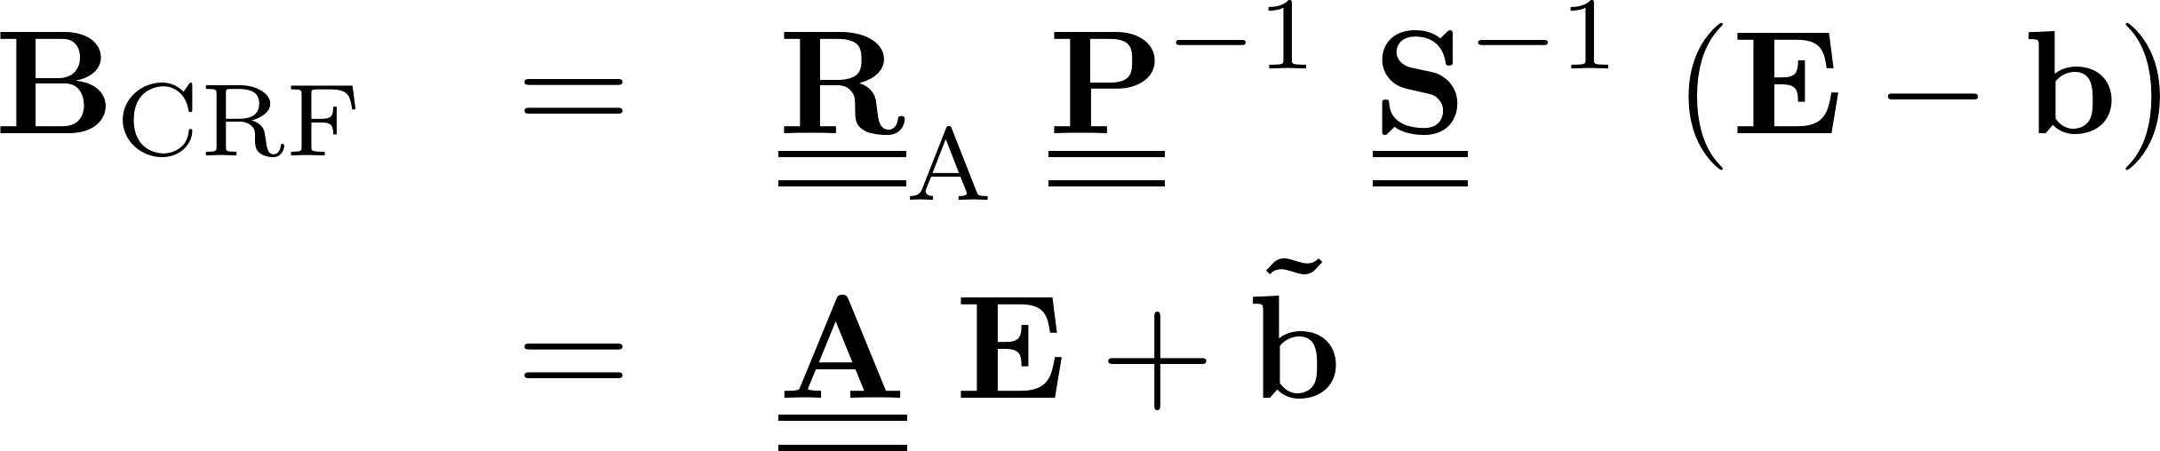

Vector Calibration of FGMs
E is uncalibrated output of the 3 sensors, B_{FGM} is calibrated magnetic field vector
in FGM frame
Assumption: linear response of each FGM instrument:
3 offsets (biases), 3 scale values (sensitivities), 3 non-orthogonalities
Alignment: rotation from FGM to CRF (Common Reference Frame of Star tracker)
3 Euler angles for describing rotation matrix
12 parameters

Slide 11
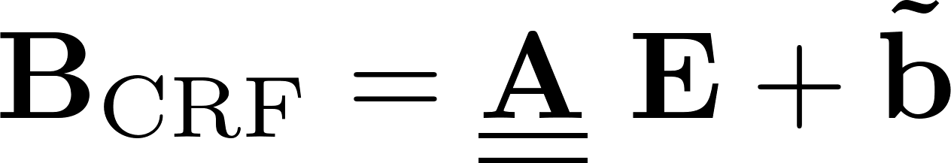


Vector Calibration of FGMs
Estimation of the 12 parameters
(offsets, scale values, non-orthogonalities, Euler angles) of
by a non-linear robust Least-Squares minimization of ΔB = B_{CRF} - B_{model CHAOS-6,CRF}
where B_{model CHAOS-6} is magnetic field vector as given by CHAOS-6 model
(describing contributions from core, crust + magnetosphere)
Can also be done by solving for the 12 parameters of the linear inverse problem
(9 elements of , 3 elements of ) followed by a (unique) determination of offsets, scale values, non-orthogonalities and Euler angles by QL decomposition of

Slide 12


Accounting for temperature, s/c disturbance, and non-linearities
12 “basic” calibration parameters, estimated separately for each of the 100 months
100 months (Aug 2010 – Dec 2018) x 12 = 1200 parameters
The 3 offsets b and 3 scale values S depend on sensor temperature T_{FGM}
Assumed to be constant for whole mission: 2 x 3 = 6 parameters
Magnetic disturbance vector of Magnetorquer currents I_{MTQ}
Assumed to be constant for whole mission: 3 x 3 tensor = 9 parameters
Magnetic disturbances due to solar array and battery current strengths I_{SA1}, I_{SA2}, I_{Batt}
Assumed to be constant for whole mission: 3 x 3 = 9 parameters
Non-linearities (“transverse effect” disturbance of fluxgate sensor x on sensor output y)
B₁ depends on E₃², and B₃ depends on E₂³ and E₃² : 3 parameters
In total 1227 model parameters estimated by robust non-linear Least-Squares
from 13.3 mio observations (= 3 x 4.4 mio data triplets)
Temporal regularisation (smoothing) of month-to-month variation of “basic” 12 parameters

Slide 13
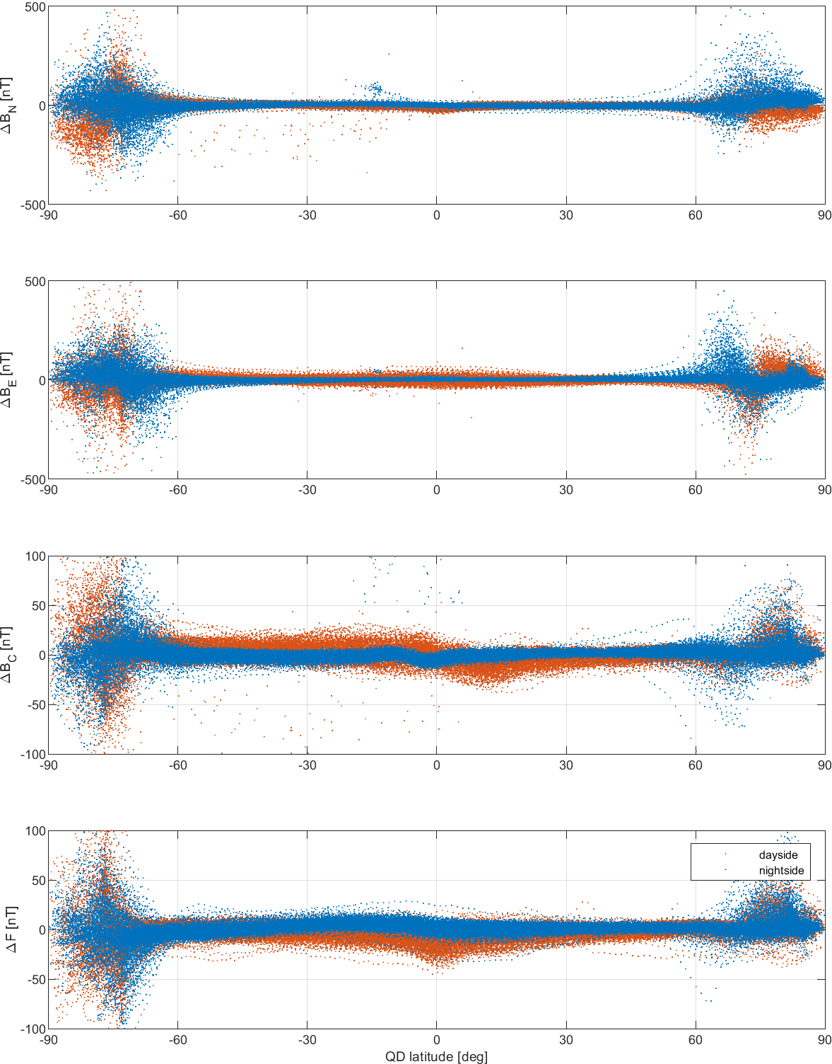
Fully calibrated and aligned B, January 2014

Slide 14
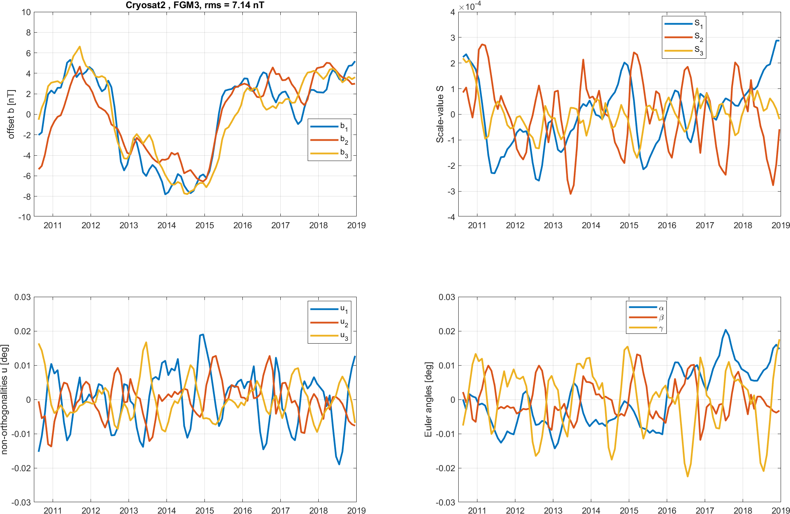
Temporal Evolution of Calibration and Alignment Parameters
Month-to-month variation:
Offsets: ± 8 nT
Scale values: ± 300 ppm
non-orthononalities and
Euler angles: ±0.02° (±72 arcsecs)
For FGM3

Slide 15
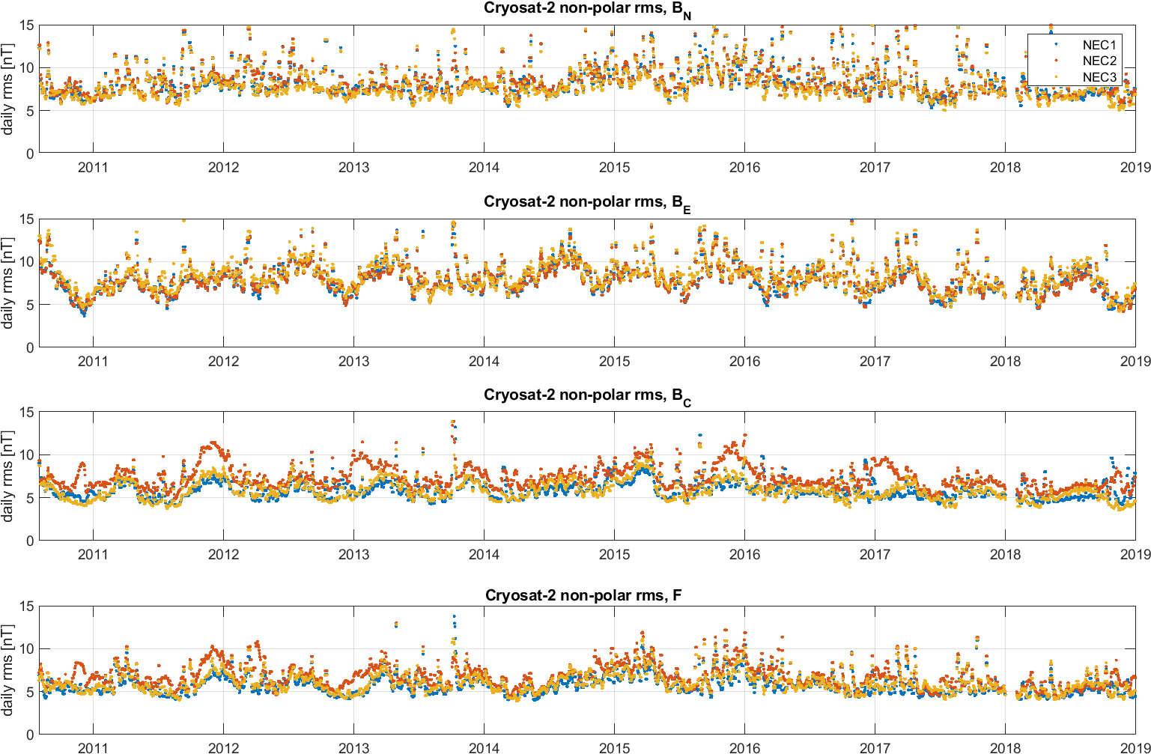
Daily rms misfit: 5 – 10 nT

Slide 16
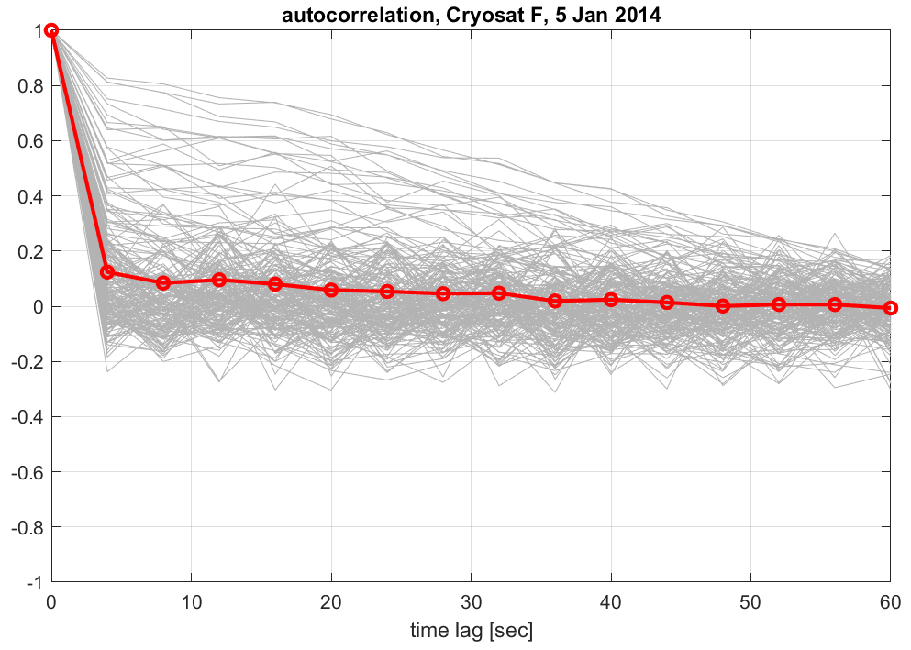
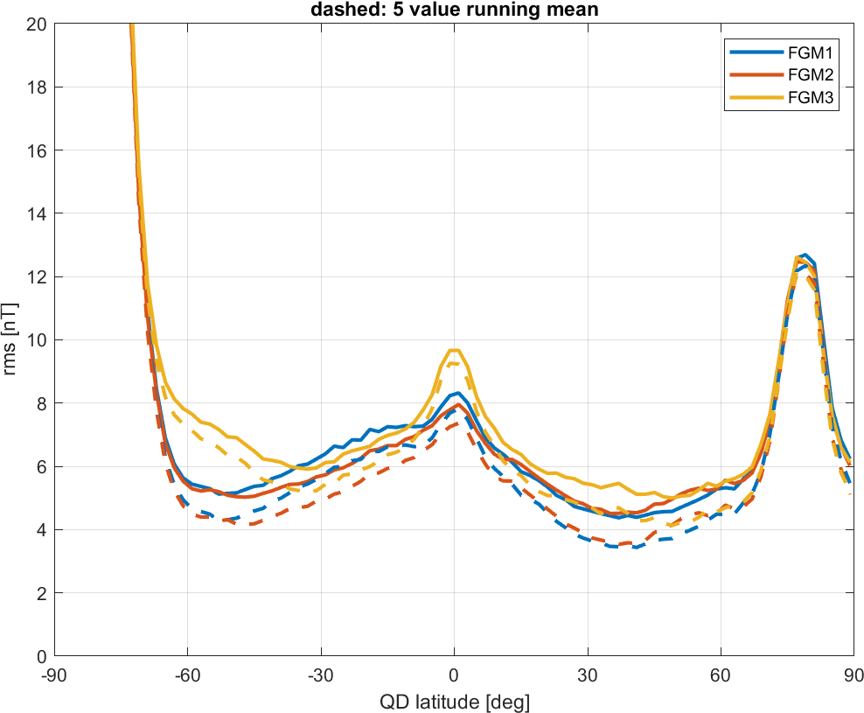
Data residuals are dominated by uncorrelated noise
Averaging over successive samples is recommended
5 sample average: 4 secs → 20 sec sampling
15 sample average: 4 secs → 60 sec sampling

Slide 17
Application:
Monitoring of Magnetospheric Ring-current activity
Orbit-by-orbit determination of “Dst-equivalent” from B_{N}
Similar to Swarm MMA_F, but only P10-term

Slide 18
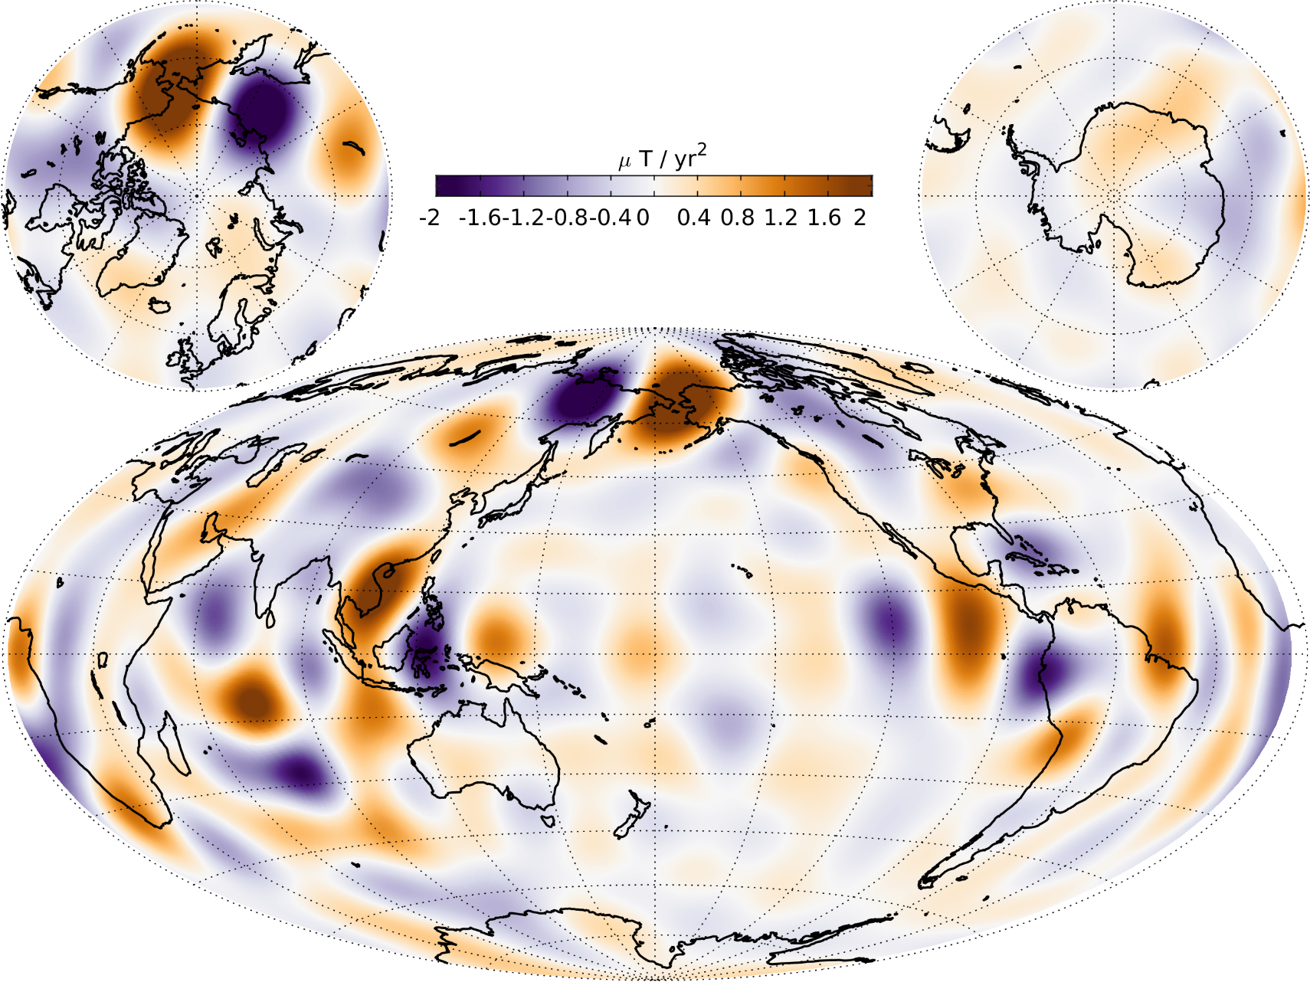
Core surface field secular acceleration
CHAOS-6-x9 to degree n = 19

Slide 19
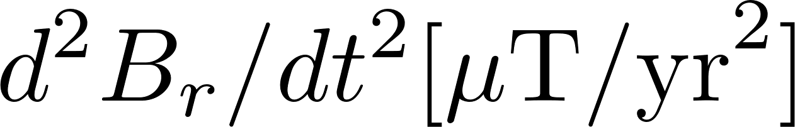
Core surface field accelerations in equatorial region
CHAOS-6-x9
Swarm
Only ground observatories
CHAMP

Slide 20
Core surface field accelerations in equatorial region
CHAOS-6-x9
SOLA: Local Inversion of CHAMP,
Cryosat and Swarm data (Hammer & Finlay 2019)
Swarm
Cryosat
CHAMP

Slide 21
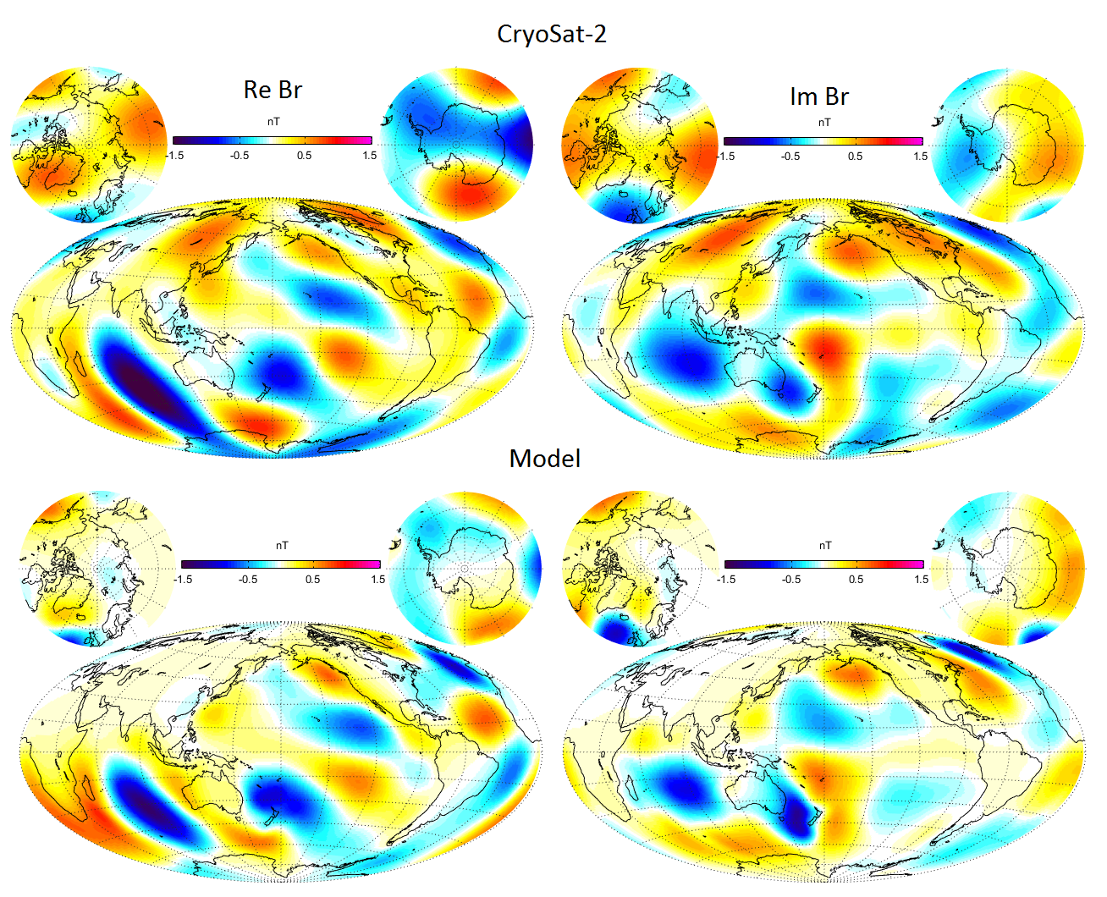
The Icing on the Cake
Magnetic field of oceanic M2 tide determined from Cryosat data
Br of M2 tidal field at 720 km (Cryosat) altitude
Model prediction (ocean tidal flow model + model of conductivity for mantle, lithospheric and seawater
Courtesy: Alexander Grayver, ETH Zürich

Slide 22
Summary and Conclusion
Almost every satellite carries magnetometers for navigational purposes
Their data can be used for scientific purposes – after calibration
Quality of magnetometer data and s/c disturbances is very different
from satellite to satellite
Data can be used for core field studies and for investigating ionospheric and magnetospheric current systems - Space-weather applications
Enormous potential for science and application
Calibrated Cryosat-2 magnetic data (Aug 2010 – Dec 2018)
are available as daily files in CDF (similar to Swarm L1b data)
at ftp://swarm-diss.eo.esa.int/%23CryoSat-2
Cryosat is not Swarm – be prepared for surprises !

