Slide 1
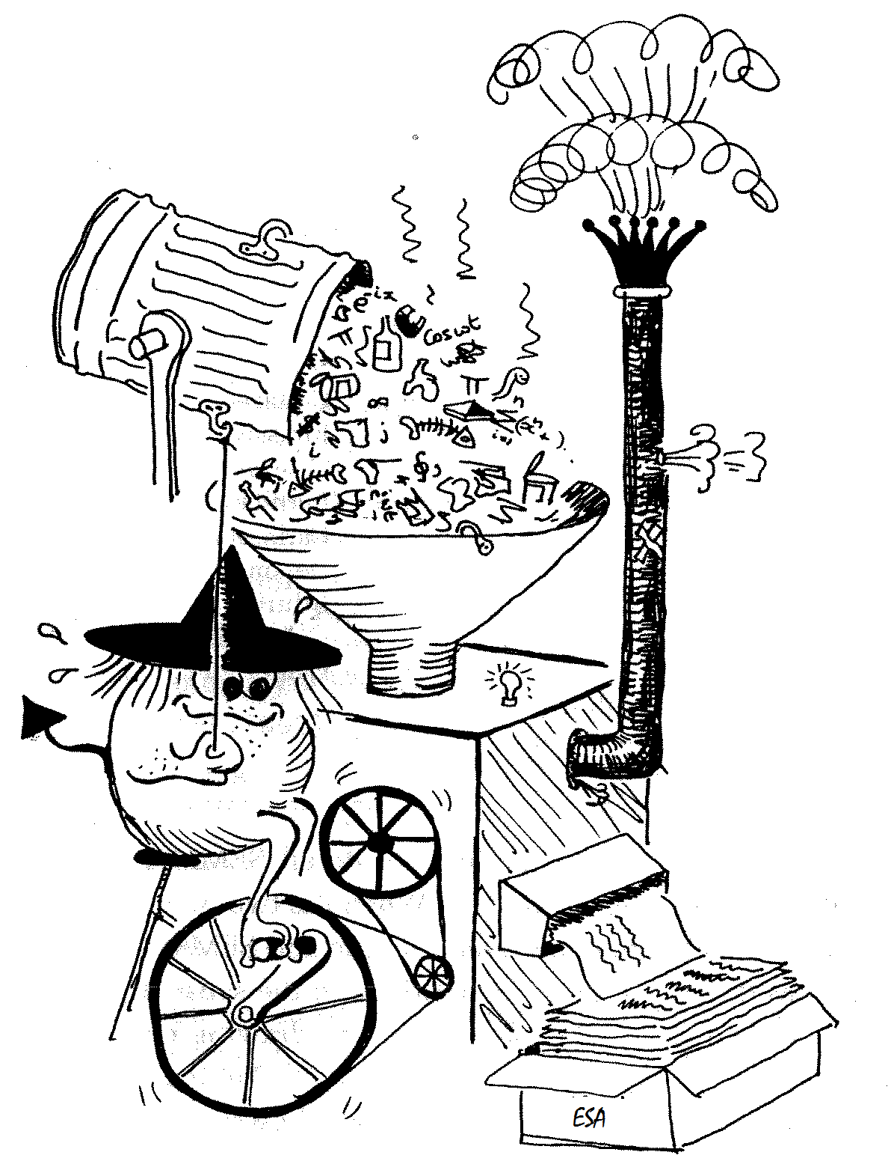
Swarm satellite constellation mission: From data to first scientific results
Nils Olsen and the Swarm SCARF Team
Patrick Alken, Ciaran D Beggan, Stephan C. Buchert, Johnathan Burchill, Arnaud Chulliat,
Eelco Doornbos, Joao Teixeira da Encarnacao, Ludwig Grunwaldt, Brian Hamilton,
Rune Floberghagen, Eigil Friis-Christensen, Giuseppe Ottavianelli, Gauthier Hulot,
Jose van den IJssel, David J. Knudsen, Alexey Kuvshinov, Jean-Michel Leger, Vincent Lesur, Hermann Luehr, Susan Macmillan, Stefan Maus, Ingo Michaelis, Max Noja, Nils Olsen,
Poul Erik H Olsen, Jaeheung Park, Radek Peresty, Gernot Plank, Christoph Puethe, Jan Rauberg, Patricia Ritter, Martin Rother, Terence J Sabaka, Reyko Schachtschneider, Olivier Sirol,
Claudia Stolle, Erwan Thebault, Alan W P Thomson, Lars Toeffner-Clausen, Jakub Velımsky,
Pierre Vigneron, Pieter N Visser
SCARF: Level 2 Data Products and Processing
Some Selected Science Results
  Plasma depletion seen in different parameters
  Multi-Point observation of Equatorial plasma irregularities
  SIFM: Swarm Initial Field Model

Slide 2
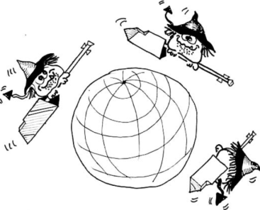
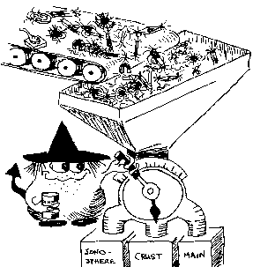
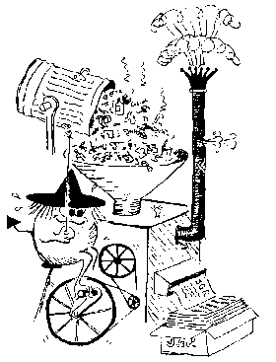
Swarm Data Processing Hierarchy
SW-A
SW-A
SW-A
L0
L1b Processor
(Operational Processor)
L1b Processor
(Prototype Processor)
L1b
L2 Processor
SCARF
L2 Processing Facility
L2
scientific users

Slide 3
Swarm Level-2 Data Processing
Swarm SCARF (Satellite Constellation Application and Research Facility)
Consortium of 10 Partners from Europe, US and Canada
(DTU, GFZ, IPGP, ETH, DEOS, BGS, NASA/GSFC, CIRES, CUP and UoC)
ESA funded Level-2 Processing Facility
Cat-1 chains with “scientists in the loop” (operated by SCARF)
advanced geomagnetic models, mantle conductivity …
Cat-2 chains with automatic processing (operated by ESRIN)
products describing Earth environment, Near Real-Time capability
10 European institutes
3 oversea partners

Slide 4
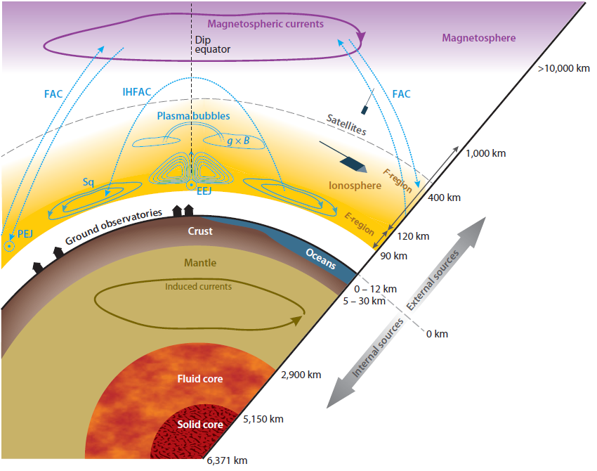
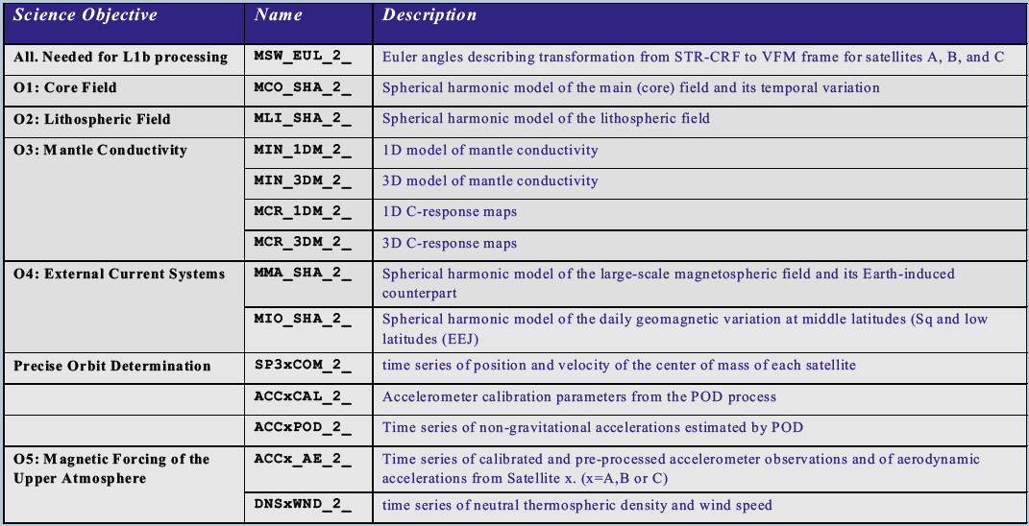
Swarm Level-2 Data Products
Example: MCO from Dedicated Inversion Chain
Filename: SW_OPER_MCO_SHAi2D_20130101T000000_20150303T000000_0101.DBL
# Swarm L2 DCO Core field model# Snap-shots derived from order-isog spline models
# There are isog-2 snap-shots per node-interval,
# plus one at each node i.e. every isog-1 snap-shots# correspond to a spline node.
# Dates are given in Years.fraction# Gauss coefficient format is F15.6
#
# First non-comment line is describing the table:
# N_min n_max N_times spline_order N_step(=spline_order-1) Validity.start Validity.end
# Second non-comment line is listing the dates in Years.fraction
# 1 20 26 6 5 2013.80 2015.17
2013.001027 2013.100958 2013.200890 2013.300821 2013.400753 ...
1 0 -29463.381499 -29462.291111 -29461.200283 -29460.109008 -29459.017281 ...
1 1 -1537.218089 -1535.413433 -1533.612511 -1531.815375 -1530.022079 ...
1 -1 4848.693817 4846.131387 4843.563496 4840.990068 4838.411027 ...
2 0 -2427.160177 -2428.063339 -2428.971201 -2429.883827 -2430.801285 ...
2 1 3019.499629 3019.136758 3018.773557 3018.410021 3018.046147 ...
2 -1 -2791.270940 -2793.982985 -2796.695329 -2799.407976 -2802.120930 ...
2 2 1672.977579 1673.151659 1673.325173 1673.498114 1673.670473 ...
2 -2 -612.885675 -614.342677 -615.799762 -617.256928 -618.714179 ...
3 0 1344.105542 1344.420837 1344.735871 1345.050638 1345.365136 ...
3 1 -2341.161298 -2341.721278 -2342.281117 -2342.840814 -2343.400366 ...
3 -1 -131.133548 -130.346667 -129.559616 -128.772393 -127.984996 ...
3 2 1226.604287 1226.559581 1226.515000 1226.470546 1226.426221 ...
3 -2 245.088304 245.081705 245.075136 245.068597 245.062090 ...
3 3 602.191947 601.178821 600.165522 599.152050 598.138401 ...
3 -3 -541.223255 -541.082060 -540.941158 -540.800553 -540.660249 ...
4 0 909.594468 909.485298 909.376195 909.267158 909.158189 ...
4 1 813.174476 813.199292 813.224080 813.248840 813.273571 ...
4 -1 285.139609 285.058469 284.977299 284.896100 284.814870 ...
4 2 138.213525 137.328070 136.442615 135.557161 134.671706 ...
...
More on Core and Lithospheric L2 Products in
”A lithospheric magnetic field model derived from the Swarm satellite measurements” by E. Thebault et al. (talk)
“Swarm dedicated core field model and it's relationship to other recent models” by M. Rother et al. (poster)
“Swarm SCARF Comprehensive Inversion Chain - First Results” by L. Tøffner-Clausen et al. (poster, session A36, Sunday)

Slide 5
Swarm Level-2 Data Products

Slide 6
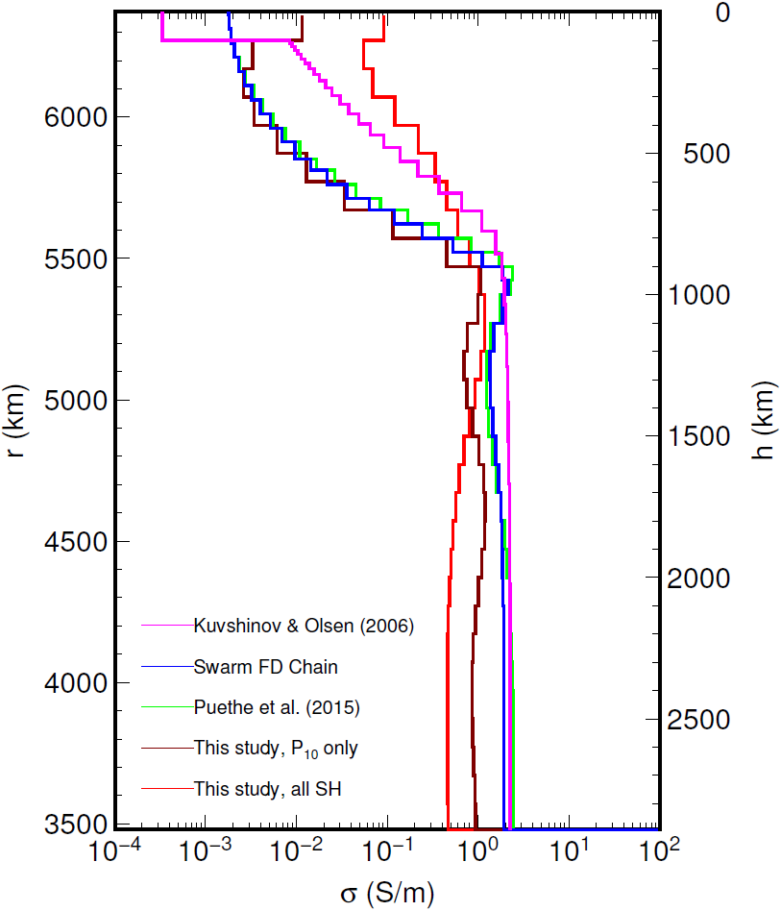
Electrical Conductivity of the Earth’s Mantle
1D mantle conductivity models
L2 products MIN_1DM
Two Level-2 chains:
Time Domain (TD) chain
Frequency Domain (FD) chain
Determination of 3D mantle conductivity structure
requires a few more years of Swarm data
More in ”A preliminary model of the electrical conductivity of the Earth's mantle from the Swarm mission” by Jakub Velimsky (talk)
and “A preliminary model of the 1-D mantle conductivity structure from Swarm data” by Christoph Püthe et al. (poster)

Slide 7
Swarm Level-2 Data Products

Slide 8
Neutral Densities
More in talk ”Precise orbit determination and neutral density retrieval for the Swarm satellites” by Pieter Visser et al

Slide 9
Swarm Level-2 Data Products

Slide 10
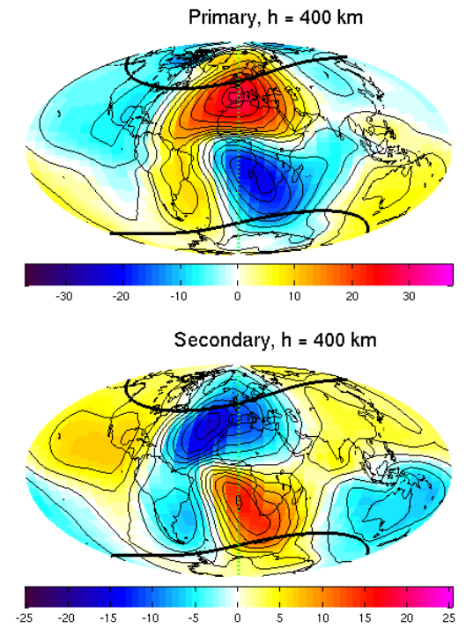
Swarm Level-2 Data Products
Ionospheric Daily Variations (”Sq”)
Product MIO_SHA_2_
Magnetic Field due to primary (ionospheric) and secondary (Earth-induced) currents
”Dedicated Ionospheric Chain”
nT
More in
”First results from the Swarm SCARF Dedicated Ionospheric Field Inversion chain” by Arnaud Chulliat et al. (talk)
”A Swarm near-real-time ring-current magnetic model”
by Alan Thomson et al. (poster)
nT

Slide 11
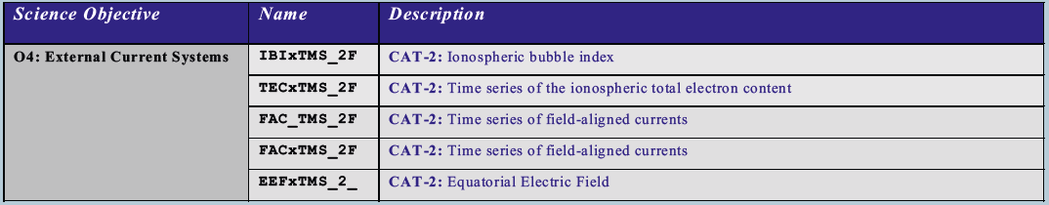
Level-2 Data Products
Cat-2: Algorithms leading to Level-2 products with minimum delay, e.g. for space weather applications. Near real-time capability. Provided in CDF. Algorithms designed by SCARF, data processed by PDGS
More in
”The Swarm electric field instruments: Status and science” by David Knudsen et al. (talk)
“Field-aligned current distribution deduced from Swarm dual-satellite observations” by Hermann Lühr et al. (talk)
”On the validity of the automated detection of low latitude plasma depletions onboard Swarm” by Claudia Stolle et al. (poster)
“Comparison of plasma density and temperature by in-situ Langmuir probes and by incoherent scatter radars”
by Laurianne Palin et al. (poster)

Slide 12
Release of Level-2 Data Products
https://earth.esa.int/web/guest/missions/esa-operational-eo-missions/swarm
This week
Mid July

Slide 13
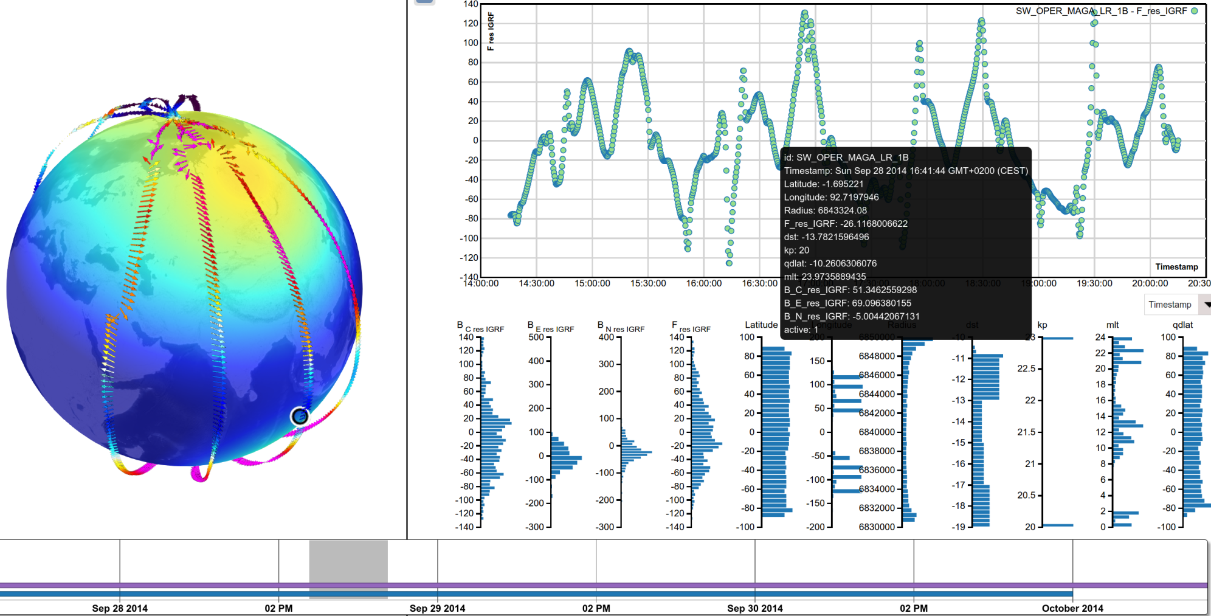
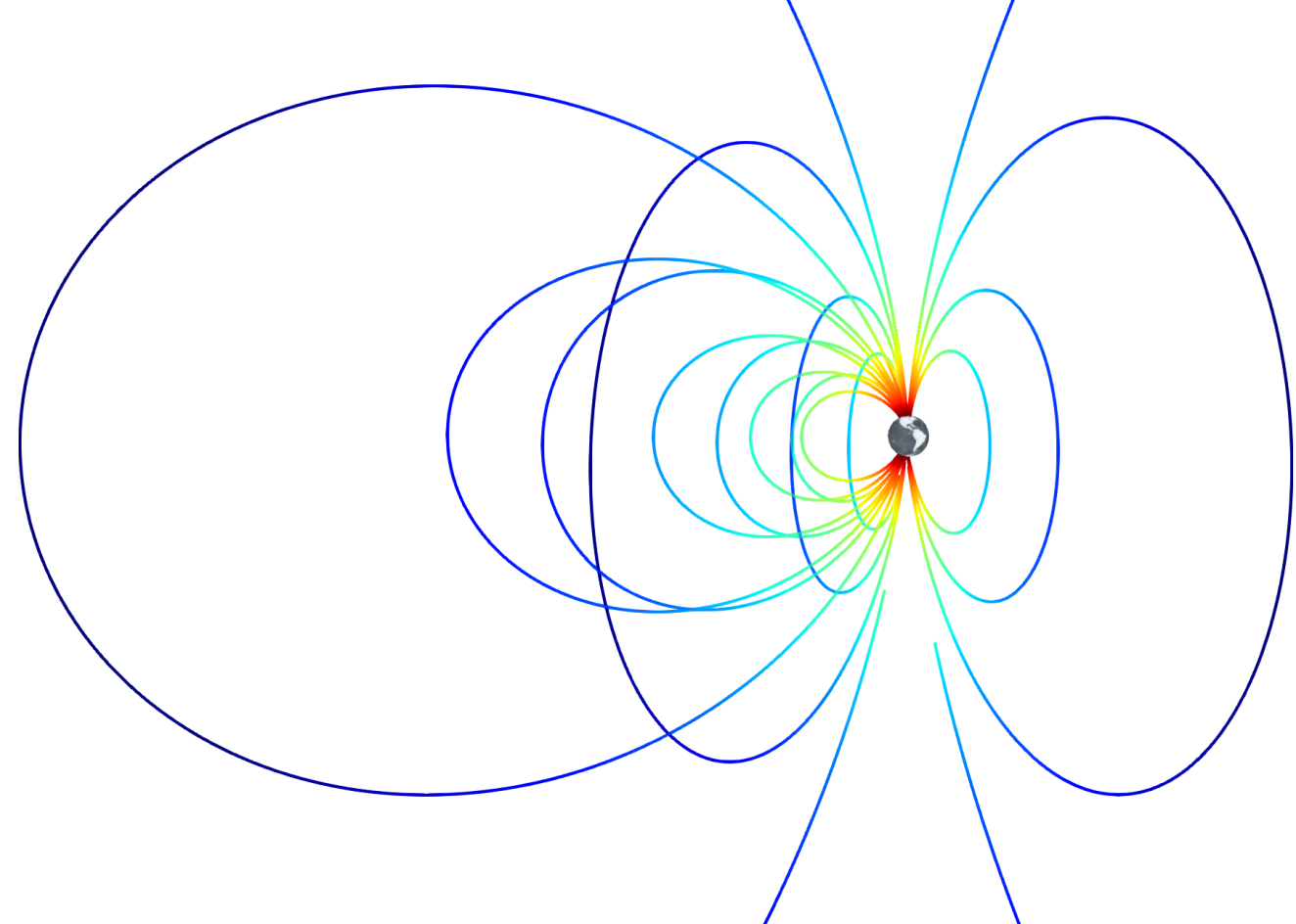
Visualisation of Data and Models
VIRES Project
More in
”Visual Analysis of Swarm and Geomagnetic Model Data”
by Daniel Santillan et al. (poster)

Slide 14
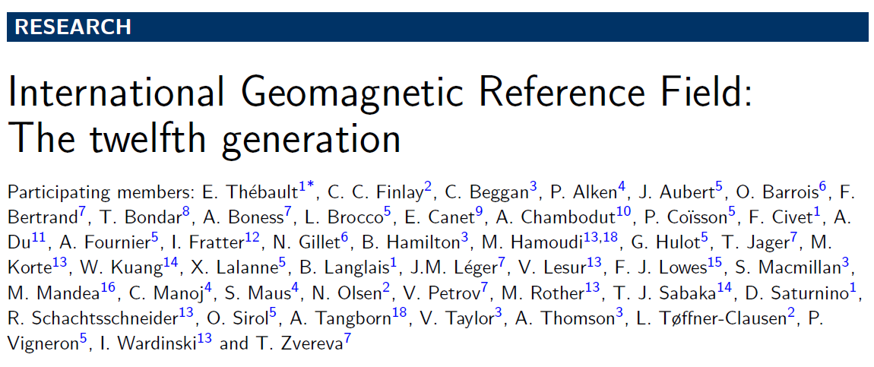
IGRF
International Geomagnetic Reference Field
Determined every 5 years by IAGA working group V-MOD
as an international collaborative effort
Latest revision, IGRF-12, is valid between 2015 – 2020
Swarm was main data source for IGRF-12

Slide 15
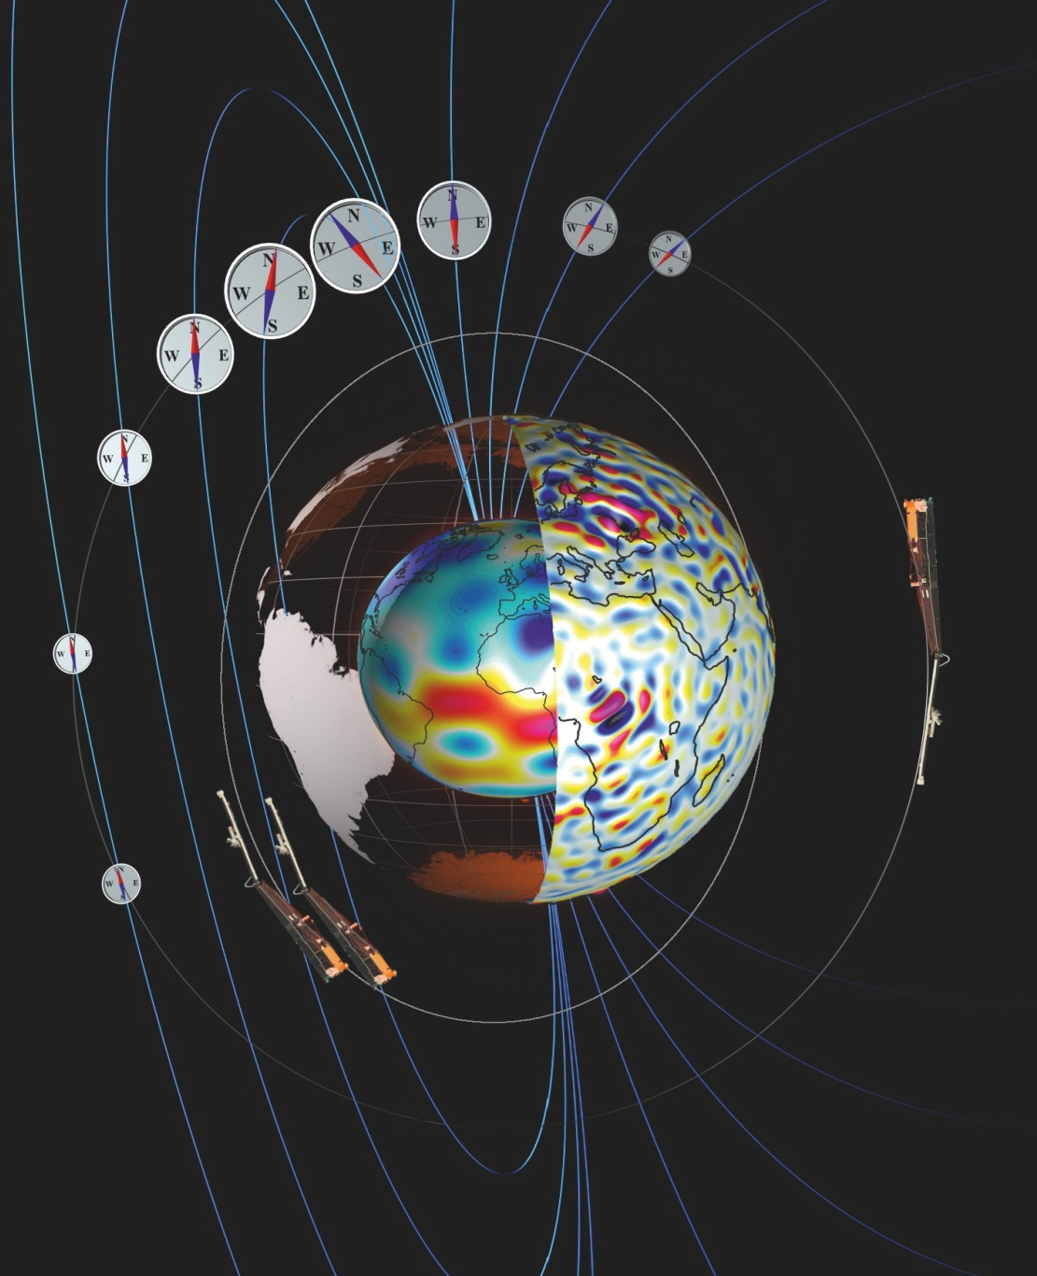
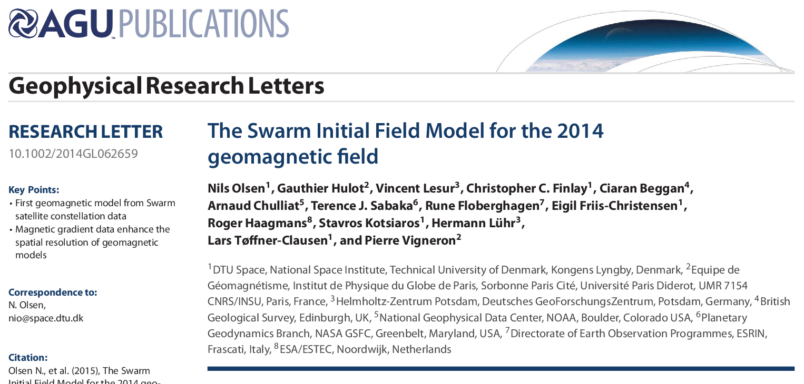
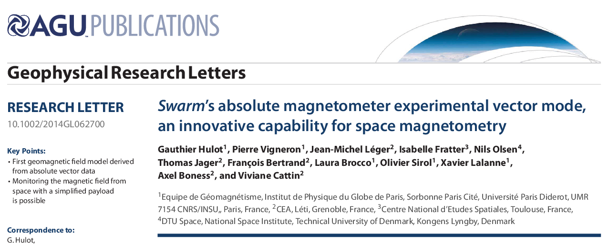
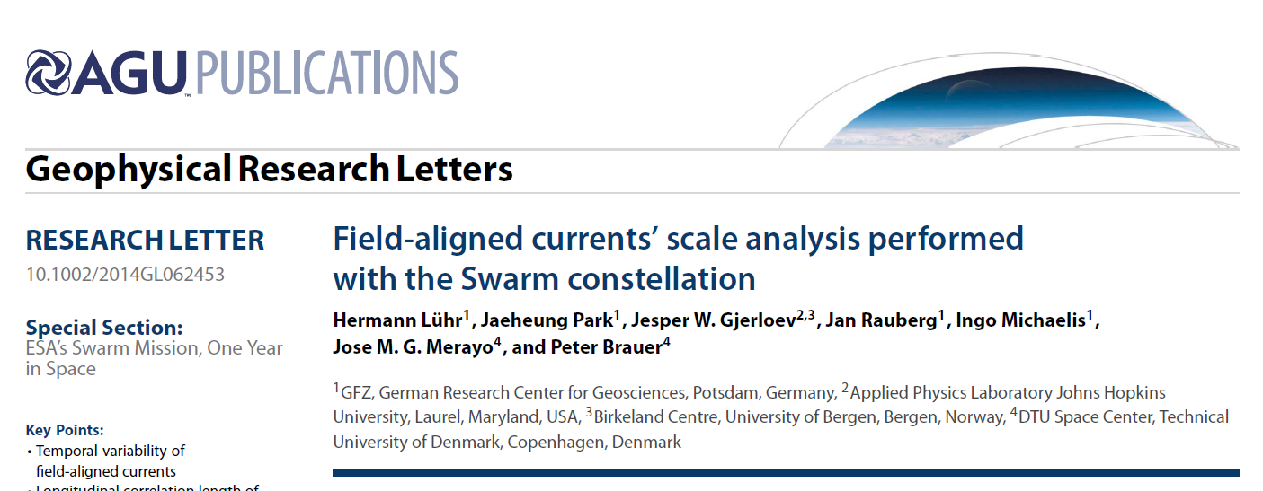
Special Section of Geophys. Res. Lett.:
ESA's Swarm Mission, One Year in Space
16 papers published
Majority of papers on external field investigations
(mainly event studies)

Slide 16
Three Selected Science Results …
Plasma depletion seen in different parameters
Multi-Point observation of Equatorial plasma irregularities
SIFM: Swarm Initial Field Model

Slide 17
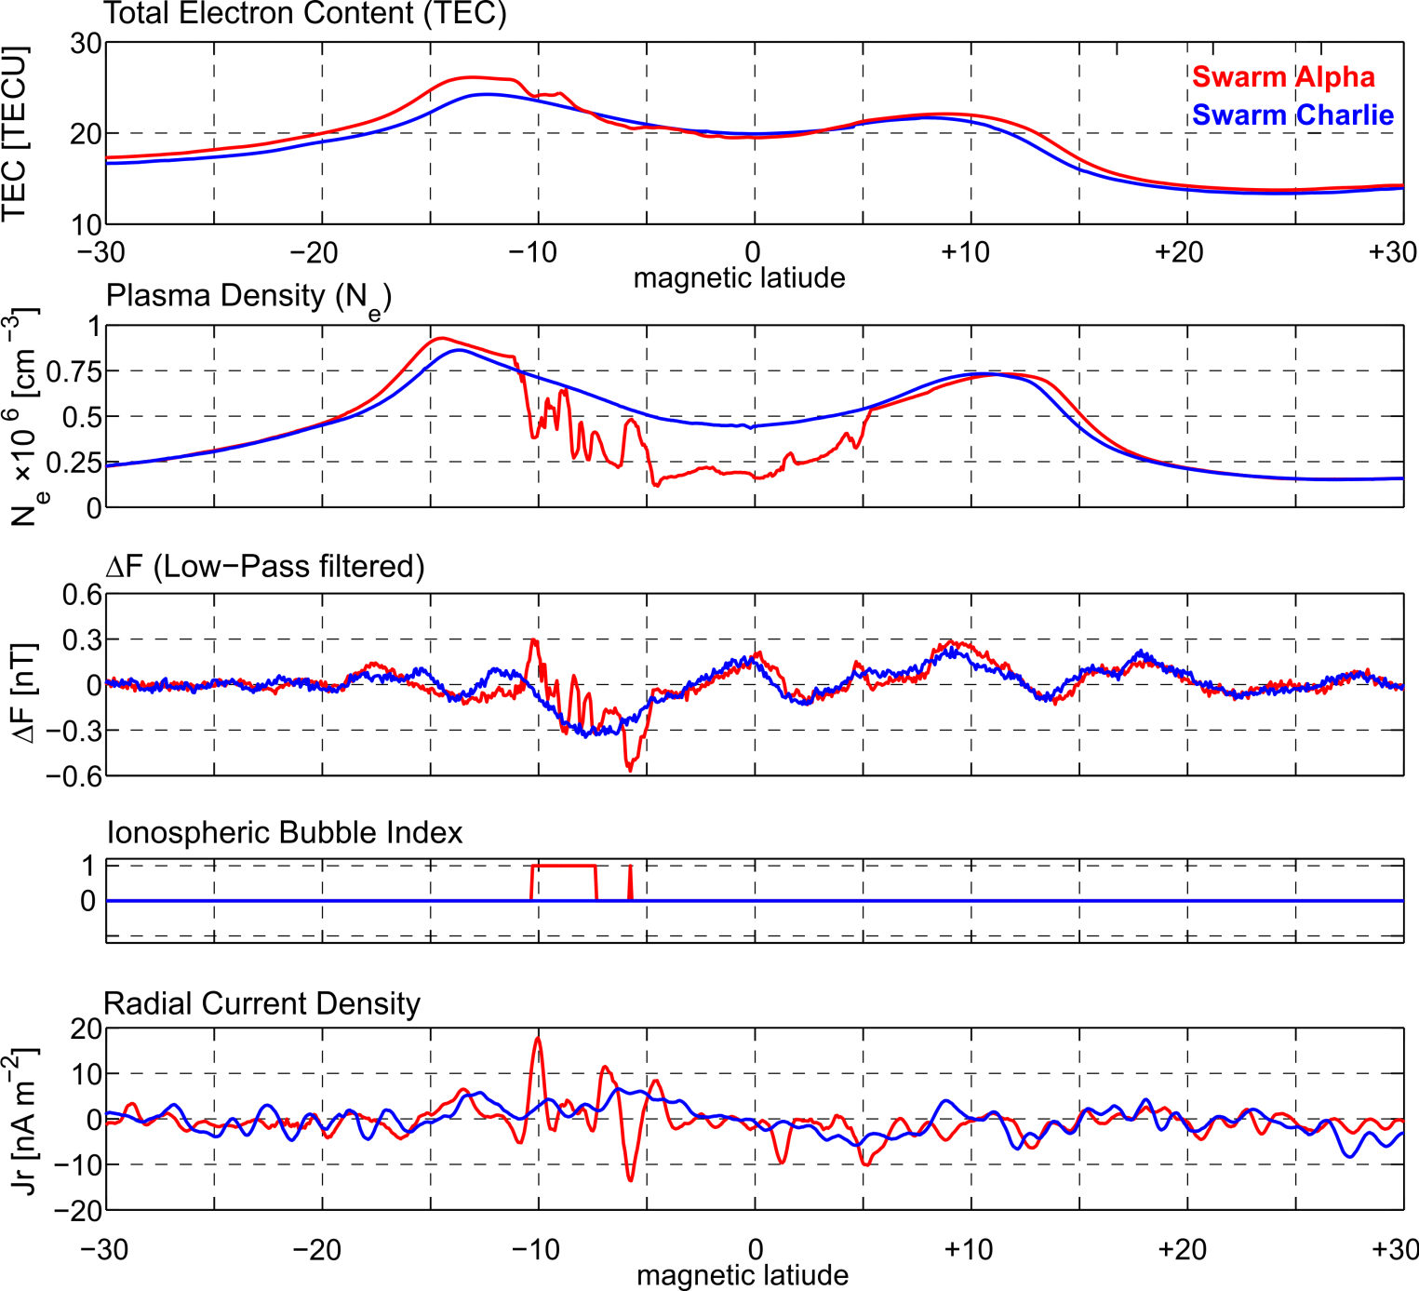
Plasma depletion seen in different parameters
11 October 2014, 16:06 UT, 22 LT 85 deg E longitude
Swarm Data
TECxTMS_2F
EFIx_PL_1B
MAGx_LR_1B
IBIxTMS_2F
FACxTMS_2F
Courtesy: C. Stolle / GFZ

Slide 18
Plasma depletion seen in different parameters
11 October 2014, 16:06 UT, 22 LT 85 deg E longitude
Swarm Data
TECxTMS_2F
EFIx_PL_1B
MAGx_LR_1B
IBIxTMS_2F
FACxTMS_2F
Courtesy: C. Stolle / GFZ

Slide 19
Plasma depletion seen in different parameters
11 October 2014, 16:06 UT, 22 LT 85 deg E longitude
Swarm Data
TECxTMS_2F
EFIx_PL_1B
MAGx_LR_1B
IBIxTMS_2F
FACxTMS_2F
Courtesy: C. Stolle / GFZ

Slide 20
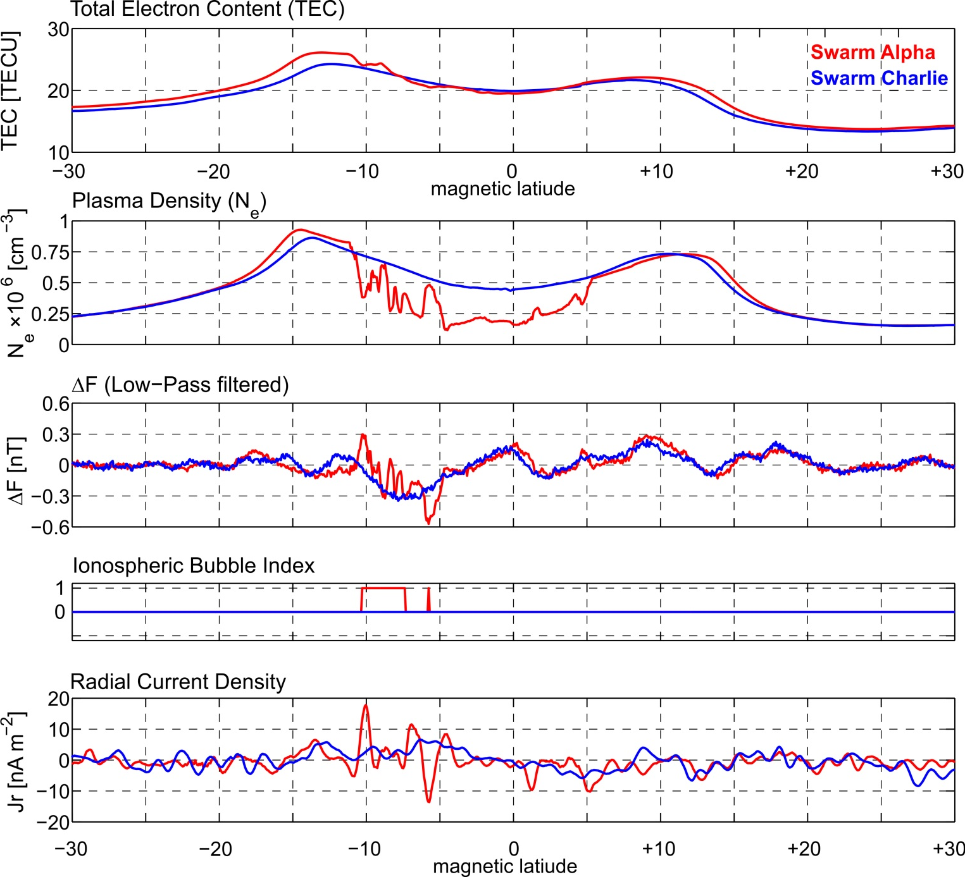
Plasma depletion seen in different parameters
11 October 2014, 16:06 UT, 22 LT 85 deg E longitude
Swarm Data
TECxTMS_2F
EFIx_PL_1B
MAGx_LR_1B
IBIxTMS_2F
FACxTMS_2F
Courtesy: C. Stolle / GFZ

Slide 21
Plasma depletion seen in different parameters
11 October 2014, 16:06 UT, 22 LT 85 deg E longitude
Swarm Data
TECxTMS_2F
EFIx_PL_1B
MAGx_LR_1B
IBIxTMS_2F
FACxTMS_2F
Courtesy: C. Stolle / GFZ

Slide 22
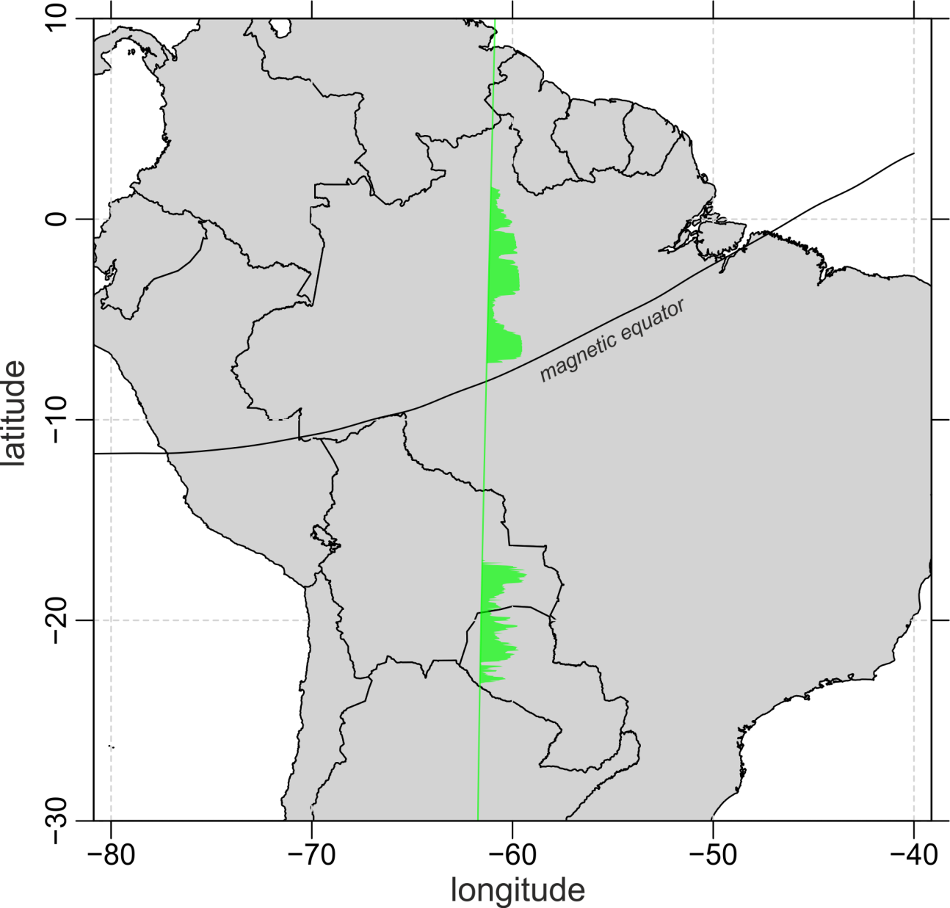
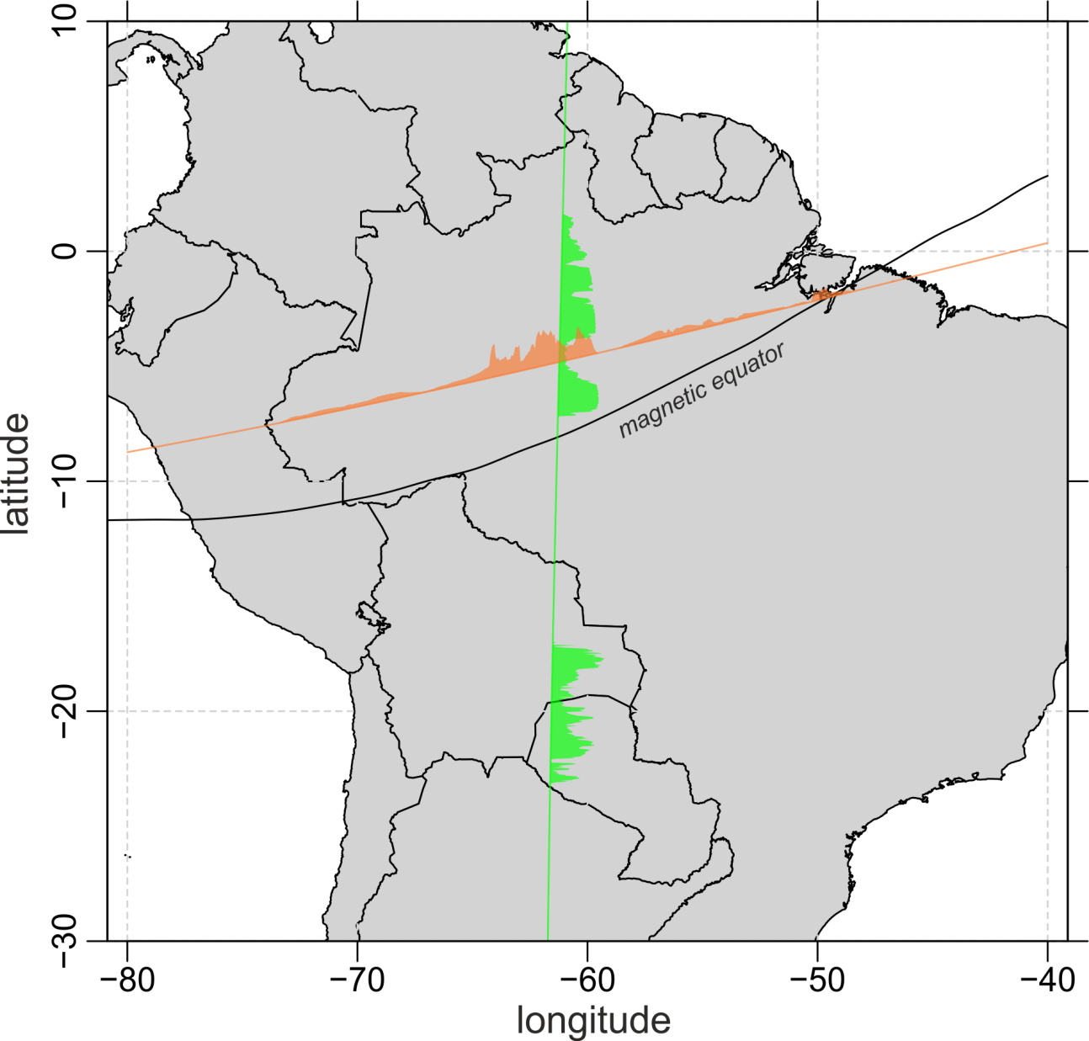
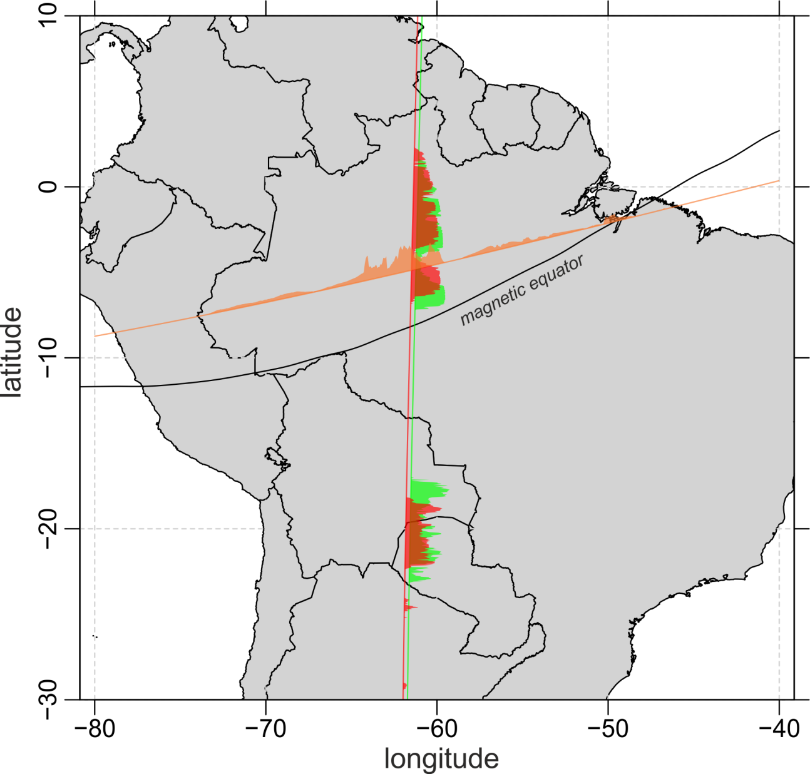
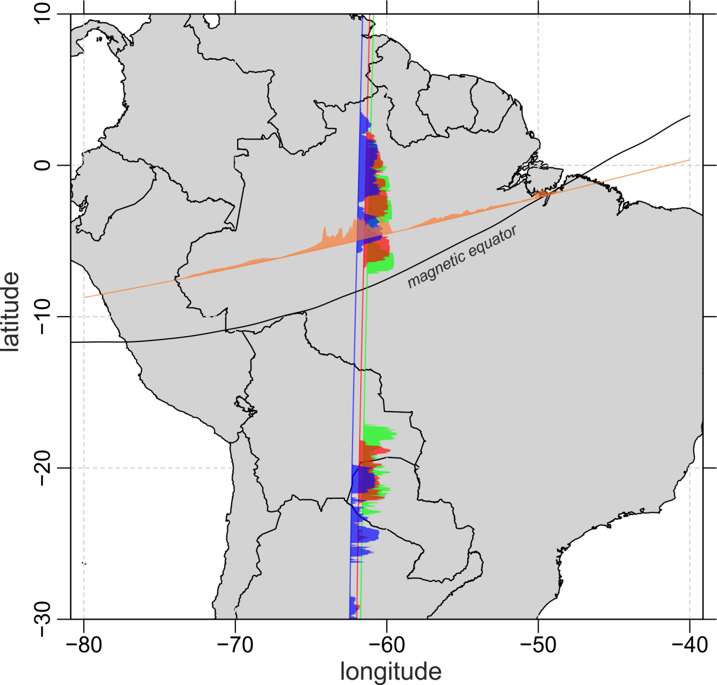

Multi-Point observation of
Equatorial plasma irregularities
1. Jan. 2014, 02:15 – 03:18 UT
Plasma density anomaly
C/NOFS
Swarm Bravo
Swarm Alpha
Swarm Charlie
Courtesy: C. Stolle / GFZ

Slide 23
Multi-Point observation of
Equatorial plasma irregularities
1. Jan. 2014, 02:15 – 03:18 UT
Plasma density anomaly
C/NOFS
Swarm Bravo
Swarm Alpha
Swarm Charlie
Courtesy: C. Stolle / GFZ
Notes:
C/NOFS 9 minutes before A
B to A: 1 min
A to C: 3 min
Rising speed 1.4 km/s

Slide 24
SIFM: Swarm Initial Field Model
14 months vector and scalar data, 8 months constellation data
E-W scalar difference (“gradient”) data: SW-A – SW-C
  both satellites at same latitude and < 50 secs apart in time
N-S scalar difference (“gradient”) data:
  along-track first differences for each satellite SW-A, SW-B, SW-C
Core field up to Spherical harmonic degree n = 13, crustal field up to n = 70
Co-estimation of instrument alignment parameters (Euler angles)

Slide 25
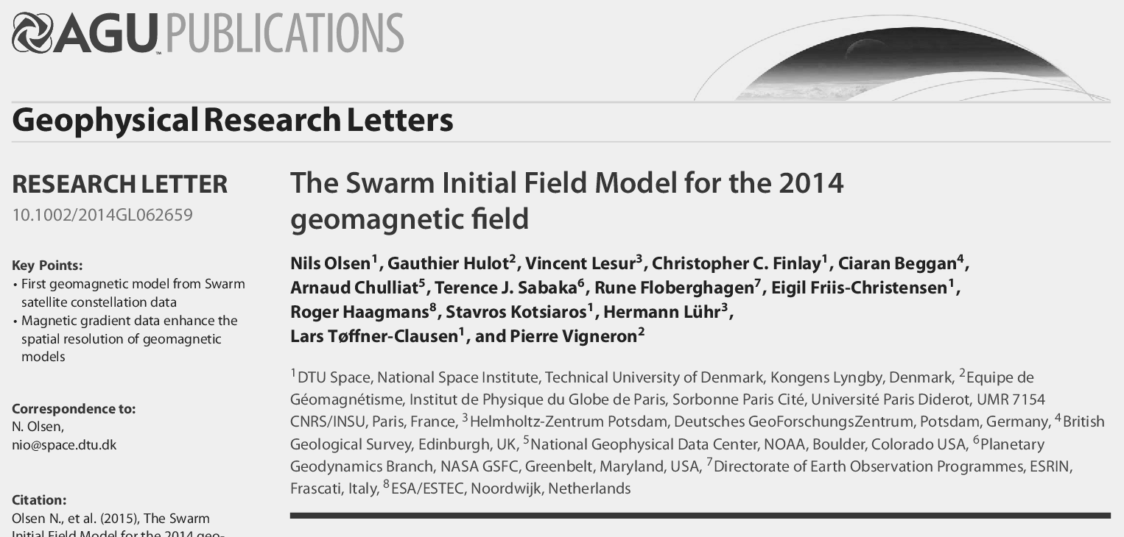
SIFM+: Swarm Initial Field Model
20 months vector and scalar data, 14 months constellation data
E-W scalar and vector difference (“gradient”) data: SW-A – SW-C
  both satellites at same latitude and < 50 secs apart in time
N-S scalar and vector difference (“gradient”) data:
  along-track first differences for each satellite SW-A, SW-B, SW-C
Core field up to Spherical harmonic degree n = 13, crustal field up to n = 80
Co-estimation of instrument alignment parameters (Euler angles)

Slide 26
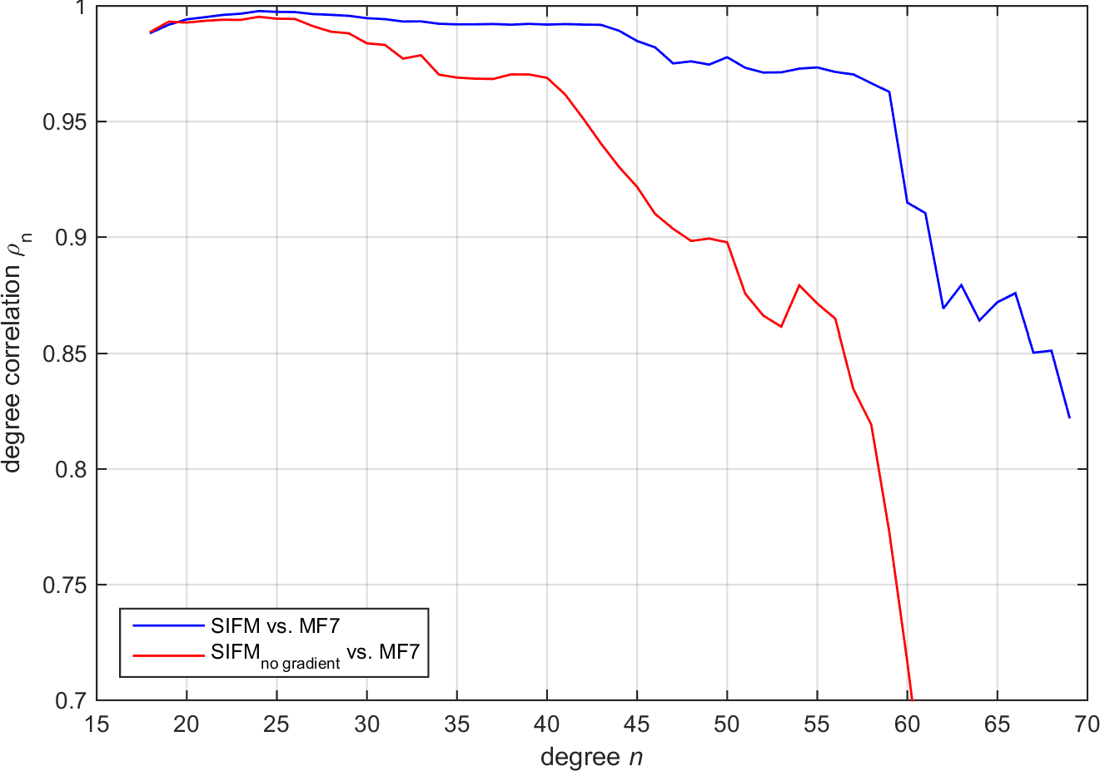
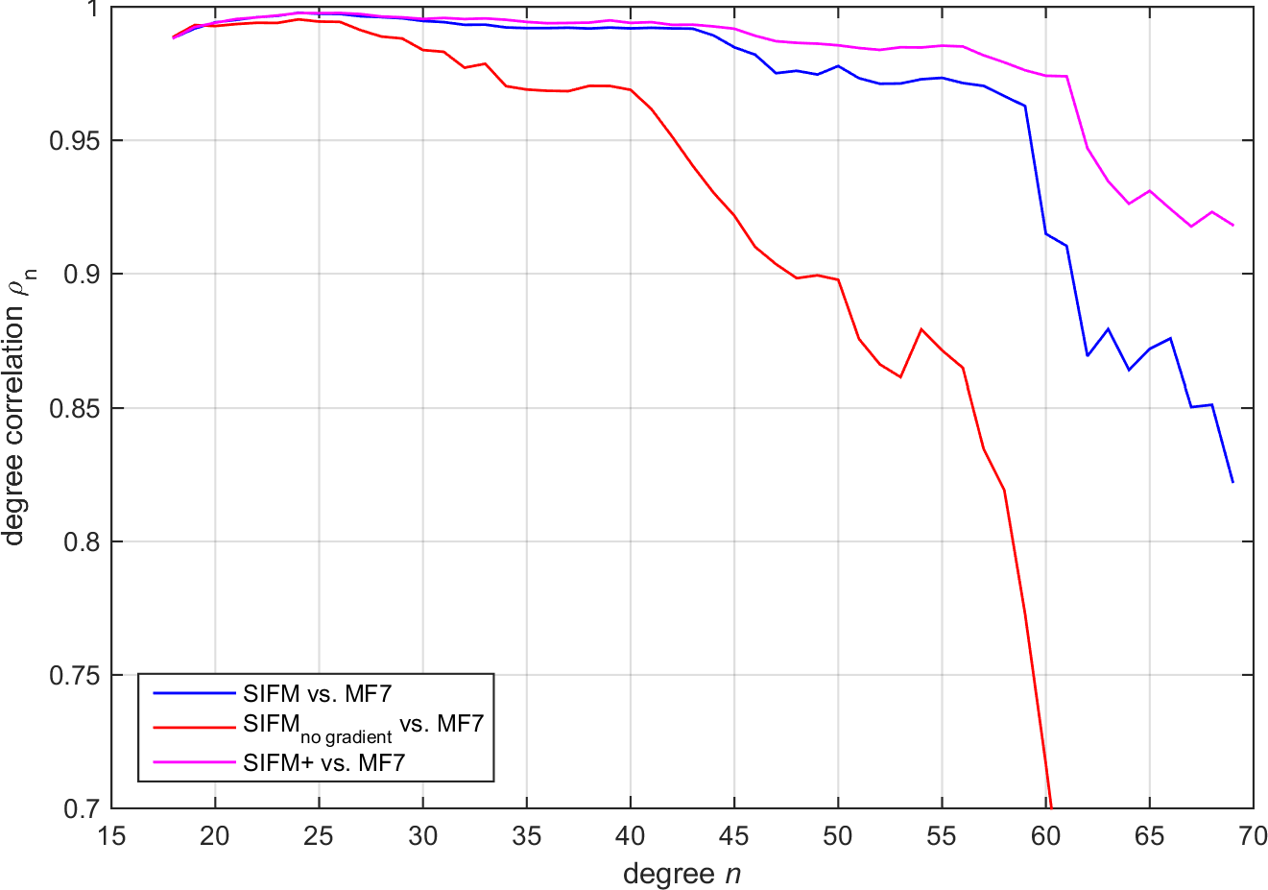
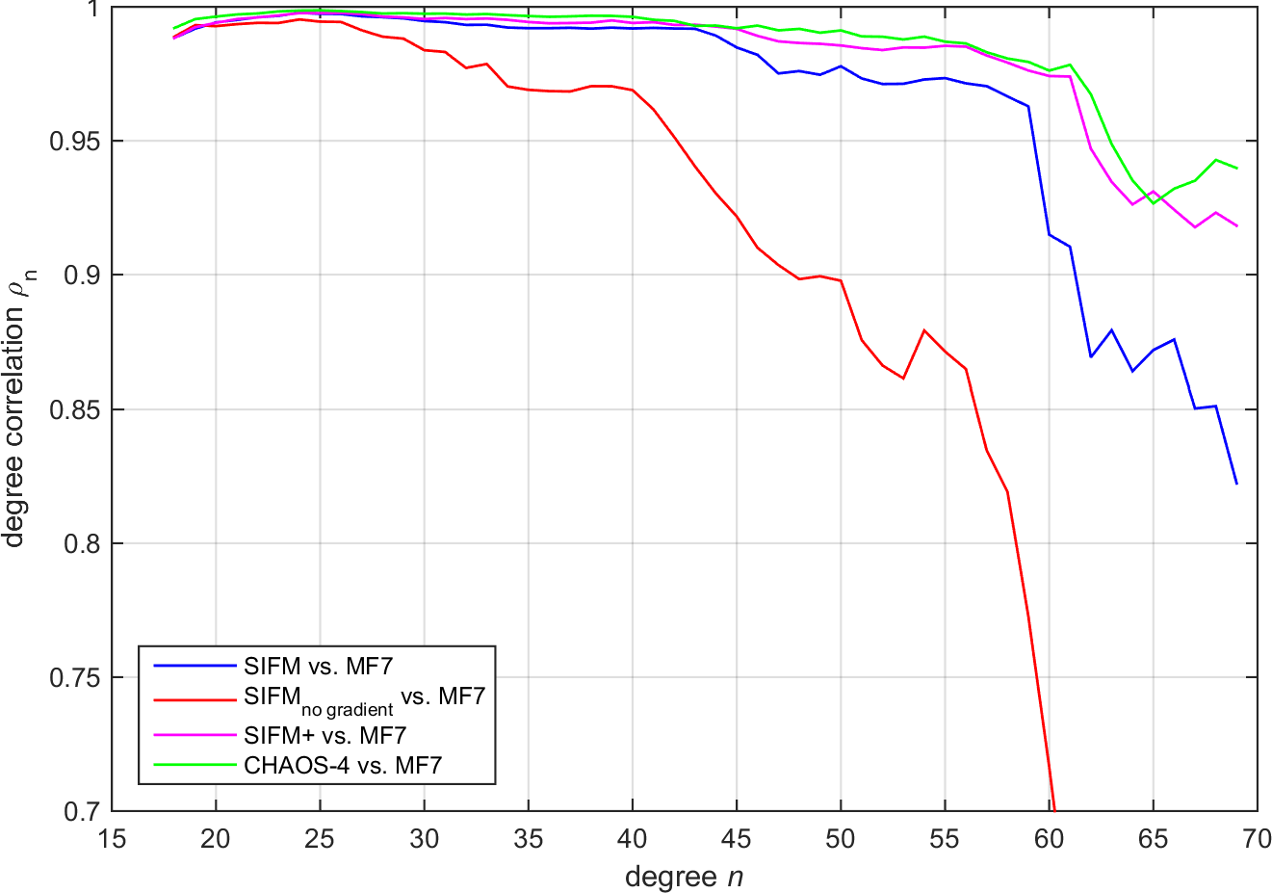
SIFM+: Model using Vector Gradient Data
Degree correlation ρ_{n}
SIFM_{no gradient}:
no gradient data
SIFM:
with scalar gradient data
no vector gradient data
SIFM+:
with scalar gradient data
with vector gradient data
Model from 2 years of CHAMP satellite data at 320 km altitude
(100 x higher crustal field power at n=90)

Slide 27
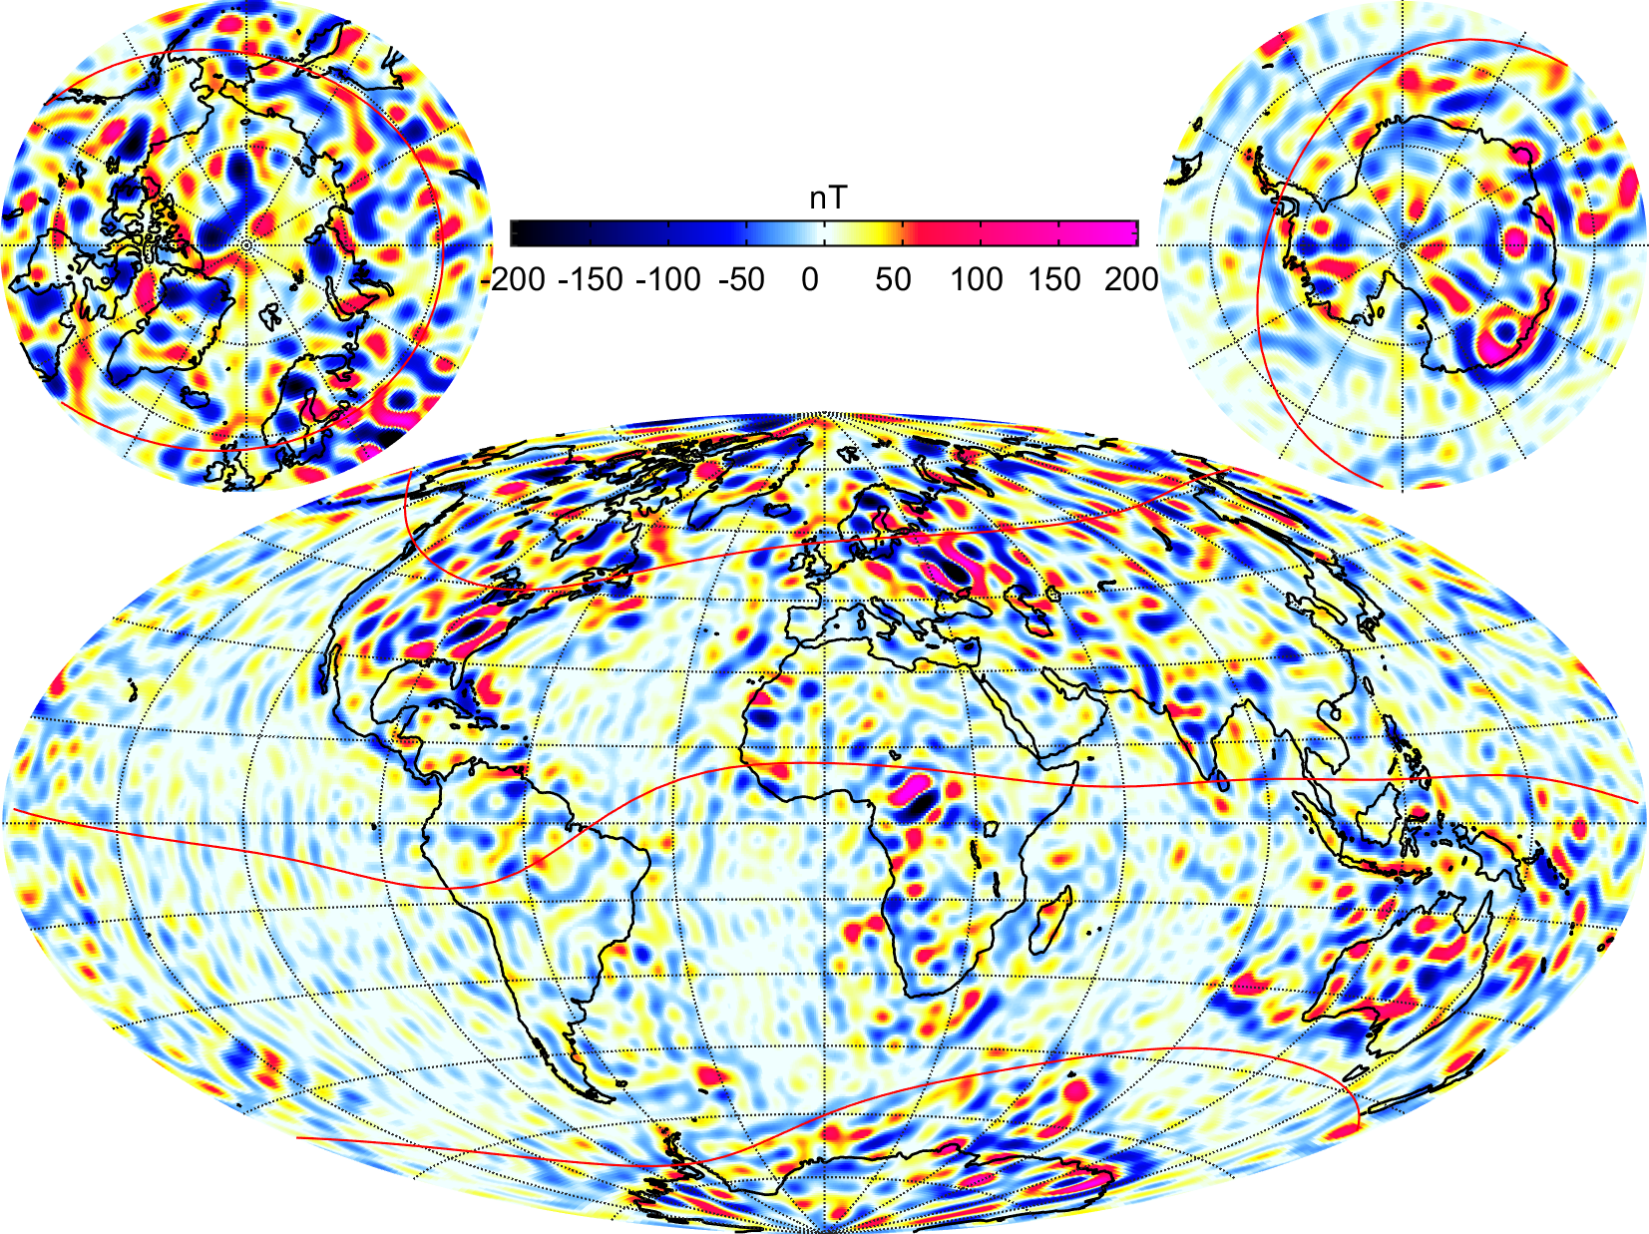
SIFM+: Model using Vector Gradient Data
B_{r} at surface, n = 16 - 75

Slide 28
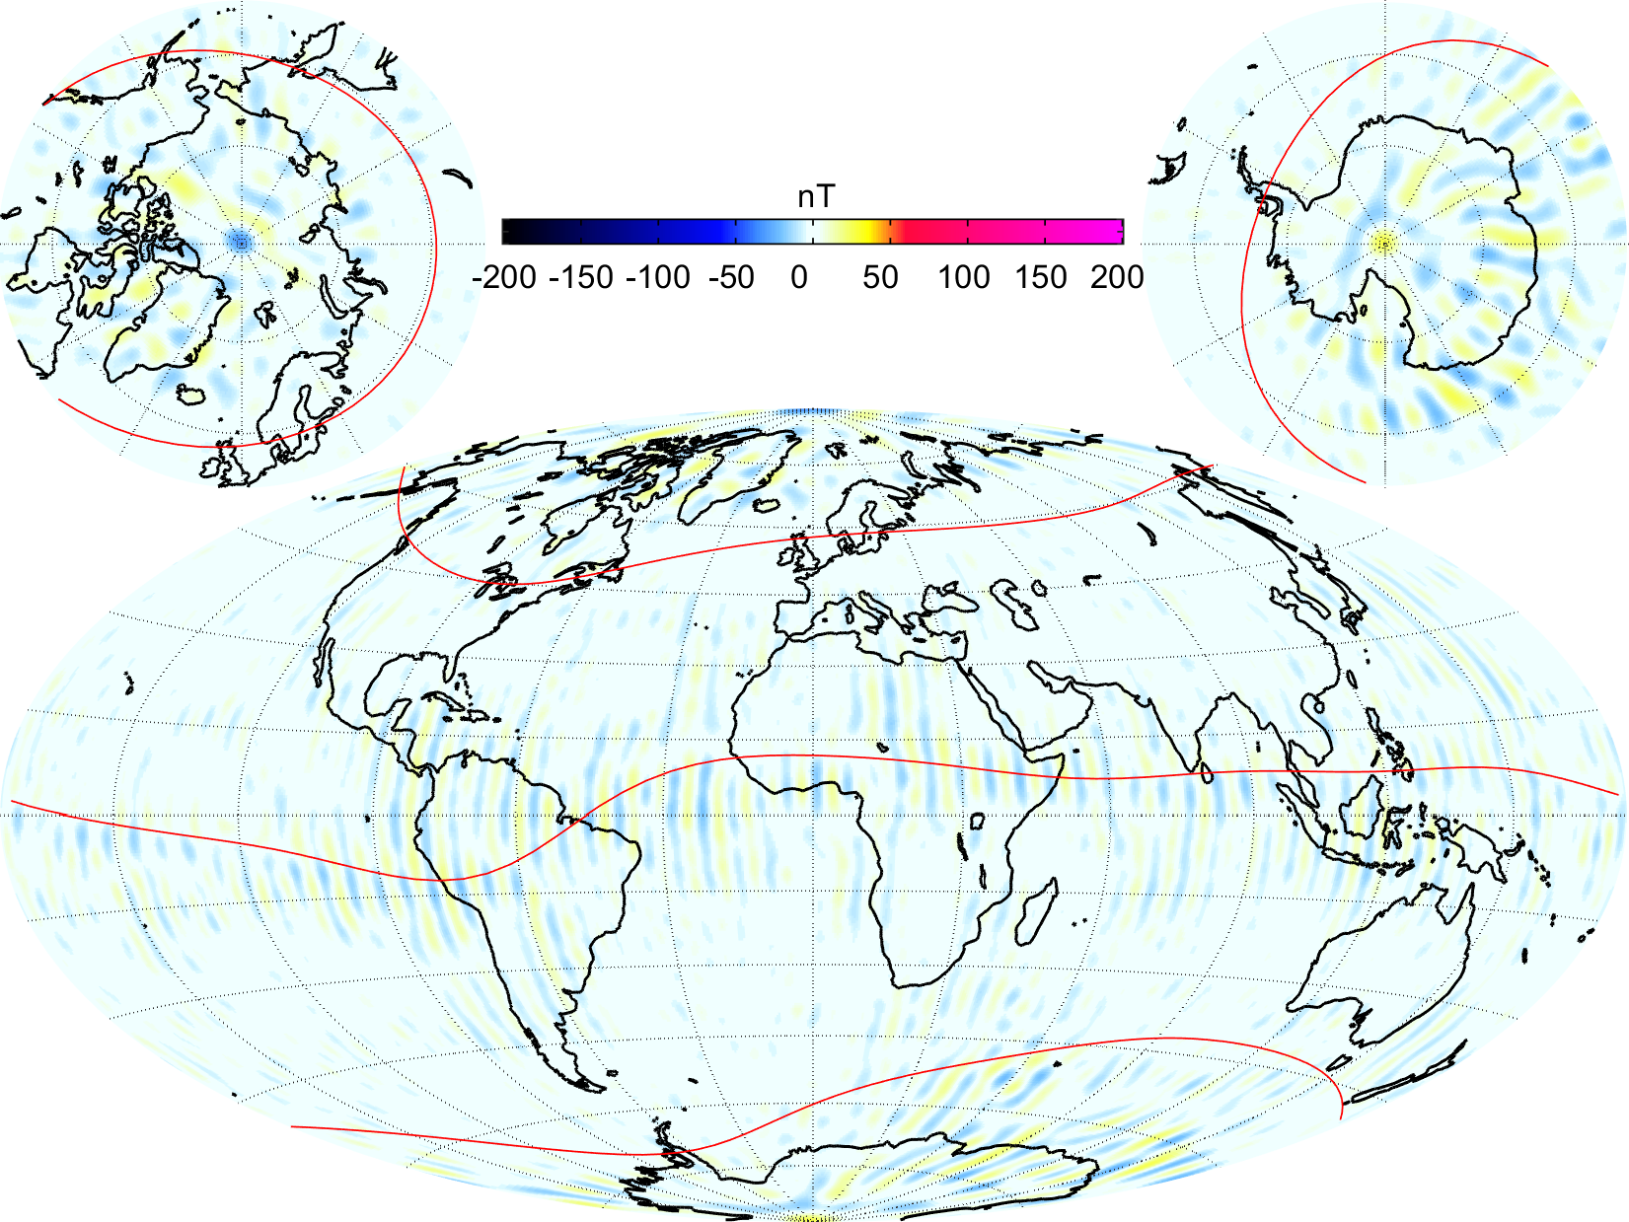
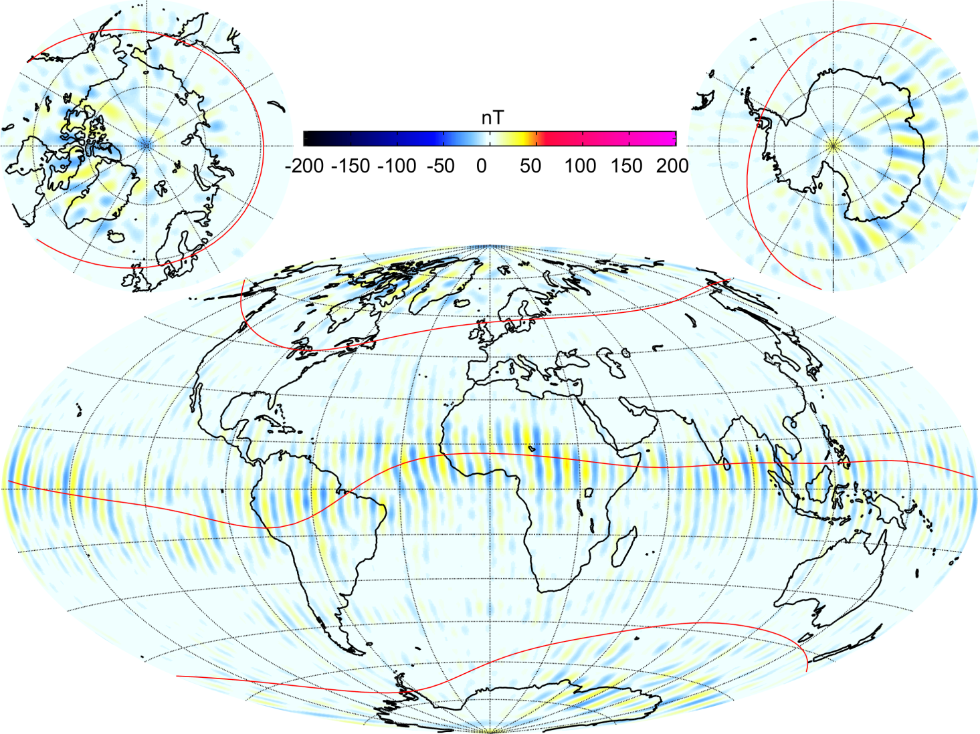
SIFM+: Model using Vector Gradient Data
Difference to MF7
B_{r} at surface, n = 16 - 75

Slide 29
Conclusions
20 months of high quality magnetic Level-1b data,
including 14 months from constellation
Misfit statistics to derived geomagnetic models (e.g. SIFM+) confirm
Swarm as “the best ever survey of the Earth’s magnetic field”
First Level-2 data products released
Swarm capabilities cover research topics spanning from the Earth’s core to the magnetosphere, including “Space weather and climate”
Ideas for making a good mission even better
  Inter-satellite (“differential”) calibration
  New data products
  …
Special Issue in Earth, Planets Space on
“Swarm Science Results after two years in Space”
based on contributions to this session (more information to follow)

Slide 30
Special Issue in Earth, Planets Space
“Swarm Science Results after two years in Space” (working title)
Offer from EPS to have a special issue, awaiting for more detailed information
in a proposal (number of possible contributions, …)
Guest editors: Nils Olsen nio@space.dtu.dk
Claudia Stolle cstolle@gfz-potsdam.de
Rune Floberghagen Rune.Floberghagen@esa.int
Gauthier Hulot gh@ipgp.fr
Tentative deadline: 31 December 2015
Interested? Please provide us with (preliminary) title, list of contributing authors

