Slide 1
magnetometer – Star-imager Alignment: Apparent Euler angle variation due to magnetospheric contributions Nils Olsen¹, Karl Magnus Laundal², Chris Finlay¹, Lars Tøffner-Clausen¹ with help from the usual suspects ¹DTU Space ²University in Bergen/Norway
The Problem: “Time-changing Euler angles”
Polar Field-Aligned Currents during “quiet” conditions and their low-latitude magnetic signature
Impact on Euler angles
Conclusions / Recommendations

Slide 2
Alignment of VFM Magnetometer and STR Star Imager
VFM magnetometer measures magnetic vector B_{VFM} in the VFM instrument frame
STR measures attitude in the STR instrument frame
Transforming B to Earth-fixed vector requires knowledge of the rotation VFM → STR where is the matrix describing the rotation of B from the VFM frame to the star tracker frame, and is the rotation matrix from the STR to the NEC coordinate frame

Slide 3
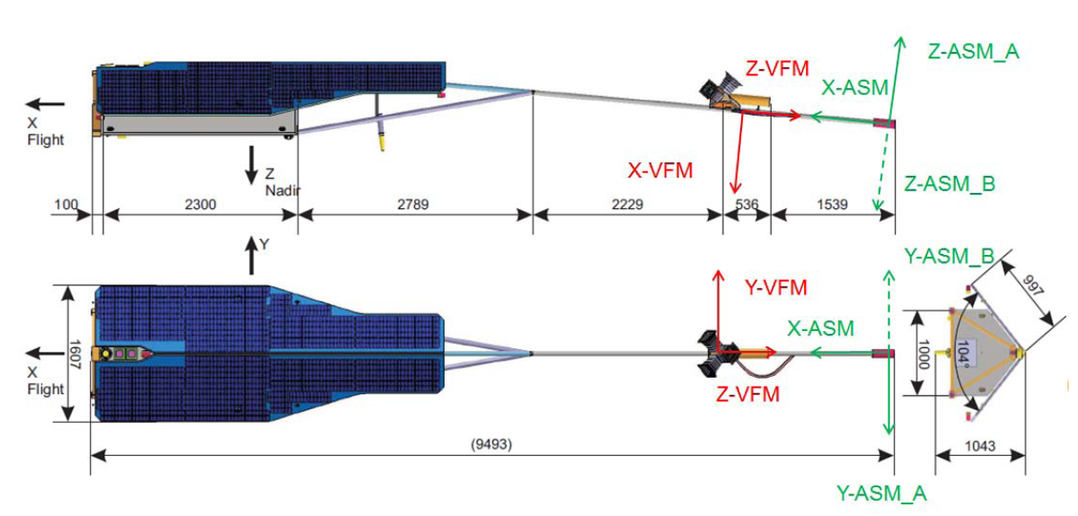
The VFM → STR rotation matrix R₃
R₃ is determined in-flight by comparing the observed vector B_{VFM,obs} with a model vector B_{VFM,mod} that has been rotated from B_{NEC,mod} → B_{VFM,mod}
R₃ is often co-estimated with a magnetic field model B_{NEC,mod}

Slide 4
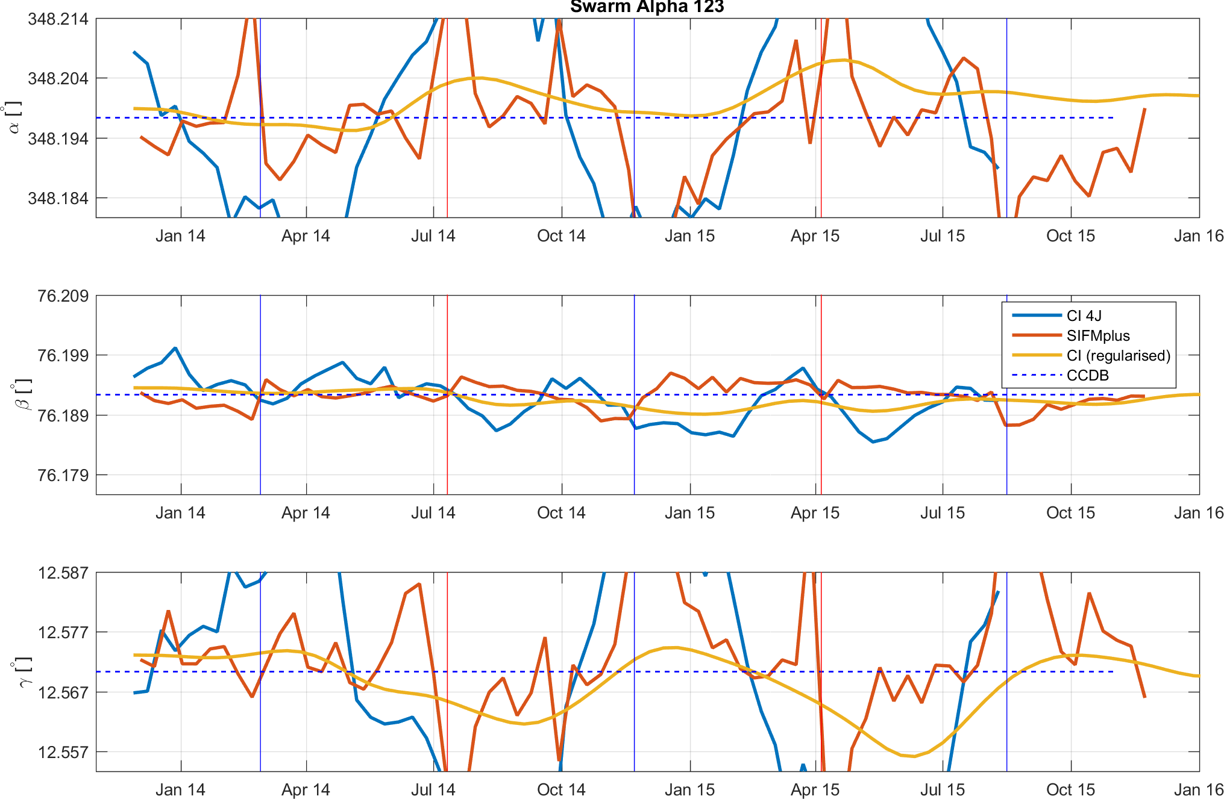
Apparent time changes of Euler angles
36”

Slide 5
The VFM → STR rotation matrix R₃
R₃ is determined in-flight by comparing the observed vector B_{VFM,obs} with a model vector B_{VFM,mod} that has been rotated from B_{NEC,mod} → B_{VFM,mod}
R₃ is often co-estimated with a magnetic field model B_{NEC,mod}
Any magnetic field contribution that is not properly described by the field model may contribute to erroneous determination of R₃ (i.e. of the Euler angles)

Slide 6
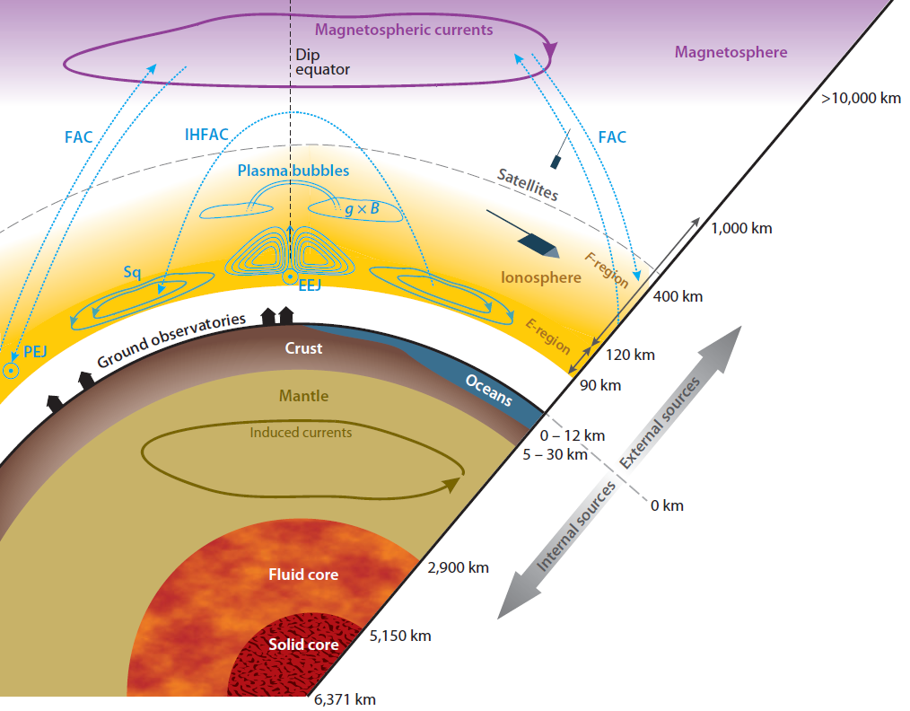
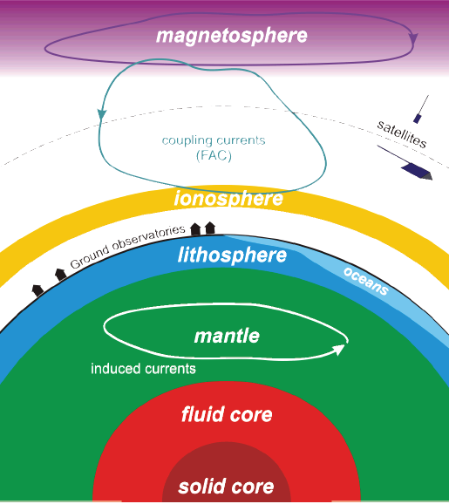
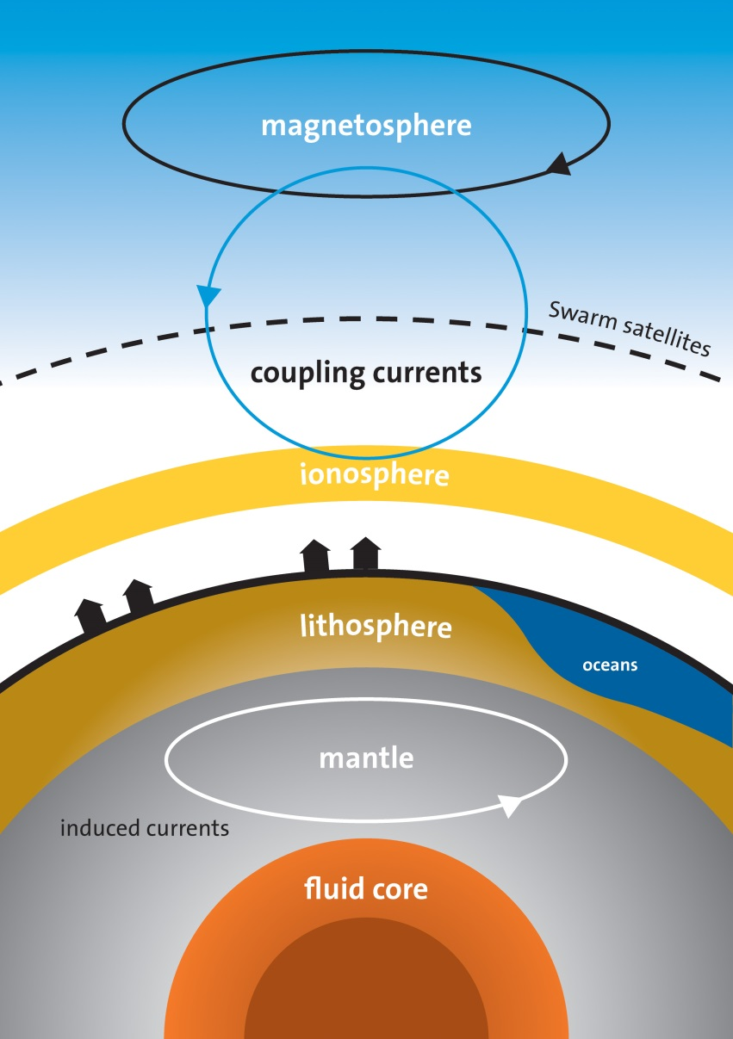
The Evolution of Simplification …
Olsen and Stolle, 2012

Slide 7
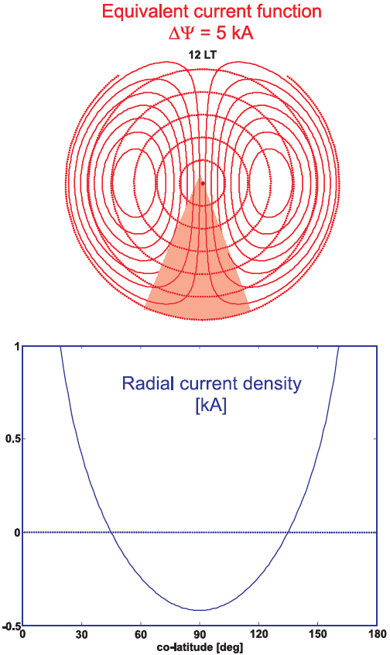
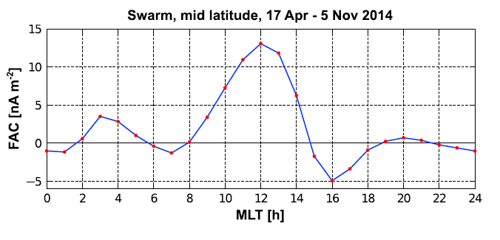
Presentation at QWG Paris, Sep 2015 Error in roll angle a due to in-situ currents
Magnetic field signature observed by a polar-orbiting satellite around local midnight can be equally well explained by
VFM-STR misalignment of 20” in roll angle α
Magnetospheric field in MLT frame
In-situ electric current density
[nA/m²]
(Lühr et al., GRL 2015)
Large-scale in-situ currents of ≈ 1 nA/m² cause apparent Euler-angle mismatch of 20”

Slide 8
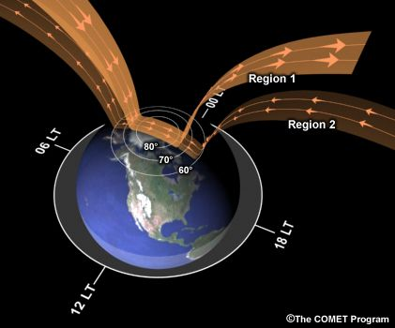
Now: Error angle mismatch due to magnetic field produced by distant Field-Aligned Currents (FACs)

Slide 9
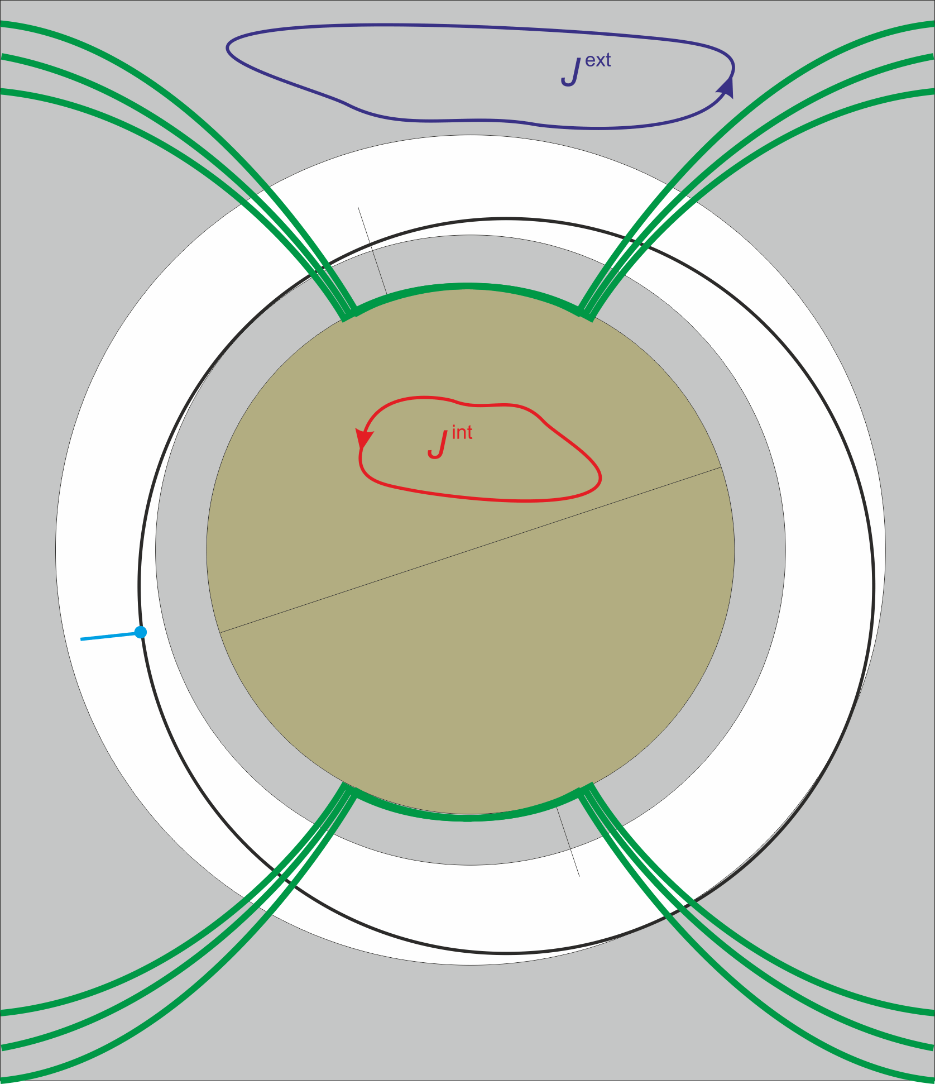
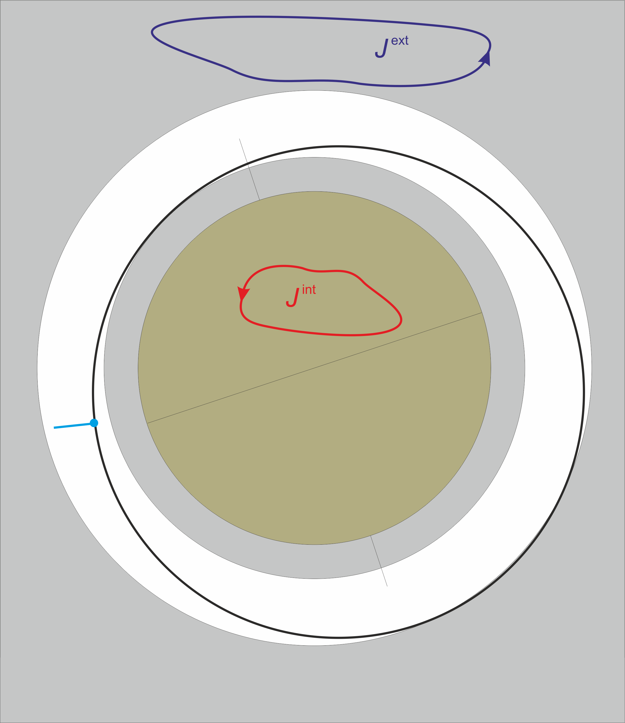
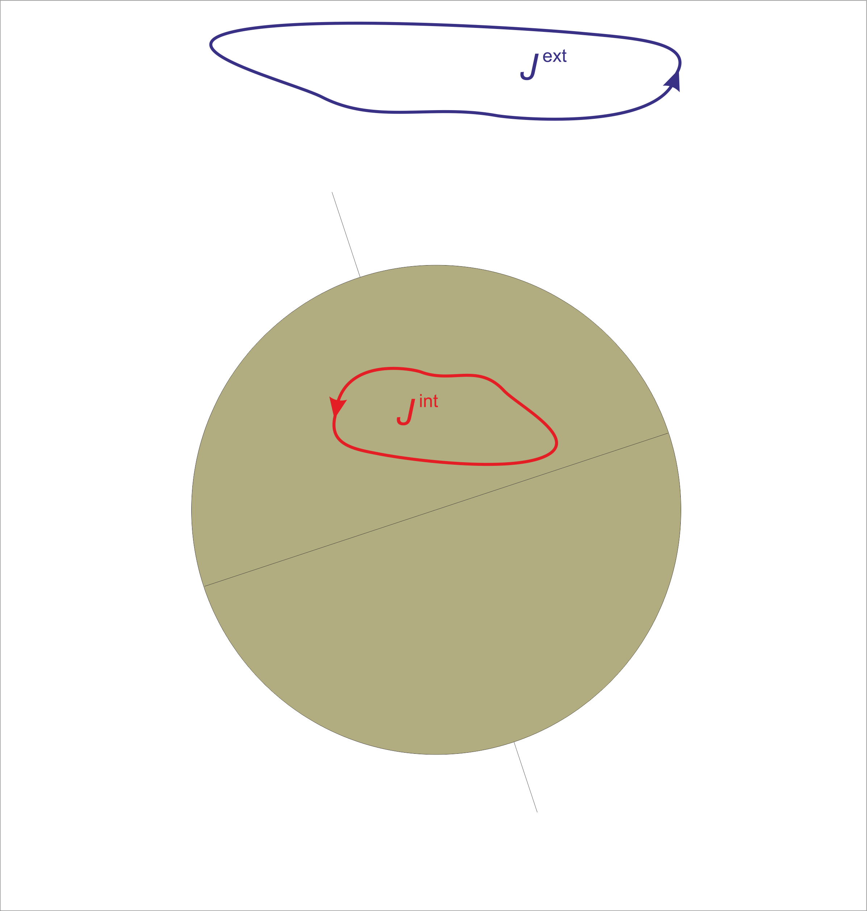
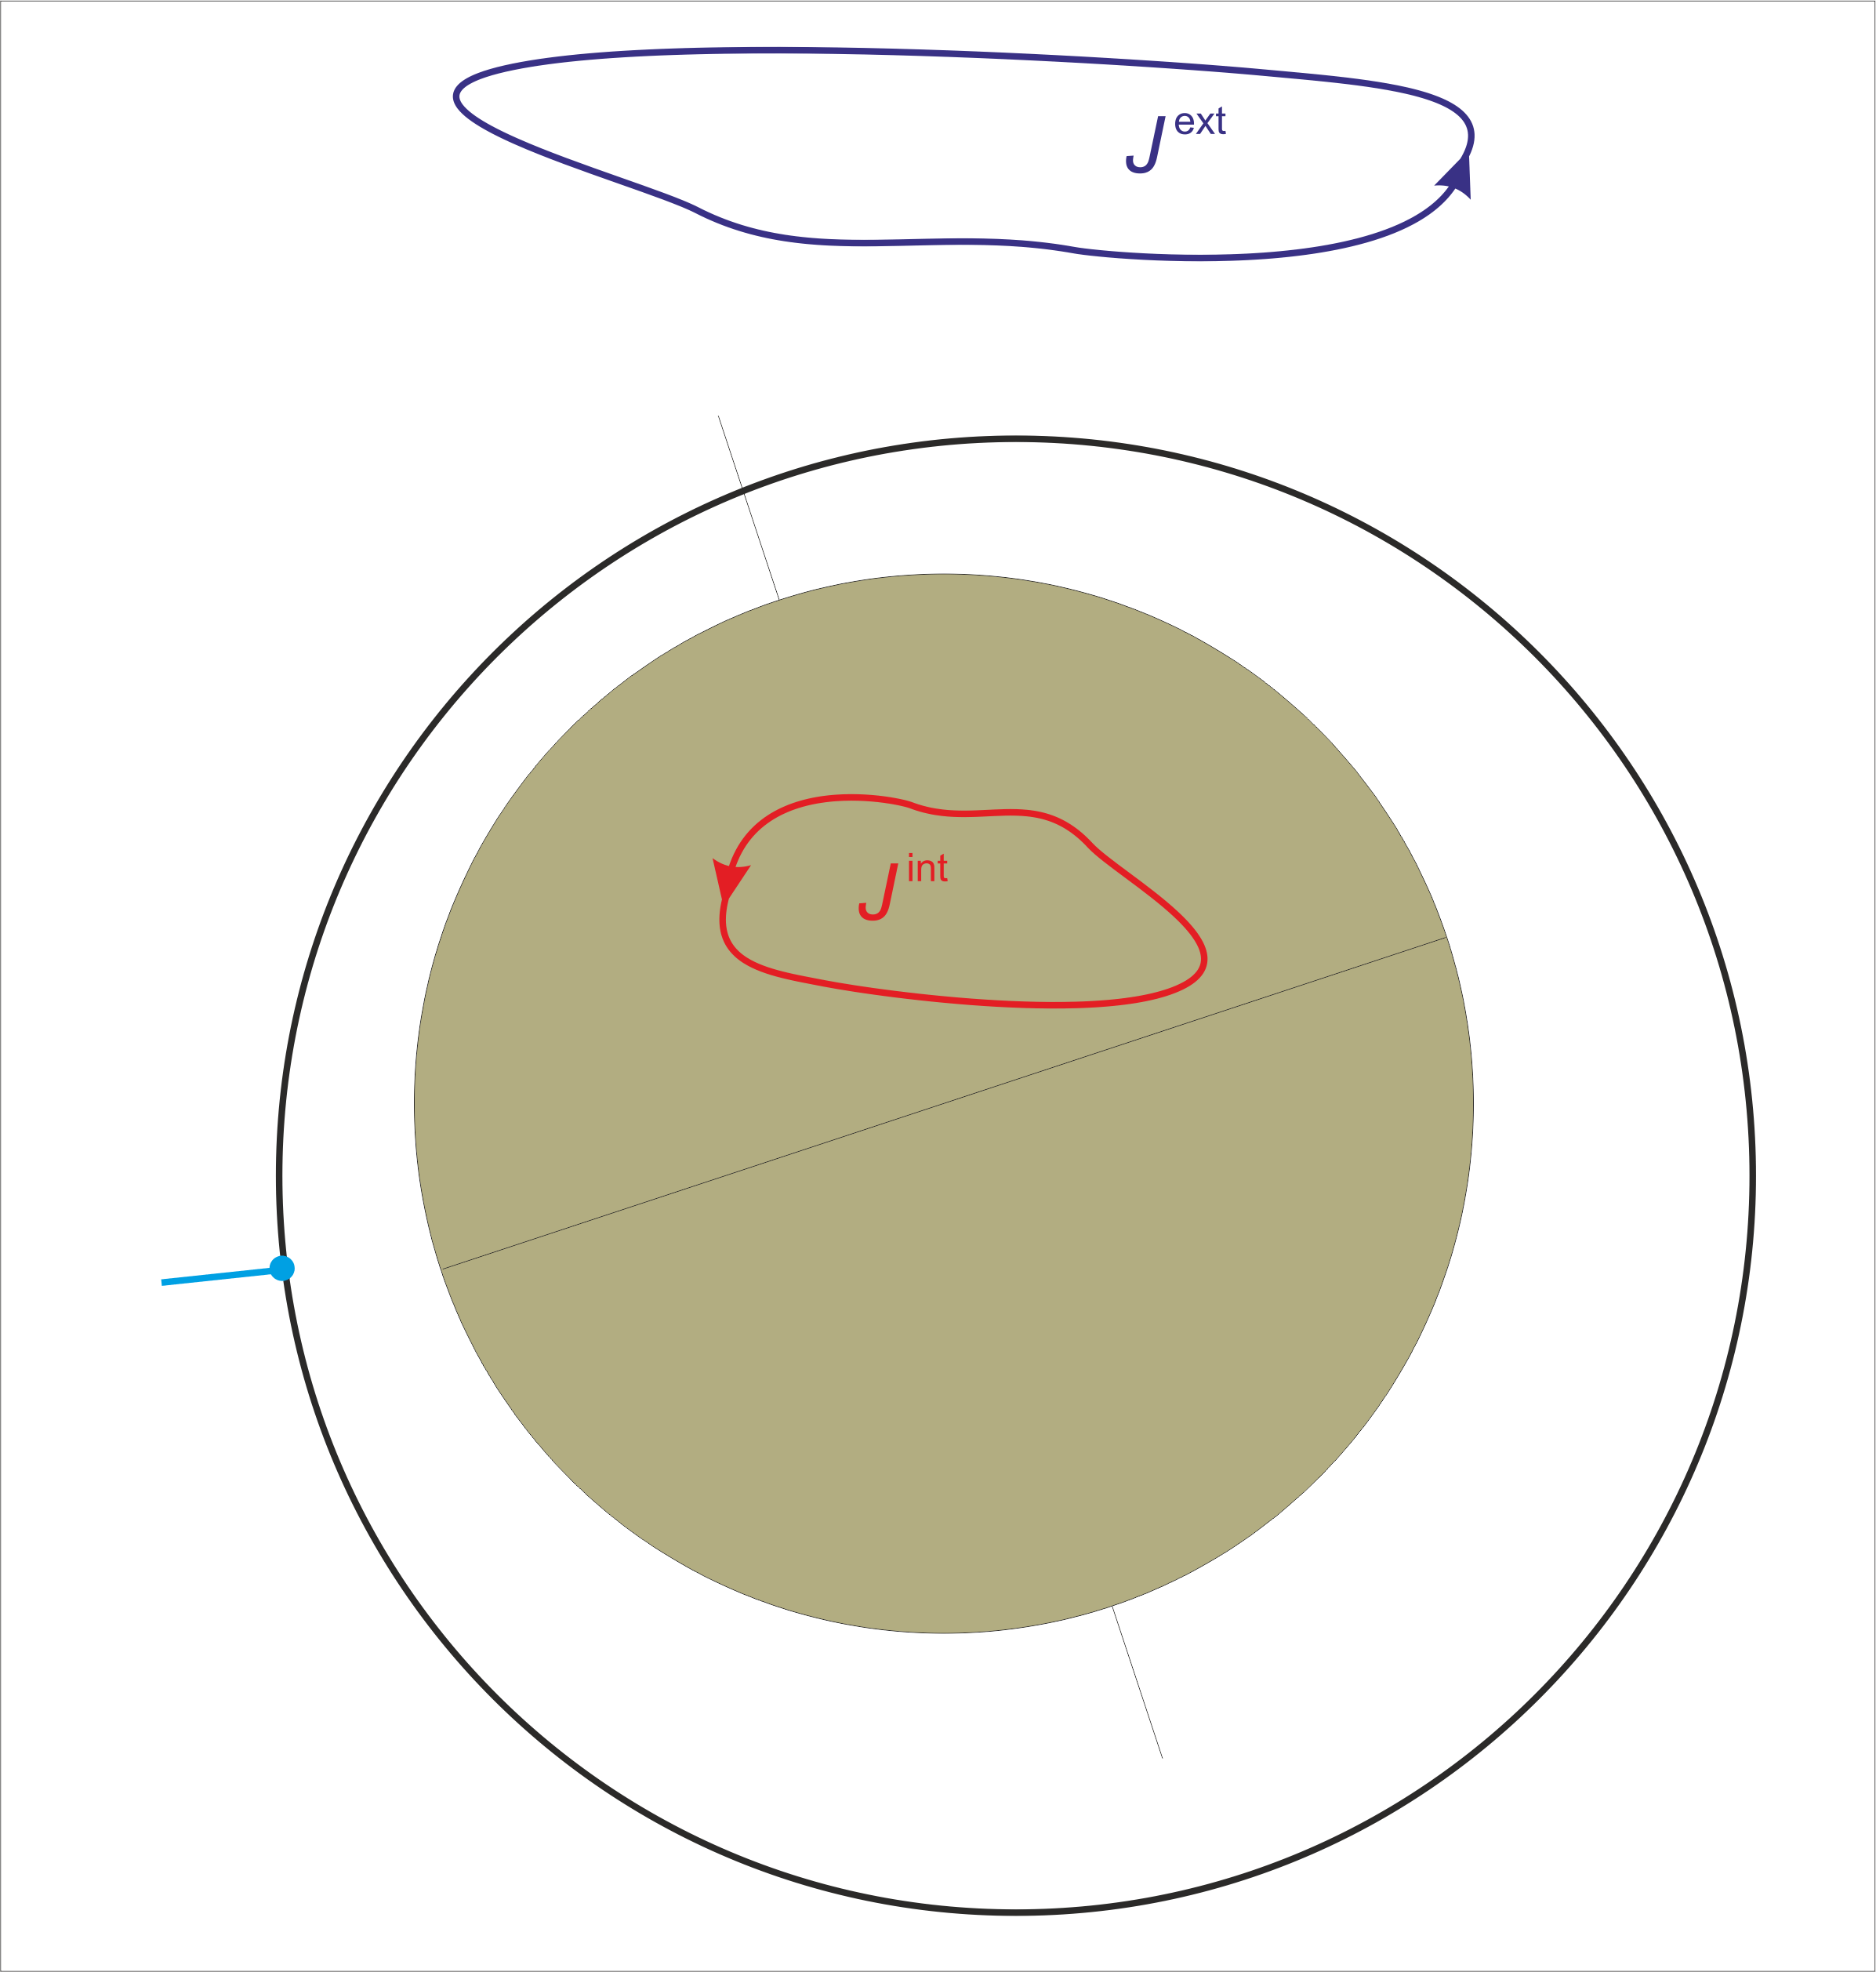
Necessary Conditions for Spherical Harmonic Analysis of B
Assumption: data are taken in current-free region (∇ × B = 0 in whole sampling region)
No spherical harmonic potential expansion possible if ∇ × B ≠ 0 in some region
Poloidal-toroidal decomposition is always possible:

Slide 10
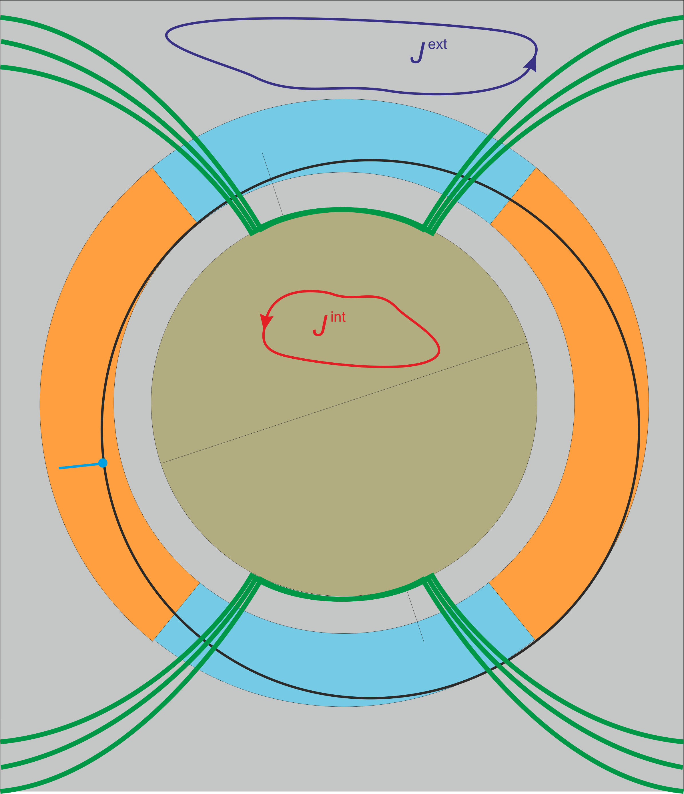
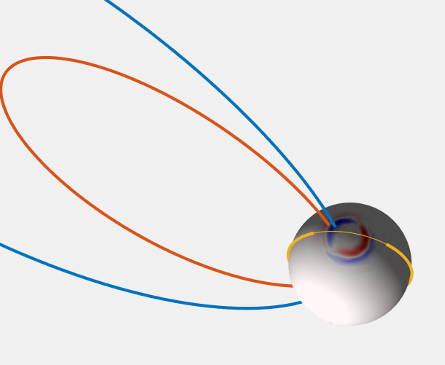
Magnetic signature from polar FACs in non-polar regions
Scalar data F
at polar latitudes (do not contribute to Euler angles)
Vector data B
at non-polar latitudes (contribute to Euler angles)

Slide 11
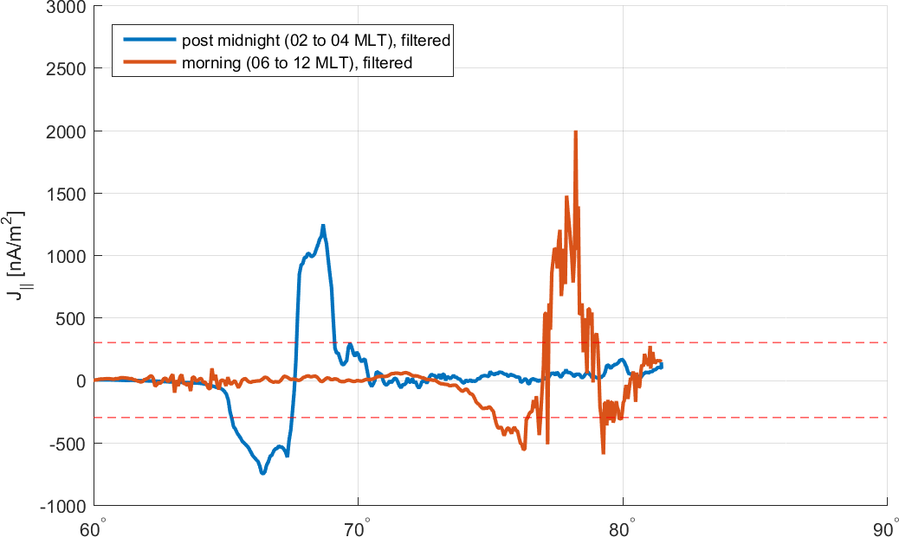
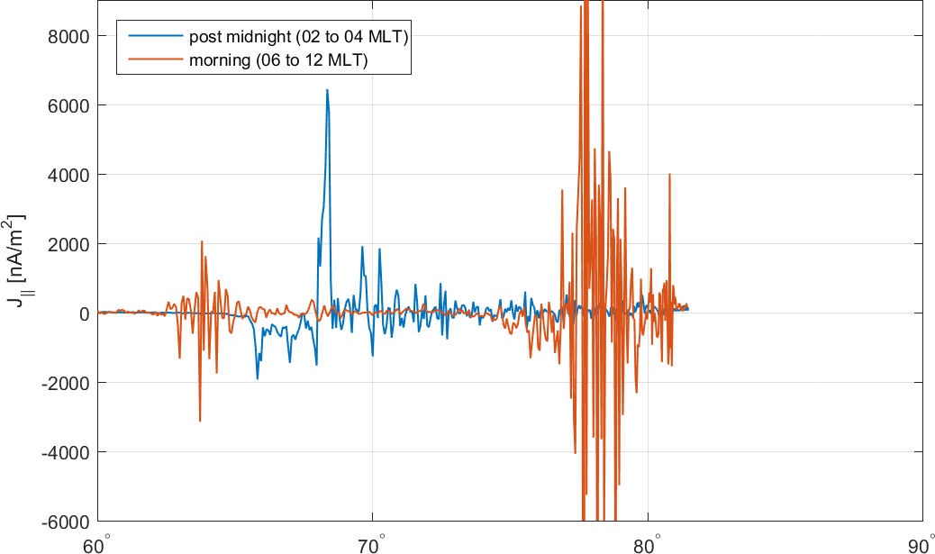
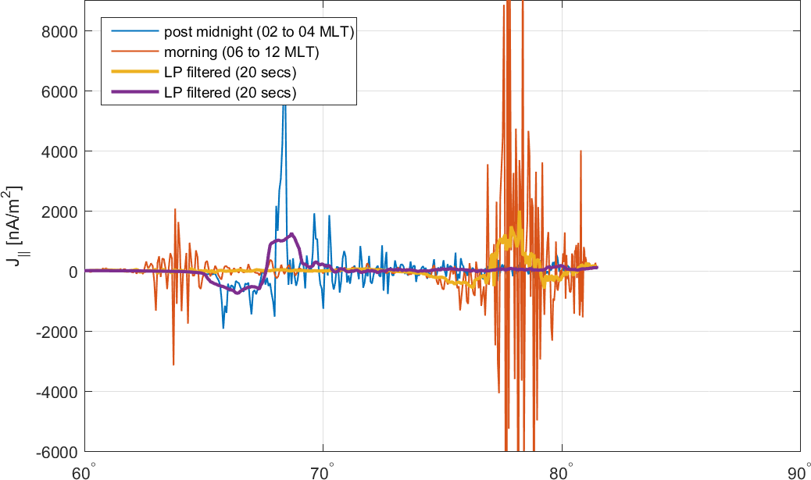
Polar FACs during ”quiet” conditions 2 May 2014, Kp = 0º – 1⁻
Cat-2 product SW_OPER_FACATMS_2F_20140502T000000_20140502T235959_0201.DBL

Slide 12
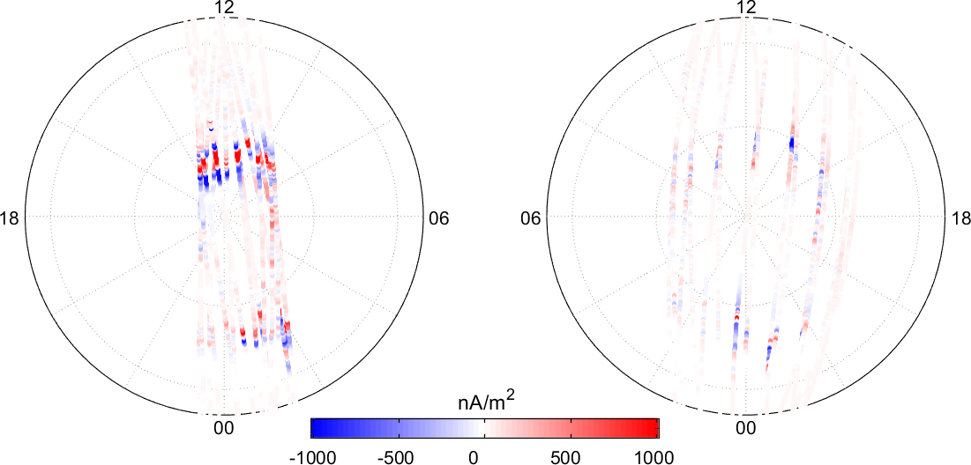
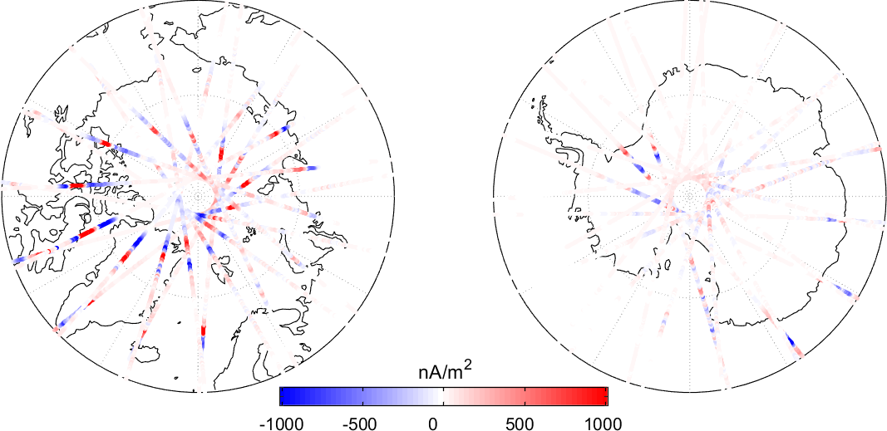
Polar FACs during ”quiet” conditions 2 May 2014, Kp = 0º – 1⁻
Northern Hemisphere Southern Hemisphere
Cat-2 product SW_OPER_FACATMS_2F_20140502T000000_20140502T235959_0201.DBL

Slide 13
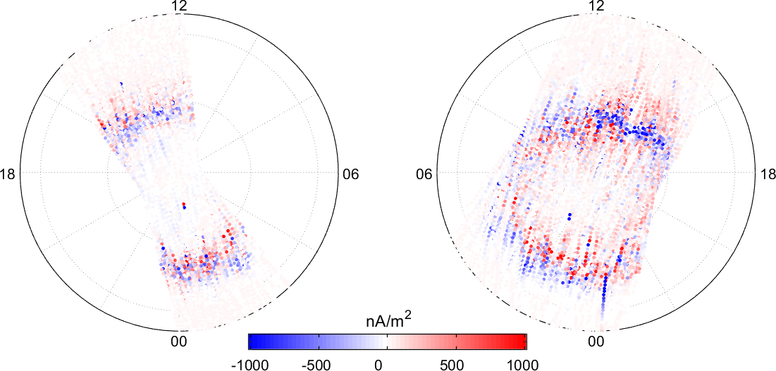
Polar FACs during ”quiet” conditions 26 Nov – 13 Dec 2013, Swarm A
Northern Hemisphere Southern Hemisphere

Slide 14
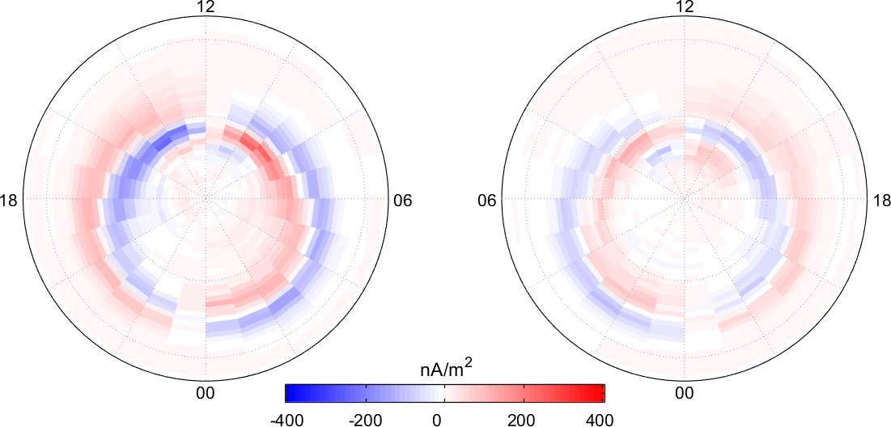
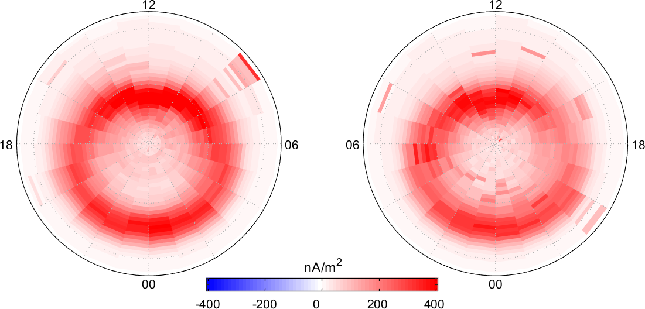
Polar FACs during ”quiet” conditions Nov 2013 – March 2016, Swarm A
Northern Hemisphere Southern Hemisphere
Standard deviation, from CAT-2 FAC
Mean values, from CAT-2 FAC

Slide 15
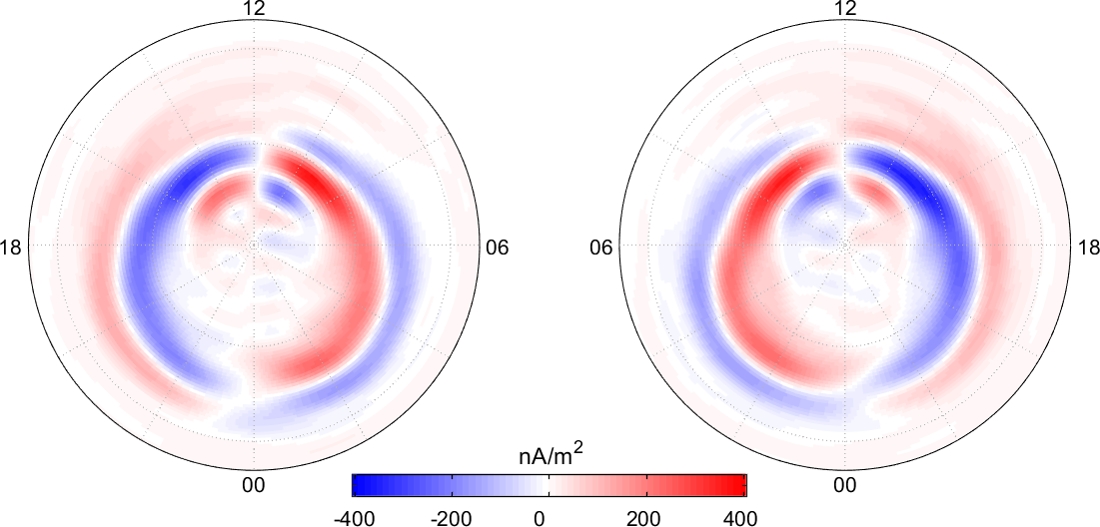
Polar FACs during ”quiet” conditions Nov 2013 – March 2016, Swarm A
Northern Hemisphere Southern Hemisphere
Determined using poloidal-toroidal decomposition of SIFMplus vector residuals

Slide 16
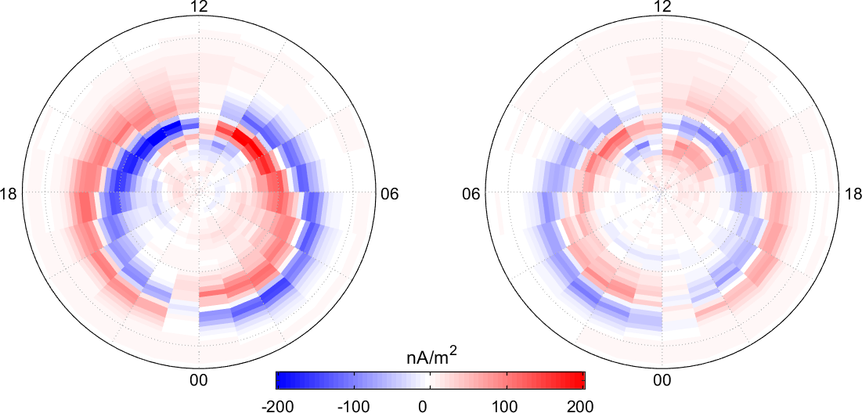
Polar FACs during ”quiet” conditions Nov 2013 – March 2016, Swarm A
Northern Hemisphere Southern Hemisphere
Mean values, from CAT-2 FAC

Slide 17
Summary: Polar FACs
Field-aligned currents (FACs) are always present at polar latitudes (> 60º magnetic latitude)
They connect ionosphere and magnetosphere, along field-lines of Earth’s main field (mainly dipolar)
Amplitudes are very varying, up to several 1000 nA/m² even during ”quiet” conditions (as used for geomagnetic field modeling and Euler angle estimation)
250 nA/m² is a typical order of magnitude mean value which we use in following

Slide 18
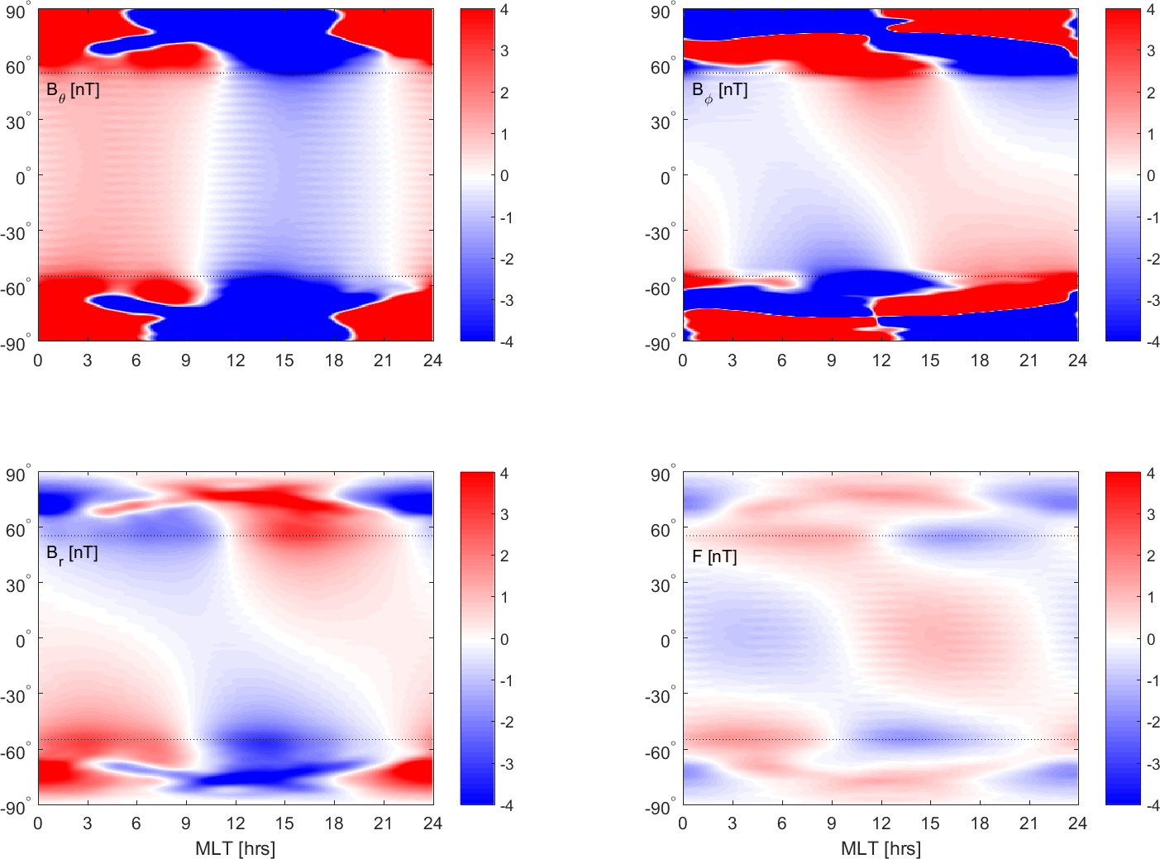
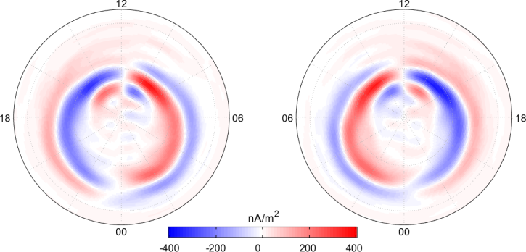
Low-latitude magnetic field contribution due to polar FACs
Construction of 3D current system J
FACs at top of ionosphere
… closing currents in ionosphere (110 km altitude)
… current continuation along field lines …
… and possibly closing currents in magnetosphere.
Determination of magnetic field vector B due to this 3D current system using poloidal-toroidal decomposition of J and B (Olsen and Engels, 1998)
This magnetic contribution is not considered in any existing field model…
… and may therefore have impact on determined Euler angles

Slide 19
Test with synthetic data
Swarm Alpha time and positions from SIFMplus data selection
Synthetic values of B_{core} + B_{FAC}
Rotated NEC → VFM frame using CCDB Euler angles (static)
Estimation of field model + Euler angles (in bins of 10 days) similar to what has been done with real data for SIFMplus (but only Swarm Alpha data, and no gradient data)
Excellent Euler-angle recovery if B = B_{core} (no B_{FAC}) (< 0.5” difference to CCDB in all 10-day bins)

Slide 20
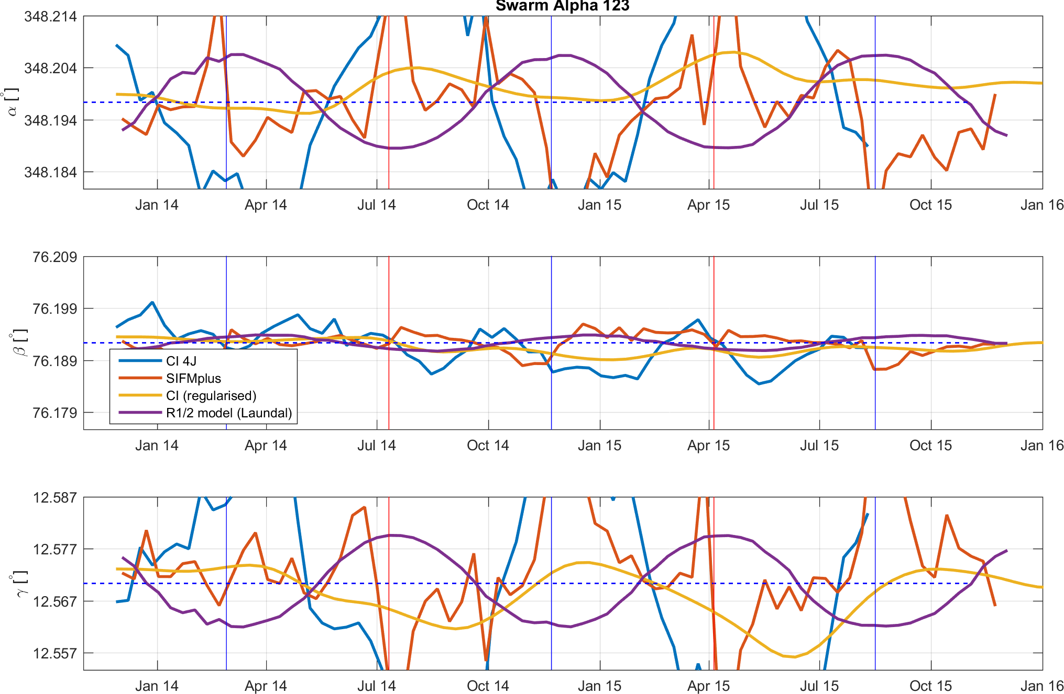
Test with synthetic data
Correct order of magnitude (250 nA/m² yields up to 60” peak-to-peak), similar MLT dependence as observed, although different phase.

Slide 21
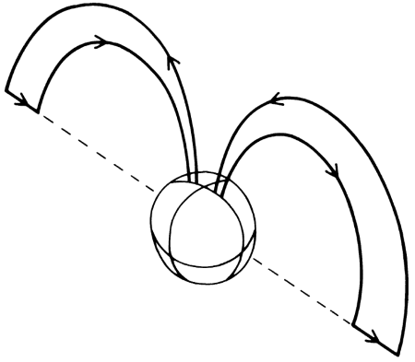
Other possible R1/2 FAC models
The used FAC model (based on SIFMplus residuals) reflect annual mean, i.e. North-South symmetry Current closure in magnetospheric equatorial plane
But there probably exist some FACs connecting Northern and Southern polar regions (North-South asymmetry)

Slide 22
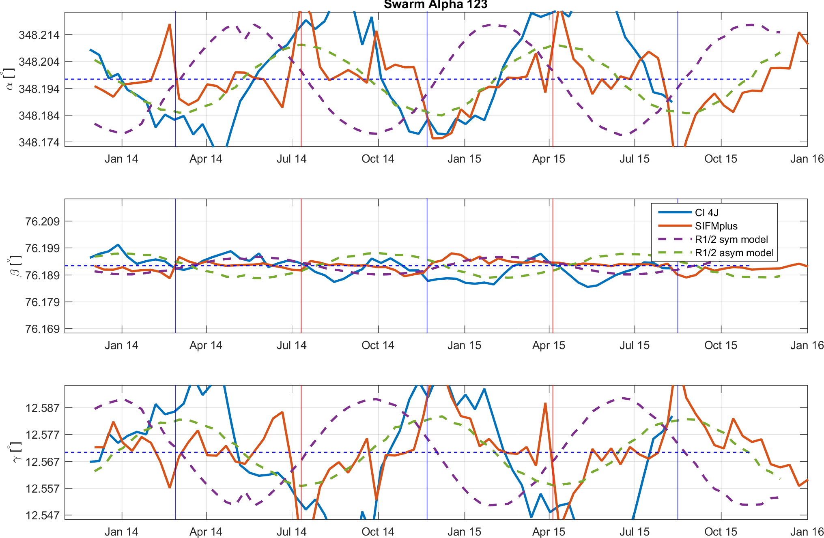
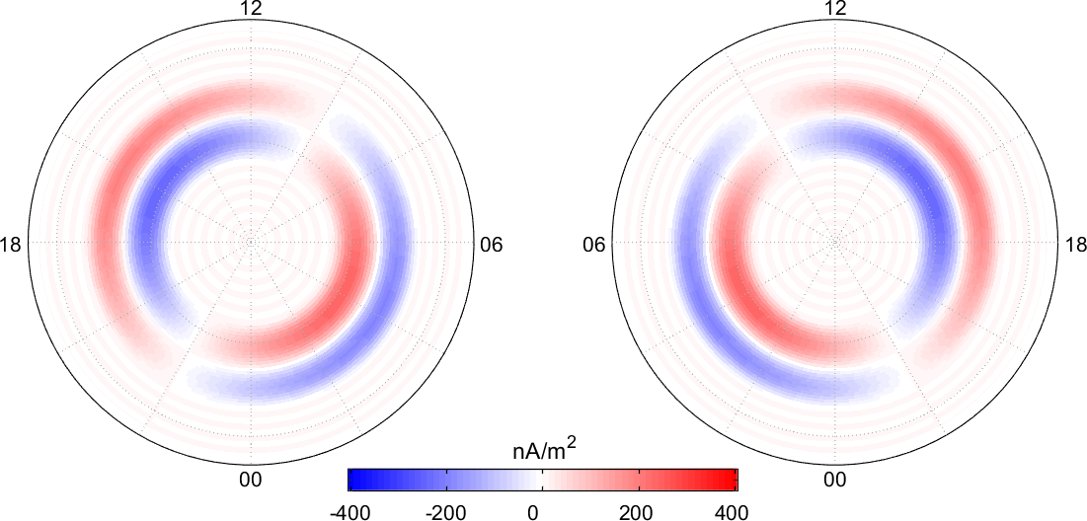
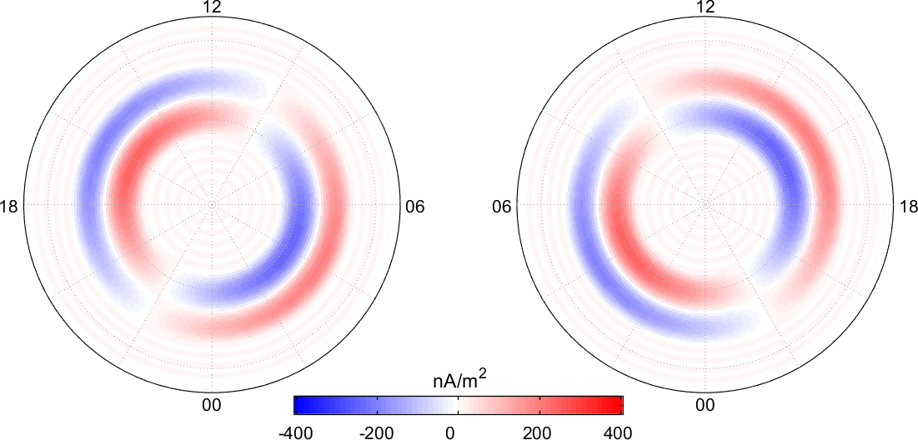
Two simplistic elementary current systems
Symmetric / asymmetric R-1/2 currents of about 250 nA/m² (much weaker than measured instantaneous currents) can explain Euler angle variation

Slide 23
Conclusions
Ionospheric/magnetospheric currents are responsible for apparent change of Euler angles No ”Mysterious misalignments”
Polar FACs current densities of 250 nA/m² can explain the observed LT variations This current densities are much lower (factor 5 to 10) then observed FACs, and thus small variations or persistent structures in FACs will cause the observed apparent Euler angle variation
No indication for true time-changing Euler angles constant (static) values should be used for L1b processing

Slide 24
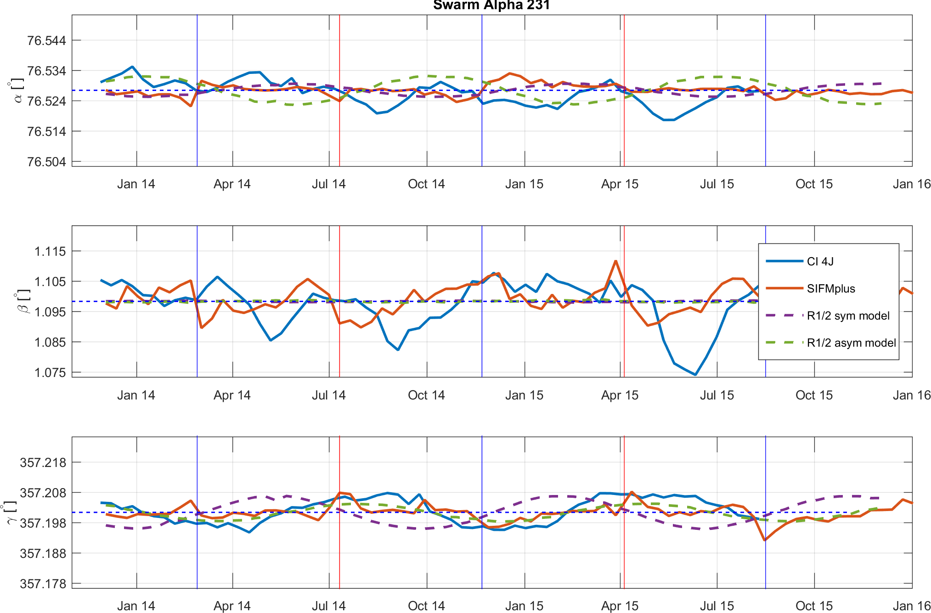
Much smaller time-variation in 2-3-1 Euler order frame
The two representations describe exactly the same rotation!

Slide 25
Euler Vector Representation
Direction of vector yields rotation axis Amplitude proportional to rotation around axis (some similarity to first 3 elements of quaternions)

