Slide 1
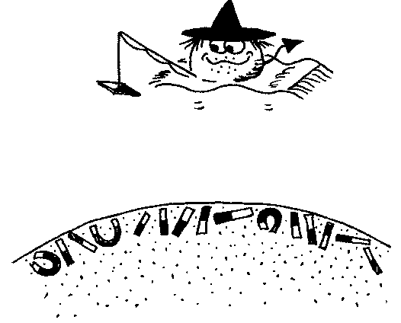
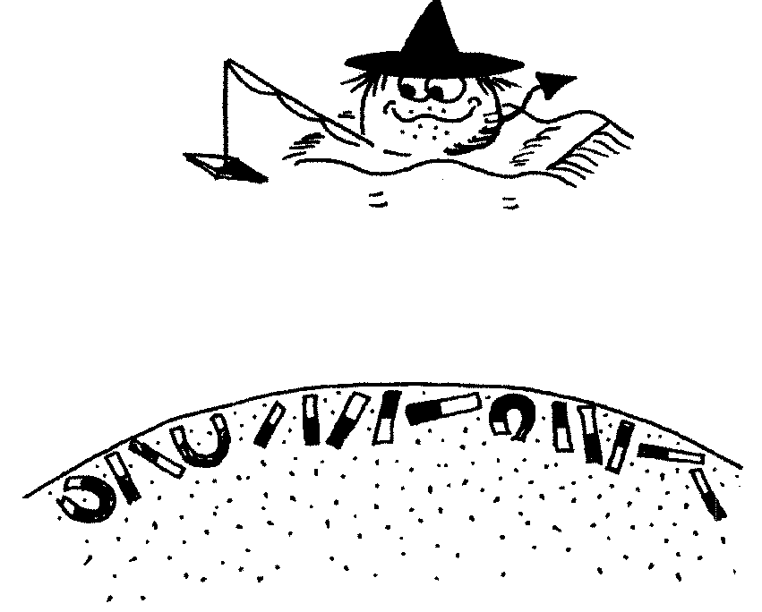
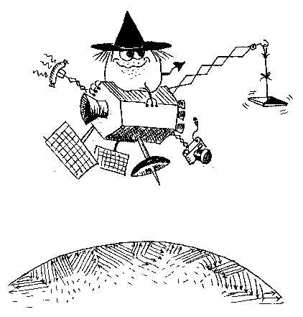



Advanced Modelling of Geospace (AMOG) Using Satellite Platform MagnetometerS
Nils Olsen¹, Fabrice Cipriani², Elisabetta Iorfida², Per Lundahl Thomsen¹, and Flemming Hansen¹
¹DTU Space, ²ESA/ESTEC

Slide 2

Most satellites carry magnetometer for navigational purposes as part of their AOCS (Attitude and Orbit Control System)
The data of these AOCS magnetometers have scientific value but data calibration is essential
Towards a true swarm of satellites …
AMOG project funded by ESA GSTP program

Slide 3
Overview: The various satellite data sets
Name | NORAD ID | years | altitude
CryoSat-2 | 36508 | 2010 - | ≈ 720 km
SMOS | 36036 | 2009 - | ≈ 760 km
Aeolus | 43600 | 2018 - 2023 | ≈ 320 km
EarthCARE | 59908 | 2024 - | ≈ 395 km
Proba-2 | 36037 | 2009 - | ≈ 720 km
AWS | 60543 | 2024 - | ≈ 600 km
GRACE-FO C | 43476 | 2018 - | ≈ 500 km
GRACE-FO D | 43477 | 2018 - | ≈ 500 km
Main challenges:
AOCS magnetometer only active in safe mode: no continuous data
Coarse magnetometer sampling rate: 10 sec or lower (1 sec is appreciated)
Data resolution, e.g. 1 μT (1 nT is appreciated)
Large magnetic disturbances from s/c and other instruments
Green: operational data processing and provision
Yellow: Not considered further, due to large magnetic disturbances or insufficient input data

Slide 4
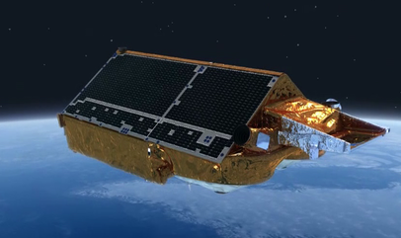
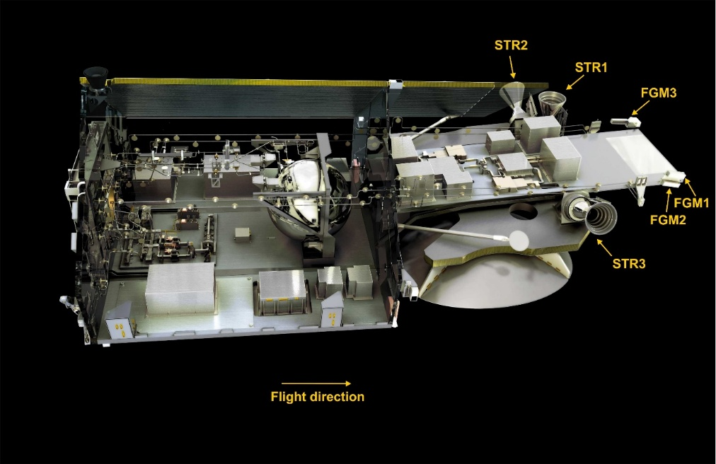
Magnetic Data from CryoSat-2
Launched in April 2010 – and still in operation
720 – 730 km altitude, 92° orbital inclination
3 AOCS vector Fluxgate magnetometers (FGMs), 4 sec sampling
3 Star imagers (STRs)
House-Keeping (HK) data available: magnetorquer currents, magnetometer temperature, …

Slide 5
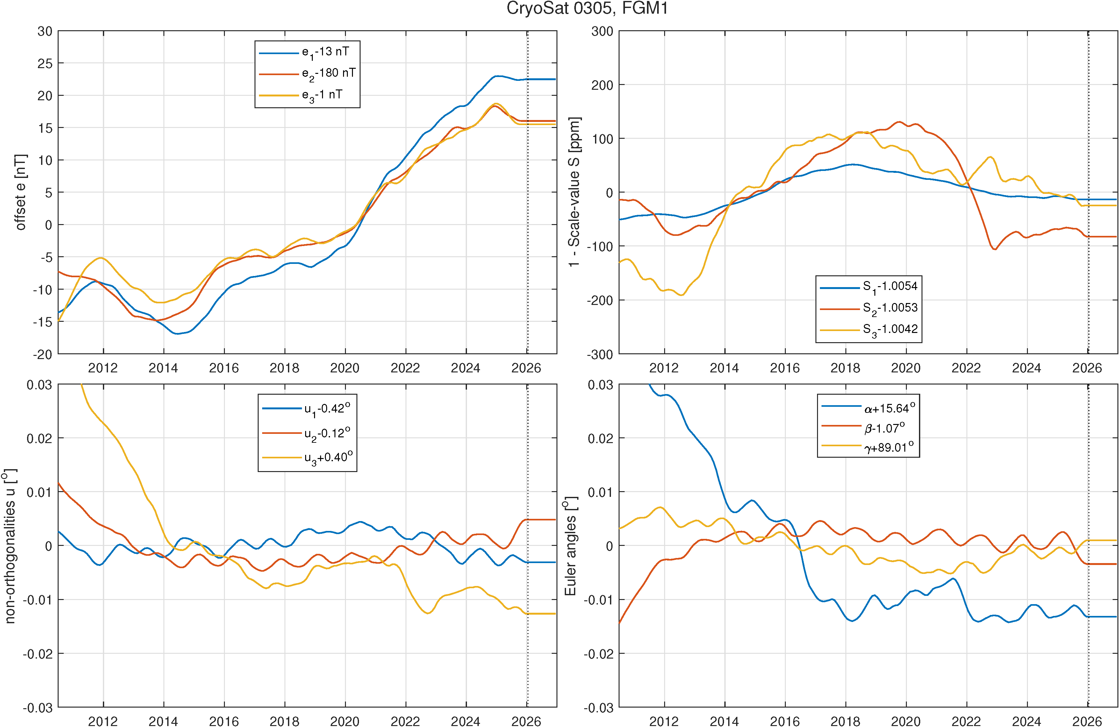
CryoSat-2
The Flagship AOCS mission – pushing the border of AOCS magnetometer processing
Determination of magnetometer calibration parameters (offsets, sensitivities, non-orthogonalities, Euler angles) and disturbance fields (magnetorquer, battery and solar array currents) by comparing of observed B_{obs} with B_{ref} from CHAOS geomagnetic field model
Operational processing since January 2025:
automatically processed in monthly batches, typically on 5th of each month
Daily CDF files in “Swarm-like” format distributed through Swarm data server
ftp://swarm-diss.eo.esa.int/Multimission/CryoSat-2
4-sec data version 0305 based on estimated parameters using data Aug 2010 - Dec 2025
New: Change in onboard operation and telemetry allows to obtain 1 sec data since Sept 2025
Operational processing of 1 sec data (version 0402, will replace the 4 sec 0305 data)

Slide 6
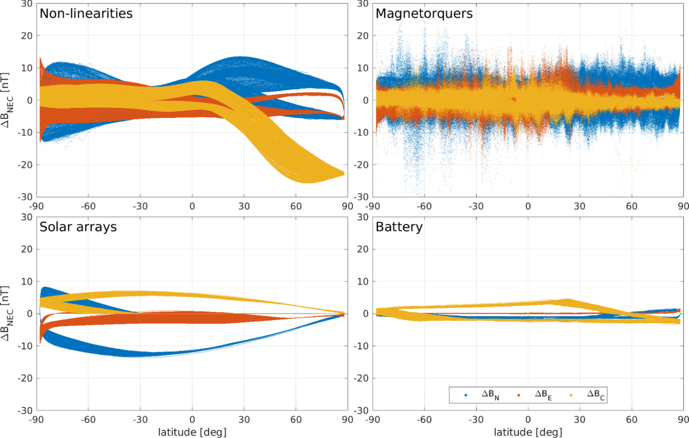
CryoSat-2 – the various disturbances

Slide 7
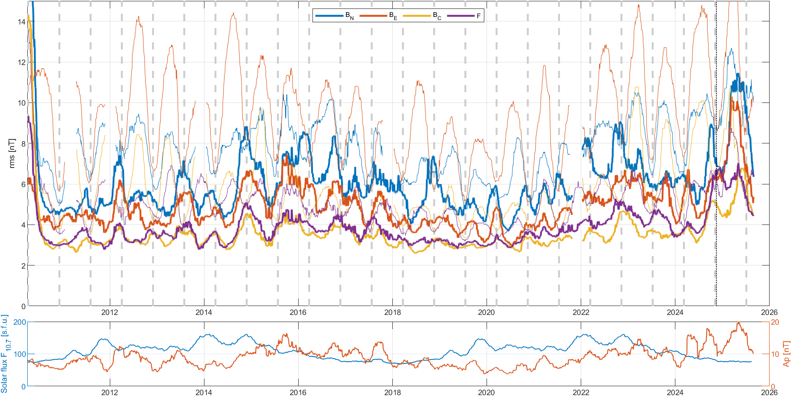
CryoSat-2
81-daily running mean of daily rms wrt CHAOS model
thick curves: nightside data
thin curves: dayside data
below 5 nT rms in B_{C} and F

Slide 8
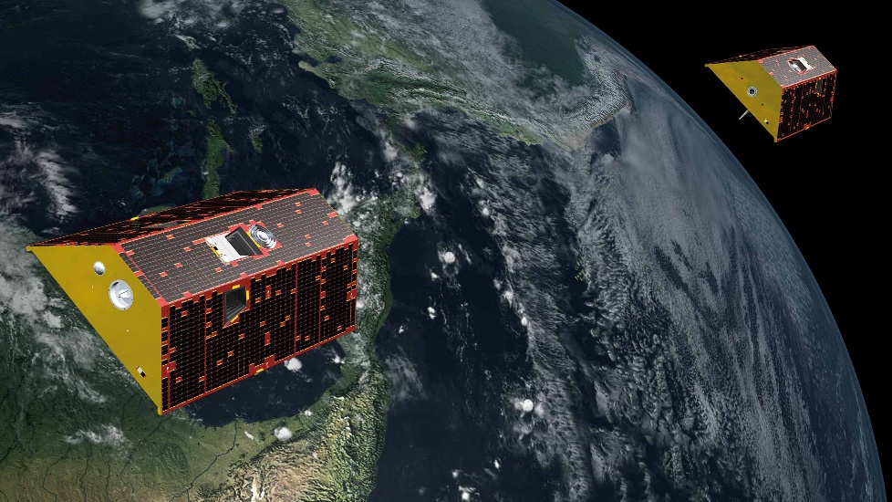
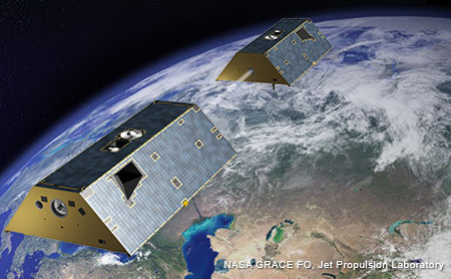
Further Successful Examples:
Magnetic Data from GRACE and GRACE-FO Satellite Duos
GRACE-FO 1 and GRACE-FO 2 follow each other with 220 km alongtrack distance
Launched in May 2018,
89° orbital inclination, 480 – 500 km altitude
Magnetic data routinely calibrated by GFZ
GRACE-A and GRACE-B follow each other with 220 km alongtrack distance
Between March 2002 and October 2017,
89° orbital inclination, 480 – 500 km altitude

Slide 9
New calibration of GRACE-FO data
67 months ”historical data” (June 2018 to Dec 2023) kindly provided by GFZ
Model parameterisation: 885 parameters (67 x 12 + 81)
12 ”basic” parameters (3 offsets, scale values, non-orthogonalitiies, Euler angles) in monthly bins
81 ”common parameters” (magnetometer non-linearities and temperature dependence, disturbances due to magnetorquer, battery and solar array currents) assumed to be constant for the whole mission
Model regularisation: minimize month-to-month variation of the 12 basic parameters
reduces ”effective” number of model parameters from 885 to 203
GFZ: all parameters estimated separately for every month (67 x 99 = 6633 model parameters)
Higher data sampling rate of 2 Hz
GFZ: 1 Hz
Model determined from northbound and southbound data for better separation of offset and scale values
GFZ: either northbound or southbound data, with extrapolation to the other half of orbit

Slide 10
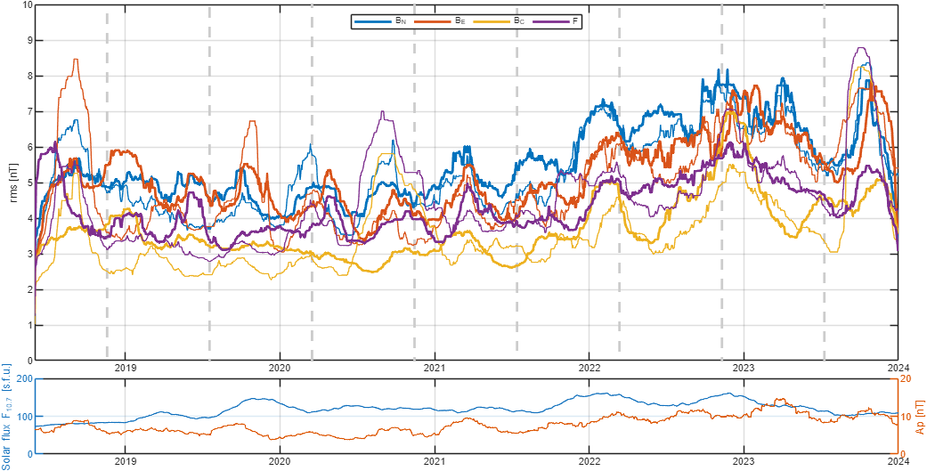
GRACE-FO
81-daily running mean of nighttime rms wrt CHAOS model
below 5 nT rms in B_{C} and F

Slide 11
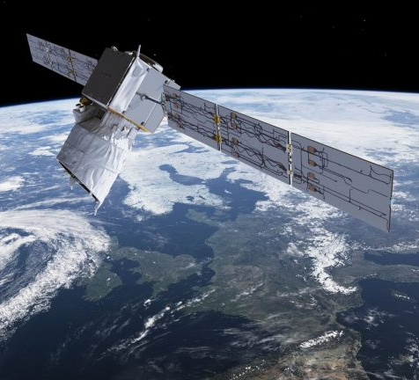
Aeolus
August 2018 – July 2023
Magnetoresistive magnetometer (no fluxgate)
10 sec sampling rate
Huge magnetorquer disturbances up to 30.000 nT
non-linear relation between I_{MTQ} and B_{MTQ}
Daily CDF files for May 2019 – June 2023

Slide 12
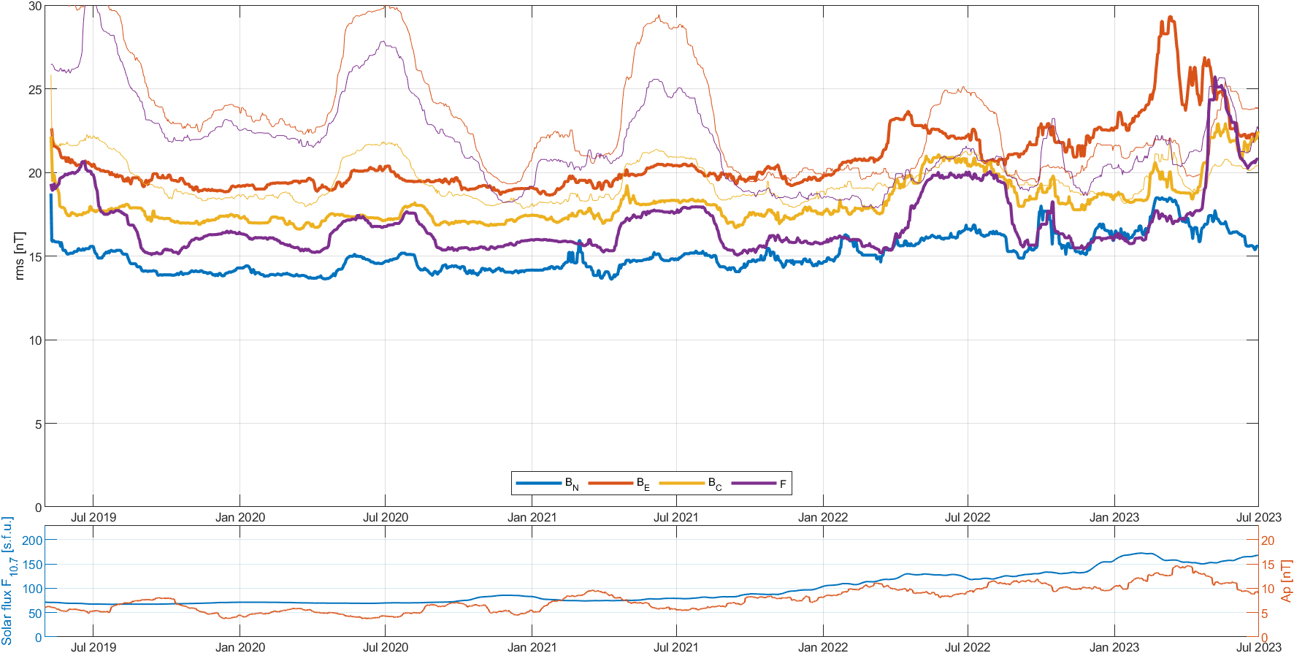
Aeolus
81-daily running mean of daily rms wrt CHAOS model
15 nT rms in B_{N}
larger in B_{C,} B_{E,} F
thick curves: 06 LT
thin curves: 18 LT

Slide 13
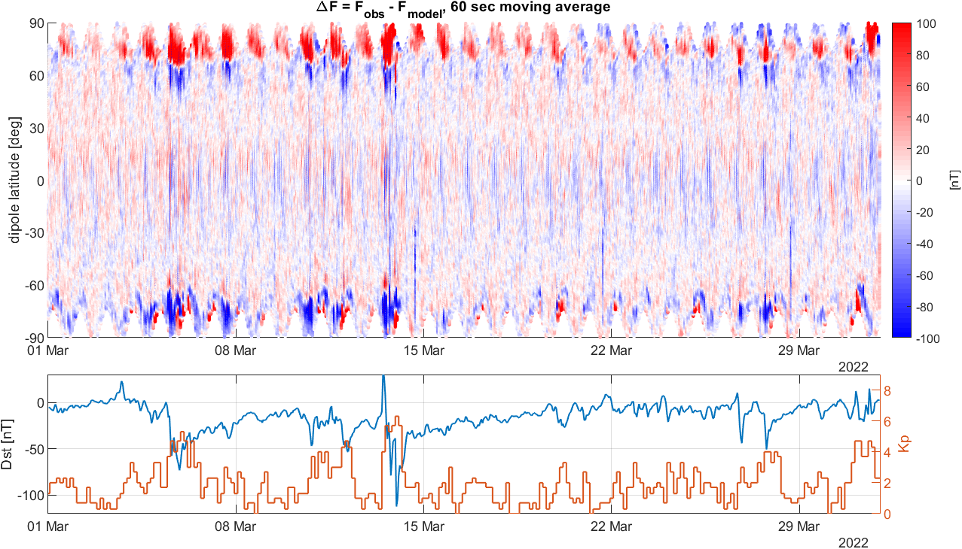
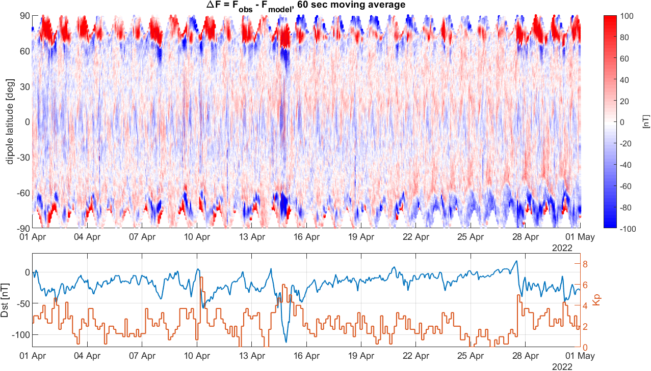
Aeolus
Despite the larger rms (> 15 nT) compared to CryoSat-2 ( ≈5 nT):
clear geophysical signal, in particular at polar latitudes (FACs)

Slide 14
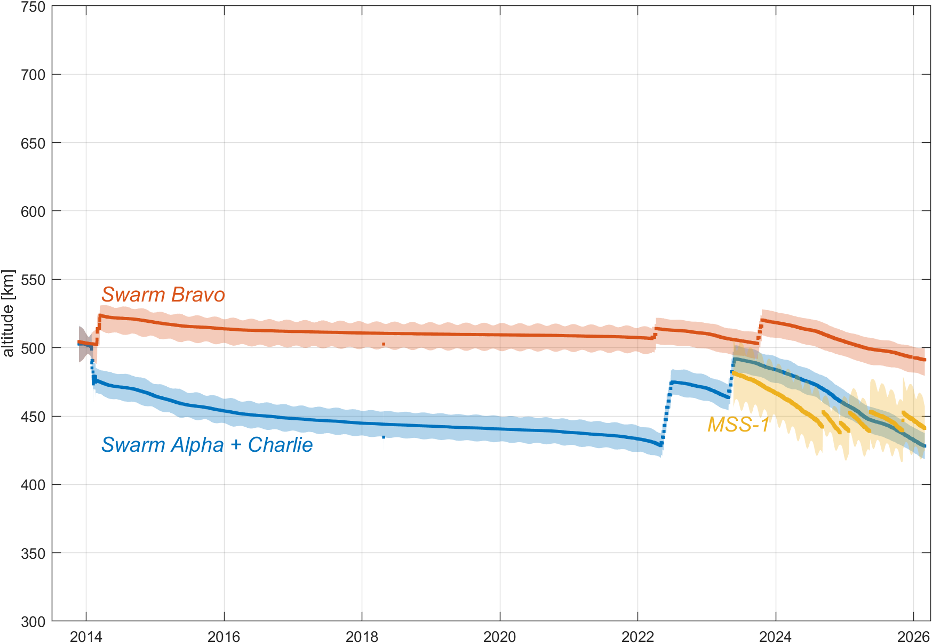
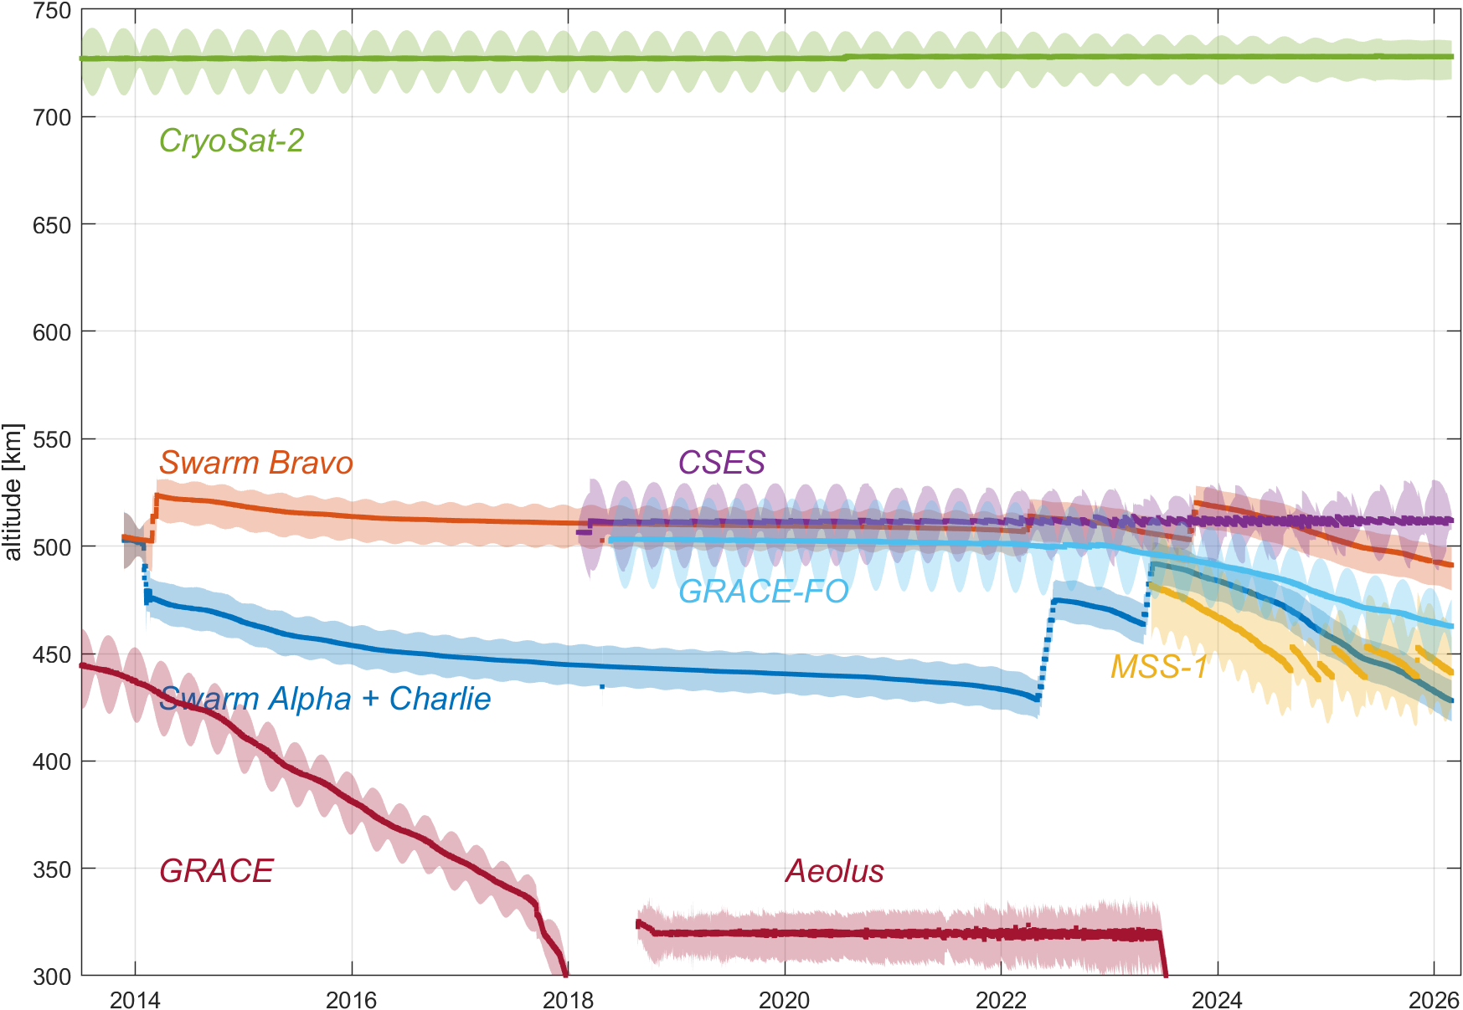
Altitude – “Swarm and Friends”
Swarm A/C
Swarm B
MSS-1
CryoSat-2
GRACE-FO A/B
CSES
Aeolus

Slide 15
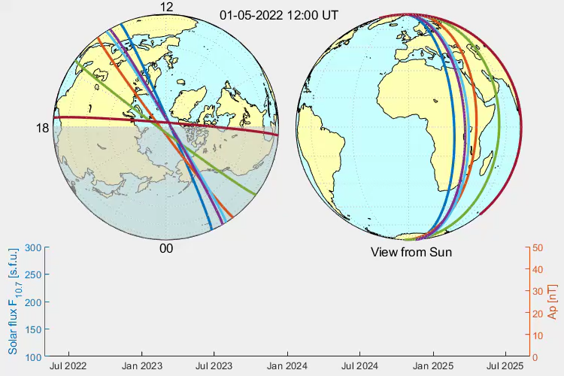
Local Time Evolution – “Swarm and Friends”
Swarm A/C
all LT in 4.4 months
Swarm B
all LT in 4.6 months
MSS-1
all LT in 26.3 days
CryoSat-2
all LT in 8.0 months
GRACE-FO A/B
all LT in 20.2 months
CSES
fixed LT at 02/14
Aeolus
fixed LT at 06/18

Slide 16
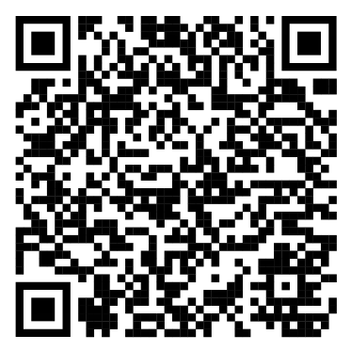
Conclusions
Calibrated magnetometer data available for
CryoSat-2, GRACE, GRACE-FO, Aeolus, GOCE
Daily files of calibrated AOCS magnetometer data freely available at
ftp://swarm-diss.eo.esa.int/Multimission/
Challenges with AOCS magnetometer data from recent ESA EOP satellites, e.g. SMOS, EarthCare
  No continuous data (magnetometer only operating in safe mode)
  Coarse sampling rate of 10 sec or longer
  Large magnetic disturbances
Future: CryoSat follow-on mission CRISTAL
to be launched in 2028, design similar to CryoSat-2
Fluxgate AOCS magnetometer, but different from the one on CryoSat-2

