Slide 1
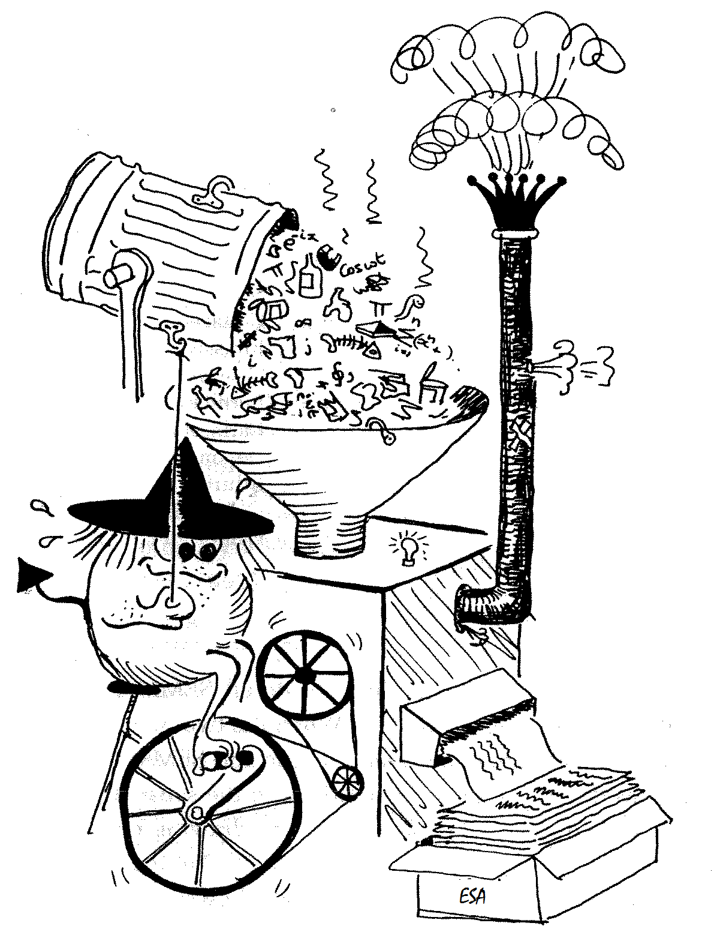
Swarm Data Processing
and First Scientific Results
Nils Olsen and the Swarm SCARF Team
Patrick Alken, Ciaran D Beggan, Stephan C. Buchert, Johnathan Burchill, Arnaud Chulliat,
Eelco Doornbos, Joao Teixeira da Encarnacao, Ludwig Grunwaldt, Brian Hamilton,
Rune Floberghagen, Eigil Friis-Christensen, Giuseppe Ottavianelli, Gauthier Hulot,
Jose van den IJssel, David J. Knudsen, Alexey Kuvshinov, Jean-Michel Leger, Vincent Lesur, Hermann Luehr, Susan Macmillan, Stefan Maus, Ingo Michaelis, Max Noja, Nils Olsen,
Poul Erik H Olsen, Jaeheung Park, Radek Peresty, Gernot Plank, Christoph Puethe, Jan Rauberg, Patricia Ritter, Martin Rother, Terence J Sabaka, Reyko Schachtschneider, Olivier Sirol,
Claudia Stolle, Erwan Thebault, Alan W P Thomson, Lars Toeffner-Clausen, Jakub Velımsky,
Pierre Vigneron, Pieter N Visser
Swarm Data Overview
Magnetic Level 1b Data assessment
SCARF: Level 2 Data Products and Processing
Model of the Earth’s magnetic field including Swarm data

Slide 2
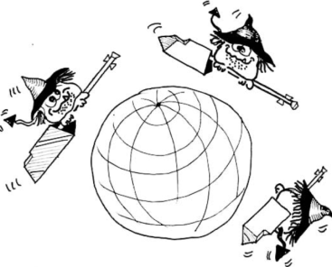
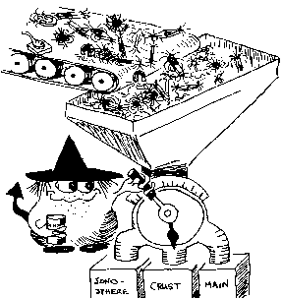
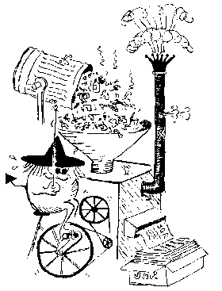
Swarm Data Processing Hierarchy
SW-A
SW-A
SW-A
L0
L1b Processor
L1b
L2 Processor
L2
scientific users

Slide 3
Level-1b Data Products
Magnetic Products
Plasma Products
Ephemeris Products
x = A, B or C
Type | Descriptive Name
MAGx_LR | Low Rate magnetic data
MAGx_HR | High Rate magnetic data
MAGx_CA | Magnetic calibration data
ASMxAUX | Magnetic stray fields at ASM sensor
VFMxAUX | Magnetic stray fields at VFM sensor
Type | Descriptive Name
EFIx_PL | Plasma data
LP_x_CA | Langmuir probe calibration data
TIIx_CA | Thermal Ion Imager calibration data
More on Swarm Level 1b Data Processing in Poster
“ESA Swarm Mission - Level 1b Products”
by Lars Tøffner-Clausen et al
Type | Descriptive Name
GPSx_RO | RINEX Observations
GPSx_RN | RINEX Navigation data
GPSxNAV | Navigational Solution
MODx_SC | Medium-Precision Orbit Determination
STRxATT | Attitude
ACCx_PR | Non-gravitational Accelerations
More on Plasma Products in Presentation
“First results from the Swarm Electric Field Instruments”
by David Knudsen et al

Slide 4
Magnetic Level-1b Data Product MAGx_LR
1 Hz magnetic field observations: time, position, F, B_{NEC} and B_{VFM}
Element | Contents | Frame |  | Units
Timestamp | Time of observation | - | CDF_EPOCH
SyncStatus | Time reference information | - | -
Latitude | Latitude of observation | ITRF | degree
Longitude | Longitude of observation | ITRF | degree
Radius | Radius of observation | ITRF | m
F | Magnetic field intensity | - | nT
dF_AOCS | Magnetic stray field correction intensity related to attitude control magneto-torquers | - | nT
dF_other | Magnetic stray field correction intensity of all other sources | - | nT
F_error | Error estimate on magnetic field intensity | - | nT
B_VFM | Magnetic field vector | VFM | nT
B_NEC | Magnetic field vector | NEC | nT
dB_AOCS | Magnetic stray field correction vector related to attitude control magneto-torquers | VFM | nT
dB_other | Magnetic stray field correction vector of all other sources | VFM | nT
B_error | Error estimates on magnetic field vector (B_VFM) | VFM | nT
q_NEC_CRF | Rotation from NEC frame to STR Common Reference Frame (CRF), quaternion | NEC ← CRF | -
Att_error | Error estimate on attitude information | - | degree/10³
Flags_F | Flags characterizing the magnetic field intensity | - | -
Flags_B | Flags characterizing the magnetic field vector measurement B_VFM and B_NEC | - | -
Flags_q | Flags characterizing the attitude information | - | -
Flags_Platform | Flags characterizing the spacecraft platform information | - | -
ASM_Freq_Dev | ASM reference frequency calibration data deviation – for ASM stability assessment | - | Hz^{½}

Slide 5
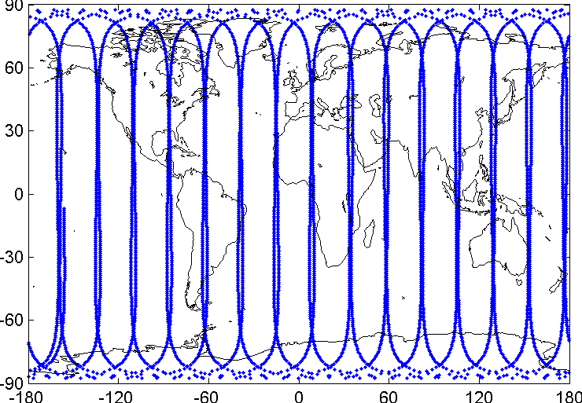
Swarm-A
1 sec Level1b Data MAGA_LR
2 December 2013
Quiet day (Kp ≤ 0⁺)

Slide 6
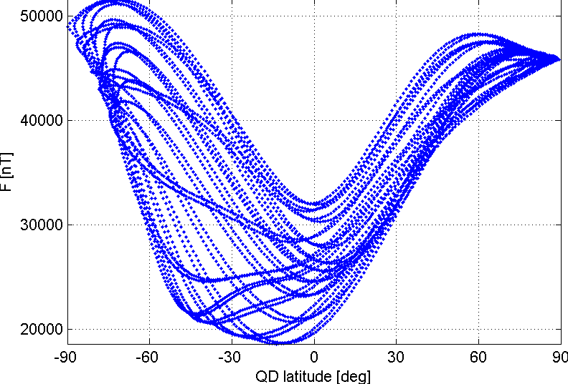
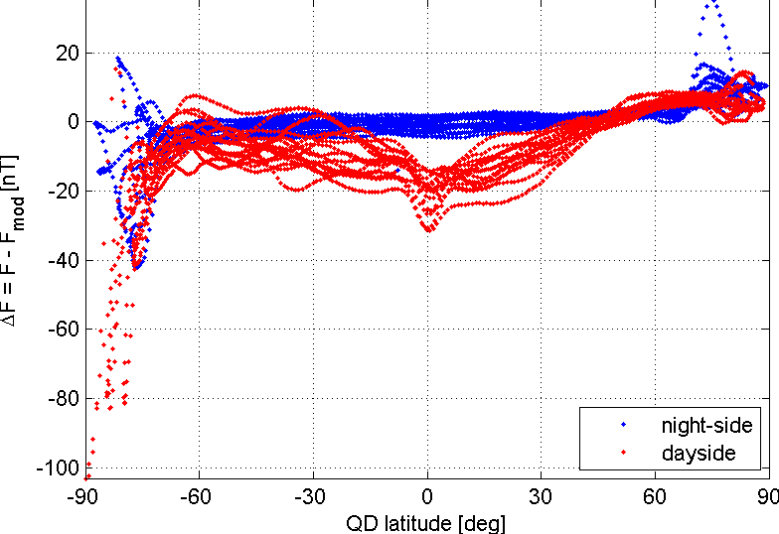
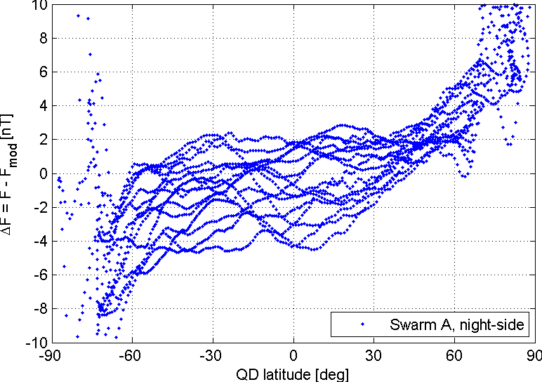
Swarm-A
1 sec Level1b Data MAGA_LR
2 December 2013
Quiet day (Kp ≤ 0⁺)
CHAOS-4 model subtracted

Slide 7
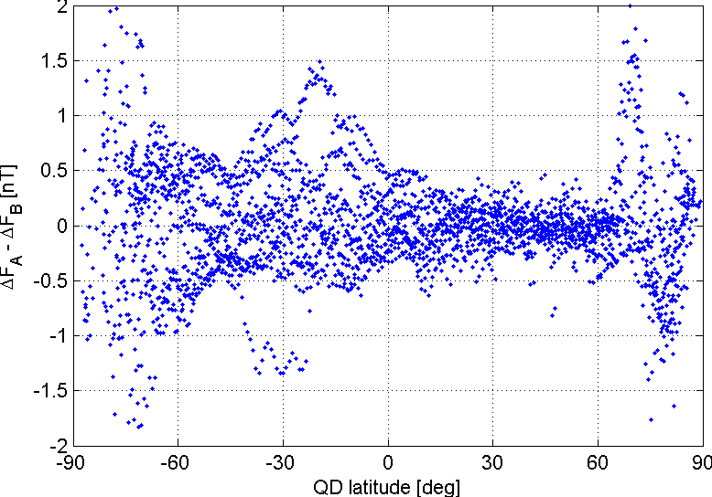
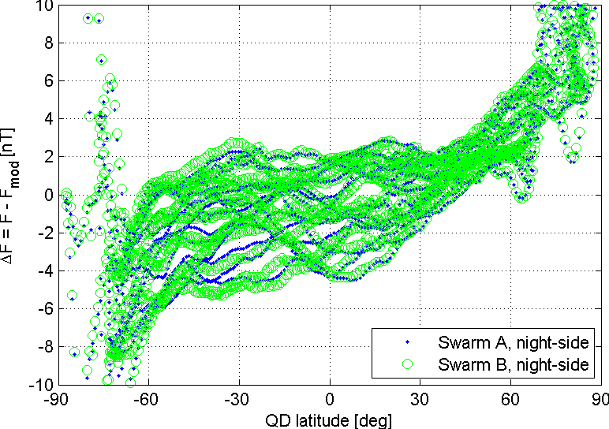
Swarm-A and Swarm-B
1 sec Level1b Data MAGA_LR
2 December 2013
Quiet day (Kp ≤ 0⁺)
CHAOS-4 model subtracted
Difference
Swarm A -Swarm B

Slide 8
Swarm Data Processing Hierarchy
SW-A
SW-A
SW-A
L0
L1b Processor
(Operational Processor)
L1b Processor
(Prototype Processor)
L1b
L2 Processor
L2
scientific users

Slide 9
Level1b Data from Operational Processor
CHAOS-4 model subtracted
Difference
Swarm A -Swarm B

Slide 10
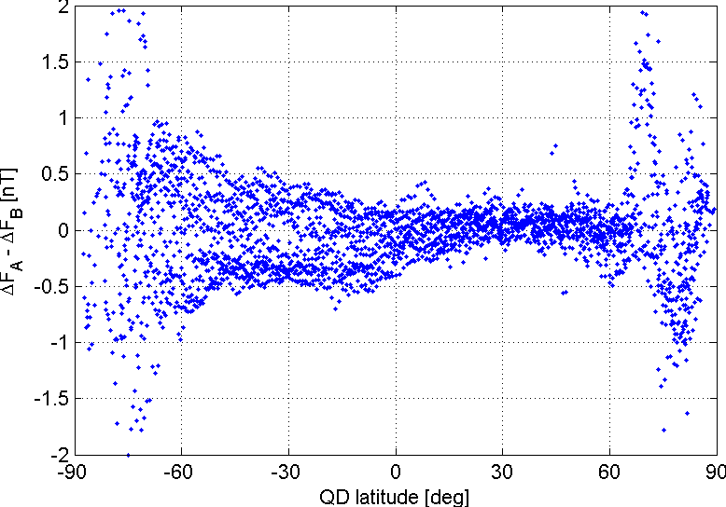
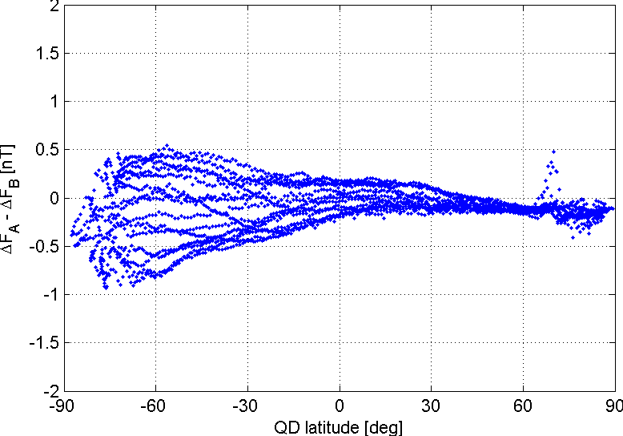
Level1b Data from Prototype Processor
(non-validated data)
CHAOS-4 model subtracted
Difference
Swarm A -Swarm B
Swarm-B data shifted by 15s
since satellite flies 120 km behind Swarm-A
(on that day)
More on Swarm Scalar Field Measurements from ASM
in Presentations by Gauthier Hulot and co-workers

Slide 11
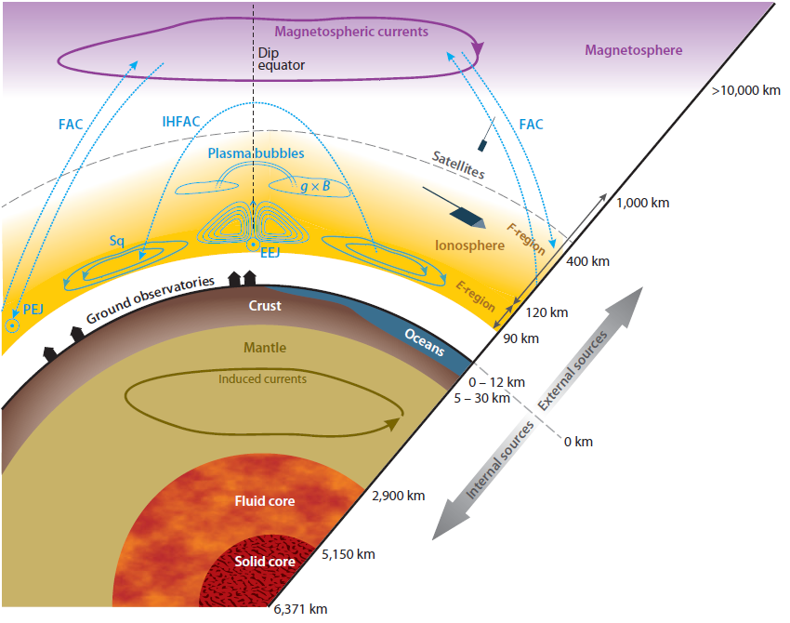
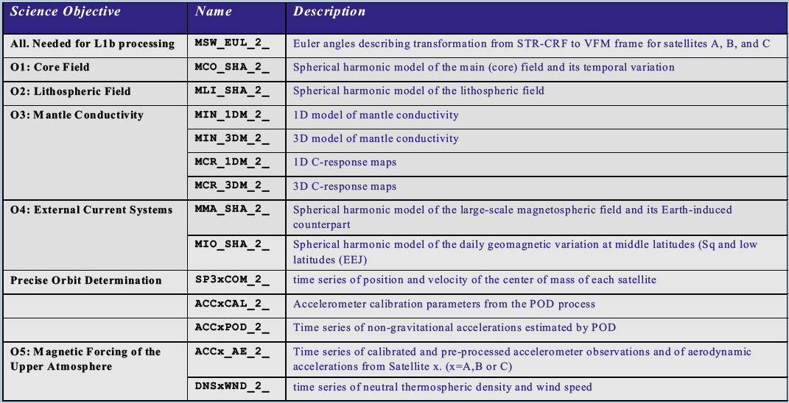
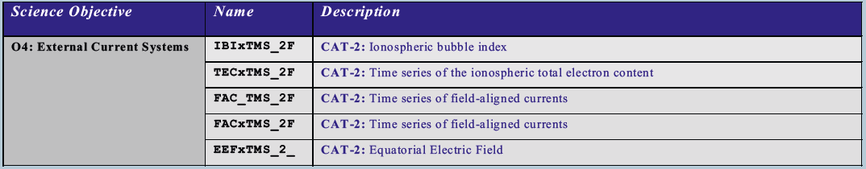
Swarm Level-2 Data Products

Slide 12
Swarm Level-2 Data Processing
Swarm SCARF (Satellite Constellation Application and Research Facility)
Consortium of 6 European partners (DTU, GFZ, IPGP, ETH, DEOS, BGS)
with support from NASA/GSFC, CIRES and CUP
ESA funded activity for Development, Implementation and Operation
of a distributed L2 Processing Facility
Cat-1 chains with “scientists in the loop” (operated by SCARF)
advanced geomagnetic models, mantle conductivity …
Cat-2 chains with automatic processing (operated by ESRIN)
products describing Earth environment, NRT capability
Development phase: Oct 2010 – March 2014
Exploitation phase: 2014 – 2018+ (at least 5 years)

Slide 13
Swarm Data Processing Hierarchy
SW-A
SW-A
SW-A
L0
L1b Processor
(Operational Processor)
L1b Processor
(Prototype Processor)
L1b
L2 Processor
SCARF
L2 Processing Facility
L2
scientific users

Slide 14
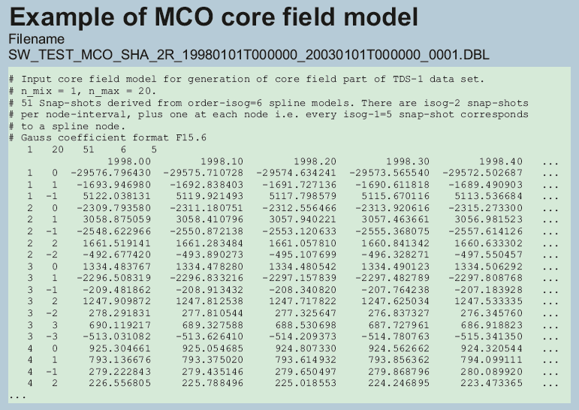
Level-2 Data Products
Cat-1: Complex algorithms to derive Level-2 products describing specific sources of the Earth’s magnetic field. Product derived by SCARF since scientific experience is required to derive these products.

Slide 15
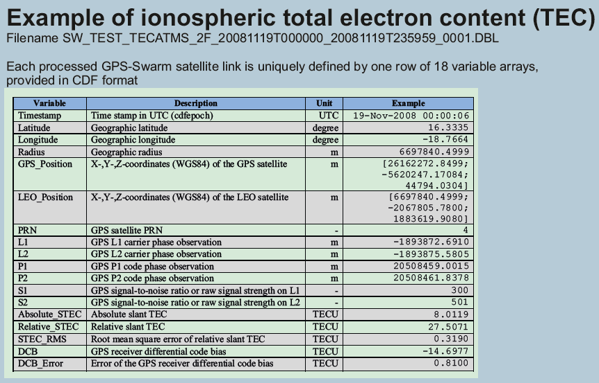
Level-2 Data Products
Cat-2: Algorithms leading to Level-2 products with minimum delay, e.g. for space weather applications. Near real-time capability. Provided in CDF. Algorithms designed by SCARF, data processed by PDGS
More on Swarm Level 2 Data Processing in Poster
“SCARF - The Swarm Satellite Constellation Application and Research Facility” by Nils Olsen et al
More on Swarm Cat-2 Data Products in talk
“The Swarm Level-2 Cat-2 Data Products” by Hermann Lühr et al
and Poster ”Swarm Equatorial Electric Field Inversion”
by Patrick Alken et al.

Slide 16
Field Modelling using Swarm data
First Results based on non-validated data
Data
  Data spaning 26 Nov 2013 to 27 April 2014
  Non-validated data from L1b Prototype Processor
  Geomagnetic quiet conditions (Kp < 2o, |dDst/dt| < 2 nT/hr)
  “Dark regions” (sun at least 10 degrees below horizon)
Model Parameterization
  Spherical Harmonic Model up to degree n=40 (static)
  linear time dependence (up to n=8)
  External field “CHAOS-4 parameterization” (SM, GSM, RC-dependence)
  Co-estimation of Euler angles describing VFM-STR transformation
  in bins of 10 days for each of the 3 Swarm satellites (as for CHAOS-4)

Slide 17
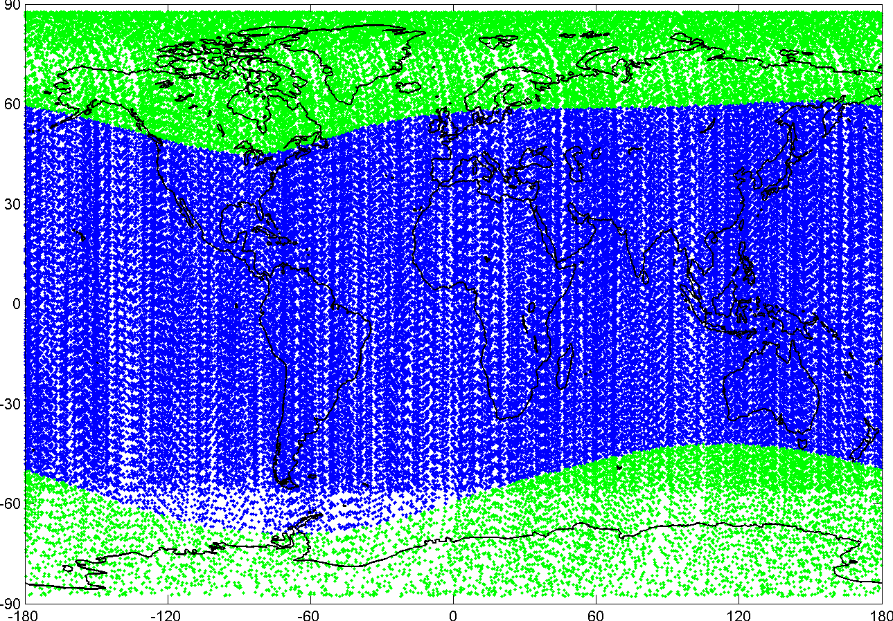
Spatial Data Distribution
Swarm A, B and C satellites
Geomagnetic quiet conditions (Kp < 2o, |dDst/dt| < 2 nT/hr)
”Dark regions” (sun at least 10º below horizon)
Swarm scalar data
Swarm vector data

Slide 18
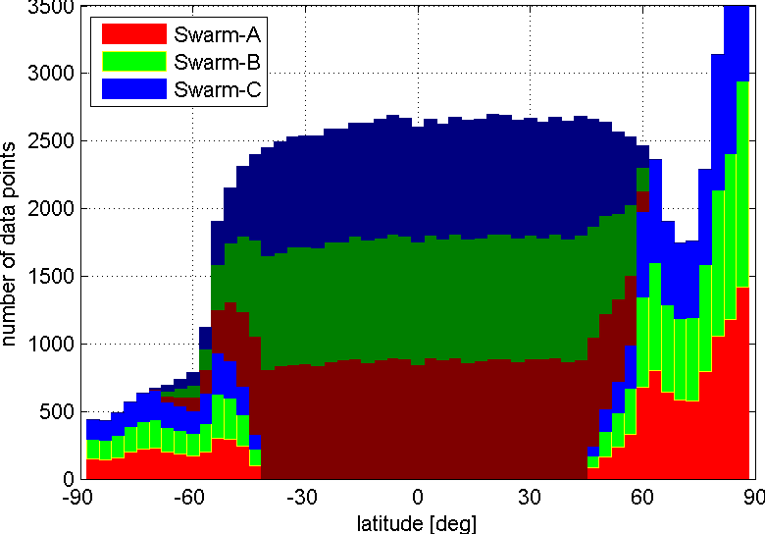
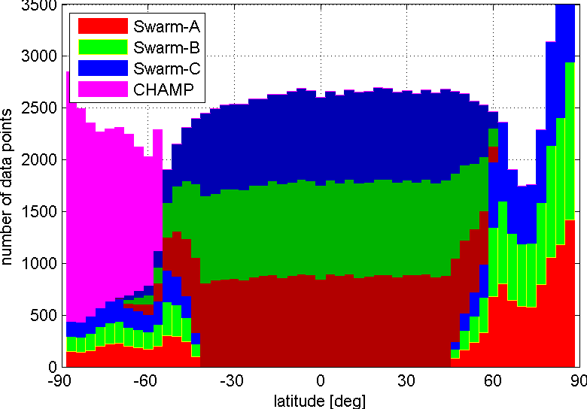
Spatial Data Distribution
Swarm A, B and C satellites
Geomagnetic quiet conditions (Kp < 2o, |dDst/dt| < 2 nT/hr)
”Dark regions” (sun at least 10º below horizon)

Slide 19
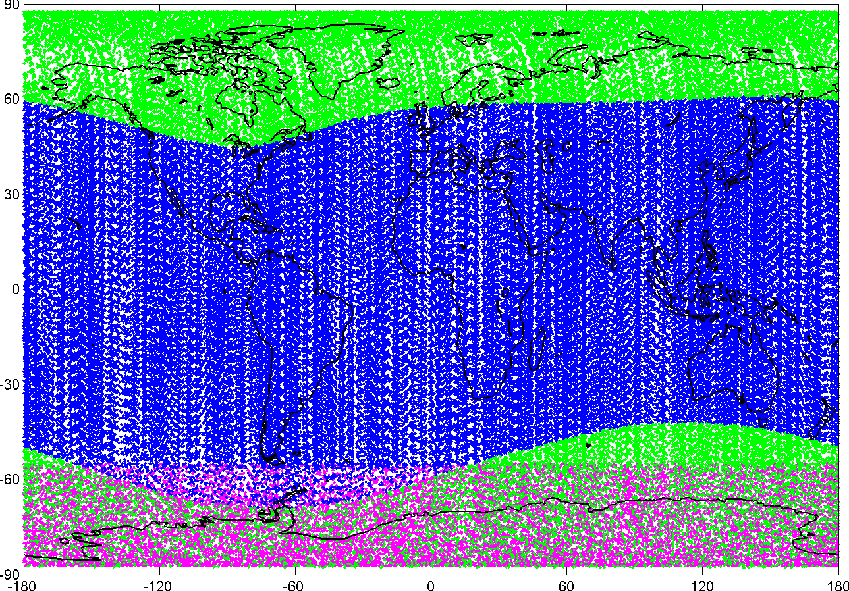
Spatial Data Distribution
Swarm A, B and C satellites
Geomagnetic quiet conditions (Kp < 2o, |dDst/dt| < 2 nT/hr)
”Dark regions” (sun at least 10º below horizon)
Swarm scalar data
Swarm vector data
CHAMP scalar data
(propagated in time by 3.5 years using CHAOS-4)

Slide 20
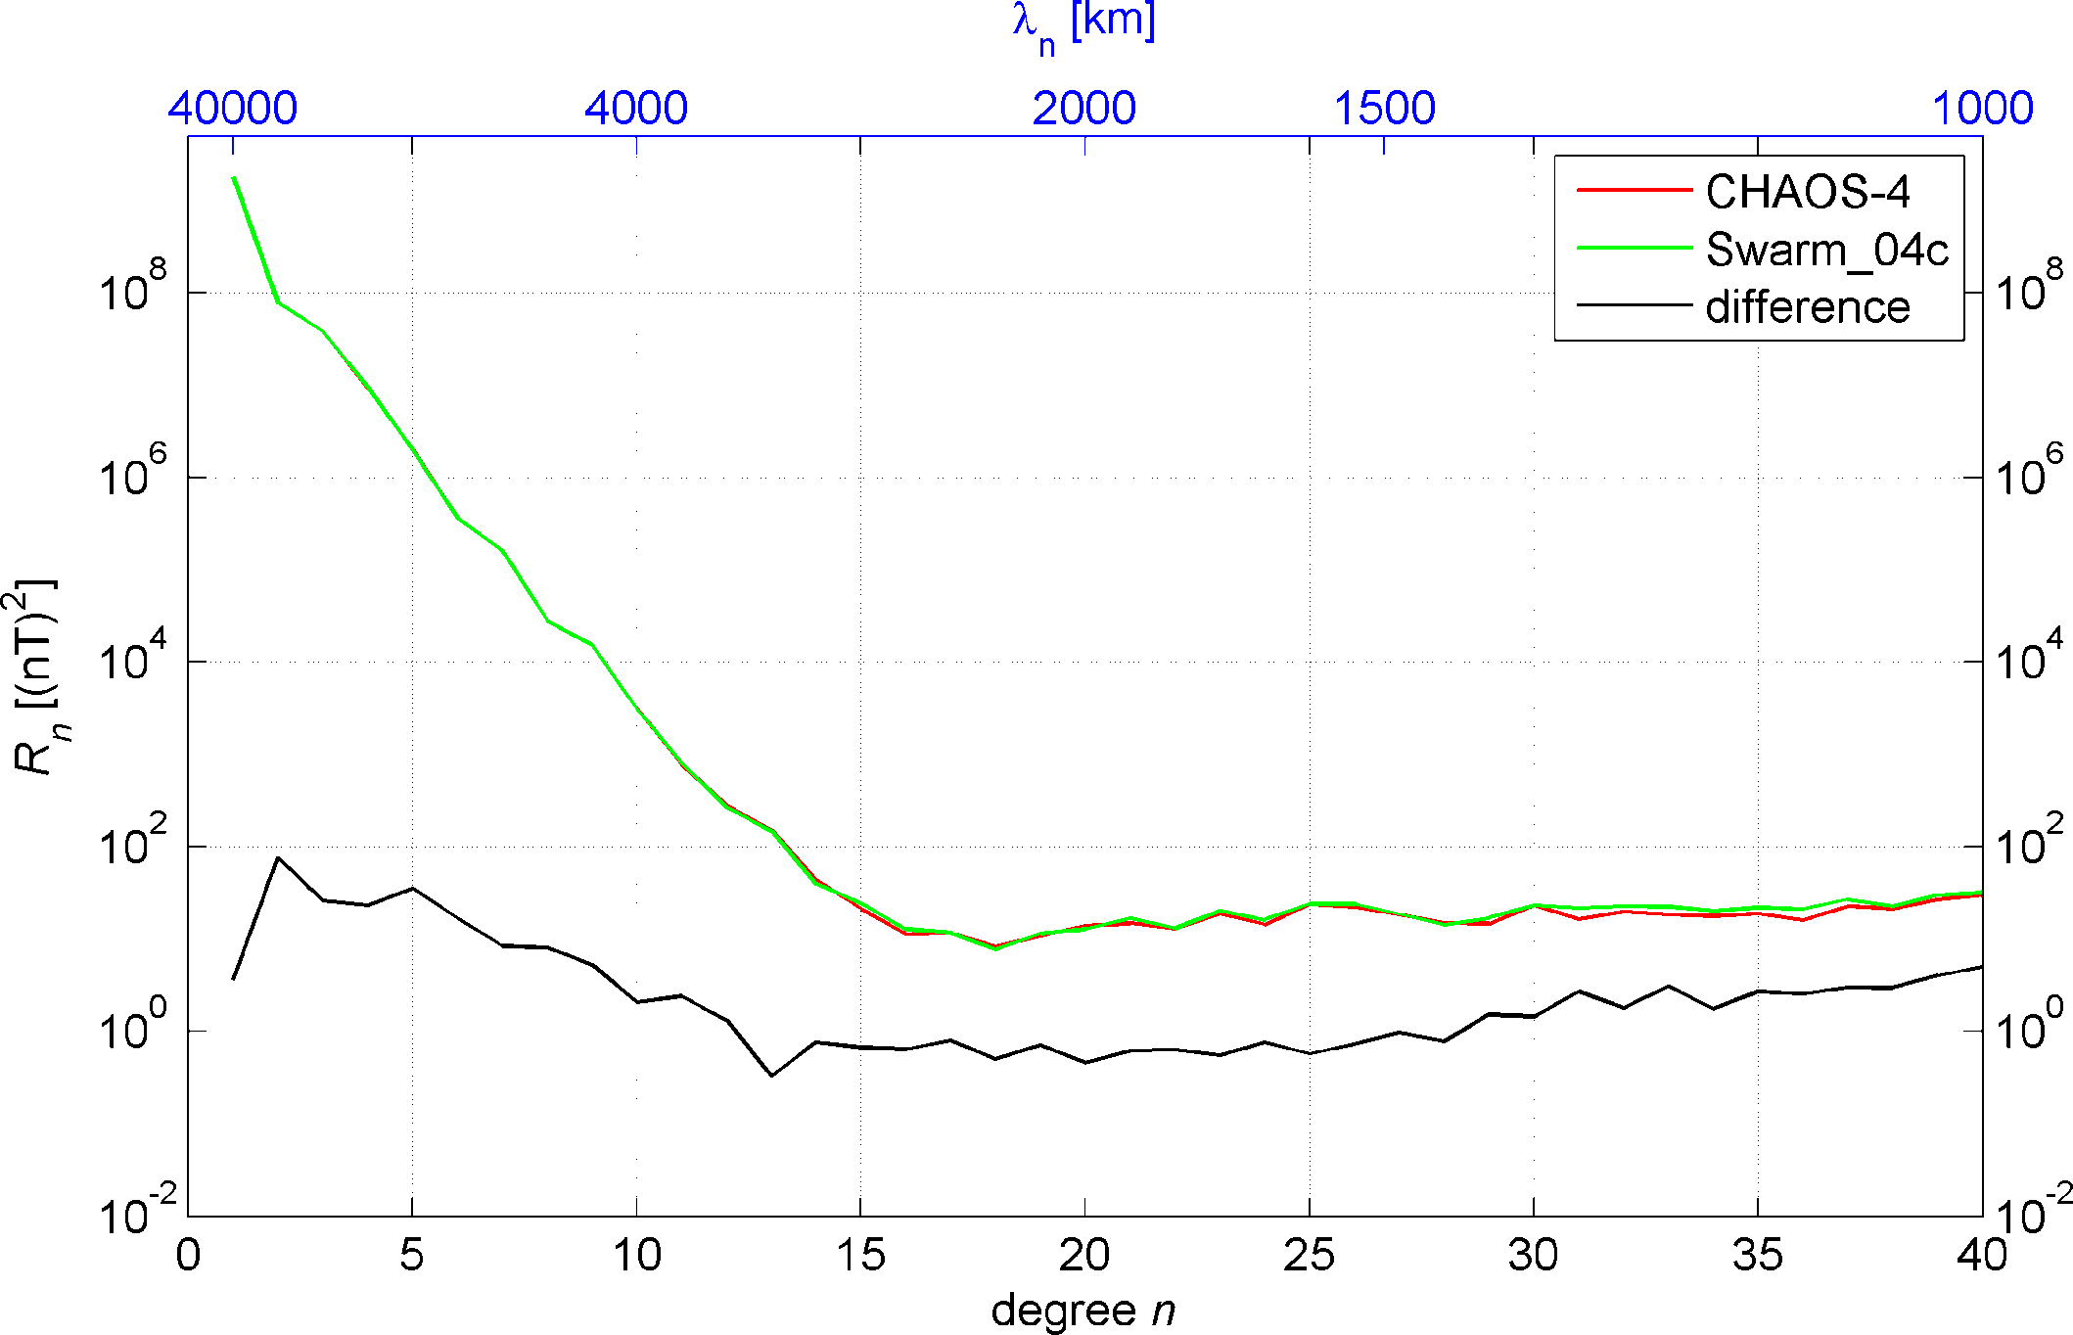
Geomagnetic Spectrum

Slide 21
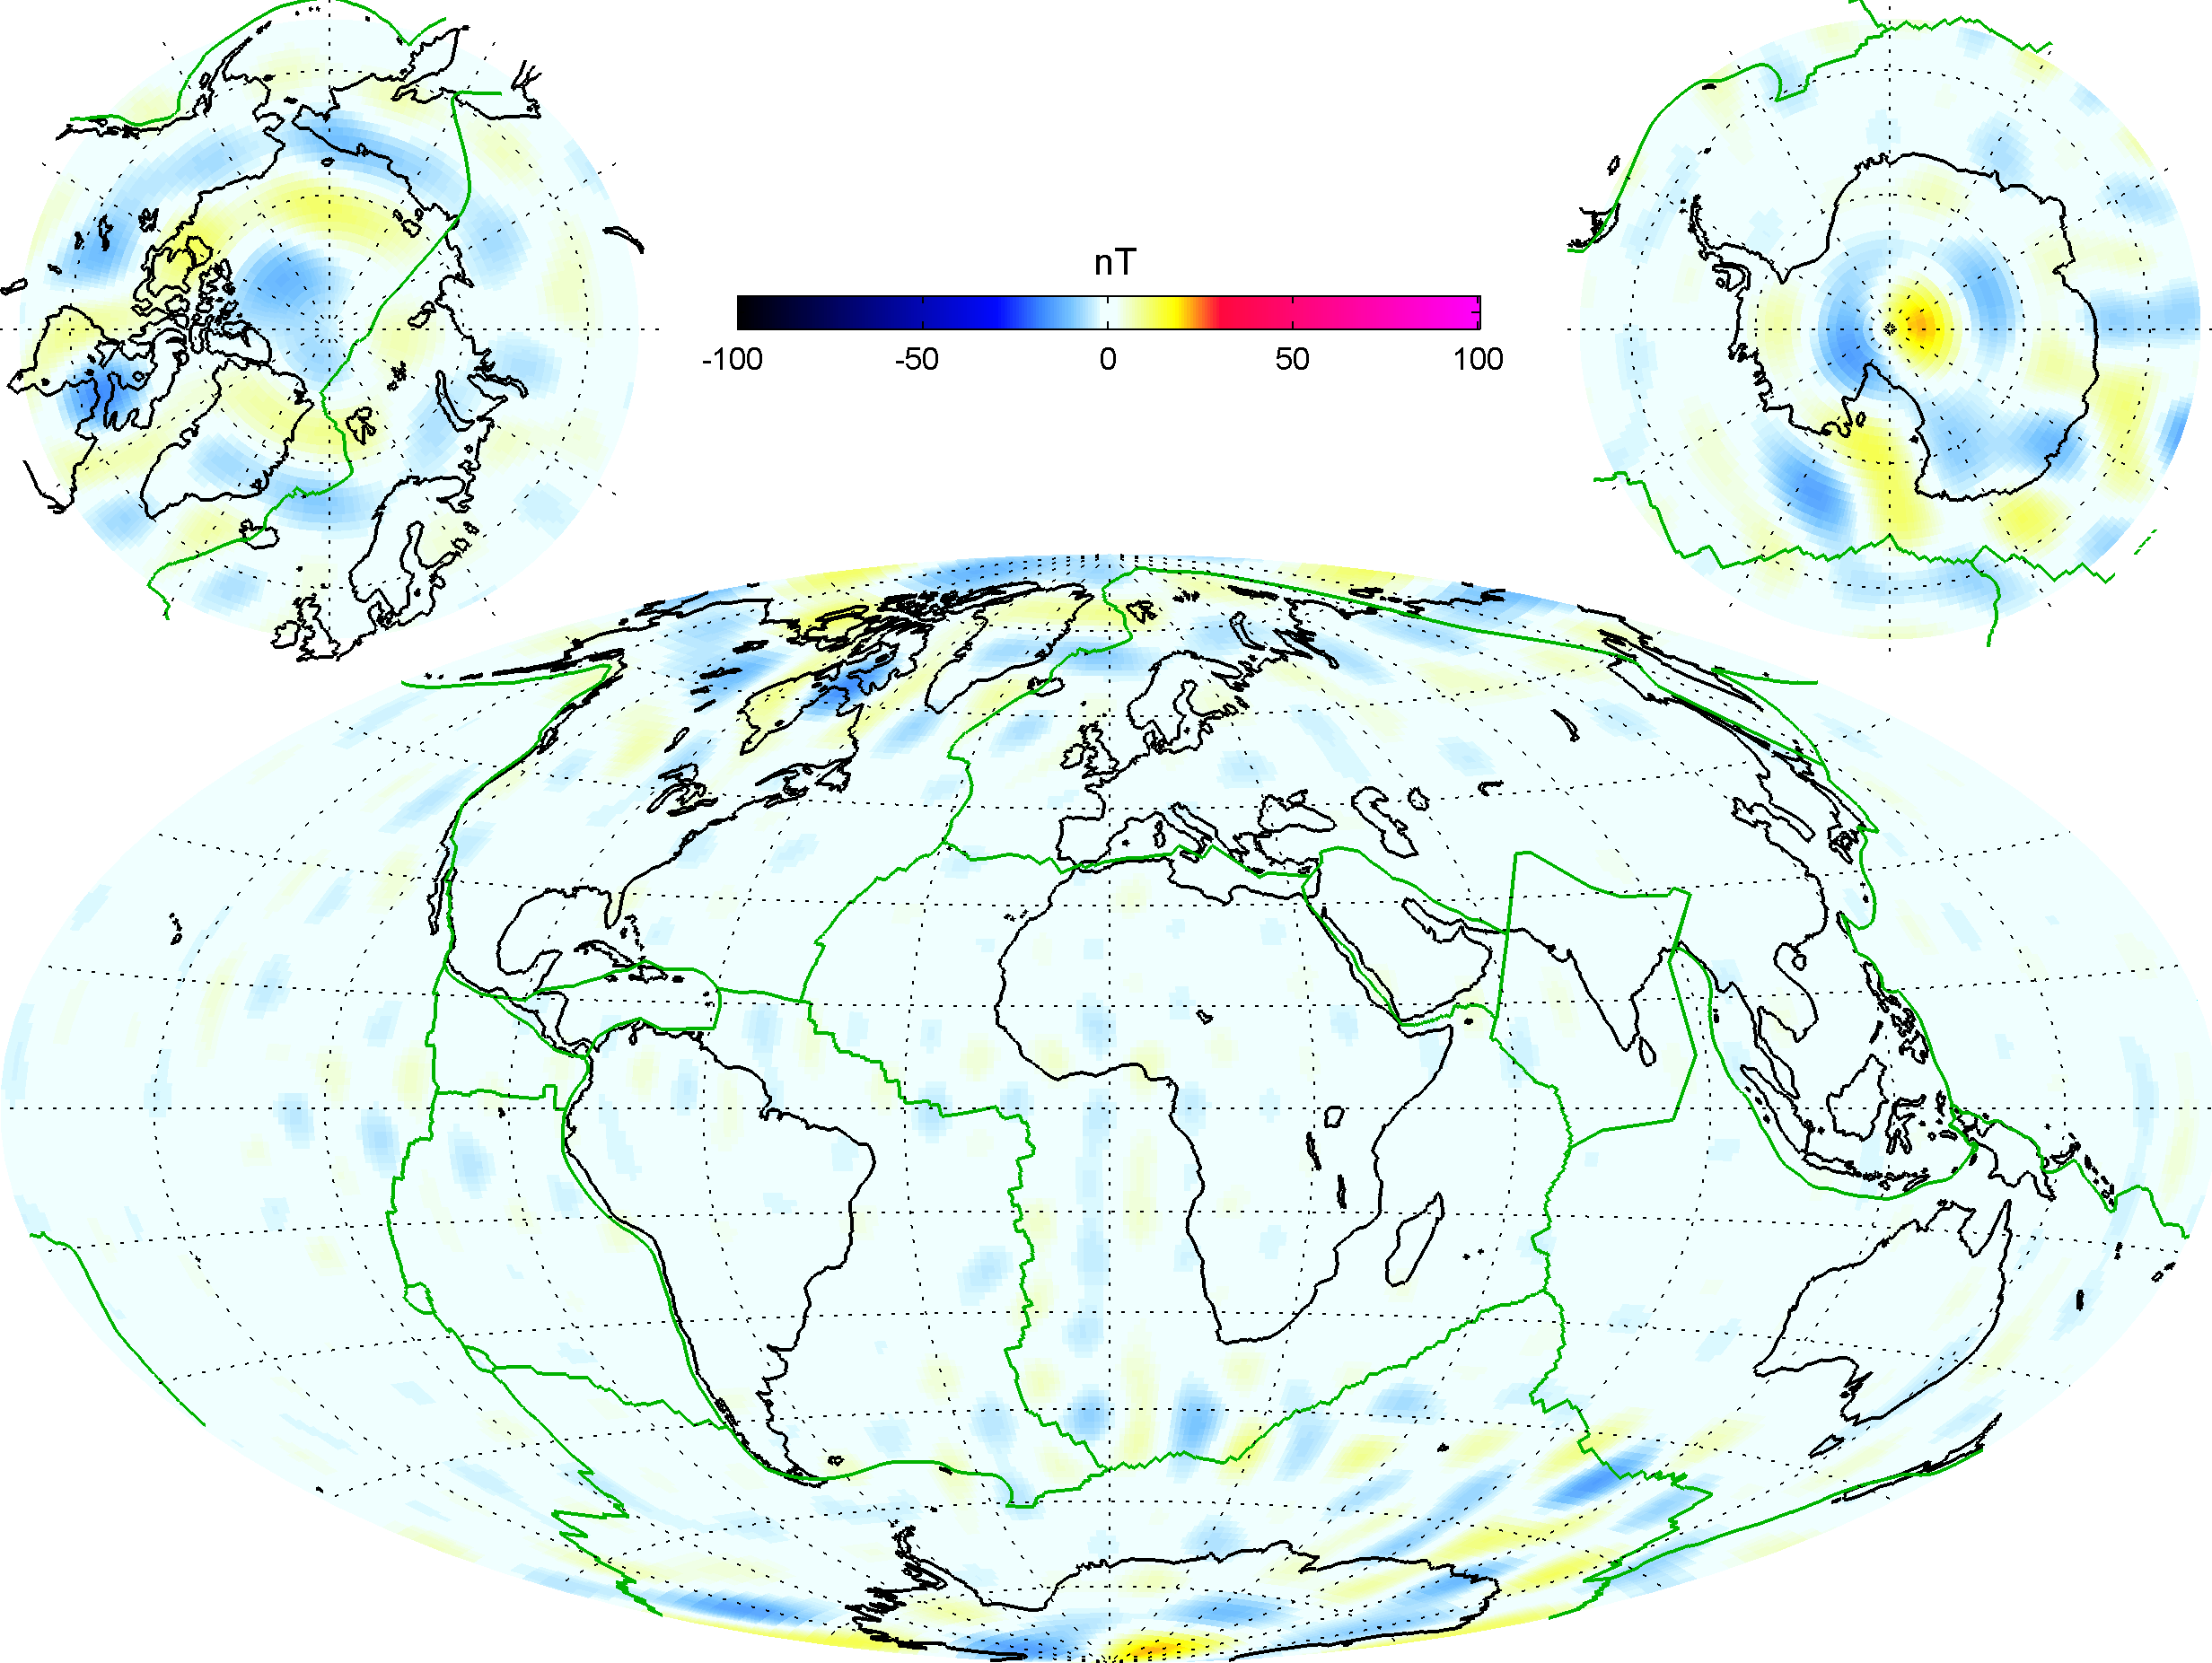
Difference in B_{r} wrt CHAOS-4
Crustal Field (n=15-30)
Good agreement of Swarm_04c and CHAOS-4

Slide 22
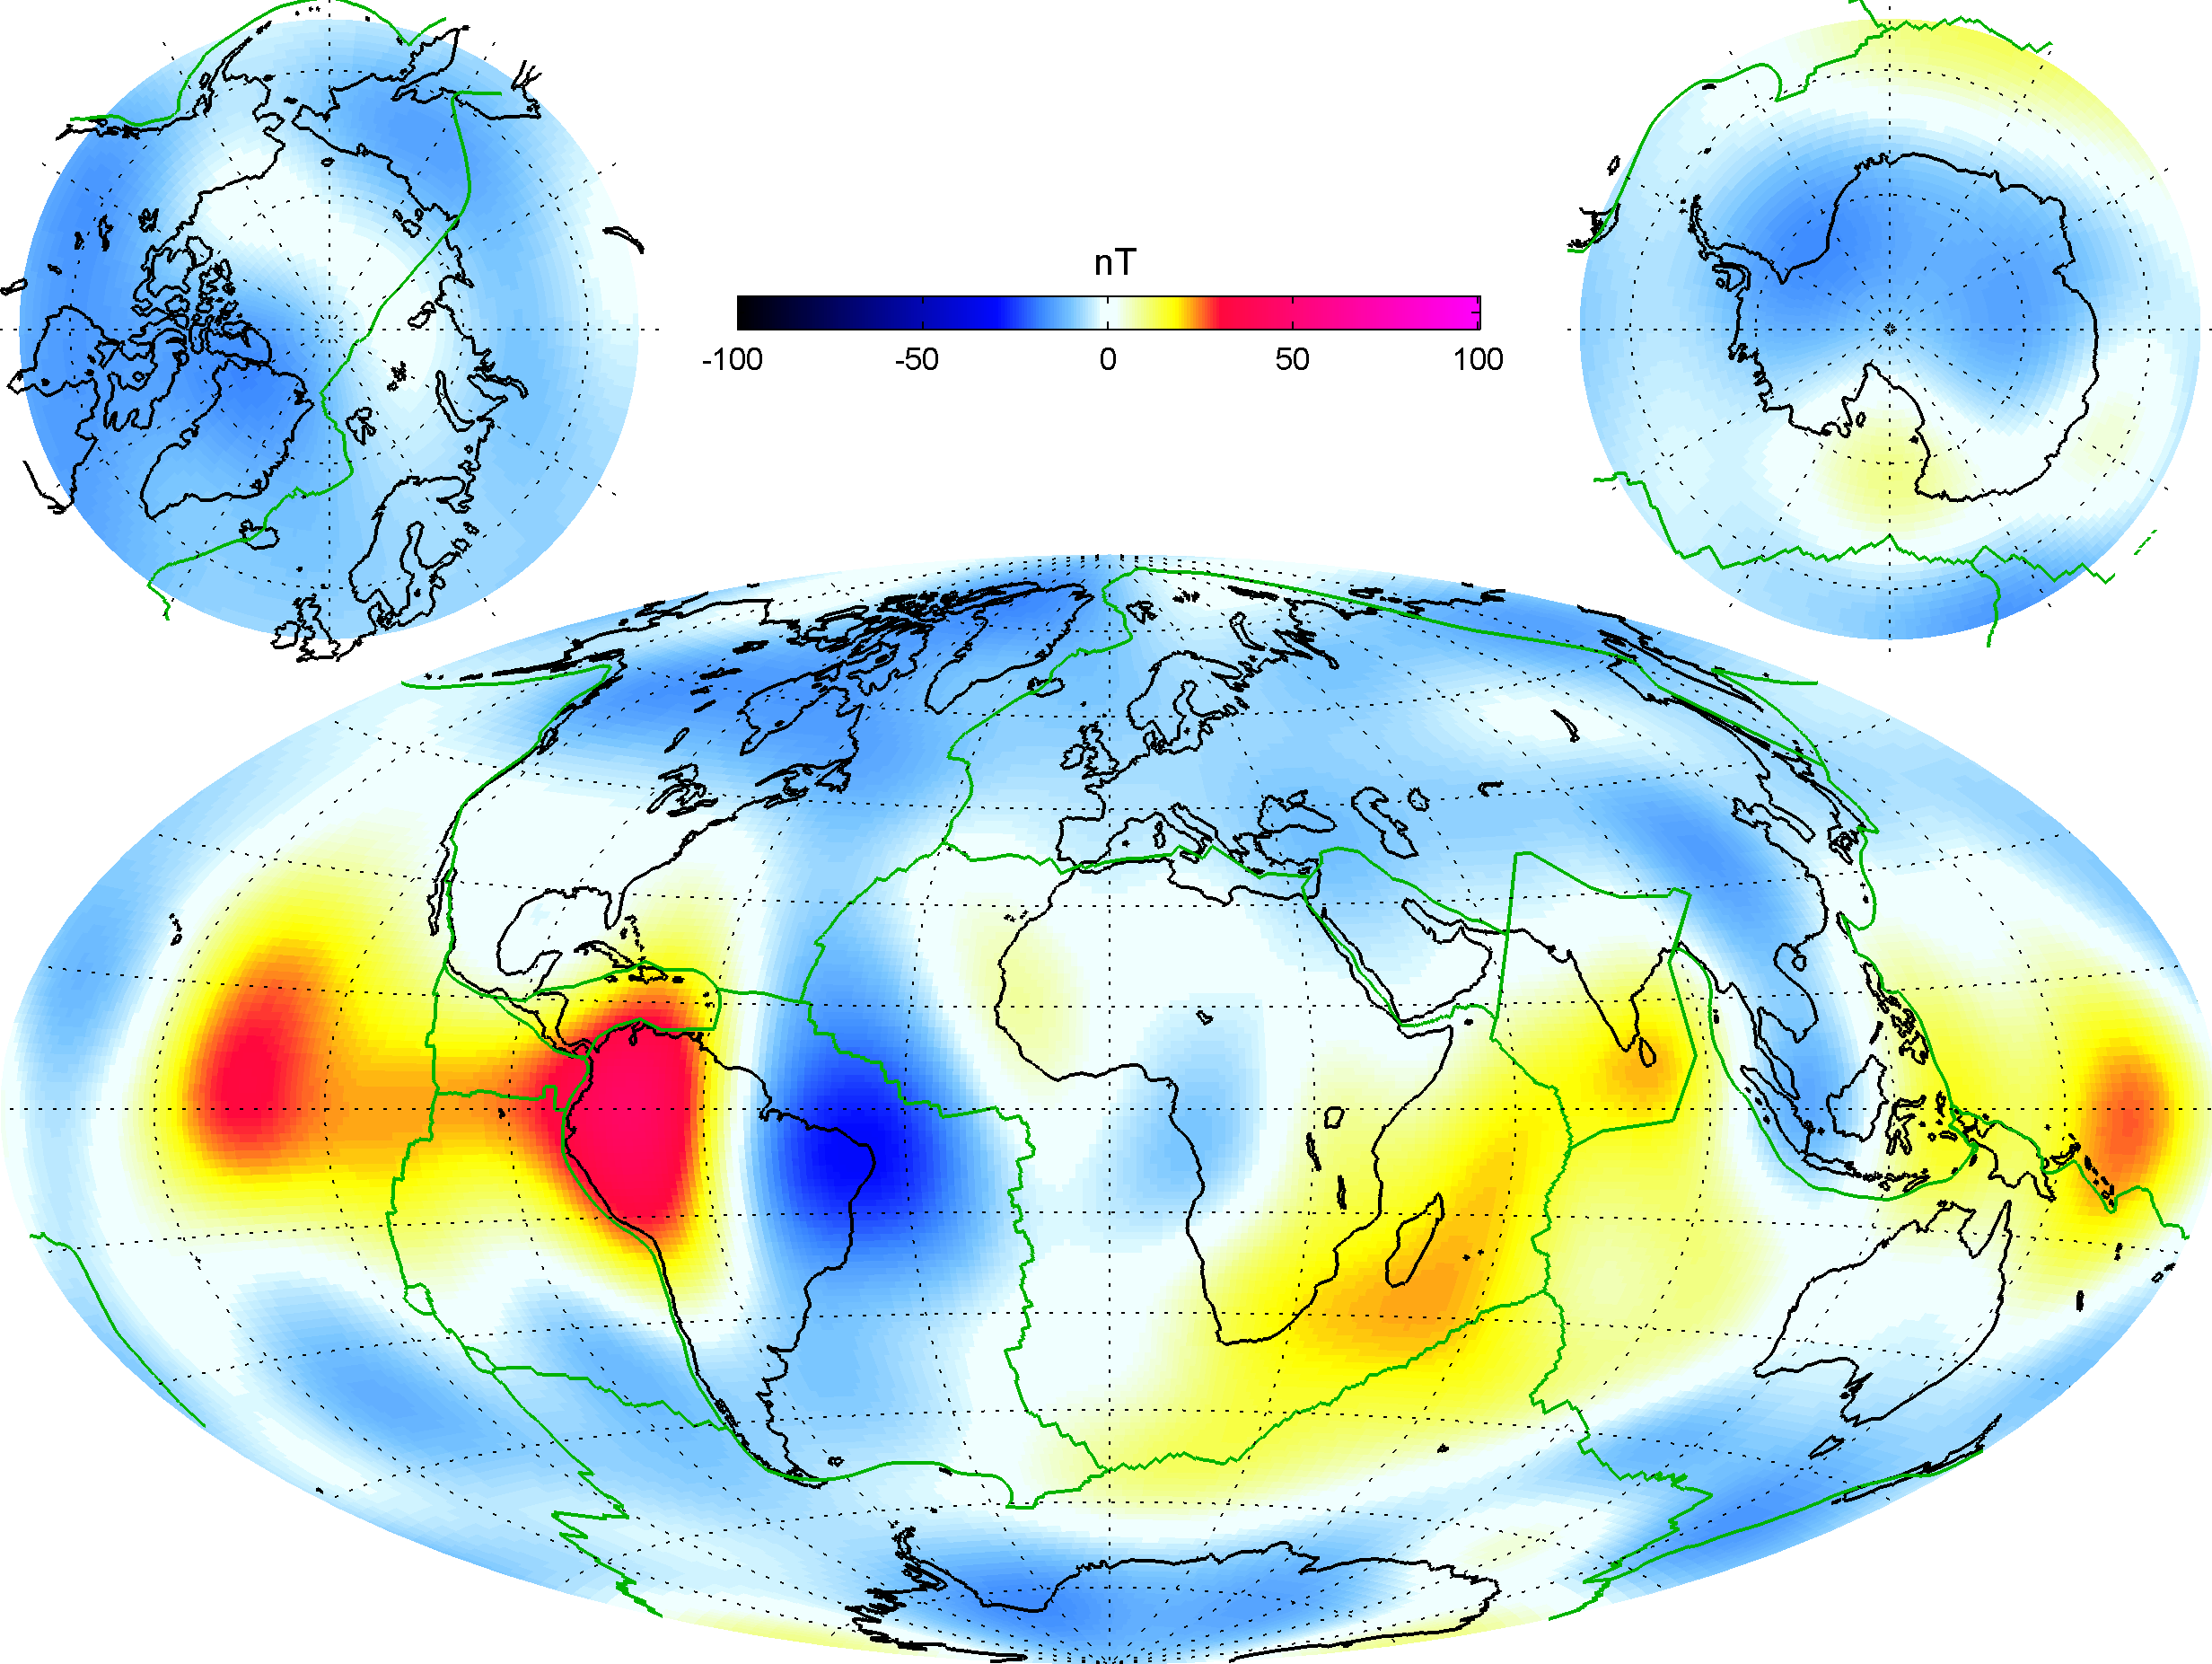
Difference in B_{r} wrt CHAOS-4
Core Field (n=1-14)
Extrapolation error of CHAOS-4
(latest vector data: Sept 2010, latest scalar data: Jul 2013)

Slide 23
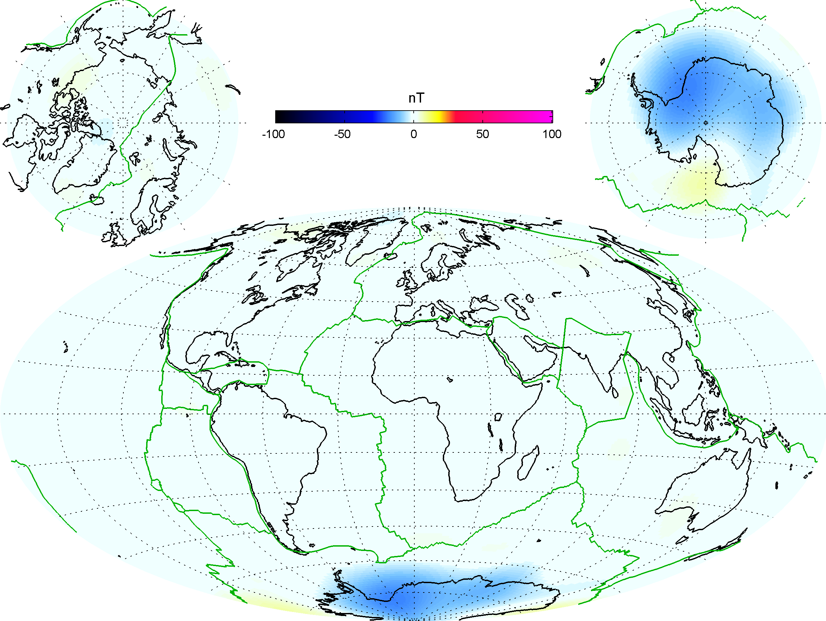
Difference in B_{r} wrt CHAOS-4plus
Core Field (n=1-14)
CHAOS-4plus:
Update of CHAOS-4, combining Ørsted, CHAMP, SAC-C and Swarm data

Slide 24
Model rms misfit
 | SW-A | SW-B | SW-C
F | 4.82 nT | 4.44 nT | 4.49 nT
B_{r} | 3.15 nT | 2.16 nT | 2.31 nT
B_{θ} | 4.21 nT | 3.51 nT | 3.60 nT
B_{φ} | 2.83 nT | 2.70 nT | 2.67 nT
Swarm-04c
Swarm-only model
 | SW-A | SW-B | SW-C | CHAMP | Ørsted
F | 4.46 nT | 4.37 nT | 4.41 nT | 4.84 nT | 3.38 nT
B_{r} | 1.97 nT | 2.39 nT | 2.58 nT | 2.80 nT | 4.45 nT
B_{θ} | 3.08 nT | 3.37 nT | 3.39 nT | 3.59 nT | 5.36 nT
B_{φ} | 2.85 nT | 2.87 nT | 2.83 nT | 2.76 nT | 5.06 nT
CHAOS-4plus
combined model
Model coefficients available at CHAOS-4 homepage
www.spacecenter.dk/files/magnetic-models/CHAOS-4/
More on CHAOS-4plus in Poster
“Towards CHAOS-5 - How can Swarm contribute?”
by Christopher C. Finlay et al

Slide 25
Conclusions
Very good Swarm magnetic data quality
  inter-satellite agreement in scalar intensity
  during quiet dark conditions is better than 5 ppm (0.2 nT)
CHAOS-4plus: Magnetic field model spanning 16 years of data
show excellent agreement of data from 6 different satellites
(Ørsted, CHAMP, SAC-C and 3 x Swarm)
First Level-2 products expected at end of 2014 …
… and already very soon for the CAT-2 products
We are waiting for more Swarm data!

