Slide 1
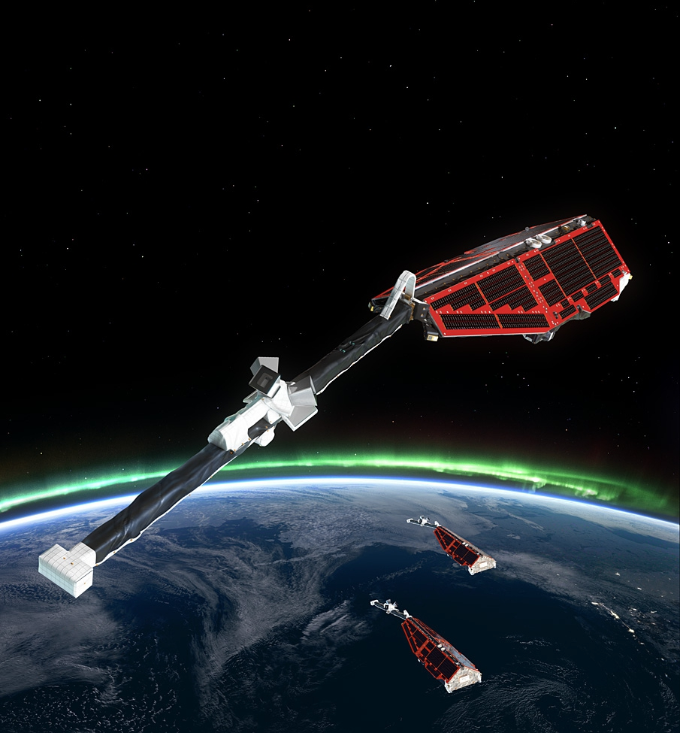
Swarm satellite constellation mission: From data to first scientific results
Claudia Stolle, Patrick Alken, Nils Olsen
and the Swarm DISC Team
Patrick Alken, Ciaran D Beggan, Stephan C. Buchert, Johnathan Burchill, Arnaud Chulliat,
Eelco Doornbos, Joao Teixeira da Encarnacao, Ludwig Grunwaldt, Brian Hamilton,
Rune Floberghagen, Eigil Friis-Christensen, Giuseppe Ottavianelli, Gauthier Hulot,
Jose van den IJssel, David J. Knudsen, Alexey Kuvshinov, Jean-Michel Leger, Vincent Lesur, Hermann Luehr, Susan Macmillan, Stefan Maus, Ingo Michaelis, Max Noja, Nils Olsen,
Poul Erik H Olsen, Jaeheung Park, Radek Peresty, Gernot Plank, Christoph Puethe, Jan Rauberg, Patricia Ritter, Martin Rother, Terence J Sabaka, Reyko Schachtschneider, Olivier Sirol,
Claudia Stolle, Erwan Thebault, Alan W P Thomson, Lars Toeffner-Clausen, Jakub Velımsky,
Pierre Vigneron, Pieter N Visser
Swarm Level 1 and Level 2 Data Products and Processing
Some Selected Science Results
  Models of the Earth’s magnetic field including Swarm data
  Currents in the ionosphere (Hermann, Kalle, Knudsen)
  Multi-Point observation of Equatorial plasma irregularities and its effect on space weather

Slide 2
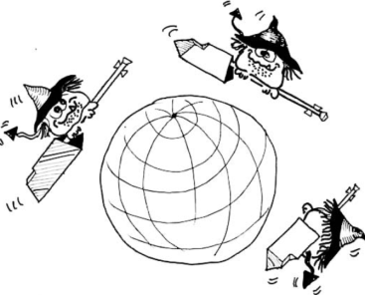
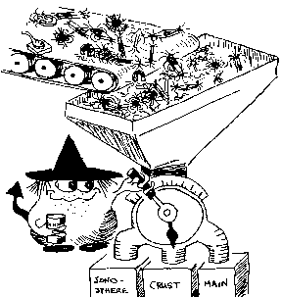
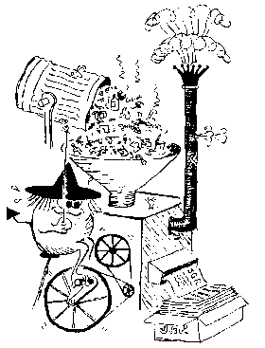
Swarm Data Processing Hierarchy
SW-A
SW-A
SW-A
L0
L1b Processor
(Operational Processor)
L1b Processor
(Prototype Processor)
L1b
L2 Processor
SCARF
L2 Processing Facility
L2
scientific users

Slide 3
Level-1b Data Products
Magnetic Products
Plasma Products
Ephemeris Products
x = A, B or C
Type | Descriptive Name
MAGx_LR | Low Rate magnetic data
MAGx_HR | High Rate magnetic data
MAGx_CA | Magnetic calibration data
ASMxAUX | Magnetic stray fields at ASM sensor
VFMxAUX | Magnetic stray fields at VFM sensor
Type | Descriptive Name
EFIx_PL | Plasma data
LP_x_CA | Langmuir probe calibration data
TIIx_CA | Thermal Ion Imager calibration data
Type | Descriptive Name
GPSx_RO | RINEX Observations
GPSx_RN | RINEX Navigation data
GPSxNAV | Navigational Solution
MODx_SC | Medium-Precision Orbit Determination
STRxATT | Attitude
ACCx_PR | Non-gravitational Accelerations

Slide 4
Magnetic Level-1b Data Product MAGx_LR
1 Hz magnetic field observations: time, position, F, B_{NEC} and B_{VFM}
Element | Contents | Frame |  | Units
Timestamp | Time of observation | - | CDF_EPOCH
SyncStatus | Time reference information | - | -
Latitude | Latitude of observation | ITRF | degree
Longitude | Longitude of observation | ITRF | degree
Radius | Radius of observation | ITRF | m
F | Magnetic field intensity | - | nT
dF_AOCS | Magnetic stray field correction intensity related to attitude control magneto-torquers | - | nT
dF_other | Magnetic stray field correction intensity of all other sources | - | nT
F_error | Error estimate on magnetic field intensity | - | nT
B_VFM | Magnetic field vector | VFM | nT
B_NEC | Magnetic field vector | NEC | nT
dB_AOCS | Magnetic stray field correction vector related to attitude control magneto-torquers | VFM | nT
dB_other | Magnetic stray field correction vector of all other sources | VFM | nT
B_error | Error estimates on magnetic field vector (B_VFM) | VFM | nT
q_NEC_CRF | Rotation from NEC frame to STR Common Reference Frame (CRF), quaternion | NEC ← CRF | -
Att_error | Error estimate on attitude information | - | degree/10³
Flags_F | Flags characterizing the magnetic field intensity | - | -
Flags_B | Flags characterizing the magnetic field vector measurement B_VFM and B_NEC | - | -
Flags_q | Flags characterizing the attitude information | - | -
Flags_Platform | Flags characterizing the spacecraft platform information | - | -
ASM_Freq_Dev | ASM reference frequency calibration data deviation – for ASM stability assessment | - | Hz^{½}

Slide 5
Level1b Data: Magnetic time series
CHAOS-6 model subtracted

Slide 6
Level1b Data: Magnetic time series
CHAOS-6 model subtracted

Slide 7
Level1b Data: EFI-Data

Slide 8
Swarm Level-2 Data Processing
Swarm SCARF (Satellite Constellation Application and Research Facility)
Consortium of 10 Partners from Europe, US and Canada
(DTU, GFZ, IPGP, ETH, DEOS, BGS, NASA/GSFC, CIRES, CUP and UoC)
ESA funded Level-2 Processing Facility
Cat-1 chains with “scientists in the loop” (operated by SCARF)
advanced geomagnetic models, mantle conductivity …
Cat-2 chains with automatic processing (operated by ESRIN)
products describing Earth environment, Near Real-Time capability
10 European institutes
3 oversea partners

Slide 9
Level2 Data:
Core field
Lithospheric field
Ionospheric field
Mantle Conductivity
Neutral density
(Precise orbits)
Cat-2

Slide 10
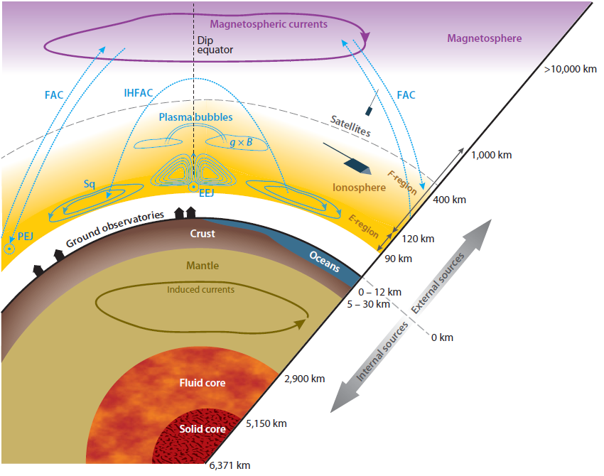
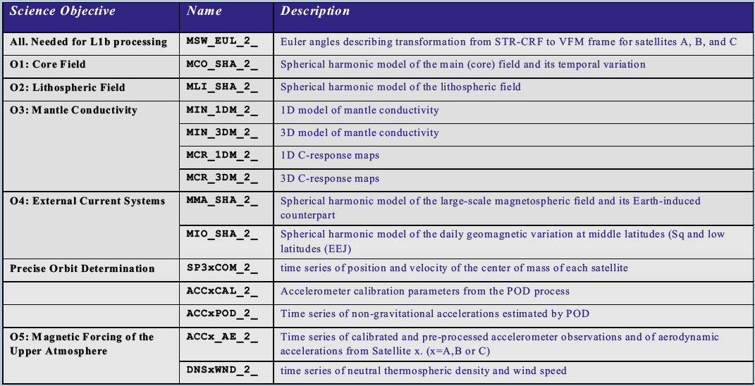
Swarm Level-2 Data Products

Slide 11
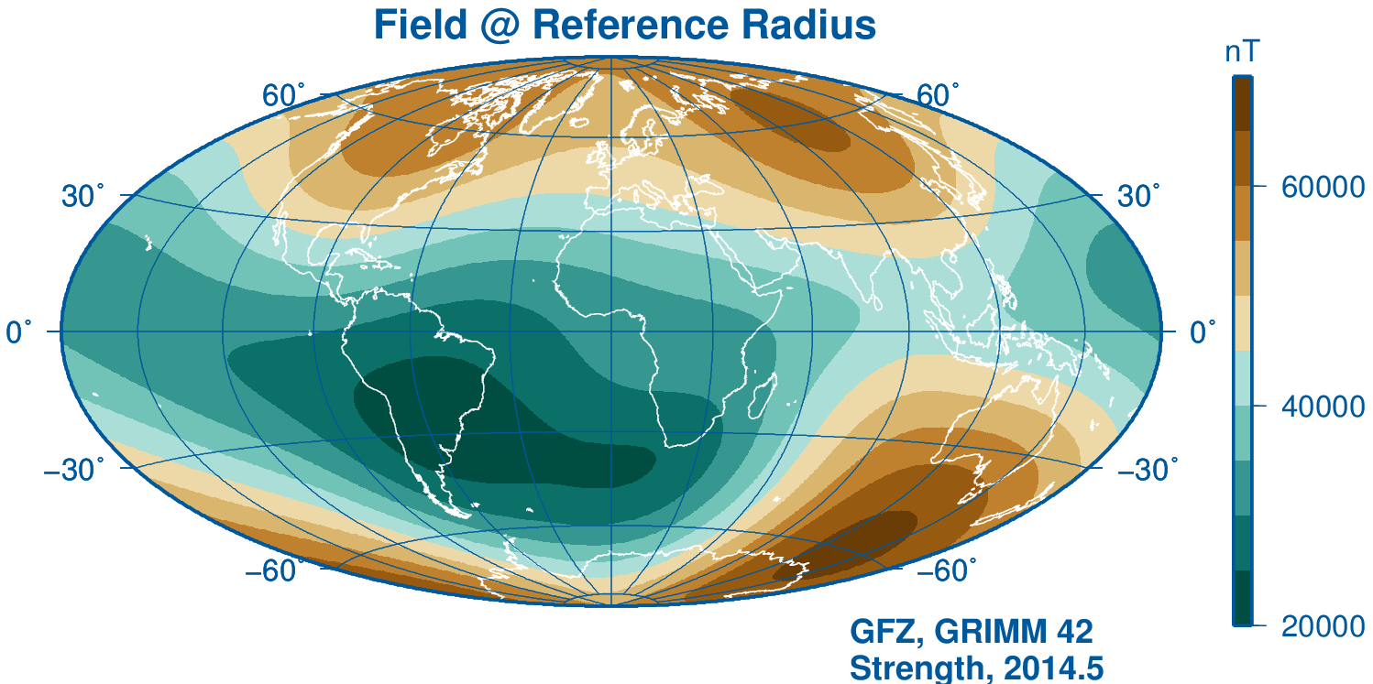
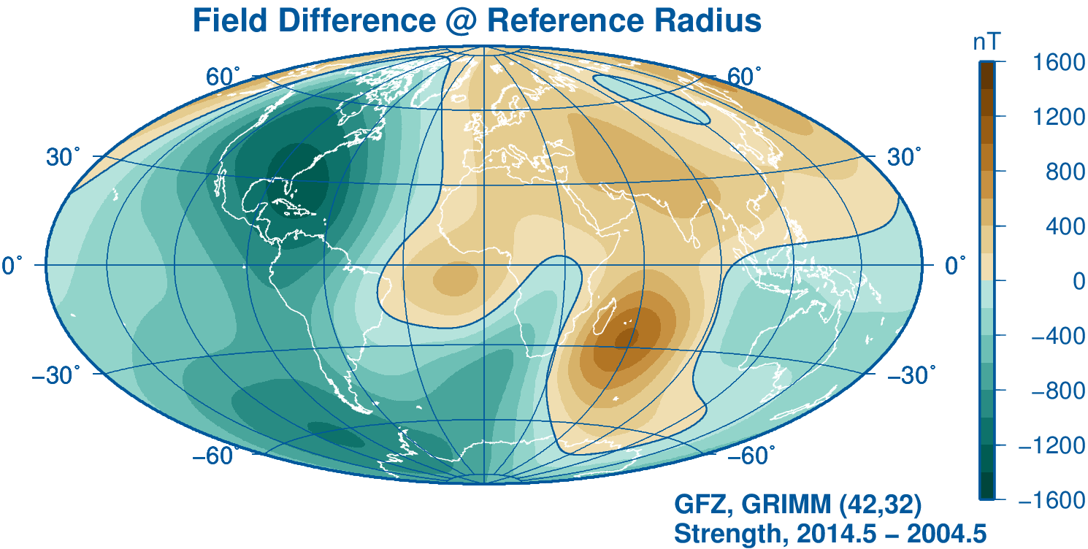
Level2 Data: Magnetic Field Models

Slide 12
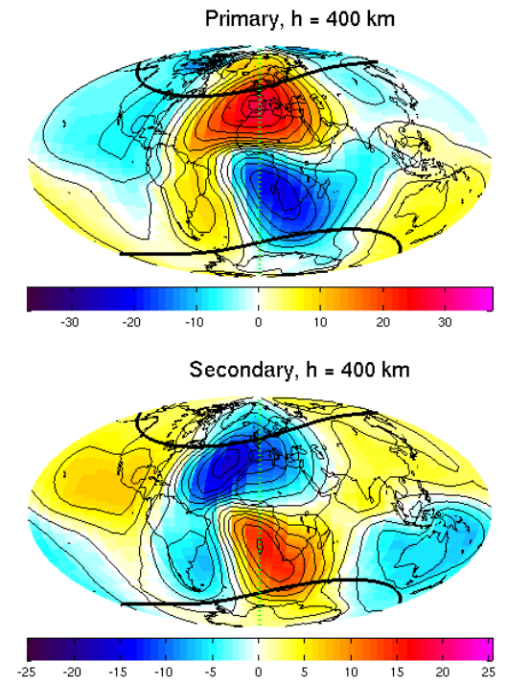
Swarm Level-2 Data Products
Ionospheric Daily Variations (”Sq”)
Product MIO_SHA_2_
Magnetic Field due to primary (ionospheric) and secondary (Earth-induced) currents
”Dedicated Ionospheric Chain”
nT
nT

Slide 13
Swarm Level-2 Data Products

Slide 14
Swarm Level-2 Data Products

Slide 15
Neutral Densities

Slide 16
Swarm Level-2 Data Products

Slide 17
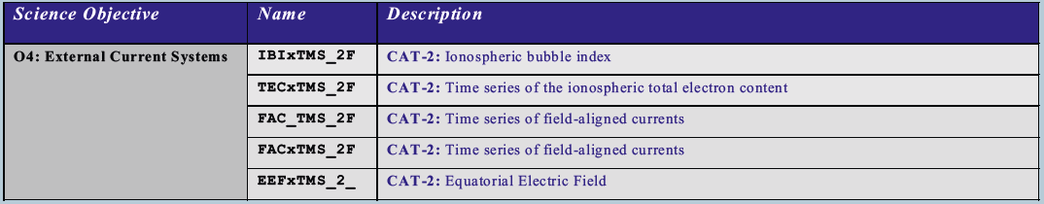
Level-2 Data Products
Cat-2: Algorithms leading to Level-2 products with minimum delay, e.g. for space weather applications. Near real-time capability. Provided in CDF. Algorithms designed by SCARF, data processed by PDGS

Slide 18
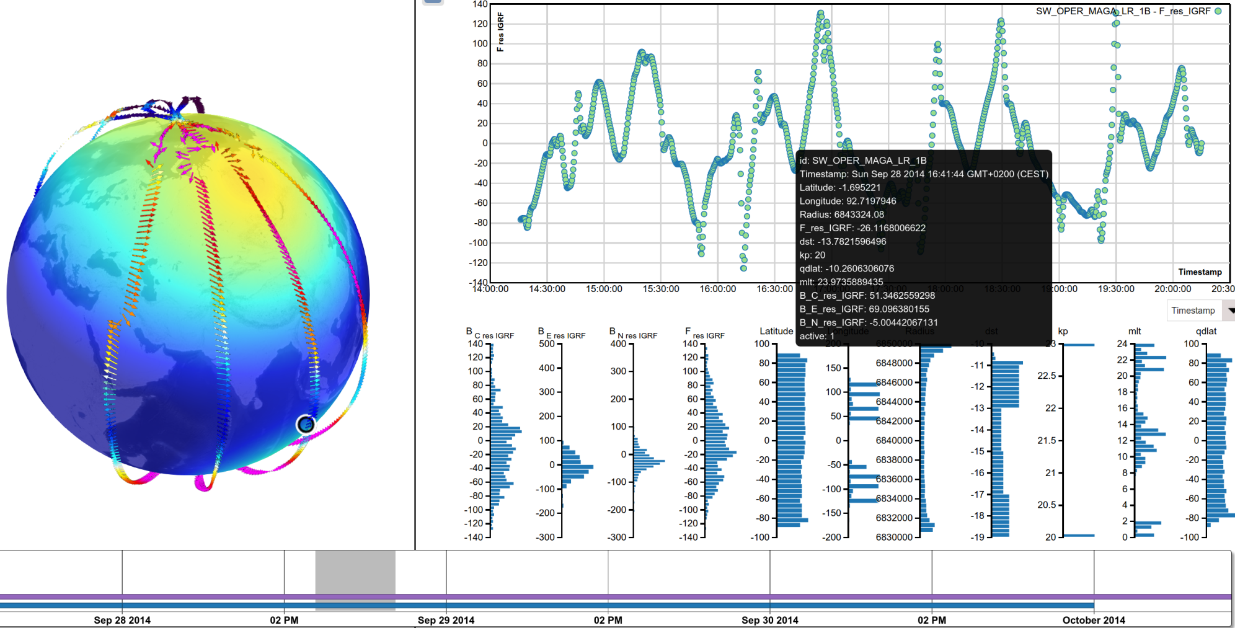
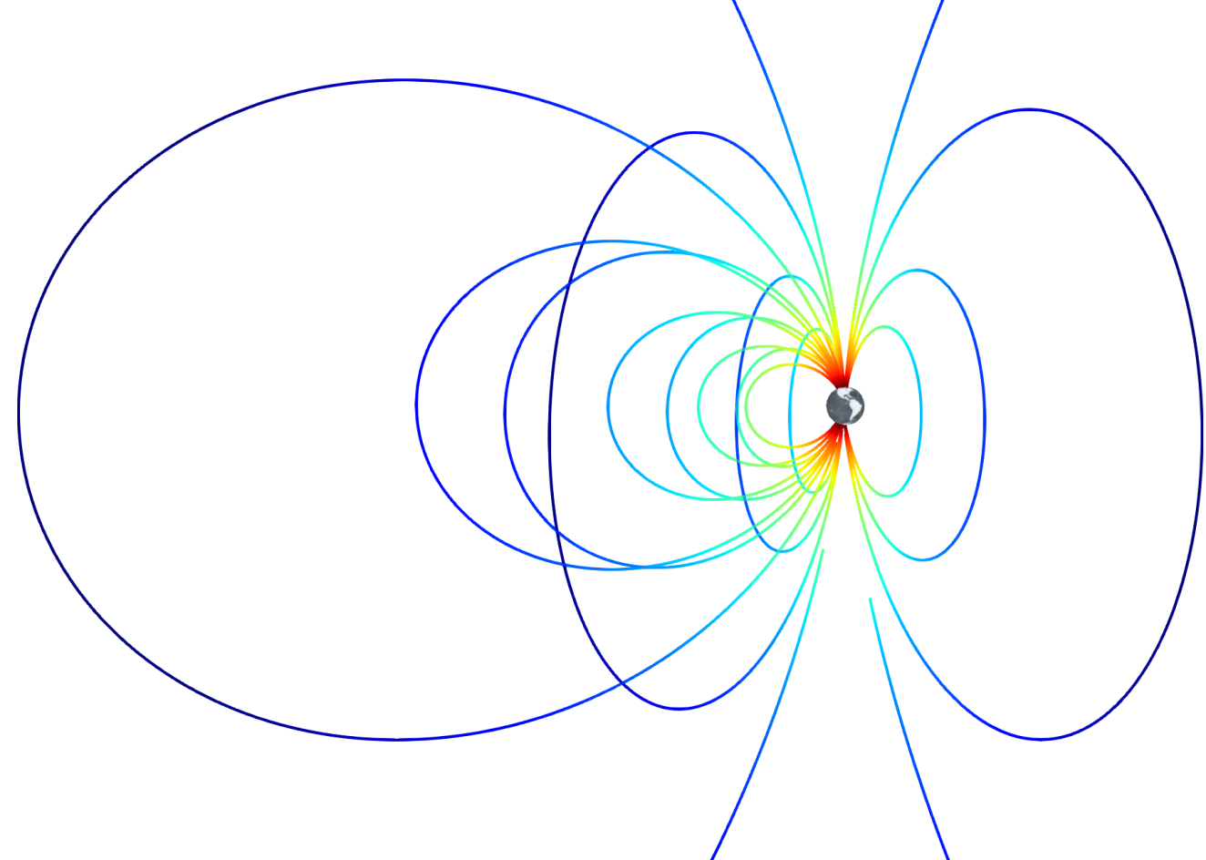
Visualisation of Data and Models
VIRES Project

Slide 19
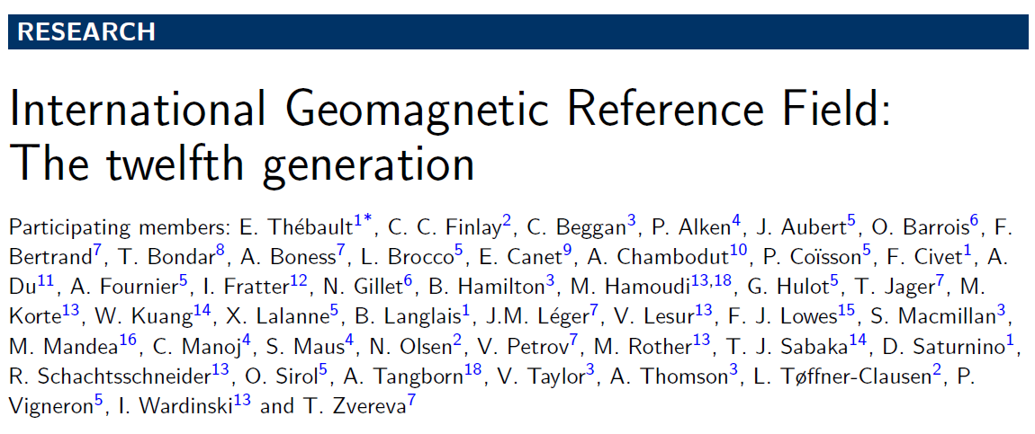
IGRF
International Geomagnetic Reference Field
Determined every 5 years by IAGA working group V-MOD
as an international collaborative effort
Latest revision, IGRF-12, is valid between 2015 – 2020
Swarm was main data source for IGRF-12

Slide 20
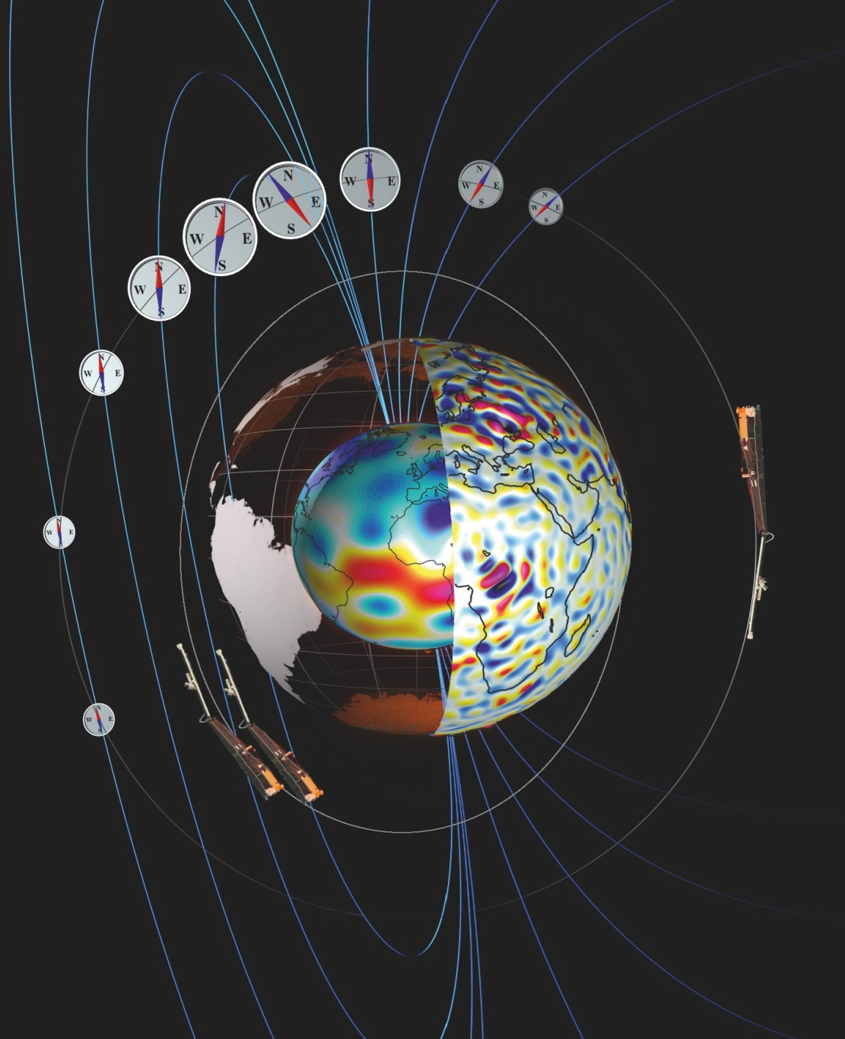
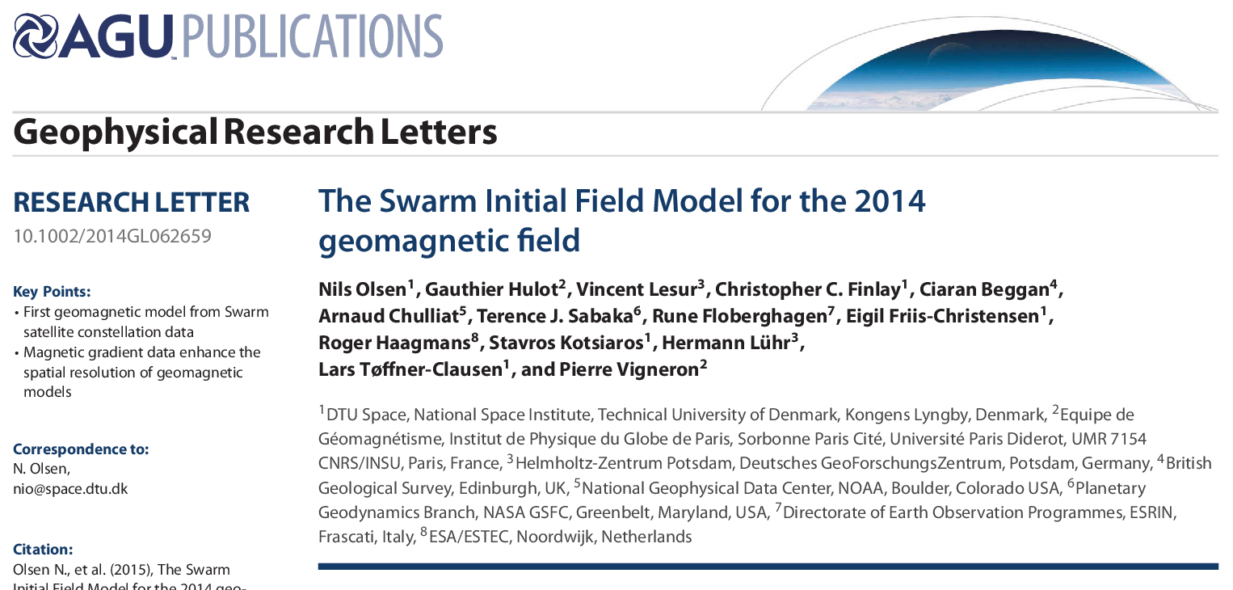
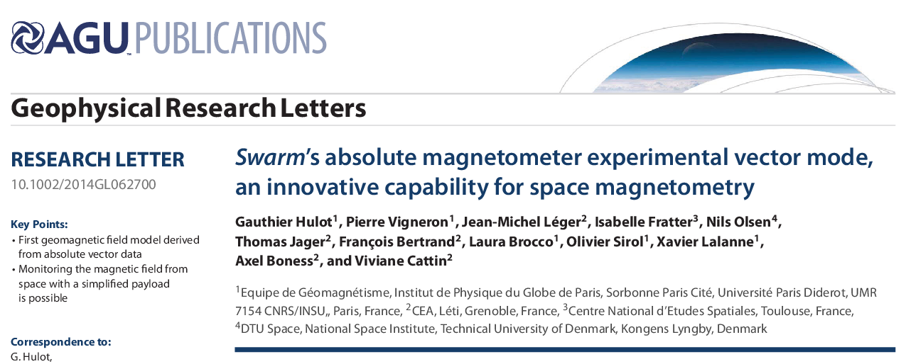
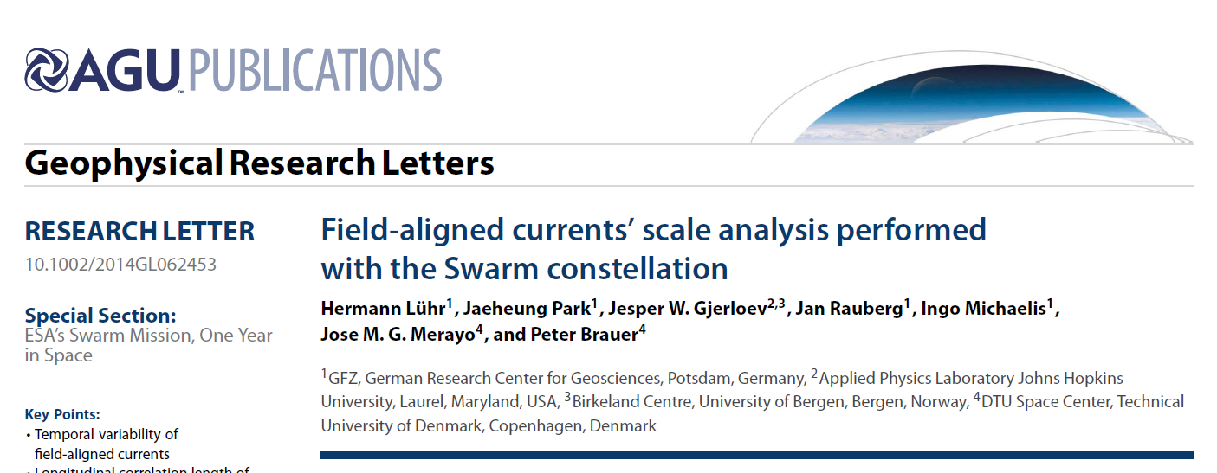
Special Section of Geophys. Res. Lett.:
ESA's Swarm Mission, One Year in Space
16 papers published
Majority of papers on external field investigations
(mainly event studies)

Slide 21
Three Selected Science Results …
Plasma depletion seen in different parameters
Multi-Point observation of Equatorial plasma irregularities
SIFM: Swarm Initial Field Model

Slide 22
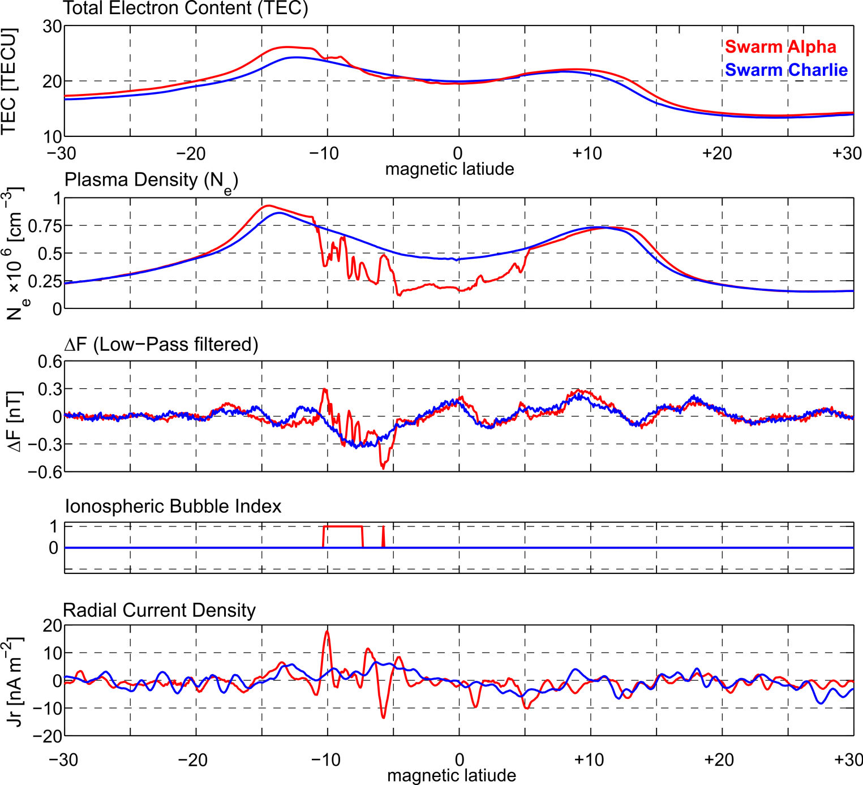
Plasma depletion seen in different parameters
11 October 2014, 16:06 UT, 22 LT 85 deg E longitude
Swarm Data
TECxTMS_2F
EFIx_PL_1B
MAGx_LR_1B
IBIxTMS_2F
FACxTMS_2F

Slide 23
Plasma depletion seen in different parameters
11 October 2014, 16:06 UT, 22 LT 85 deg E longitude
Swarm Data
TECxTMS_2F
EFIx_PL_1B
MAGx_LR_1B
IBIxTMS_2F
FACxTMS_2F

Slide 24
Plasma depletion seen in different parameters
11 October 2014, 16:06 UT, 22 LT 85 deg E longitude
Swarm Data
TECxTMS_2F
EFIx_PL_1B
MAGx_LR_1B
IBIxTMS_2F
FACxTMS_2F

Slide 25
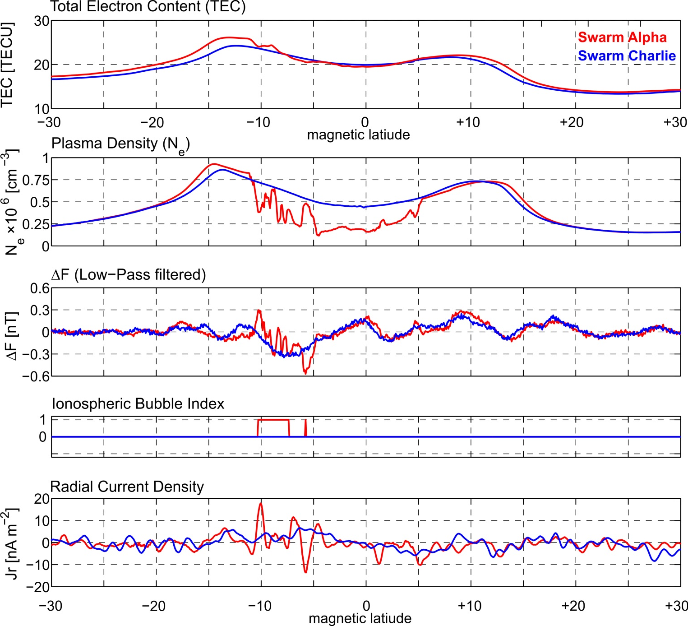
Plasma depletion seen in different parameters
11 October 2014, 16:06 UT, 22 LT 85 deg E longitude
Swarm Data
TECxTMS_2F
EFIx_PL_1B
MAGx_LR_1B
IBIxTMS_2F
FACxTMS_2F

Slide 26
Plasma depletion seen in different parameters
11 October 2014, 16:06 UT, 22 LT 85 deg E longitude
Swarm Data
TECxTMS_2F
EFIx_PL_1B
MAGx_LR_1B
IBIxTMS_2F
FACxTMS_2F

Slide 27
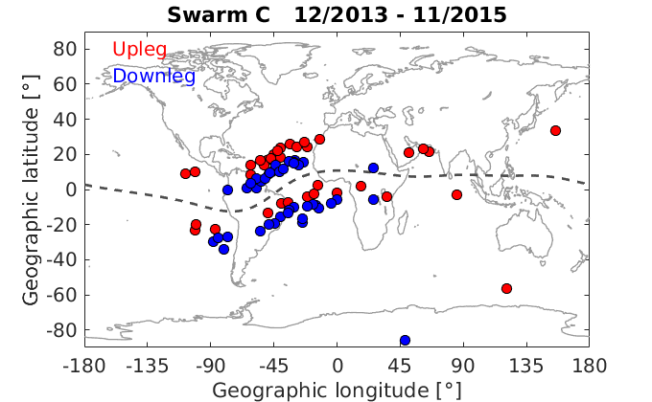
Plasma irregularities: GPS loss of signal

Slide 28
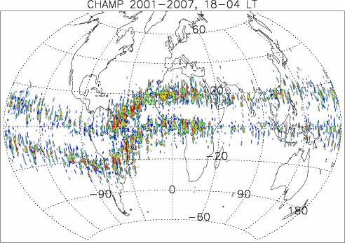
F region equatorial plasma irregularities

Slide 29
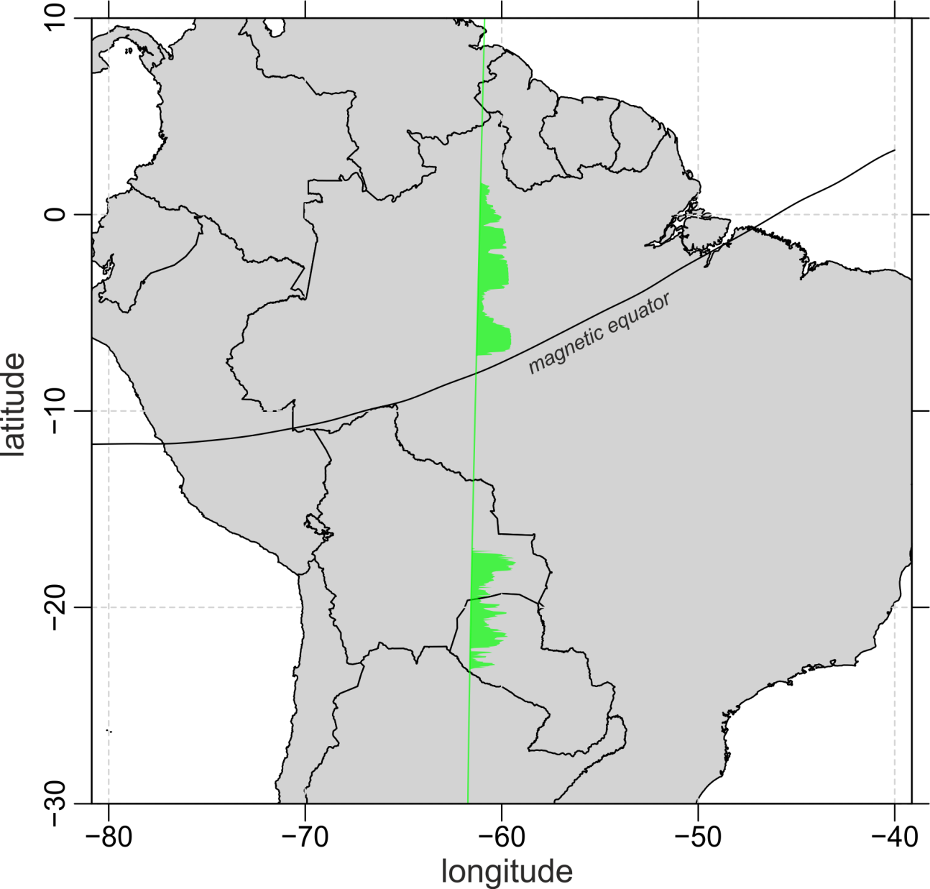
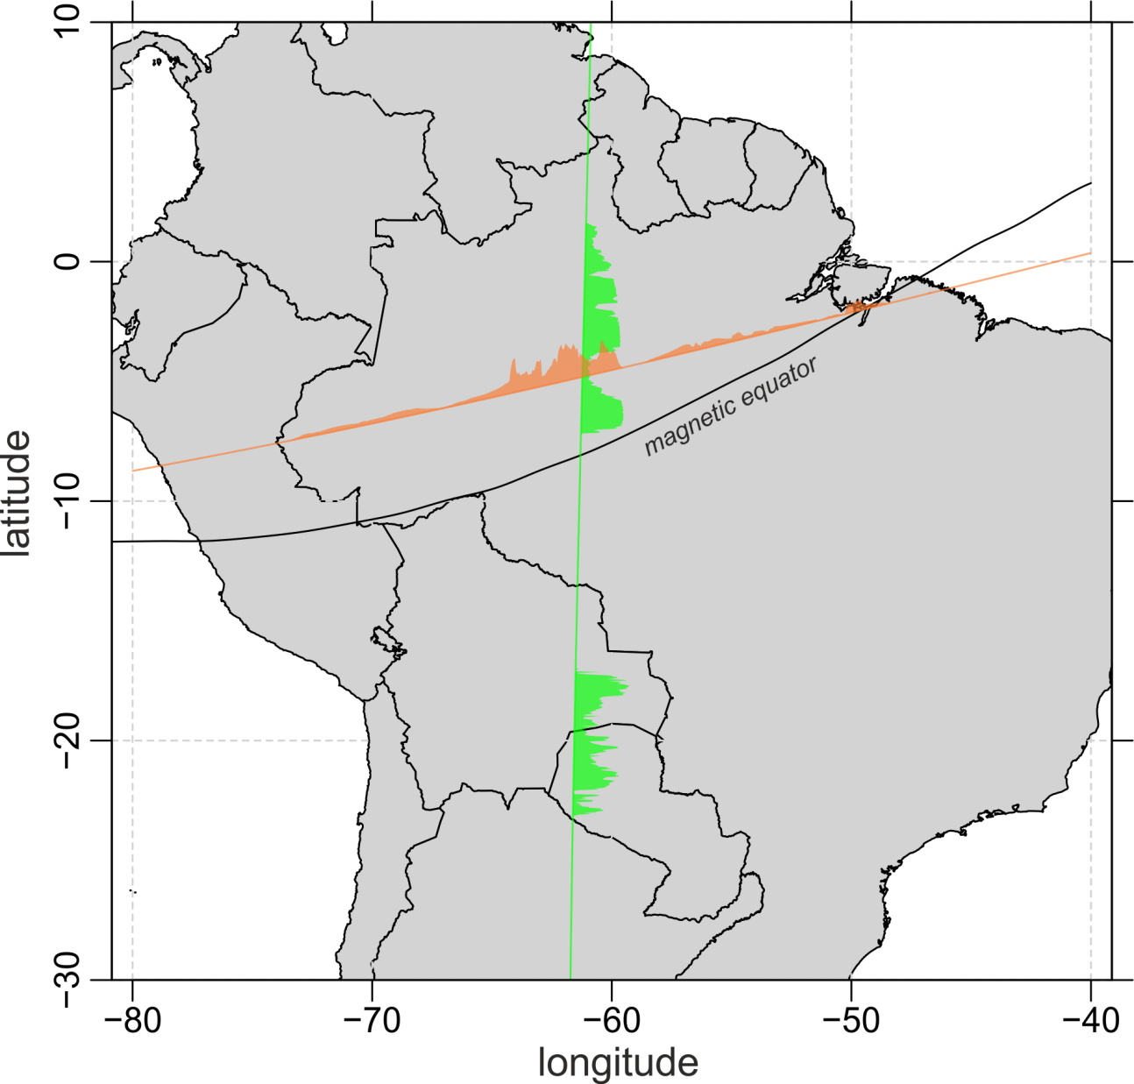
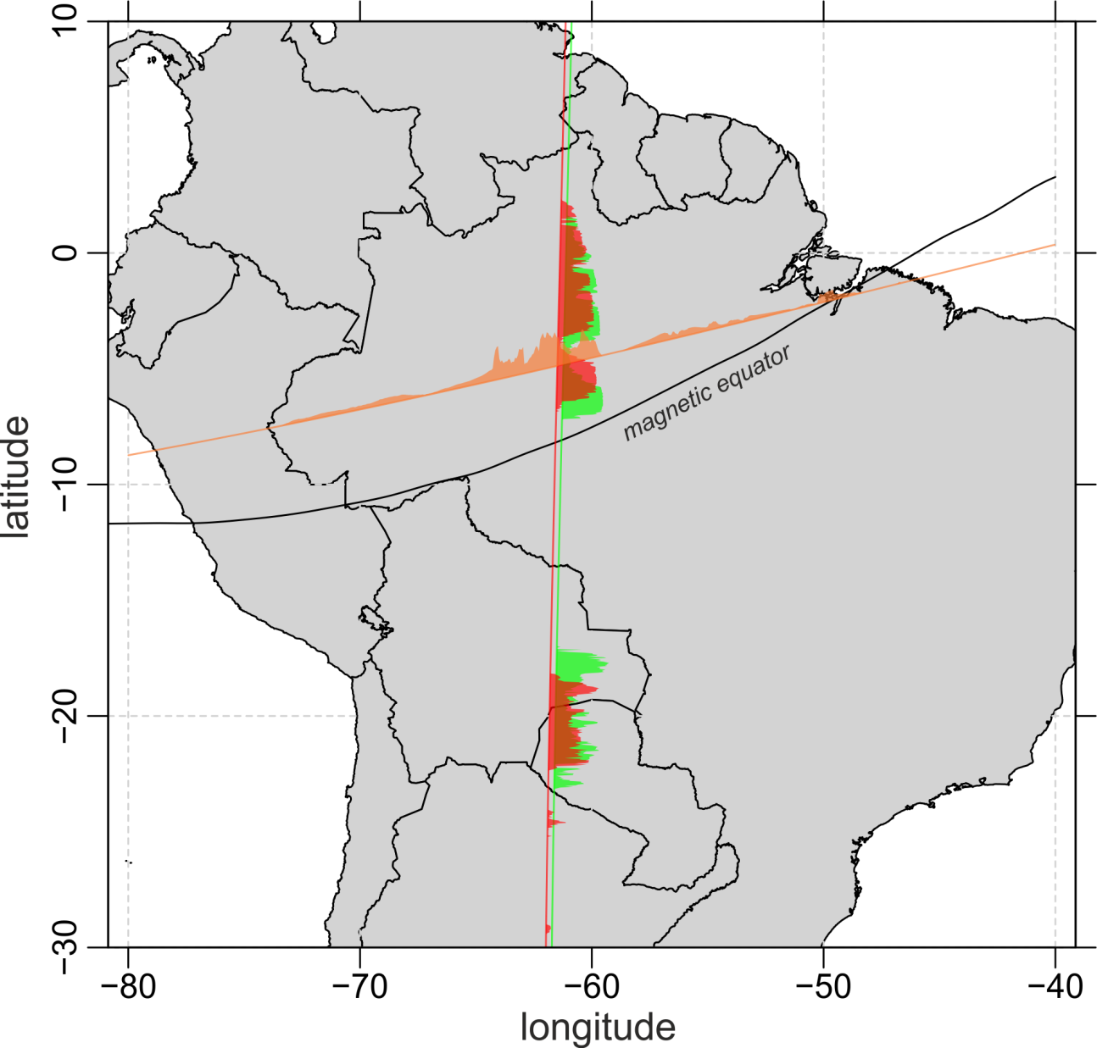
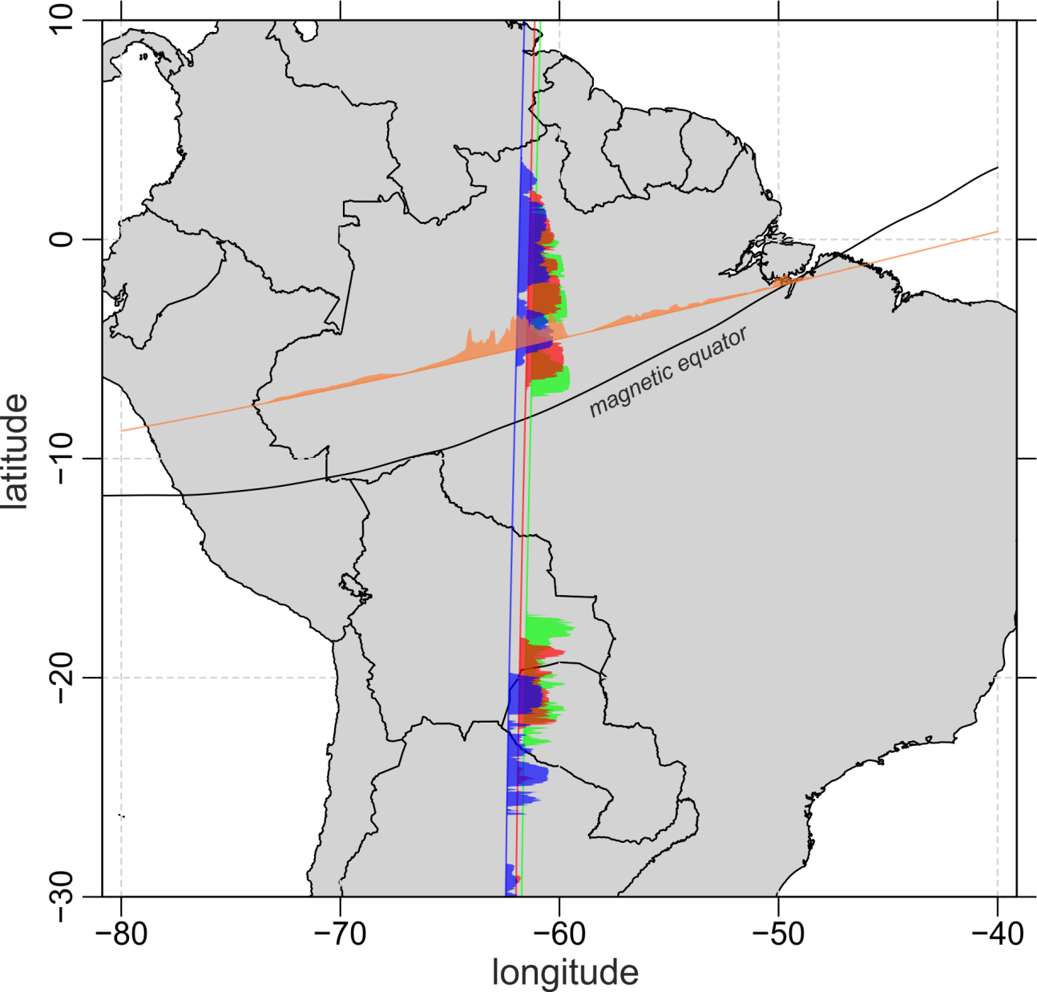

Multi-Point observation of
Equatorial plasma irregularities
1. Jan. 2014, 02:15 – 03:18 UT
Plasma density anomaly
C/NOFS
Swarm Bravo
Swarm Alpha
Swarm Charlie
Courtesy: C. Stolle / GFZ

Slide 30
Multi-Point observation of
Equatorial plasma irregularities
1. Jan. 2014, 02:15 – 03:18 UT
Plasma density anomaly
C/NOFS
Swarm Bravo
Swarm Alpha
Swarm Charlie
Courtesy: C. Stolle / GFZ
Notes:
C/NOFS 9 minutes before A
B to A: 1 min
A to C: 3 min
Rising speed 1.4 km/s

Slide 31
Conclusions
20 months of high quality magnetic Level-1b data,
including 14 months from constellation
Misfit statistics to derived geomagnetic models (e.g. SIFM+) confirm
Swarm as “the best ever survey of the Earth’s magnetic field”
First Level-2 data products released
Swarm capabilities cover research topics spanning from the Earth’s core to the magnetosphere, including “Space weather and climate”
Ideas for making a good mission even better
  Inter-satellite (“differential”) calibration
  New data products
  …
Special Issue in Earth, Planets Space on
“Swarm Science Results after two years in Space”
based on contributions to this session (more information to follow)

Slide 32
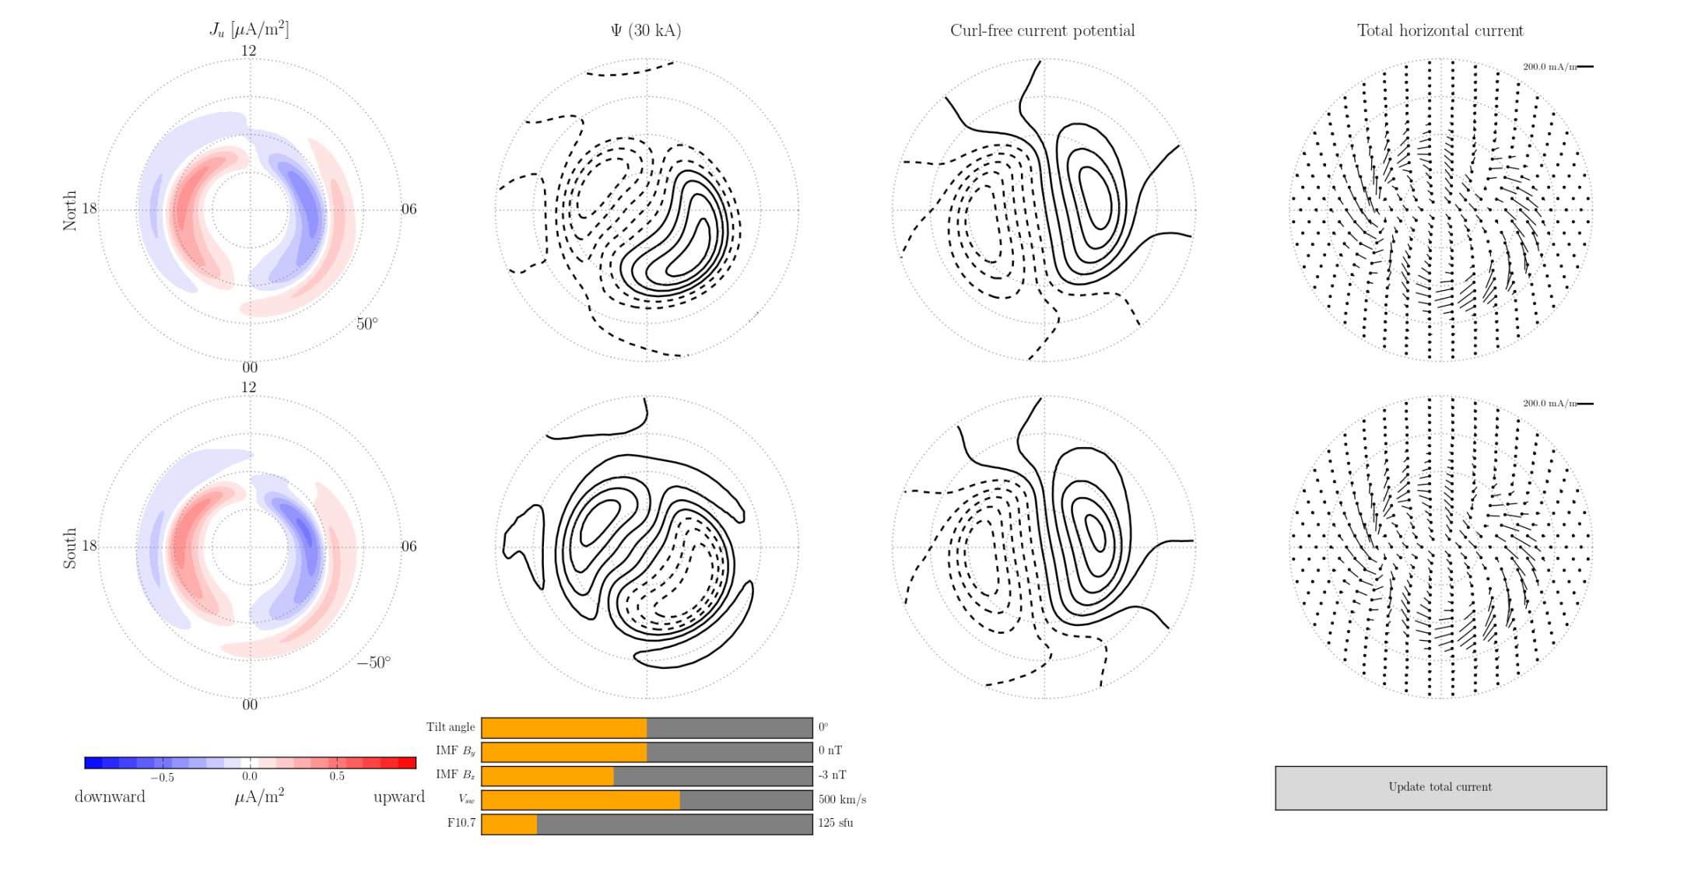
Ionospheric Currents
Climatological Model, from CHAMP and Swarm magnetic data parameterized by IMF B_{y}, B_{z}, v_{SW},, F_{10.7}, tilt angle (season)
First-ever determination of horizontal ionospheric and Field-aligned currents
No additional a-priori information (e.g. no information on ionospheric conductance, E-field, …)
J_{r} J_{equ}
South North
Courtesy K. M. Laundal
Birkeland Centre for Space Science
Univ. Bergen/N

