Slide 1
Final Review AGENDA:
AMOG Public Presentation
14:00-14:10 Welcome and introduction (ESA)
14:10-14:50 AMOG Final Presentation (DTU/NIO)
14:55-15:10 AMOG Technical Status Presentation (DTU/PLT)
15:10- 15:30 Q&A
15:30-15:50 Coffee
AMOG Contractual Meeting
15:50-17:00 Review and agreement of RID's.(Discussion)
      Address comments which have been raised on the documents if any and questions that will be asked live- some comments might result in updates
17:00-17:30 Conclude and Agree on way forward (Discussion)
      Review the schedule and anticipate on next steps until the contract closure
      Assess whether the FR is successful
      After that, discuss on possible follow-on
AOB

Slide 2
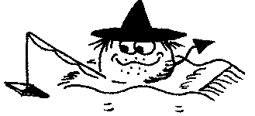
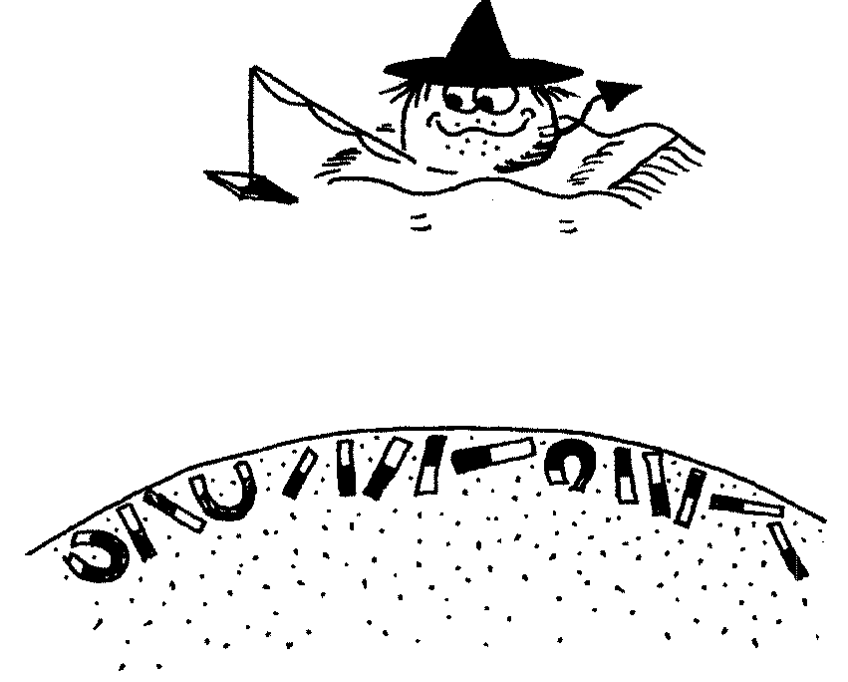
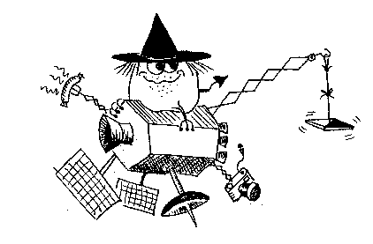



AMOG
Advanced MOnitoring of Geospace using Satellite Platform Magnetometers
Nils Olsen (DTU Space)

Slide 3
Study Goal and Study Logic
Most satellites carry magnetometer for navigational purposes as part of their AOCS
(Attitude and Orbit Control System)
The data of these AOCS (= “platform”) magnetometers have scientific value
but proper data calibration and processing is essential
The AMOG Project tackles this from two sides:
Sensor, platform, satellite design, programmatics:
Review of available AOCS magnetometers
Guideline for a magnetic cleanliness program
AMOG Questionnaire
Data: analysis of existing AOCS magnetometer data
Identification and selection of satellites providing AOCS magnetometer data
Analysis of test data sets
Operational processing for selected “good” satellites
In this presentation: “Data-driven approach”
“Why and How ?”

Slide 4
Thanks!
The generous support by the
CryoSat
Aeolus
EarthCARE
Biomass
AWS
SMOS
Proba-2
GRACE-FO
teams for spending their time and providing data is greatly acknowledged!
This study would not have been possible without your support.

Slide 5
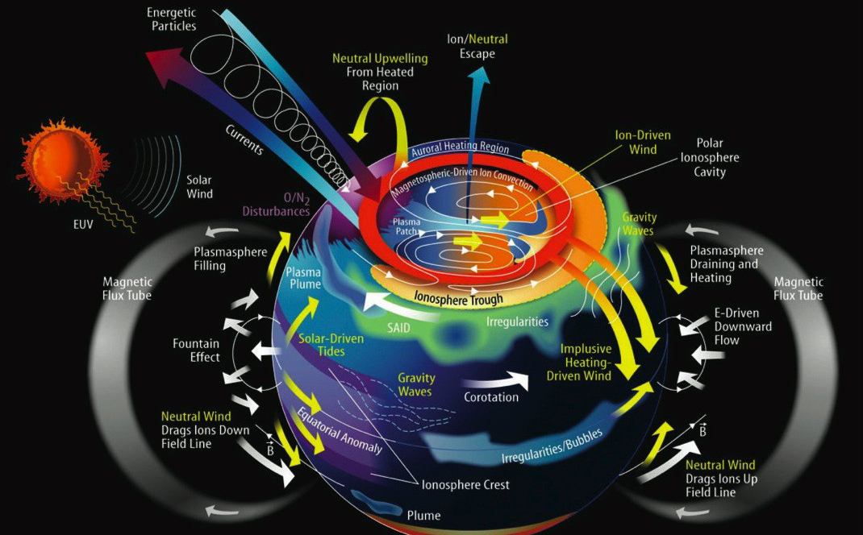
Why? Remote Sensing of Electric currents in Geospace by Magnetic Measurements
Magnetospheric Ring-current

Slide 6
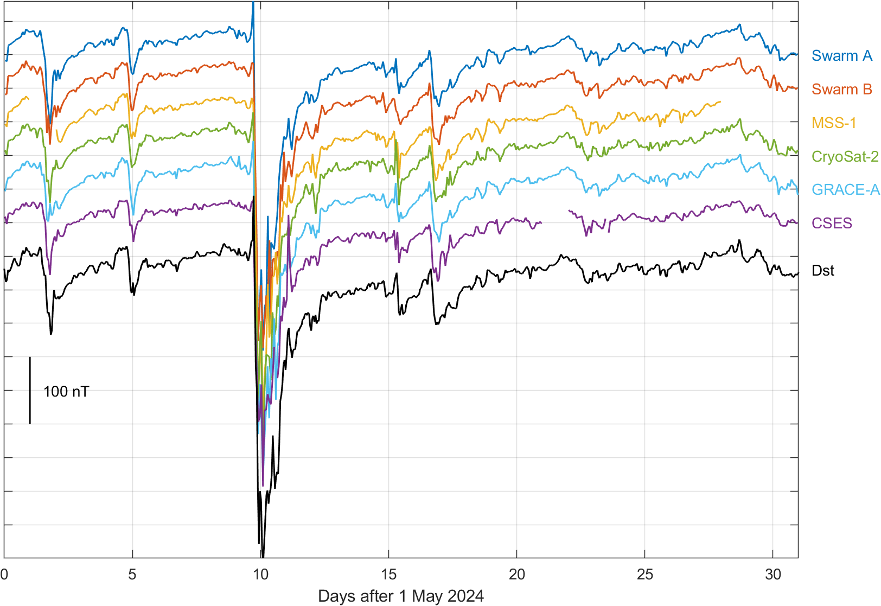
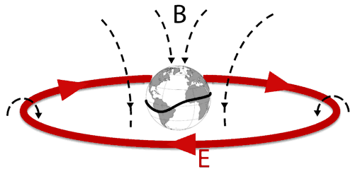
Application: Monitoring of Magnetospheric Ring-current activity
Low-latitude variation of horizontal component variation
Independent observation of time-evolution of magnetospheric
ring-current with magnetic data
from 6 satellites …
… and comparison with Dst-index derived from ground magnetic data

Slide 7
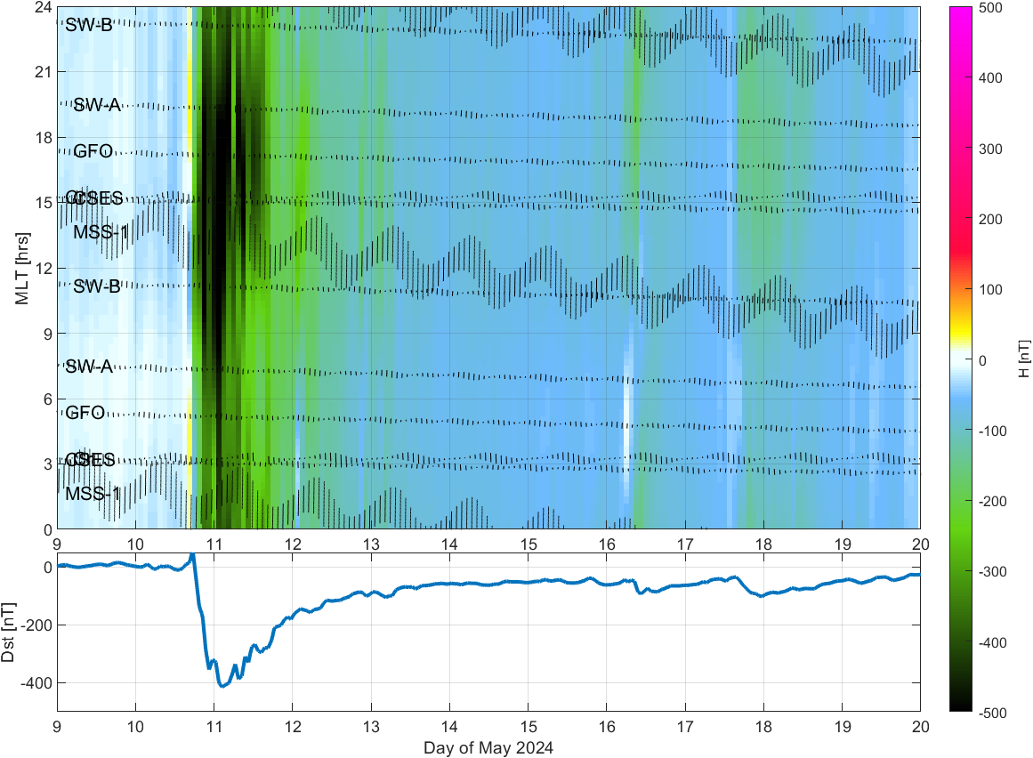
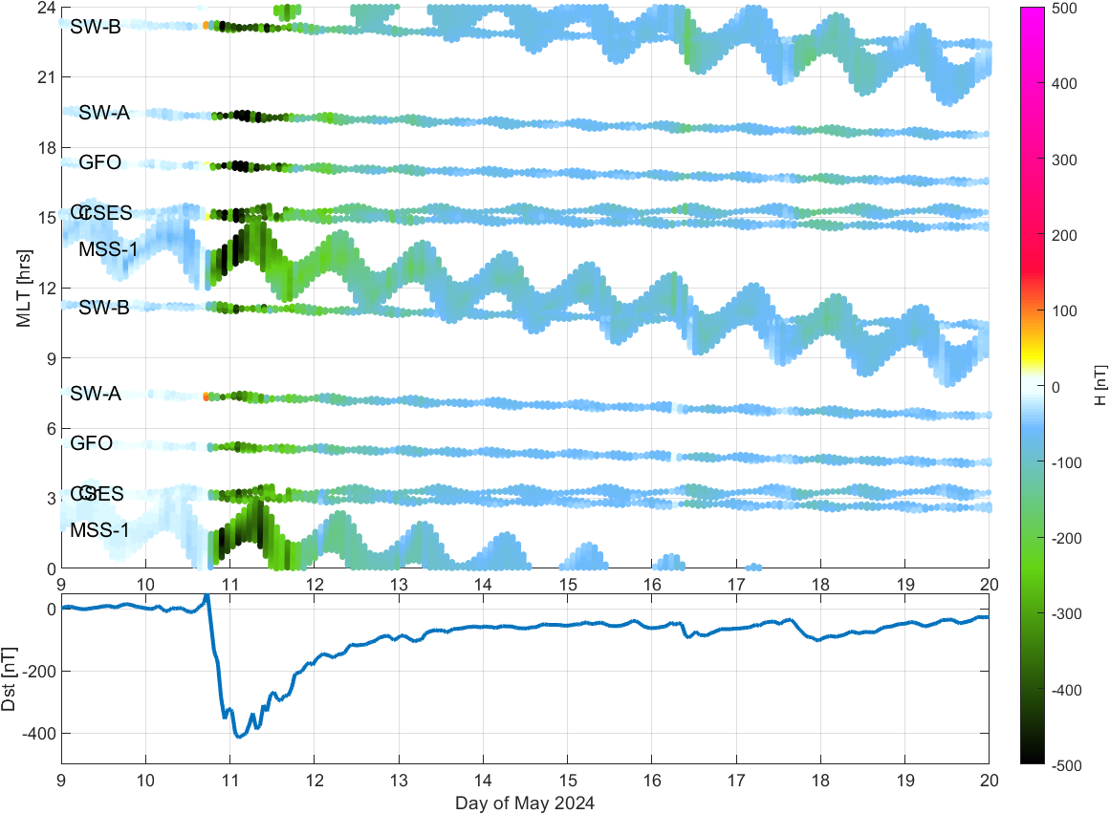
Application: Monitoring of Magnetospheric Ring-current activity
Low-latitude variation of horizontal component variation
Horizontal component variation at low latitudes
(±10° dipole latitude)
Removal of CHAOS-8.1
core and crustal field
Spherical Harmonic Analysis up to d/o N=3 in 1.5-hour bins
Stronger ring-current on evening-side

Slide 8
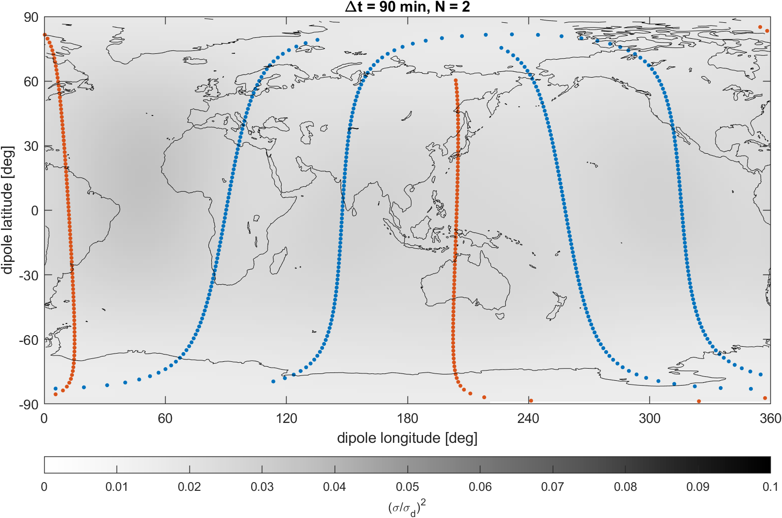
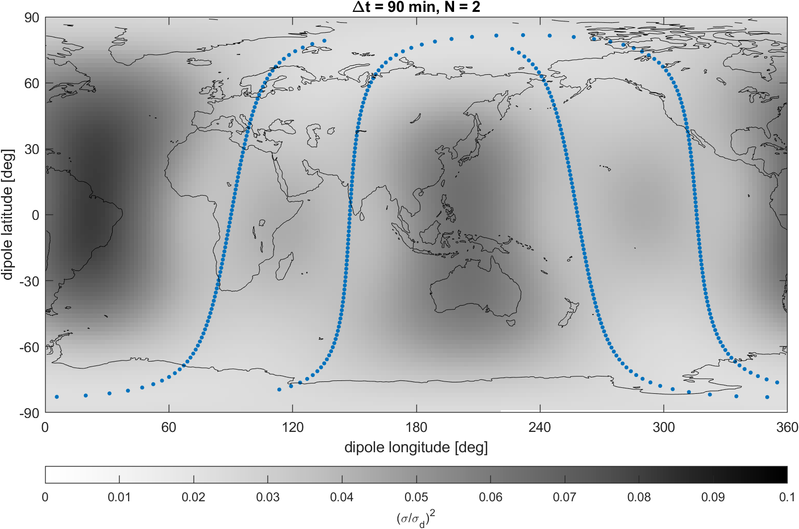
Model prediction error σ² on 6 May 2024 18:00 – 19:30
Swarm A + B
CryoSat-2
Spatial resolution up the spherical harmonic degree N = 2

Slide 9
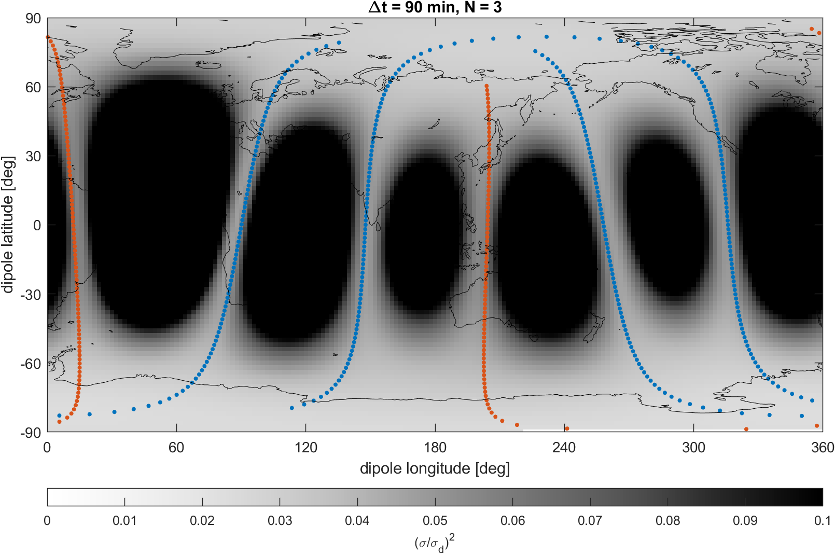
Model prediction error σ² on 6 May 2024 18:00 – 19:30
Swarm A + B
CryoSat-2
Spatial resolution up the spherical harmonic degree N = 3

Slide 10
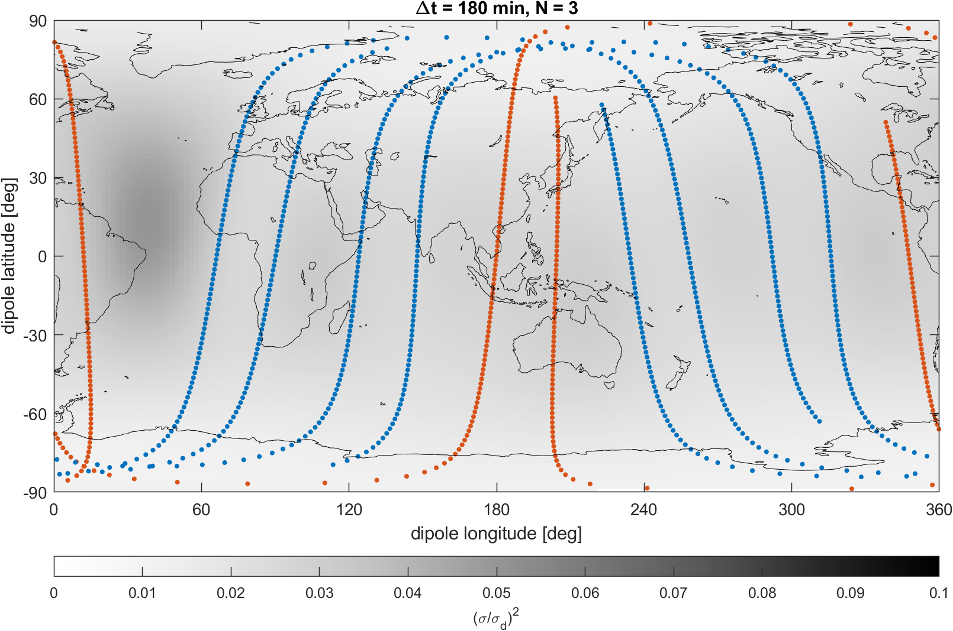
Model prediction error σ² on 6 May 2024 18:00 – 21:00
Swarm A + B
CryoSat-2
Spatial resolution up the spherical harmonic degree N = 3

Slide 11
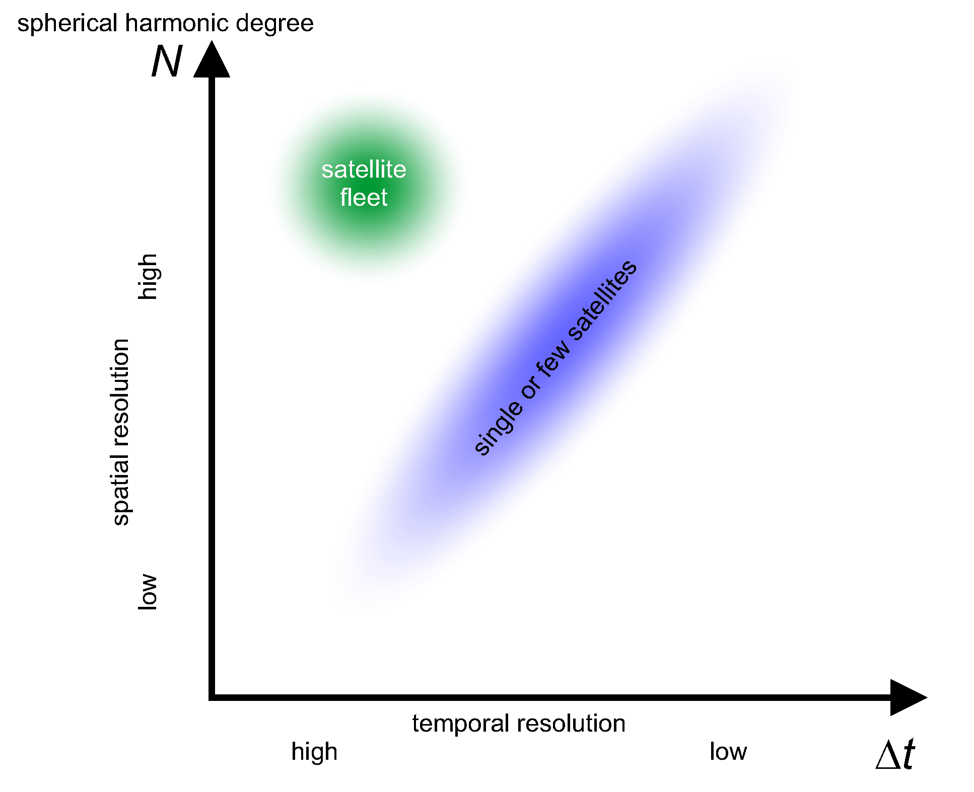
Trade-off between good spatial and good temporal resolution
Good spatial resolution (large N)
and good temporal resolution (small Δt)
requires simultaneous magnetic data from many locations in space

Slide 12
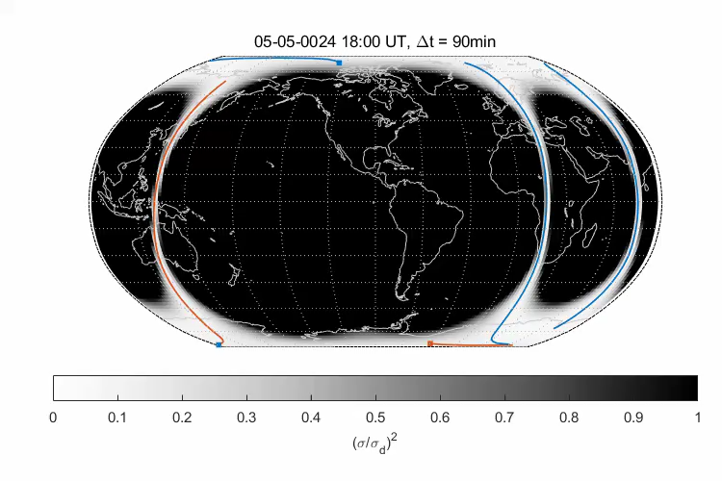
Model prediction error σ², Δt = 90 min
Swarm A + B
CryoSat-2
Spatial resolution up the spherical harmonic degree N = 3

Slide 13
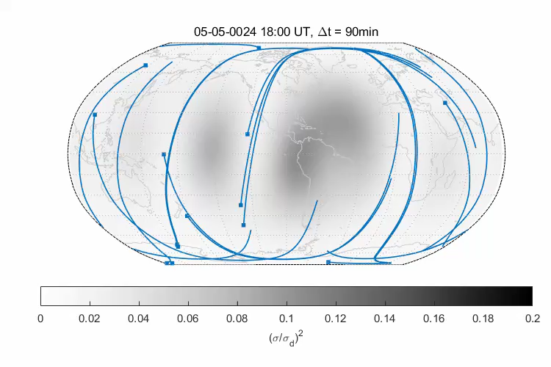
Model prediction error σ², Δt = 90 min
ESA EOP satellites
Spatial resolution up the spherical harmonic degree N = 3

Slide 14
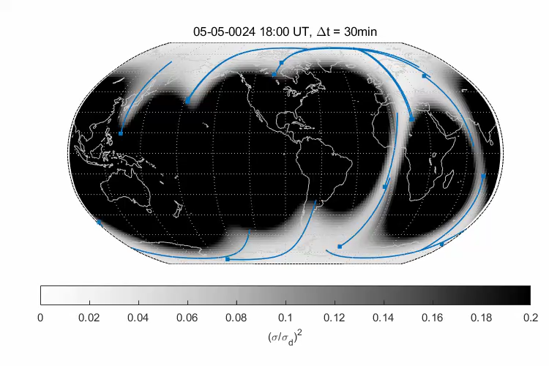
Model prediction error σ², Δt = 30 min
ESA EOP satellites
Spatial resolution up the spherical harmonic degree N = 3

Slide 15
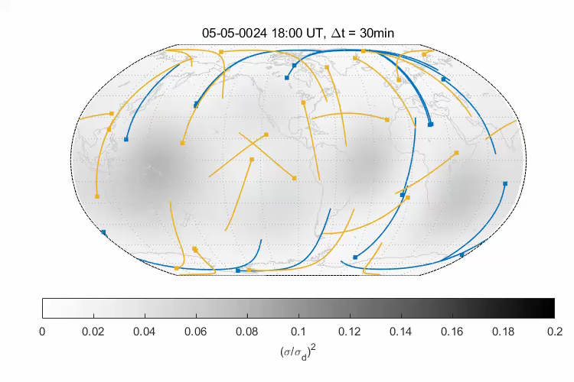
Model prediction error σ², Δt = 30 min
ESA EOP satellites
NASA satellites
Spatial resolution up the spherical harmonic degree N = 3

Slide 16
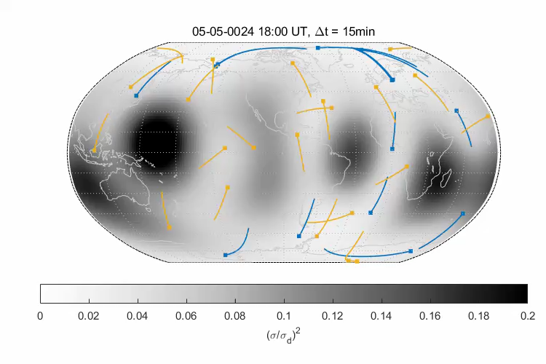
Model prediction error σ², Δt = 15 min
ESA EOP satellites
NASA satellites
Spatial resolution up the spherical harmonic degree N = 3

Slide 17
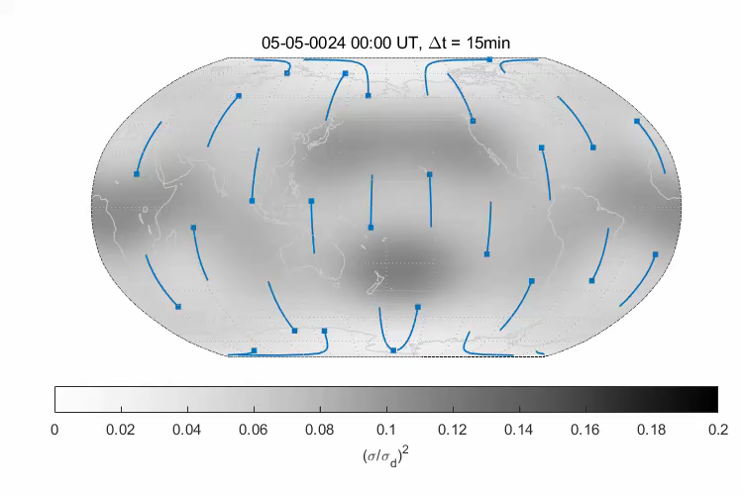
Model prediction error σ², Δt = 15 min
Constellation with 25 satellites
5 orbit planes
Spatial resolution up the spherical harmonic degree N = 3

Slide 18
Why? Remote Sensing of Electric currents in Geospace by Magnetic Measurements
Magnetospheric Ring-current

Slide 19
Steps of AOCS Magnetometer Calibration
Transforming raw AOCS magnetometer sensor readings to magnetic field vector in NEC
(North, East, Center) frame includes
  Calibration (of the sensor), including temperature dependencies, non-linear effects, …
  Characterisation (of s/c magnetic disturbances), e.g. from magnetorquer activity,
  battery and solar array currents
  Alignment (of the vector data), requires information on s/c attitude (quaternions)
Estimation of the AOCS magnetometer calibration/characterisation/alignment parameters is typically done on a data subset (e.g. 60 sec sampling, non-polar latitudes) …
… followed by an Application of the estimated parameters to the whole data set
(full magnetometer sampling rate, all latitudes)

Slide 20
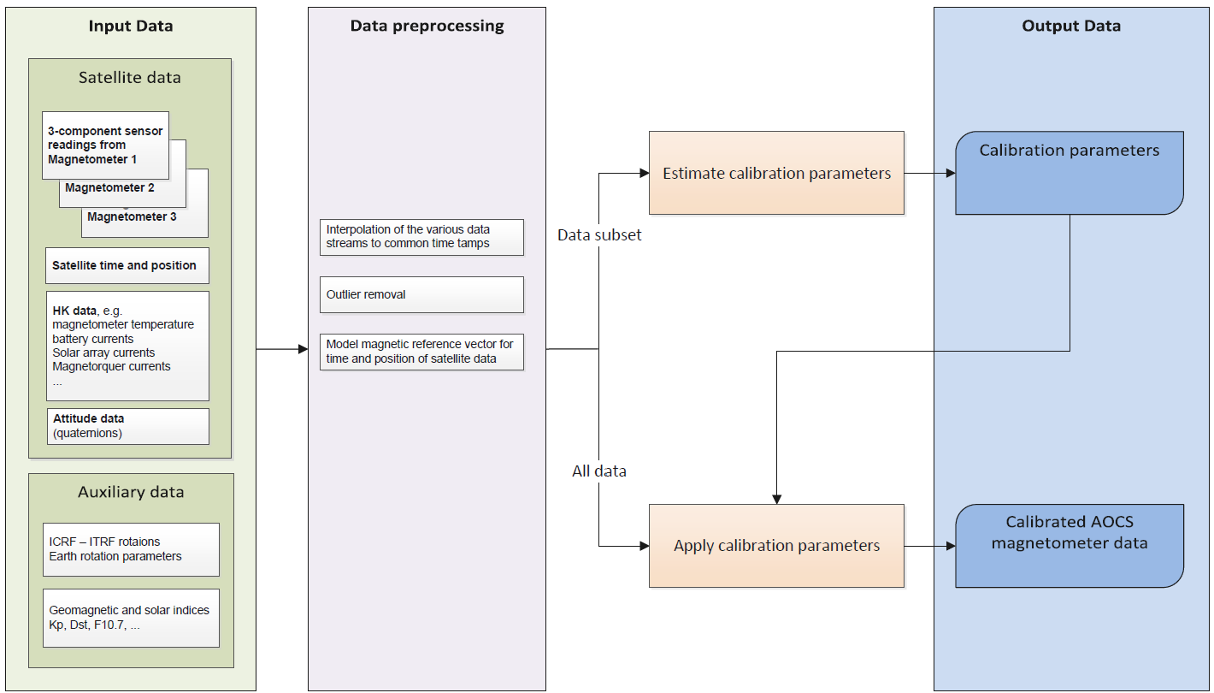


How? - Calibration of AOCS Magnetometer Data
Requires a
“scientist-in-the-loop”
Can run automatically

Slide 21
Overview: The various satellite data sets used in this study
Name | NORAD ID | years | altitude
CryoSat-2 | 36508 | 2010 - | ≈ 720 km
SMOS | 36036 | 2009 - | ≈ 760 km
Aeolus | 43600 | 2018 - 2023 | ≈ 320 km
EarthCARE | 59908 | 2024 - | ≈ 395 km
Biomass | 63772 | 2025 - | ≈ 660 km
Proba-2 | 36037 | 2009 - | ≈ 720 km
AWS | 60543 | 2024 - | ≈ 600 km
GRACE-FO C | 43476 | 2018 - | ≈ 500 km
GRACE-FO D | 43477 | 2018 - | ≈ 500 km
Main challenges: AOCS magnetometer only active in safe mode: no continuous data
Coarse magnetometer sampling rate: 10 sec or lower (1 sec is appreciated)
Data resolution, e.g. 1 μT (1 nT is appreciated)
Large magnetic disturbances from s/c
Green: “operational” data processing and provision
Yellow: on hold, e.g. because of large magnetic disturbances or insufficient input data

Slide 22
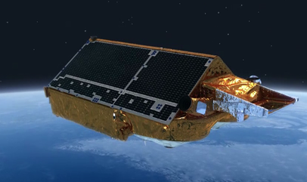
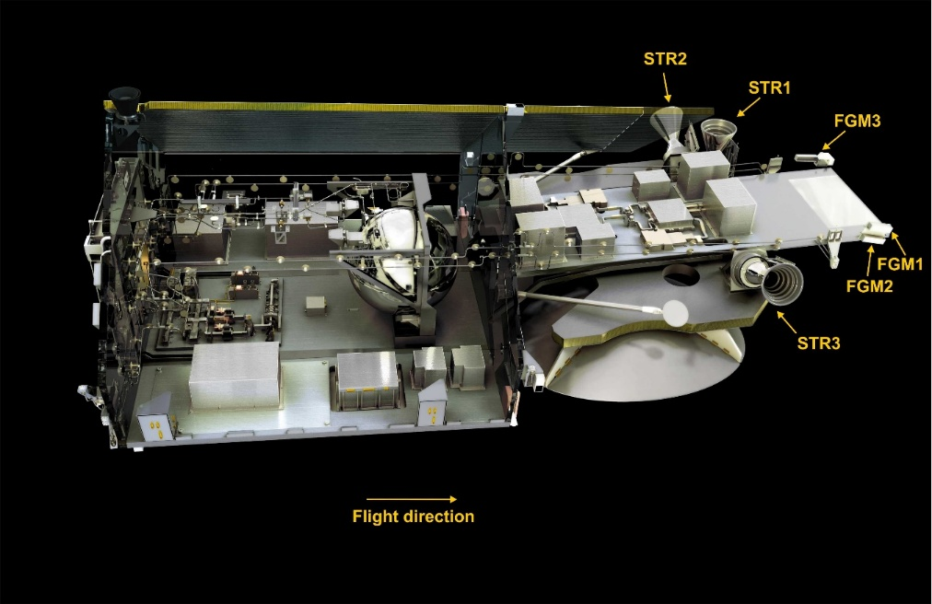
Magnetic Data from CryoSat-2
Launched in April 2010 – and still in operation
720 – 730 km altitude, 92° orbital inclination
3 AOCS vector Fluxgate magnetometers (FGMs), 4 sec sampling
3 Star imagers (STRs)
House-Keeping (HK) data available: magnetorquer currents, magnetometer temperature, …

Slide 23
Calibration of a satellite Fluxgate vector magnetometer
Calibration is done by minimization of difference ΔF² = (|B_{FGM}|– |B_{ref}|)²
where B_{FGM} is measured magnetic field
and |B_{ref}| is reference magnetic field strength at same position and time
On dedicated magnetic satellites like Swarm: Reference magnetic field strength |B_{ref}| is provided by second absolute scalar magnetometer
For other satellites: |B_{ref}| is given by CHAOS model of Earth’s magnetic field
(core, crust, large-scale magnetosphere + induced contributions)
Cryosat-2: Estimation of 12 basic calibration parameters in monthly bins (200 x 12 parameters)
Model regularisation to minimize month-to-month variability
Calibration includes estimation of time-varying magnetic disturbances due to Magnetorquer action, Solar arrays and battery currents, magnetometer non-linearities
4 second sampling rate, 16 years: April 2010 – December 2025 (200 months)
In total 2472 model parameters estimated by robust non-linear Least-Squares
from 16.5 mio observations (= 3 x 5.5 mio vector triplets)

Slide 24
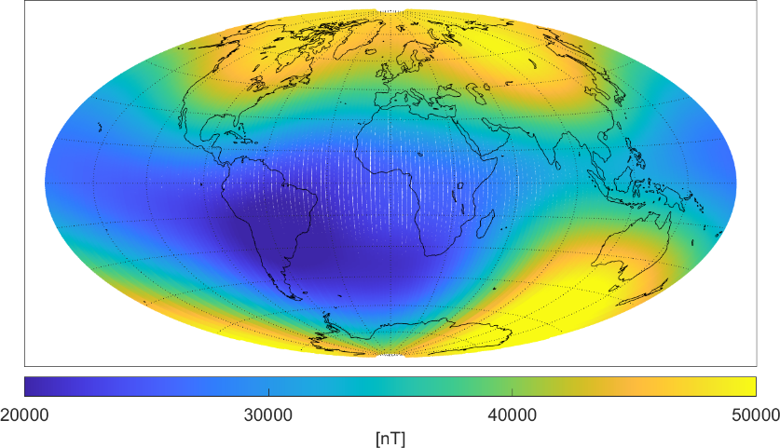
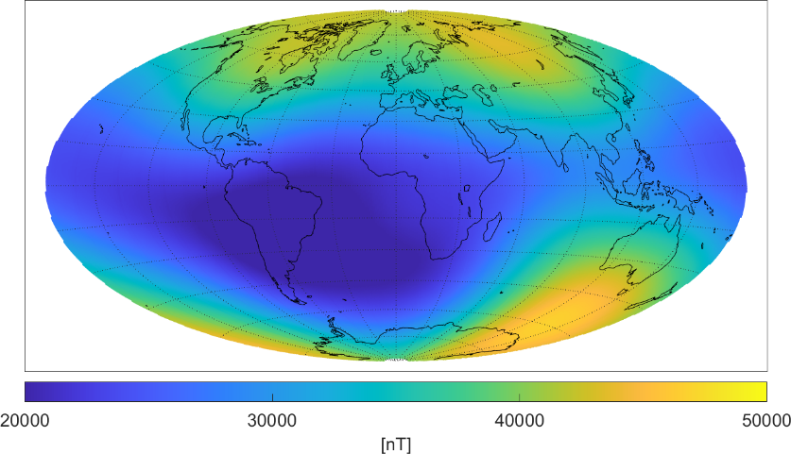

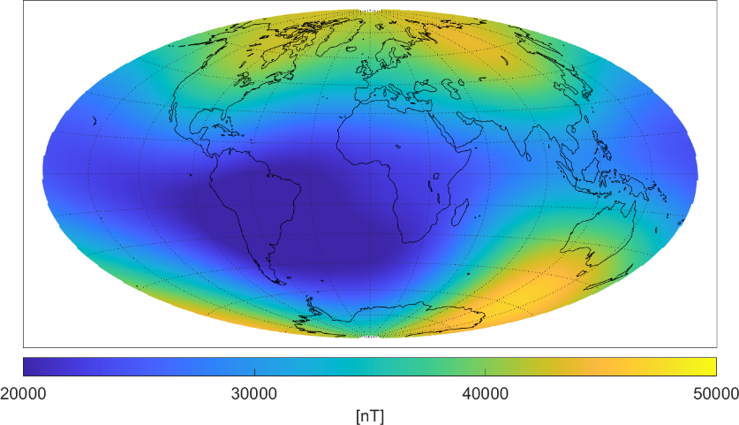
Magnetic field strength F = |B|
August 2018
Swarm A
CryoSat-2
430 km altitude
720 km altitude
observed F_{obs}
model F_{mod}

Slide 25
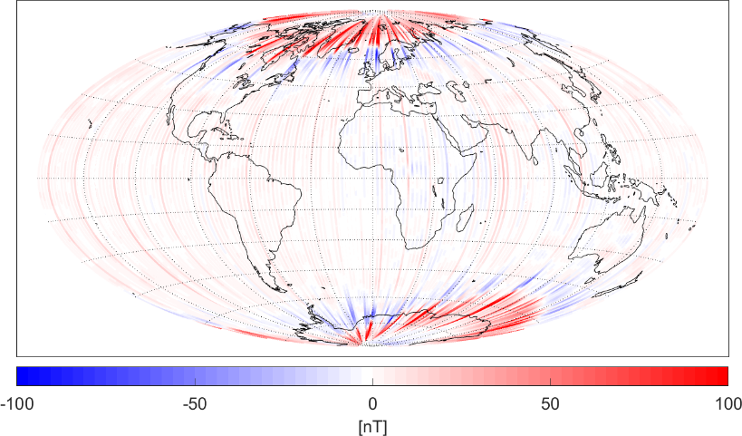
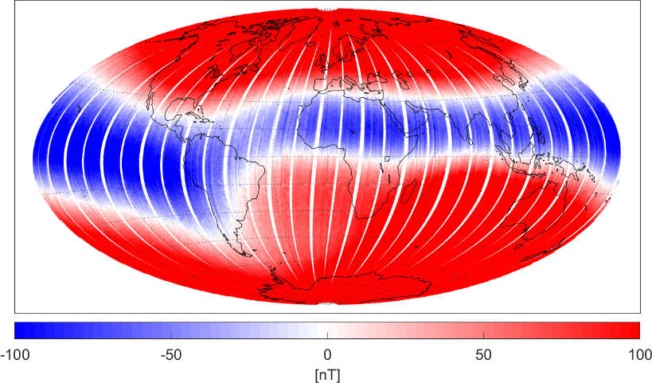
Magnetic field strength F = |B|
August 2018
Swarm A
CryoSat-2, uncalibrated
ΔF = F_{obs} – F_{mod}
Polar ionospheric currents

Slide 26
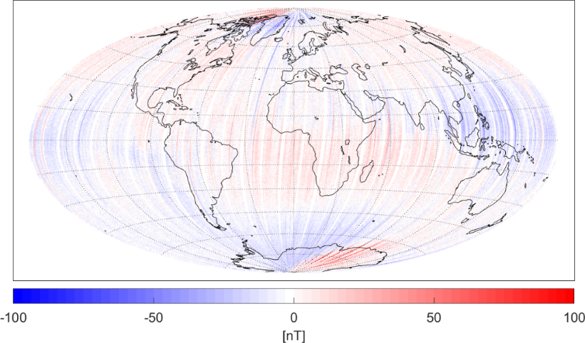
Magnetic field strength F = |B|
August 2018
Swarm A
CryoSat-2, calibrated
ΔF = F_{obs} – F_{mod}
weaker in CryoSat,
due to higher altitude
Polar ionospheric currents

Slide 27
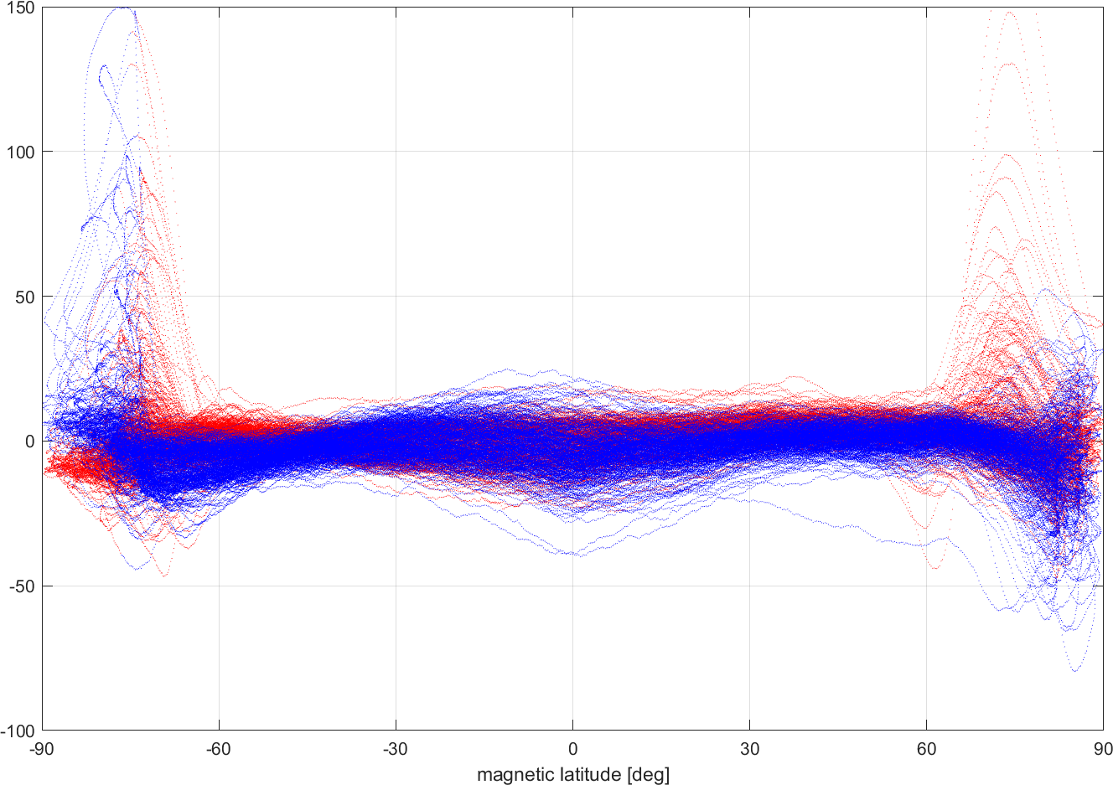
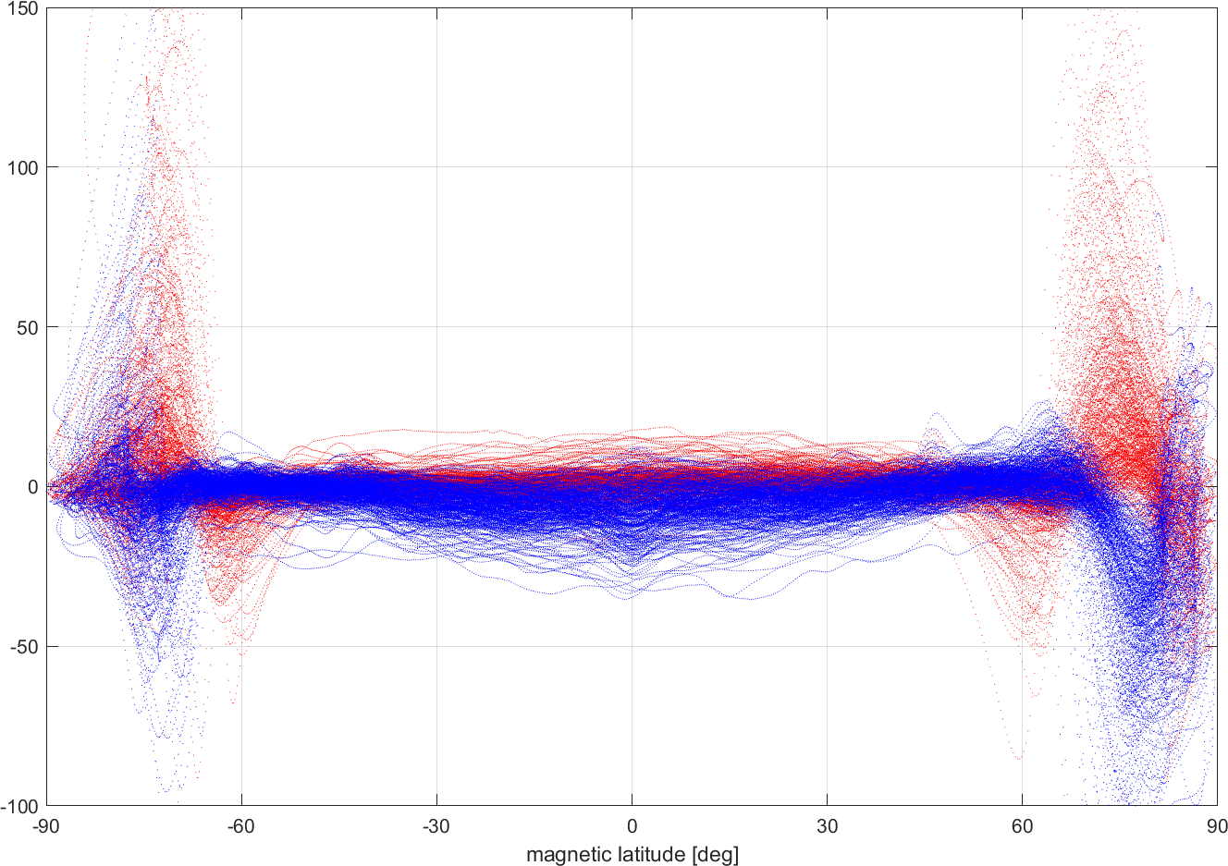
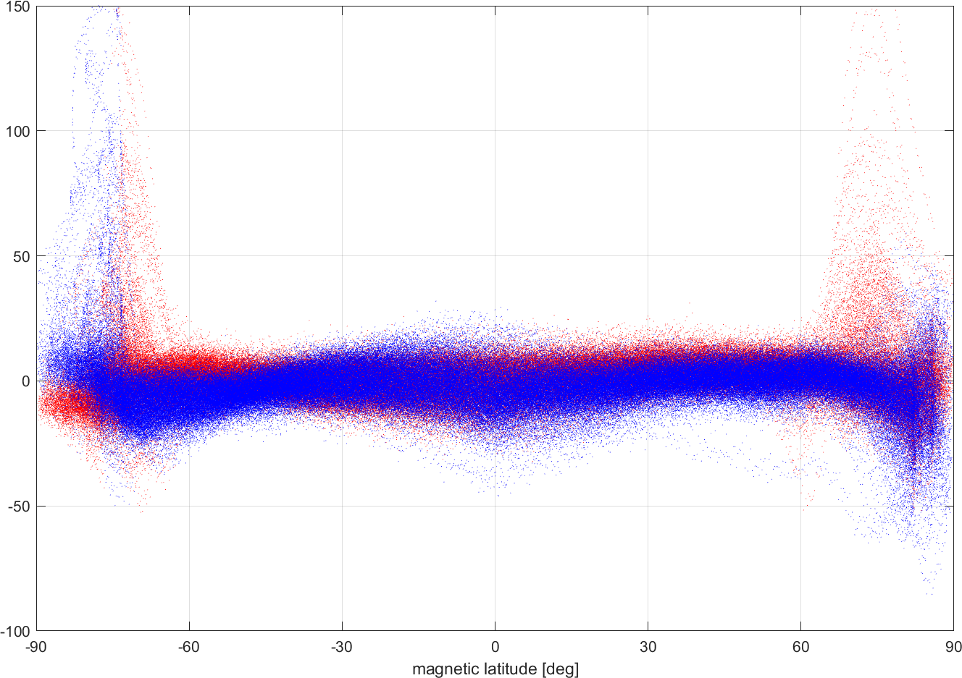
Magnetic field strength F = |B|
August 2018
Swarm A
CryoSat-2, calibrated
1.9 nT rms
measurement error: < 0.5 nT
6 nT rms
ΔF = F_{obs} – F_{mod}
dayside
nightside
magnetospheric ring-current
Polar ionospheric currents

Slide 28
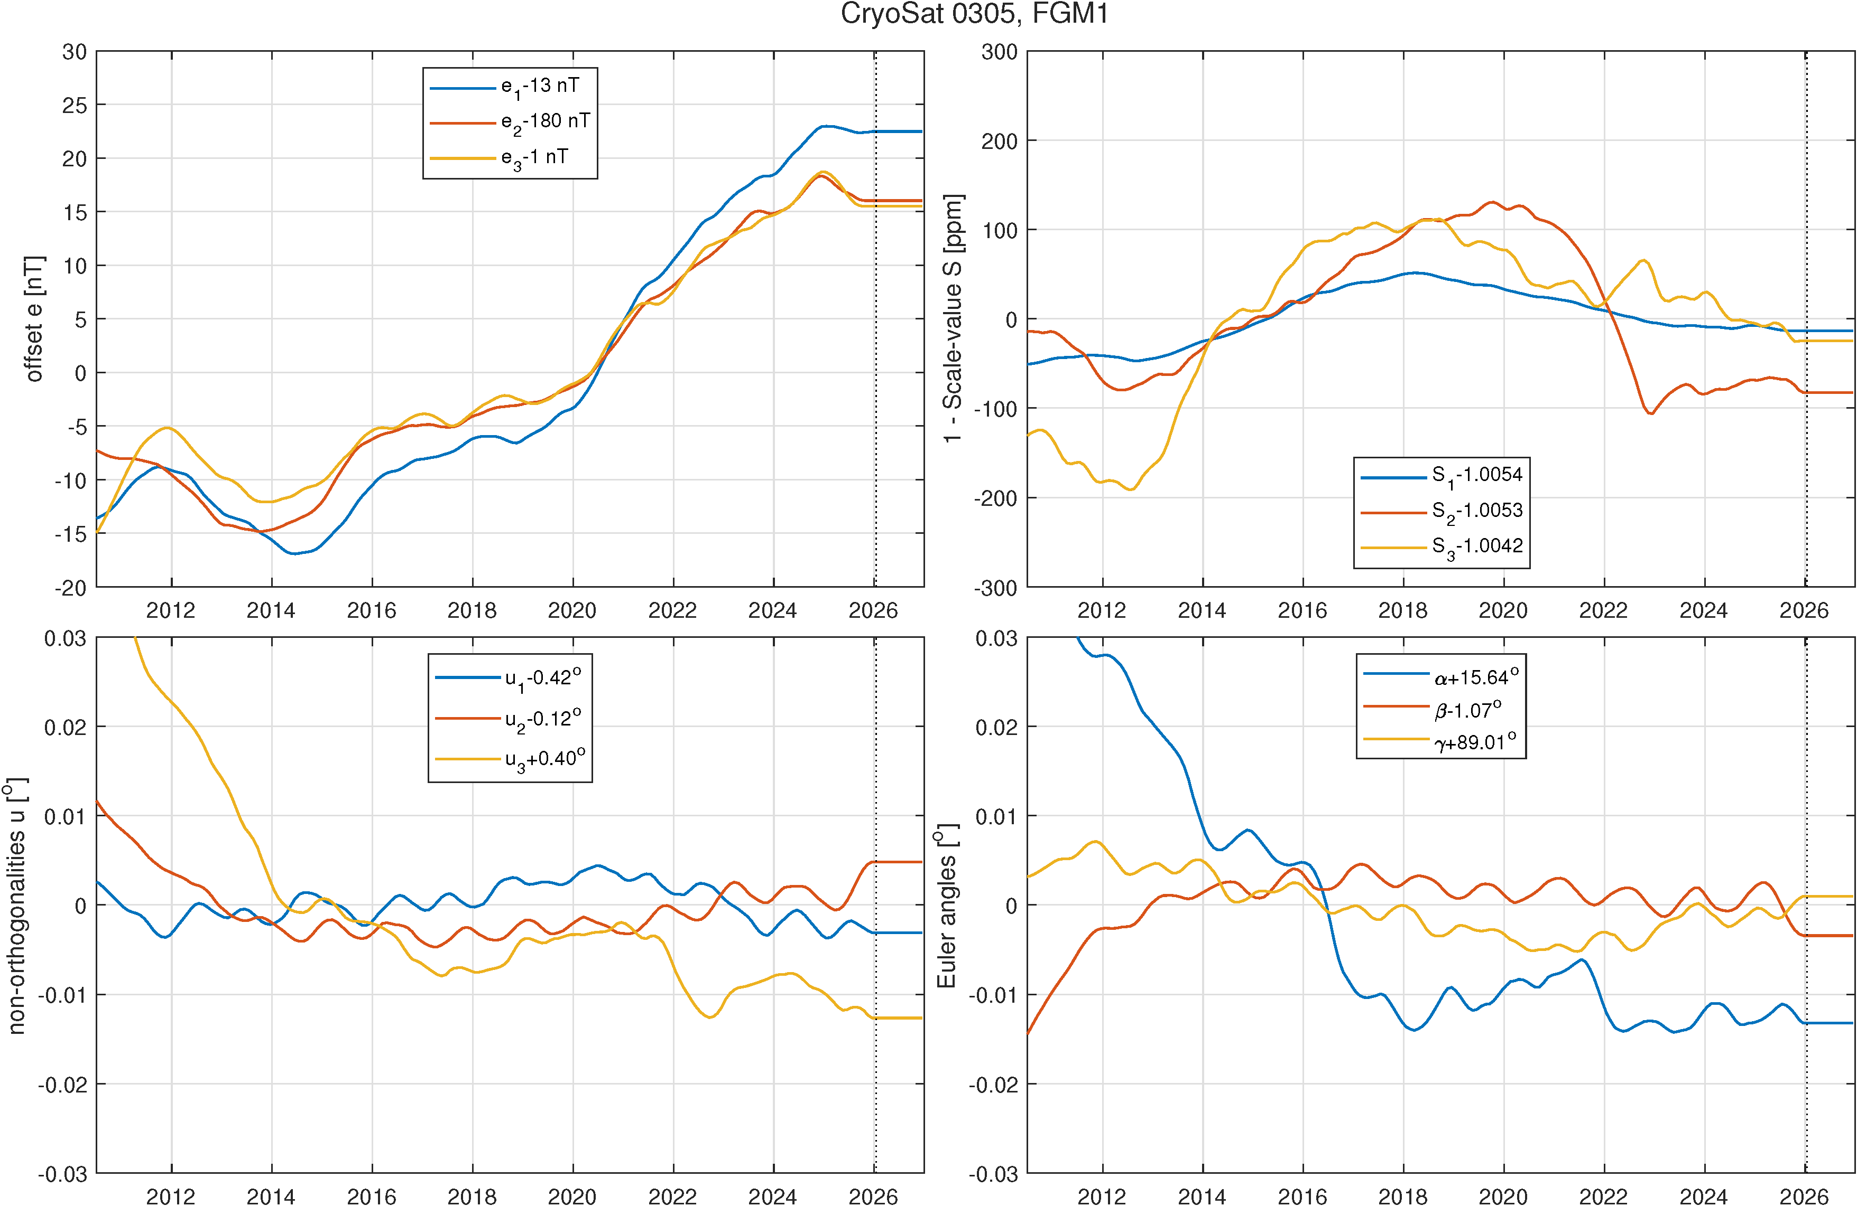
CryoSat-2
The Flagship AMOG mission – pushing the border of AOCS magnetometer processing
Data since April 2010, 4 sec sampling rate, 3 FGM magnetometers, 3 Star Tracker
Operational processing since January 2025:
processed in monthly batches, typically on 5th of each month
Daily CDF files in “Swarm-like” format distributed through Swarm data server
ftp://swarm-diss.eo.esa.int/Multimission/CryoSat-2
Proper determination of the time variation of the calibration parameters requires re-processing of the last few months of data, due to temporal smoothing of these parameters (minimizing month-to-month variation). For the operational processing we assume constant extrapolation of these parameters for up to 12 months, after which a recalibration of whole data period from BOM is performed
4-sec data version 0305 based on estimated parameters using data Aug 2010 - Dec 2025
New: Change in onboard operation and telemetry allows to obtain 1 sec data since Sept 2025
Operational processing of 1 sec data (version 0402, will replace the 4 sec 0305 data)

Slide 29
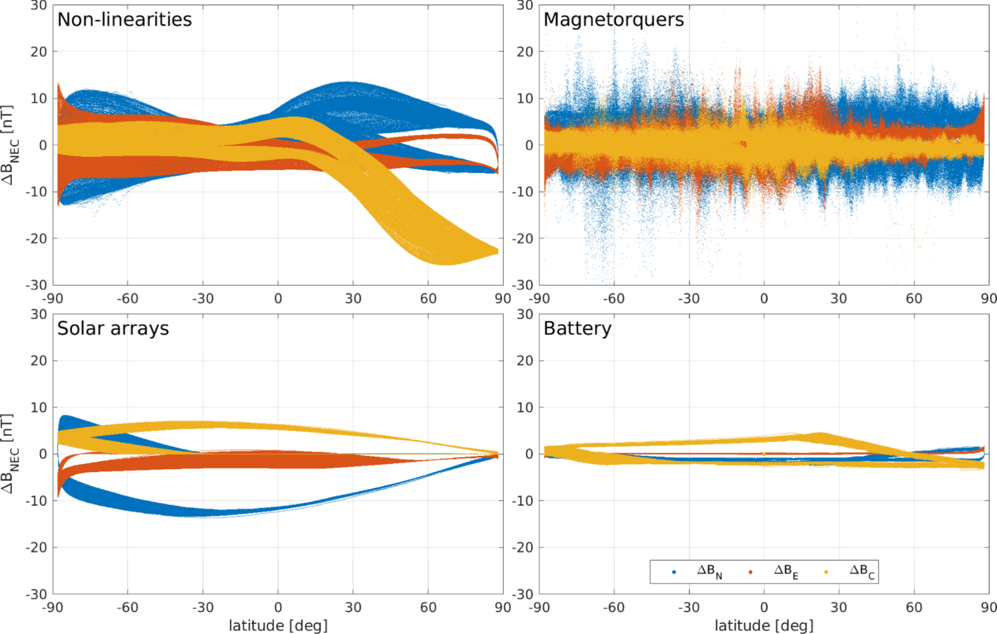
CryoSat-2 – the various disturbance fields

Slide 30
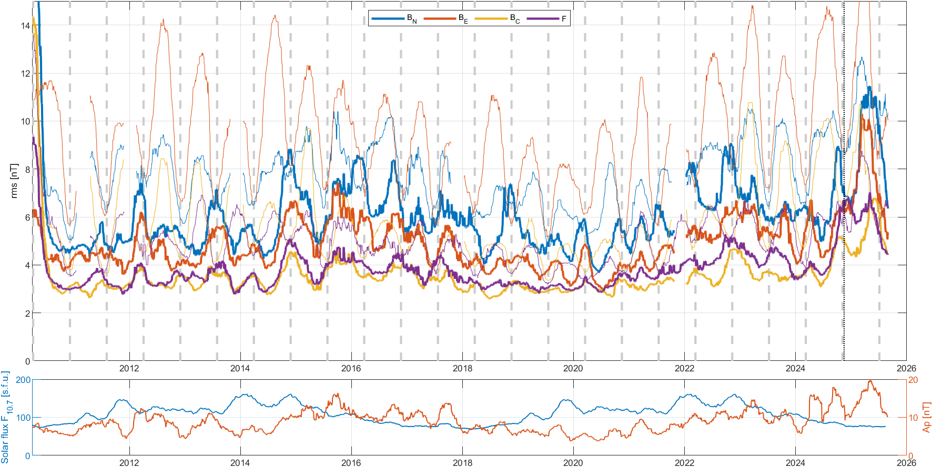
CryoSat-2
81-daily running mean of daily rms wrt CHAOS model

Slide 31
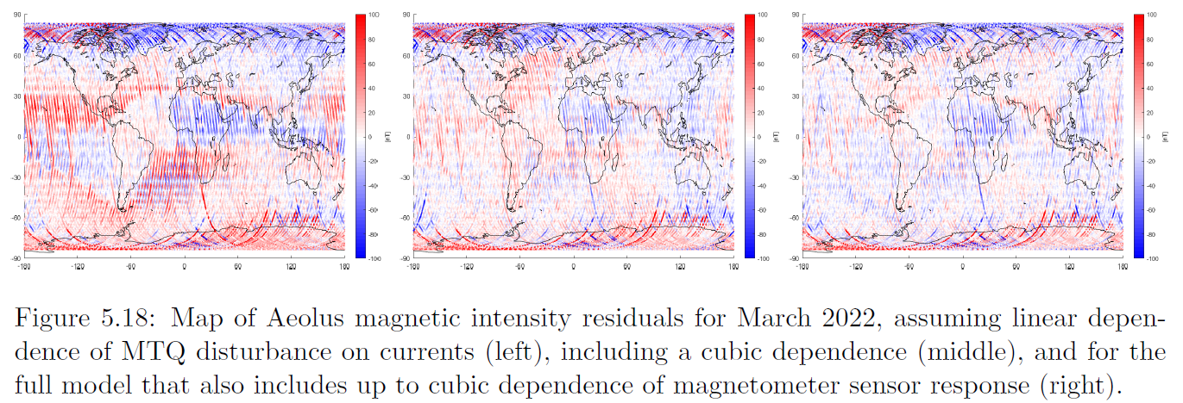
Aeolus
August 2018 – July 2023
Magnetoresistive magnetometer (no fluxgate)
Huge magnetorquer disturbances (same magnitude as Earth’s magnetic field)
accounting for non-linear relation between I_{MTQ} and B_{MTQ}
“Operational” processing of whole mission, daily CDF files May 2019 – June 2023
10 sec sampling, Time, position, B, attitude quaternions, MTQ, solar array and battery currents

Slide 32
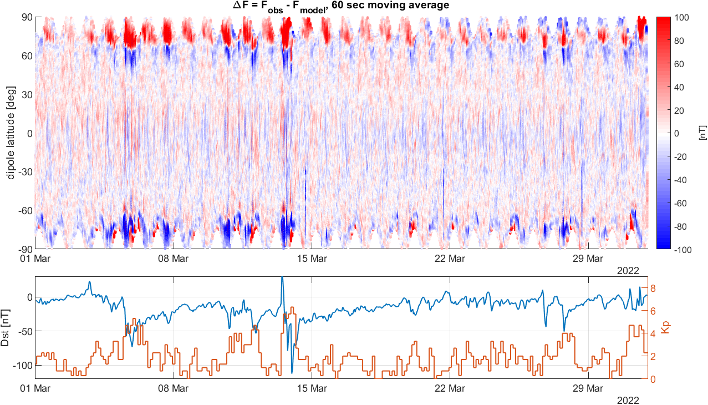
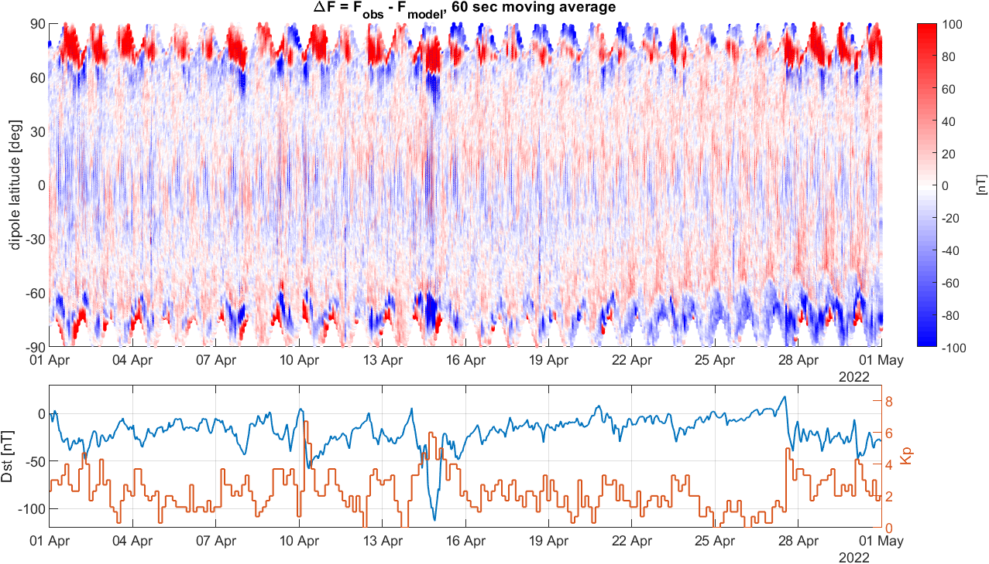
Aeolus
Despite the larger rms (30 nT) compared to CryoSat-2 (< 10 nT):
Clear geophysical signal, in particular at polar latitudes (FACs)

Slide 33
Magnetorquer current and magnetic disturbance
CryoSat-2 GRACE Aeolus

Slide 34
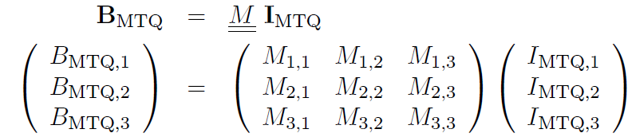
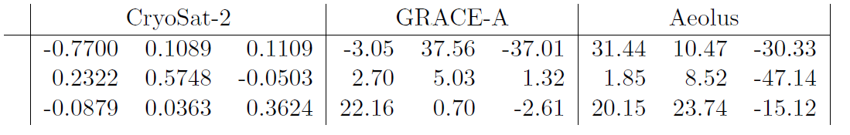
Magnetorquer current and magnetic disturbance
[nT/mA]
MTQ response is ≈50 times larger for GRACE and Aeolus compared to CryoSat-2
In addition, Aeolus MTQ currents are 3 times larger than those of GRACE/CryoSat-2
But still it is possible to correct for the Aeolus magnetorquer disturbance!

Slide 35
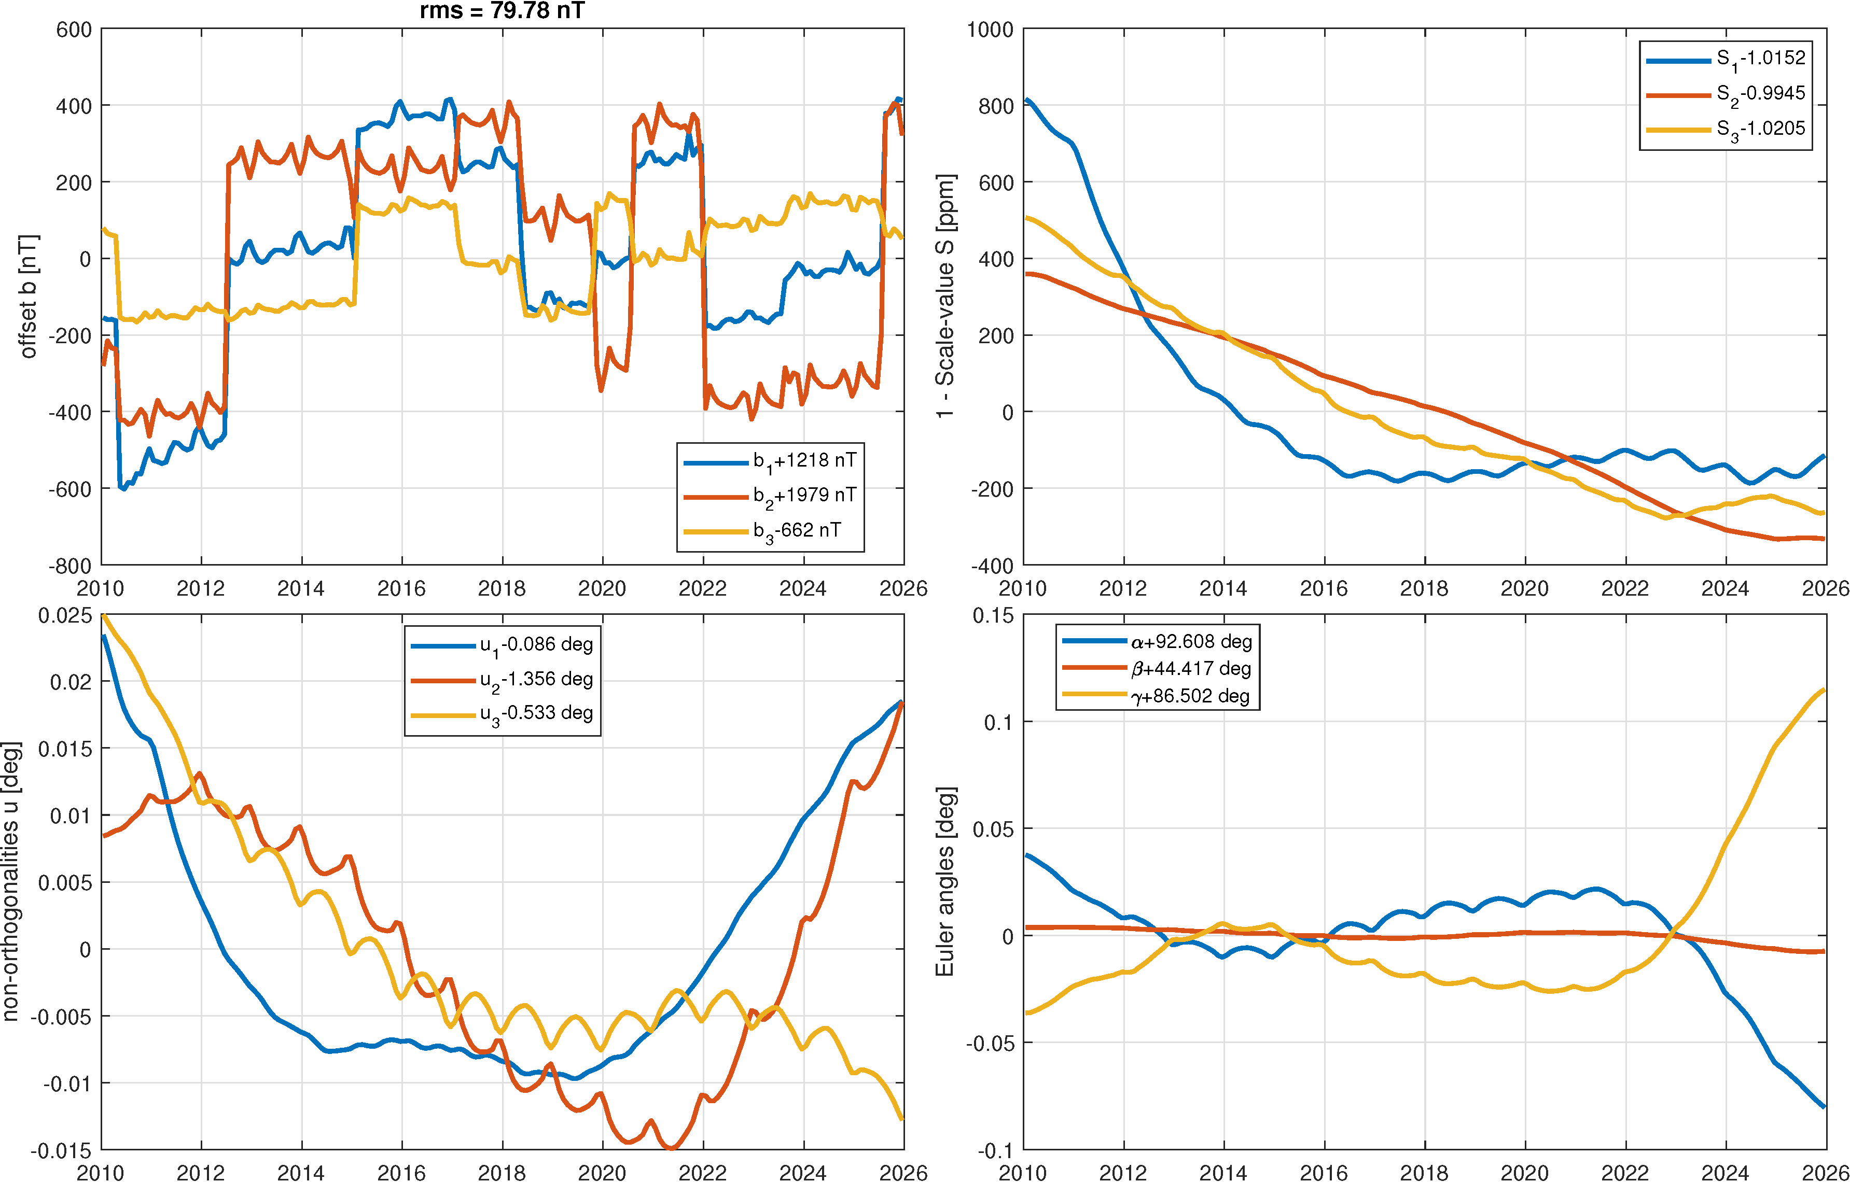
PROBA-2
Launched on 2 Nov 2009, sun-synchronous (dawn/dusk), 720 km altitude
Magnetometers:
Credit Card Magnetometer (CCM), Lusospace, (similar instrument as on Aeolus), 10 sec sampling
“A set of magnetometers (ZMM) from ZARM, Germany”
We found data from one magnetometer (MM), 30 s sampling (sometimes 3 sec ?)
DTU’s “Science Grade Vector Magnetometer” SGVM: unknown status
(no response from instrument team)
Position, attitude, MTQ currents, 2 Battery and 3 Solar Array currents
Rather coarse attitude (sun-sensor, no star tracker ?)
Sun pointing, with “fixed” attitude for 30 minutes, followed by rather abrupt change
MTQ currents are zero apart from the attitude changes
For our calibration we only use data when no MTQ action
CMM period: end March 2010 – Nov 2014
MM period: March 2010 – Dec 2025, rms = 80 nT

Slide 37
AMOG Work Logic

