Slide 1
Exploring Earth's magnetic field and its environment with CryoSat-2
Nils Olsen
DTU Space
Technical University of Denmark

Slide 2
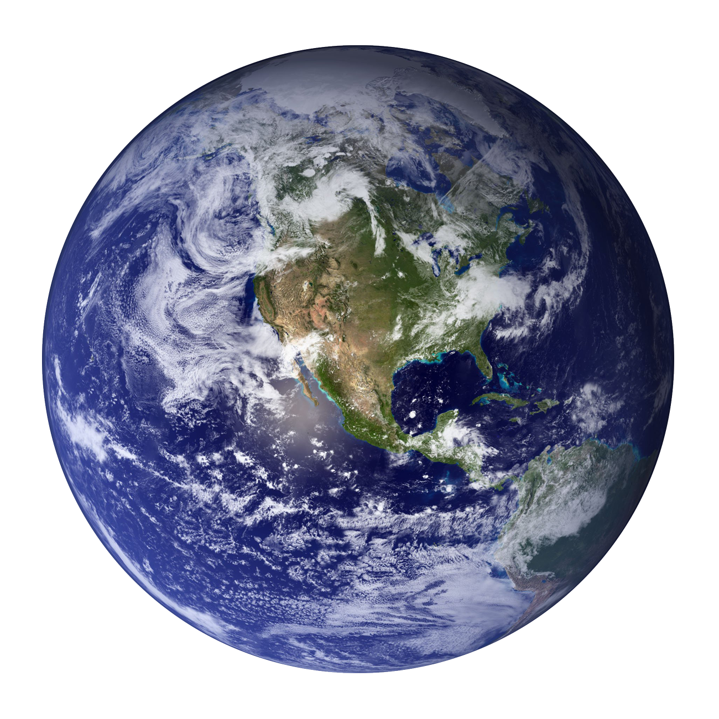
Exploring Earth's magnetic field and its environment with CryoSat-2
Nils Olsen
DTU Space
Technical University of Denmark

Slide 3

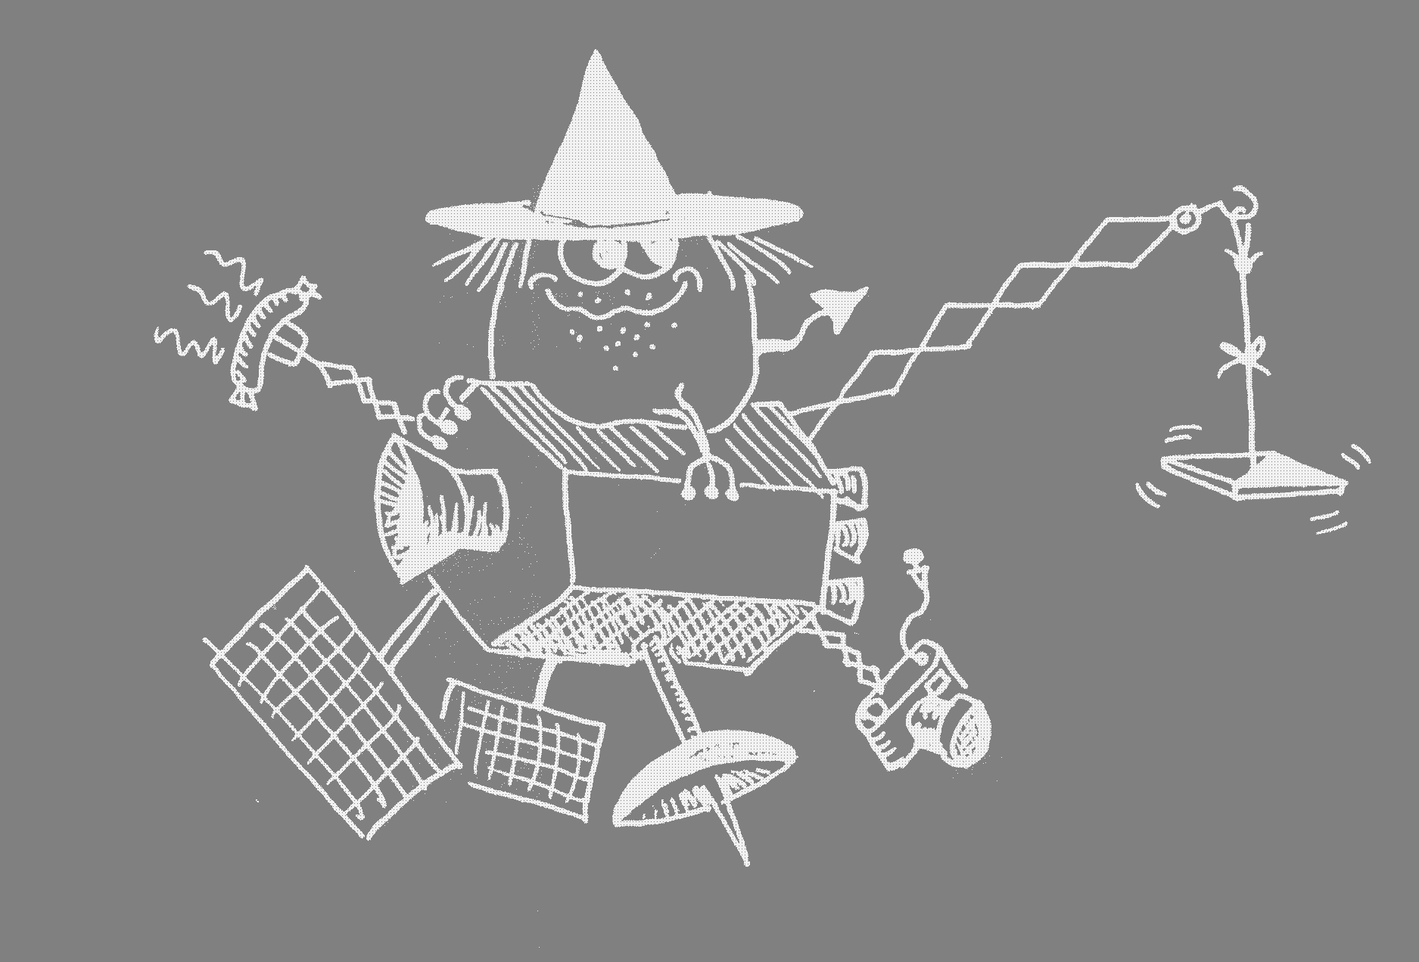
Exploring Earth's magnetic field and its environment with CryoSat-2
Earth’s magnetic field
Why using CryoSat ?
How ?
Applications
Thanks to: Giuseppe Albini,
Jerome Bouffard, Tommaso Parrinello and the Technical Team of CryoSat
Nils Olsen
DTU Space
Technical University of Denmark

Slide 4
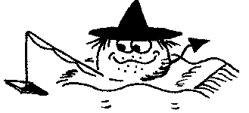
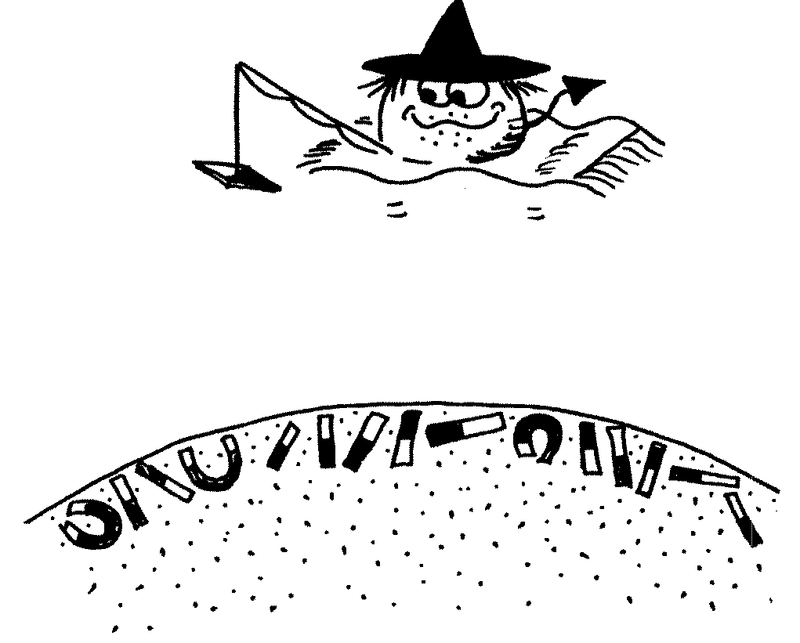
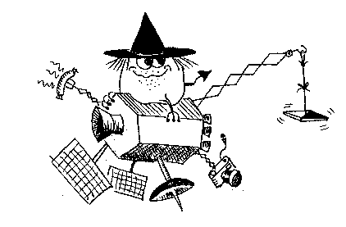



Most satellites – including CryoSat - carry magnetometer for navigational purposes as part of their AOCS (Attitude and Orbit Control System)
The data of these AOCS magnetometers have scientific value but data calibration is essential
Towards a true swarm of satellites …

Slide 5
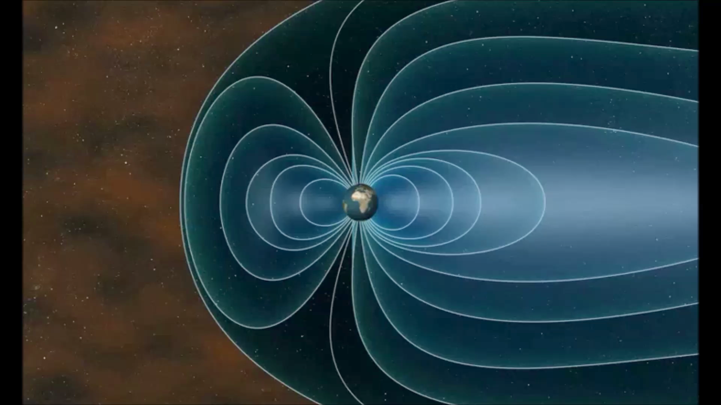
Sources of the Near-Earth Magnetic Field

Slide 6
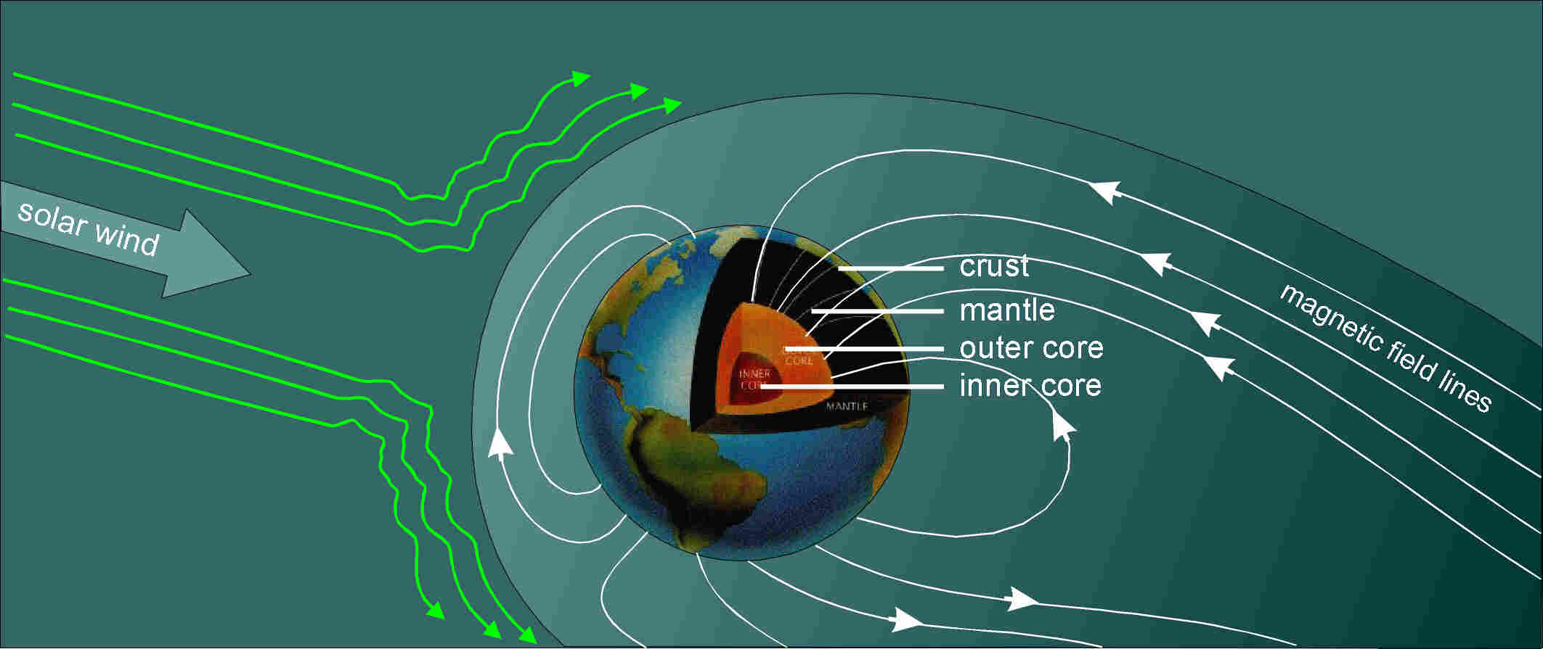
Sources of the Near-Earth Magnetic Field
Internal sources
  fluid outer core: 94% electrical currents created by motion of a conductor
  crust: 3% permanent magnetization of minerals
  (mantle: induced currents due to time varying B)
External sources
  current systems in ionosphere and magnetosphere: 3%, but highly time-variable!
  caused by solar particles, fields, and radiation

Slide 7
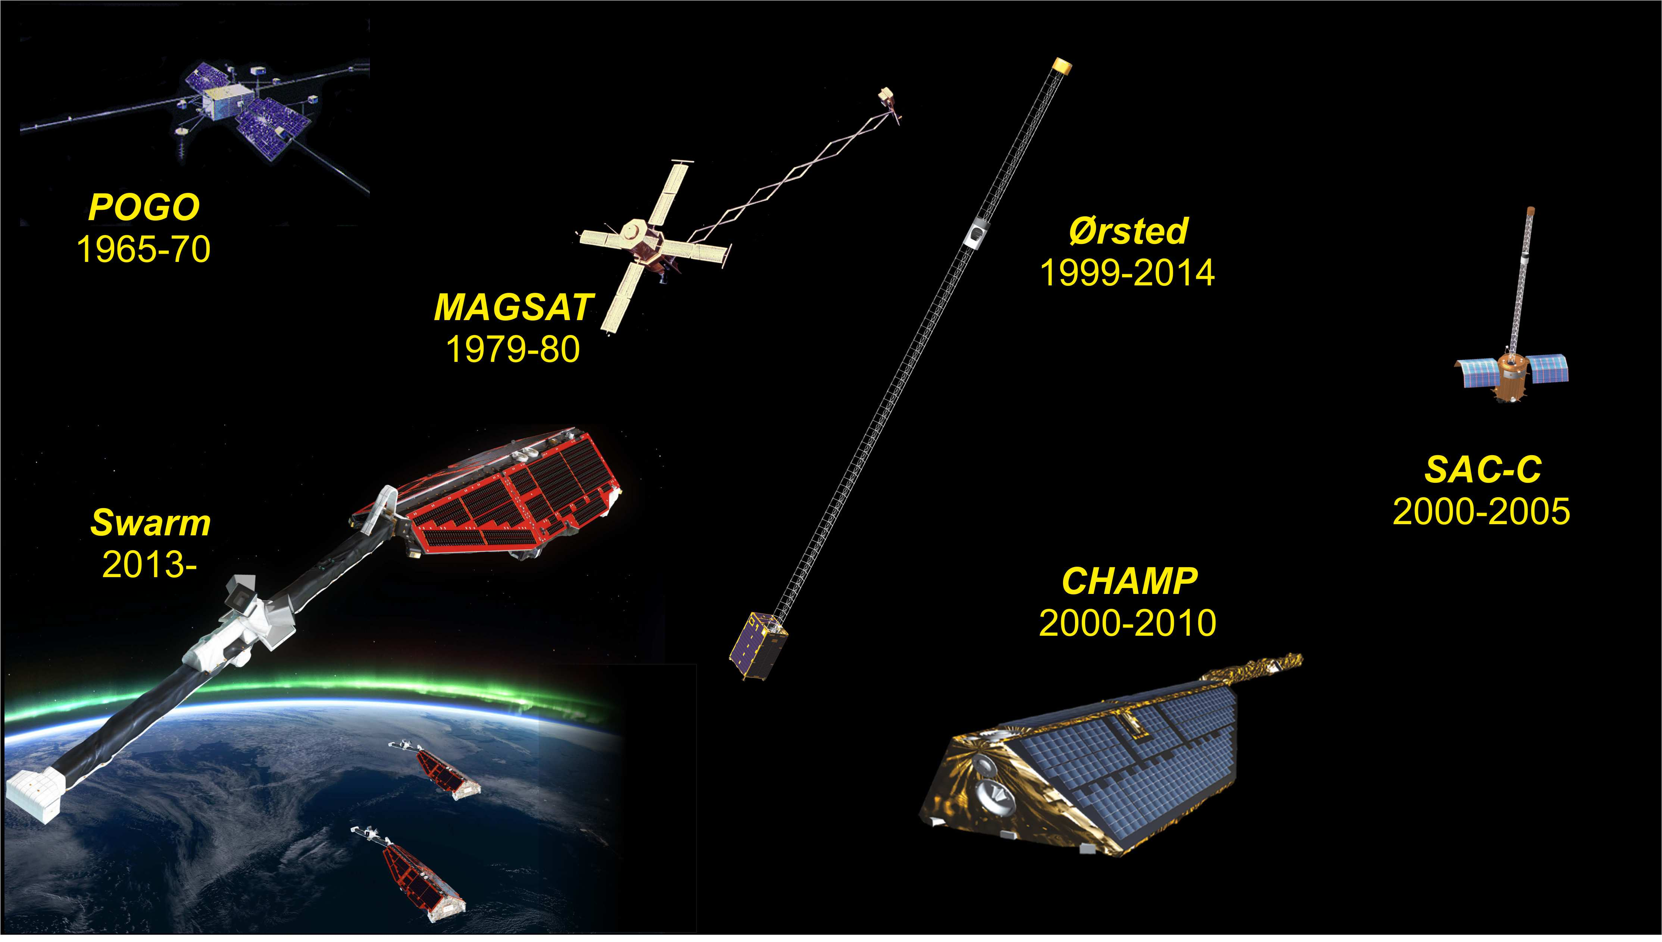
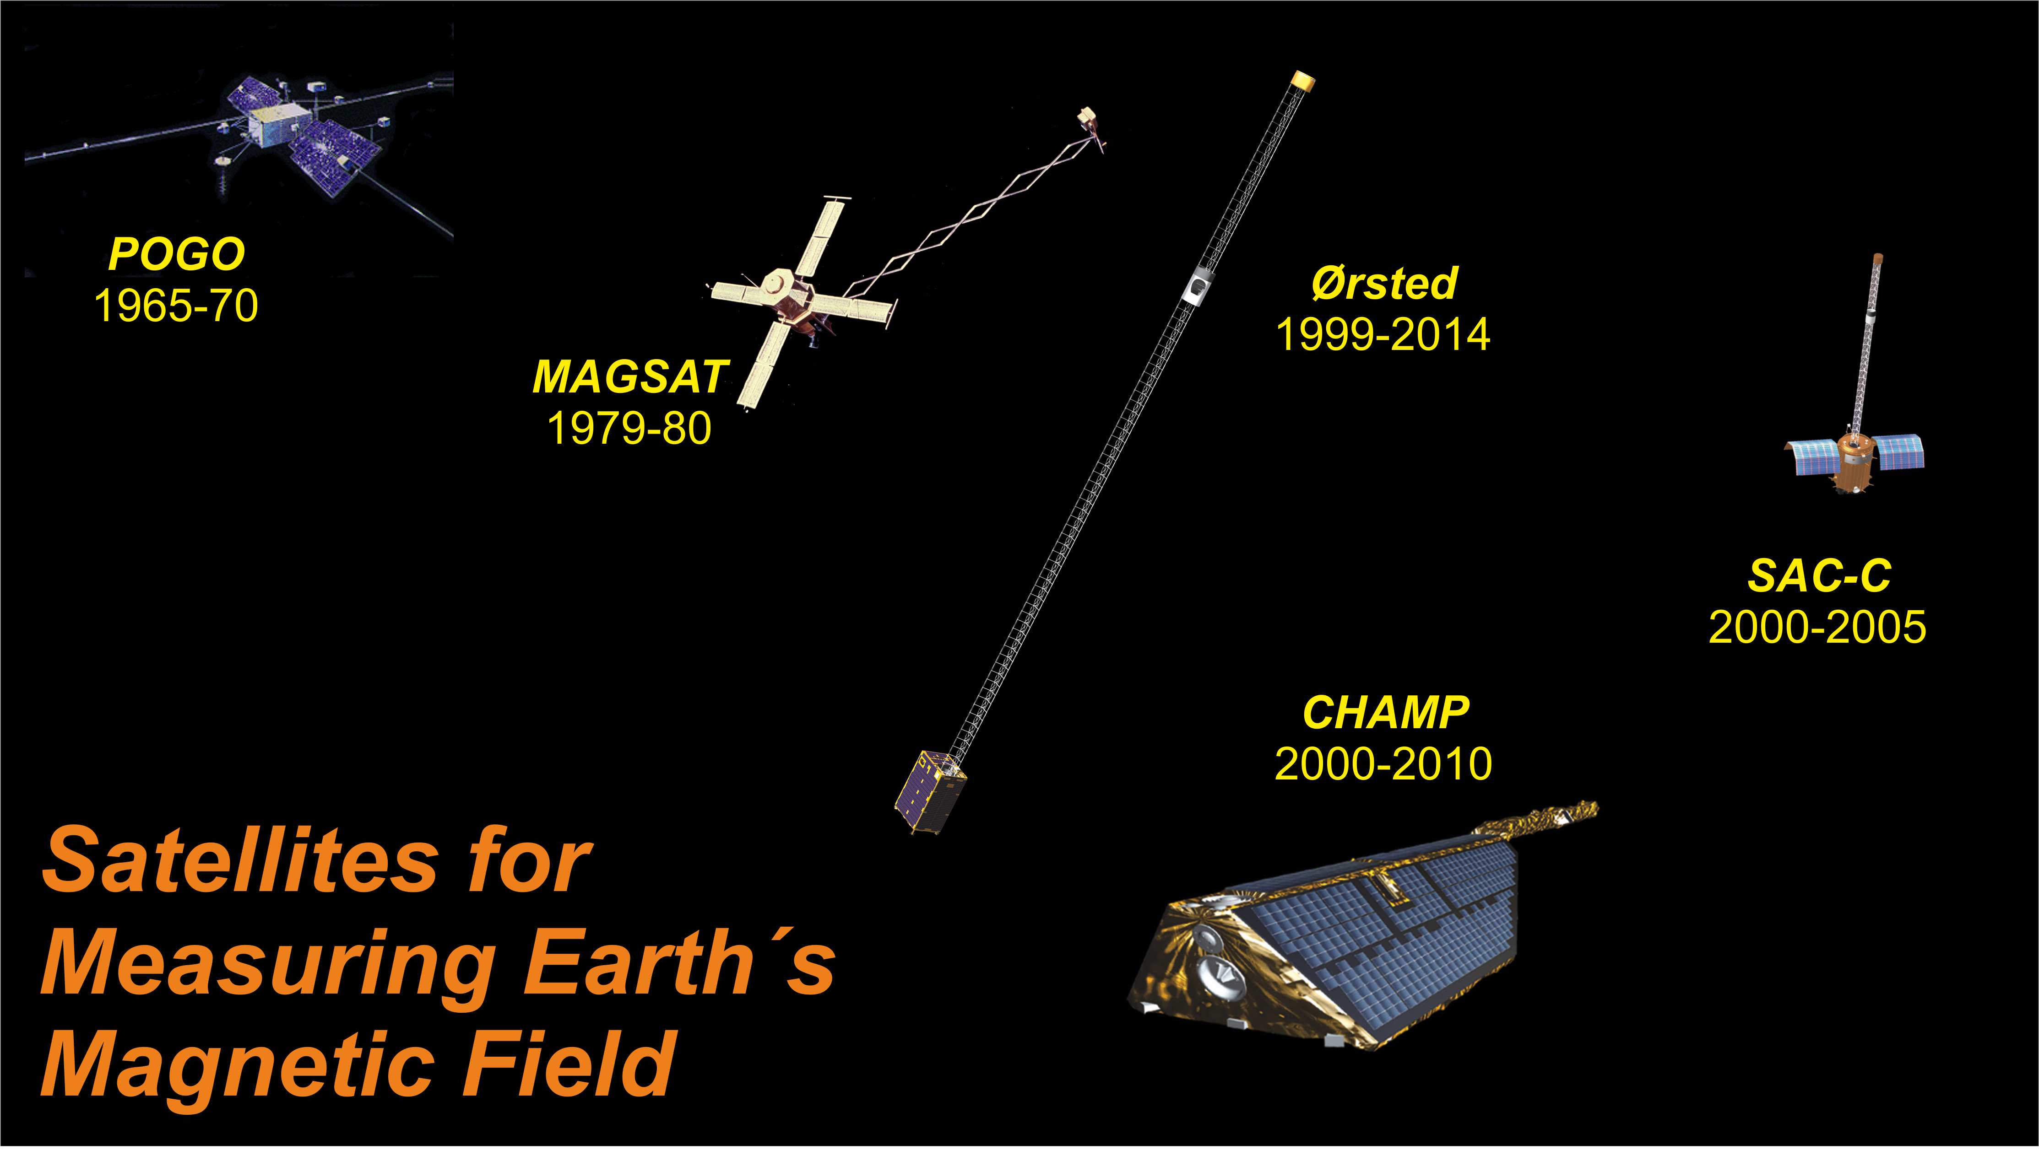
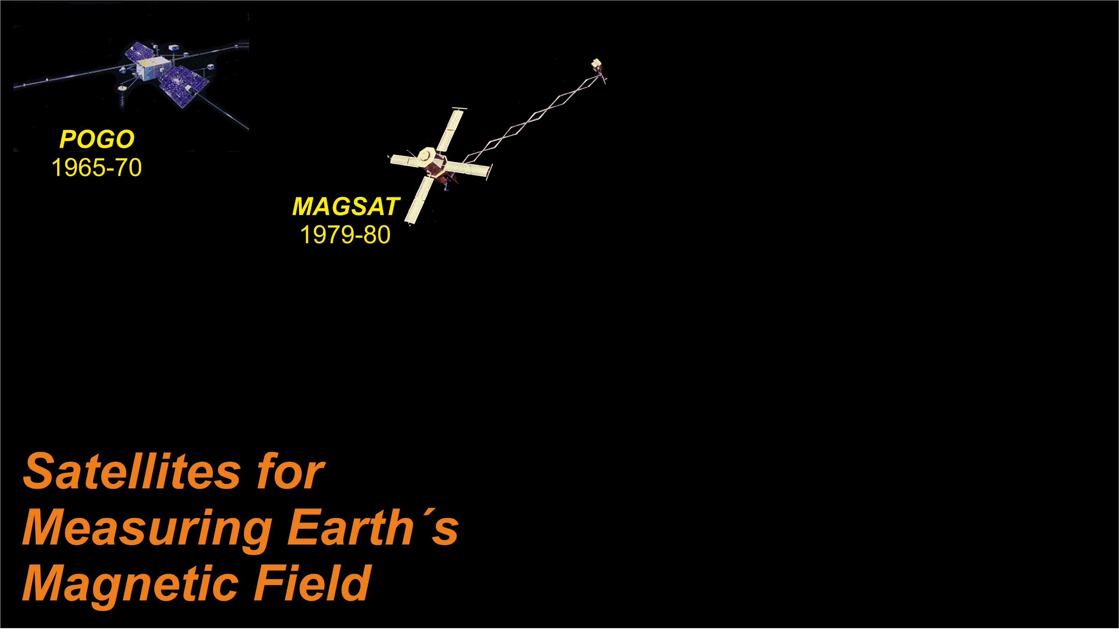

Slide 8
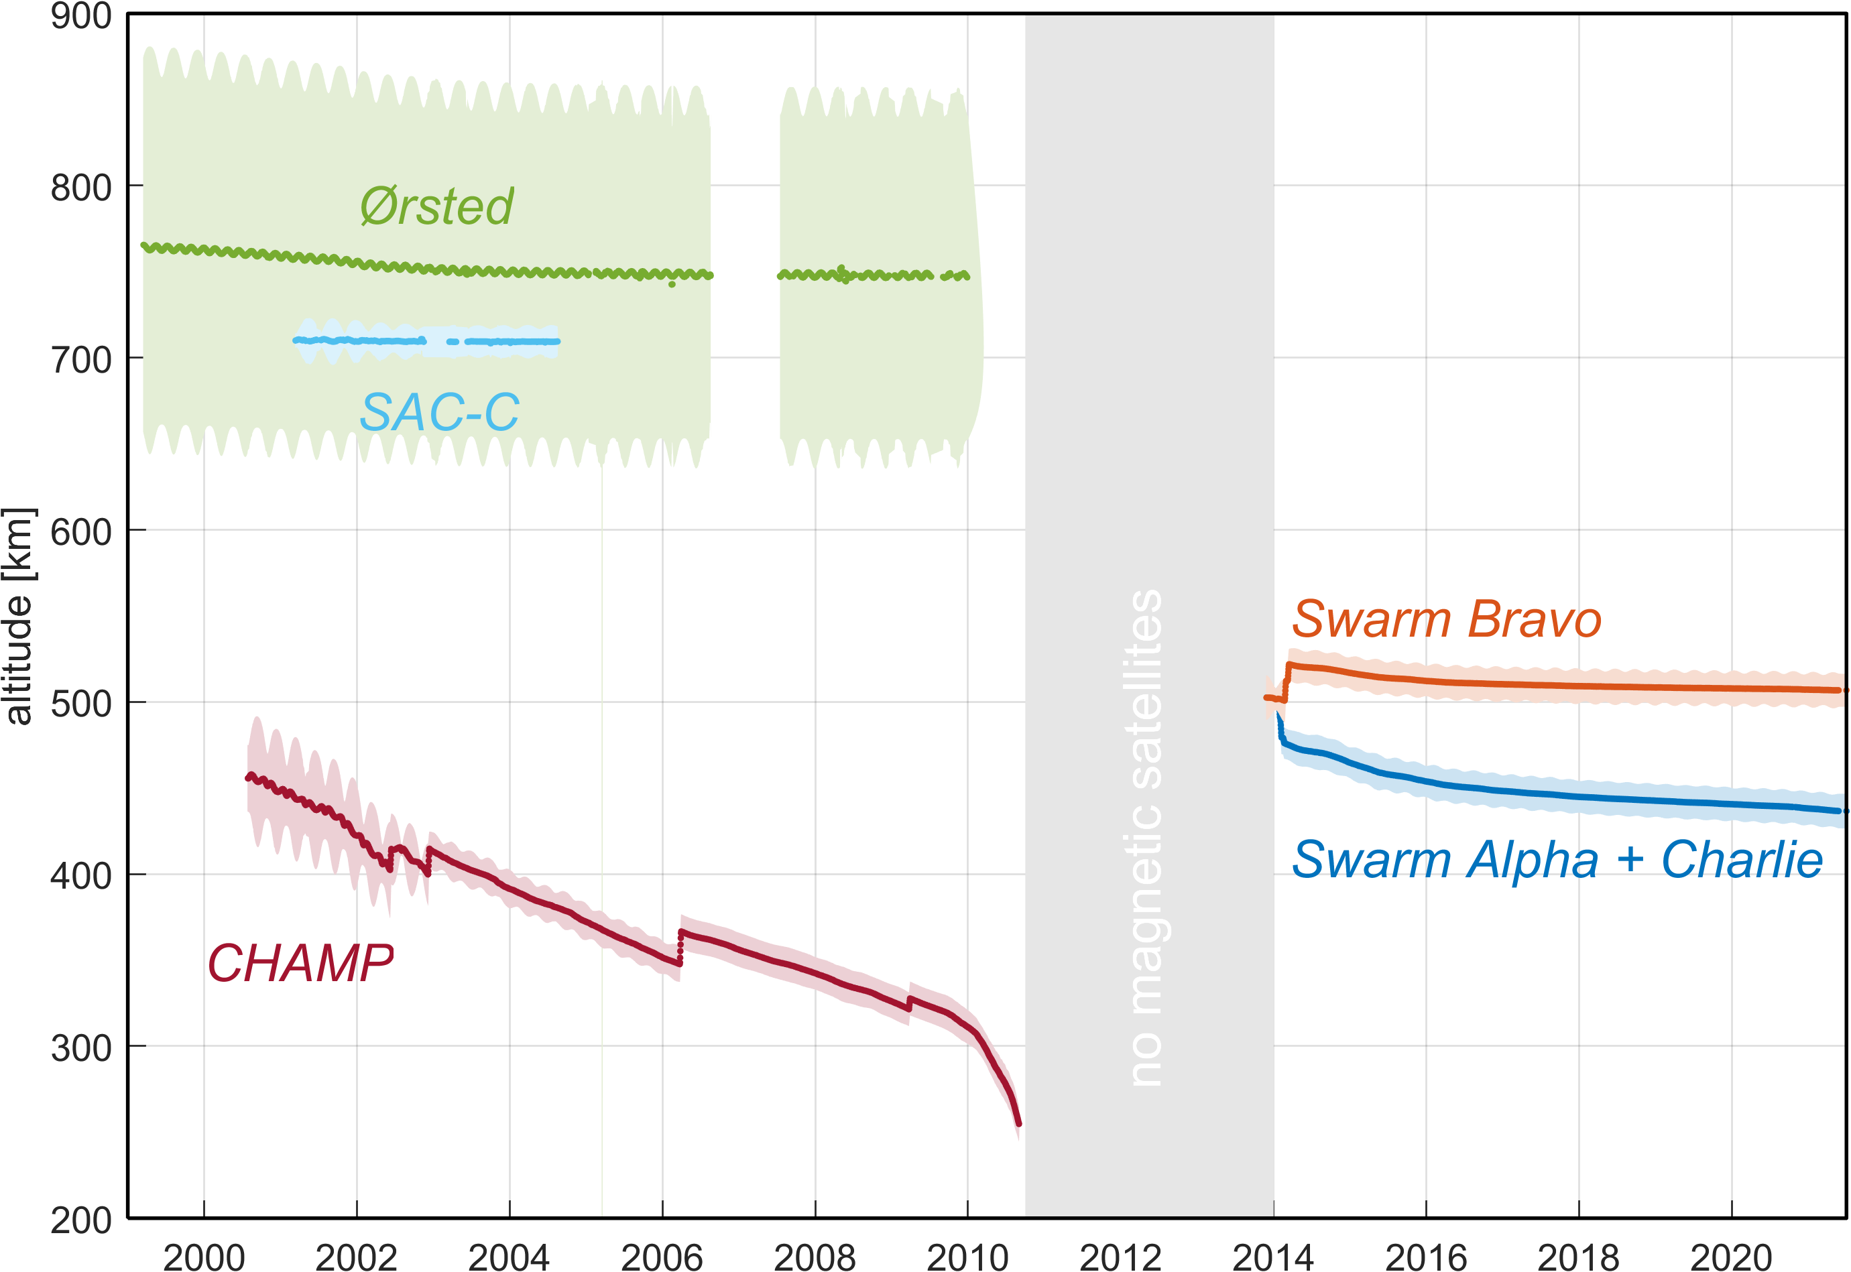
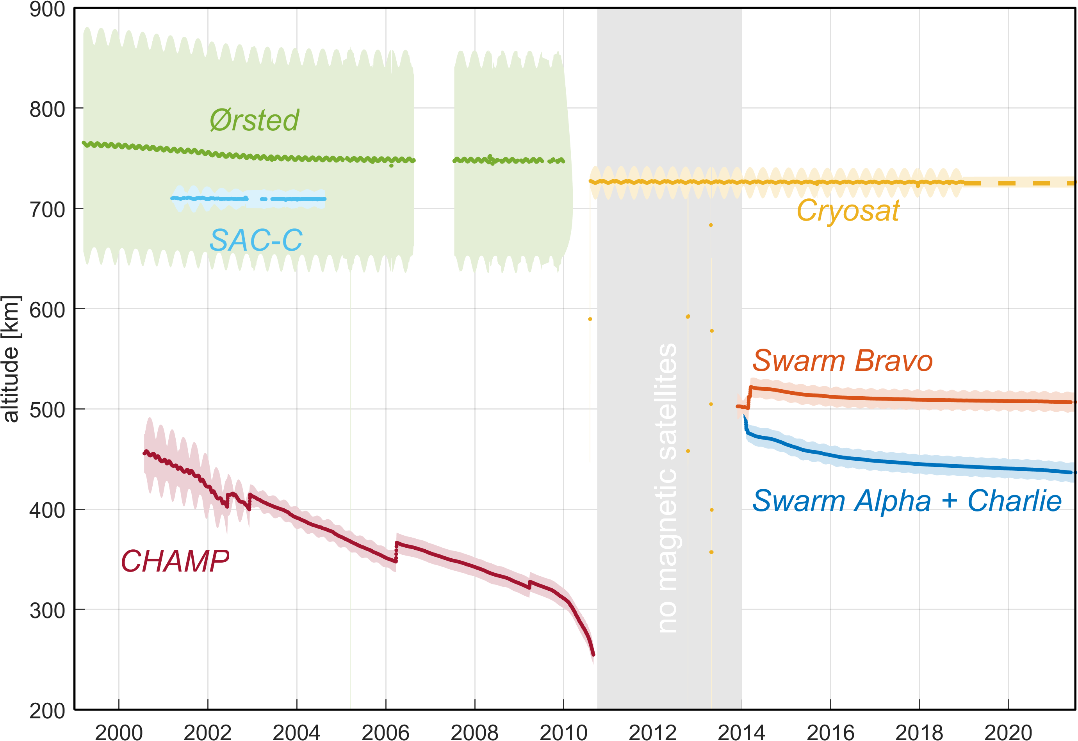
Why using CryoSat for exploring Earth’s magnetic field?
No high-precision magnetic field data are available between in the gap between CHAMP and Swarm
(Oct 2020 and Nov 2013)
CryoSat helps to fill this gap, for improved study of the dynamics of Earth’s core field

Slide 9
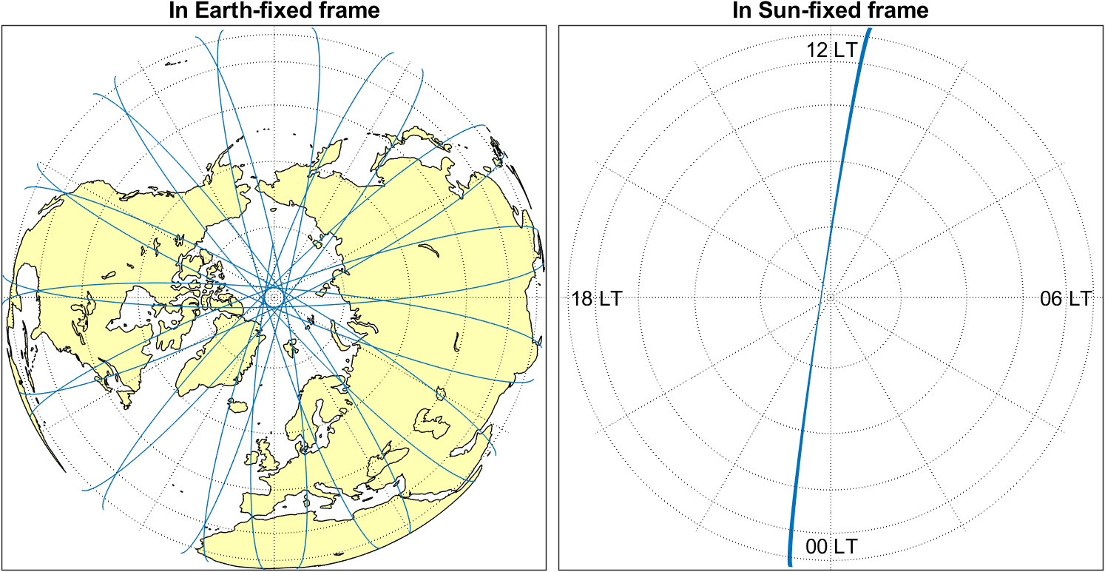
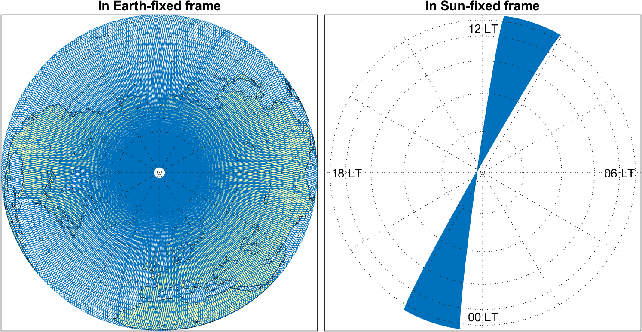
Why using CryoSat for exploring Earth’s magnetic field?
Ionospheric and magnetospheric electric current systems are oriented wrt Sun
Single satellites only measure at one specific local time (slowly drifting in time)
Simultaneous magnetic data from many satellites allows to detangle time-space structure of external sources
CryoSat-2, 1 Aug 2018
CryoSat-2, 1 - 29 Aug 2018

Slide 10
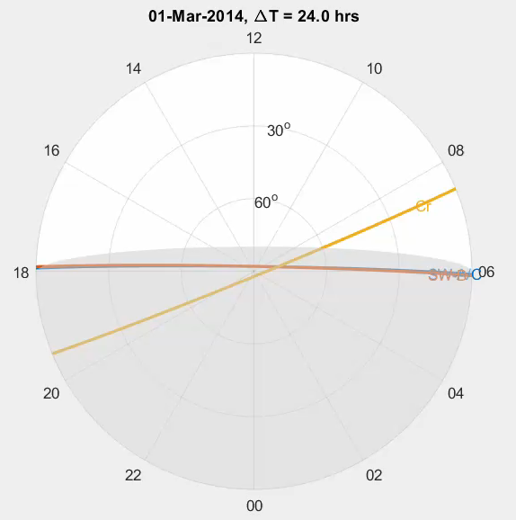
Local Time evolution of Swarm and CryoSat-2
Swarm A/C
change in LT of 2.73 hrs/month
all LT in 4.4 months
Swarm B
change in LT of 2.61 hrs/month
all LT in 4.6 months
CryoSat-2
change in LT of 1.50 hrs/month
all LT in 8 months

Slide 11
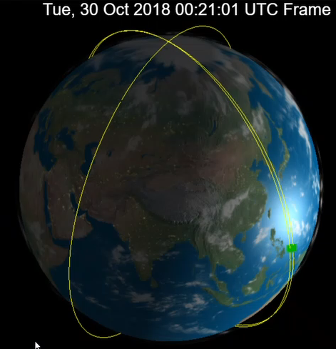
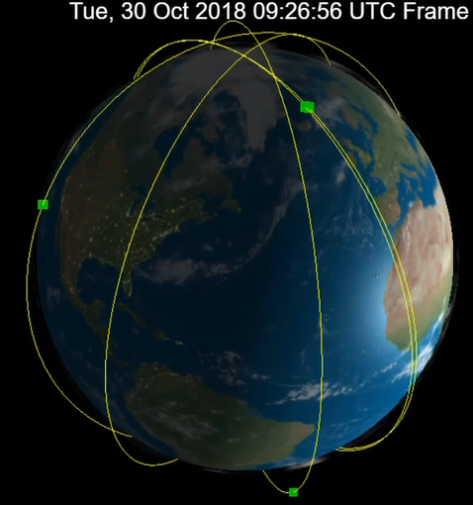
Swarm only …
Swarm + Cryosat + CSES
Sven Kardol, http://orbits.tudelft.nl/

Slide 12
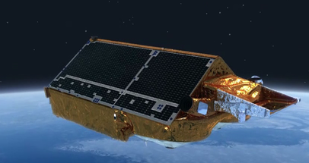
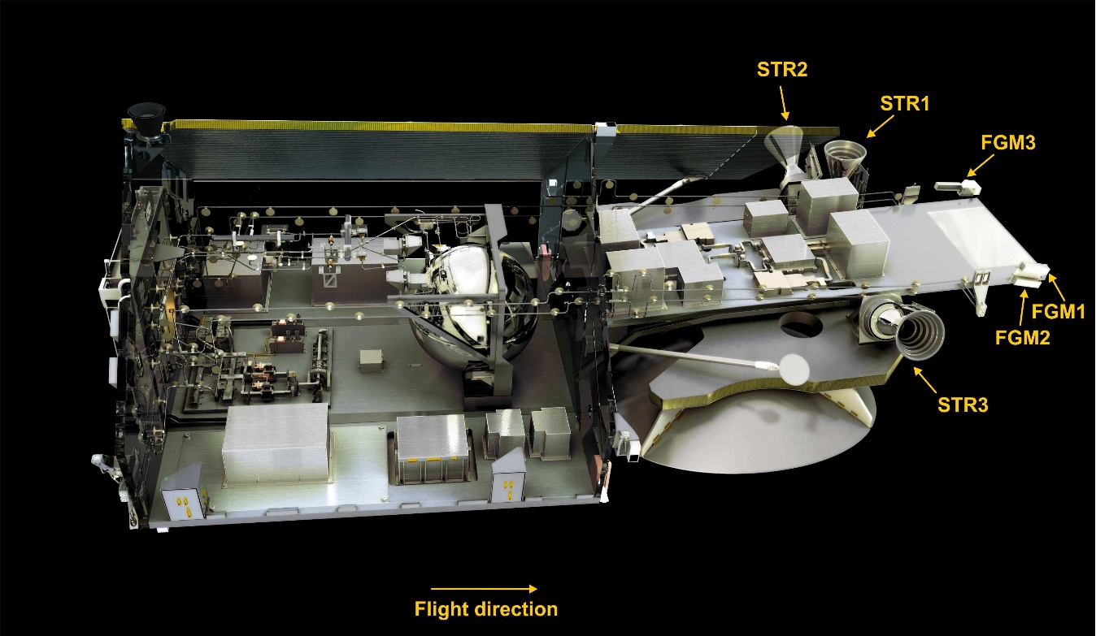
The “secret instruments” of CryoSat-2
3 Vector Fluxgate magnetometers (FGMs)
3 Star imagers (STRs)
Estimation of calibration parameters requires FGM sensor output E and STR quaternions q
and model values B_{mod} of the magnetic field vector at satellite position and time
Available: 4-sec sampled CryoSat-2 magnetic data E spanning 9.5 years (Aug 2010 – Dec 2018)

Slide 13


Vector Calibration of FGMs
E is uncalibrated output of the 3 magnetometer sensor axes, B_{FGM} is calibrated magnetic field vector in FGM frame
Assumption: linear response of each FGM instrument:
3 offsets (biases), 3 scale values (sensitivities), 3 non-orthogonalities
Alignment: rotation from FGM to CRF (Common Reference Frame of Star tracker) using STR quaternions q
3 Euler angles for describing rotation matrix
Estimation of the 12 parameters (offsets, scale values, non-orthogonalities, Euler angles)
by a robust Least-Squares minimization of ΔB = B_{CRF,obs} – B_{CRF,model}
where B_{CRF,model} is magnetic field vector as given by CHAOS-6 geomagnetic field model
(describing contributions from core, crust + magnetosphere)

Slide 14


Accounting for temperature, s/c disturbance, and non-linearities
12 “basic” calibration parameters, estimated separately for each of the 100 months
(Aug 2010 – Dec 2018) x 12 = 1200 parameters
The 3 offsets b and 3 scale values S depend on sensor temperature T_{FGM}
Assumed to be constant for whole mission: 2 x 3 = 6 parameters
Magnetic disturbance vector of Magnetorquer currents I_{MTQ}
Assumed to be constant for whole mission: 3 x 3 tensor = 9 parameters
Magnetic disturbances due to solar array and battery current strengths I_{SA1}, I_{SA2}, I_{Batt}
Assumed to be constant for whole mission: 3 x 3 = 9 parameters
Non-linearities (“transverse effect” disturbance of fluxgate sensor x on sensor output y)
B₁ depends on E₃², and B₃ depends on E₂³ and E₃² : 3 parameters
In total 1227 model parameters estimated by robust non-linear Least-Squares
from 13.3 mio observations (= 3 x 4.4 mio data triplets)
Temporal regularisation (smoothing) of month-to-month variation of “basic” 12 parameters

Slide 15
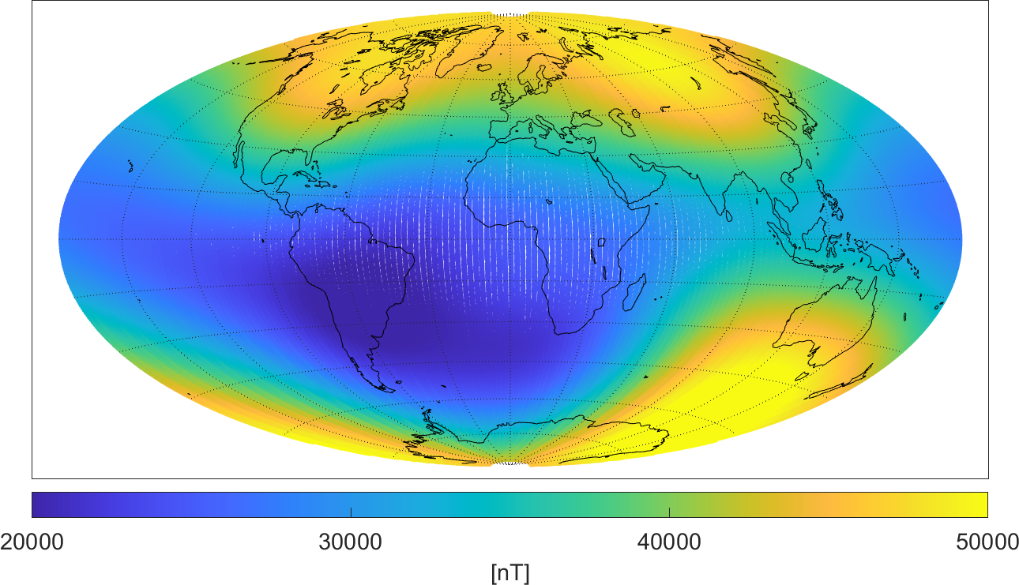
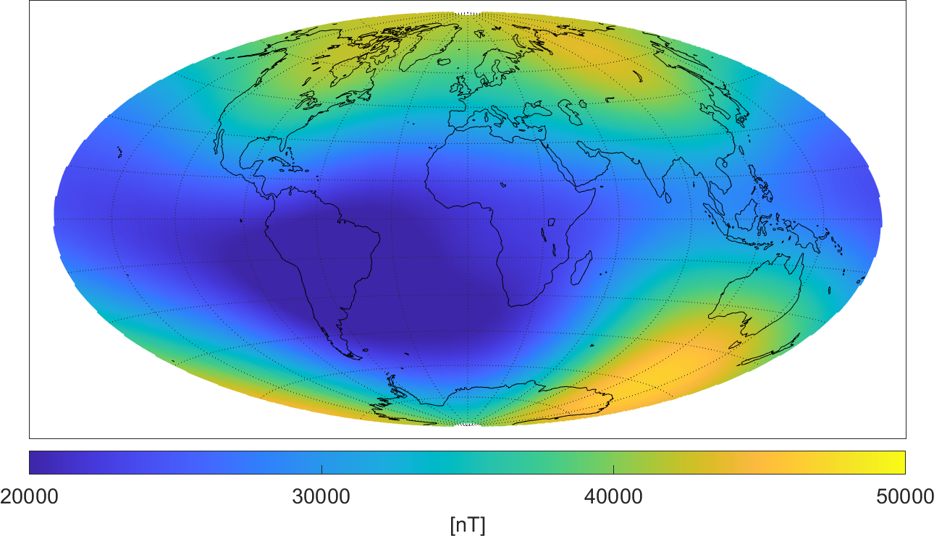

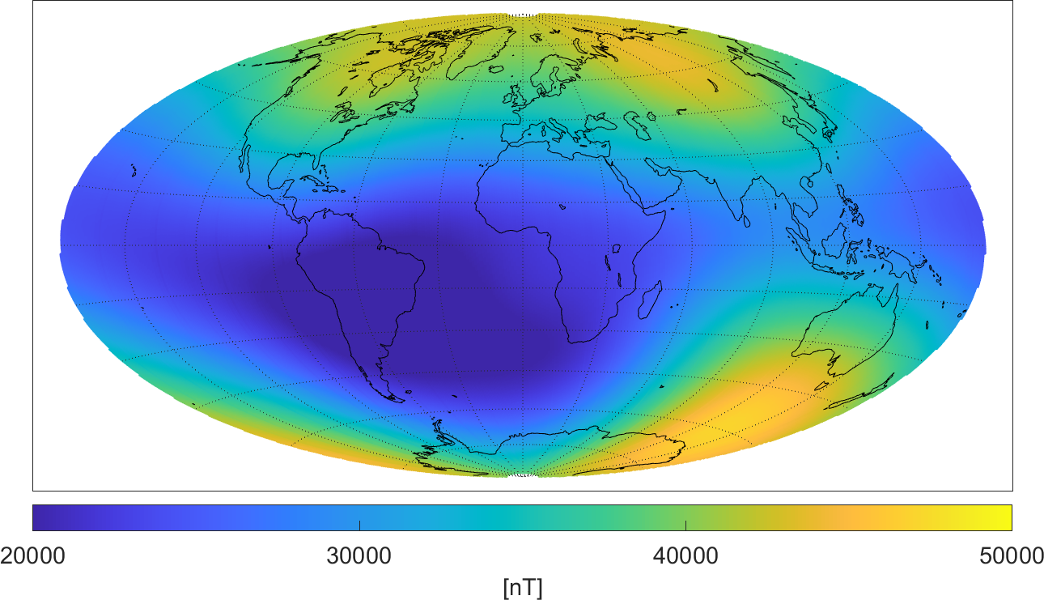
Magnetic field strength F = |B|
August 2018
Swarm A
CryoSat-2
430 km altitude
720 km altitude
observed F_{obs}
model F_{mod}

Slide 16
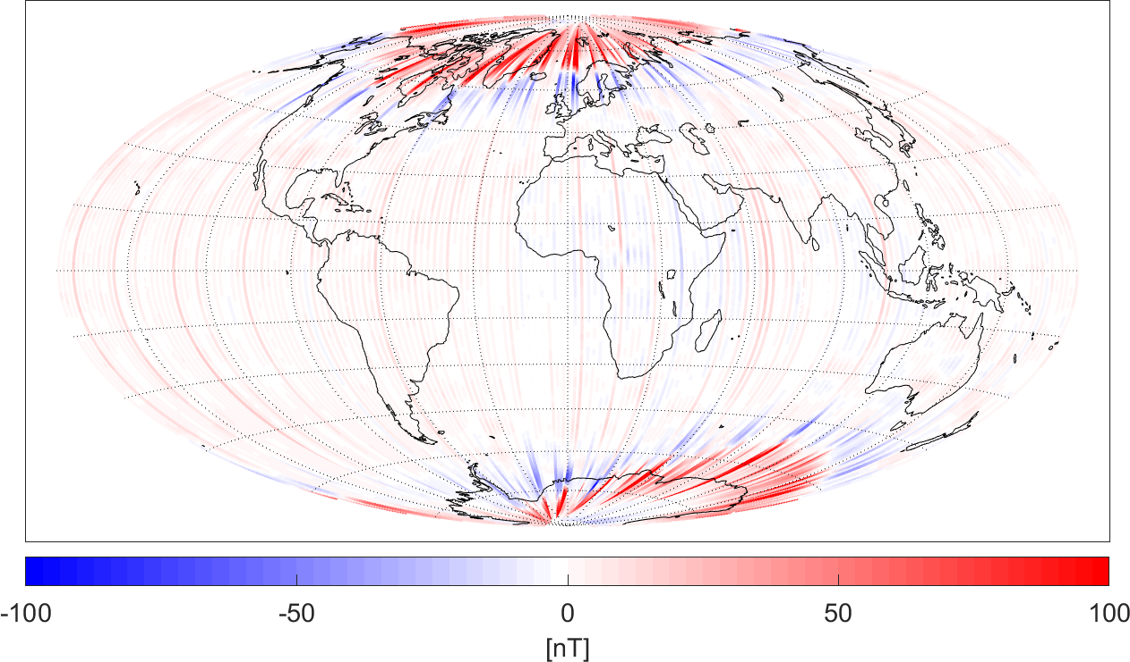
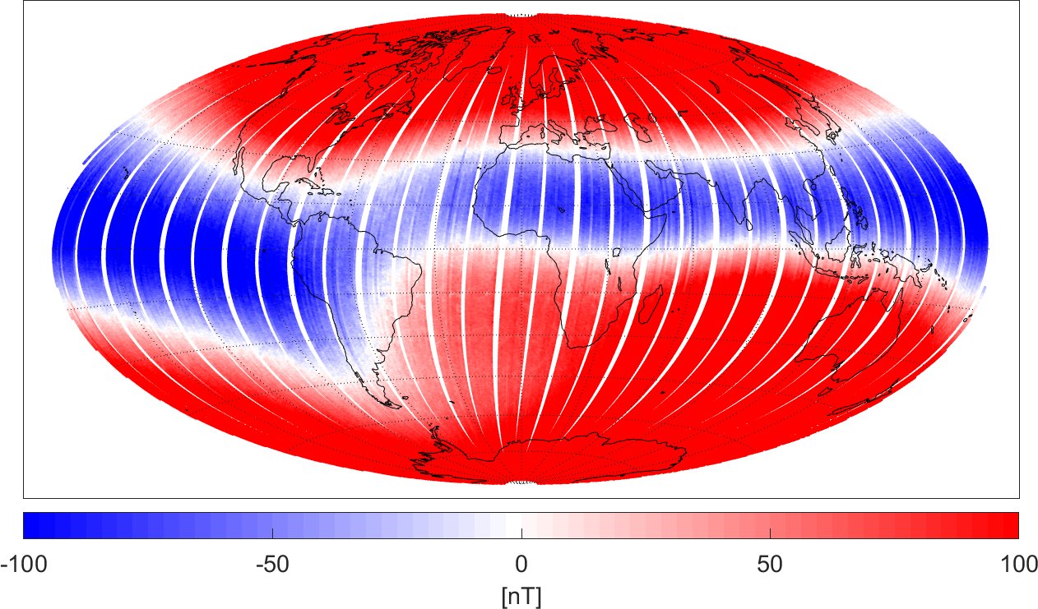
Magnetic field strength F = |B|
August 2018
Swarm A
CryoSat-2, uncalibrated
ΔF = F_{obs} – F_{mod}
Polar ionospheric currents

Slide 17
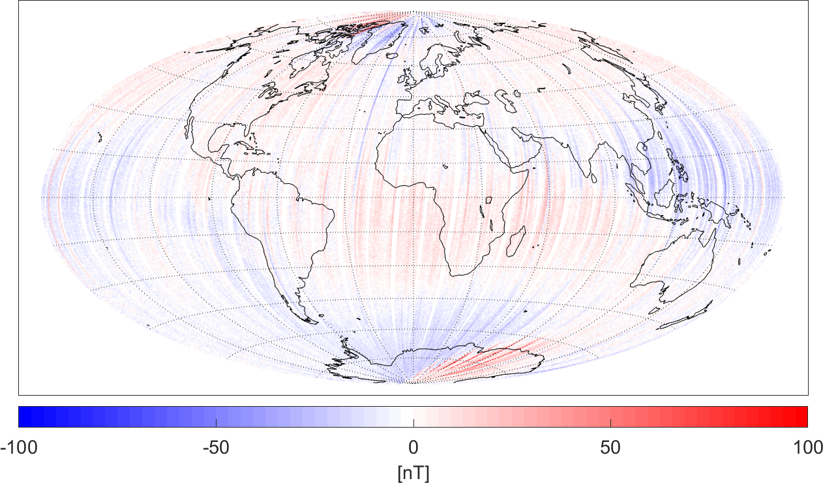
Magnetic field strength F = |B|
August 2018
Swarm A
CryoSat-2, calibrated
ΔF = F_{obs} – F_{mod}
weaker in CryoSat,
due to higher altitude
Polar ionospheric currents

Slide 18
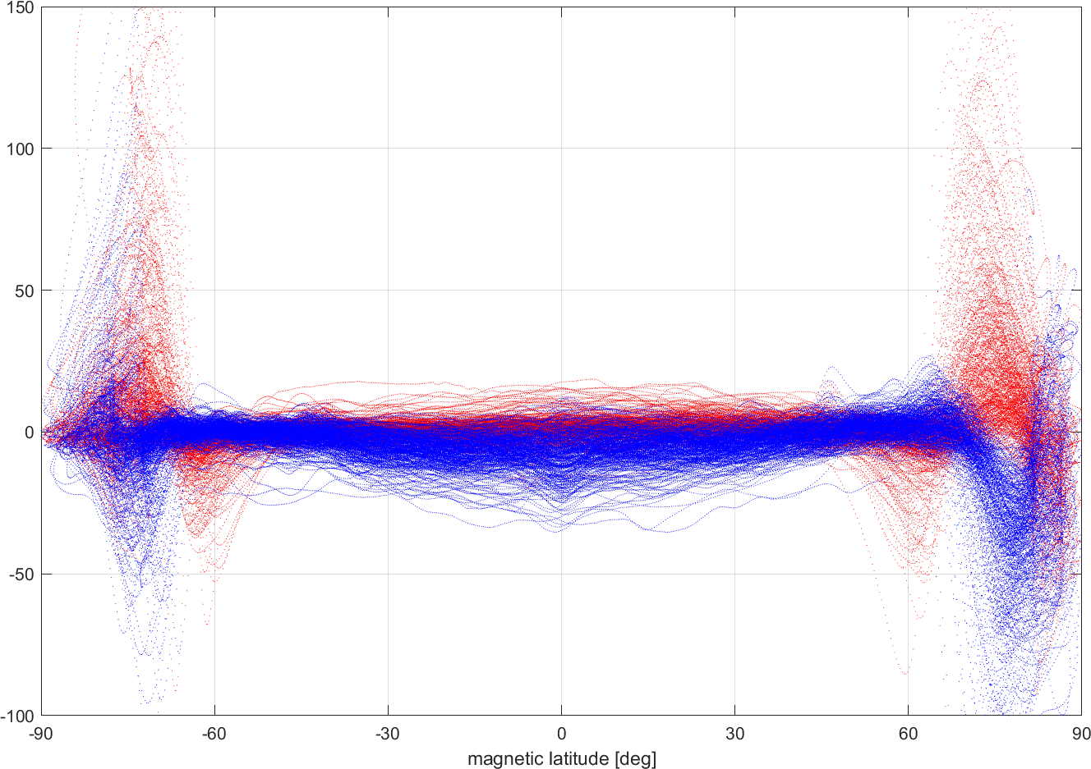
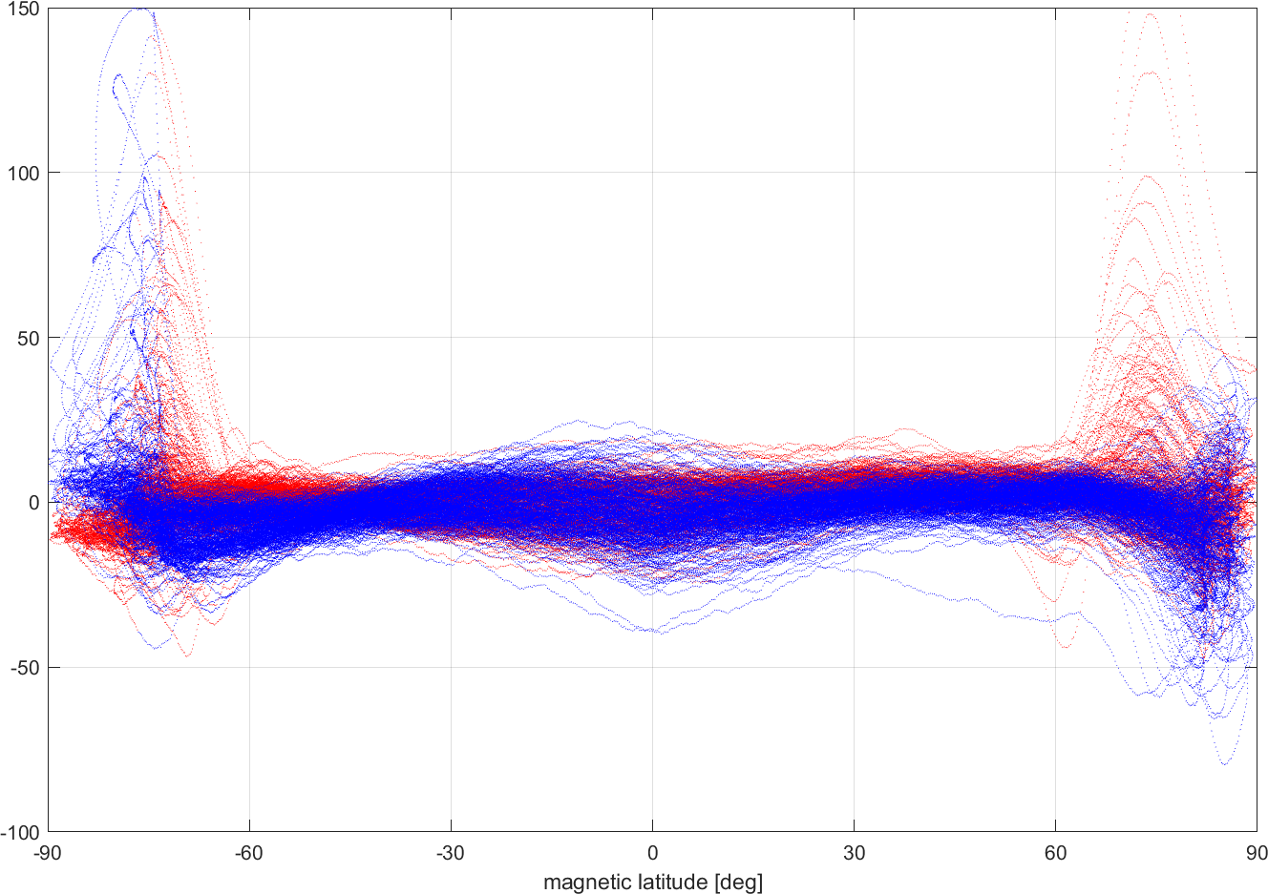
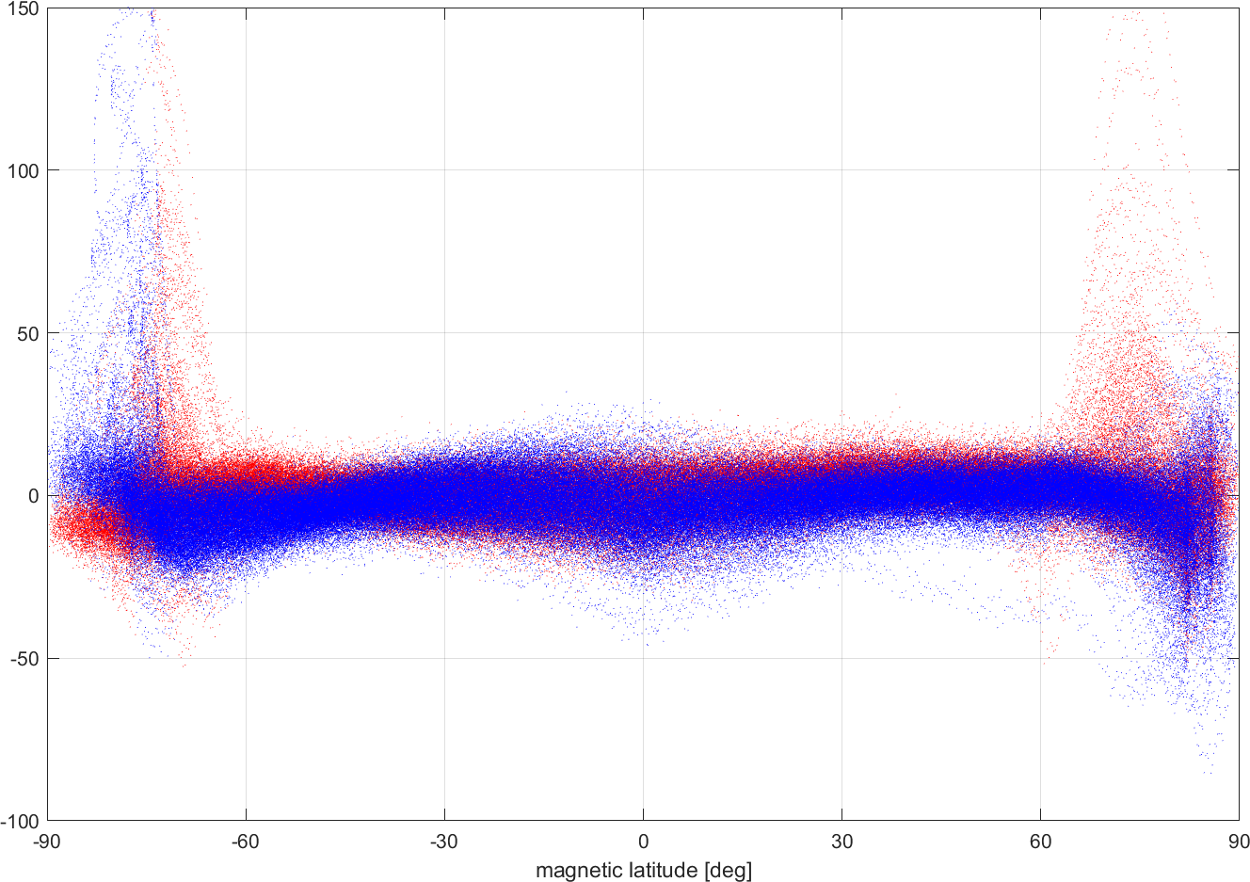
Magnetic field strength F = |B|
August 2018
Swarm A
CryoSat-2, calibrated
1.9 nT rms
measurement error: < 0.5 nT
6 nT rms
ΔF = F_{obs} – F_{mod}
dayside
nightside
1 min (15 values) moving average

Slide 19
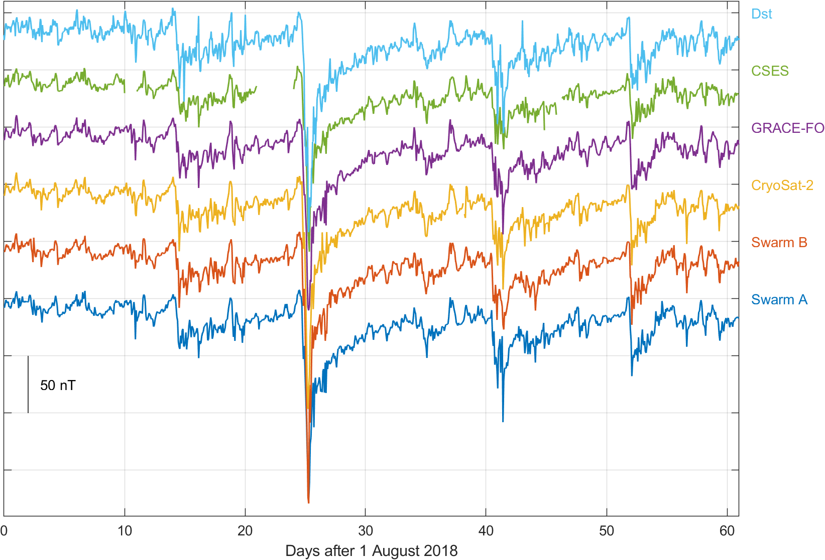
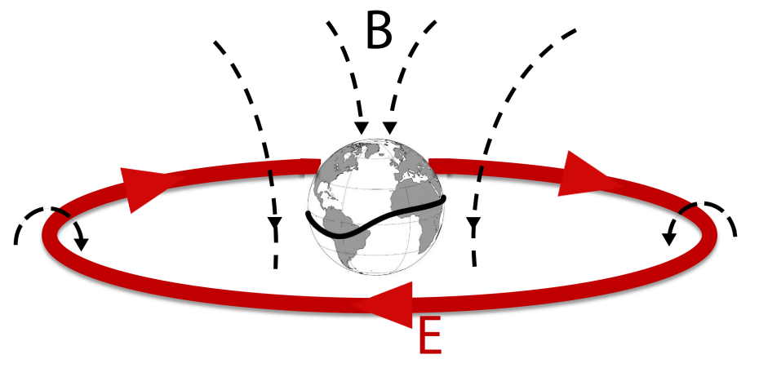
Application:
Monitoring of Magnetospheric Ring-current activity
Independent observation of time-evolution of magnetospheric ring-current with magnetic data
from 5 satellites …
… and comparison with Dst-index derived from ground magnetic data
50 nT
Swarm A
Swarm B
CryoSat-2
GRACE-FO
CSES
Dst

Slide 20
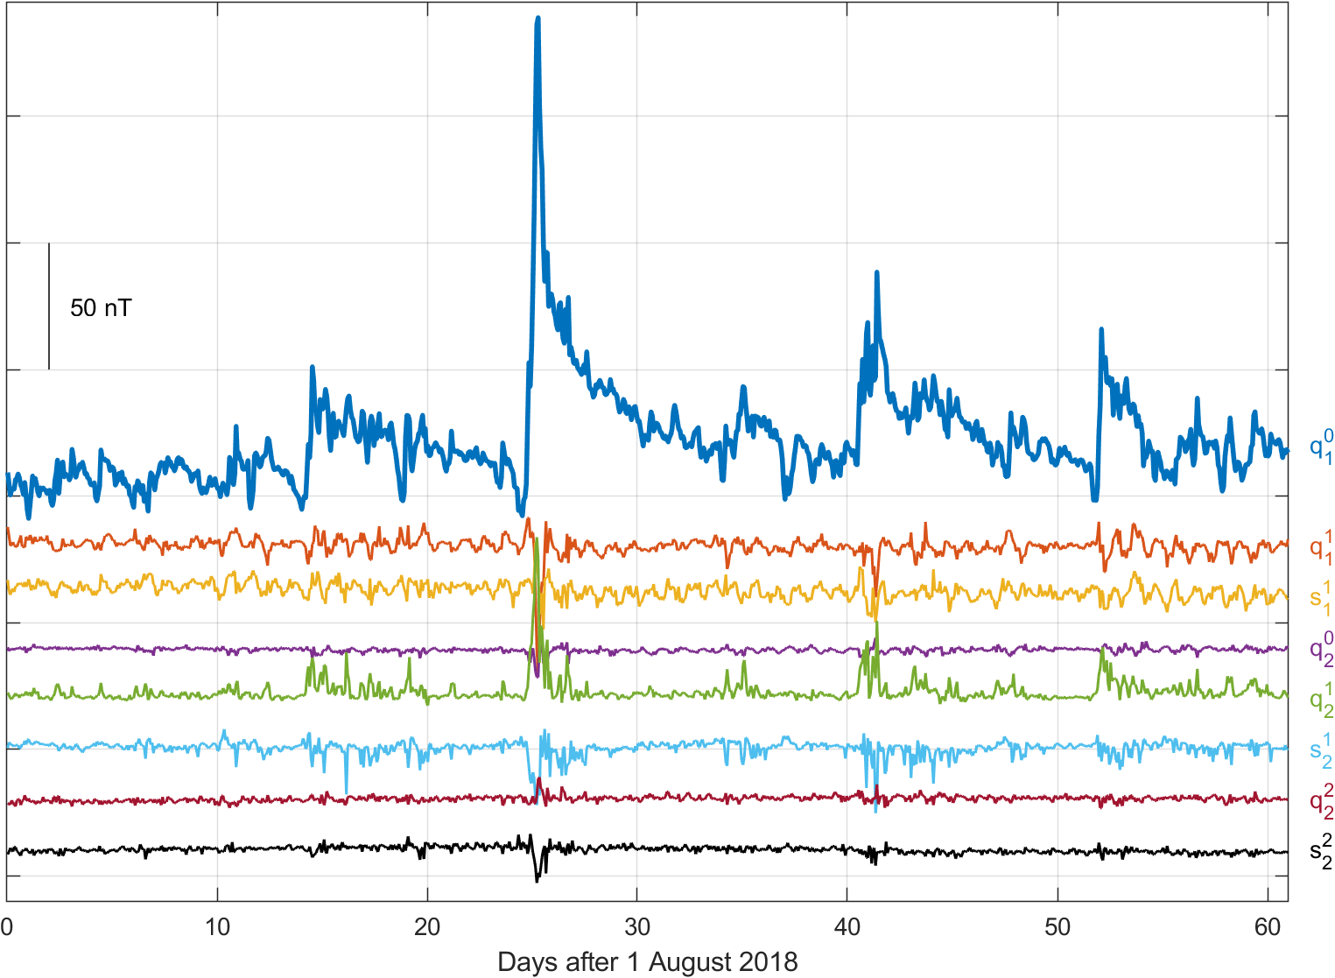
Space-time structure of magnetospheric field
q₁⁰ is main ring-current term
describes symmetric ring-current in equatorial plane
Joint spherical harmonic analysis using magnetic data from 5 satellites
Strong asymmetric ring current during storm expansion phase
contributions from terms with m = 1, faster decay compared to main term
Terms describing asymmetric ring-current

Slide 21
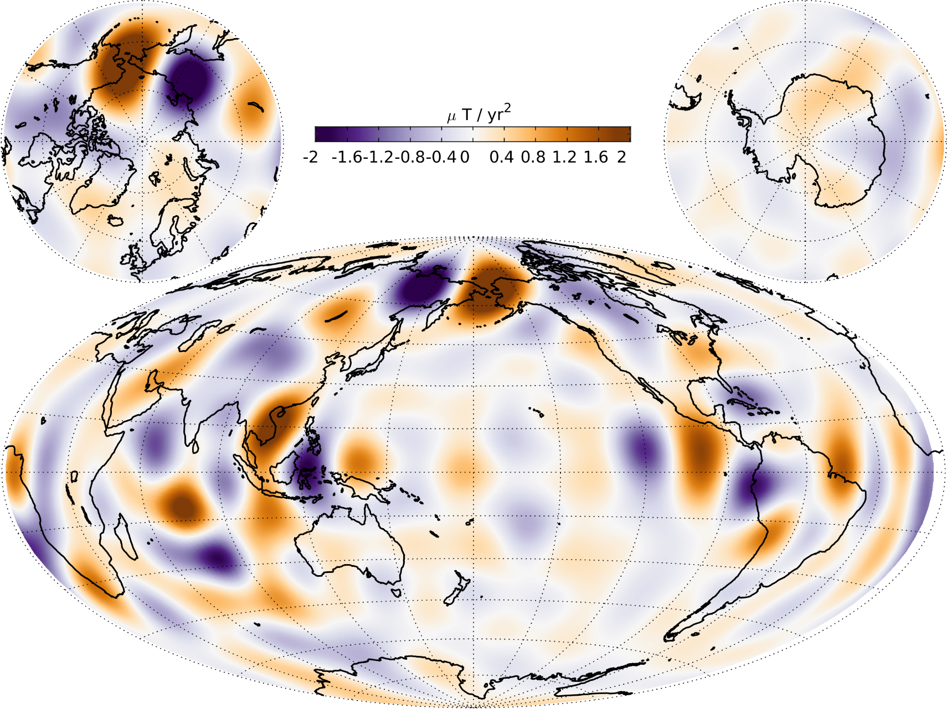
Application: Core surface field secular acceleration
CHAOS-6 model of Earth’s magnetic field
up to spherical harmonic degree n = 19

Slide 22
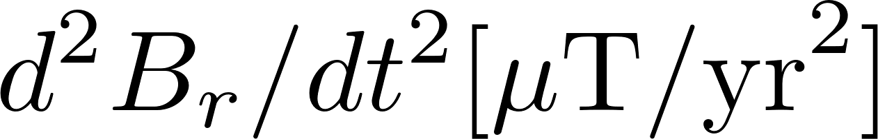
Application: Core surface field secular acceleration
CHAOS-6
Swarm
Only ground observatories
CHAMP

Slide 23
Application: Core surface field secular acceleration
CHAOS-6
SOLA: Local Inversion of CHAMP,
Cryosat and Swarm data (Hammer & Finlay 2019)
Swarm
Cryosat
CHAMP

Slide 24
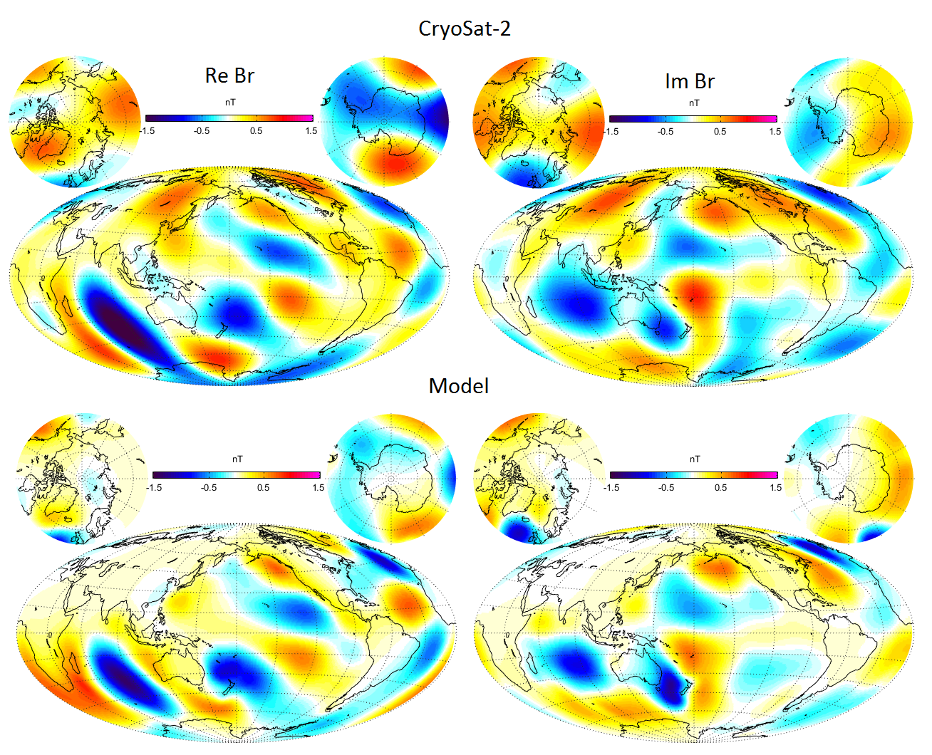
The Icing on the Cake
Magnetic field of oceanic M₂ tide determined from Cryosat data
B_{r} of M₂ tidal field at 720 km (Cryosat) altitude
Model prediction
(ocean tidal flow model + model of conductivity for mantle, lithosphere and seawater
Courtesy: Alexander Grayver, ETH Zürich

Slide 25
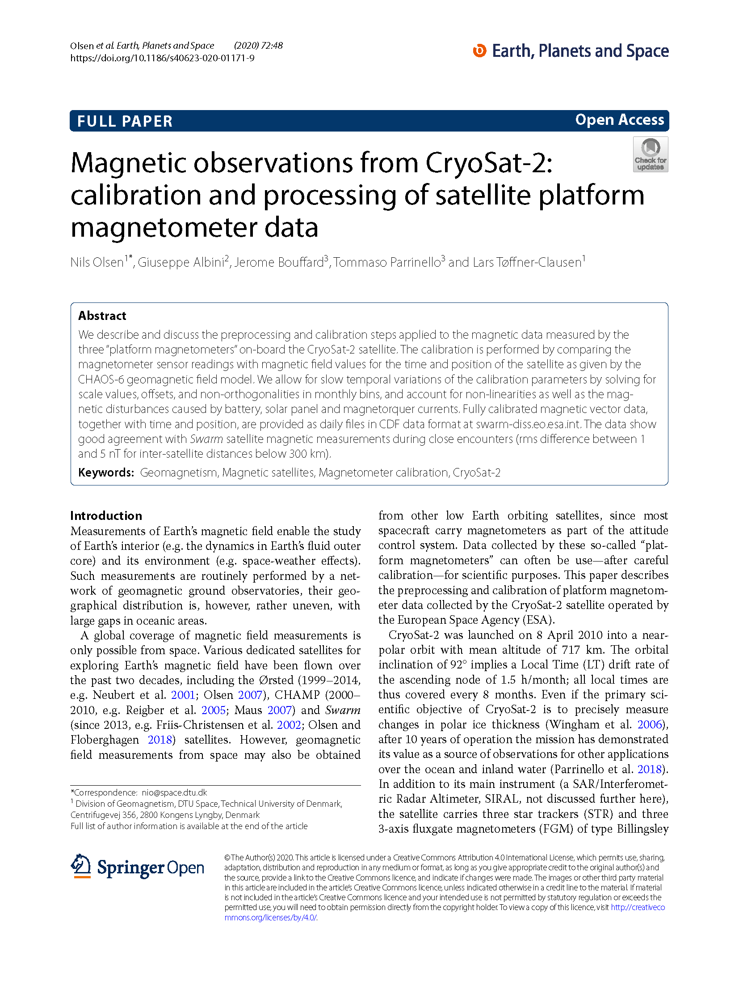
Summary and Conclusion
CryoSat has set new standards of what is possible with navigational magnetometers:
(until now) the satellite with best magnetic data quality
Data can be used for core field studies and for investigating ionospheric and magnetospheric current systems - Space-weather applications
Enormous potential for science and application
Calibrated Cryosat-2 magnetic data (Aug 2010 – Dec 2018)
are available as daily files (similar to Swarm L1b data)
at ftp://swarm-diss.eo.esa.int/%23CryoSat-2

Slide 26
Terminology …
Calibration: From Vector Fluxgate Magnetometer (FGM) 3-sensor output E
to magnetic field B_{FGM} vector in FGM frame
Estimation of the parameters describing FGM calibration and applying them to data
in order to get B_{FGM} in physical units (nT) in an orthogonalized instrument frame
Alignment: Rotation of B_{FGM} from FGM frame to Star Imager (STR) frame
and further to B_{NEC} in NEC (North-East-Center) frame
Estimation of rotation parameters (“Euler angles”) and applying them to B_{FGM}
using STR attitude data q in order to get magnetic field vector in NEC frame
Characterization: Accounting for influence from instrument and/or S/C
e.g. magnetorquer effect on FGM data, temperature dependence of FGM calibration parameters
Estimation of disturbance parameters and correction of B_{FGM}
Often done by co-estimation with calibration parameters

Slide 27
Temporal Evolution of Calibration and Alignment Parameters
Month-to-month variation:
Offsets: ± 8 nT
Scale values: ± 300 ppm
non-orthononalities
and Euler angles:
±0.02°(±72 arcsecs)
For FGM3

Slide 28
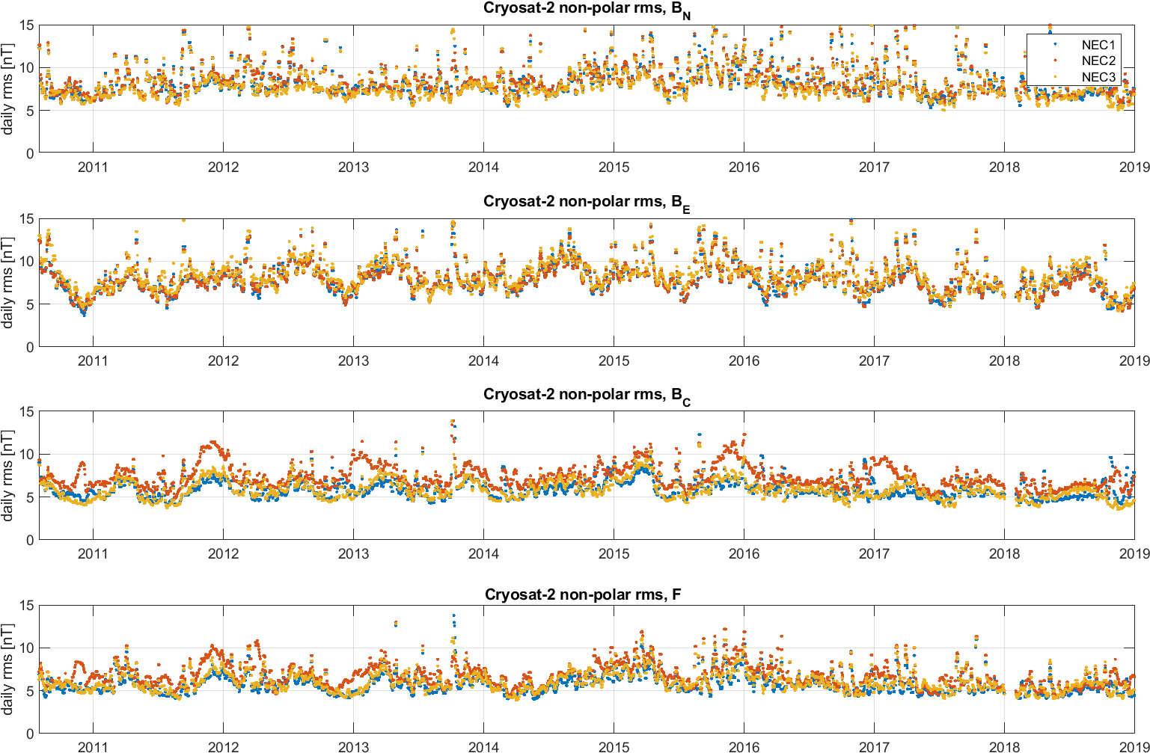
Daily rms misfit: 5 – 10 nT
B_{N}: North component
B_{E}: East component
B_{C}: Downward component
F: Magnetic intensity

Slide 29
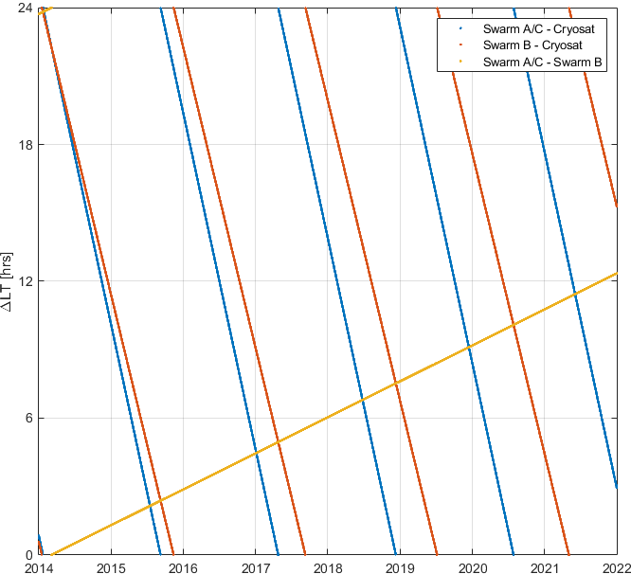
Conjunctions Swarm / CryoSat-2
Test case for “All-Swarm-satellites-in-one-orbital-plane” of October 2021
Swarm B vs CryoSat
Swarm A/C vs CryoSat
Counter-rotating orbits
Swarm A/C vs B: October 2021

Slide 30
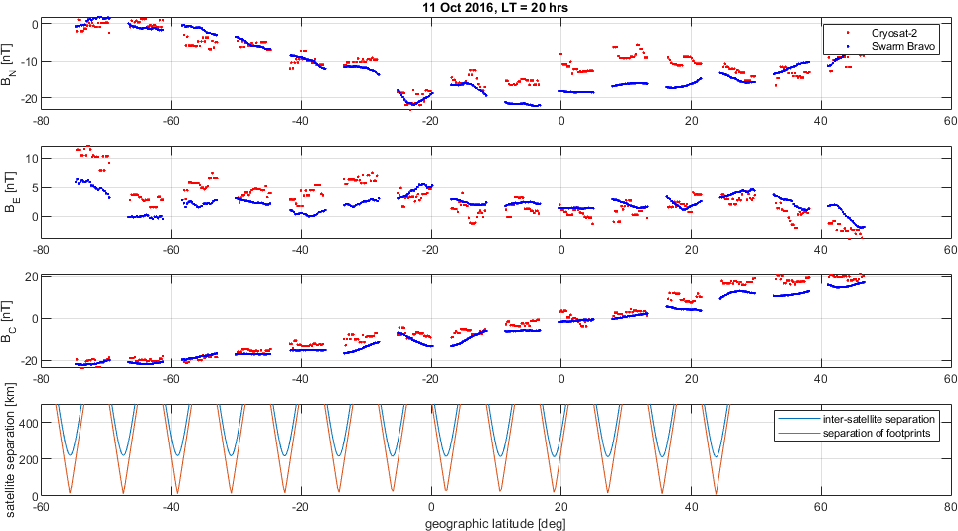
Conjunctions Swarm-B / CryoSat-2 on 11 Oct 2016
CHAOS-6_x9 core removed

