Slide 1
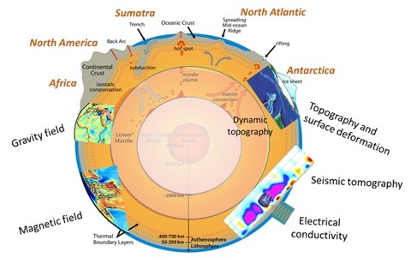
Effect of Icelandic hotspot on Mantle viscosity below Kangerlussuaq glacier in SE-Greenland
NKG Copenhagen 5-8 September 2022
Valentina R. Barletta
W. van der Wal, A Bordoni and SA Khan
contact: vr.barletta@gmail.com
Projects:
ESA 3DEarth/GOCE+Greenland

Slide 2
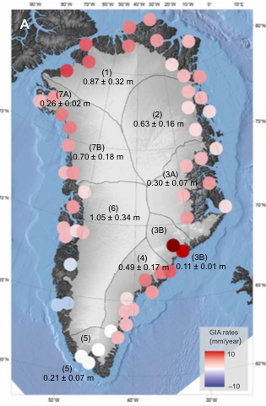
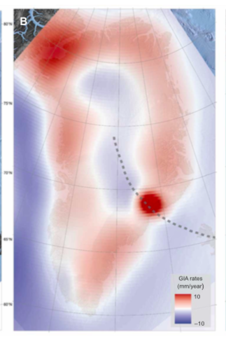
Anomaly in GPS uplift residual in SE-Greenland
Khan et al. 2016
Hint of Hotspot track

Slide 3
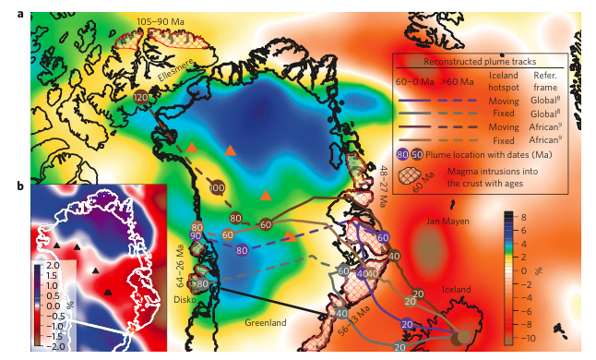
Hotspot tracks
Rogozhina et al. 2016 - NatGeo

Slide 4
Motivations
There is a clear uplift anomaly in SE-Greenland detected by GNSS. More specifically two GPS nearby Kangerdlugssuaq glacier shows a residual uplift rate larger than the average in Greenland.
Below the same area there is one of the possible Icelandic hotspot tracks.
That could indicate the presence of a low viscosity mantle and with this study we want to investigate that possibility and see if we can constrain the values of such viscosity

Slide 5
The residual GPS uplift rate
Khan et al. 2016

Slide 6
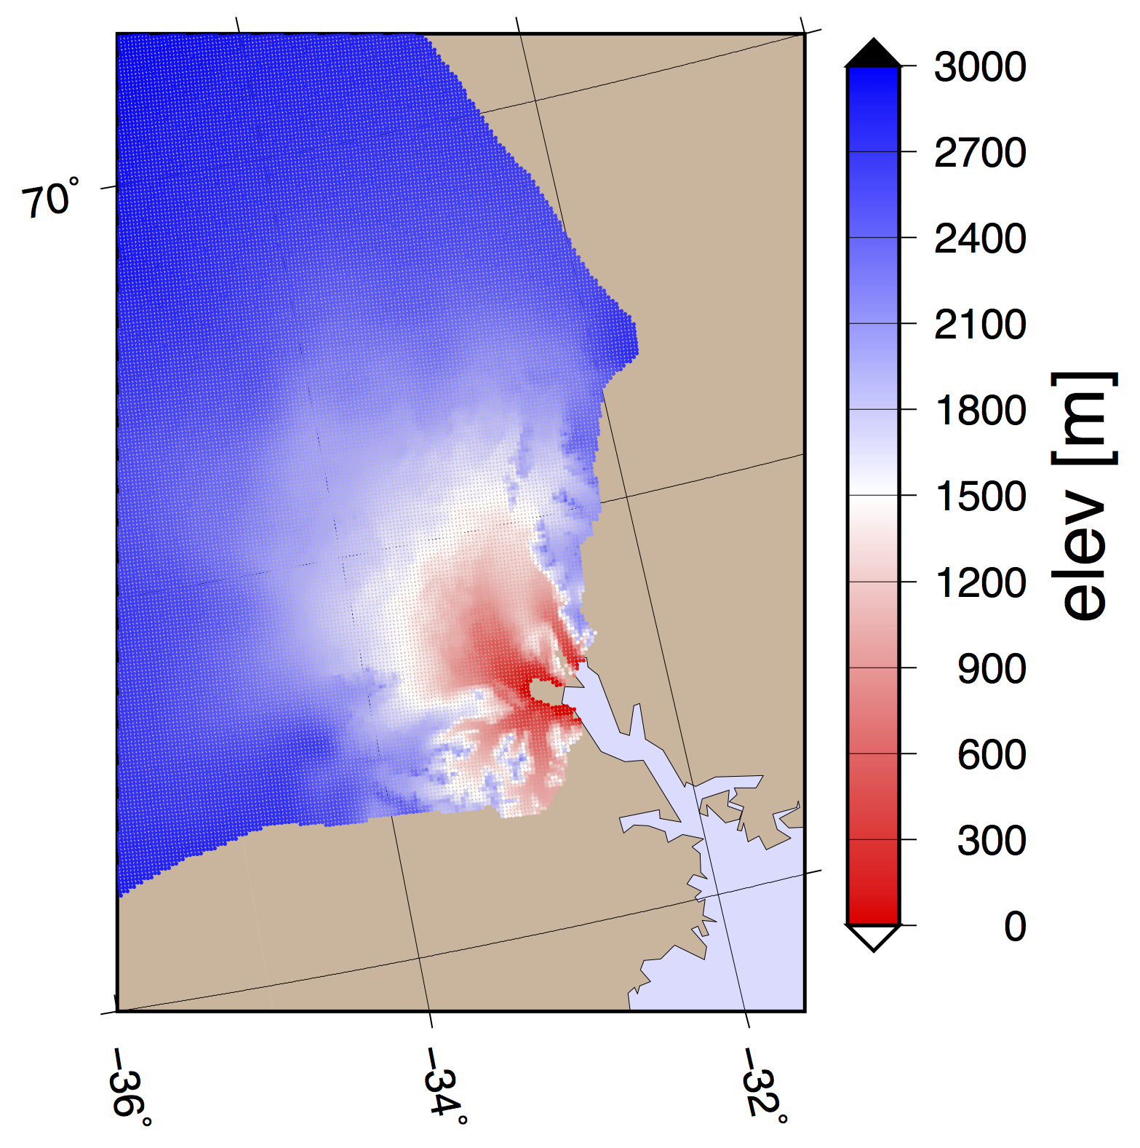
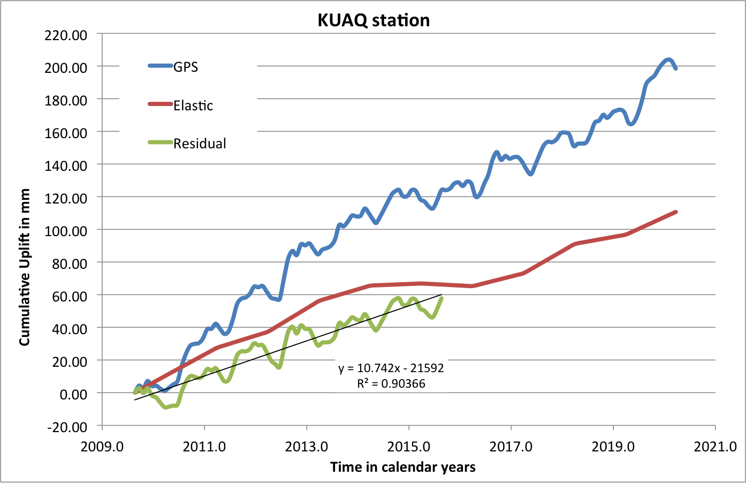
GPS time series
KUAQ

Slide 7
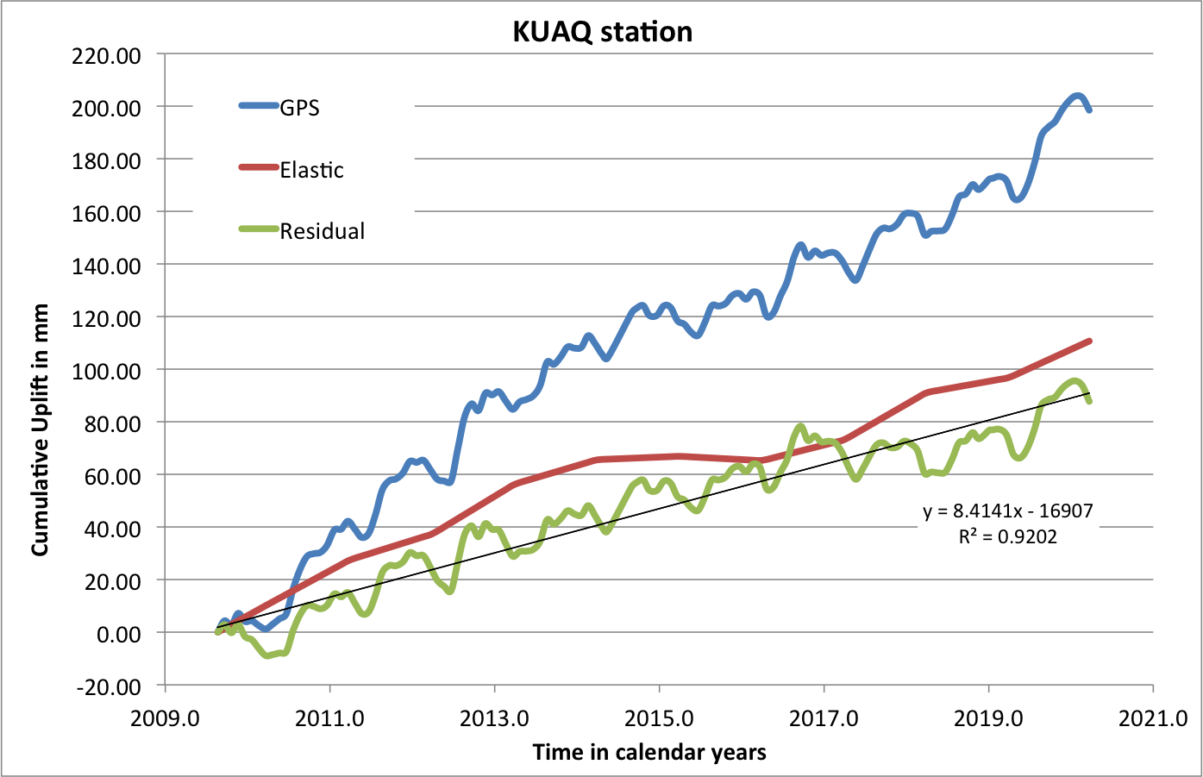
GPS time series
KUAQ

Slide 8
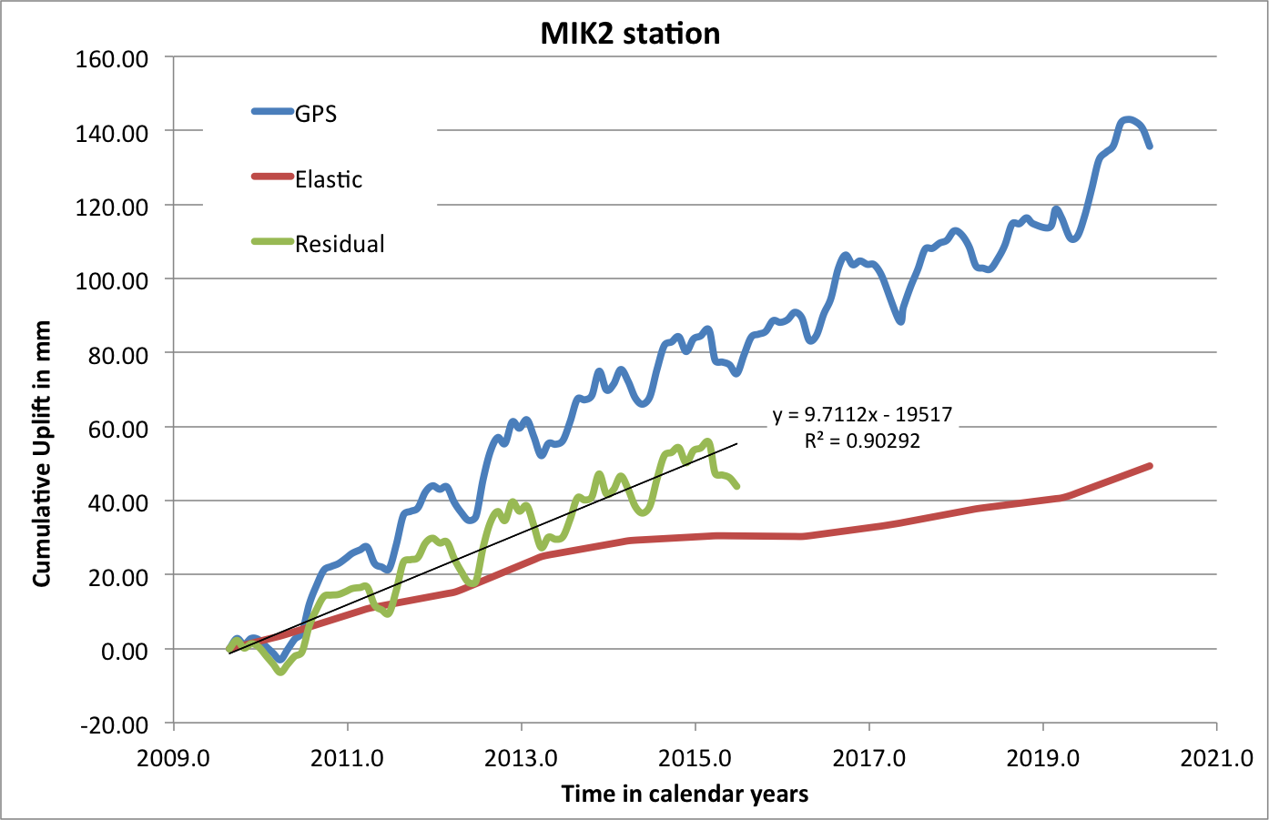
GPS time series
MIK2

Slide 9
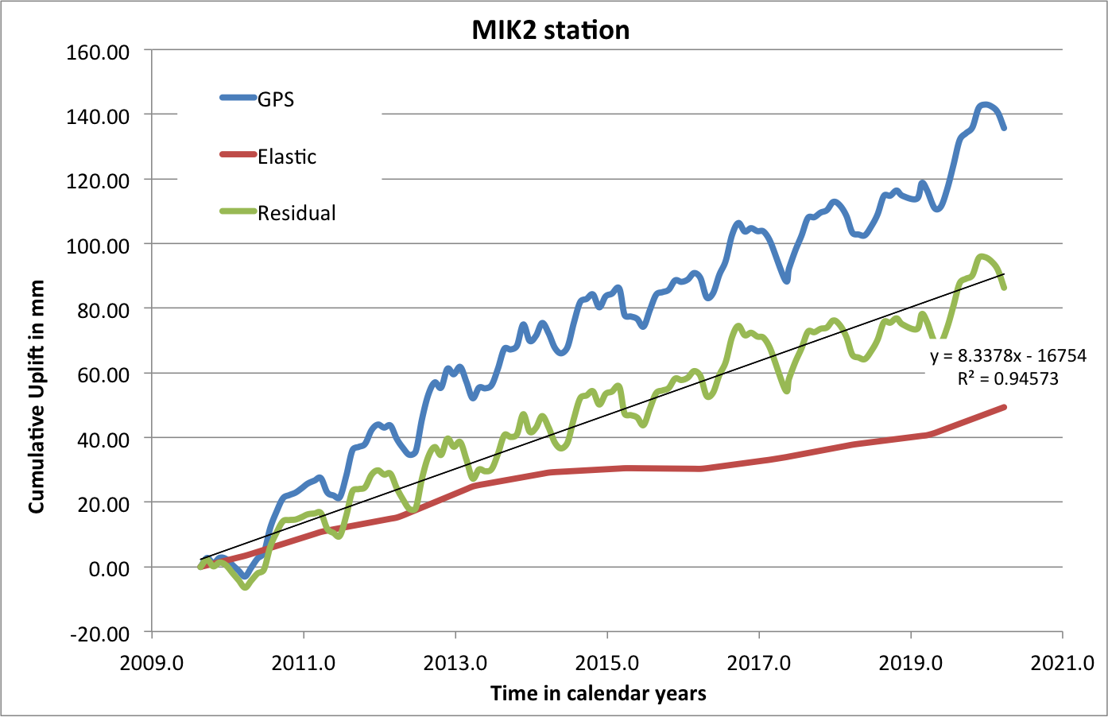
GPS time series
MIK2

Slide 10
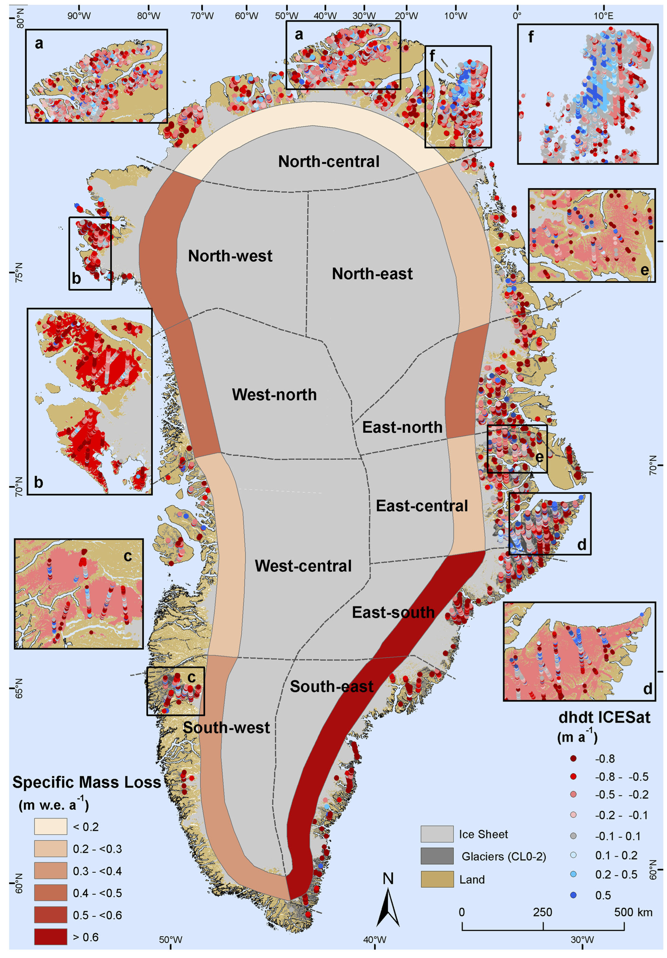
Peripheral Glaciers
From ESA Glaciers CCI
Bolch et al. 2013
Non-continuous observations
(IceSat1 period)
KUAQ
MIK2

Slide 11
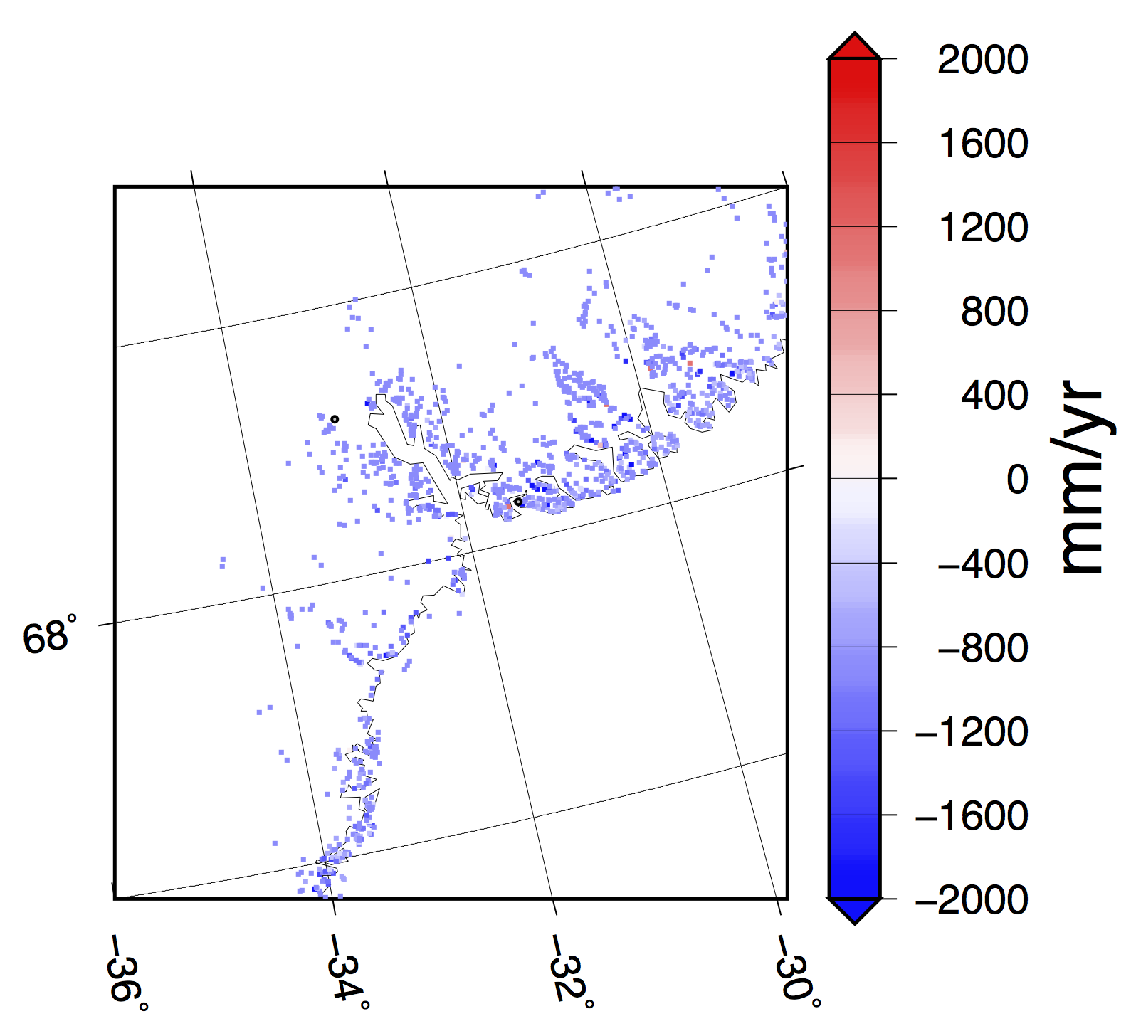
Modeled time series for outer glaciers
Full resolution version of the Global glacier model (GGM, Marzeion et al. 2012) – Greenland glaciers. Time series from 1901 to 2017
KUAQ
Extracted Trend for the period 2007-2017
Average trend per glacier -809.2 mm/yr (in water equivalent)
MIK2
Elastic Contribution for Peripheral Glaciers:
KUAQ 2.39 mm/yr
MIK2 3.17 mm/yr

Slide 12
Elastic for Peripheral Glaciers
GPS uplift rates residual (Observed – Elastic)
KUAQ
KUAQ 12.0 +/- 1.3 mm/yr
MIK2 10.3 +/- 0.2 mm/yr
Elastic Contribution for Peripheral Glaciers
MIK2
KUAQ 2.39 mm/yr
MIK2 3.17 mm/yr

Slide 13
Ice history in Kangerlugssuaq since Little Ice Age
Khan et al. 2014
S. A. Khan, K. K. Kjeldsen, K. H. Kjær, S. Bevan, A. Luckman, A. Aschwanden, A. A. Bjørk, N. J. Korsgaard, J. E. Box, M. van den Broeke, T. M. van Dam, A. Fitzner, Glacier dynamics at Helheim and Kangerdlugssuaq glaciers, southeast Greenland, since the Little Ice Age. Cryosphere 8, 1497–1507 (2014).
Frontal position of
Kangerlugssuaq Glacier from:
Oblique aerial image (1932)
Corona satellite (1966)
Vertical aerial image (1972, 1981)
Landsat 5 TM (1985, 1991)
Landsat 7 ETM+ (1999-2012)

Slide 14
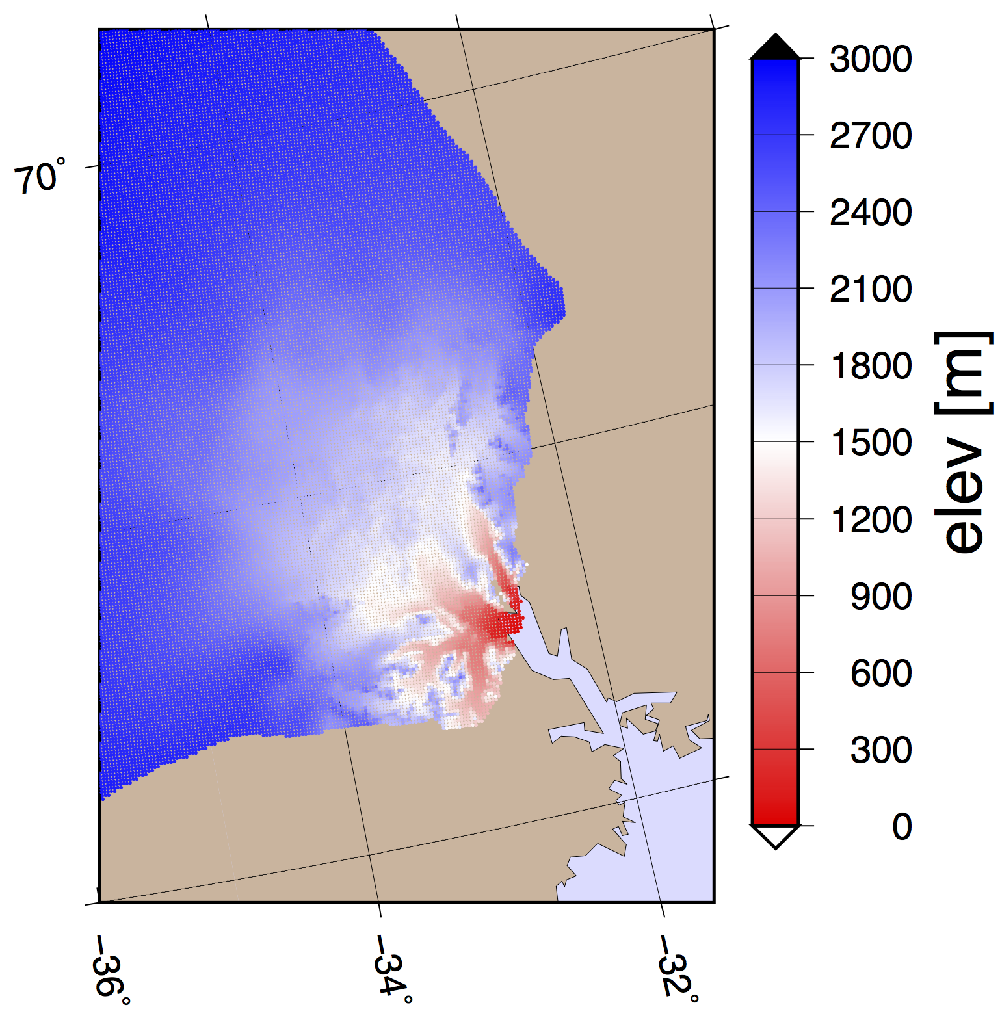
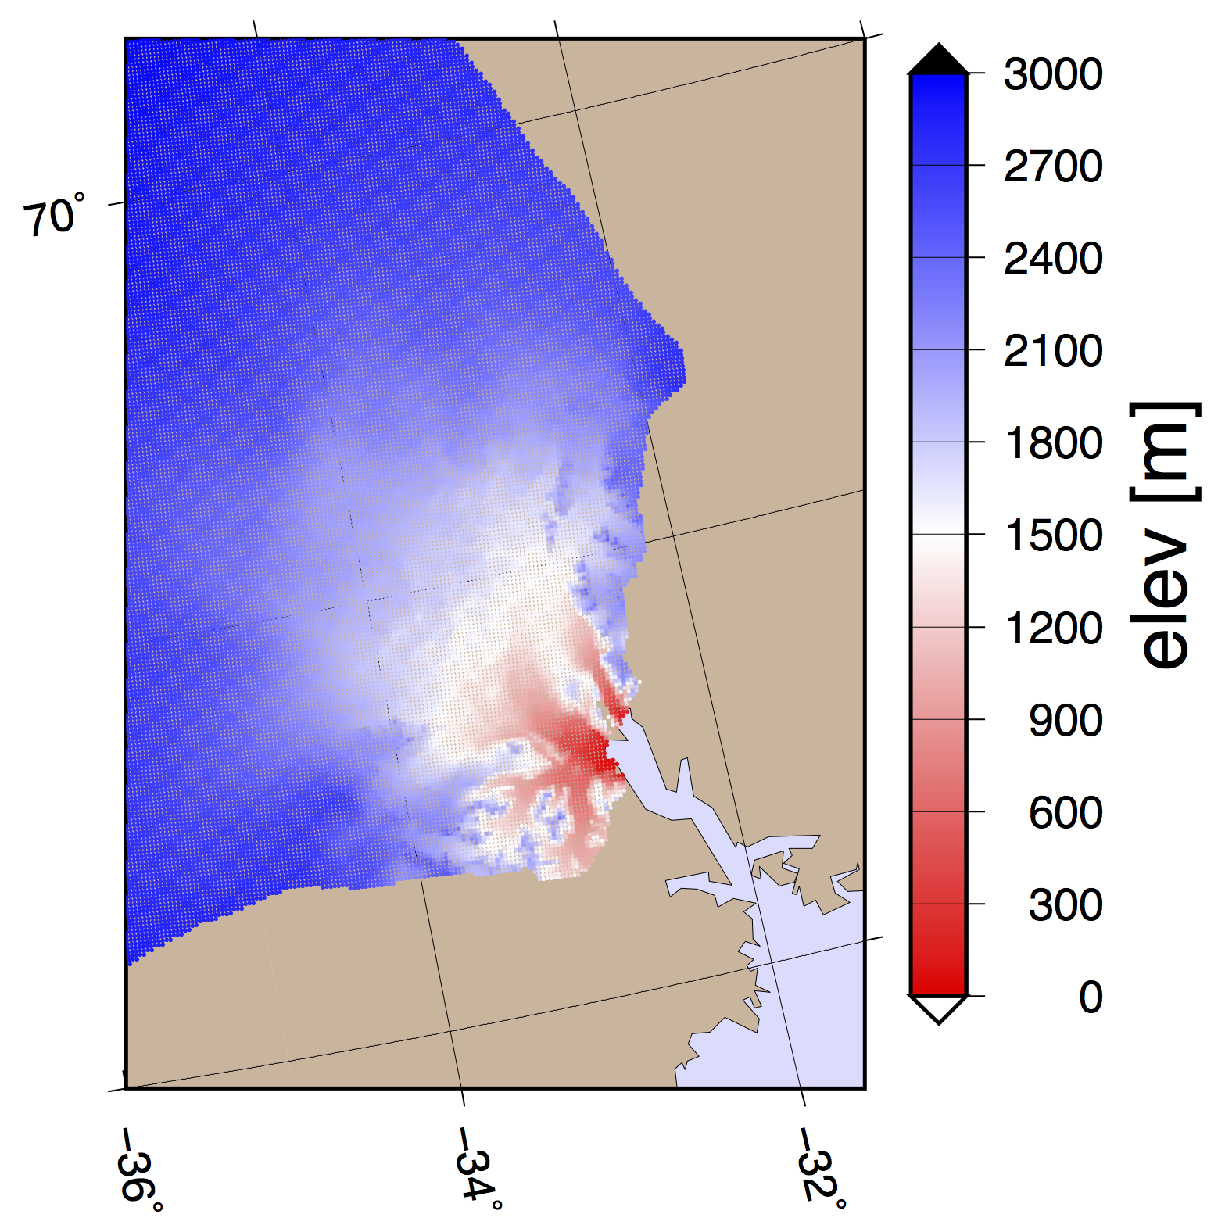
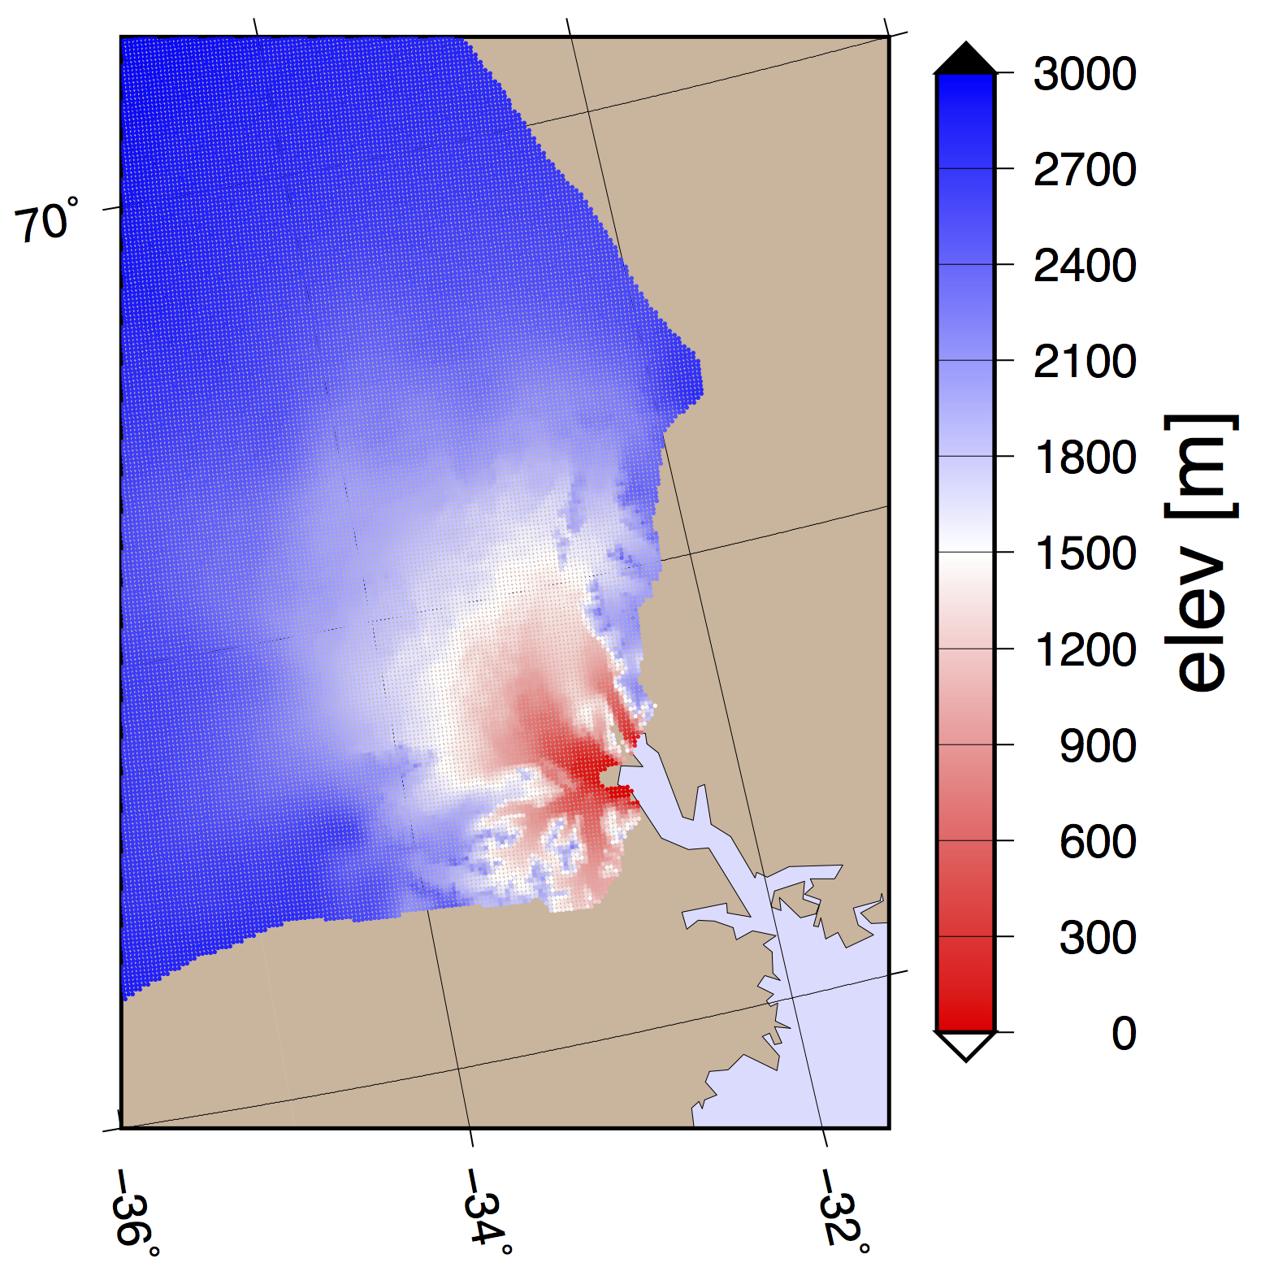
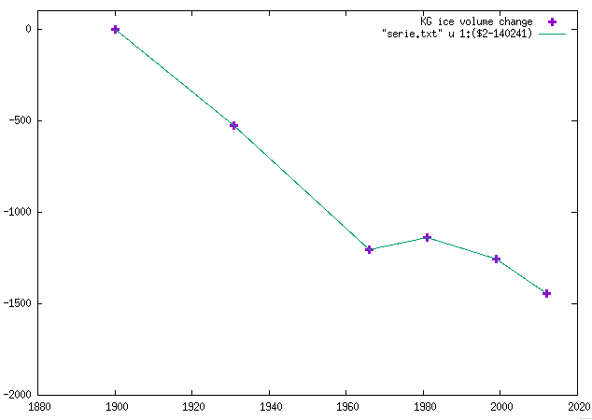
Estimate of ICE change since LIA
1900
1931
1966
2012
data from
Khan et al. 2014
1900-1961
1981-2012
Volume in km³
Volume changes in Kangerlugssuaq

Slide 15
The (low-viscosity) mantle structure
Lithosphere
30 - 100 km
Shallow UM (SUM)
ν_{SUM} = 10¹⁷ – 10²¹ Pa s
200 km
Deep UM (DUM)
Upper Mantle (UM)
ν_{DUM} = 10¹⁸ – 6.3x10²¹ Pa s
3165 Earth models
combinations of 3 parameters
400 km
Transition Zone (TZ)
ν_{TZ} = 6.3x10²¹ Pa s
670 km
ν_{LM} = 2x10²² Pa s
Lower Mantle (LM)

Slide 16
The solid Earth model
1D viscoelastic compressible Earth model and software used in Barletta et al. 2018
as local approximation with a 5 layer viscoelastic Earth structure (in the previous slide).
We use the software VE-CL0V3RS v3.6 to compute the elementary viscoelastic time-dependent Green's functions up to degree 1195 and thereafter we assume they do not change with time, so the trend is zero.
For each combination of Earth parameters we performed a temporal and spatial convolution with the ice history to compute uplift rate prediction as GPS sites. Such convolution is performed using the VE-HresV2 (Visco-Elastic High-Resolution technique for Earth deformations) software (Barletta et al. 2018 and 2006).
For the comparison between model prediction and GPS residual we use a simplified Chi test:

Slide 17
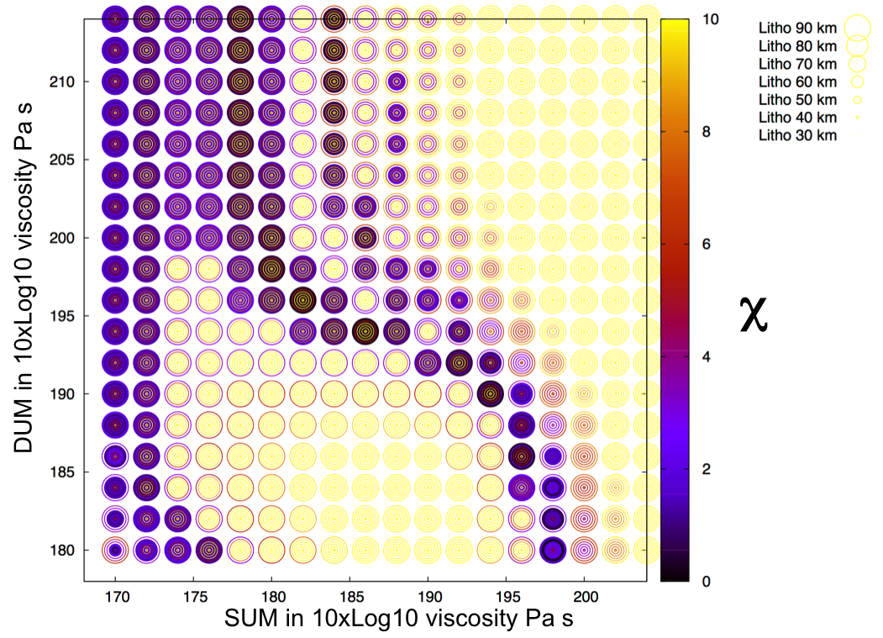
Test with corrected residual for both stations
KUAQ
MIK2
GPS residual – Elastic from Glaciers
KUAQ 9.60 +/- 1.3 mm/yr
MIK2 7.13 +/- 0.2 mm/yr
Solid circle for Chi<2

Slide 18
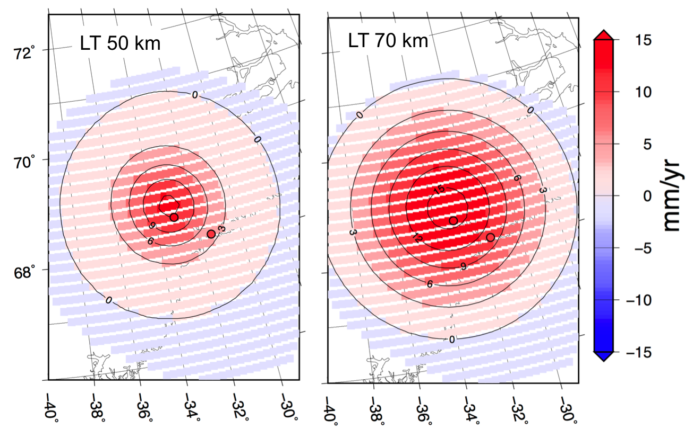
The spatial pattern
KUAQ
MIK2
The GIA signal in this case is a very simple bell-shaped pattern with the maximum near KUAQ station and decreasing more or less rapidly (depending on LT) farther away. A thin lithosphere doesn't seem suitable because the modelled signal decreases too much when it reaches MIK2. Moreover, we have a larger error on KUAQ station, which means that the predictions of the model there can have a wider spread.

Slide 19
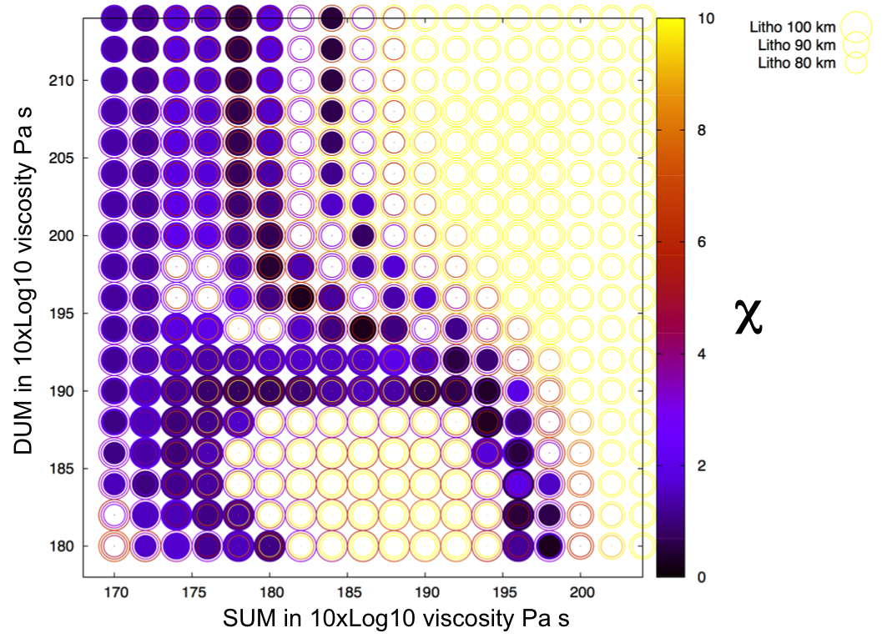
Test with corrected residual for both stations
KUAQ
MIK2
Solid circle for χ<2

Slide 20
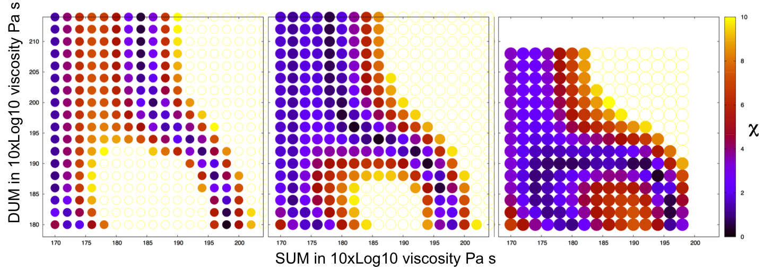
Chi Test for 80 - 90 - 100 km lithosphere

Slide 21
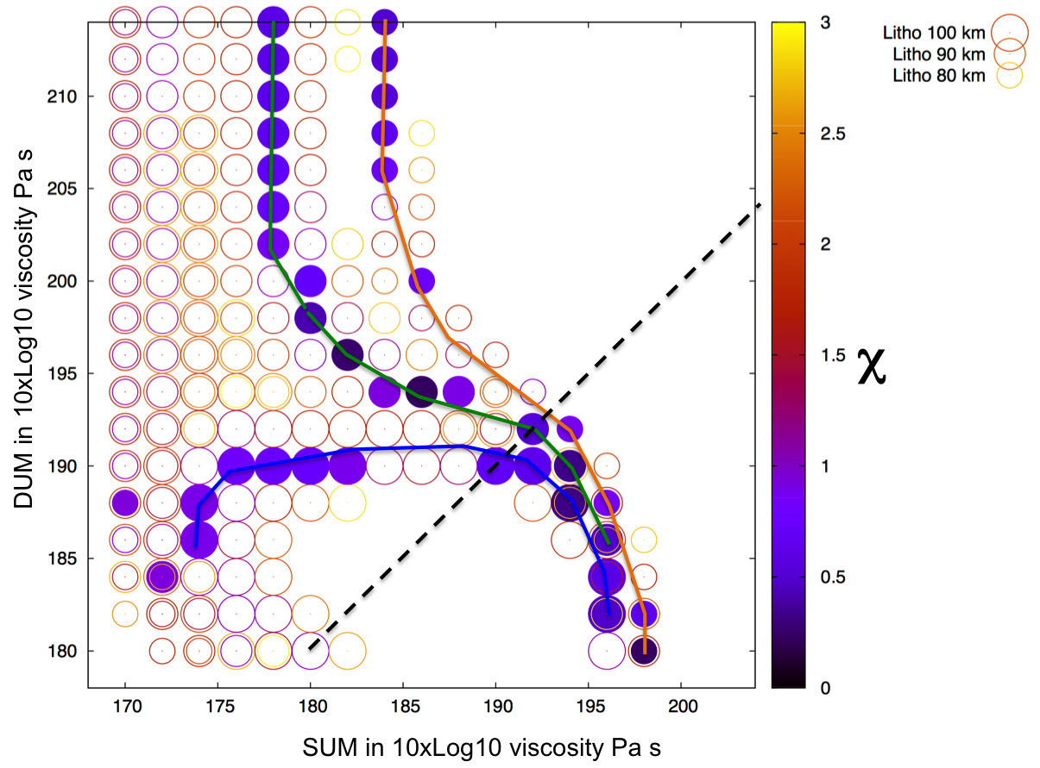
Equally good models
4 regions for the viscosity
DUM > 10²⁰ Pa s, very low viscosity SUM (6.3x10¹⁷ - 2.5x10¹⁸ pa s), LT 90 - 80 km. The thicker the LT and the lower the SUM viscosity has to be. No good models are found for LT <70 km in this range of viscosities.
very low viscosity for both SUM (<184 10xLog10 Pa s) and DUM (< 10¹⁹ Pa s). LT=100 km is preferred.
very low viscosity DUM (< 10¹⁹ Pa s) and SUM around 4x10¹⁹ Pa s. LT, from 80 to 100 km, give equally good results.
Around DUM 195 and SUM 184 (10xLog10 Pa s) LT 90 km best models
Solid circle for χ<1

Slide 22
Equally good models
4 regions for the viscosity
DUM > 10²⁰ Pa s, very low viscosity SUM (6.3x10¹⁷ - 2.5x10¹⁸ pa s), LT 90 - 80 km. The thicker the LT and the lower the SUM viscosity has to be. No good models are found for LT <70 km in this range of viscosities.
very low viscosity for both SUM (<184 10xLog10 Pa s) and DUM (< 10¹⁹ Pa s). LT=100 km is preferred.
very low viscosity DUM (< 10¹⁹ Pa s) and SUM around 4x10¹⁹ Pa s. LT, from 80 to 100 km, give equally good results.
Around DUM 195 and SUM 184 (10xLog10 Pa s) LT 90 km best models
Solid circle for χ<1

Slide 23
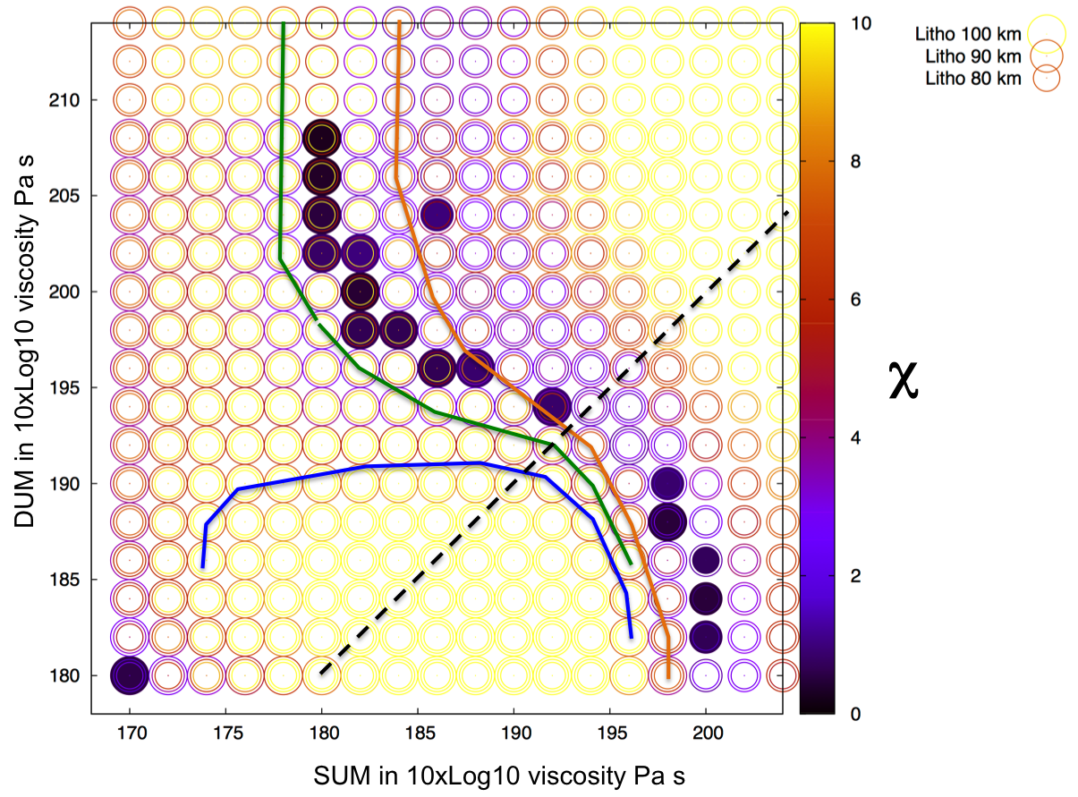
Using the updated GPS uplift rates
Clear shift of about 2 units
of the SUM scale.
This corresponds to a 5% variation in the results upon a variation around 30% of the data.
=> the pattern we found is quite stable

Slide 24
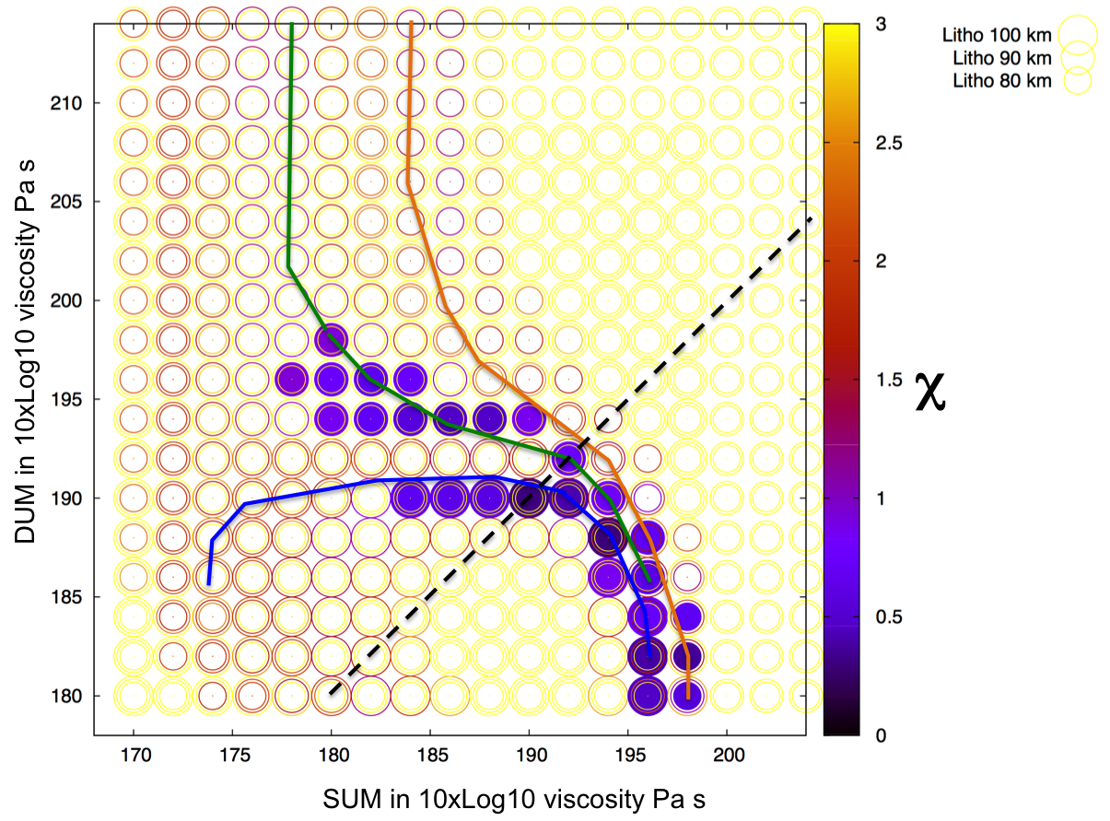
Using same weight for both GPS stations
fixed 0.5 mm/yr error (weight) for both GPS points
The best models have LT 100
and are in the region where SUM has slightly higher viscosity than DUM

Slide 25
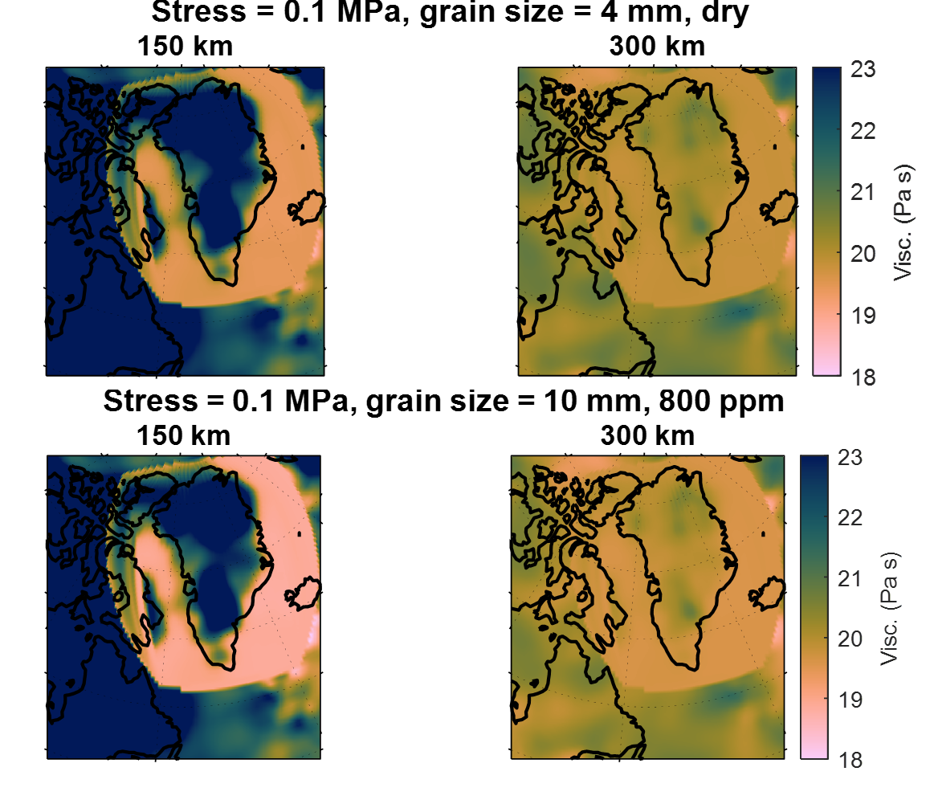
3D viscosity maps
Viscosities calculated with a temperature model. The temperature model does not cover the entire domain.
A lower viscosity in the deeper upper mantle can be achieved if the grain size decreases with depth. Grain size reaches a minimum around 150 km, and then slowly increases to depth of 400 km or remains constant (Behn et al., 2009). Water content is not likely to increase with depth as there is no subduction that brings water to larger depth.

Slide 26
Conclusions
With only two GPS time series and GIA modelling we can gain insight on both the lithospheric thickness and the viscosity structure below Kangerlussuaq region, overall indicating a strong compatibility with the presence of the hot spot track.
Overall a rather thick lithosphere is preferred, i.e. between 90 and 100 km. This is compatible with a lithospheric thickness of about 20% less than the average of the rest of Greenland.
The upper mantle most likely has a structure, i.e. it is not uniform. The overall upper mantle viscosity has to be quite low, however it is not well constrained which part of the upper mantle has to be low. Two well-fitting solution can be taken as reference: LT 90 km S186-D194 and LT 100 km S194-D188.
The peculiar viscosity structure we find can also be explained with 3D viscosity maps calculated with more complex Earth models.
We verified the stability of our viscosity grid search and we find that our conclusion about the upper mantle having low viscosity and a quite clear structure remains solid even if the GPS residual are about 30% different from what we used.
Thank you

