Slide 1
Astrophysics
Allan Hornstrup
Head of section

Slide 2
Aim
Three main focus areas
  Large Scale Structure of the Universe
  Compact Objects
  X-ray instrumentation
Combine science and technology
  360 degrees view
Participate in consortia to develop, procure and launch instruments on astrophysical interesting science missions. Goal: Participate as a major player every 5 years and as a minor player every 2 years.
Participate in other scientific and technological consortia to enable infrastructure for research missions in physics in general, specifically astrophysics and in space.

Slide 3
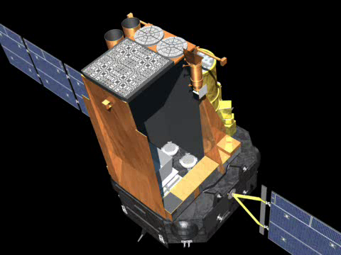
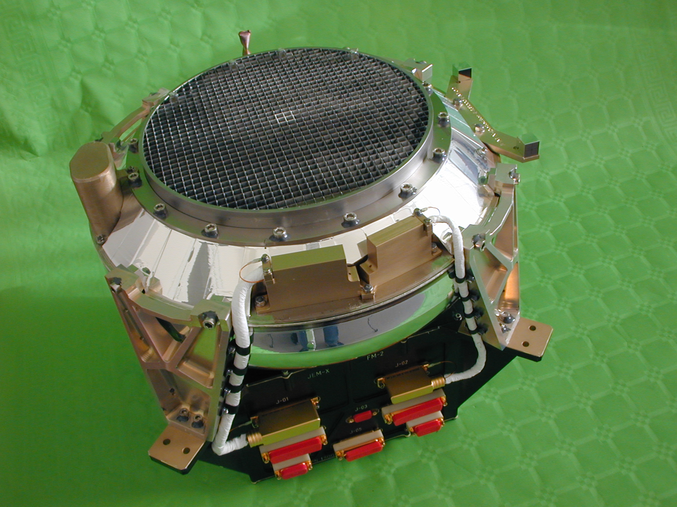
INTEGRAL and JEM-X
Launch 2002,
DTU Space PI for X-ray monitor JEM-X

Slide 4
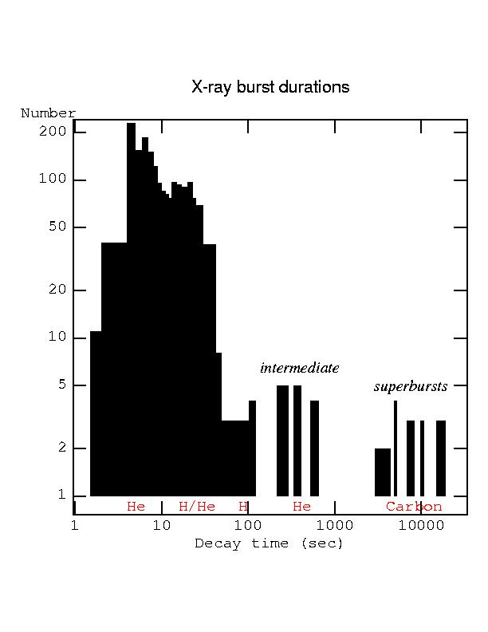
Science with JEM-X, eg. X-ray bursts
JEM-X is currently the best instrument to catch exceptional events such as the rare long bursts. Studying those allow us to probe the thermal properties of the neutron star crust.
By performing a systematic investigation of the ≈2000 bursts in our JEM-X database, we aim to better understand the thermonuclear burning processes, as well as constrain the equation of state of the ultra-dense matter of the neutron stars.
Superburst

Slide 5
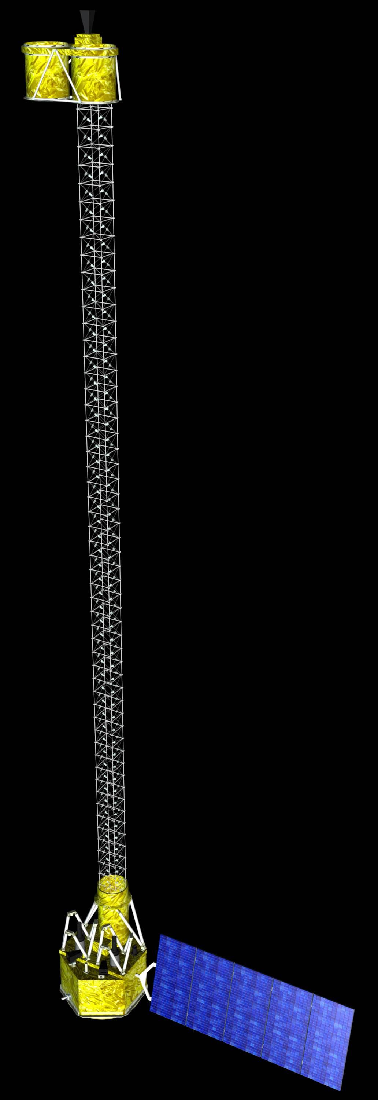
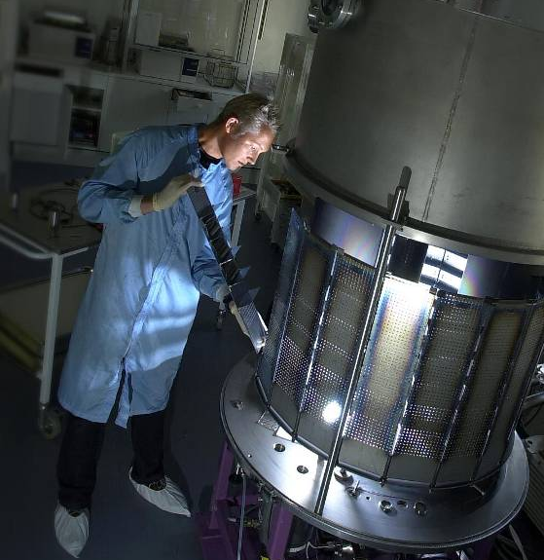
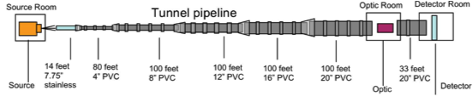
NuSTAR
Developed coatings for telescopes,
  DTU Space and CalTech in collaboration on HEFT – a balloon project, and NuSTAR, a NASA SMEX project
DTU Space has coated all 5000+ mirror pieces for NuSTAR
Launch in February 2012
Part of science definition teams
Calibration effort (X-ray facility in New York).

Slide 6
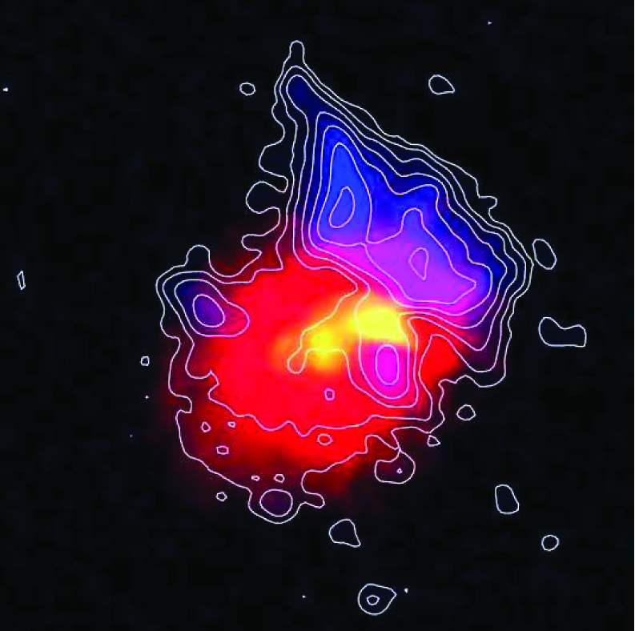
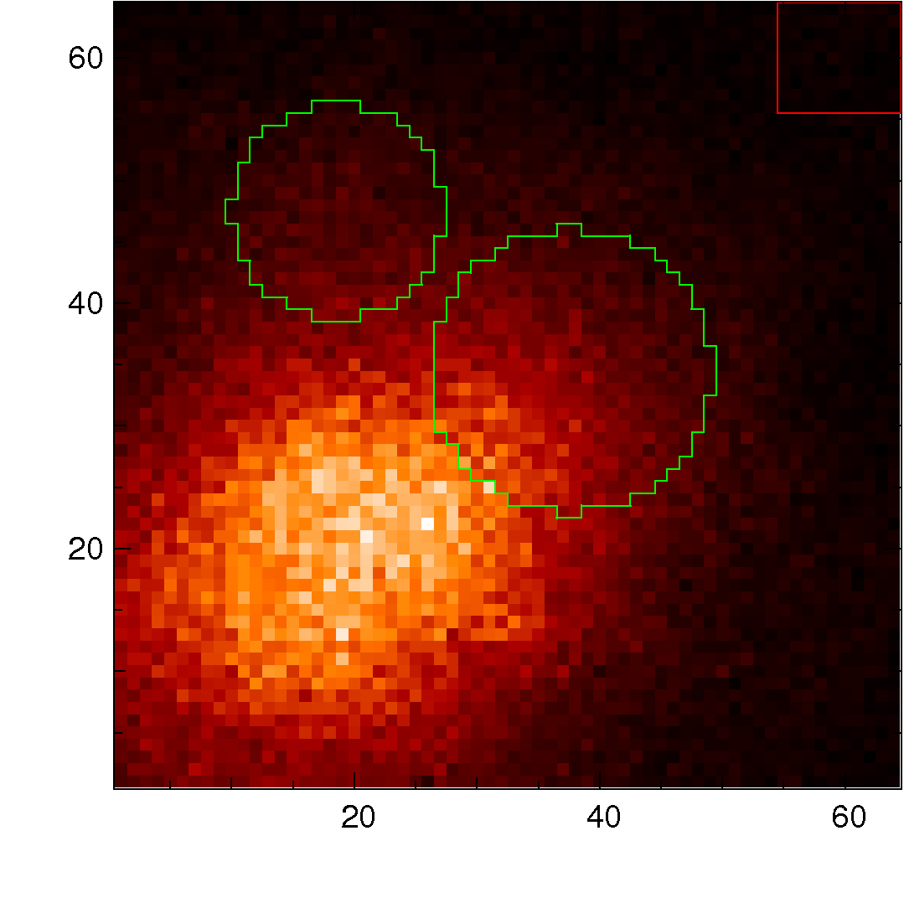
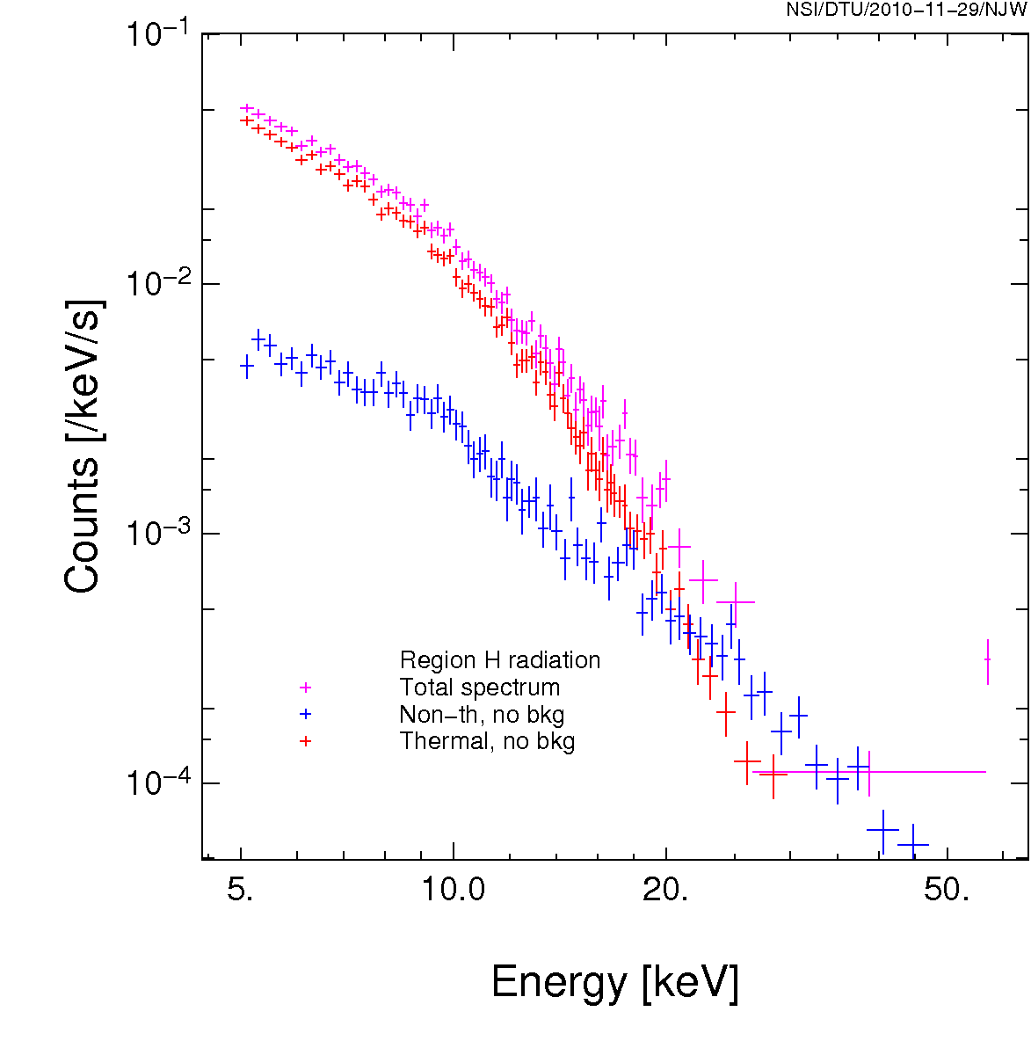
Science with NuSTAR
Example:
  Clusters of galaxies – nonthermal emission
A2256
Z=0.056
Picture from Clarke and Ensslin 2006, showing 1.4GHz radio and Chandra X-ray
Extragal. Science:
AGNs, Blazars,
survey of selected areas
100 ks exposure
Simulations by N. J Westergaard, DTU Space

Slide 7
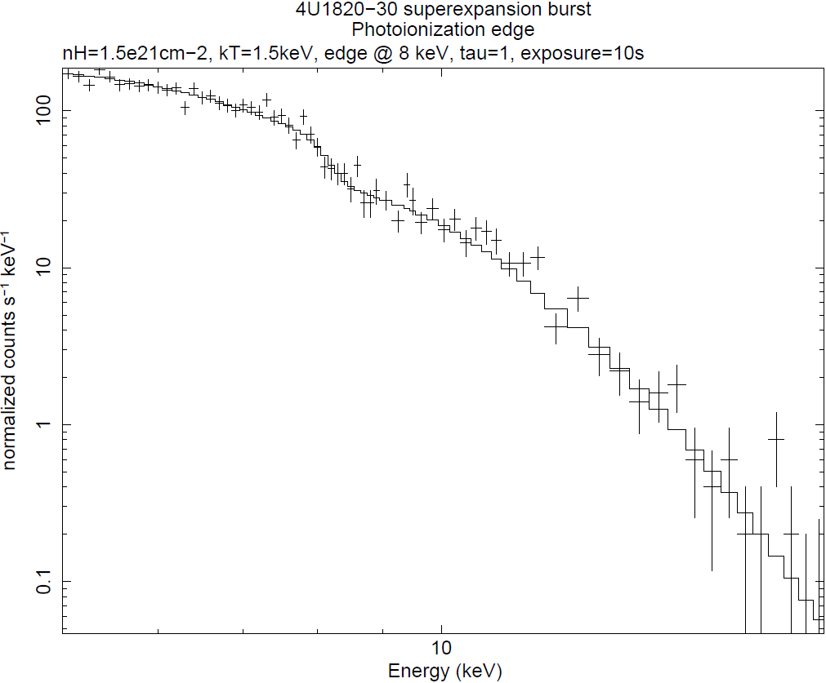
Science with NuSTAR – compact objects
Example
  The hard X-ray sensitivity of NuSTAR will allow for the first time detailed studies of faint X-ray binaries:
    Search for pulsations and/or a spectral break in hard X-rays from obscured high-mass binaries discovered by INTEGRAL  presence of a neutron star?
    Investigation of the lowest accretion states of black holes.
    Search for spectral features such as cyclotron lines from accreting pulsars and absorption edges in X-ray bursts.
Some X-ray bursts are powerful enough that the elements produced by the nuclear burning are ejected from the neutron star.
We propose to observe X-ray bursts with NuSTAR to detect spectral signatures from the ejected nuclear ashes, and identify the corresponding nucleo-synthesized elements.
Photoionization edge
Gal. Science:
SNRs, Black holes, NS’s
survey of selected areas

Slide 8
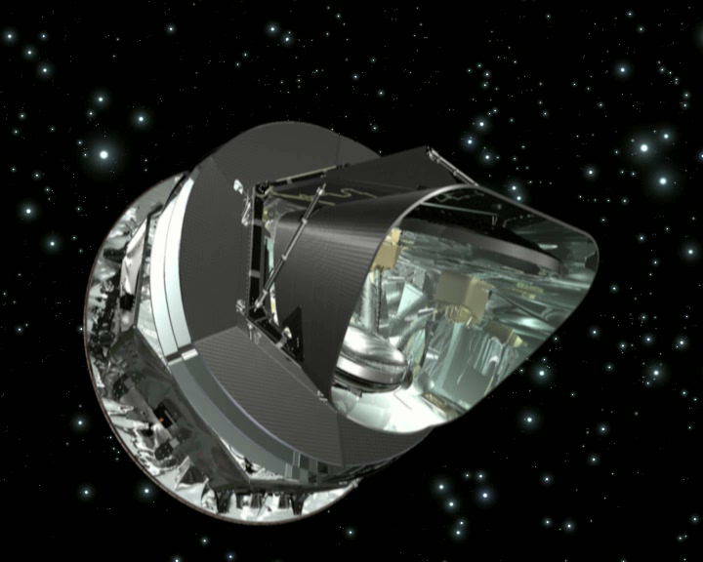
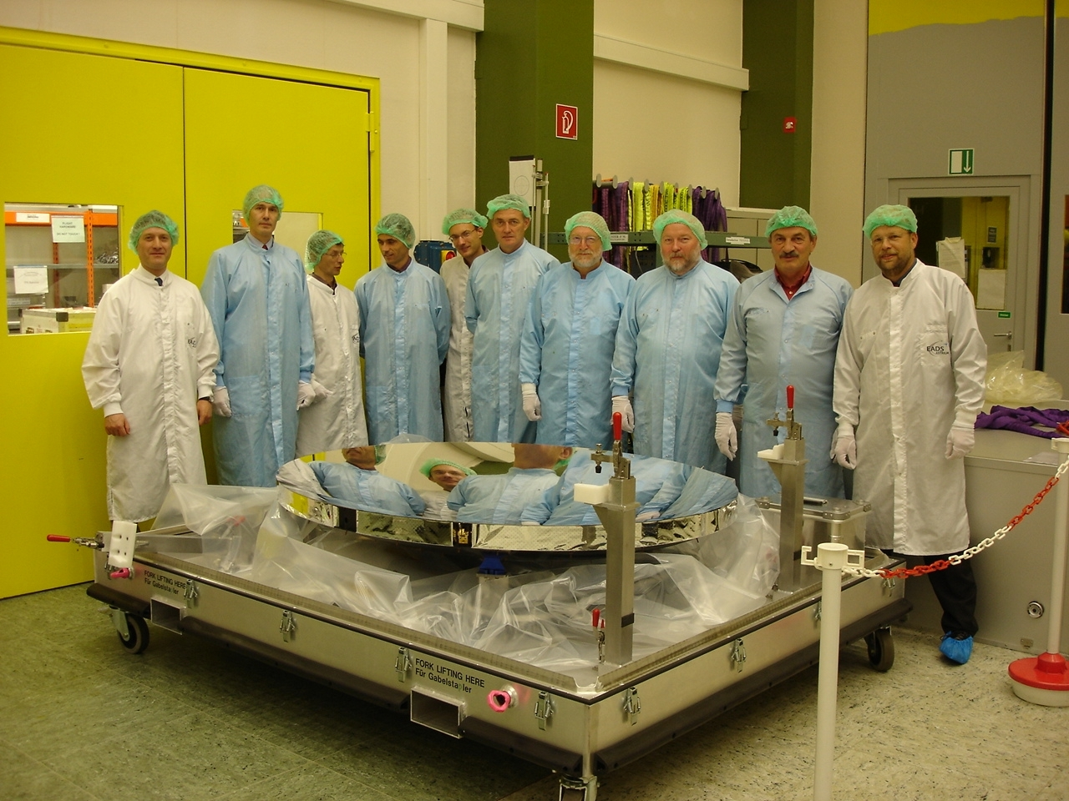
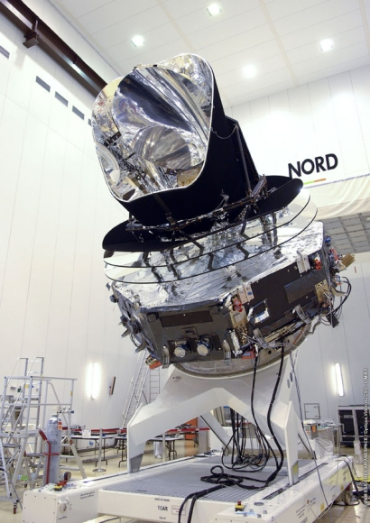
Planck
Mirrors (collaboration with ESA)
Carbon Fibre
CFRP– mirrors : 29.2 kg / 13.6 kg
Al : 500 kg / 160 kg
glass : 470 kg / 150 kg

Slide 9

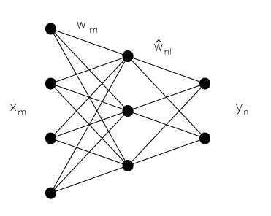
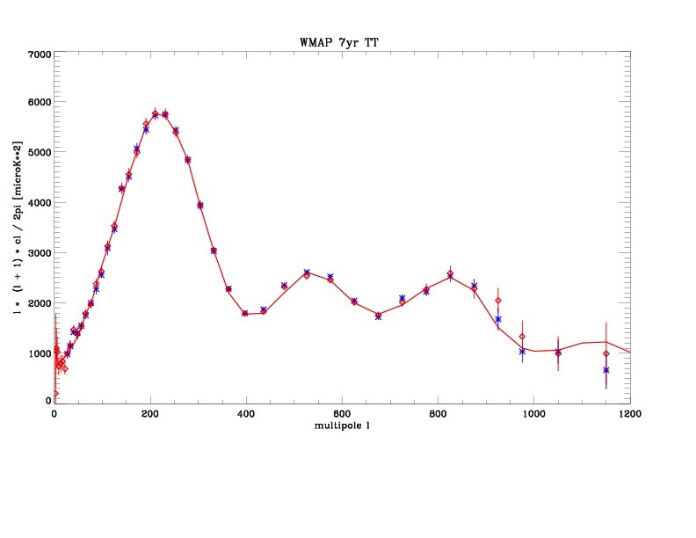
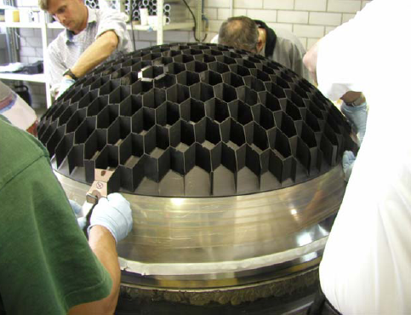
Science with Planck
Foreground removal using neural networks
Telescope beam pattern

Slide 10
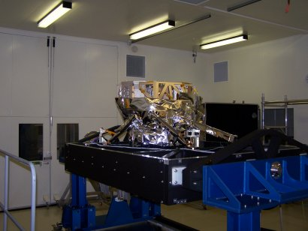
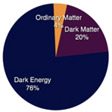
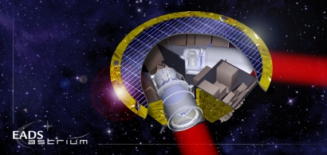
Carbon Fibre (CFRP) Technology
Using heritage from Planck to develop struts for
MIRI (on JWST) and for a thermal blanket
  Science “reward”: First light objects
Using CFRP technology in EUCLID (ESA M2 mission) to develop
  Optical Ground Support Equipment (in collaboration with Copenhagen University)
Also invited to contribute similarly to EChO – a possible ESA M3 mission to study spectra from extrasolar planets
Have developed a carbon fibre concept for LISA telescope system (LISA: Gravitational waves)
  Invited to engage in that again, after NASA’s withdrawal from LISA

Slide 11
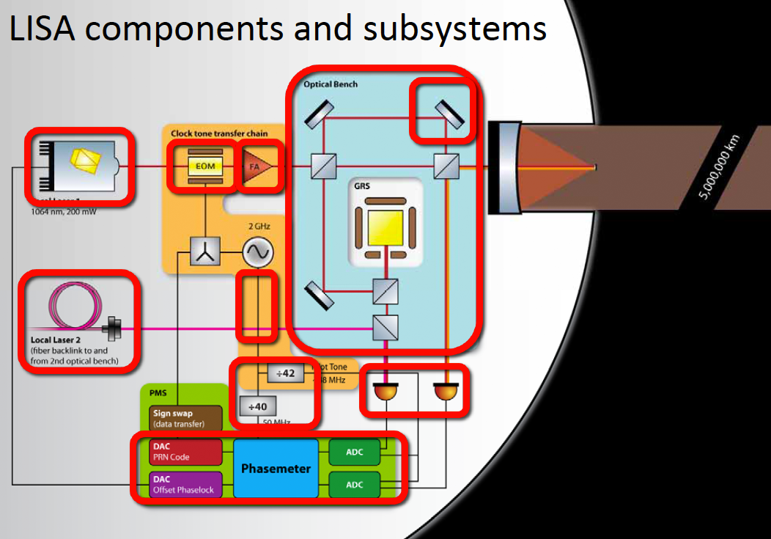
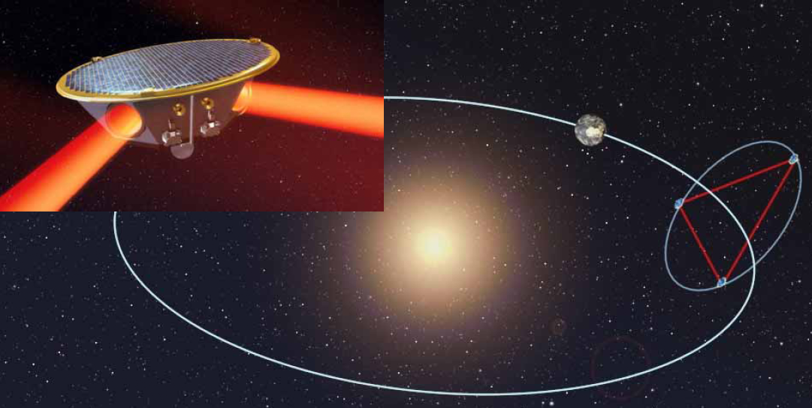
LISA - further
DTU Space has an ESA contract in collaboration with
  Albert Einstein Institute, Hannover, Germany and
  Axcon AS in Lyngby, Denmark
  To develop the LISA metrology system, capable of measuring picometer movements of the probes over 5 mill km distances using a principle of phase shift measurements…

Slide 12
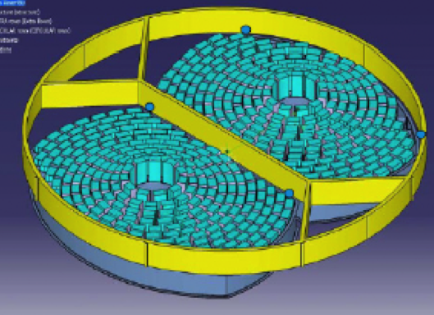
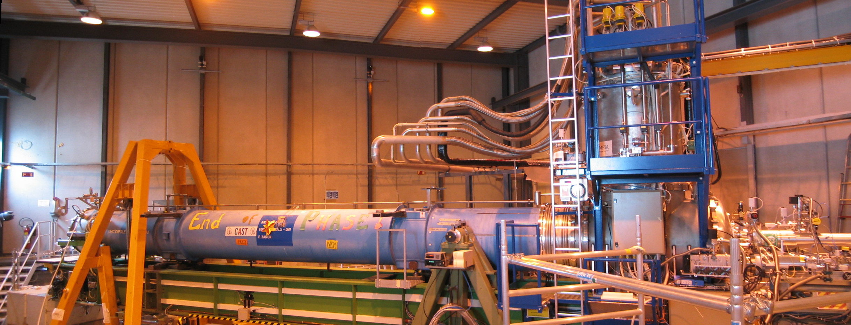
Future missions and concept studies
X-ray telescopes
  ATHENA
    ESA contract to develop coatings and to optimize optics
    Baseline: Si pore optics
  CAST – CERN Axion Solar Telescope.
  Collaboration between DTU Space, Columbia Univ., Lawrence Livermore
  450+ keV focusing telescope
    Maybe even a 511+ keV focusing telescope?
    New coating methods to be developed (ESA contract pending)
    50 m focal length, formation flying…

Slide 13
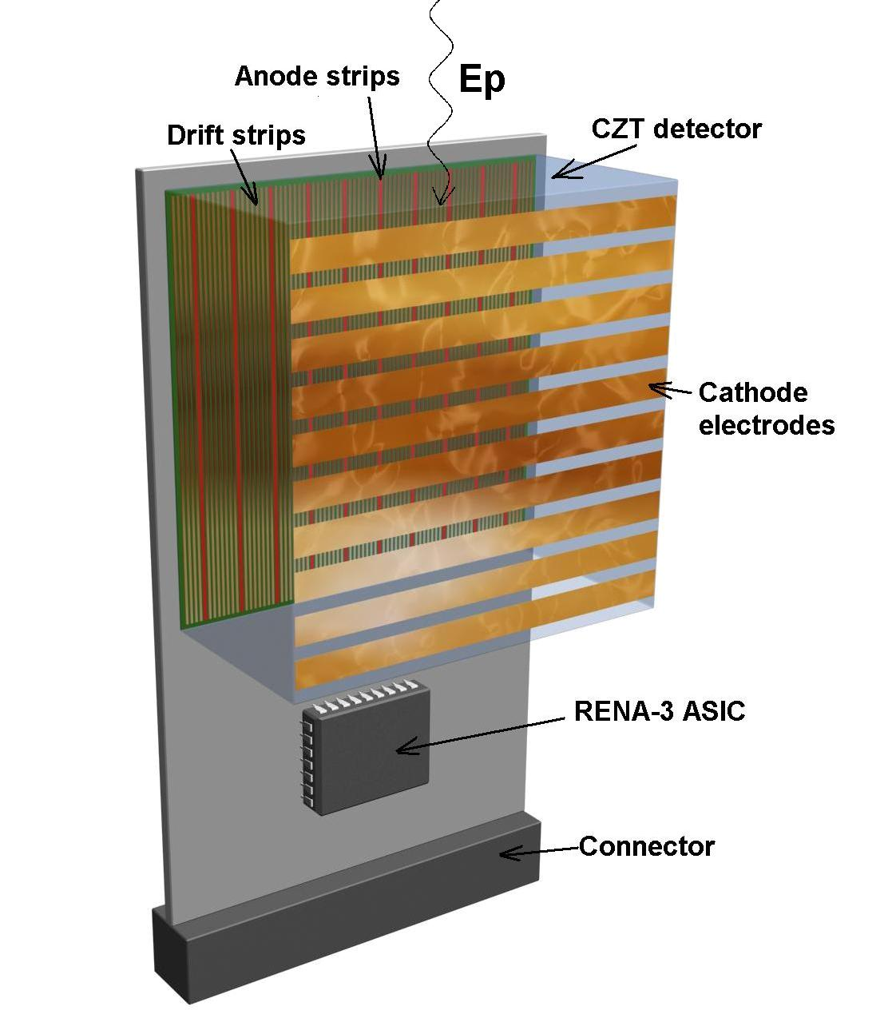
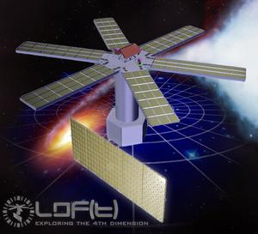
Future missions and concept studies
X-ray detectors
  ASIM – our X-ray detector system looking down
  (more later)
  3D CZT detector – concept study financed by ESA
  LOFT – a 10+ m² Si-detector mission.
  DTU Space CoPI for the Wide Field Monitor (WFM) Assessment Study.

Slide 14
Summary
Science and technology hand in hand
  Excellent science
  Excellent technological research
  Fine balance in combining science and technology
  Highest international level
    Also participating in definition of practically all future ESA Cosmic Vision astrophysics missions technically and scientifically:
      L: ATHENA, LISA,
      M: EUCLID (2), LOFT (3), EChO (3)
Future
  Thus many opportunities,
  And many new ideas and concept studies on-going
Professors?
  Needed to further support and emphasize strength of department.

Slide 15
Excursion
Walk to the labs to see
  Multilayer coating facility
    Coating of HEFT, NuSTAR mirrors
    Now coating test samples for ATHENA telescopes.
  X-ray laboratory
    Test of telescope components, detectors etc
  Detector development laboratory
    ASIM, 3D CZT etc.

Slide 16

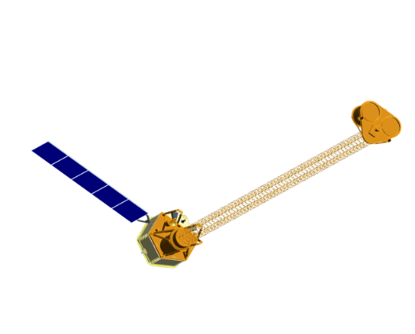
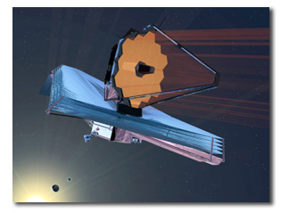
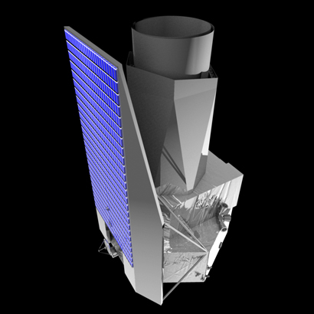
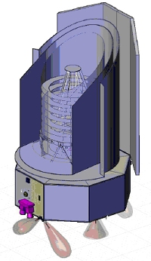
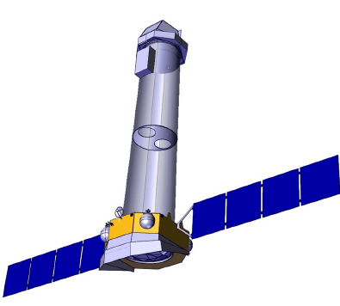
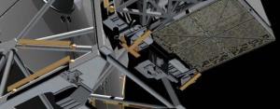
 | Thank you

