Slide 1
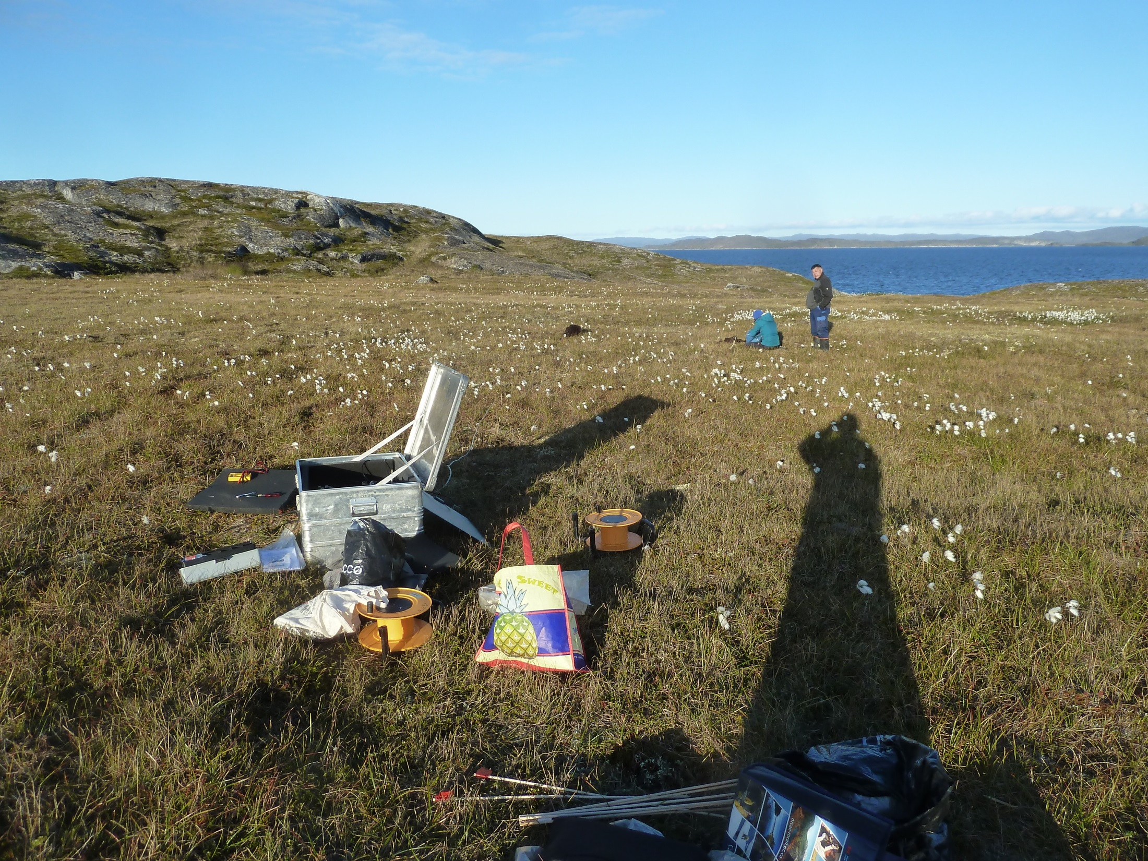
Magnetotelluric in Greenland
Notes:
Background about my self
Started in june 2013 …

Slide 2
Magnetotelluric in Greenland
Original plan:
- ADU-07e with induction coils and electrodes (1-2 hours)
- EDL with induction coils and electrodes (1-2 days)
- EDL with Fluxgate and electrodes (1 month)
Notes:
Original plan for the survey consisted of three different instruments setup.
1. High frequency measurements with the ADU-07e data logger from Metronix, with two/three induction coils and PbPbCl2 Electrodes. Measured with a sampling frequency of around 50000Hz
Would be setup first to record while next setup was prepared
2. 500Hz measurements with the Earth Data Logger (EDL) with similar induction coils and with AgAgCl Electrodes from GFZ.
Recorded for 1-2 nights while other stations where setup.
3. 10 Hz measurement with the EDL and a GeoMag Fluxgate with with AgAgCl Electrodes also from GFZ.
Recorded form 1 month.

Slide 3
Magnetotelluric in Greenland
Notes:
The planned survey area, was a 100 km north-south profile, south of Aasiaat in North-Greenland, with 12 stations. (Blue triangles)

Slide 4
Magnetotelluric in Greenland
Notes:
Before the survey began I was able to select possible station sites with the help of geological maps and a Digital Elevation Model. At the same time the selected sites were also accessiable from the water by boat.
The time schedule was tight so there were not enough time to reach both fjords, so the stations were al setup in the first fjord, marked with red squares. The profile is now consisted of 10 stations in more NW-SE direction.

Slide 5
Magnetotelluric in Greenland
Problems:
EDL setup for 1-2 days period
Foxes
Limited Metronix data
Notes:
The survey took place in August until September. However, a few problems occured. The measurements with the EDL which was setup for 1-2 days (500Hz), had a setup error which was discovered to late, so no measurement are available.
Besides this there were a lot of trouble with the local foxes, they had bitten the electrode cables on 6 of the stations , so the data from these are limited.
And the high frequency metronix data is also very limited. The plan had been to setup the metronix on the first trip in August before the EDL setup. However, I became sick and was unable to attend this trip, so the measurement were persponed until the September trip.
But when we discorvered the missing data from the short term EDL measurements, we desided to use the metronix to measure the 500 Hz. We now have data from 2 stations in the survey and 1 from the Disco Island , north of the survey.

Slide 6
Magnetotelluric in Greenland
Data available:
Fluxgate = 10 stations with data from 11 days – 1 month
Electrodes = 9 stations with data from 1 hour – 1 month
Metronix 500 Hz = 2/3 stations 10-15 hours
Notes:
So data available is
Fluxgate data is recorded for al 10 stations and last between 11days until 1 month.
Electric measurements for 9 stations last between 1 hour and 1 month.
(2 station = 1 month, 2 station = 14 days, 2 stations = 1 day, 1 station = 5 days, 1 station = 1 hour)
Metronix 500 Hz data = 10-15 hours on al sites.

Slide 7
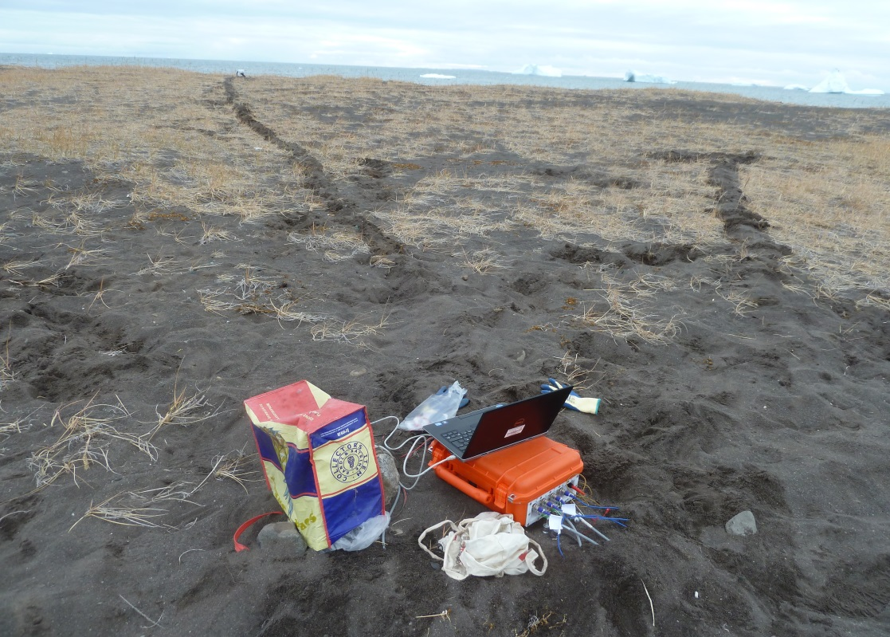
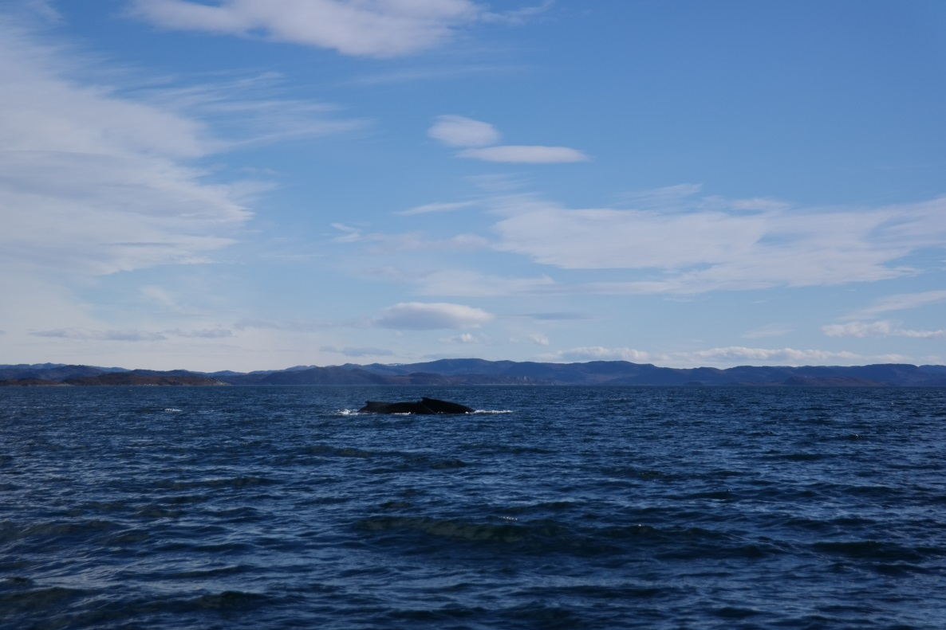
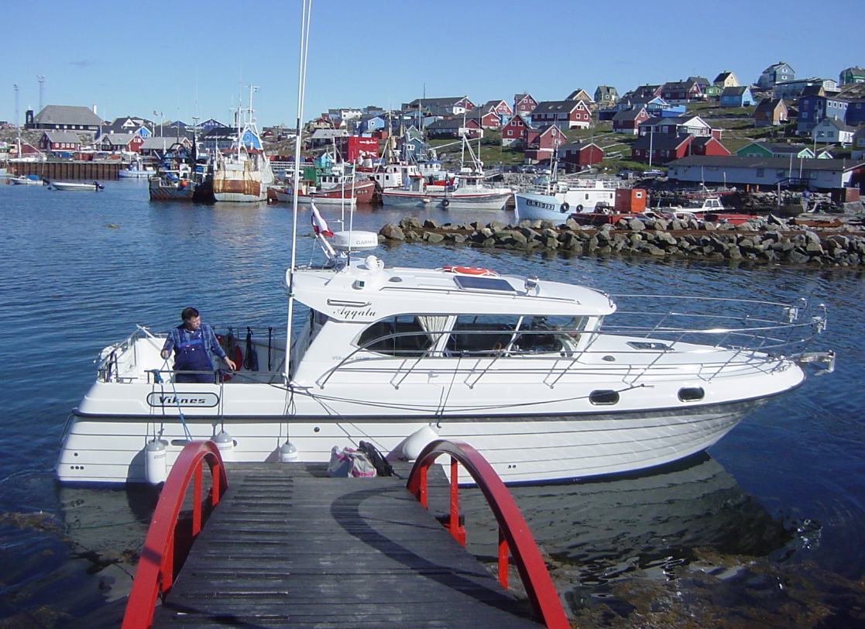
Magnetotelluric in Greenland
Notes:
After the survey I have used the last two month to convert the different data files in to Ascii, for our future work here in Frankfurt ☺

