Slide 1


Using the NORDIC13 and DTU15 global marine gravity fields for geological interpretation in the Arctic Ocean and in the Santos Area off-shore Brazil
Ole B. Andersen (DTU Space). Asbjoern N. Christensen (Nordic Geoscience), Arne Døssing (DTU Space), Carmen Gaina (University of Oslo) and H. Ruth Jackson (Geological Survey of Canada Atlantic).
Notes:
Thank you for giving me the opportunity to present this presentation on the new NORDIC13 gravity data set over the Santos Basin in offshore Brazil

Slide 2
Outline
Satellite Altimetry in the Arctic
Example from the North:
DTU15 gravity for Cretacious ocean formation in the Amerasian Basin of the Arctic Ocean.
Example from the South:
NORDIC13 gravity for Pre-Salt, Santos Basin
Conclusions
Disclamer: Asbjorn Christensen and/or Arne Døssing should have given this presentation as this is not my field of expertise and questions should go to them
Notes:
First I will briefly introduce you the concept of computing the gravity field from sea surface heights
Then I will outline some recent developments in satellite-derived gravity that has allowed us to create the NORDIC13 gravity data sets
Then I will show three examples of the NORDIC13 gravity data sets from the Santos Basin
First an example from shallow-water in the Santos South Area near the Baúna-Piracucá (formerly Tiro-Sidon) and Piracucá producing fields
Next an overall view of the relations between the NORDIC13 gravity data and the some of the discoveries in the deep-water Santos Pre-Salt
And finally we will look at the Libra field in the Santos Pre-Salt in more detail
I will finish the presentation with a number of conclusions

Slide 3
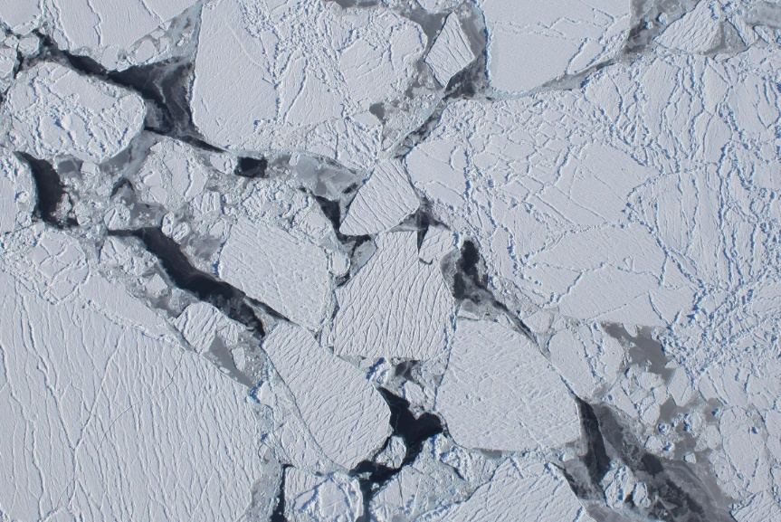
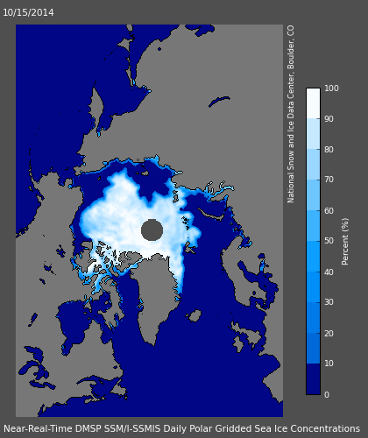
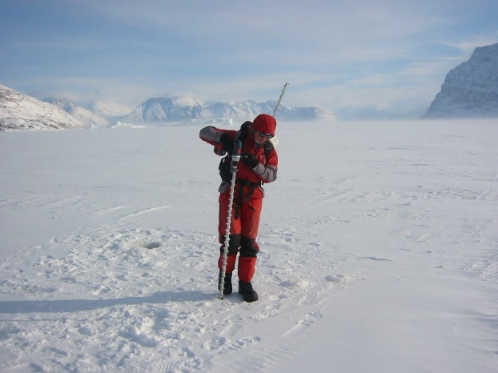
The Arctic Ocean
Sea ice concentration sept 2015 week
Photo: NASA
National Snow and Ice Data Center
Maslanik and Stroeve 1999
Photo: DTU Space

Slide 4
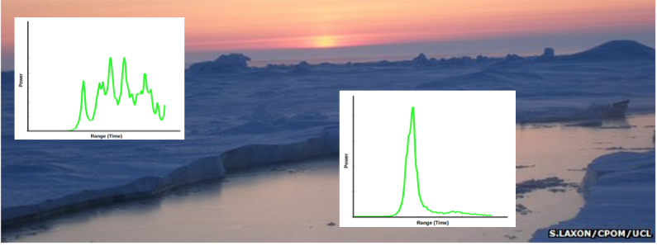
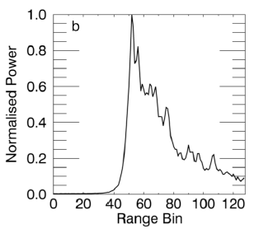
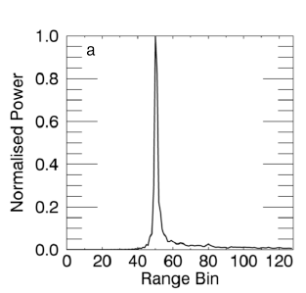
Arctic Ocean:
Cryosat-2 SAR mode with small footprint of 4 km2 to detect LEADS
Leads retrack individual 20 Hz observation despite higher noise (sqrt(20))

Slide 5
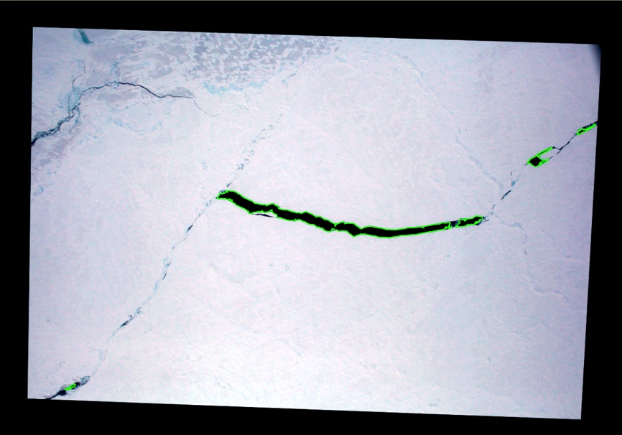
Validation: IceBridge
Stenseng, 2014b and Dominguez, 2014

Slide 6
Validation: IceBridge
Leads in aerial photos and CryoSat-2 data
Detected ~80% of leads >500 m²
LiDAR observations ~4 cm std. dev.
Mean difference 0 cm Only 34 collocated observations
Stenseng (2014b)

Slide 7
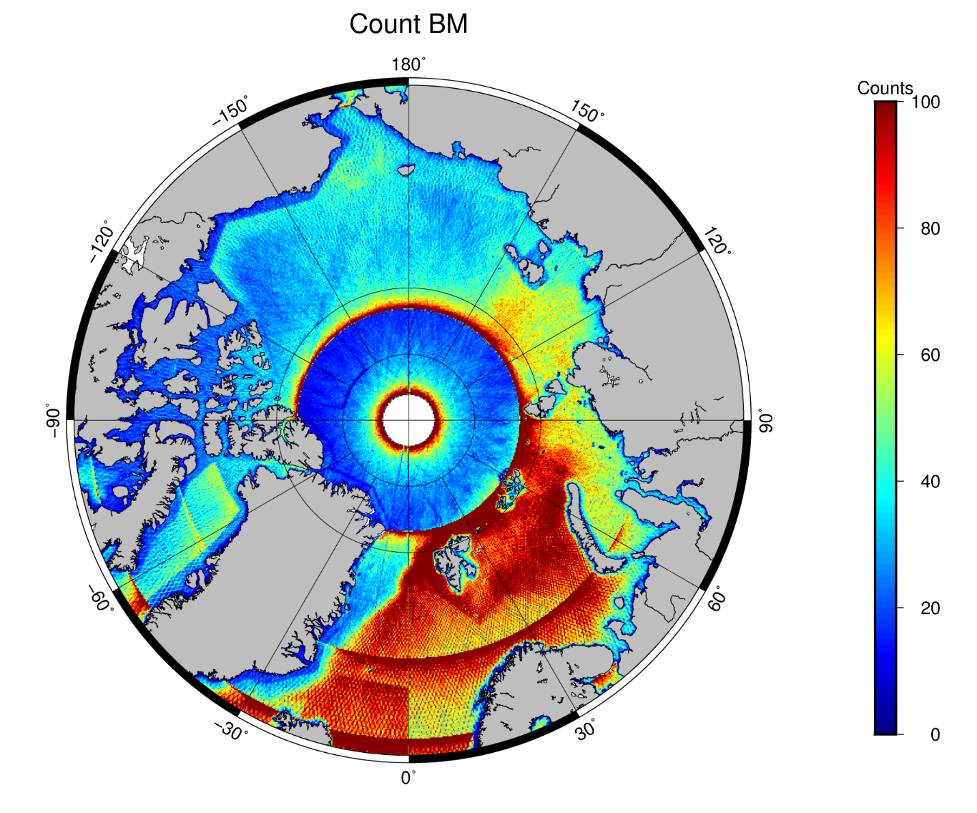
Arctic Ocean
All Altimetry: E1+GS+C2 LRM+SAR+SARin
Counts per
10x 10 km

Slide 8
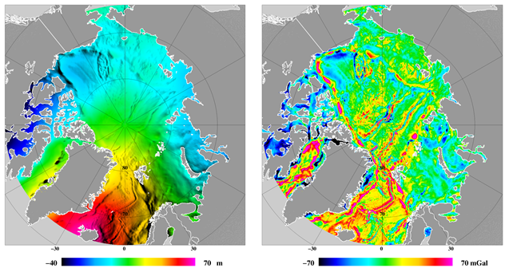
DTU13/DTU15 Arctic Ocean
GEOID (~Mean Sea Surface ) Free Air Gravity
The Polar Gap north of 88 is completed using EGM2008 (ArcGP data)
Notes:
Will explore the smaller gravity low in the central Canadian Basin

Slide 9
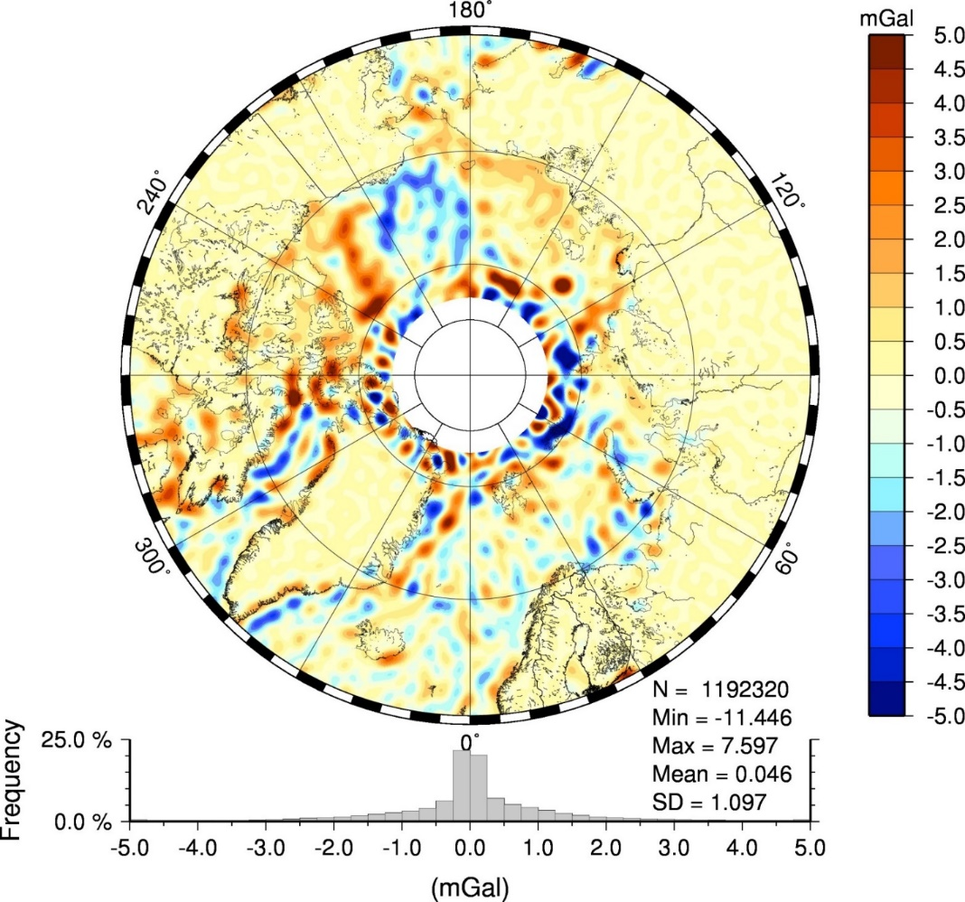
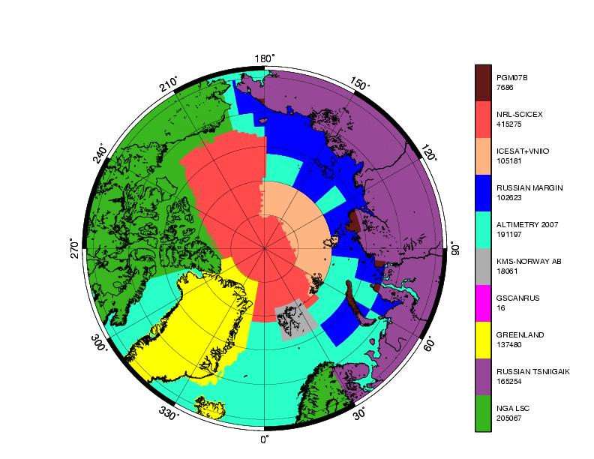
Arctic Ocean.
Evaluation with GOCE GOCO 05S to d/o=200
ArcGP
Courtesy of
Simon Holmes
SGTinc

Slide 10
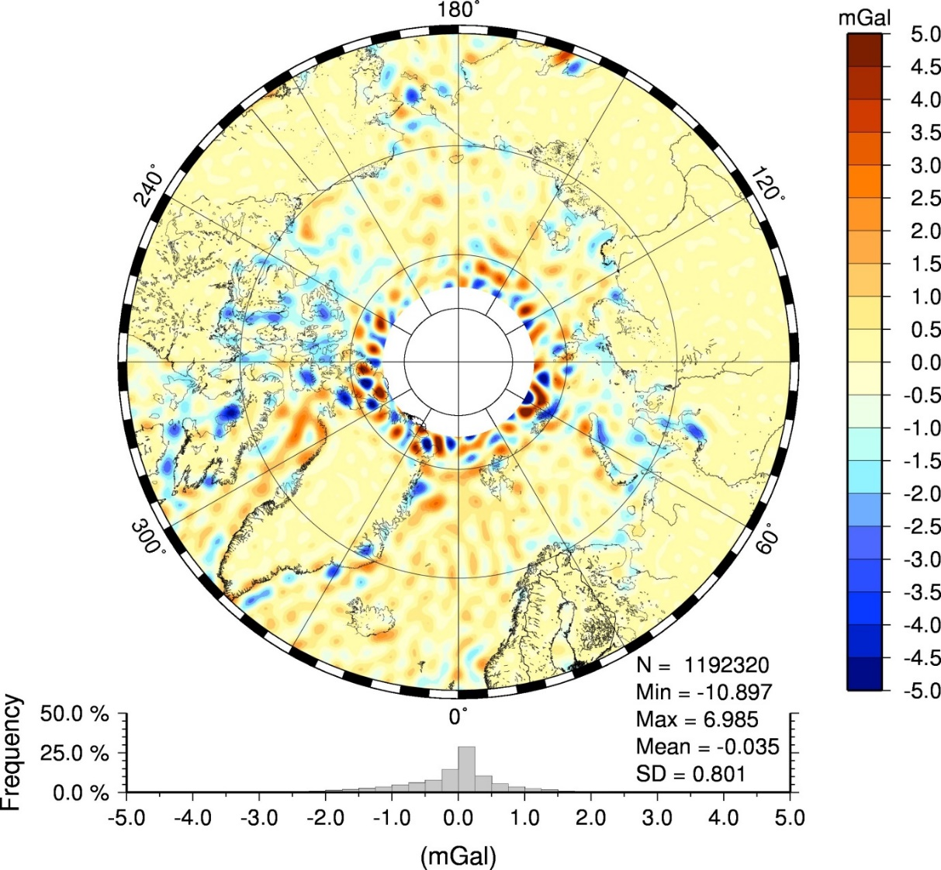
SS 23.1
DTU15
Patched in
north of 79N

Slide 11
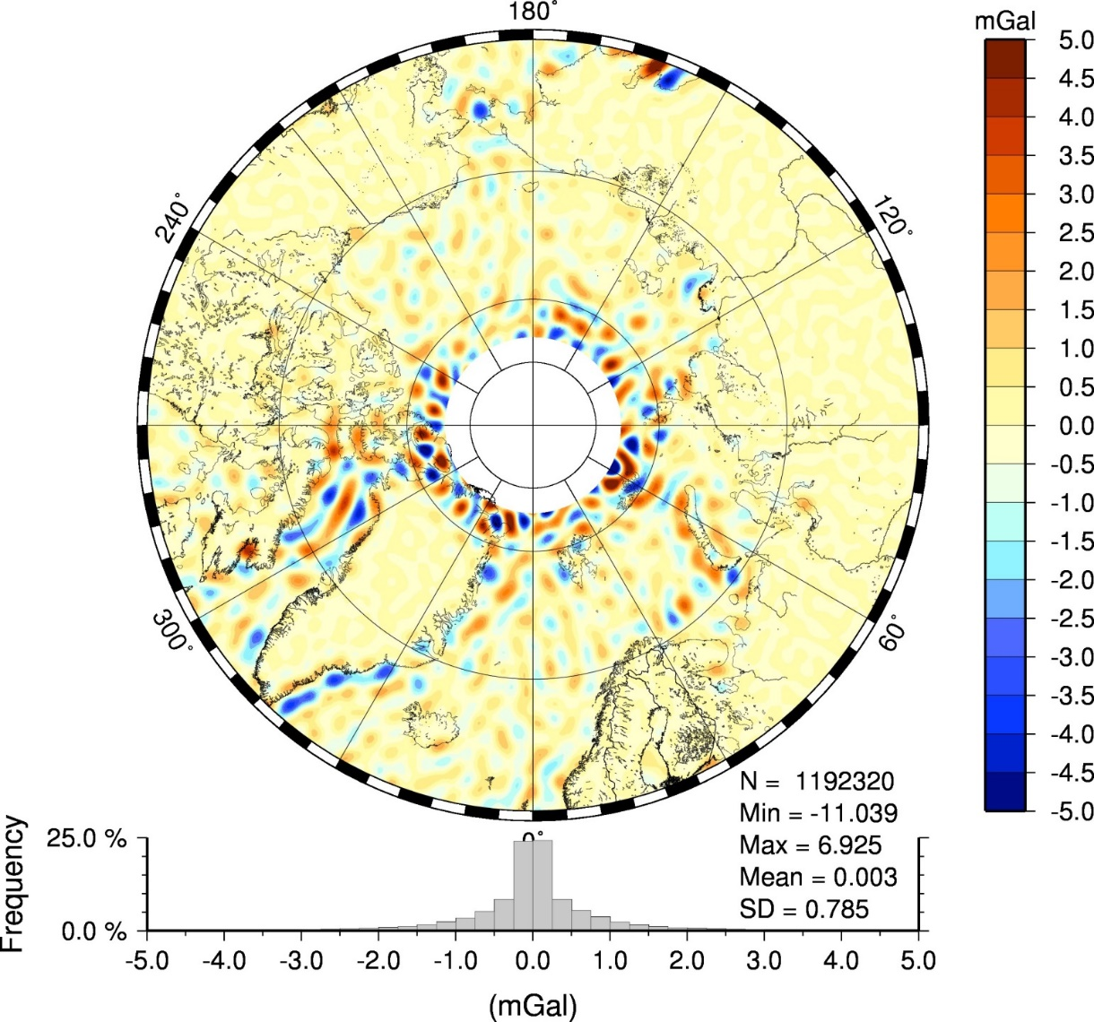
DTU15
DTU 15

Slide 12
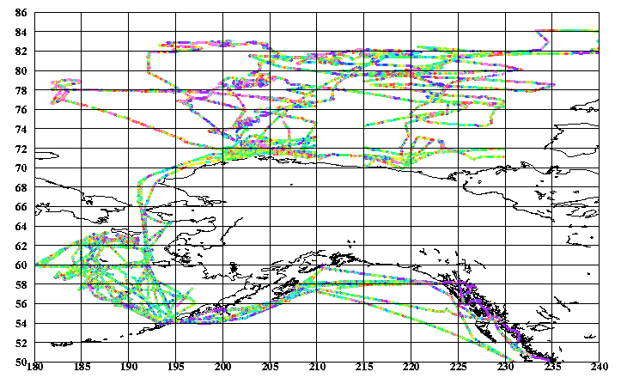
Compariwon with Univ of Alaska (North of 68) submarine data
865000 NGA data | STD | Max | Mean
DTU15 | 3.87 | 28 | -0
DTU17 | 3.37 | 28 | -0
SS V23.1 | 3.61* | 28 | 0
EGM08 | 5.97 | 42 | -1
* For SSV23.1 comparison I only used 599400 data south of 80N

Slide 13
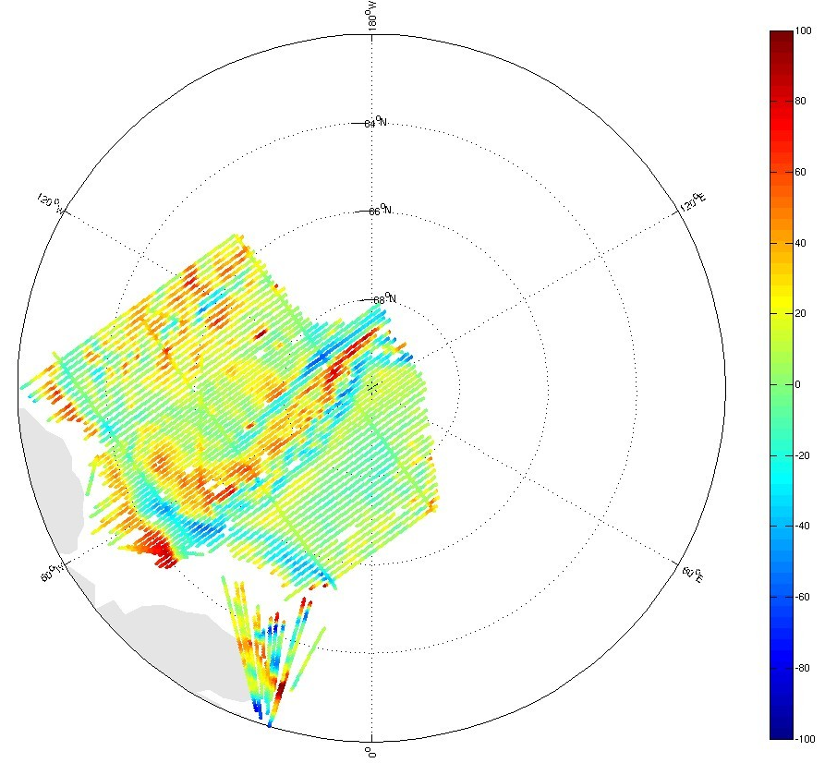
LomGrav 2009 Airborne survey.
Region has Permanent ice coverage
Making it bad for altimetric gravity
DTU gravity is still more ”noisy”
Here than elsewhere.
In line with knowledge about
Higher noise on 20 hz SSH obs.
All mGal | DTU13 | DTU15 | EGM08 | DTU17
LomGrav 2009 | 5.89 | 5.45 | 9.82 | 4.22

Slide 14
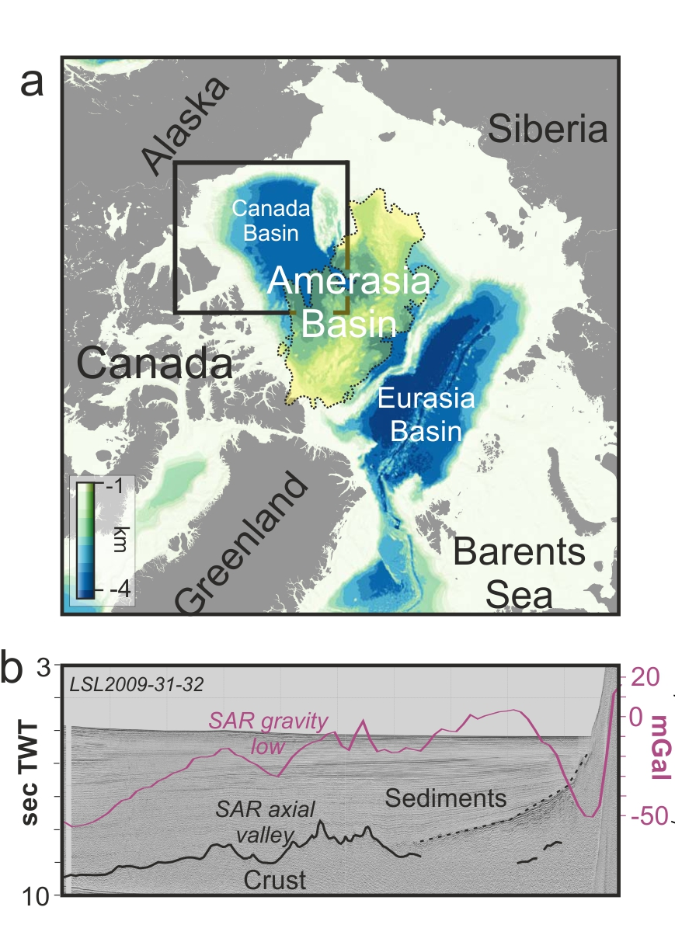
Cretaceous ocean formation in the Arctic
Ameration and Eurasian basin separated by Lomonosov Ridge across North Pole.
South Amerasia Ridge is poorly known. It was identified in 1994 satellite altimetry (Laxon and McAdoo).
The low is representing a fossil spreading center which Canada opened by rotation during cretaceous.
High Arctic Large Igneous Provinces (HALIP) has overprinted most of its earlier structures particulaly within the Amerasia Basin

Slide 15
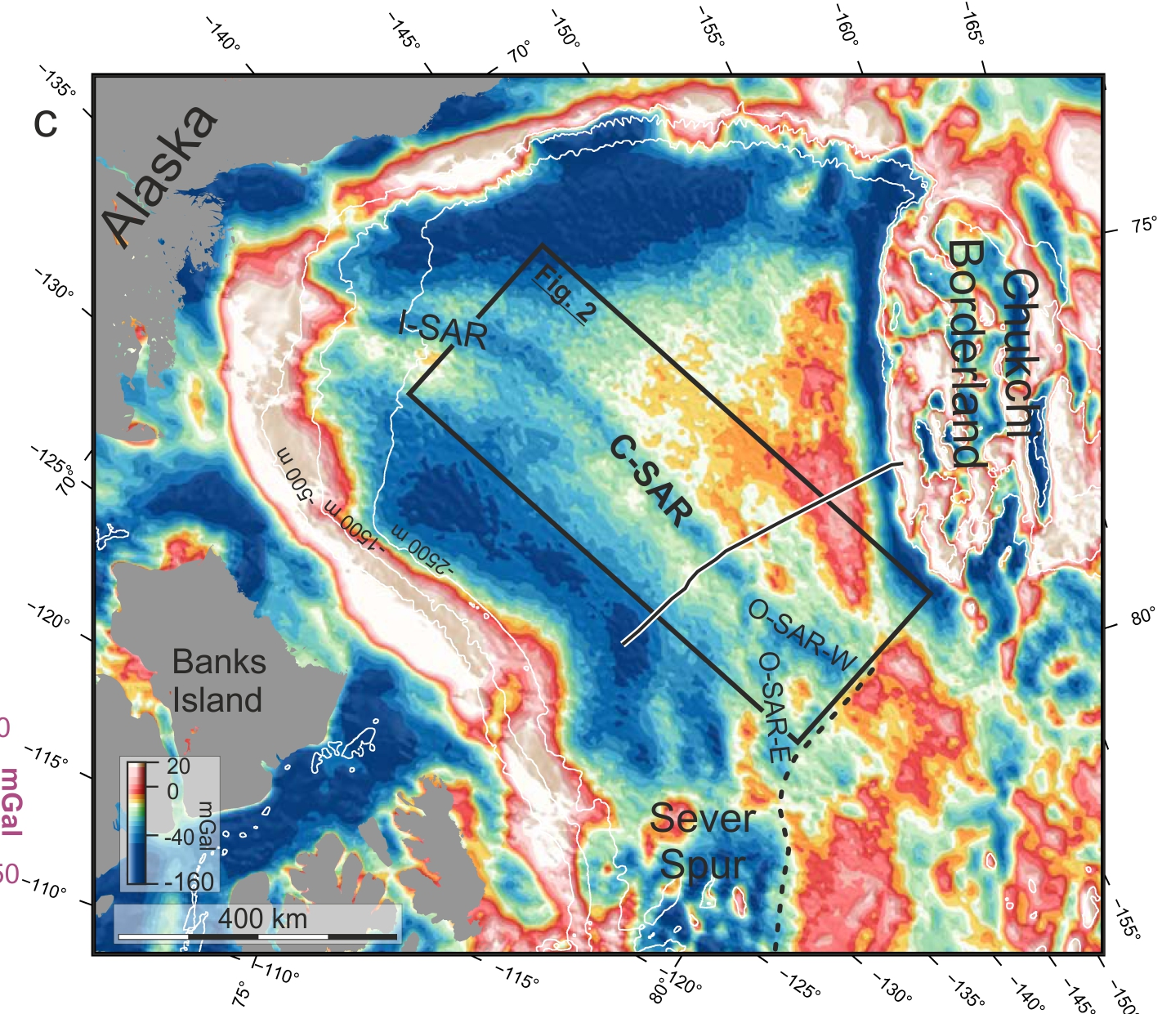
South Amerasia Ridge.
A north south trending gravity low in the Canadian Basin can be seen
Based on along-strike orientatoin SAR is seperated into 4 sections: Inner,central,outer and western.
Only very few seismic profile available in the region.

Slide 16
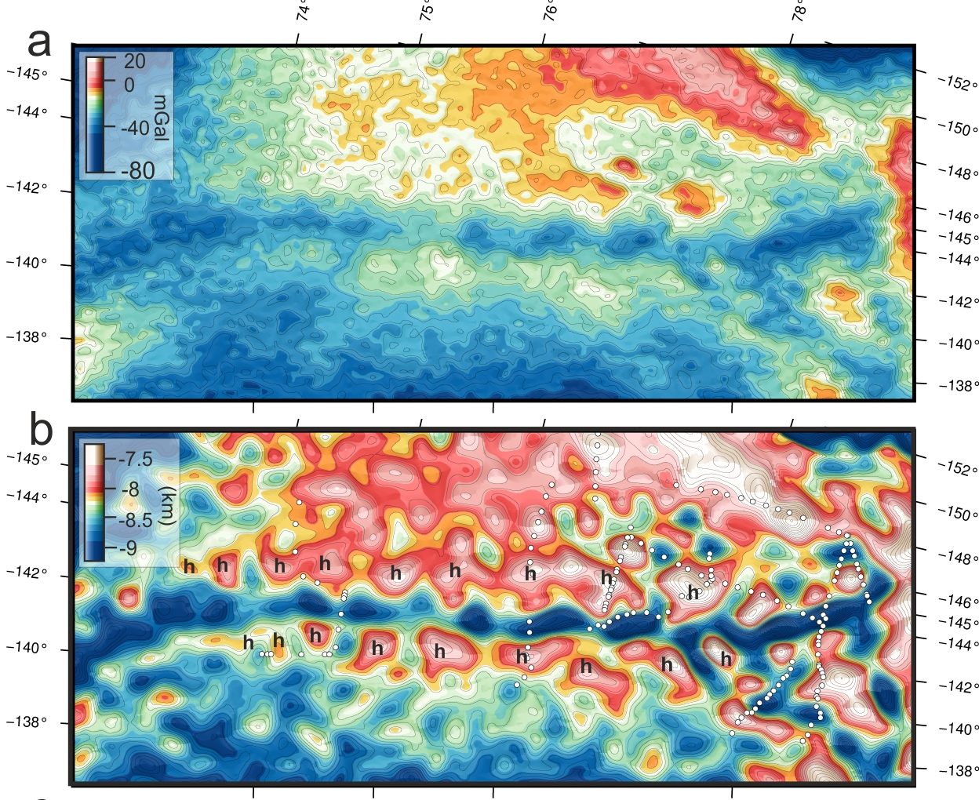
DTU15 free air Gravity anomalies (upward continuated to 2 km).
Basement topography from 3D gravity inversion (constrained by seismics).
Basement highs has
20 km (inclined relative to regional trend)
High sub-segmented.

Slide 17
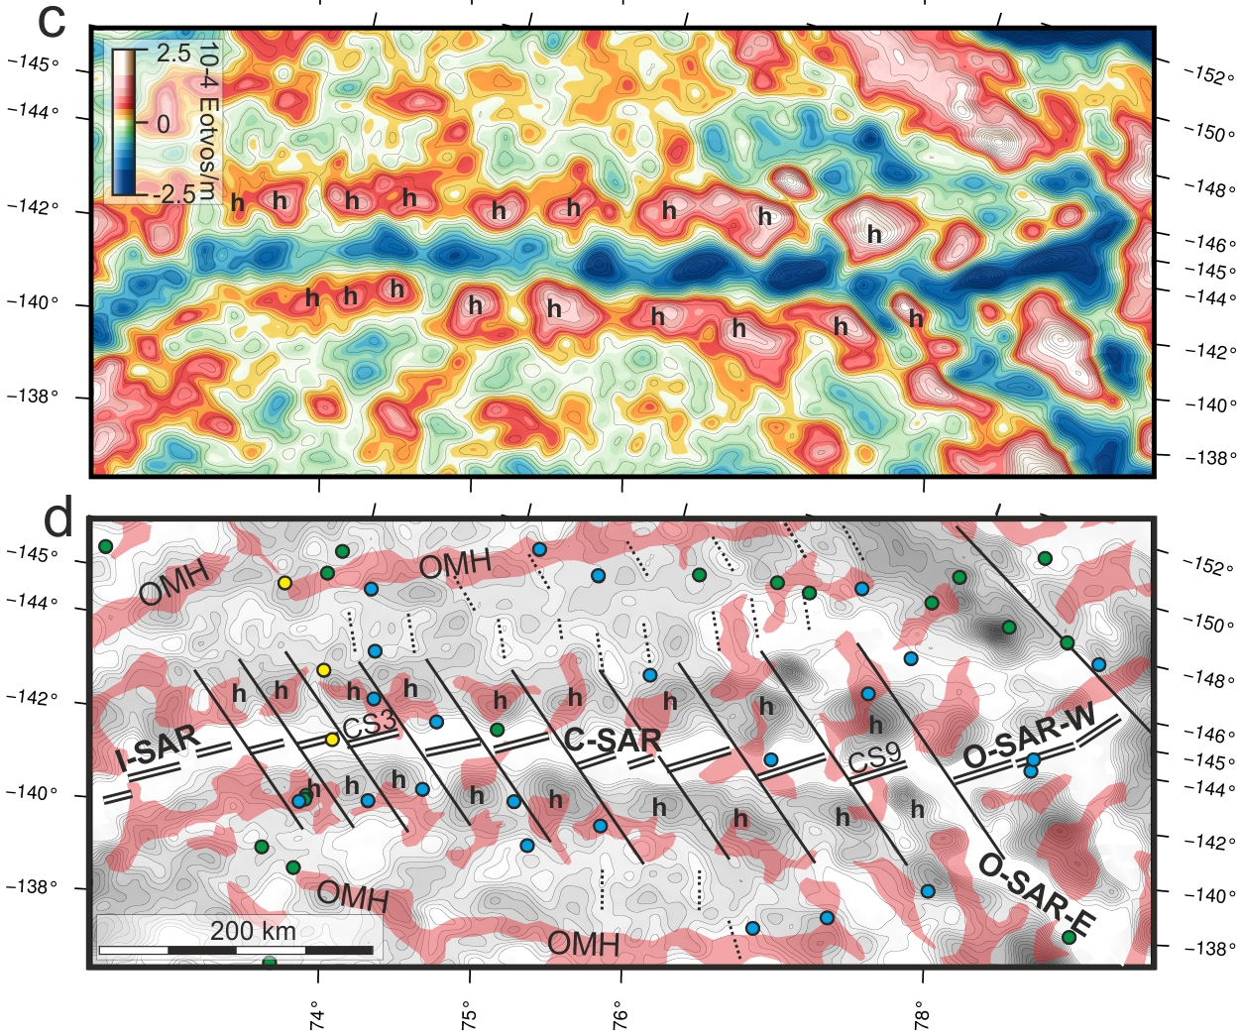
Second Vertical Derivative (and 1VD) of band limited gravity field (~isostatic anomalies) both supports the interpretation of sub segmentation of the C-SAR ridge
Our preferred interpretation is an oblique segmentation
A highly crenulated basement terrain along C-SAR is seen stretching 80-125 km on either side.

Slide 18
South Amerasia Ridge
An oblique segmentation document ocean formation in the Arctic during at least 2 distinct phases.
Initial sub-orthogonal opening (phase 1)
Secondary younger highly oblique and segmented opening (phase 2).
Many of the highs correlate well with magnetic highs indicating magmatic origin.
(volcanism)

Slide 19
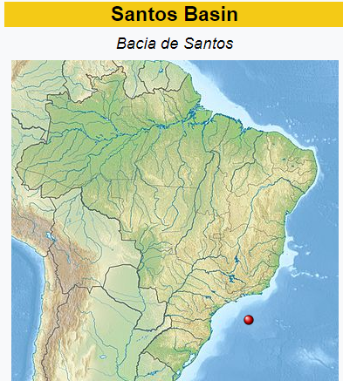
Southern Example
NORDIC13 gravity
interpretation in South Area,
Santos Basin,
Located Roughly 300 km from Santos Brazil
Notes:
First I will briefly introduce you the concept of computing the gravity field from sea surface heights
Then I will outline some recent developments in satellite-derived gravity that has allowed us to create the NORDIC13 gravity data sets
Then I will show three examples of the NORDIC13 gravity data sets from the Santos Basin
First an example from shallow-water in the Santos South Area near the Baúna-Piracucá (formerly Tiro-Sidon) and Piracucá producing fields
Next an overall view of the relations between the NORDIC13 gravity data and the some of the discoveries in the deep-water Santos Pre-Salt
And finally we will look at the Libra field in the Santos Pre-Salt in more detail
I will finish the presentation with a number of conclusions

Slide 20
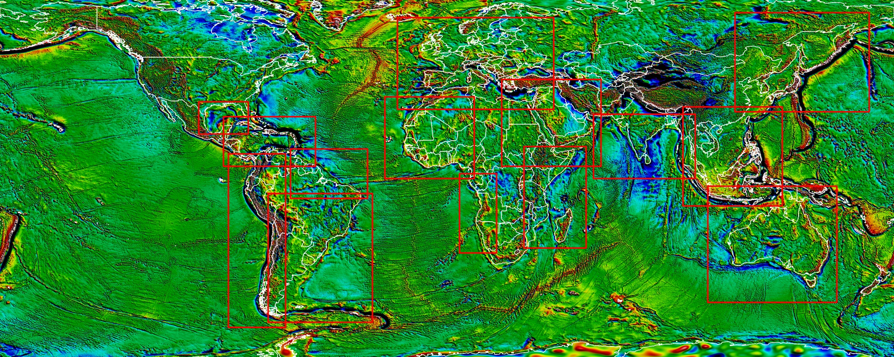
NORDIC13 Gravity Data Sets
NORDIC 13:
Bathymetry, Free Air,
Full Bouguer Gravity,
Residual Isostatic Gravity
1VD Filter enhancements
15 offshore regions
Global FA gravity field over
15 offshore exploration regions
1 minute cells = ~ 2km x2km
Resolution = 6.5km
Accuracy < 2mGal
Notes:
So here is the NORDIC13 gravity data sets, consisting of:
NORDIC13 Bathymetry
NORDIC13 Free Air Gravity
NORDIC13 Full Bouguer Gravity
NORDIC13 Residual Isostatic Gravity
And geophysical filter enhancements (1VD)
Over 15 offshore petroleum exploration regions world-wide.
The data is provided as 1 minute grid cells ~2km by 2km.
The resolution is 6.5km
The accuracy is between 1mGal and 2mGal.
All

Slide 21
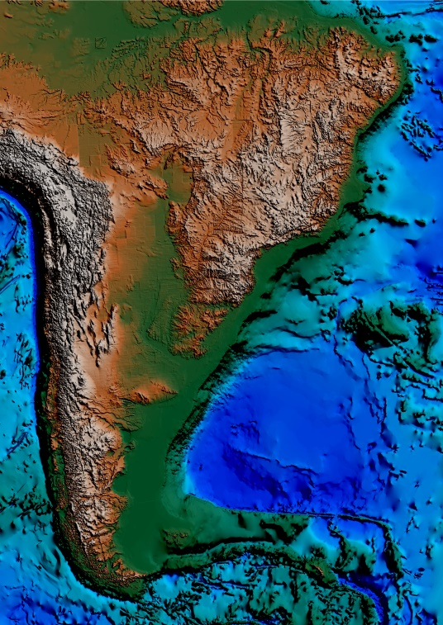
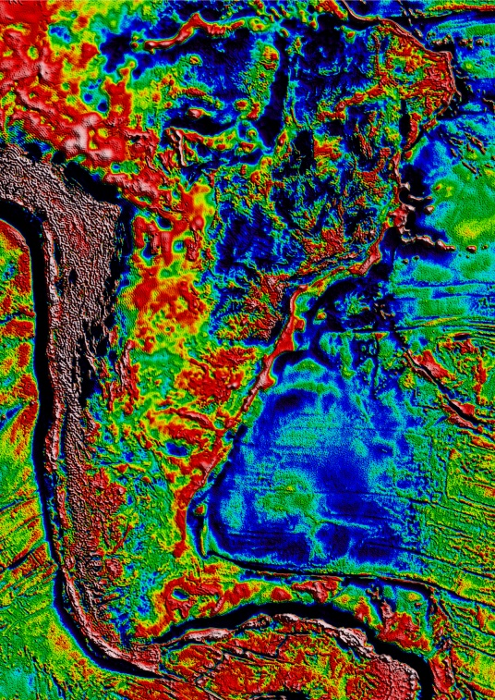
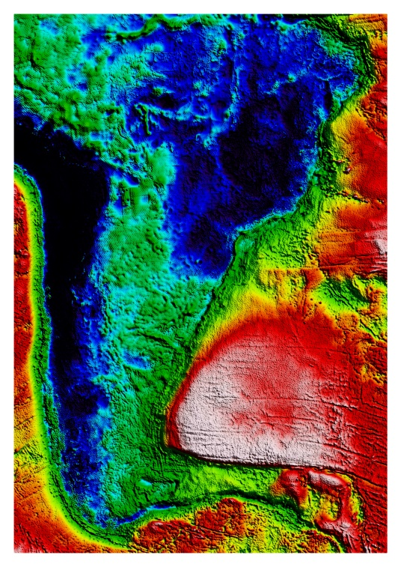
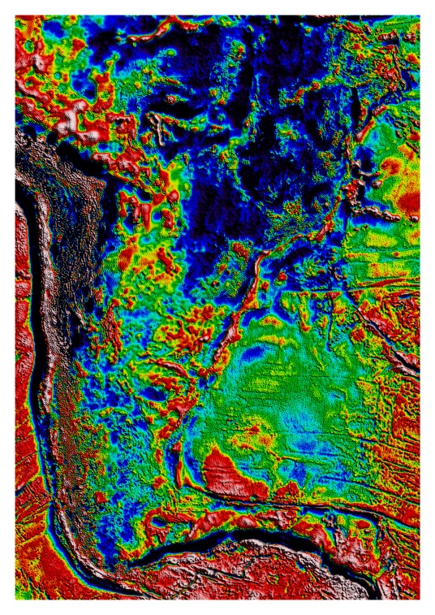
NORDIC13 example: South Area, Santos Basin
NORDIC13
Residual Isostatic Gravity
NORDIC13 Bathymetry
NORDIC13 Free Air Gravity
NORDIC13 Bouguer Gravity
Notes:
As an example here is the NORDIC13 gravity data set covering South America –South Atlantic.
NORDIC13 Bathymetry
NORDIC13 Free Air Gravity
NORDIC13 Full Bouguer Gravity
NORDIC13 Residual Isostatic Gravity

Slide 22
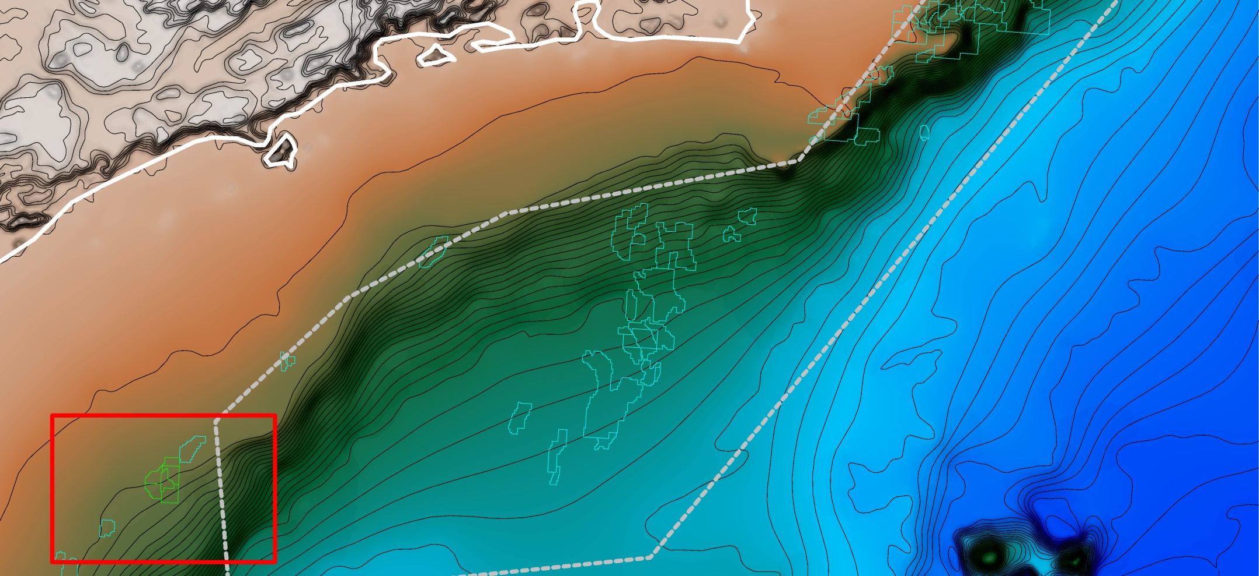
South Area, Santos Basin, Brazil
NORDIC13 Bathymetry and DEM
100km
Campos Basin
Uruguá
Area
Mexilhão
Area
Merluza
Area
Pre-Salt
South
Area
Santos Basin
Jean Charcot
Seamounts
Contour 100m
Notes:
In this example we are going to look a bit closer on some recent discoveries (here in green) in shallow water (~200m)
in the Santos South Area near the Baúna-Piracucá (formerly Tiro-Sidon) and Piracucá producing fields.
In the next slide we will have zoomed in to the red rectangle (here)

Slide 23
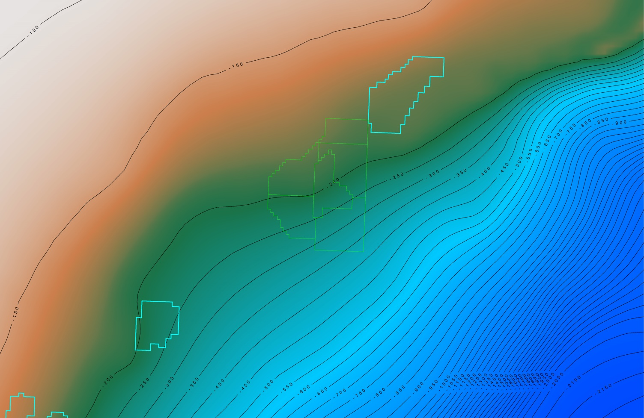
South Area, Santos Basin, Brazil
NORDIC13 Bathymetry and Exploration
Piracucá
Kangaroo
Echidna
Bilby
Piracaba
(Sidon)
30km
Baúna
(Tiro)
Baúna Sul
(Maruja)
Contour 50m
Notes:
So now we have zoomed in to the Santos South Area near the Baúna-Piracucá (formerly Tiro-Sidon) here in the southern end and the and Piracucá producing fields here in the northern end.
We are just at the edge of continental shelf – water depths are 200m – but 90km to the SE we are down to 2,150m.
The area outlined in green is the exploration acreage of Karoon Gas/Pacific Exploration and Production . They have made three petroleum discoveries in this acreage: Kangaroo, Echidna, and Bilby
On the next slide I will show the NORDIC13 residual isostatic gravity over the area…..

Slide 24
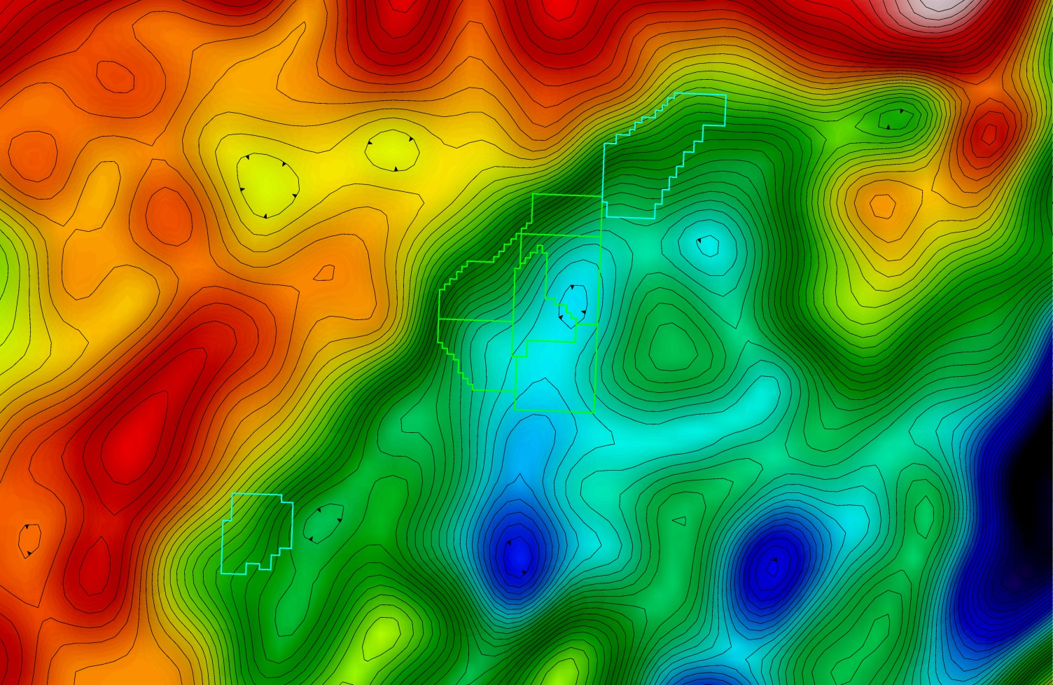
South Area, Santos Basin, Brazil
NORDIC13 Residual Isostatic Gravity
30km
Contour 1 mGal
Notes:
Here is the NORDIC13 residual isostatic gravity over the area…..
Note the strong SW-NE running gravity gradient traversing the region – indicating a regional fault or lithological contact.
Also note the elongated gravity low running parallel to the east. Indicating a sub-basin.
Now in order to extract a bit more information, on the next slide I will show the First Vertical Derivative (1VD) of the NORDIC13 residual isostatic gravity.

Slide 25
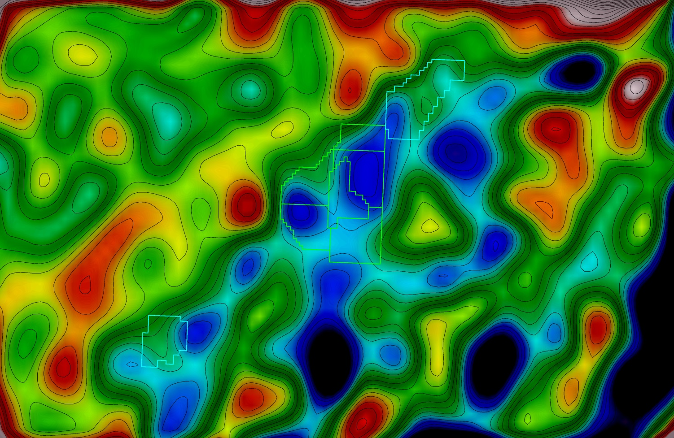
South Area, Santos Basin, Brazil
NORDIC13 Residual Isostatic Gravity - 1VD
30km
Contour 2 Eötvös
Notes:
Here is the First Vertical Derivative (1VD) of the NORDIC13 residual isostatic gravity.
Note how the 1VD filter attenuates longer wavelengths in the data – associated with regional geology
and instead accentuates the short wavelength anomalies associated with local geological structures
Note how the filter accentuates short wavelength features into local highs and lows.

Slide 26

South Area, Santos Basin, Brazil
NORDIC13 Residual Isostatic Gravity - 1VD
30km
Contour 2 Eötvös
Notes:
On the next slide I am going to zoom in on the red rectangle enclosing the Karoon Gas/Pacific Exploration and Production exploration license – outlined in green.

Slide 27
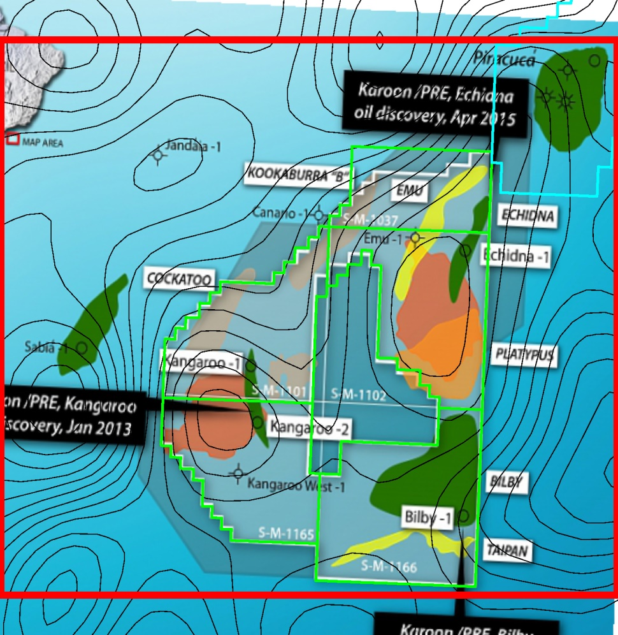
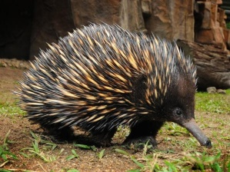
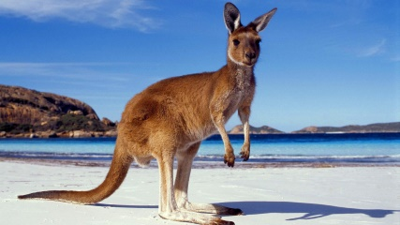
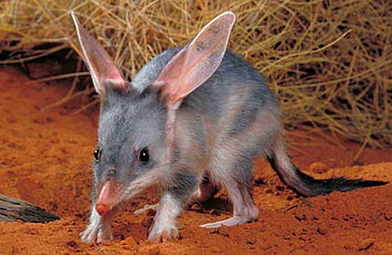
South Area, Santos Basin, Brazil
Three Petroleum Discoveries in Eocene Sandstone
25km
www.australiazoo.com.au
Echidna (2015)
30km
www.dreamlandia.com
Kangaroo
(2013)
Bilby (2013)
www.factzoo.com
Notes:
Karoon Gas/Pacific Exploration and Production have made three petroleum discoveries in primarily Eocene sandstones (post-Salt) – Turbidites(?)
Kangaroo (2013), Bilby (2013) and Echidna (2015)

Slide 28
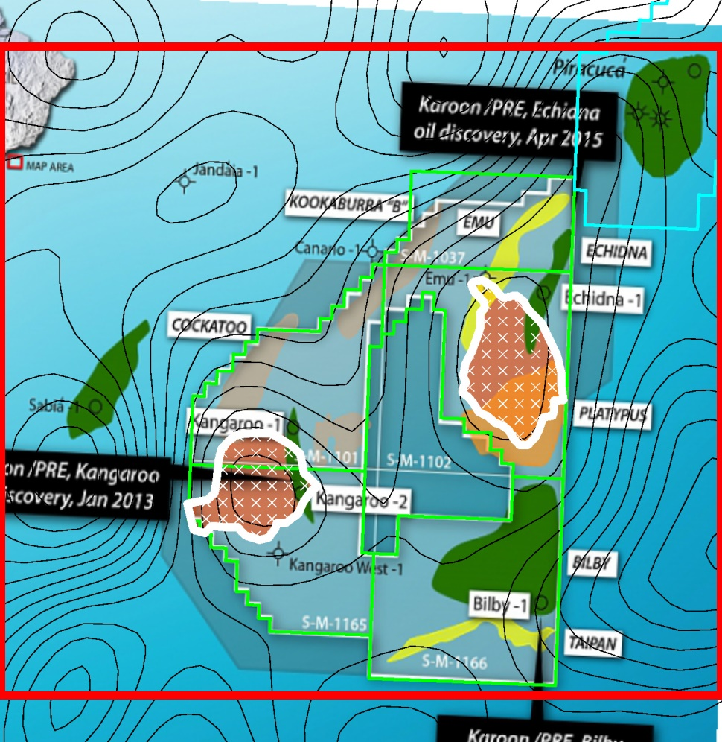
Echidna – Kangaroo – Bilby, Santos Basin, Brazil
Salt Diapirs
25km
Echidna (2015)
Salt diapirs
30km
Kangaroo
(2013)
Bilby (2013)
Notes:
Two of the discoveries - Kangaroo and Echidna – are associated with structural traps created by movement of adjacent salt-diapirs (halokinesis)
Here are the outlines of the base of the two larger salt-diapirs….

Slide 29
South Area, Santos Basin, Brazil
Salt Diapirs
25km
Seismic cross-section
A
A”
Salt diapirs
30km
Notes:
On the next slide I will show a section cross section across the salt diapir associated with the Kangaroo discovery

Slide 30
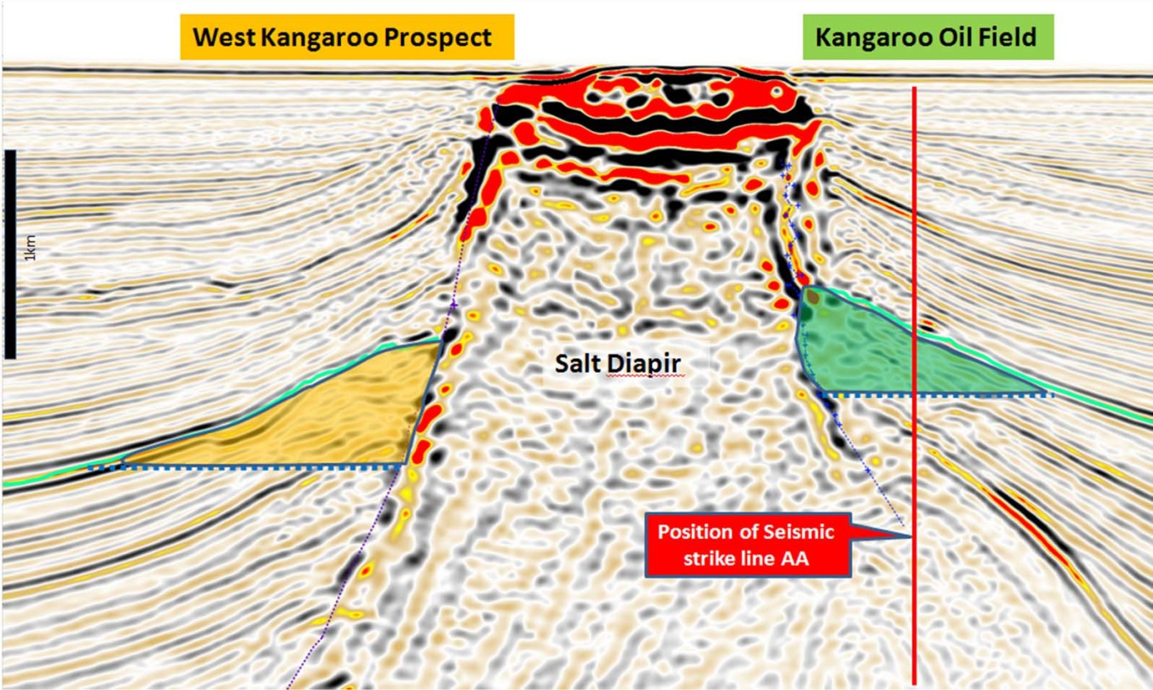
South Area, Santos Basin, Brazil
Salt Diapirs
A
A”
2km
Reservoir in Eocene
interbedded sandstones
Karoon Review May 2013
Notes:
The Kangaroo oil field is associated with a structural trap created by movement of the nearby salt-diapir (halokinesis)
The salt diapir has breached the surface of the seafloor?
Note that the salt-diapir is ~5km across, and appears to be widening with depth

Slide 31
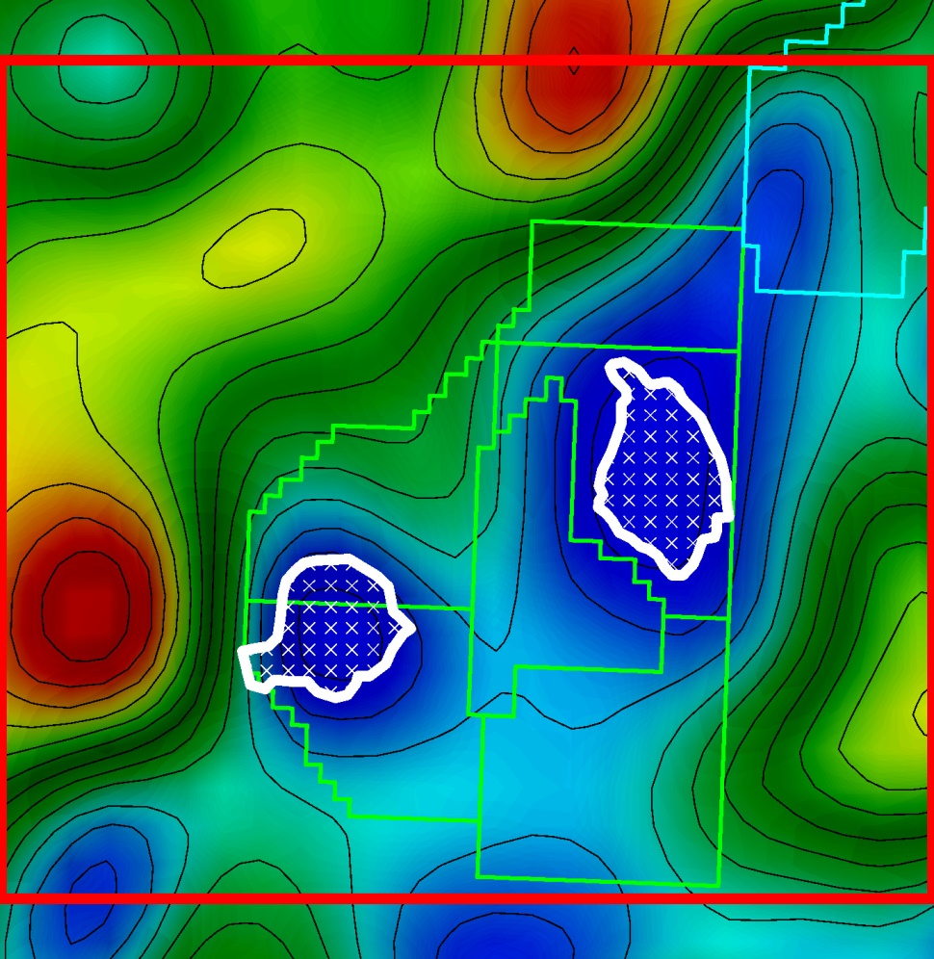
South Area, Santos Basin, Brazil
NORDIC13 Residual Isostatic Gravity - 1VD
25km
Salt diapirs
30km
Contour 2 Eötvös
Notes:
Here are the outlines of the salt diapirs on the 1VD of the NORDIC 13 residual isostatic gravity data………
You can see an excellent correlation between the lows in the vertical gravity gradient and the locations of the salt diapirs.
However, there is a limit to the resolution of the NORDIC13 data…..

Slide 32
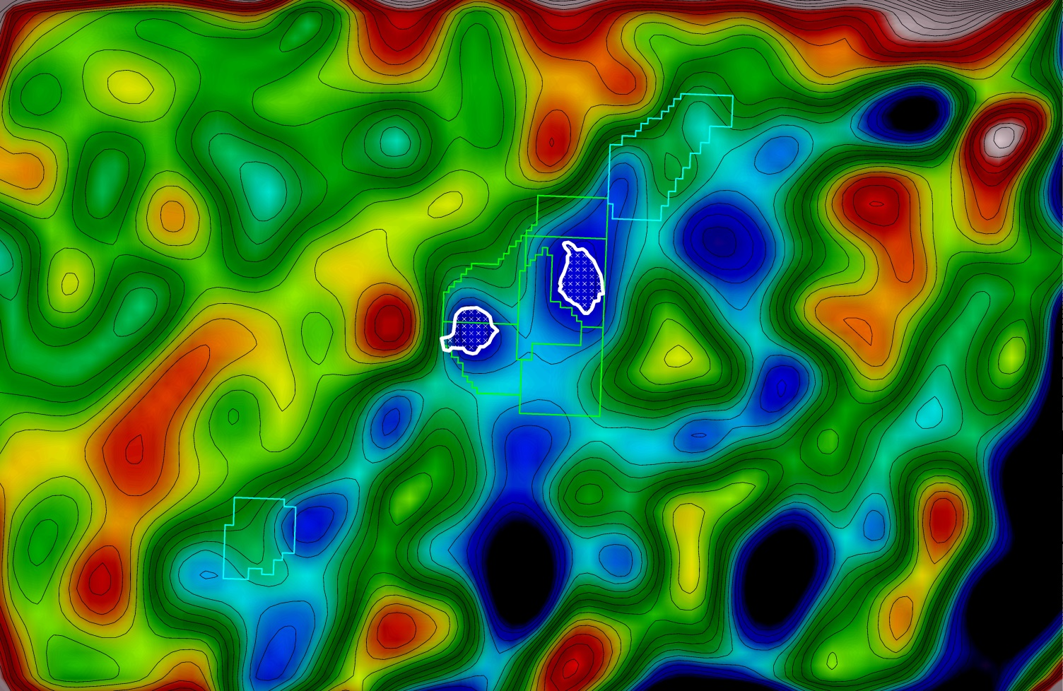
South Area, Santos Basin, Brazil
NORDIC13 Residual Isostatic Gravity - 1VD
30km
Piracucá
Kangaroo
Echidna
Bilby
Piracaba
(Sidon)
Baúna
(Tiro)
Baúna Sul
(Maruja)
Contour 2 Eötvös
Notes:
What about other gravity lows. Can these be salt structures as well.
First of all, note that most of the oil discoveries in this area are situated on the flanks of these gravity gradients lows

Slide 33
South Area, Santos Basin, Brazil
NORDIC13 Residual Isostatic Gravity - 1VD
30km
Piracucá
Kangaroo
Echidna
Bilby
Piracaba
(Sidon)
Baúna
(Tiro)
Baúna Sul
(Maruja)
Contour 2 Eötvös
Notes:
I can show you another example from the nearby Baúna (formerly Tiro) oil field.
On the next slide I will have zoomed in on the red rectancle (here)

Slide 34
South Area, Santos Basin, Brazil
NORDIC13 Residual Isostatic Gravity - 1VD
Most of the oil discoveries in this area are
situated on the flanks of gravity gradient
lows associated with larger salt diapirs
Piracucá
?
?
Kangaroo
Echidna
Bilby
Piracaba
(Sidon)
30km
Baúna
(Tiro)
Baúna Sul
(Maruja)
Contour 2 Eötvös
Notes:
So the gravity gradient low to the south-west of Bauna is alo associated with a salt diapir.
I have not found any geological information about the Piracuca oil field – but again the two producing regions are situated on the flanks of gravity gradient lows.
In fact: Most of the oil discoveries in this area are situated on the flanks of gravity gradients lows associated with larger salt diapirs

Slide 35
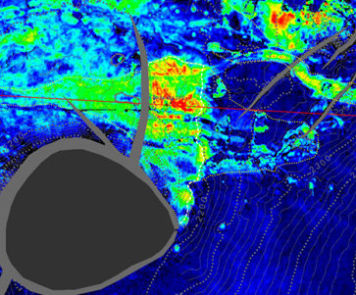
South Area, Santos Basin, Brazil
Baúna (Tiro) Oil Field
A
A”
SALT DIAPIR
A”
SALT DIAPIR
Stratigraphic thinning
& “pinch-out” of reservoir
onto flank of salt diapir.
A
Karoon Review October 2011
Karoon Review October 2011
Notes:
Here is a TWT structure map over the Baúna (Tiro) oil field.
Like the Kangaroo discovery – the Baúna (Tiro) oil field is a structural/stratigraphic trap on the flank of a salt diapir.

Slide 36
South Area, Santos Basin, Brazil
NORDIC13 Residual Isostatic Gravity - 1VD
NORDIC13 gravity gradient lows may provide a map of
the lateral extent of the larger salt-diapirs in the region
L
L
L
L
L
L
L
L
L
These can be used as vectors
for future exploration efforts
L
L
L
L
L
L
30km
L
L
L
L
Contour 2 Eötvös
Notes:
The NORDIC13 gravity gradient lows may provide a map of the lateral extent of the larger salt-diapirs in the region.
These can be used as vectors for future exploration efforts.
Further 3D Modelling can provide more information about the distribution of halites and clastic sediments in the sub-basin

Slide 37
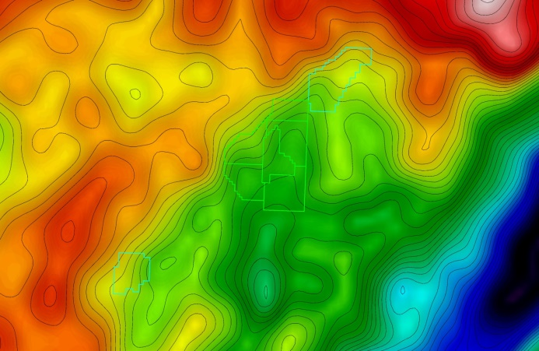
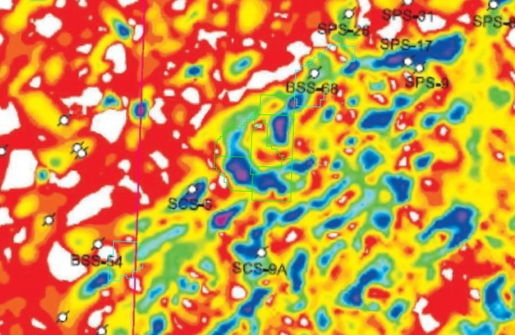
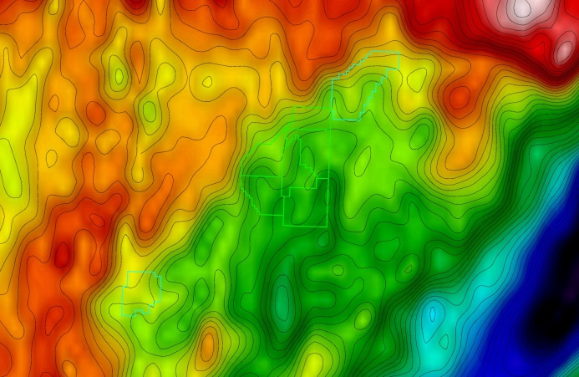

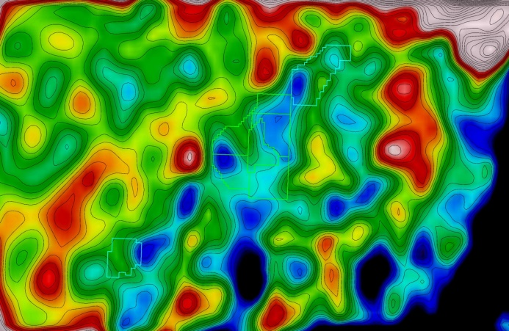
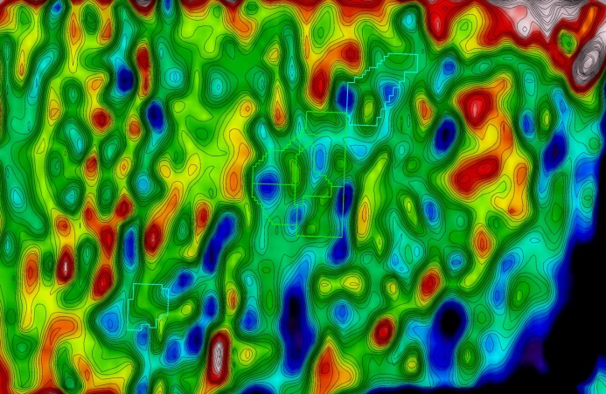
South Area, Santos Basin, Brazil
Free Air Gravity and Free Air Gravity 1VD Comparison
NORDIC13 Free Air Gravity
Salt Seismic Isochron
Sandwell & Smith v24.1 Free Air Gravity
NORDIC13 Free Air Gravity 1VD
Salt Seismic Isochron
Sandwell & Smith v24.1 Free Air Gravity 1VD
Modica and Brush (2004)
Notes:
Here is the NORDIC13 free air gravity over the area…..
Note the strong SW-NE running gravity gradient traversing the region – indicating a regional fault or lithological contact.
Also note the elongated gravity low running parallel to the east. Indicating a sub-basin.

Slide 38
Sandwell-Smith 24.1 Free Air Gravity – Issues
Short wavelength noise
Along-track striping
Numerous noise spikes near coast lines
(from onshore reflections)
Poor alignment with onshore gravity
Sorell Basin

Slide 39
Conclusions
Satellite Altimetry is an important tool to support of geological interpretation
Cretaceous Ocean formation and Oblique segmentation in the South Amerasian Basin was found from inversion of gravity and also seen on 1VD and 2VD
Used the 1VD of the DTU15/NORDIC13 gravity data shows a strong correlation between the location of larger salt diapirs (>4km width) and gravity gradient lows. Smaller salt-features (<2km width) are not resolvable in NORDIC13.
The NORDIC13 gravity gradient lows may provide a map of the lateral extent of the larger salt-diapirs in the region. Many of the oil discoveries in the South Area of the Santos Basin are situated on the flanks of salt diapirs.
The inferred locations of larger salt diapirs in South Area of Santos can be used as vectors for future exploration efforts in the region

Slide 40


For information about NORDIC13 (and soon NORDIC15) pricing and purchasing,
please contact Nordic Geoscience.
Contact: Asbjorn Norlund Christensen, Director, Nordic Geoscience Pty. Ltd.
Phone: +61 4 1771 6859
Email: asbjorn.christensen@nordicgeoscience.com
Nordic Geoscience – Gravity, Magnetics, Airborne Gravity Gradiometry, EM, Processing, Interpretation, R&D, …and much more

Slide 41
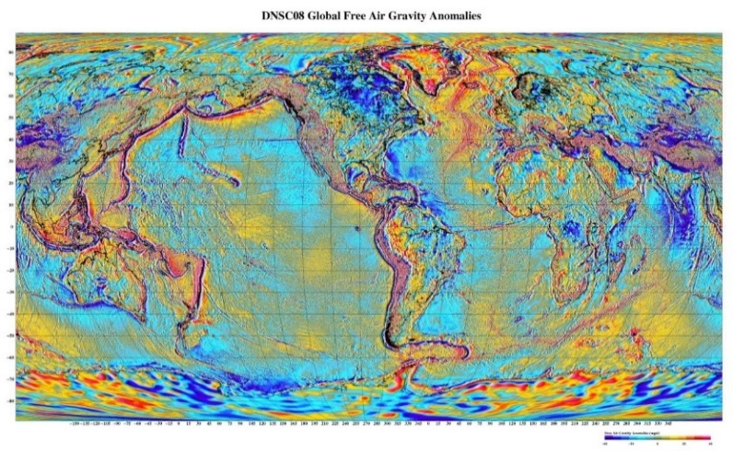
Thank you!

Slide 42
References
Alves, Carlos, 2011, Pre-salt Santos basin, Capital Markets Day -March 14th 2011, GalpEnergia http://www.galpenergia.com/EN/Investidor/Apresentacoes/Documents/Pre-salt%20Santos%20basin.pdf
ANP (2010), Review and evaluation of ten selected discoveries and prospects in the pre-salt play of the deep water Santos basin, Brazil. Gaffney, Cline & Associates Report, 15 sep. 2010. http://www.anp.gov.br/?dw=39132
Beasley, C., Fiduk, J.C.,Bize, E., Boyd, A., Frydman, M., Zerilli, Andrea, Dribus, J.R., Moreira, J.L.P., and Pinto, A.C.C., Brazil’s Presalt Play, Oilfield Review, 22,3, Autumn 2010, 28-37
https://www.slb.com/~/media/Files/resources/oilfield_review/ors10/aut10/03_presalt.pdf
Moczydlower, Bruno, 2014, Brazilian Pre-Salt & Libra, Presentation to KIVI Engineering Society,
https://www.kivi.nl/uploads/media/565f1082c89da/Pre-Salt_Presentation_to_KIVI_Oct14_R2.pdf
Modica, C.J., and Brush, E.R., 2004, Postrift sequence stratigraphy, paleogeography, and fill history of the deep-water Santos Basin, offshore southeast Brazil, AAPG Bulletin, v. 88, no. 7 (July 2004), pp. 923–945
Petersohn, Eliane, Abelha, Marina, and Pedrosa, Luciene, 2013, Brazil Pre-Salt Libra, ANP
http://www.brasil-rounds.gov.br/arquivos/Seminarios_P1/Apresentacoes/partilha1_tecnico_ambiental_ingles.pdf

