Slide 1
Global altimetric marine gravity field – towards the 1 mGal global goal in 2020.
Ole B. Andersen (DTU Space).
With valuable input from
Per Knudsen, A. Abulaitijiang (DTU Space),
J. Factor (NGA)
Simon Holmes (SGT-inc)

Slide 2
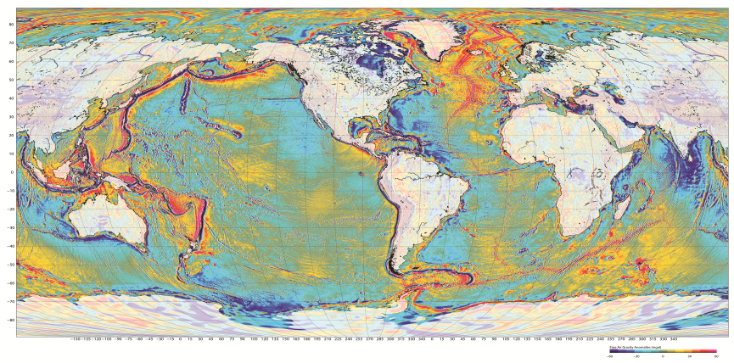
Global Free-air gravity
(Sandwell, DTU-Andersen or EGM2008)

Slide 3
Outline
The Basics in a glance
The Revolution within satellite altimetry
Going from ERS-1 and GEOSAT to new 2nd generation satellites.
Global Altimetric Gravity improvement
Spatial filtering
Accuracy
A surprising new geodetic Mission (SARAL / AltiKA) and DTU17
The coast: Ocean Tide Issues
Towards 2020
Introducing ”The Slope Correction”
JASON-2 EOL Geodetic Missing
Availability

Slide 4
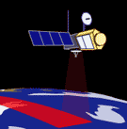
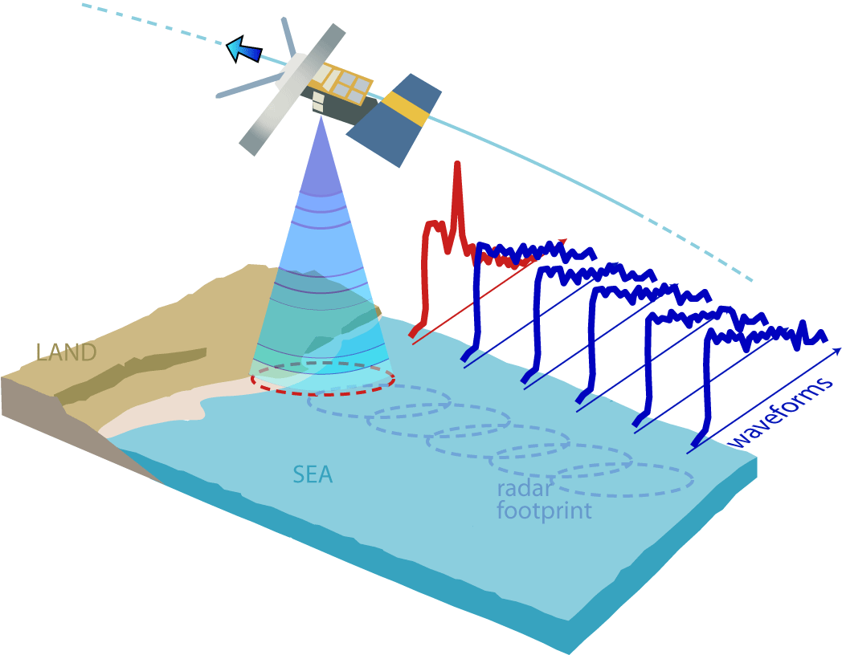

Slide 5
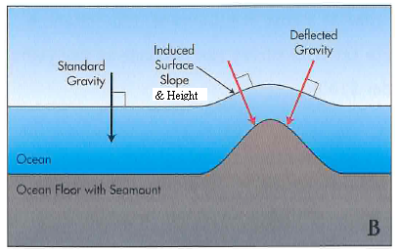
The Basics at a glance
The 1-2 mGal issue
Key here: RANGE PRECISION
More accurate SSH =>
More accurate Gravity
ACCURACY is of less importance
Predicting a 2 mGal anomaly corresponds to retrieving the SSH (difference) with ~2 cm height precision (7 km)
7 km distance corresponds to 1 Hz SSH observations.
Altimetry has to be of very high precision (why we have retired ERS-1 (1995) and Geosat (1985) altimetry

Slide 6
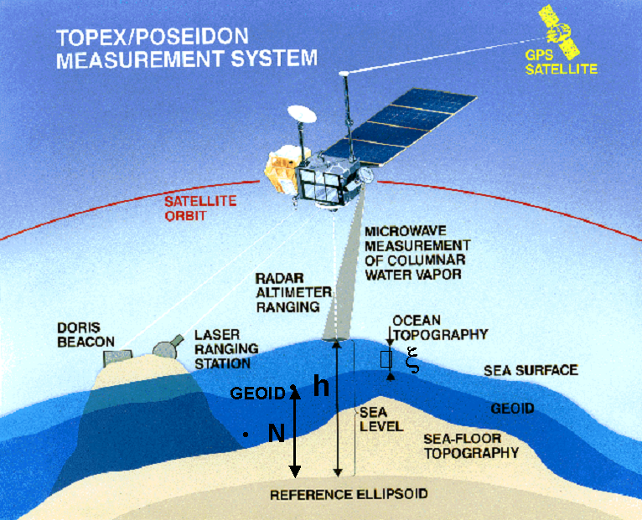
Gravity Machinery prediction engine
  Use Geodetic Mission sea surface height data.
  h = (N_{LW} + ∆N) + MDT + h(t)
Select Area-tile (process world in tiles)
Remove N_{LW} (EGM2008 d/o = 1960)
Remove MDT (MDT_{DTU07/EGM2008} d/o=100)
Perform crossover adjust (”reduce” h(t))
Iterative (despiking /re-xover )
”Designed” collocation interpolate to a regular grid
Convert ∆N to ∆g using FFT & Restore EGM2008 gravity
NOTICE WE HAVE NOT USED GOCE MDT due to consistency issues
ISSUE: Getting ∆N as accurate as possible……

Slide 7
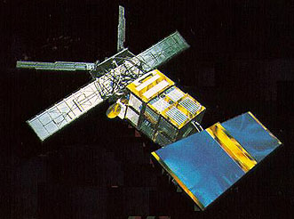
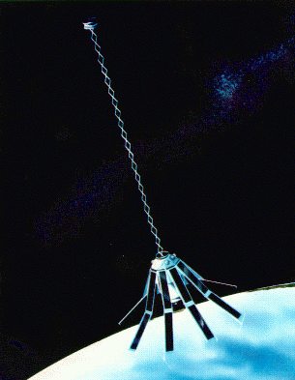
ERS-1 and GEOSAT
Geodetic Missions.
ERS-1 (1994-1995) 11 month GM
8 km ground track pattern.
GEOSAT (1985 -1986) 15 month GM
4-8 km non systematic ground track pattern
Since then 65 years of Exact Repeat Altimetry
have been measured by various satellites.
Numerous gravity field released
With increasing refined/reprocessed/
Retracked/repicking
Data by groups
CLS, SiO, NCTU, KMS, GTECH, DTU etc......

Slide 8
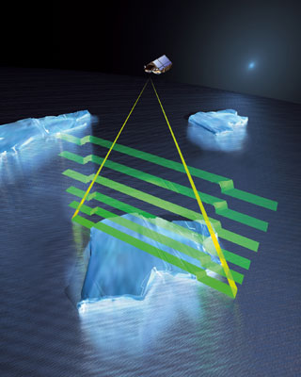
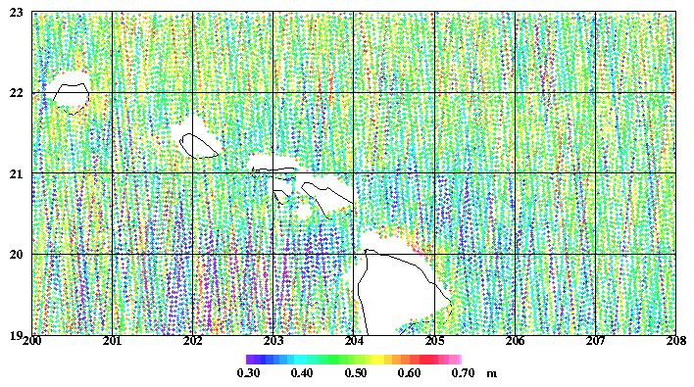
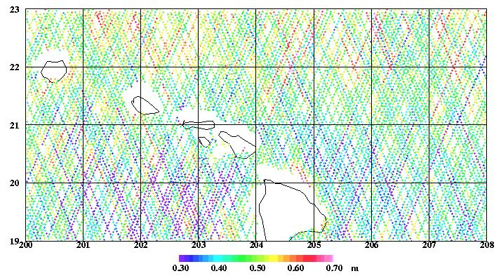
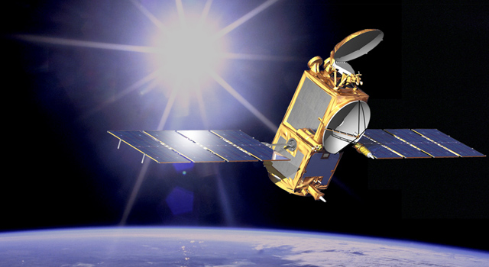
Two new ”Geodetic Missions”
CryoSat-2
Cryosat-2 Launched April 2010.
High Inclination (88º) – Covers most of the Arctic
Completed 7 near repeats of 369 days.
Offers LRM, SAR and SAR-in altimetry.
Track Spacing = 8 km
JASON-1 EOL
April 2012 – May 2013
Jason-1 End-of-Life Scenario
Low inclination (66º)
406 Days GM
Track Spacing = 7 km
Lost J-1 after 409 days

Slide 9
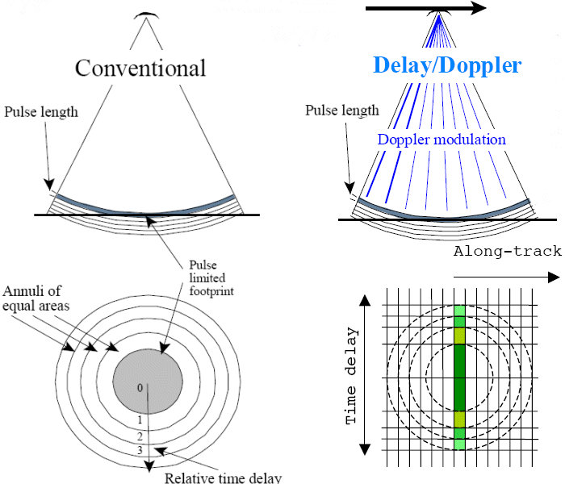
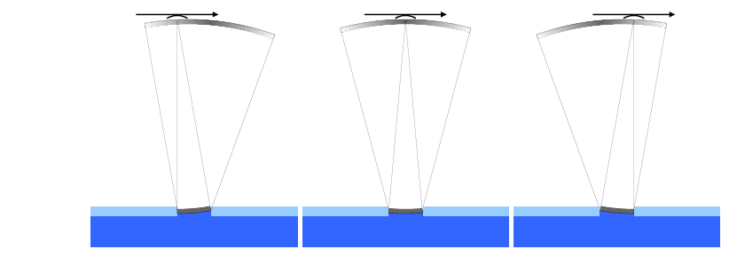
Jason/ENVISAT Cryosat-2, Sentinel-3
LRM SAR

Slide 10
Cryosat Delay Doppler ”promised” and delivered
Conventional
DD Cryosat
Factor of 2 on ssh RANGE PRECISION over conventional altimetry
RANGE PRECISION independent of Sea State:
C2 caviat: C2 only employs transmit and listen procure which lowers accuray by 1.5
As the efficient Pulse Repetition Frequensy is less than 1 MHtz

Slide 11
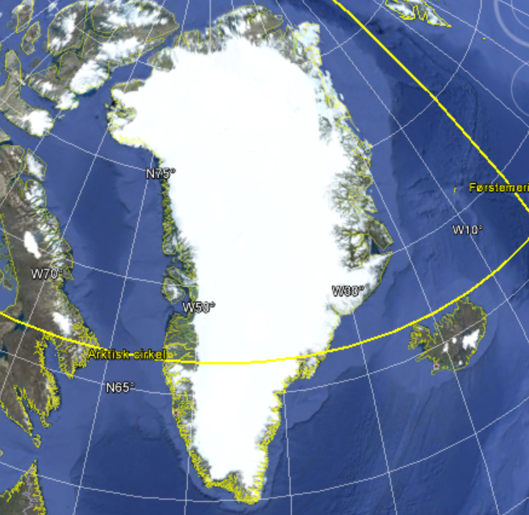
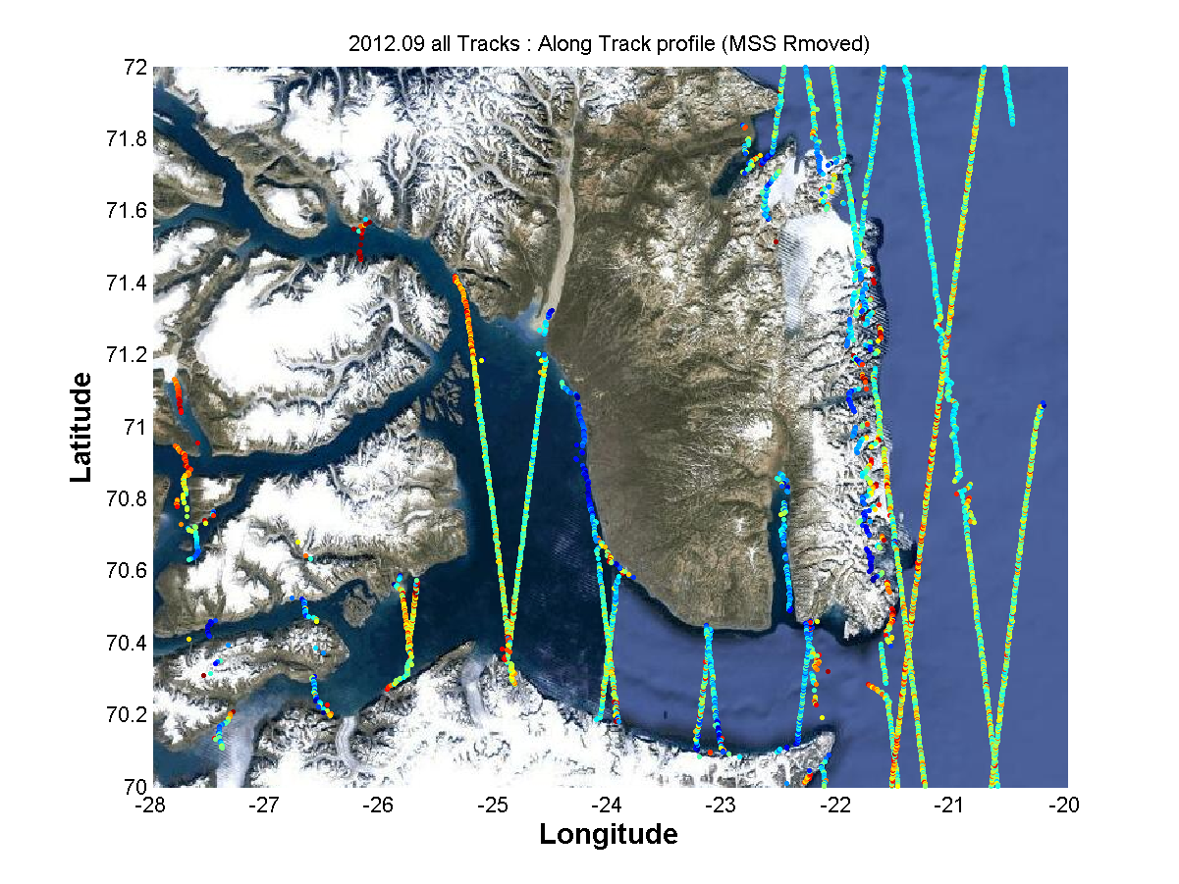
C2 SAR-improvments for coastal sea level within Fjord

Slide 12
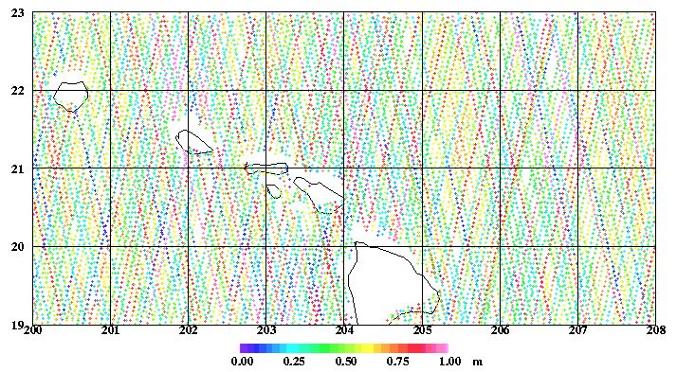
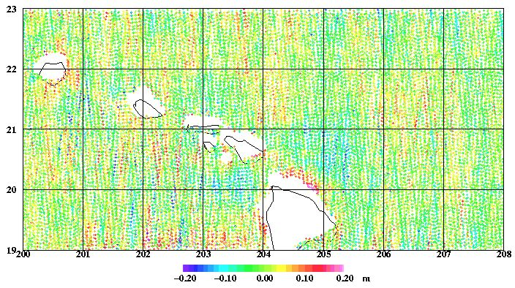
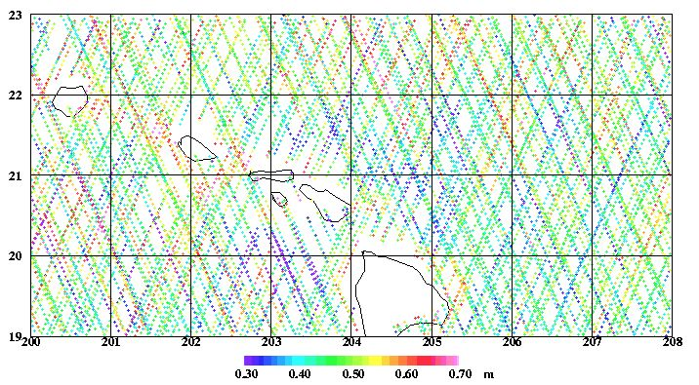
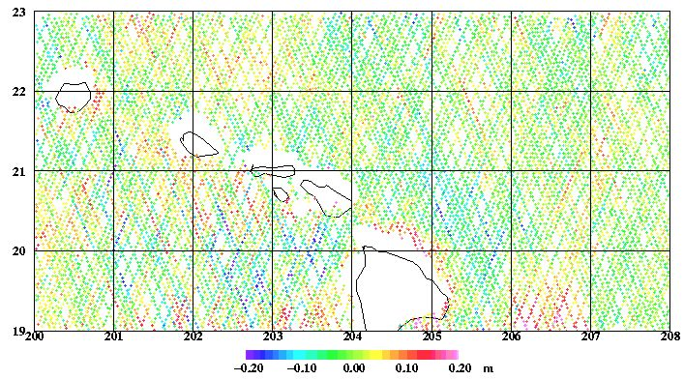

Slide 13
Based on data from these two new GM
Andersen(DTU) and Sandwell (S&S) released initially SS21.1 and DTU13
When we explored and realized the full potential of these data these were updated to the SS23.1 and DTU15.
Again this field
Could be DTU10
SS 23 or EGM08
The difference is
All in the local scales

Slide 14
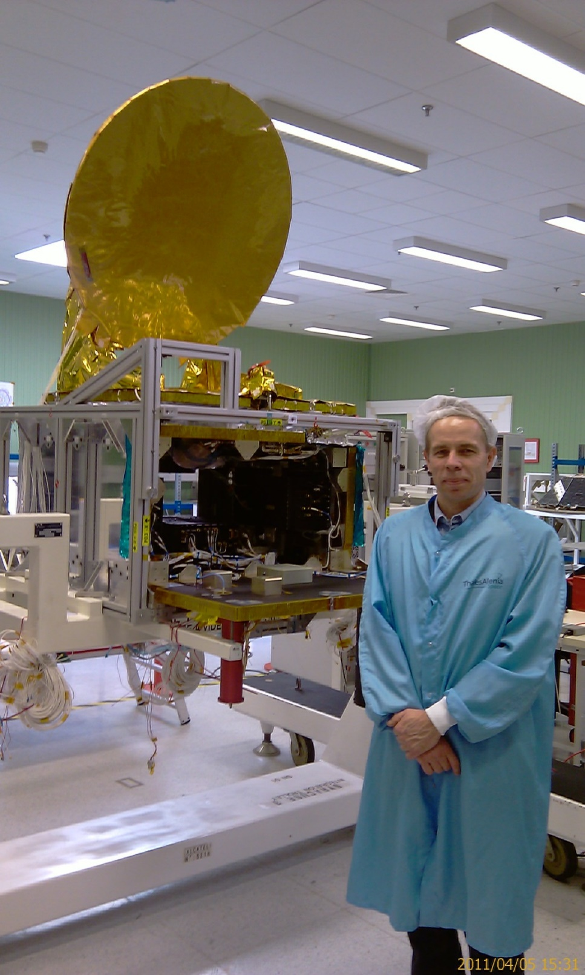
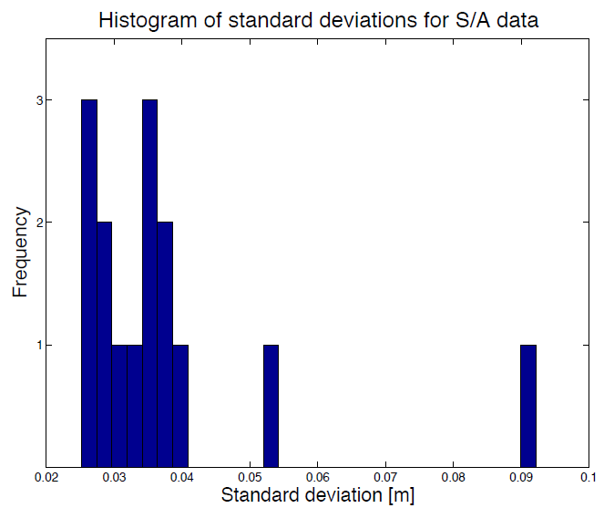
The surprising new Geodetic Mission
For DTU17: SARAL/AltiKa
Due to Gyro failure SARAL was put into
uncontrolled GM in 2016
AltiKa is interesting because:
>Higher sampling rate= higher precision
(4 kHz vs 2 kHz )
>Ka altimeter has smaller Footprint
(20% of Jason-1)
>Range precision < 0.9 cm (1 Hz)
SARAL/AltiKa at Thales in 2010

Slide 15
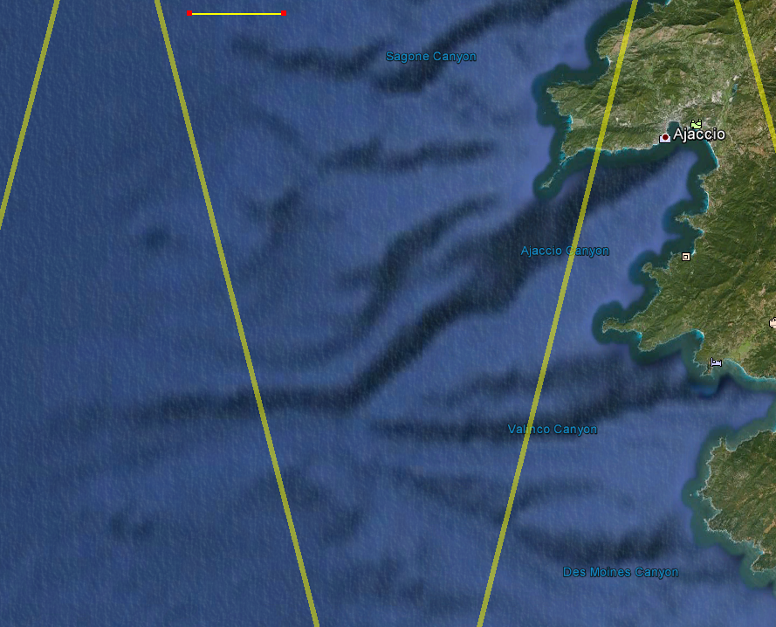
DTU17 GM data
Used 7 years of Cryosat-2 for DTU17
Used 1 year of Jason-1 (=DTU15)
Used 1 year of Saral/AltiKa.
Cryosat-2 SAR/LRM mask
Controlled by ESA using a
”fixed” mask
Arctic is under SAR & SARin mask
LRM (conventional) data is
from RADS.
10 km
Jason-1&2
Alti-Ka
C2 LRM
C2 SAR

Slide 16
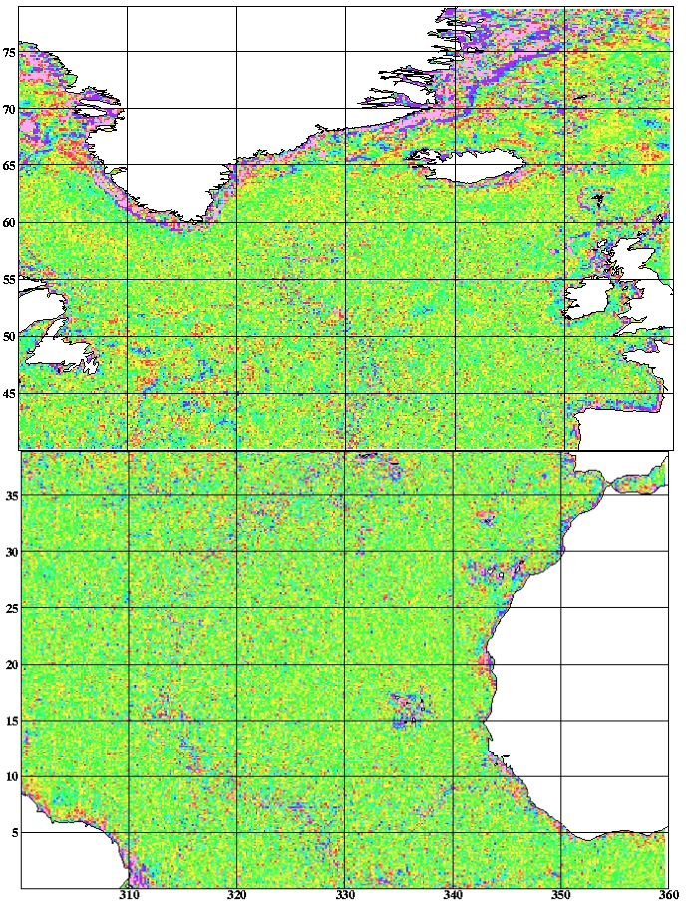

Filtering: (DTU17)
  Spatial filtering
  from 9 km (DTU10)
  to 6.5 km (DTU13)
  to 5.5 km (DTU15)
  to 4.75 km (DTU17) half wl.
  Resolves increasingly
  more signal related to
  geophysical strutures:
  I.e. the Mid-Atlantic
  Spreading ridge.
  Very hard to see visually.
  Show: DTU10 – DTU13

Slide 17
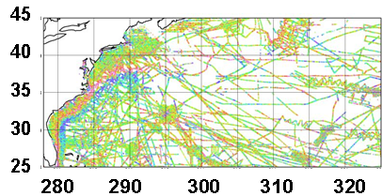
Comparisons
NW Atlantic
Old NGA data
”Puzzeling”
Why so little improvement
321.400 obs | Mean | Std Dev. | Max Dev
KMS02 | 0.44 | 5.15 | 49.38
DNSC08 | 0.39 | 3.91 | 36.91
DTU10 | 0.39 | 3.88 | 36.89
DTU13 | 0.40 | 3.71 | 36.80
DTU15 | 0.40 | 3.69 | 36.40
SS V16.1 SS V18.1 SS V19.1 SS V21.1 | 0.59 0.41 0.43 0.41 | 4.88 3.96 3.93 4.09 | 45.29 36.99 36.81 38.20

Slide 18
Comparisons
NW Atlantic
New edited NGA 2014
marine gravity
(∆ = 2mgal )
>1.4mill obs | Std (mGal) | Mean (mGal) | Max (mGal)
DTU17 | 2.52 ?? | 0.5 | 33.9
DTU15 | 2.51 | 0.5 | 33.9
DTU13 | 2.83 | 0.5 | 32.2
SS 23.1 | 3.13 | 0.7 | 43.4
SS 24.1 | 3.11 | 0.7 | 41.9
DTU17 (Versioin of last week) I have been recomputing DTU17 over the weekend.
Notice that the comparison contains both Altimetric + Marine Gravity errors

Slide 19
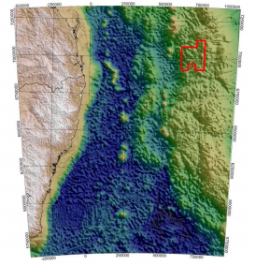
Australian Geoscience
Survey 2009
Accuracy around 1 – 1.5 mgal
Confirms altimetric Gravity at the
1 – 1.5 mGal accuracy level.
54000 obs | Std (mGal) | Min (mGal) | Max (mGal)
DTU15 | 1.81 | -5.9 | 8.6
DTU13 | 2.00 | -6.1 | 8.6
SS 23.1 | 1.98 | -9.7 | 11.1
Altimetric gravity accuracy better than 2 Mgal.
Constrains the use of marine gravity to regions
with recent accurate GNSS positioned surveys

Slide 20
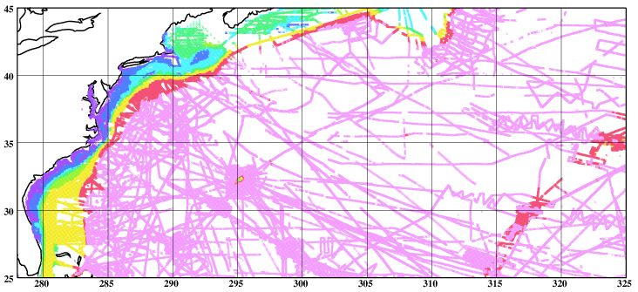
Coastal regions heavily improved
A´ll > 40.000 obs | Std (DTU17) | Std (DTU15) | DTU17-DTU15 %Improvement | Std (KMS02)
Purple (0-25 m) | 2.20 | 2.32 | 5 | 5.54
Dark Blue (25-50 m) | 2.18 | 2.38 | 2 | 4.16
Light Blue (50-100 m) | 2.28 | 2.54 | 8 | 4.06
Green (100-500 m) | 2.70 | 2.77 | 3 | 5.74
Yellow (500-1000 m) | 2.55 | 2.52 | -2 | 5.36
Red (1000-2000 m) | 2.57 | 2.52 | -1 | 5.60
Pink (2000-5000 m) | 2.55 | 2.55 | 0 | 5.58

Slide 21
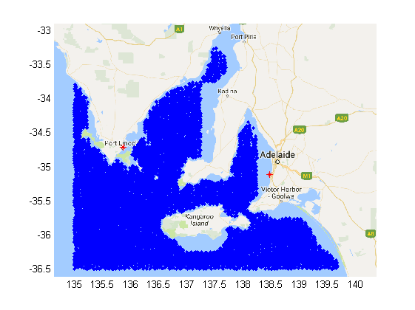
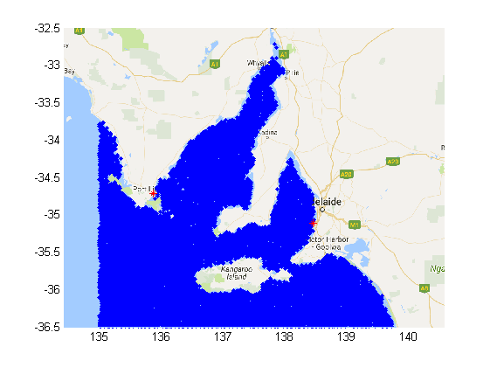
Coastal issue:
GOT4.10 (DTU15) FES2012 (DTU17)
Issue is GOT4.10 is only given on 0.5 degree resolution and not extrapolated to the coast.
In some areas GOT4.10 is unfortunately better than FES2012 (await FES2014)

Slide 22
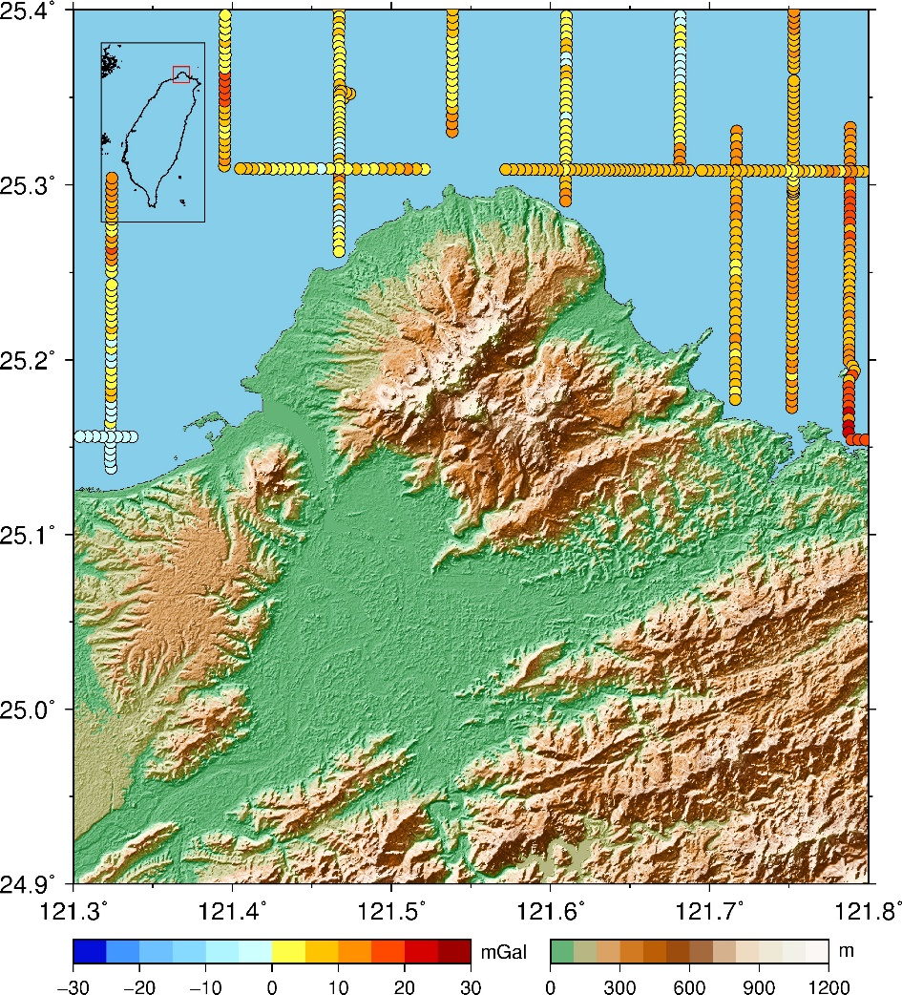
Courtesy By
Professor Cheinway Hwang
NCTU Taiwan.
Original shipborne data
430 measurements within the study area

Slide 23
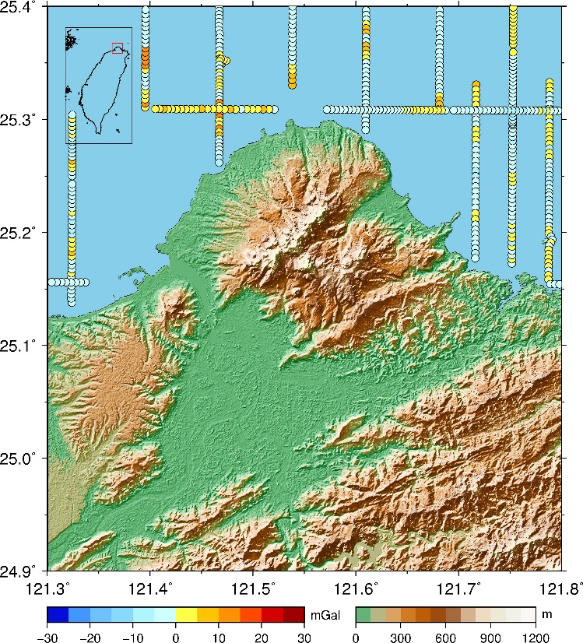
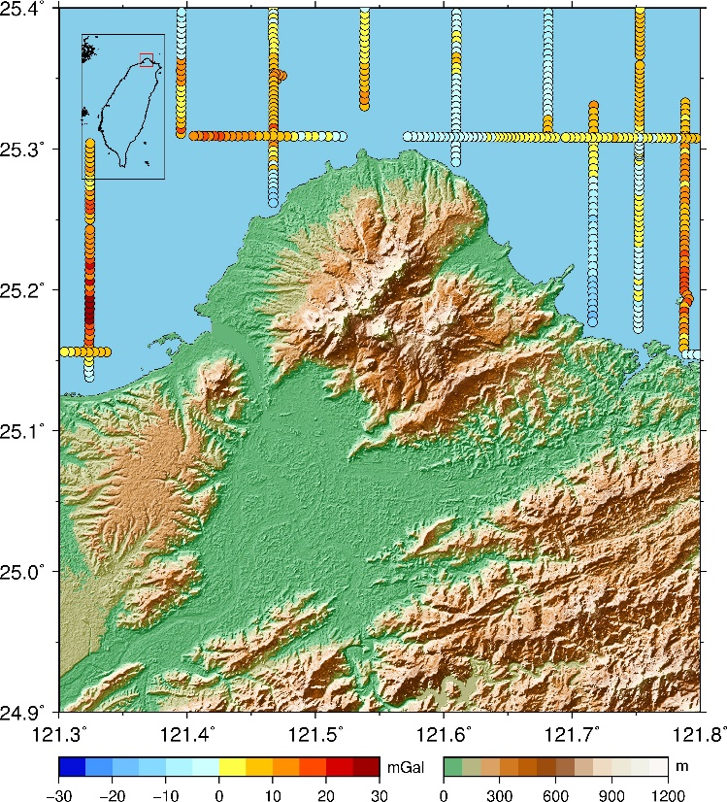
Ship – DTU15
Ship – Sandwell24
Case (unit in mGal) | Max | Min | Mean | STD
Ship – DTU15 | 12.55 | -8.94 | -0.93 | 3.92
Ship – Sandwell24 | 27.75 | -16.24 | 7.60 | 8.44

Slide 24
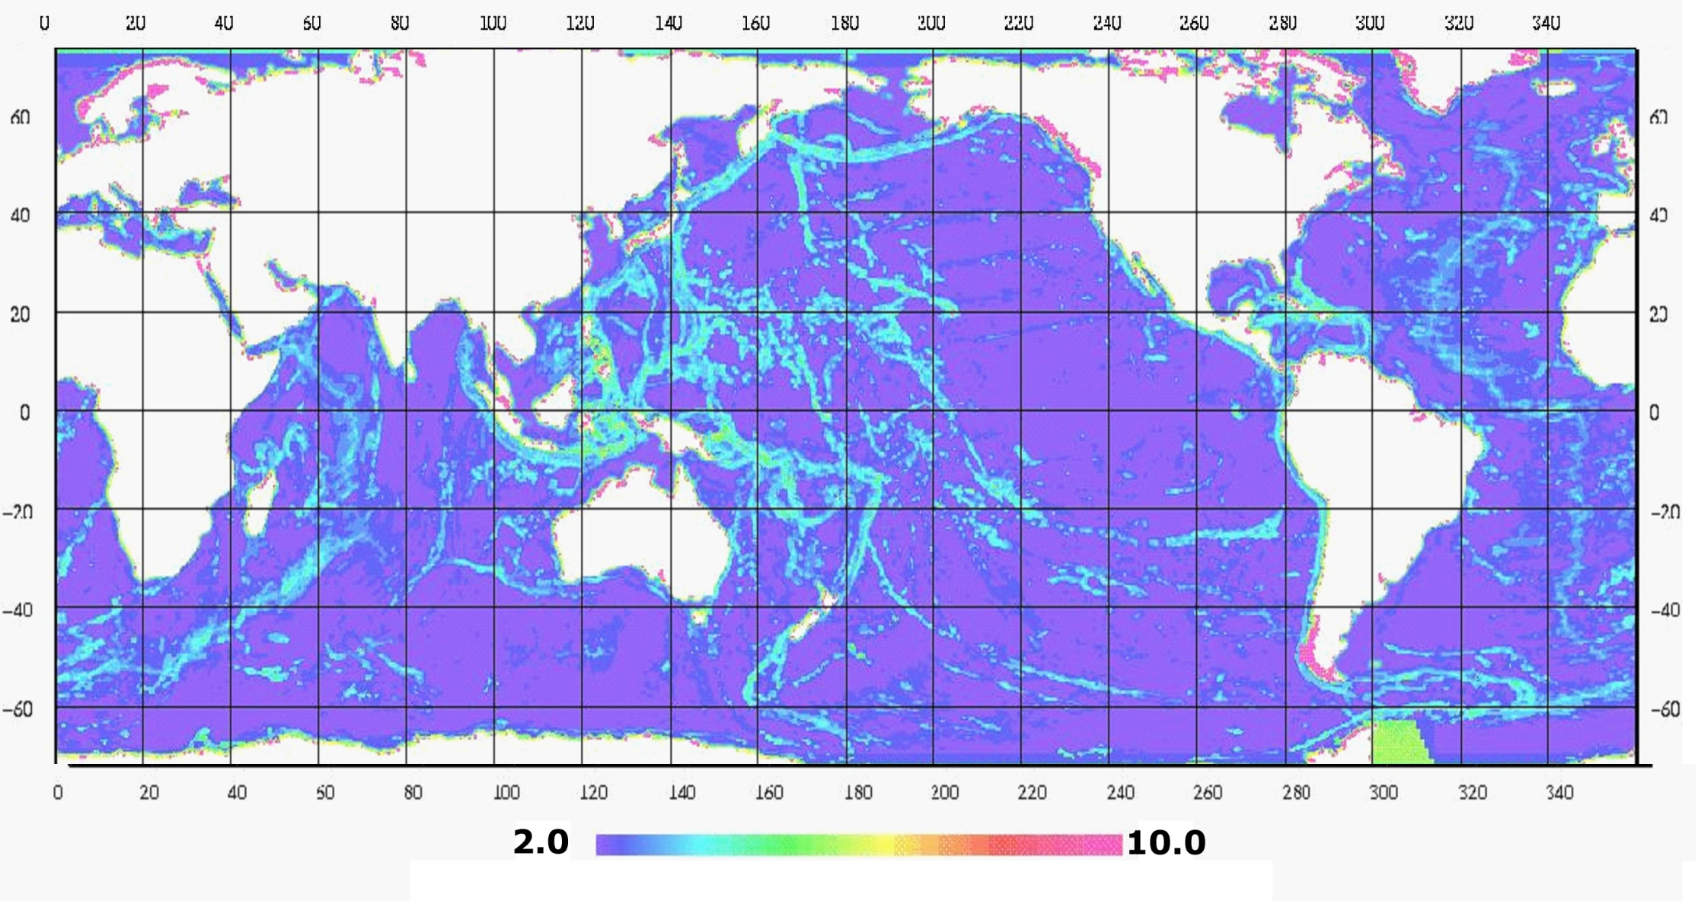
Δg ”Error estimate”
mGal
In Many regions Satellite Gravity is now better than existing Marine gravity.......

Slide 25
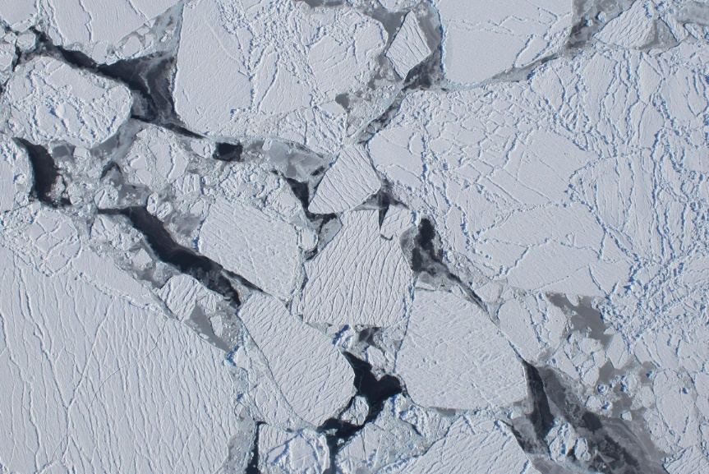
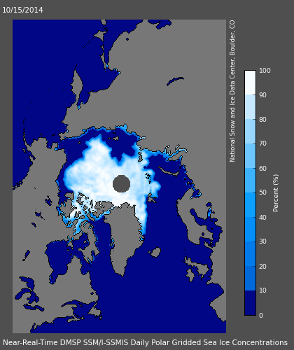
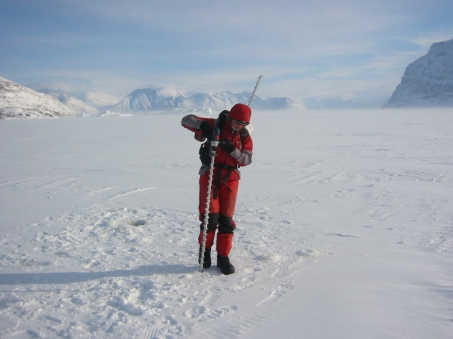
The Arctic Ocean
Sea ice concentration sept 2015 week
Photo: NASA
Photo: DTU Space
National Snow and Ice Data Center
Maslanik and Stroeve 1999

Slide 26
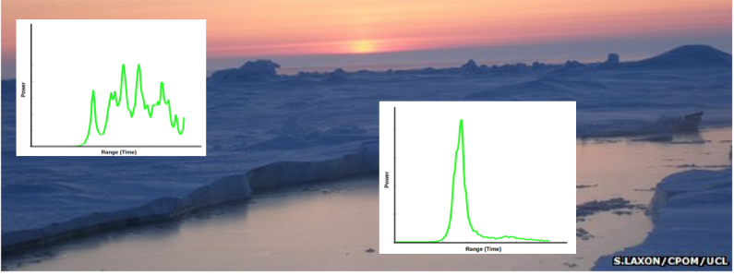
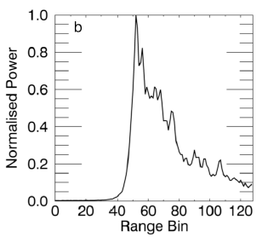
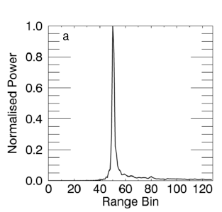
Arctic Ocean:
Cryosat-2 SAR mode with small footprint of 4 km2 to detect LEADS
Leads retrack individual 20 Hz observation despite higher noise (sqrt(20))

Slide 27
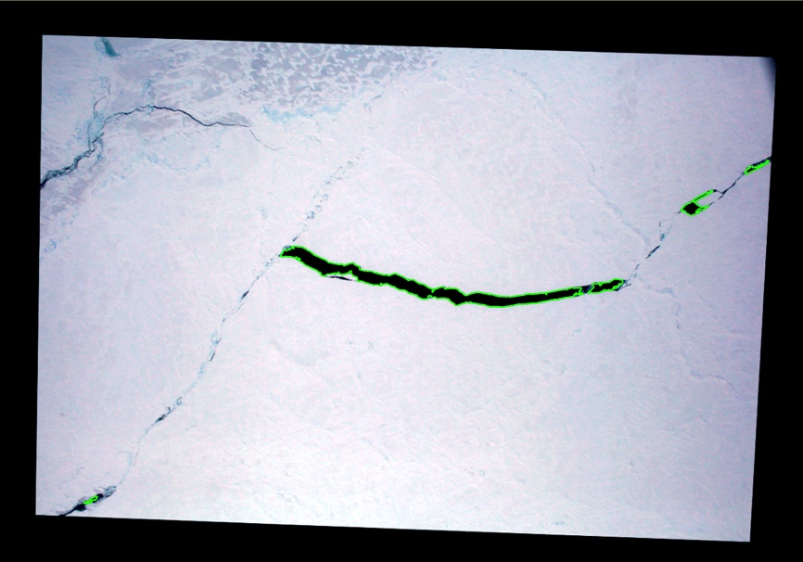
Validation: IceBridge
Stenseng, 2014b and Dominguez, 2014

Slide 28
Validation: IceBridge
Leads in aerial photos and CryoSat-2 data
Detected ~80% of leads >500 m²
LiDAR observations ~4 cm std. dev.
Mean difference 0 cm Only 34 collocated observations
Stenseng (2014b)

Slide 29
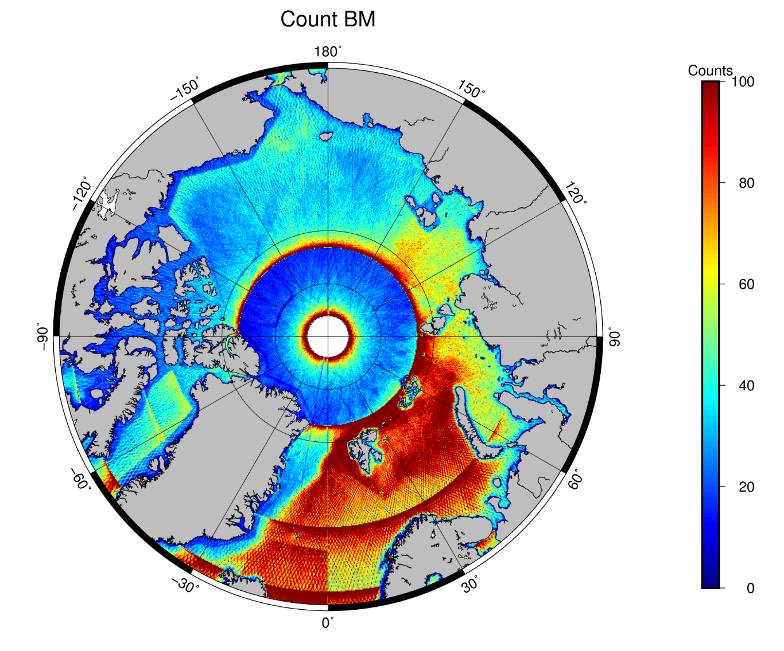
Arctic Ocean
All Altimetry: E1+GS+C2 LRM+SAR+SARin
Counts per
10x 10 km

Slide 30
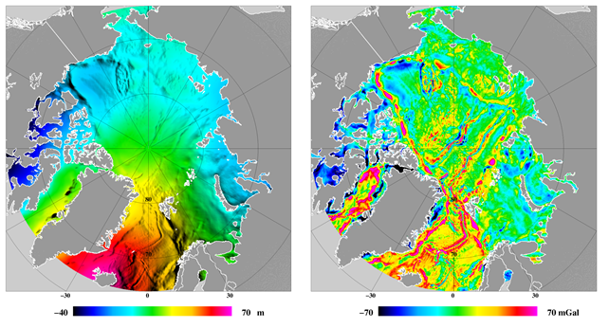
DTU13/DTU15 Arctic Ocean
GEOID (~Mean Sea Surface ) Free Air Gravity
The Polar Gap north of 88 is completed using EGM2008 (ArcGP data)
Notes:
Will explore the smaller gravity low in the central Canadian Basin

Slide 31
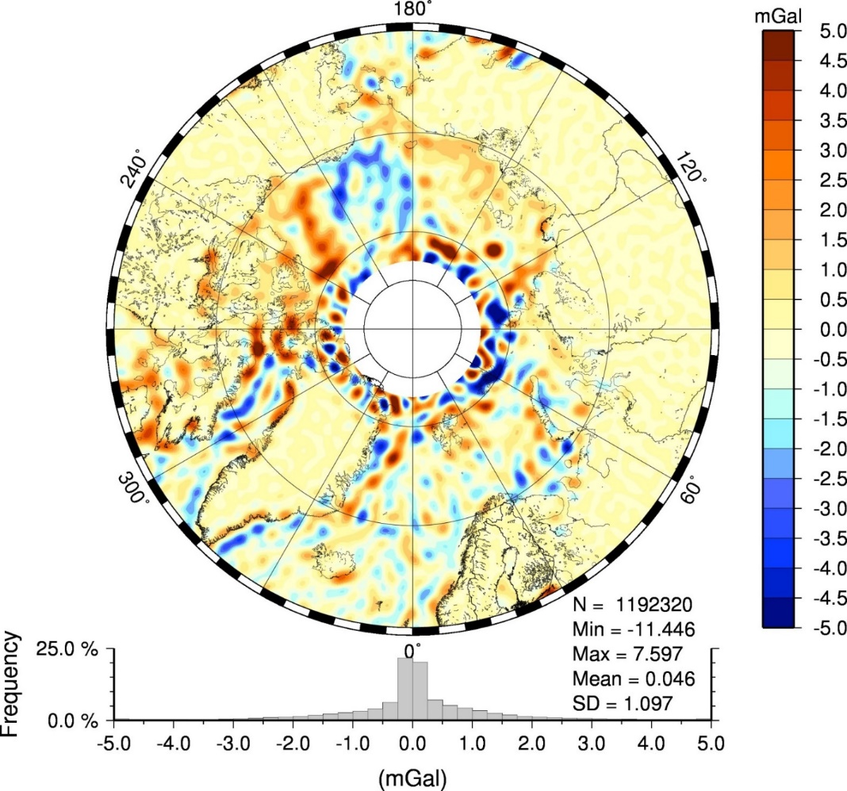
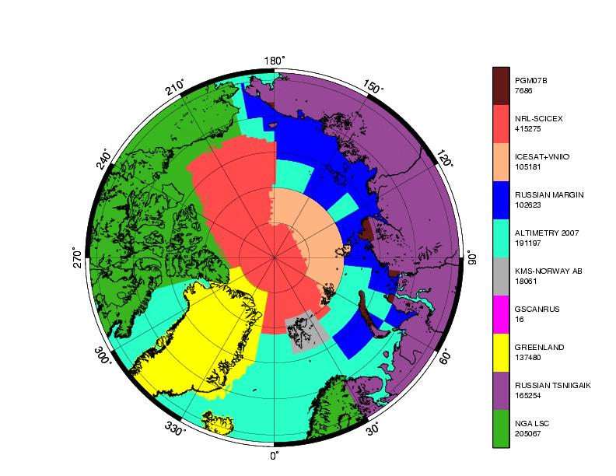
Arctic Ocean.
Evaluation with GOCE GOCO 05S to d/o=200
ArcGP
Courtesy of
Simon Holmes
SGTinc

Slide 32
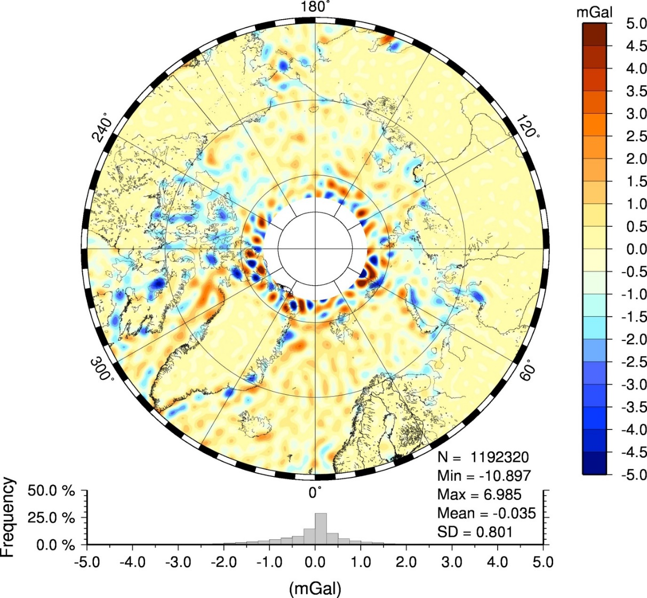
SS 23.1
DTU15
Patched in
north of 79N

Slide 33
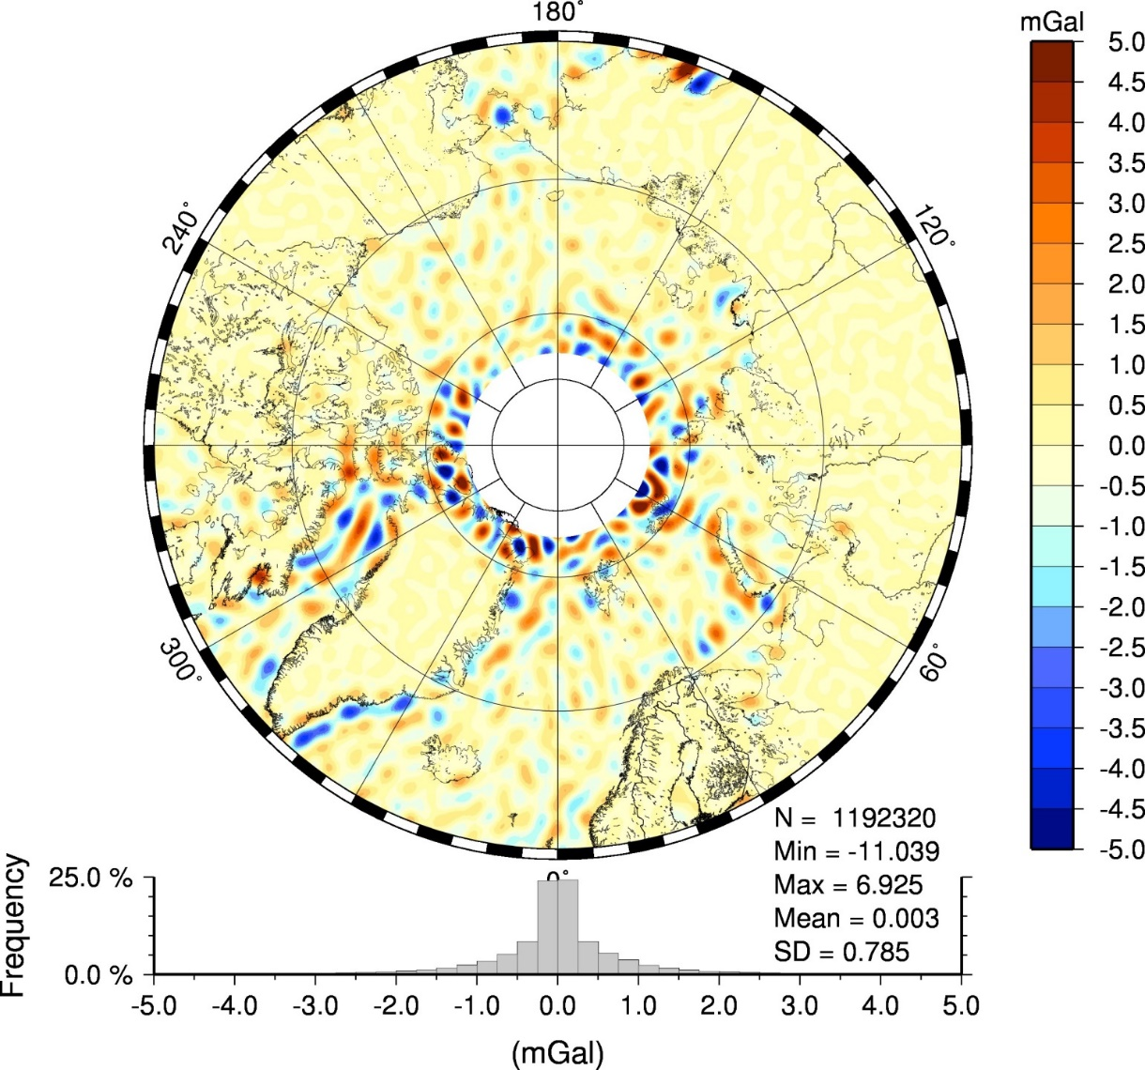
DTU 15

Slide 34
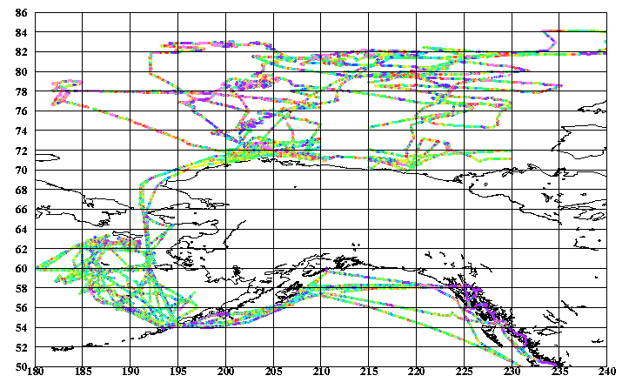
Compariwon with Univ of Alaska (North of 68) submarine data
865000 NGA data | STD | Max | Mean
DTU15 | 3.87 | 28 | -0
DTU17 | 3.37 | 28 | -0
SS V23.1 | 3.61* | 28 | 0
EGM08 | 5.97 | 42 | -1
* For SSV23.1 comparison I only used 599400 data south of 80N

Slide 35
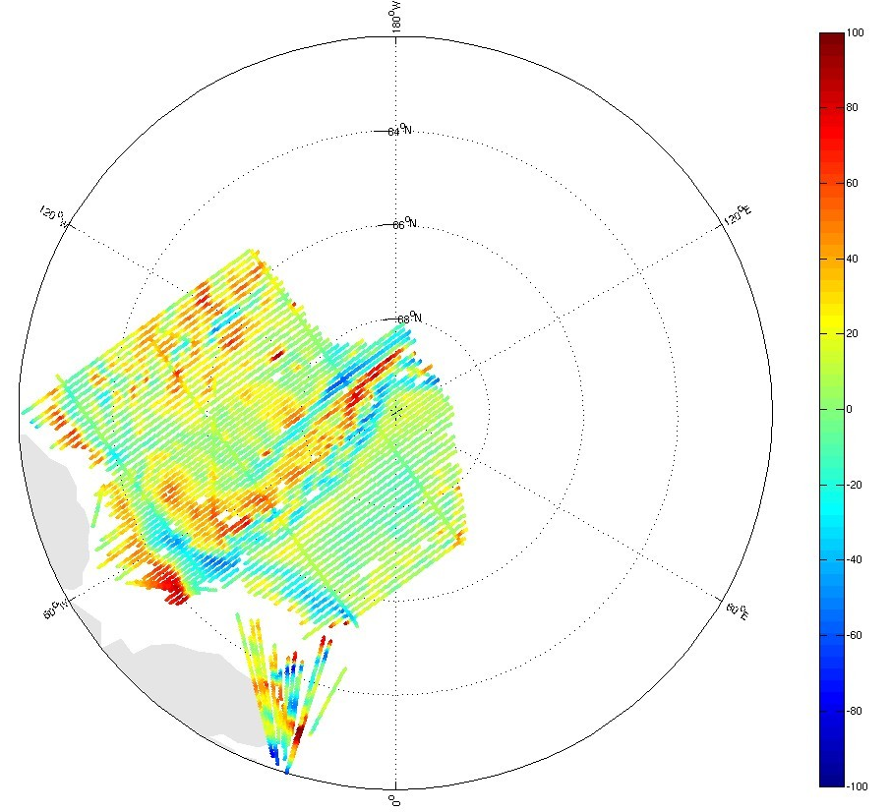
LomGrav 2009 Airborne survey.
Region has Permanent ice coverage
Making it bad for altimetric gravity
DTU gravity is still more ”noisy”
Here than elsewhere.
In line with knowledge about
Higher noise on 20 hz SSH obs.
All mGal | DTU13 | DTU15 | EGM08 | DTU17
LomGrav 2009 | 5.89 | 5.45 | 9.82 | 4.22

Slide 36
Towards the 1mGal in 2020
JASON-2 EOL
July 2017 –> End 2019?
Jason-2 End-of-Life Scenario
Low inclination (66º)
2 x 406 Days GM
Final Track Spacing = 3. km => DOUBLE ”CONTROLLED” GEODETIC MISSION
Current safehold – problematic
SENTINEL 3A +3B
FULL SAR satellites.
Not GM but will help.
Cryosat-2 EOL ???
Ideas of a 4 km Ground Track shift of Cryosat-2

Slide 37
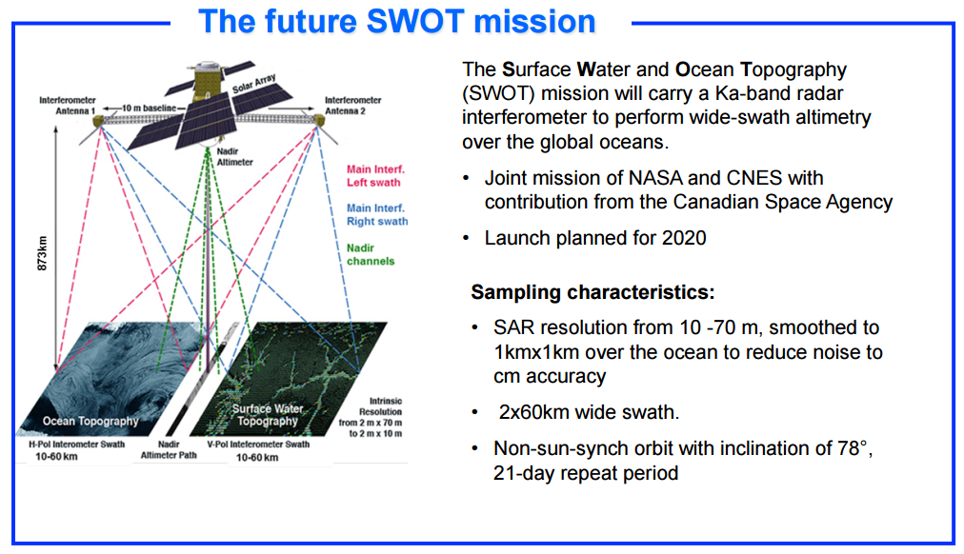
SWOT

Slide 38
Implementing the Sandwell
Smith slope correction?
An altimeter measures the range to the mean scattering surface, ρ, which is not necessarily the range to nadir, H.
If the mean surface is inclined to the ellipsoid, the height of the surface at nadir is over-estimated and needs to be reduced by a correction
Δh = H – ρ.
Courtesy of D. Sandwell

Slide 39
How wrong is the slope? North Pacific
The slope error exceeds 1 μrad in the Aleutian Trench.
This converts into
A gravity error
Of 1 mGal.

Slide 40
Summary
Seen huge development in altimetric gravity
Currently on the 2 mGal level
Despite huge improvements we can still improve altimetric gravity field
Next steps.
Working towards the 1 mGal accuracy level.
Introducting retracked SARAL/AltiKa at > 1 Hz (2-4 km along track)
Inclusion of Sentinel-3 SAR altimetry
Looking into of the slope error correction
More Geodetic Missions comming – SWOT in 2020
Jason-1 just entered a 3-year (4 km across-trk) End-of-Life GM.

Slide 41
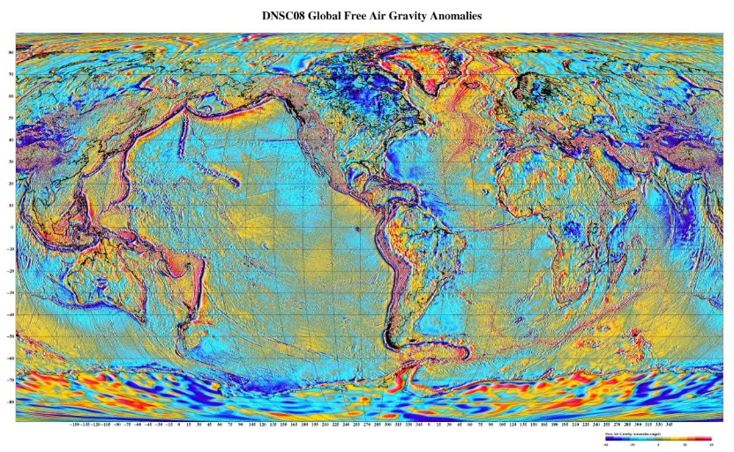
DTU field availability
Internet point of download:
FTP: ftp.space.dtu.dk/pub/DTUXX
WWW: www.space.dtu.dk (but link to DTU10)
1 minute Products (in 3 different formats).
  Global Free Air Gravity
  Mean Sea Surface
  Mean Dynamic Topography
  Altimetric derived Bathymetry
  Error/Accuracy field
  Ocean Tides + LAT/Latoid
DTU13 publically available
Access to DTU15/17GRA via mail: Ole B. Andersen oa@space.dtu.dk
Access granted for research&non commercial purposes (up to 80N)

