Slide 1
Coastal Sea Level From Cryosat-2 SAR And SAR-In Altimetry.
Ole B. Andersen, Adil Abulaitijiang
L. Stenseng & P. Knudsen
Acknowledge valuable input from the LOTUS team
P. Thibaut, T. Moreaux (CLS) and A. Ejido (Starlab)

Slide 2
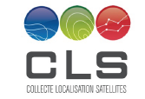
Overview
Costal sea level from altimetry (LRM vs SAR vs SAR-in)
SAR altimetry in Danish waters (narrow straits) – Go to the coast
The problematic Ocean tide correction.
SAR-in altimetry in Greenland Fjords. Go onto the coast.
Conclusions.
LOTUS:
Ongoing EU 7th FW supported project to support the Copernicus Space program by enhancing the take-up of Sentinel-3 SAR altimetry data for ocean and Land.
DTU Space (P. Knudsen) leads LOTUS

Slide 3
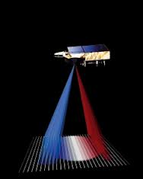
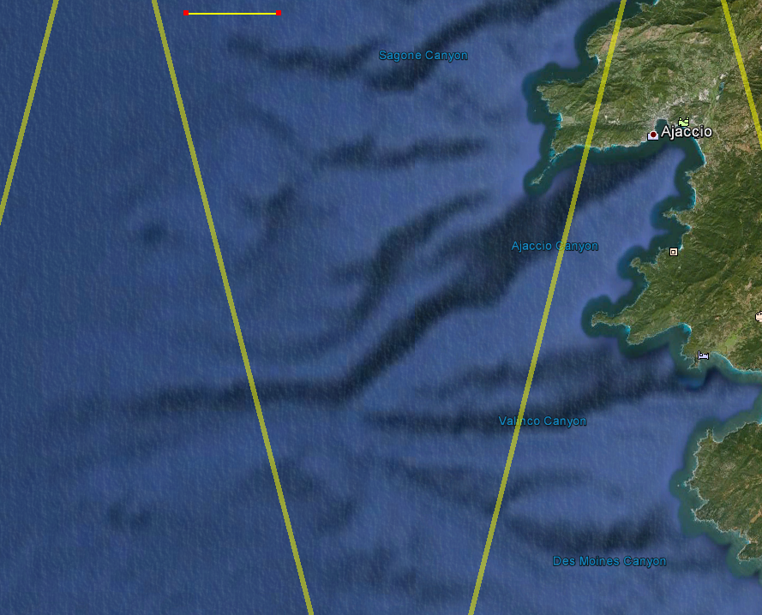
Conventional (LRM) vs SAR altimetry
LRM/Conventional ocean retrackers uses the Brown model
SAR altimetry uses i.e. SAMOSA model.
WF = FSSR * PTR * PDF
10 km
WF : Waveform
FSSR : Flat Sea Surface Response
PTR : Point Target Response
PDF : Probability Density Function
of wave heights
Jason-2
Alti-Ka
In coastal region this assumption is violated as the PDF is not homogeneous within the footprint
Envisat
C2 SAR
Envisat RA-2 tracks

Slide 4
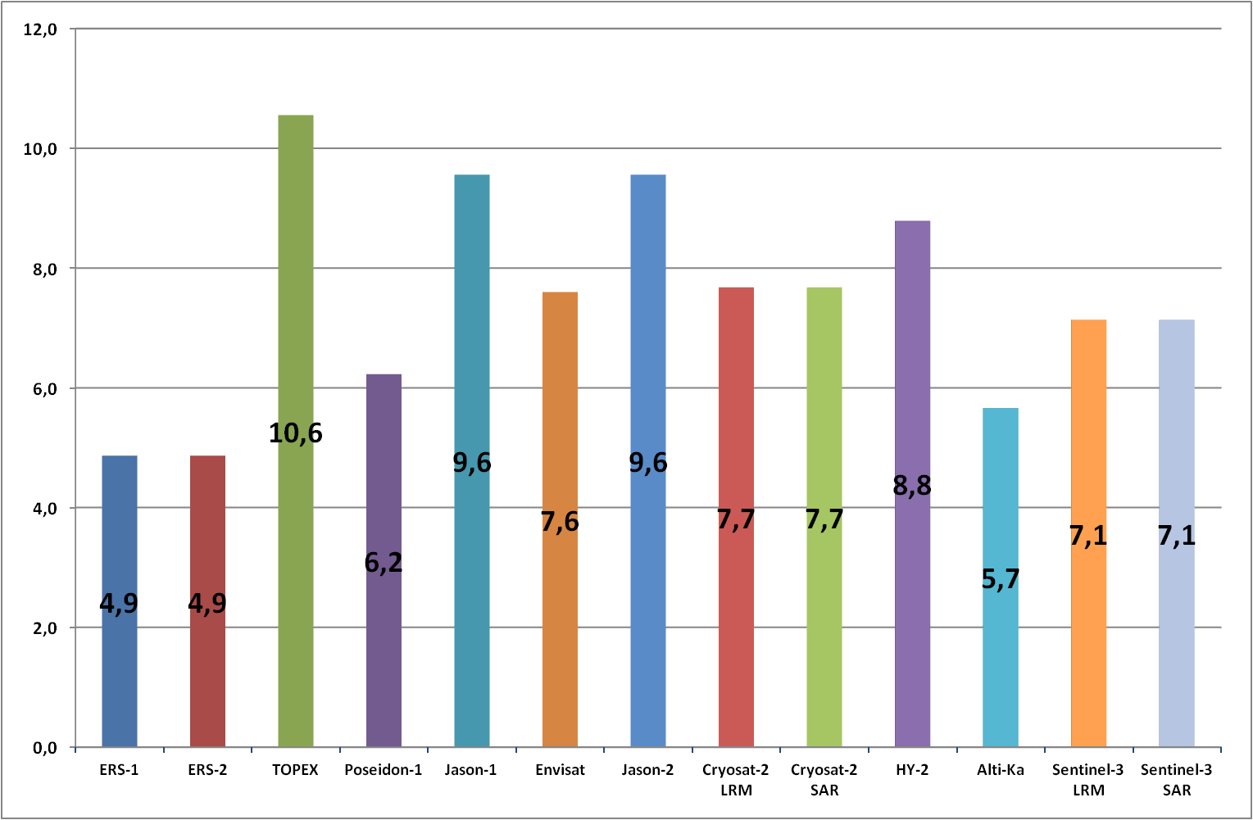
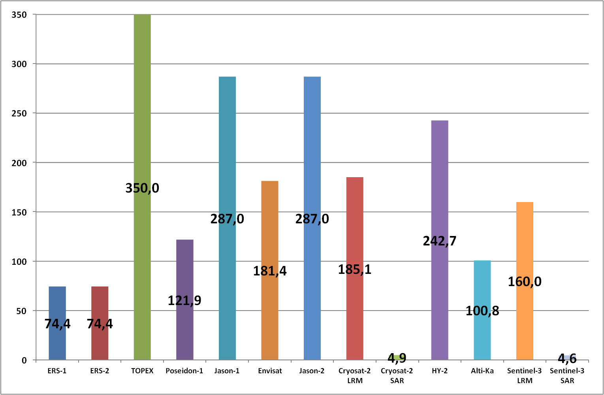
Value of SAR-altimeter foot prints.
Radius of the
waveform
footprnt
(km)
ERS-1
ERS-2
Topex
P-1
J-1
RA-2
J-2
CS-2
LRM
CS-2
SAR
HY-2
AltiKa
S3
LRM
S3
SAR
Surface of the
waveform
footprint
(km²)
Courtesy of P. Thibaut

Slide 5
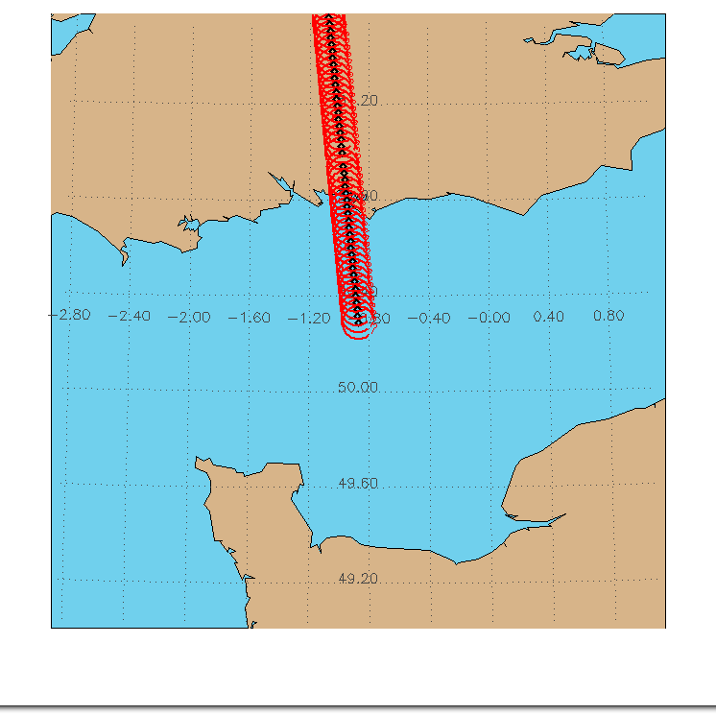
C-2 SAR coastal waveforms
Under optimal conditions we can retrieve SLA all the way to the coast

Slide 6
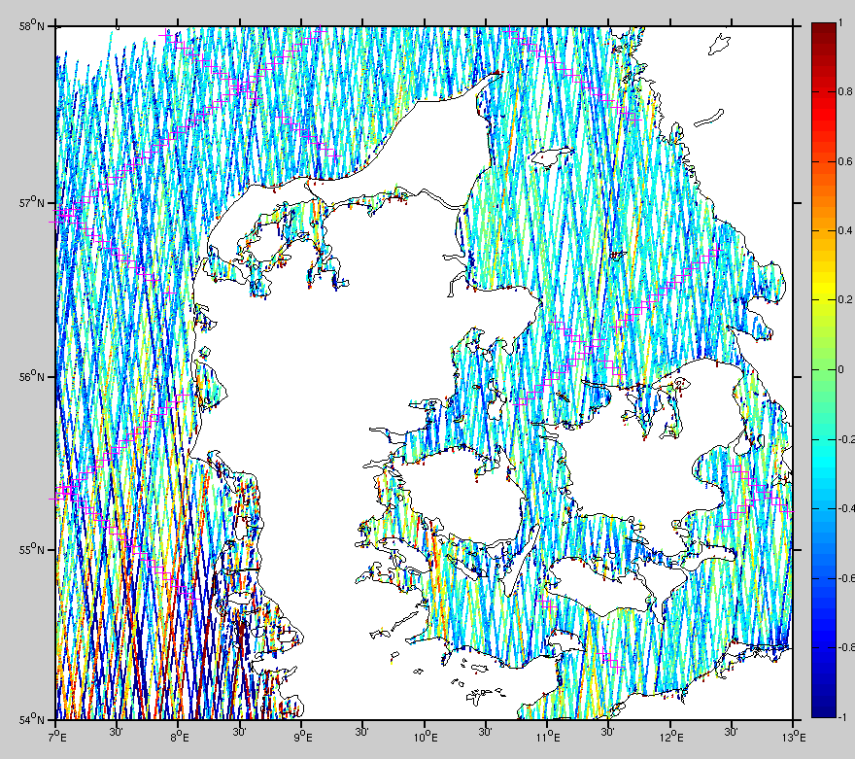
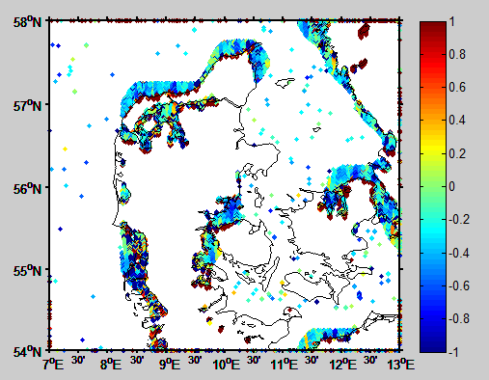
Near Coastal issues (0-5 km )
More data very close to the coast
Accuray of range and geophysical corrections?.
Calls for upgrade of range correction models (wet/tides/DAC)

Slide 7
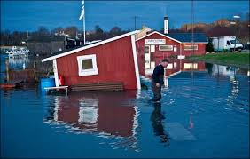
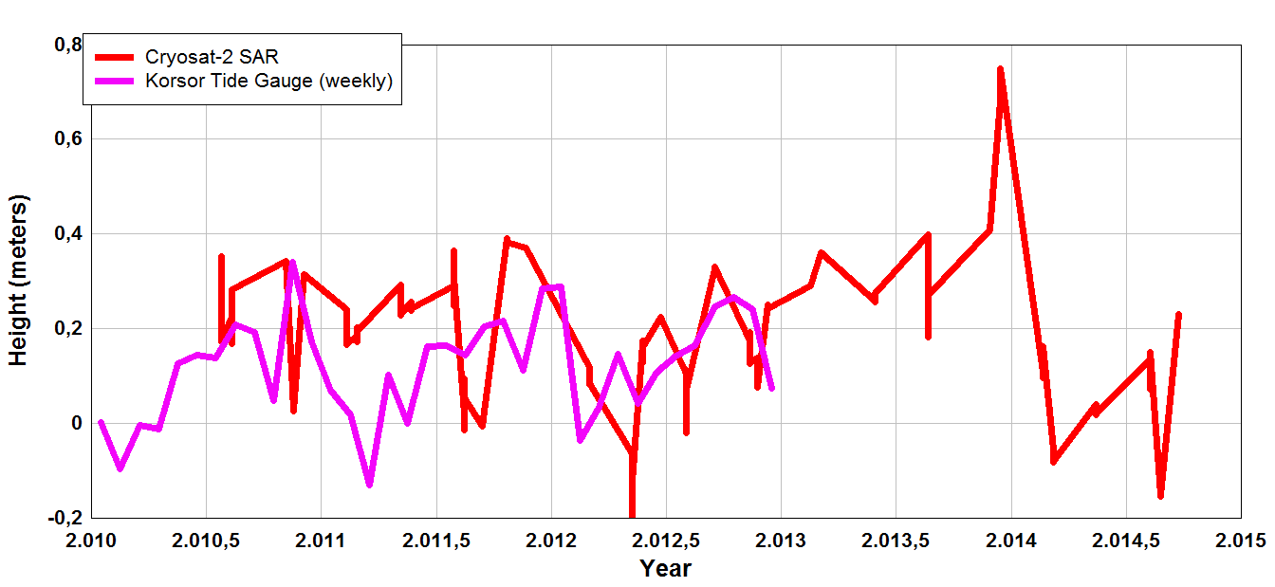
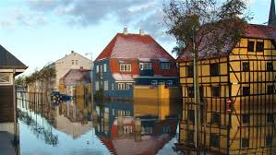
Coastal C-2 SAR data in complicated regions.
2013 December Storm Surge Bodil or Xavier was captured by Cryosat-2. Caused 2 meter surge (largest on record) in Kattegat and severe flood damage in Denmark.
Though sampling is not ”perfect” the Cryosat-2 occational observations are
Extremely valuable for coastal research and safety.

Slide 8
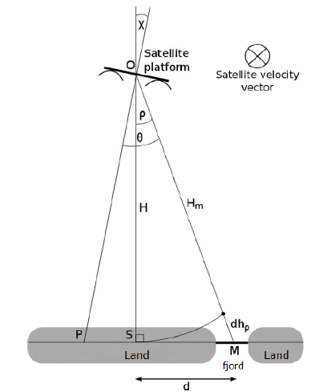
Next step. Can we measure coastal sea level when altimetry flies over land?
SAR doesnt let you know where the scattere is.
The solution is SAR-in
Less accurate compared with SAR

Slide 9
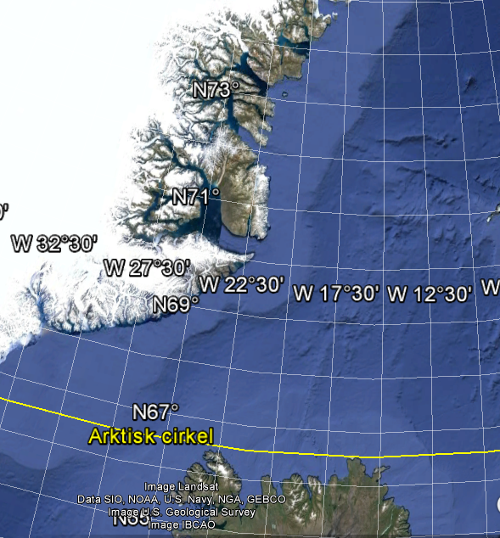
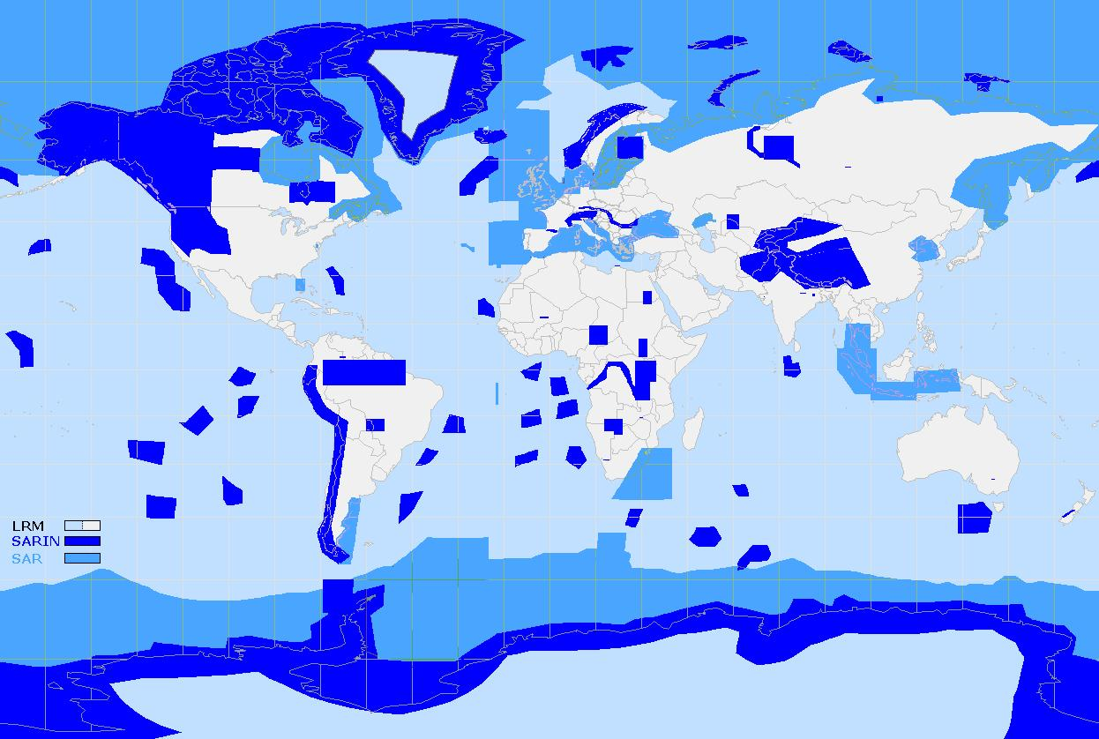
Fjords in Eastern Greenland
Joseph Fjord
(250 km deep)
Scoresbysund Fjord
(600 km deep)
50 km

Slide 10
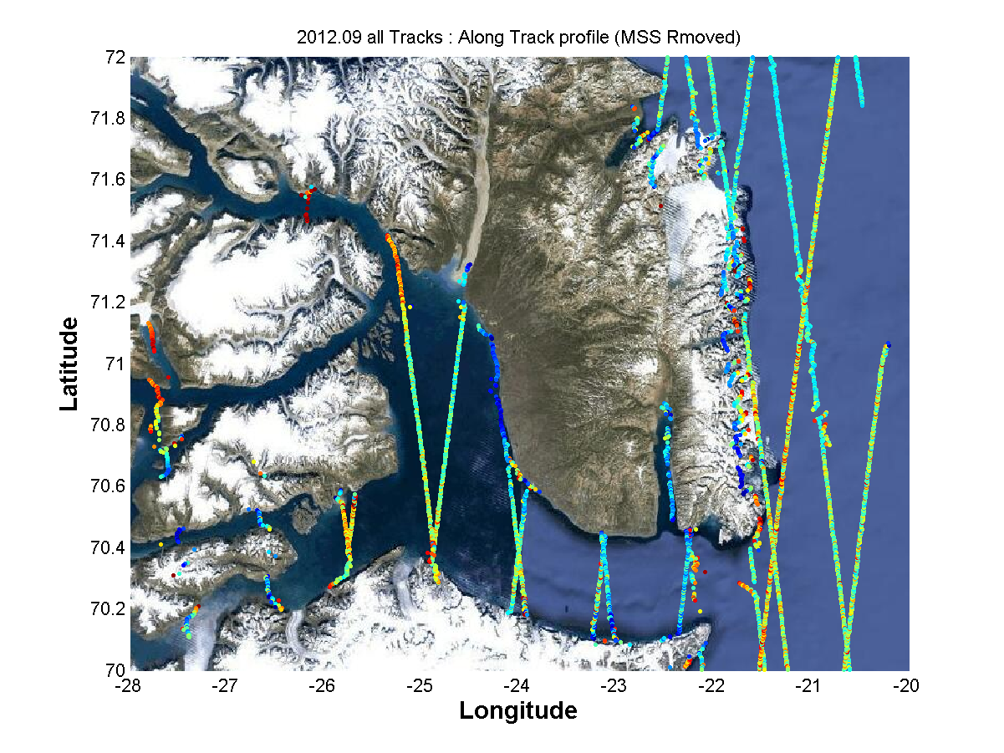
C2 SAR-in coastal sea level within Fjord

Slide 11
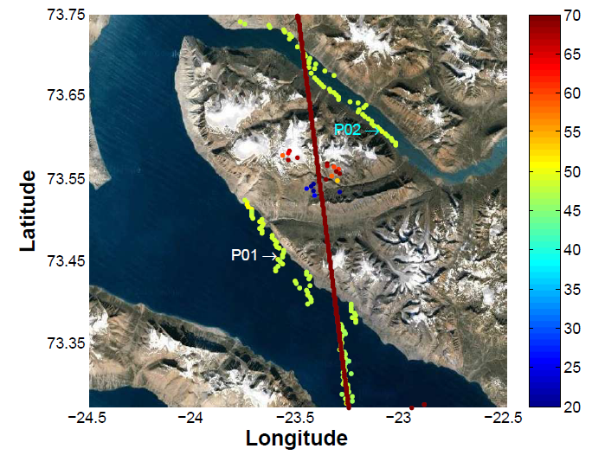
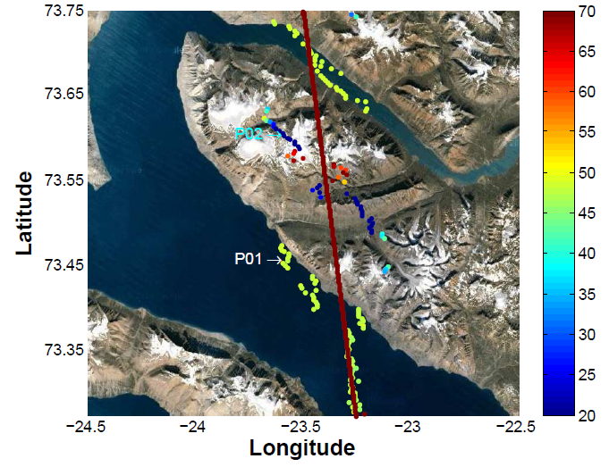
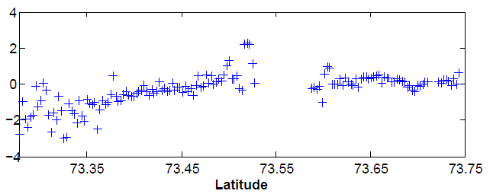
SARin (phase wrapping).
Obs from outside
Main beam (3 Db)
Are phase wrapped.
Correcting these
We retrieved SSH
When C-2 flies up
to 13 km INLAND
SSH rel to DTU10MSS

Slide 12
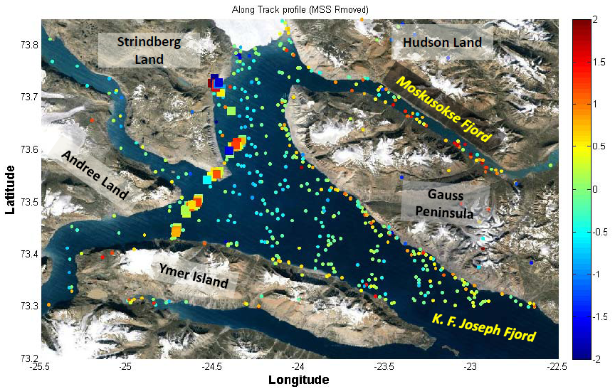
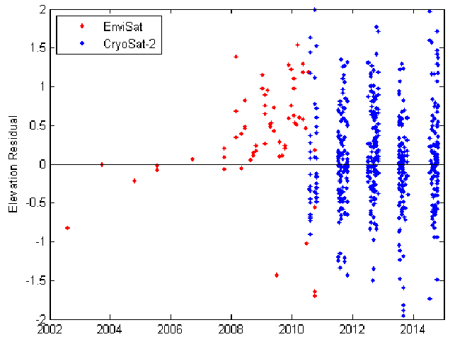
Resolving coastal sea level in fjords
10 Years of Envisat-2 gave 93 SLA. 4 years of Cryosat > 800 Sea Level Obs
Ocean tide applied (range 70 cm – applying it reduces SLA with 5 cm)
RMS (Envisat) = 1.1 meter, RMS (Cryosat) = 62/61 cm.

Slide 13
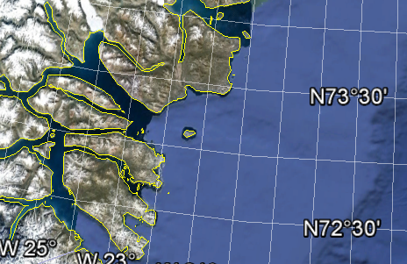
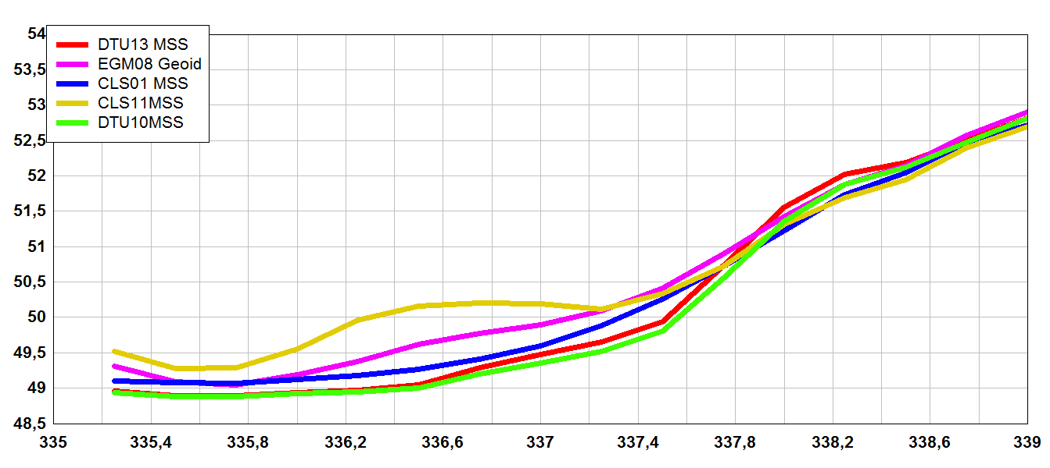
MSSH differences up to 1 meter
200 km
Open Ocean

Slide 14
Summary.
With Cryosat-2 SAR and particularly SAR-in a new era for coastal altimetry has been initiated.
With SAR-in we can retrieve sea level information all the way to 13 km inland.
Existing range and geophysical models must be revisited to enhance accuracy in ”complicated coastal regions” (fjords and sounds)
One approach is to use these new data to upgrade our models.
SAR-in should really be exploited more for the coastal applications.

