Slide 1
The Great Value of Cryosat-2
SAR and SAR-in for coastal sea level monitoring
Ole B. Andersen, Adil Abulaitijiang
L. Stenseng, P. Knudsen
M. Idzanovic and O. Vegard (NMBU)

Slide 2
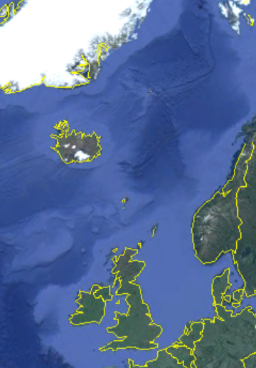
Overview
Costal sea level from C2 (LRM vs SAR vs SAR-in)
SAR(in) altimetry along simple coastlines
  Cryosat measures all the way to the coast.
  Storm surge Bodil/Xavier
SAR(in) altimetry along complicated coastlines.
  Comparison with TG + conventional altimetry.
SAR-in altimetry in complicated fjords.
  Greenland Fjords.
  Cryosat measures sea level from inside coast.
Conclusions.

Slide 3
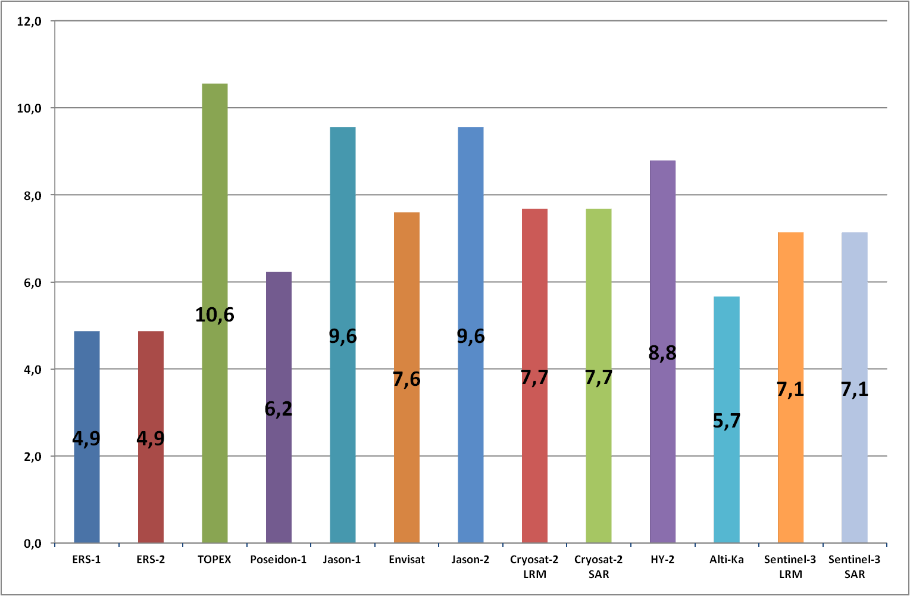
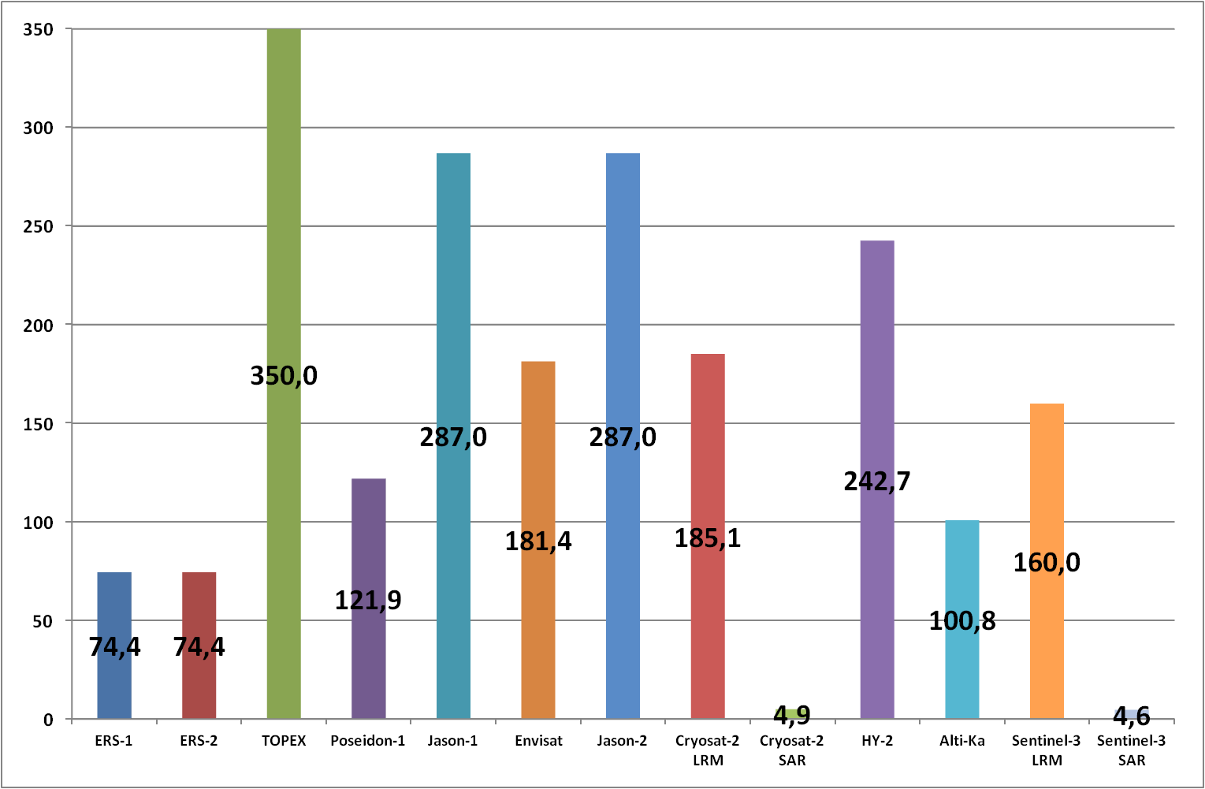
Value of SAR-altimeter foot prints.
Radius of the
waveform
footprnt
(km)
ERS-1
ERS-2
Topex
P-1
J-1
RA-2
J-2
CS-2
LRM
CS-2
SAR
HY-2
AltiKa
S3
LRM
S3
SAR
Surface of the
waveform
footprint
(km²)
Courtesy of P. Thibaut

Slide 4
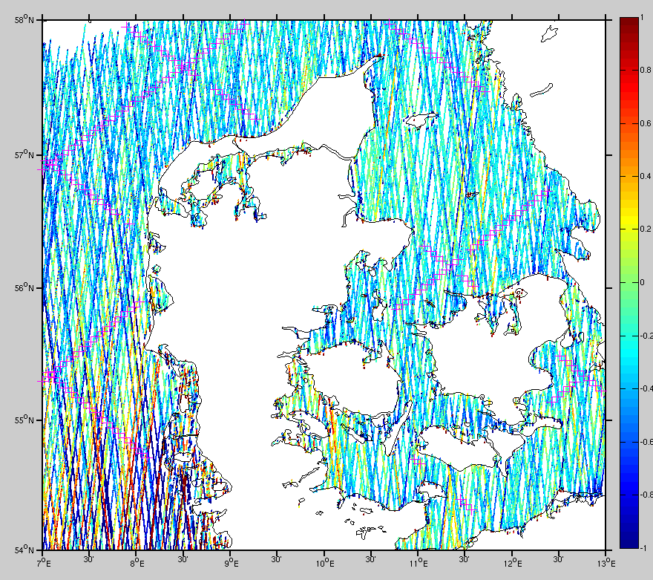
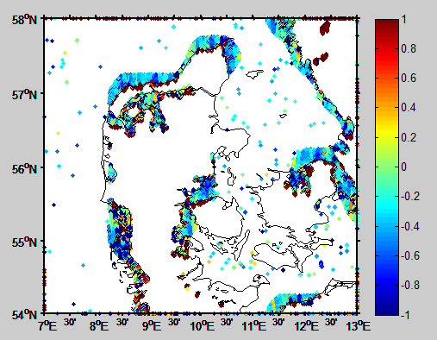
Near Coastal issues (0-5 km )
New knowledge (but also new problems) coastal signal.
Accuray of range and geophysical corrections – calls for upgrade
Calls for upgrade of range correction models (wet/tides/DAC/MSS)

Slide 5
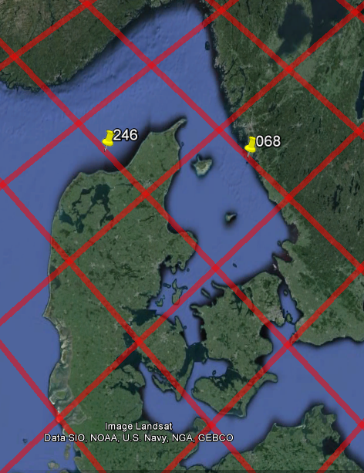
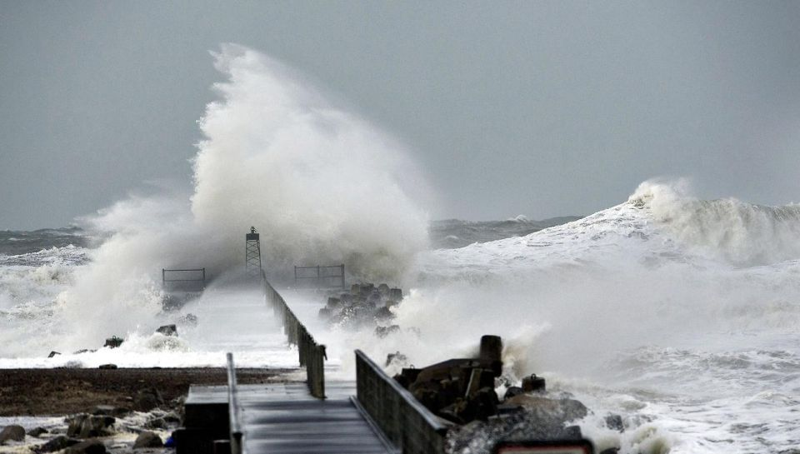
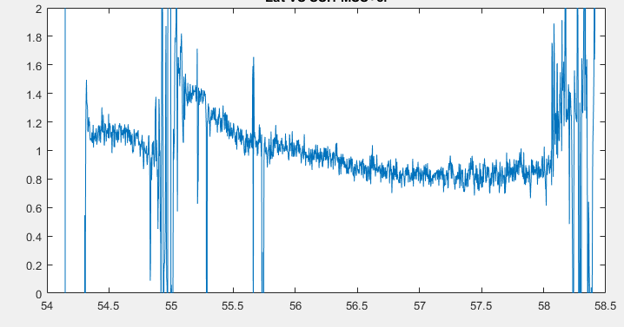
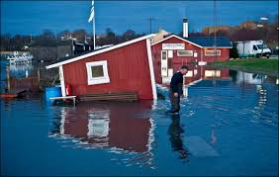
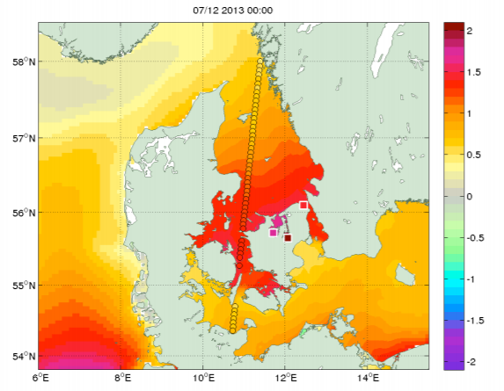
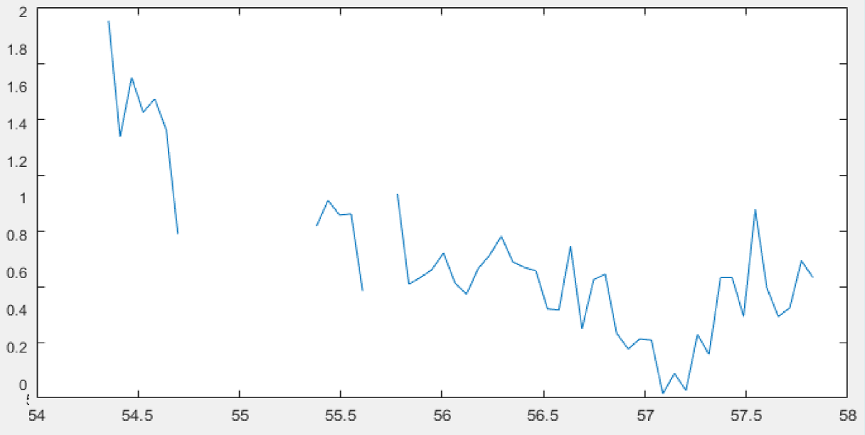
Bodil/Xavier stormsurge
6-7 December 2013 Stormen Bodil/Xavier was observed by Cryosat-2 i Kattegat (1000 year event). Surge peaked at 1.91 meter (gauge) and 1.90 meters by Cryosat-2 in Kattegat
DMI

Slide 6
C2 coastal Snagging (SAR vs SARin)

Slide 7
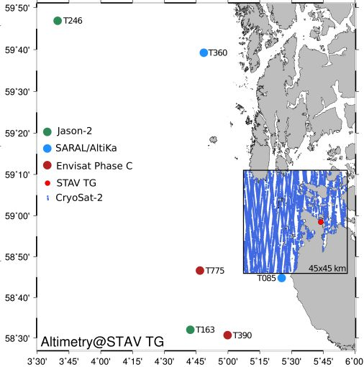
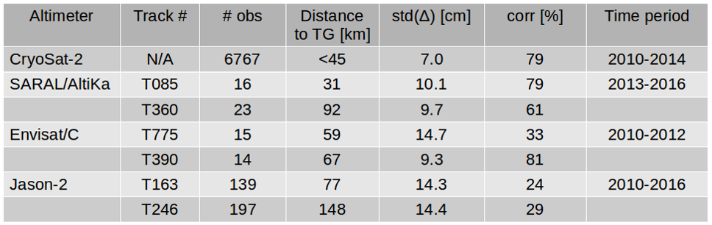
C2 Sea level vs Norwegian tide gauges
Cryosat-2 SARin Altimetry in 45 km box
-> Treating as SAR(no xtrk)
-> No radiometer correction
-> Simple NP Threshold rtrk
-> No repeated tracks.
-> Averaging over 40 km
Better Std with C2 than conventionel

Slide 8
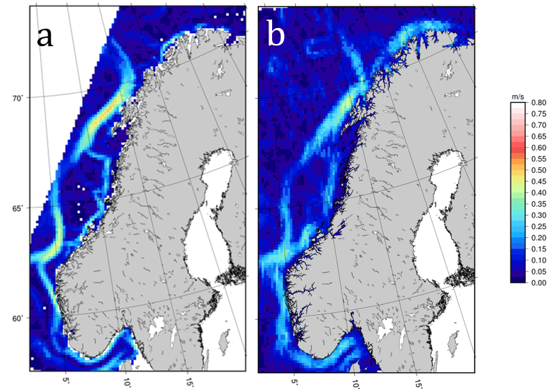
Coastal currents from Cryosat-2 SAR
Nordkyst MDT (800 m res) CryoSat-2 MDT
THIS IS IMPORTANT FOR COASTAL MSS DETERMINATION

Slide 9
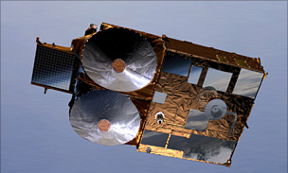
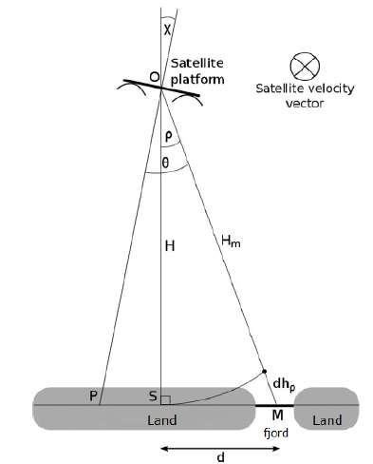


Next step.
Measuring coastal sea level when altimetry flies over land?
SAR doesnt let you know where the scattere is.
The solution is SAR-in
Less accurate compared with SAR

Slide 10
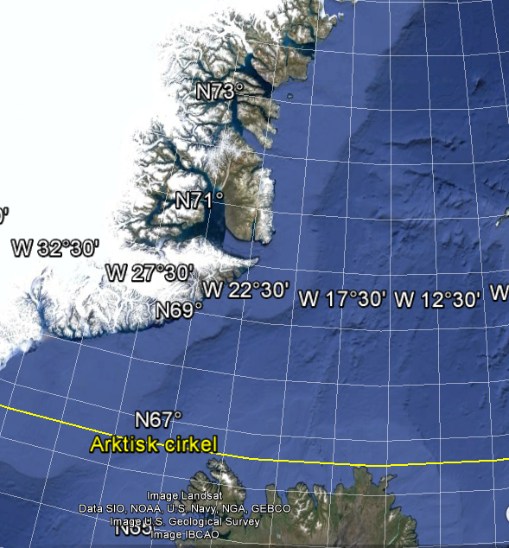
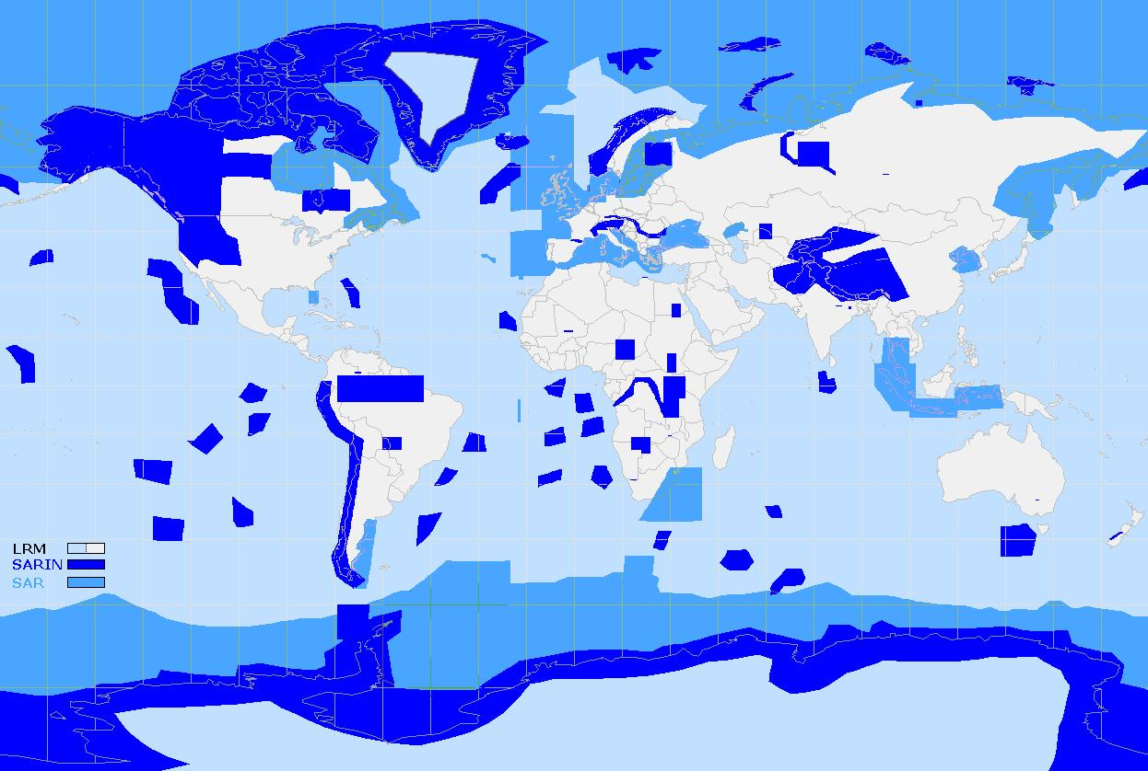
Fjords in
Eastern
Greenland
Joseph Fjord
(250 km deep)
Scoresbysund Fjord
(600 km deep)
50 km

Slide 11
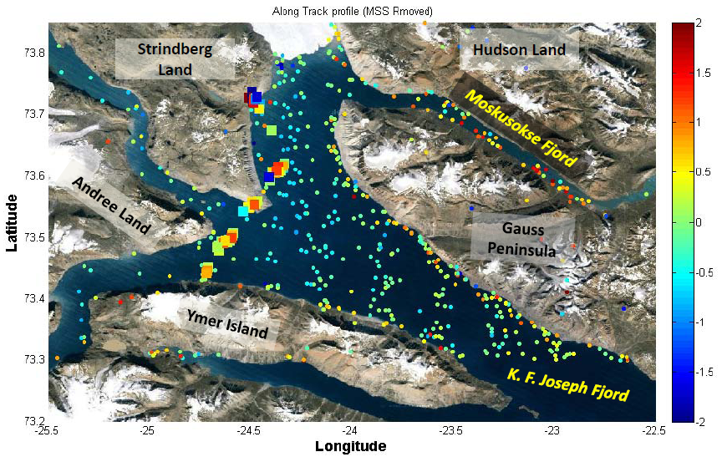
Resolving coastal sea level in fjords
10 Years of Envisat-2 gave 93 SLA (20 Hz obs).
5 years of Cryosat > 1000 (20 Hz Sea Level Obs)
RMS (Envisat) = 1.1 meter, RMS (Cryosat) = 62/61 cm.

Slide 12
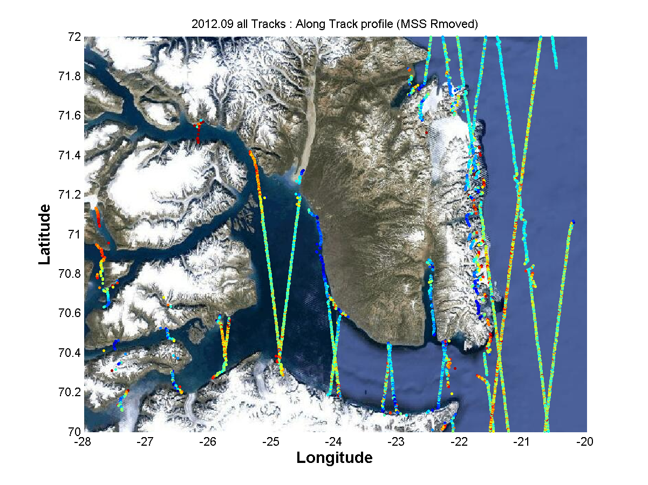
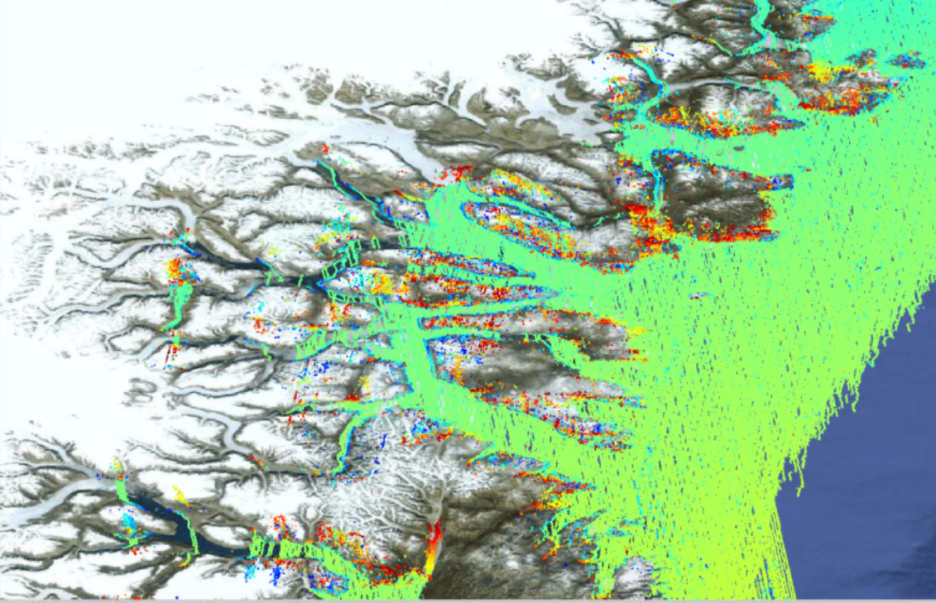
C2 SAR-in coastal sea level within Fjord

Slide 13
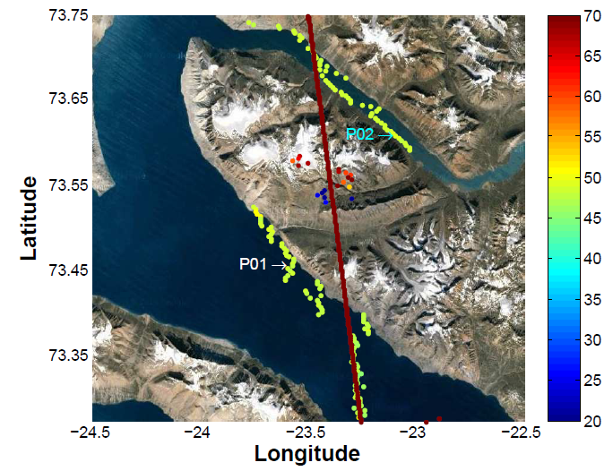
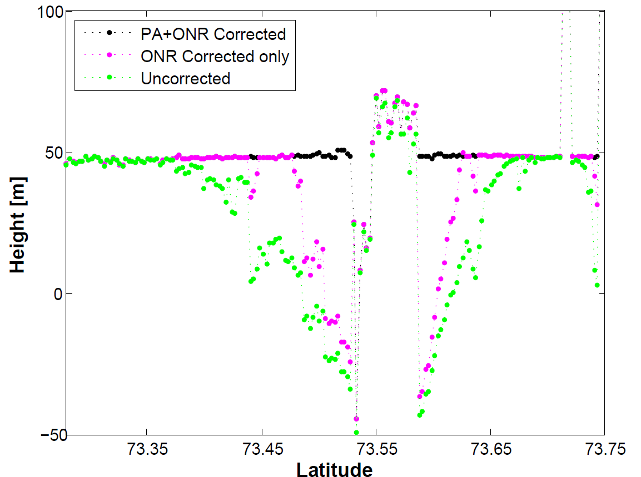
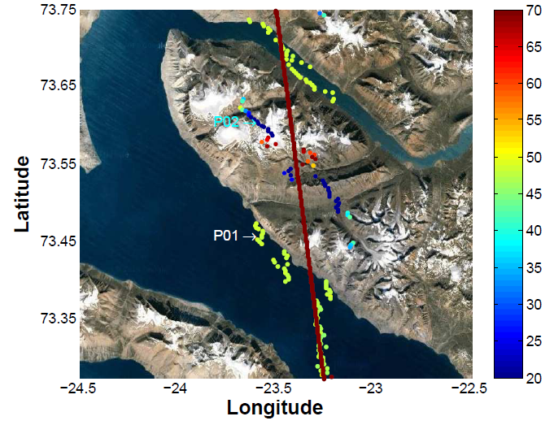
SARin (phase wrapping).
Obs from outside
Main beam (3 Db)
Are phase wrapped.
Correcting these
We retrieved SSH
When C-2 flies up
to 13 km INLAND

Slide 14
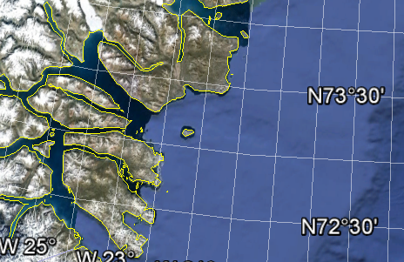
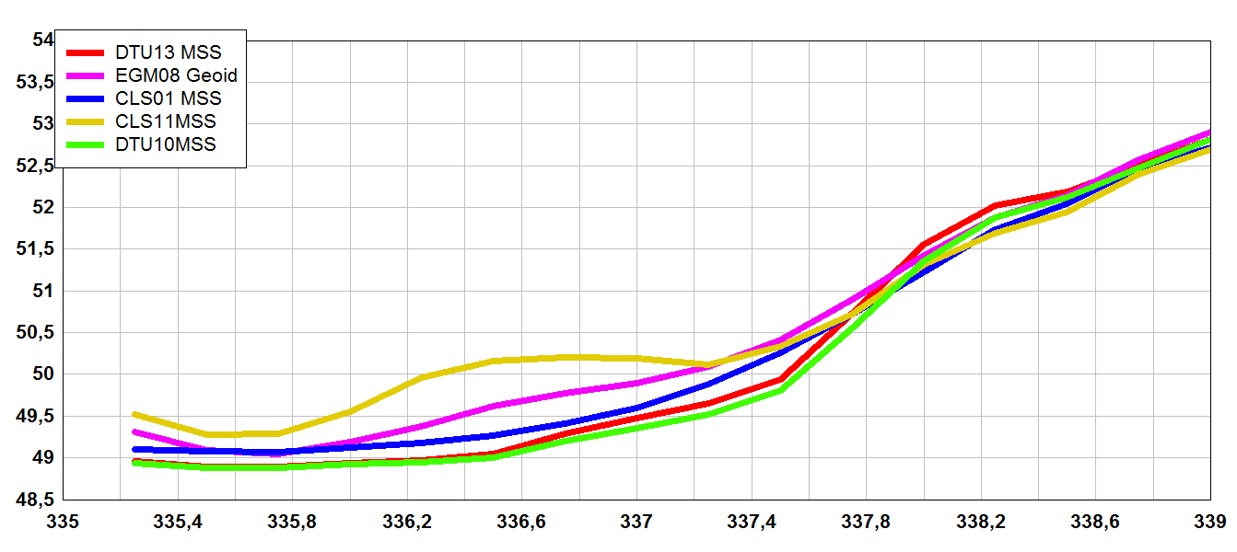
We need to update current MSSH models to obtain full potential of C2 data in coastal regions.
200 km
Open Ocean

Slide 15
Summary.
With Cryosat-2 SAR and SAR-in a new era for coastal altimetry has been initiated.
With SAR-in we can retrieve sea level information all the way to the coast and under favorable conditions ”byond”
Existing range and geophysical models must be revisited to enhance accuracy. Particularly in ”complicated coastal regions” (fjords and sounds)
Particulaly MSS should be updated
  side effect: will result in better coastal gravity
The pros/cons of SAR-in vs SAR for coastal regions must be further investigated/understood for future missions.

